Slide 1
Overview of Onsite Sewage Treatment and Disposal Systems
Bureau of Environmental Health
Division of Disease Control and Health Protection
Florida Department of Health
August 1, 2019

Slide 2
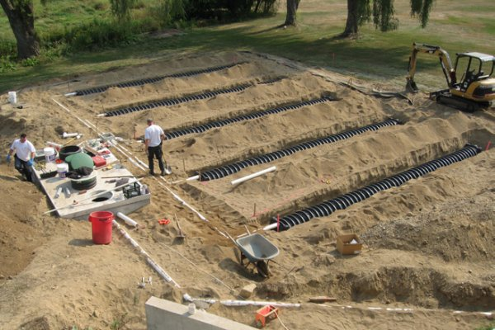
What is an OSTDS?
Onsite sewage treatment and disposal system
Includes septic systems (septic tank and drainfield) but also includes systems capable of greater treatment

Slide 3
Septic Systems and “Advanced” Systems
Septic tanks provides basic treatment
Removal of solids and fats, oils and greases
“Advanced” systems provide greater treatment
Removal of degradable organic material
Removal of nutrients

Slide 4
EPA/625/R-00/008 February 2002
OSTDS are recognized as low-cost and long-term approaches to wastewater treatment
Are effective and protective when properly designed, installed, operated, and maintained
Onsite Wastewater Treatment Systems Manual
OSTDS are among the many sources contributing nitrogen to groundwater.
Office of Water Office of Research and Development U.S. Environmental Protection Agency

Slide 5
Modern OSTDS in Florida protect Public Health and the Environment
About 2.4 million OSTDS serve a third of the state
OSTDS are effective alternative to central sewer
Less environmentally disruptive in some areas
Less than 40% of OSTDS in environmentally sensitive areas
Construction standards and setback distances protective
Primarily protect public from waterborne illness
More than 90% of drinking water in FL comes from groundwater
The drainfield further breaks down viruses/pathogens from septic tank; can reduce nitrogen by 10-50%
Florida can and does establish policies for additional protection of sensitive environmental areas

Slide 6
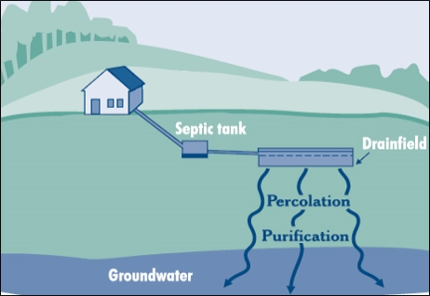
Septic Tank and Drainfield (A Conventional OSTDS)
18
http://www.epa.gov/owm/septic/pubs/homeowner_guide_long.pdf

Slide 7
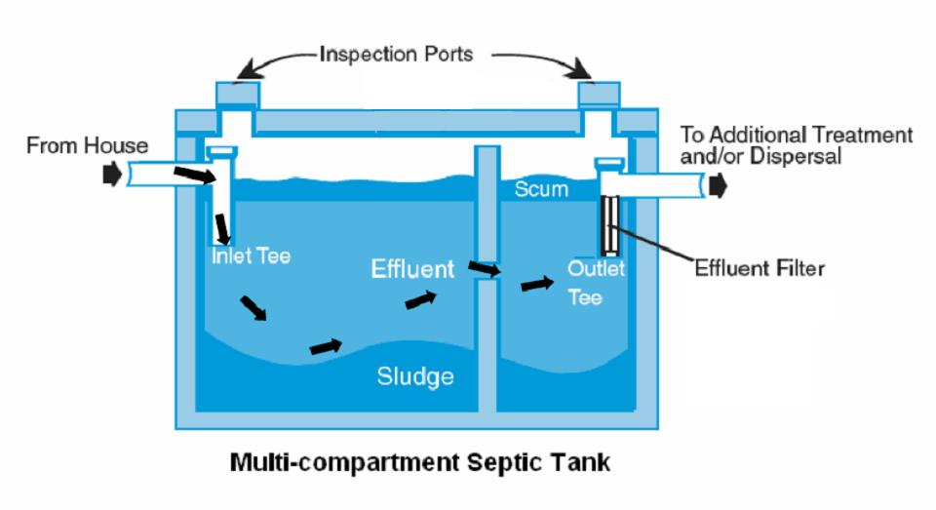
How Do Septic Tanks Work?
Modern septic tanks are water tight
Collect solids and consume a third to half of biodegradable material (carbonaceous biochemical oxygen demand after 5 days[CBOD5])

Slide 8
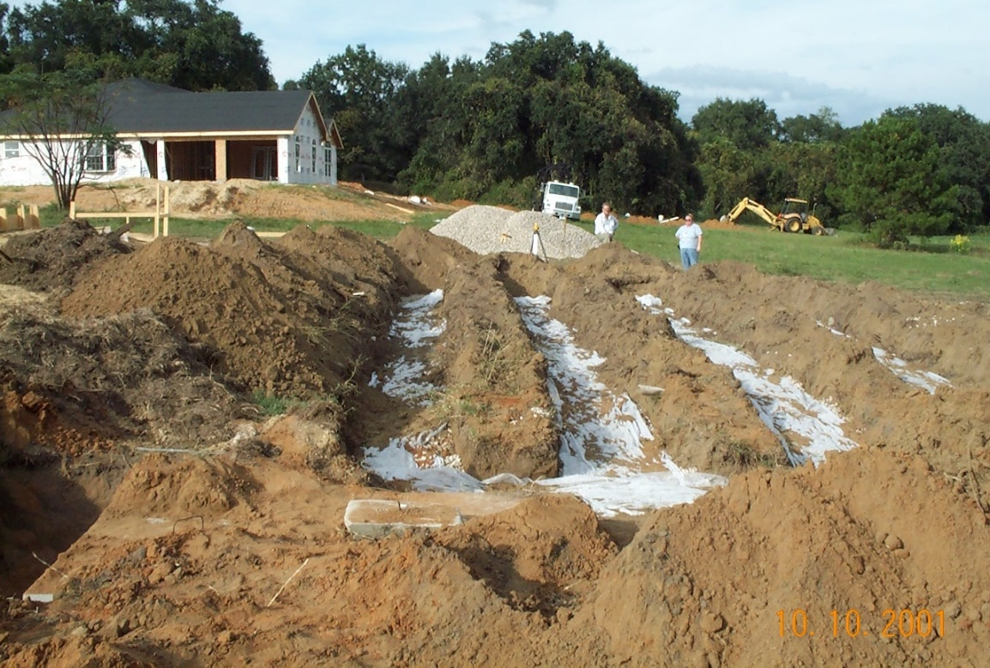
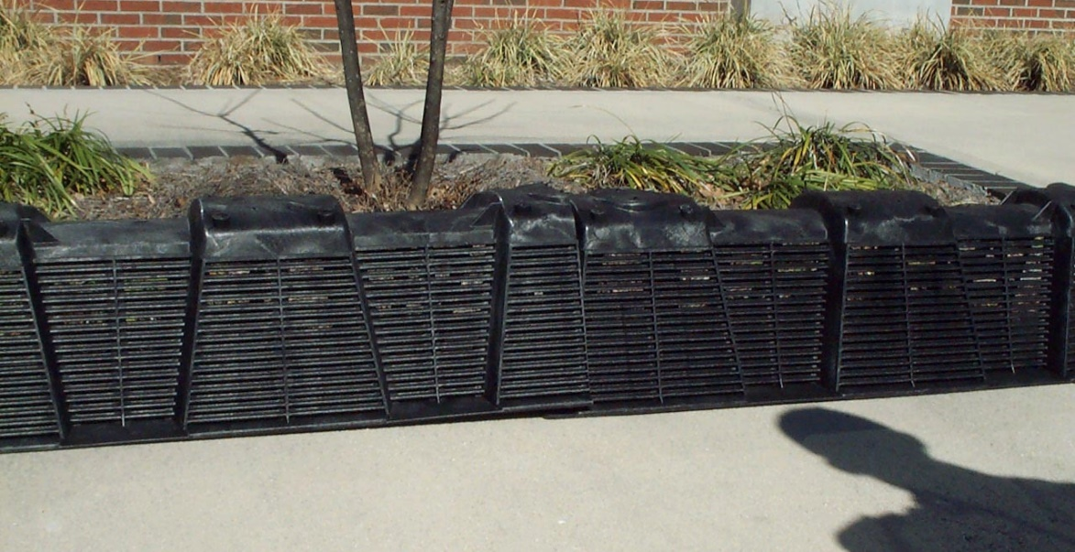
How Does a Drainfield Work?
Liquid that comes from septic tank drains into soil
Soil/Air/Water combination:
Removes/filters pathogens, suspended solids in the area above groundwater
Converts ammonia to nitrate (removes 10-50% of nitrogen)
Groundwater

Slide 9
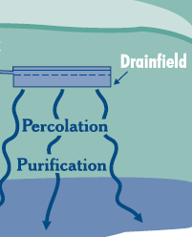
Modern Drainfield Design Protects the Environment
Separation to wet season water table important for treatment
6 inch between top of drainfield and ground surface
Drainfield thickness (12 inch for gravel)
2 feet between bottom of drainfield and wet season water table required to provide air and soil treatment

Slide 10
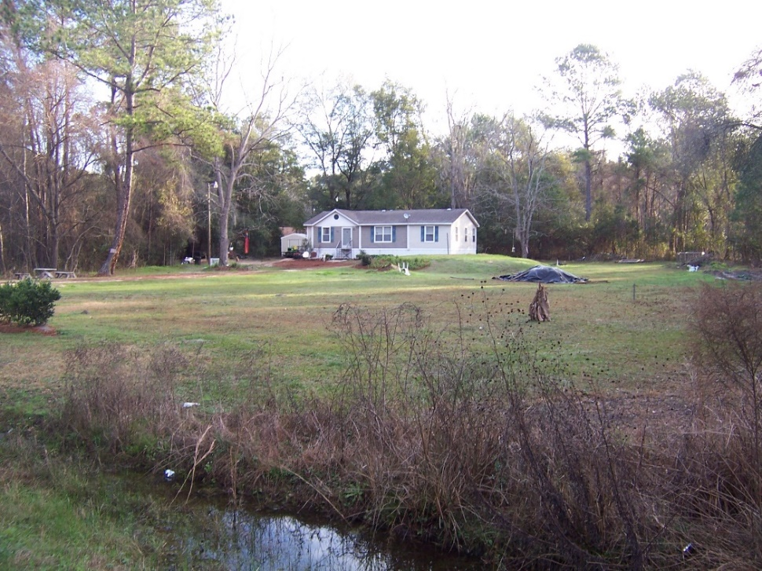
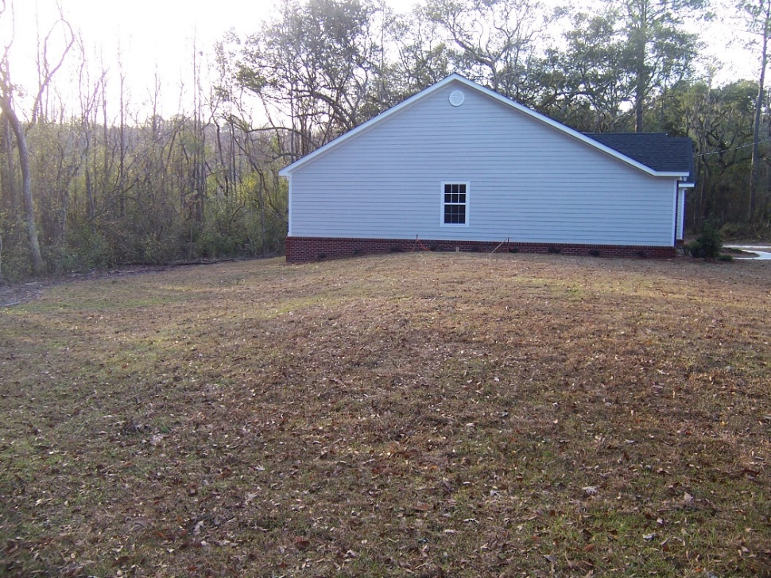
Mound As Alternative Drainfield
A system can be elevated (Mound system) to protect environment
• Wet season water table too high
• Prohibited soils (e.g., rock) exist

Slide 11
Options for Nutrient Reduction
To limit OSTDS-contribution of nutrients (in general or for specific areas)
Lower the number of OSTDS
Sewer
County ordinances (lot size, setback)
Existing statute density-limitations (Sections 381.0065(4)(a)-(g), Florida Statutes)
Require higher treatment by OSTDS

Slide 12
Aerobic Treatment Unit (ATU)
Pretreatment Tank or Compartment
Aeration
Tank or Compt.
Clarifier
Sewage
Drainfield
ATU certification based on certain performance standard
All ATUs certified to meet standard NSF 40; some are also certified to meet a 50% nitrogen-reduction standard (NSF 245)

Slide 13
Performance-Based Treatment System (PBTS)
Specialized onsite sewage treatment and disposal system
In many cases, includes an ATU
Designed and certified by professional engineer to achieve specific and measurable established performance standards for:
Carbonaceous biochemical oxygen demand,
Total suspended solids,
Total nitrogen,
Total phosphorus,
Fecal coliforms

Slide 14
PBTS Based on Nitrogen-Reducing ATU
recycle for denitrification
Sewage
Aeration
Chamber
Drainfield
One example of a nitrogen-reducing ATU
Field evaluations show about 50% nitrogen reduction
More complex technologies with higher treatment effectiveness are becoming available

Slide 15
Two-Stage Nitrogen Reduction Process Example
In-tank Nitrogen Reduction Biofilter - PBTS
Wastewater
Q
Ground Surface
Drainfield
Septic Tank
Pretreatment
Stage 1 Biofilter
Nitrification
Stage 2 Biofilter
Denitrification
Note: In flat landscapes may need a single pump.

Slide 16
In-ground Nitrogen-Reducing Biofilter
A nitrate-reducing layer below drainfield; material reacts with nitrate

Slide 17
Dr. Kendra Goff - Chief
Kendra.Goff@flhealth.gov
(850) 245 4250
Ed Barranco- Section Lead Dr. Eb Roeder
Ed.Barranco@flhealth.gov Eberhard.Roeder@flhealth.gov
Dr. Xueqing Gao Debby Tipton
Xueqing.Gao@flhealth.gov Debby.Tipton@flhealth.gov
Onsite Sewage Programs Section
Bureau of Environmental Health
Division of Disease Control and Health Protection

