Slide 1
Cyanobacteria Blooms and their Toxins
CAN I SWIM?
Kendra F. Goff, PhD, DABT, CPM, CEHP
Chief & State Toxicologist
Bureau of Environmental Health
Florida Department of Health

Slide 2
What is the Department’s Role?
“To Protect, Promote and Improve the health
of all people in Florida”
Evaluation of Human Health Effects
Surveillance of Human Illness
Education of Health Care Professionals
Outreach to the Public

Slide 3
Integrated Department of Health
Department of Health
(DOH)
67 County Health
Departments -
Environmental
Health
Central Office -
Environmental Health

Slide 4
Government Partners
Dept. of Environmental Protection (DEP)
Evaluates environmental impacts
Florida Fish and Wildlife Conservation Commission (FWC)
Evaluates impact on wildlife and fisheries
Dept. of Agriculture and Consumer Services (FDACS)
Provides local shellfish harvesting status
Centers for Disease Control and Prevention (CDC) and Environmental Protection Agency (EPA)
Partners with DOH in assessing human health impacts
And many more….
All partners work together on public messaging.

Slide 5
Cyanotoxins
Florida is home to many types of cyanobacteria (blue-green algae)
Cyanobacteria don’t always produce cyanotoxins
Cyanotoxins have different toxicities
Some toxins are more potent than others
Organs affected may differ

Slide 6
Potential Exposure Pathways
The dose makes the poison.
Direct Skin Contact
swimming, water sports
Inhalation of Aerosols
disruption of water surface
Incidental Ingestion
swimming, water sports
Drinking Water
surface water sources
Ingestion of Food
intake of seafood such as fish and shellfish

Slide 7
Health Impacts: Cyanotoxins
Shorter Term Impacts in Florida
Self-reported exposures and self-reported illness
Most common reported symptoms:
Rashes
Eye, nose and throat irritation
There may be other compounds released by cyanobacteria, including hydrogen sulfide (H₂S) with a noticeable odor, that may be respiratory irritants

Slide 8
Health Impacts: Cyanotoxins
Longer Term Impacts in Florida
Links suggested, but not yet conclusive
Determining exposure (or not) is key to understanding risk
For example: Beta-methylamino-L-alanine (BMAA)
Amyotrophic lateral sclerosis/ parkinsonism-dementia complex?
Consensus still needed regarding its ubiquitous occurrence
Uncertainty on concentrations reported
Problems with replication of study findings
Analytical methodology variable

Slide 9
Hydrogen Sulfide (H₂S)
An odor-generating by-product of cyanobacteria
Outdoor exposure to H₂S does not cause serious health effects but can be a respiratory irritant at low levels (< 10 ppm)
Florida’s outdoor environmental testing of H₂S from algal blooms found very low levels (<1 ppm)

Slide 10
Challenges to Evaluating Health Impacts
Limited understanding of exposure dose from some exposure pathways
Symptoms not specific to harmful algal bloom (HAB) exposures
No FDA approved clinical laboratory tests for exposure
Health care professionals lack expertise in HAB-related illnesses

Slide 11
Challenges to Evaluating Health Impacts
cont.
Migration of people in and out of affected areas
Scarcity of air monitoring data
Expense and time of conducting long-term, human health studies

Slide 12
Animal Illness
We know at higher exposure levels, cyanotoxins are poisonous
Animal morbidity and mortality is documented
Animals (i.e.: dogs, livestock) drink raw surface water, eat “non-food” items such as surface scums
Illness presentation includes:
acute vomiting, diarrhea, severe thrombocytopenia, elevated alanine aminotransferase and hemorrhage

Slide 13
DOH Provides Public Health Education
Provides educational material
Provides presentations
Talks to citizens
Talks to health care providers
Attends community events
Has signage and rack cards
Provides alerts & press releases

Slide 14
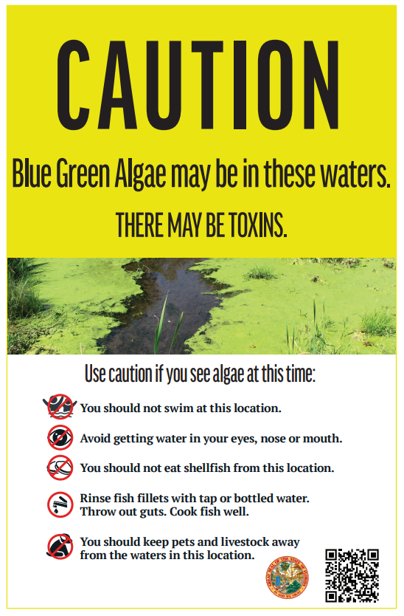
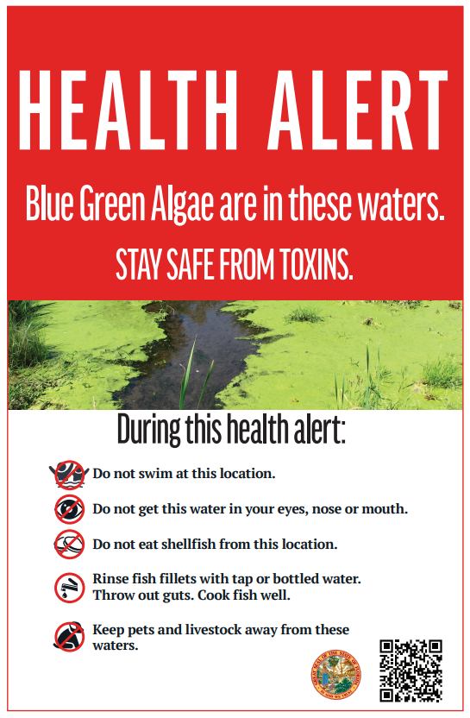
Cyanobacteria/Blue-Green Signage
http://ww11.doh.state.fl.us/comm/_partners/aquatic_toxins_swim_it_shore_it/

Slide 15
Caution Signs
“If you see algae, stay out of the water”
Placed at beginning of season
Removed at the end
Placed where public may contact HABs
Locations chosen with local partners

Slide 16
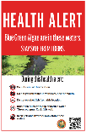
Health Alert Sign
Data driven
Local decision whether to use
Uses laboratory-certified data
Trigger is the presence of toxins
Negative toxin tests triggers removal
More messaging available
Local CHD website alert
Press release
Health Alert signage

Slide 17
Caution Signs
Consistent statewide approach
Real-time
Posted at public access points where blooms are present
Not reliant on toxin results
Easy to understand, clear message

Slide 18
Partner Communications
DOH HAB website - http://www.floridahealth.gov/environmental-health/aquatic-toxins/index.html
DEP is developing a website where state partners can share water quality information with the public

Slide 19
Florida Healthy Beaches Program
Provides water quality monitoring of saltwater and brackish beaches
Uses enterococci (fecal bacteria) as water quality indicator
If bacteria levels are above the beach action value (BAV), an advisory is issued. Sign is placed on beach.
Remove sign when bacterial levels decrease
Monitors/collect samples in 30 coastal counties for 220 beaches
Different from cyanobacteria which is a freshwater organism monitored/sampled by DEP.

Slide 20
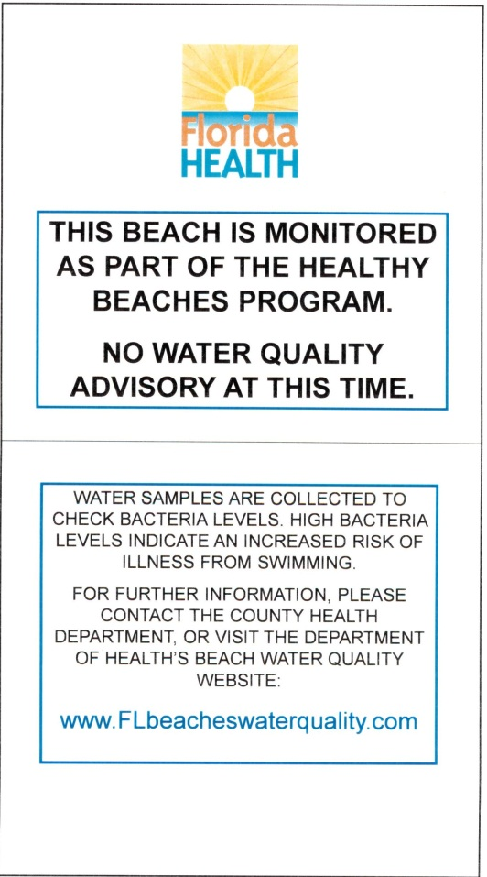
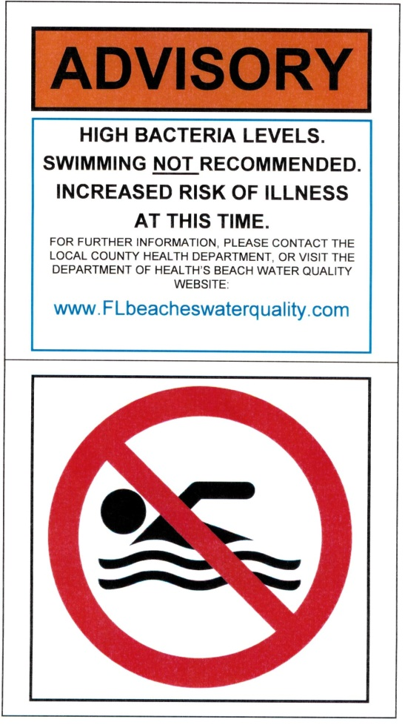
Fecal Bacteria Signage

Slide 21
Appropriation 2019-2020
Appropriated $650,000 on July 1, 2019
DOH will:
Fund research on health impacts from algal toxins
Directly contract with universities through exempt procurement process
DOH contacted universities last week of July
Applications sent week of August 1; Deadline August 30
Scoring and contract execution in early September
Request for recurring funding in new legislative session

Slide 22
Research Priorities
Prevention: Focus on prevention of impacts from exposure to HAB toxins
Treatment: Focus on improved treatment of impacts from exposure to HAB toxins
Health Disparities: Contribute to reduction of impacts from exposure to HAB toxins resulting from health disparities due to race, ethnicity, or income
Screening: Improve screening accuracy, detect high-risk subgroups, and/or improve implementation of screening program to increase early detection or prevention of HAB-related illness

Slide 23
So, can you swim?
The answer is …
Yes….If the water is free of blooms; no caution sign
No….If the blooms are visible; caution sign
Check https://floridadep.gov/AlgalBloom for status
“If you see algae, stay out of the water”

Slide 25
Questions?
Dr. Kendra Goff
Bureau Chief & State Toxicologist
Bureau of Environmental Health
Florida Department of Health

