Slide 1
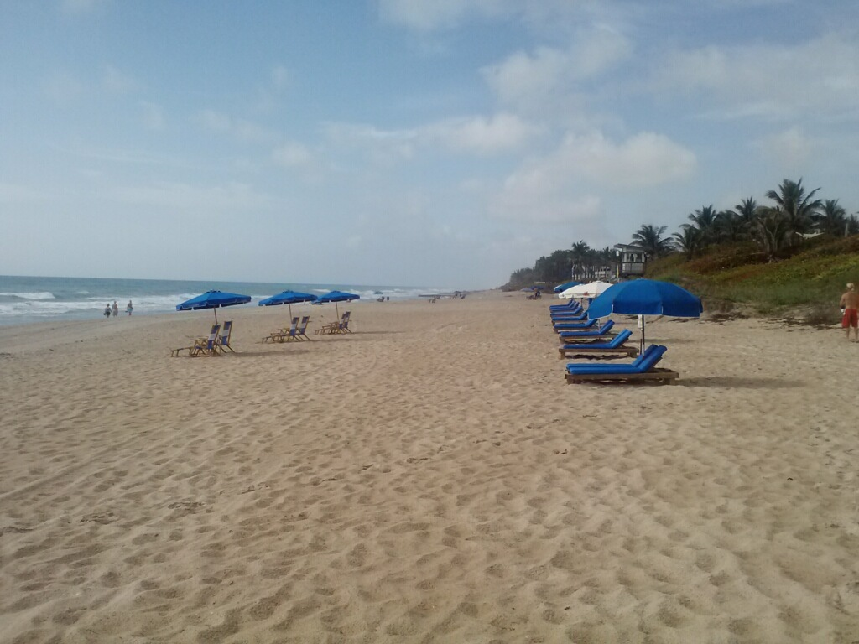
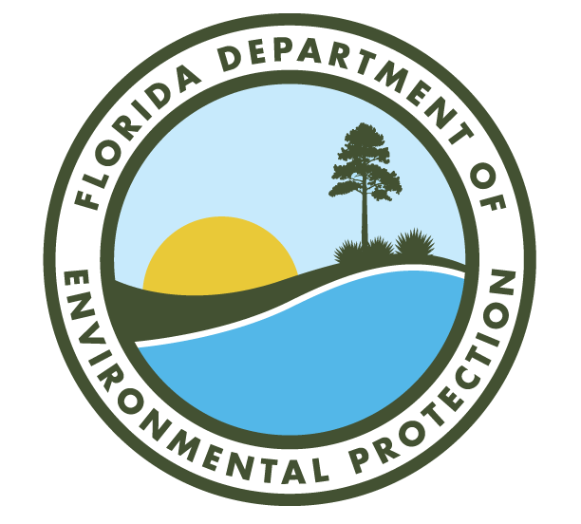
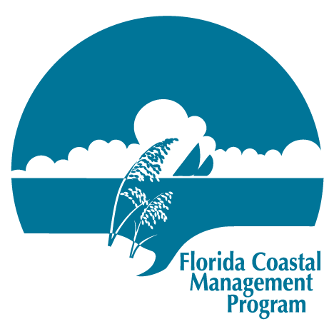
Florida Coastal Management Program Grant Opportunities
June 2023
Holly Edmond, Grant Administrator
Holly.Edmond@FloridaDEP.gov or 850-245-2181
Florida Coastal Management Program

Slide 2
Coastal Partnership Initiative
The Coastal Partnership Initiative (CPI) is administered by the Florida Coastal Management Program, in the Office of Resilience and Coastal Protection, of the Florida Department of Environmental Protection.
Funding provided through a partnership with the National Oceanographic and Atmospheric Administration, Coastal Zone Management Program.

Slide 3
Coastal Partnership Initiative
The Coastal Partnership Initiative was developed to promote the protection and effective management of Florida’s coastal resources in four specific priority areas:
Resilient Communities.
Coastal Resource Stewardship.
Public Access to Coastal Resources.
Working Waterfronts.

Slide 4
Who is Eligible?
Florida’s 35 coastal counties and municipalities within their boundaries that are required to include a coastal element in their comprehensive plan. An entity (a local government or other eligible applicant) may submit one application per funding cycle.
Florida’s public colleges, universities, regional planning councils, national estuary programs and nonprofit groups may also apply provided that an eligible local government agrees to participate as a partner and signs the application.
Notes:
NOTES: Coastal element: shall set forth the principles, standards, and strategies that guide the local government’s decisions and program implementation with respect to protecting human life against the effects of natural disasters; limiting public expenditures that subsidize development in high-hazard areas; maintaining, restoring, and enhancing the overall quality of the coastal zone environment; and assessing development and infrastructure impacts associated with redevelopment, hazard mitigation and financial assurances regarding public facilities maintenance, and necessary adopted regulatory and management techniques. (paraphrased from statute)

Slide 5
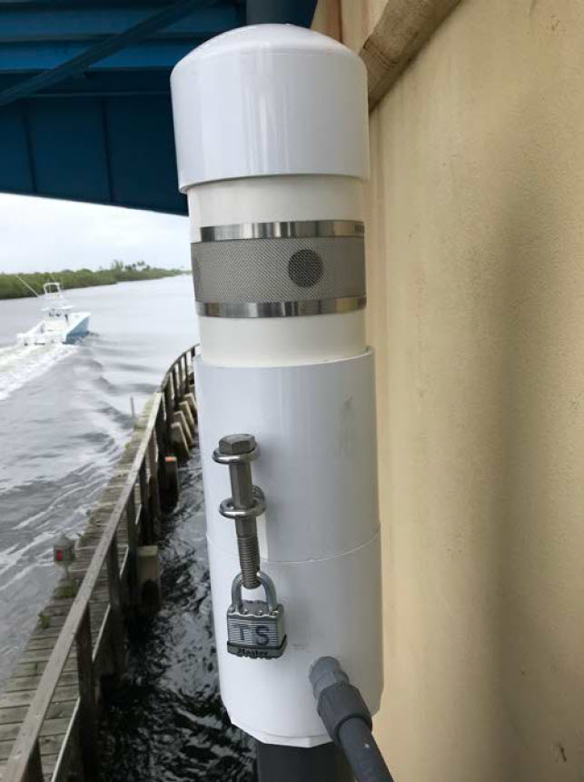
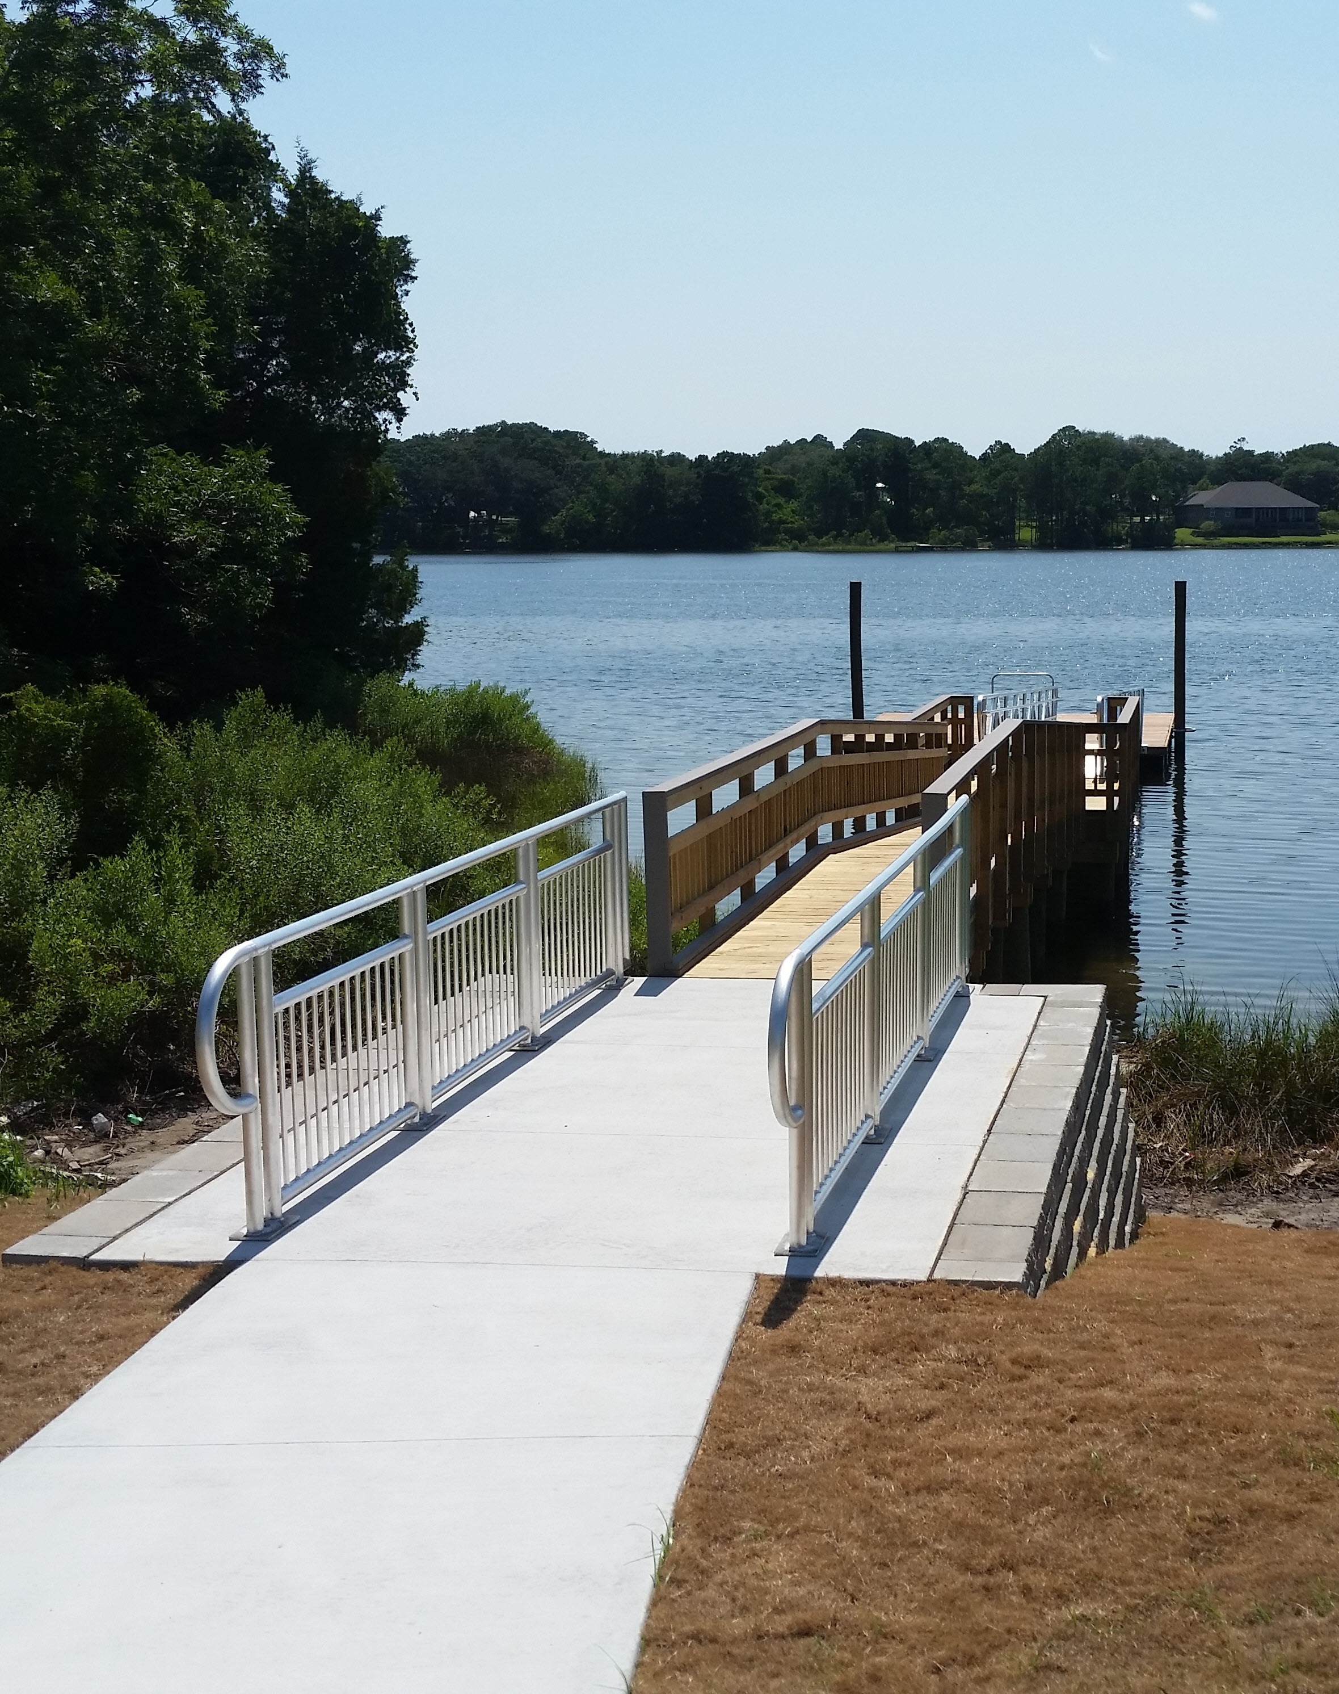
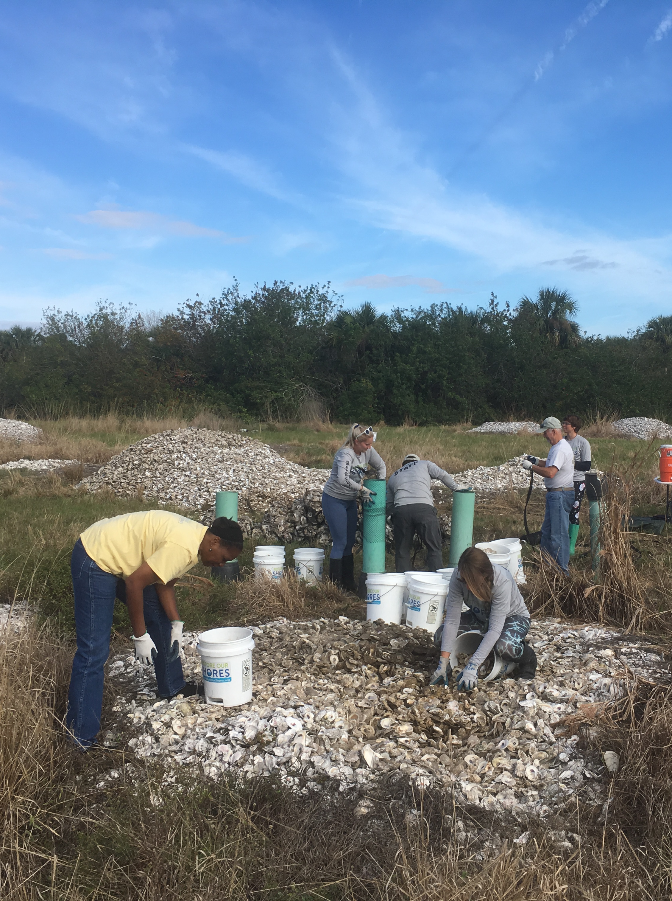
CPI Priority Areas
Resilient Communities
Public Access to Coastal Resources
Coastal Resource Stewardship
Working Waterfronts
Vulnerability analyses and risk assessments; coastal wetland restoration; improving community resiliency to coastal hazards.
Small-scale capital improvements like walkovers, boardwalks, and facilities; land acquisition and management planning.
Coastal clean-ups; environmental awareness initiatives; resource restoration; invasive species management.
Small-scale construction projects that renew or promote interest in waterfront districts; developing vision plans.
Notes:
Resilient communities: help coastal communities prepare for and respond to the effects of climate change and natural hazard events and disasters. Project examples include vulnerability analyses and risk assessments; developing post-disaster redevelopment plans and business continuity plans; developing climate change adaptation strategies for incorporation in local comprehensive plans or ordinances; developing policies, guidance, and best management practices related to resiliency; restoring and preserving coastal wetlands and shorelines for coastal hazard mitigation and developing energy efficiency and alternative energy strategies.
Public Access to Coastal Resources: to help communities identify and improve public access to cultural, historical, and natural areas while protecting resources from overuse and damage. Project examples include planning for and construction of small-scale projects such as fishing piers, dune crossovers, boardwalks, observation decks, canoe/kayak, and sailboat launches; or natural shoreline restoration; invasive exotic plant removal; waterfront park improvements; or development of recreational surface water use plans.
Coastal Resource Stewardship: to promote stewardship and appreciation of fragile coastal resources through local involvement. Examples include dune and wetland restoration; invasive exotic plant removal; costal clean-ups, cultural resource protection; environmental awareness initiatives; coastal learning centers; and environmental education and field trips. And
Working Waterfronts: to assist communities with waterfront revitalization by supporting projects that enhance and sustain traditional waterfront communities while addressing public access, resource protection, and hazard mitigation issues. Project examples include constructing boat ramps, waterside boardwalks, kiosks and fish cleaning stations, and restoring shorelines or implementation other measures that help waterfront communities mitigate the effects of natural hazards.

Slide 6
CPI Awards
Financial awards are limited to no more than $60,000 for construction projects, habitat restoration, invasive exotic plant removal or land acquisition, and no more than $30,000 for planning, design and coordination activities. The minimum award is $10,000 and requires 100% (1:1) cash or in-kind match from the recipient.
Funding Cycle
The funding year typically begins July 1 and ends June 30 the following year. Projects are to be completed within 12 months. Awards for this cycle would begin July 1, 2024.

Slide 7
CPI Application Process
Application Window and Deadline
A Notice of Funds Availability will be published in the Florida Administrative Register (target: mid June) to open the application period. Applications must be received by 4:00 p.m. EDT on the day identified in the notice, via email (preferred) or hardcopy.
Application Review
Eligible CPI applications are reviewed and ranked by a committee of coastal resource experts, using the criteria listed in the application. The highest ranked projects will be considered for funding as available. All information required for application evaluation must be submitted in the CPI grant application.

Slide 8
CPI Application Form
Application Form
An application form must be completed by the applicant.
Construction and restoration projects also require a completed 306A Questionnaire.
The application form and 306A Questionnaire can be downloaded from the Grants webpage: https://floridadep.gov/rcp/fcmp/content/grants
The application form and 306A Questionnaire can also be provided via email upon request.
Notes:
Note that we will go over the application form in detail after the presentation for technical questions.

Slide 9
Federal Environmental Compliance
under the National Environmental Protection Act
Required for construction and soil disturbing projects, including restoration and invasive species management/removal.
Applicants must complete 306A Questionnaire.
Permits do not need to be in place prior to application, but applicant must conduct preliminary consultation with regulatory authorities
Project timeline must include adequate time for permitting.
Additional review by NOAA for NEPA compliance.

Slide 10
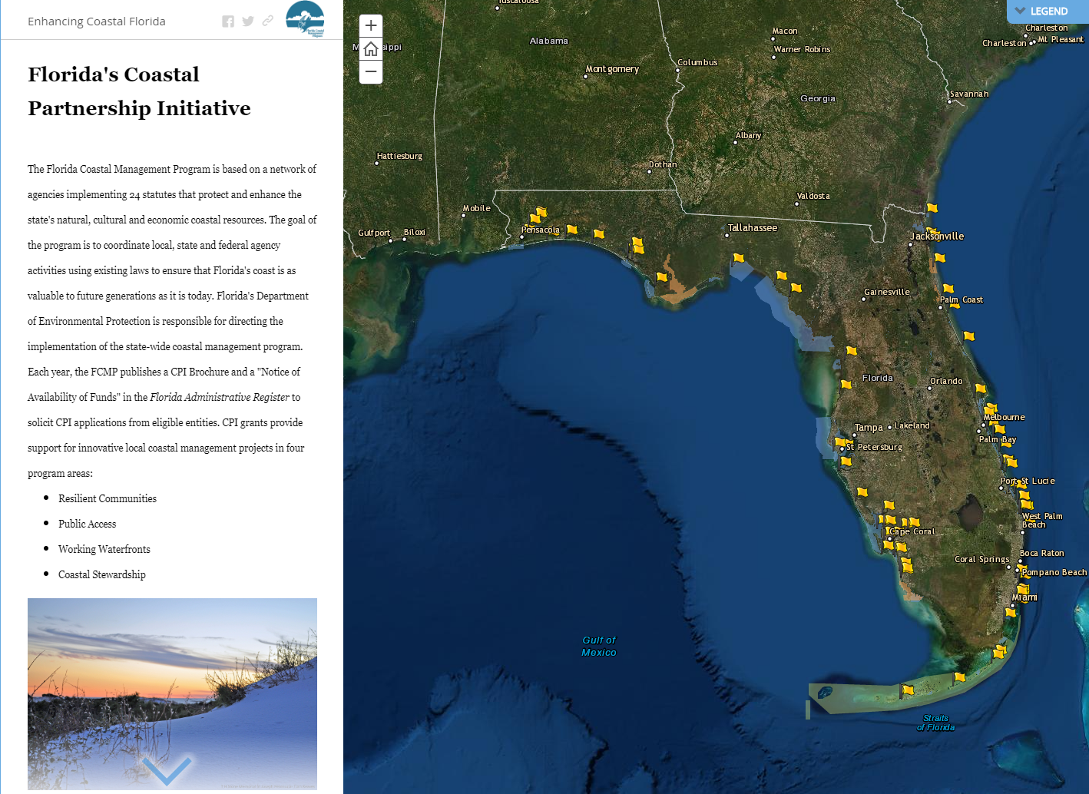
Florida’s Coastal Partnership Initiative
Notes:
Click through to story map to demonstrate

Slide 11
Questions?
Information relating to the notice for availability of funds, grant applications and the Grant Rule 62S-4, FAC, and more, can be found on the Coastal Partnership Initiative webpage at:
https://floridadep.gov/rcp/fcmp/content/coastal-partnership-initiative
https://floridadep.gov/rcp/fcmp/content/grants

Slide 12
Bipartisan Infrastructure Law Funding
Bipartisan Infrastructure Law (BIL) grant funding will be available for the 2023-24 fiscal year from NOAA, through the state/territory coastal management programs and national estuarine research reserves (NERRs).
FCMP can submit up to three project ideas in “letter of interest” format.
Local governments and NGO project partners can be direct recipients but FCMP must support and submit the proposal.
Projects can support conservation land acquisition ($6M project cap), habitat restoration, and habitat restoration planning, engineering, and design.
Notes:
Projects submitted by the FCMP can be up to $6M each, while projects submitted by the NERRs can be up to $4M each.

Slide 13
BIL Funding: Land Acquisition
Land Acquisition projects must be publicly owned or leased land and allow for passive access
Land must be owned by the public entity receiving funds by the end of the project, but NGOs can participate in “buy & hold” acquisition process
Priorities:
Significant ecological value.
Demonstrated need for protection.
Able to be effectively managed and protected.
Serve to mitigate adverse impacts caused by coastal population growth.
Notes:
Projects submitted by the FCMP can be up to $6M each, while projects submitted by the NERRs can be up to $4M each.

Slide 14
BIL Funding: Habitat Restoration
Habitat Restoration projects must take place on publicly owned land
Priorities:
Meet coastal habitat restoration goals identified in state/regional plans.
Restore important habitats and connected ecosystem functions or species.
Restore hydrologic connections between habitats that improve ecosystem function.
Enhance/restore ecosystem services that support coastal communities, vulnerable populations, or cultural resources (i.e., coastal flood protection, extreme weather resilience, chronic coastal erosion, etc.).
Notes:
Projects submitted by the FCMP can be up to $6M each, while projects submitted by the NERRs can be up to $4M each.

Slide 15
BIL Funding Timeline
NOAA Notice of Funding Opportunity (NOFO) planned for mid May.
Letters of Interest due in 60 days (mid July).
Successful applicants notified in September to prepare full proposals.
Full proposals from invited applicants due in 90 days (early December).
Successful project applicants notified in February 2024.
Awards expected to begin July 2024.
FCMP is accepting ideas now! Email ideas to Holly.Edmond@FloridaDEP.gov
Notes:
We will work with interested parties on project ideas and if selected for submission, will coordinate on drafting the letter of interest. FCMP staff capacity is limited, and we would prefer projects from partners who are eligible and willing to be award recipients.

Slide 16
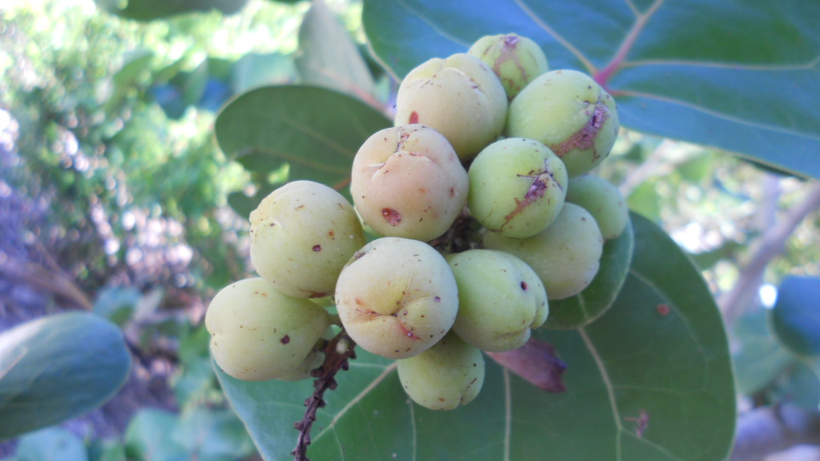
Thank you!
Holly Edmond, Grant Administrator
Holly.Edmond@FloridaDEP.gov 850-245-2181
Tiffany Herrin, Grant Manager
Tiffany.Herrin@FloridaDEP.gov 850-245-2953
Amy Harrison, Grant Manager
Amy.M.Harrison@FloridaDEP.gov 850-245-8398

