Slide 1
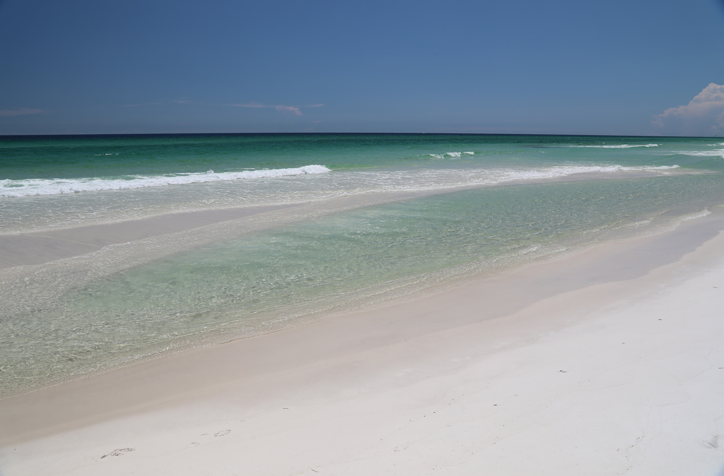
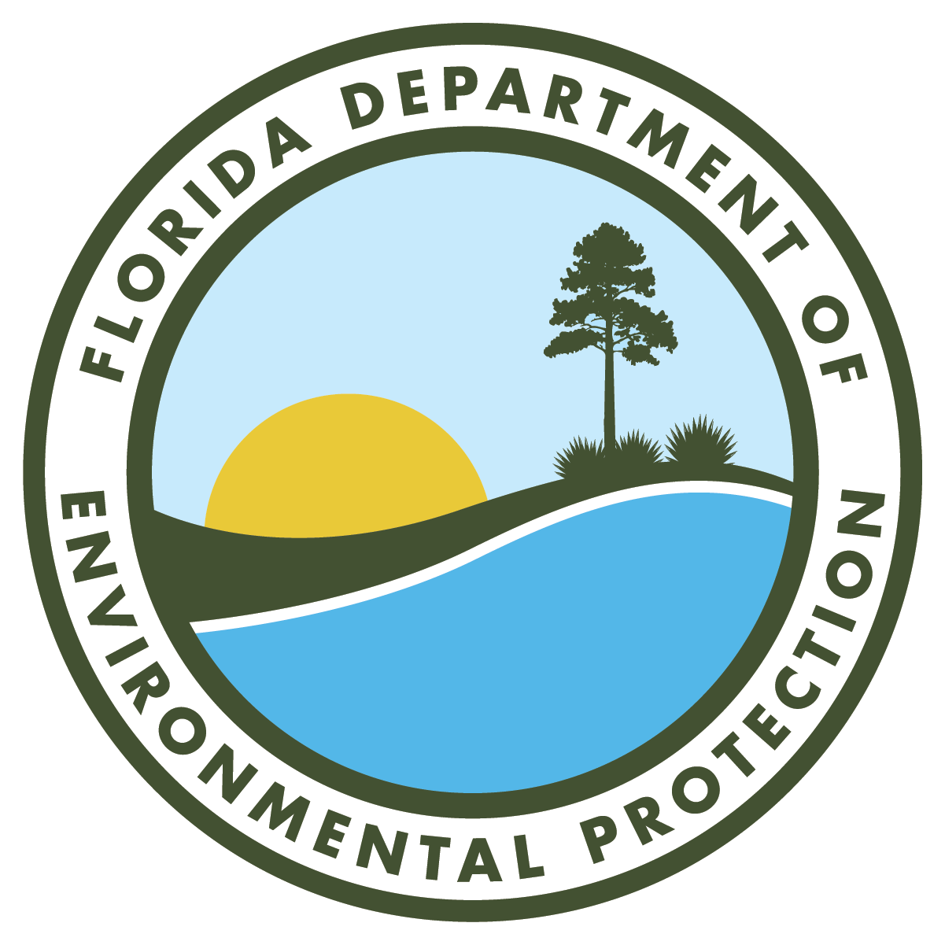
62B-33, F.A.C.
Rule Development Workshop
Doug Aarons, P.E.
Office of Resilience and Coastal Protection
Florida Department of Environmental Protection
September 11, 2025

Slide 2
62B-33.002, F.A.C.
DEFINITIONS
(3) “Armoring” is a manmade structure designed to either prevent erosion of the upland property or protect structures from the effects of coastal wave and current action and anticipated relative sea level rise. Armoring includes certain rigid coastal structures such as geotextile bags or tubes, seawalls, revetments, bulkheads, retaining walls, or similar structures but does not include jetties, groins, or other construction whose purpose is to add sand to the beach and dune system, alter the natural coastal currents, or stabilize inlet shorelines.
(4) “Armoring Replacement” is the complete replacement, within the same footprint or immediately seaward, of existing armoring that has deteriorated, has exceeded its design service life or has been significantly damaged, with new armoring of similar design.
(5) “Armoring Upgrade” is an improvement to existing functional and intact armoring that prevents further erosion of the upland property or further protects structures from the effects of coastal wave and current action, and anticipated relative sea level rise. Examples may include addition or extension of return walls, and increasing the cap elevation of the existing armoring.

Slide 3
62B-33.002, F.A.C.
DEFINITIONS
(1618) “Expendable Structure” means a structure that is subject to use or consumption, suitable for sacrifice, or is not essential to preserve, or is not necessary for the occupation of a habitable structure.
(1719) “Fifty (50)-foot Setback” or “Setback Line” is the line of jurisdiction established pursuant to the provisions of Section 161.052, F.S., in which construction is prohibited within 50 feet of the line of mean high water at any riparian coastal location fronting the Gulf of America Mexico or the Atlantic coast shoreline.
(2729) “Major Reconstruction” is the complete or partial replacement or rebuilding, within the same footprint while taking relative sea level rise into account, to its original level of protection, of a significant portion of an existing armoring structure which has failed or deteriorated or exceeded its service life.
(2931) “Marine Turtle Nesting Habitat” is all sandy beaches adjoining the waters of the Atlantic Ocean, the Gulf of AmericaMexico, and the Straits of Florida in all coastal counties and all inlet shorelines of those beaches. Nesting habitat includes all sandy beach and unvegetated or sparsely vegetated dunes immediately adjacent to the sandy beach and accessible to nesting female turtles.
(49) “Relative Sea Level Rise” is defined as sea level rise measured by professionally accepted and approved tide gauge consistent with 380.093(3)(d)3.d., F.S..

Slide 4
62B-33.002, F.A.C.
DEFINITIONS
(5962) “Vulnerable” is when an eligible private structure is subject to either direct wave attack or to erosion from a 15-year return interval storm which exposes any portion of the foundation, or when eligible public infrastructure is subject to either direct wave attack or to erosion from a 25-year return interval storm which exposes any portion of the foundation or otherwise renders the infrastructure non-functional. Vulnerability will be determined by using the methodologies referenced in subparagraph 62B-33.0051(1)(a)2., F.A.C., or the “SBEACH-32 Users Interface Manual “dated January 10, 1996 http://www.flrules.org/Gateway/reference.asp?No=Ref-12082, “SBEACH Report 1”dated July 1, 1989, http://www.flrules.org/Gateway/reference.asp?No=Ref-12083, “SBEACH Report 2” dated May 1 1990, http://www.flrules.org/Gateway/reference.asp?No=Ref-12084, “SBEACH Report 3” dated May 1,1993, http://www.flrules.org/Gateway/reference.asp?No=Ref-12085, “SBEACH Report 4” dated April 1, 1996, http://www.flrules.org/Gateway/reference.asp?No=Ref-12086, and “SBEACH Report 5” dated August 1,1998, http://www.flrules.org/Gateway/reference.asp?No=Ref-12087 by the U.S. Army Corps of Engineers, which is hereby adopted and incorporated by reference, and which may be obtained at the following web address: www.dep.state.fl.us/beaches. Storm surge hydrographs shall include the effects of relative sea level rise in modeling efforts.

Slide 5
62B-33.004, F.A.C.
EXEMPTIONS FROM PERMIT REQUIREMENTS
(2) In addition to the exemptions provided in Section 161.053(11), F.S., the following are exempt from the provisions of Section 161.053, F.S., and this Chapter:
(a) Construction of offshore structures, such as drilling platforms, gas and oil rigs, towers, or navigation aides, located beyond the effective limits of littoral sediment transport.
(b) Construction, excavation, and damage or destruction of vegetation conducted by the United States Government on lands owned and maintained by the United States Government.
(c) Minor activities that are not part of a larger project or development, and do not cause a disturbance to any significant or primary dune, do not disturb marked or known marine turtle nests or interfere with nesting and hatchling sea turtles, damage existing native salt-tolerant vegetation, obstruct public access, or damage adjacent properties. Exempt minor activities include:
1. Beach or deck furniture and awnings that are removed from the beach at night or stacked in a manner to reduce interference with sea turtle nesting.
(4) If the Department determines the proposed minor construction is exempt from the provisions of Section 161.053(11)(c)9., F.S., the Department shall issue a notice of exemption. using the DEP exemption form. The exemption form, which is entitled “Exemption Determination Pursuant to Section 161.053 or 161.052, F.S.,” DEP Form #73-120 (Updated 3-05XX-XX), is hereby incorporated by reference. A copy of the form can be obtained by contacting the Department of Environmental Protection, 2600 Blair Stone Road, MS 3522, Tallahassee, Florida 32399-2400, at https://floridadep.gov/water/coastal-construction-control-line/content/coastal-construction-control-line-cccl-forms or by telephoning (850)245-2094. The exemption notice shall be posted on the project site for the duration of the activity. If the proposed activity is determined not to be exempt, a permit pursuant to Section 161.053, F.S., and this chapter is required.

Slide 6
62B-33.005, F.A.C.
GENERAL CRITERIA FOR AREAWIDE AND INDIVIDUAL PERMITS
(9) All structures, except those required for public safety, beach access, and those associated with dune restoration and special events, shall be located a sufficient distance landward of the beach and frontal dune. This distance landward shall be sufficient to permit allow natural shoreline fluctuations, to preserve and protect beach and dune system stability, and to allow natural recovery of the existing beach and seaward dune system to occur following storm-induced erosion. If such structure is proposed at a location where there is no frontal dune, but the project includes dune restoration to reestablish a frontal dune that is consistent with the frontal dune on adjacent properties, then the structure shall be located a sufficient distance landward of the beach and restored or reestablished frontal dune to permit natural shoreline fluctuations, to preserve and protect beach and dune system stability, and to allow natural recovery to occur following storm-induced erosion. Where a rigid coastal structure exists it must be certified by an engineer licensed in the State of Florida or determined by the Department to provide protective value from a 15-year or greater return interval storm event, and the proposed major structures shall be located a sufficient distance landward of the rigid coastal structure to allow for future maintenance or repair of the rigid coastal structure. Although fishing piers shall be exempt from this provision, their foundation piles shall be located so as to allow for the maintenance and repair of any rigid coastal structure that is located in close proximity to the pier.

Slide 7
62B-33.005, F.A.C.
GENERAL CRITERIA FOR AREAWIDE AND INDIVIDUAL PERMITS
(12) In considering project impacts to native vegetation, the Department shall evaluate:
(a) The type and extent of native vegetation;
(b) The degree and extent of disturbance by invasive nuisance species and mechanical and other activities;
(c) The protective value to adjacent structures and natural plant communities;
(d) The protective value to the beach and dune system; and
(e) The impacts to marine turtle nesting and hatchlings including dune vegetation trimming that increases light visibility from the nesting habitat.
The Department shall restrict activities that lower the protective value of natural and intact beach and dune, coastal strand, and maritime hammock plant communities. Activities that result in the removal of protective root systems or reduce the vegetation’s sand trapping and stabilizing properties of vegetation are considered to lower its protective value. Construction shall be located, where practicable, in previously disturbed areas or areas with non-native vegetation in lieu of areas of native plant communities when the placement does not increase adverse impact to the beach and dune system. Planting of invasive nuisance plants, such as those listed in the Florida Invasive Species Council’s most current Florida Exotic Pest Plant Council’s 2005 List of Invasive Species – Categories I and II, will not be authorized if the planting will result in removal or destruction of existing dune-stabilizing native vegetation or if the planting is to occur on or seaward of the dune system. A copy of this list is available on the Internet at https://www.floridainvasives.org/ www.fleppc.org; or can be obtained by contacting the Department of Environmental Protection, 2600 Blair Stone Road, MS 3522, Tallahassee, Florida 32399-2400; at https://floridadep.gov/water/coastal-construction-control-line/content/coastal-construction-control-line-cccl-forms or by telephoning (850)245-2094. Special conditions relative to the nature, timing, and sequence of construction and the remediation of construction impacts shall be placed on permitted activities when necessary to protect native vegetation and native plant communities. A construction fence, a designated location for construction access or storage of equipment and materials, and a restoration plan shall be required if necessary for protection of existing native salt-tolerant vegetation during construction.

Slide 8
62B-33.005, F.A.C.
GENERAL CRITERIA FOR AREAWIDE AND INDIVIDUAL PERMITS
(13) Special conditions relative to the nature, timing, and sequence of construction shall be placed on permitted activities when necessary to protect marine turtles and their nests and nesting habitat. In marine turtle nesting areas, all forms of lighting shall be shielded, and utilize long wavelength light sources only (e.g. 560 nanometers (nm) or longer and absent wavelengths below 560 nm) with all lamps recessed within well shielded, full cut-off fixtures or otherwise designed so as not to disturb marine turtles. Tinted glass or similar light control measures shall be used for windows and doors which are visible from the nesting areas of the beach. Tinted glass shall be 45 percent or less inside to outside light transmittance on all non-opaque doors, walls, balcony, deck railings, and windows. Glass balcony and deck railings shall be tinted to allow 45 percent or less light transmittance when necessary to reduce visible lighting from the sea turtle nesting habitat. The Department shall suspend any permitted construction when the permittee has not provided the required protection for marine turtles and their nests and nesting habitat.

Slide 9
62B-33.0051, F.A.C.
COASTAL ARMORING AND RELATED STRUCTURES
(1)(a) 2. The structure to be protected is vulnerable. The determination of vulnerability will be made utilizing the dune erosion model contained in the report entitled “Erosion due to High Frequency Storm Events,” by the University of Florida, dated November 22, 1995, which is incorporated herein by reference, SBeach developed by the U.S. Army Corps of Engineers, or other models accepted by the Department staff demonstrating sufficient calibration and verification for application in the project vicinity. Where direct application of the model shows that the structure to be protected is not vulnerable, but the construction otherwise meets the requirements of this rule chapter, an applicant may further demonstrate vulnerability by taking into account the effects of shoreline change rates, natural physical features, and existing manmade structures in accordance with the following circumstances:
a. If it is projected that the eligible structure will become vulnerable at some future date which falls within the authorized time limit of a permit, then the permit shall authorize the construction of armoring once the anticipated site condition changes occur and the structure becomes vulnerable. The permit shall allow additional time to allow for construction operations and appropriate timing to avoid construction during the marine turtle nesting season.
b. Where there are multiple eligible structures in close proximity to one another, but not all of the structures are vulnerable and shoreline trends indicate continued erosion stress on the shoreline, and the Department determines through the use of numerical modeling and engineering analysis that the construction of armoring for only the vulnerable structures would cause the adjacent structures to become vulnerable following installation of the armoring, then all the eligible structures are considered vulnerable.
c. Where an eligible structure is located on a dune or escarpment and the dune erosion model predicts that the erosion from a 15-year return interval storm for private structures or a 25-year return interval storm for public infrastructure would fall landward of the existing dune crest or escarpment and seaward of the eligible structure, and where the applicant has provided the Department appropriate geotechnical analysis by a qualified professional engineer specialized in geotechnical or foundation engineering which demonstrates that the structure would be in danger of imminent collapse following the occurrence of erosion from a 15-year return interval storm for private structures or a 25-year return interval storm for public infrastructure. Imminent collapse means the structure’s foundation will fail due to its own weight under normal conditions, resulting in structural damage to the supported structure.
d. Where an applicant demonstrates to the Department that another site specific circumstance exists other than listed in sub-subparagraphs 62B-33.0051(1)(a)2.a. through c., F.A.C., such that the eligible structure is vulnerable; or

Slide 10
62B-33.0051, F.A.C.
COASTAL ARMORING AND RELATED STRUCTURES
(1)(a) 3. A gap exists, that does not exceed 250 feet, between a line of rigid coastal armoring that is continuous on both sides of the unarmored property. For the purposes of this subparagraph, continuous means a minimum of two consecutive armored properties, or twice the length of the proposed armoring. Such adjacent armoring shall not be deteriorated, dilapidated, or damaged to such a degree that it no longer provides adequate protection to the upland property. The top of the adjacent armoring must be at or above the still water level, including setup, for the design storm of a 15-year return interval storm for private structures or a 25-year return interval storm for public infrastructure plus the breaking wave calculated at its highest achievable level based on the maximum eroded beach profile and highest surge level combination. The adjacent armoring must be stable under the design storm of 15-year return interval storm for private structures or a 25-year return interval storm for public infrastructure, including maximum localized scour with adequate penetration, and must have sufficient continuity or return walls to prevent upland erosion and flooding under the design storm of 15-year return interval storm for private structures or a 25-year return interval storm for public infrastructure. Such installation shall:
  a. Be sited no farther seaward than the adjacent armoring;
  b. Close the gap between the adjacent armoring;
  c. Avoid significant adverse impacts to marine turtles;
  d. Not exceed the highest level of protection provided by the adjoining walls; and,
  e. Comply with the requirements of Section 161.053, F.S.
  4. The armoring shall not result in a loss of public access along the beach without providing alternative public access;
  5. The construction will not result in a significant adverse impact.

Slide 11
62B-33.0051, F.A.C.
COASTAL ARMORING AND RELATED STRUCTURES
(1) (c) Minor reconstruction and major reconstruction, armoring replacement within the previously existing or more landward footprint, and armoring upgrades of existing armoring is exempt from the conditions of paragraph 62B-33.0051(1)(a), F.A.C., provided that the proposed construction would not result in a significant adverse impact.
(d) Major reconstruction of existing armoring is exempt from the requirements of subparagraph 62B-33.0051(1)(a)2., F.A.C., unless the habitable structure protected by the armoring has been destroyed to the extent that it requires rebuilding.
(2) Siting and Design. Armoring shall be sited and designed to minimize adverse impacts to the beach and dune system, marine turtles, native salt-tolerant vegetation, and existing upland and adjacent structures and to minimize interference with public beach access, in accordance with the following criteria:
(b) Design. Armoring shall be designed to provide protection to vulnerable structures while minimizing adverse impacts and shall be designed consistent with generally accepted engineering practice. The following criteria apply:
1. Coastal armoring structures shall be designed for the anticipated wave runup, overtopping, erosion, scour, and anticipated water loads of the design storm event. Design considerations shall consider anticipated relative sea level rise for the next 30 years. Armoring shall have a minimum design life of 30 years and designed to withstand a minimum 15 year return interval storm. Design procedures are available in the latest edition of the Department of the Army Corps of Engineers’ Coastal Engineering Manual (EM 1110-2-1100), or other similar professionally recognized publications.
2. To minimize adverse impacts to the beach and dune system, adjacent properties, and marine turtles, the shore-normal extent of armoring which protrudes seaward of the dune escarpment, vegetation line, or onto the active beach shall be limited to minimize encroachment on the beach. In areas with viable marine turtle habitat, the highest part of any toe scour protection shall be located to minimize encroachment into marine turtle nesting habitat.
3. All armoring shall be designed to remain stable under the hydrodynamic and hydrostatic conditions for which they are proposed. Armoring shall provide a level of protection generally compatible with existing topography or adjacent armoring. not to exceed a 50-year design storm.

Slide 12
62B-33.0051, F.A.C.
COASTAL ARMORING AND RELATED STRUCTURES
(3) Marine Turtle Protection. Construction of armoring shall not be conducted during the marine turtle nesting season if the Department determines that the proposed construction will result in a significant adverse impact, except as allowed under subsection 62B-33.0051(65), F.A.C., or unless under the provisions of Rule 62B-33.014, F.A.C., emergency permitting procedures are enacted. No additional armoring shall be permitted on public lands in the Archie Carr National Wildlife Refuge. For the purposes of this provision, public lands means lands owned by local, state, or federal governments, or any lands acquired for the specific purpose of allowing them to be managed as part of the refuge. This ban does not apply where armoring is necessary, and there is no reasonable alternative, to protect public infrastructure as that term is defined in Section 161.085, F.S.
(5) Emergency Protection.
(k) If installation of emergency protection structures occurs during the marine turtle nesting season, the following measures for the protection of marine turtles shall be implemented prior to siting and during installation of the emergency protection structure:
1. The Department shall be contacted for information on appropriate siting of the emergency structure to minimize impacts to marine turtles and provided with the location of any known marine turtle nests within the area of the proposed project.
2. Temporary emergency protection structures shall be sited and constructed in a manner that protects marine turtles.
3. Construction and storage of equipment or materials shall be conducted from or located at upland locations landward of the nesting habitat beach.

Slide 13
62B-33.008, F.A.C.
APPLICATION REQUIREMENTS AND PROCEDURES FOR AREAWIDE AND INDIVIDUAL PERMITS
Any person desiring to obtain a permit for construction seaward of the CCCL or 50-foot setback from the Department, except those persons applying pursuant to the emergency procedures in Rule 62B-33.014, F.A.C., shall submit a completed application form to the Department at the address below. The permit application form, which is entitled “Application for a Permit for Construction Seaward of the CCCL or 50 Foot Setback” – DEP Form #73-100, September 2018, is hereby adopted and incorporated by reference, located here: http://www.flrules.org/Gateway/reference.asp?No=Ref-09946. Copies of the form can be obtained by contacting the Department of Environmental Protection, 2600 Blair Stone Road, MS 3522, Tallahassee, Florida 32399-2400; at https://floridadep.gov/water/coastal-construction-control-line/content/coastal-construction-control-line-cccl-forms or by telephoning (850)245-2094. The application shall contain the following specific information:
  (k) For rigid coastal structures, engineering calculations for design anticipated wave runup, overtopping, erosion, scour, and anticipated loads of the design storm event, a dimensioned site plan and detailed final construction plans and specifications for all proposed structures or excavation. These documents shall be signed and sealed by an engineer licensed in the State of Florida and shall bear the certification specified in paragraph 62B-33.0051(2)(c), F.A.C., and the site plan shall include all information required in subsection 62B-33.0081(1), F.A.C.
  (8) As an alternative to the above procedure, the Department issues field permits for certain minor structures and activities if the Department determines the activity has minor impacts. The field permit form that, is entitled “Field Permit Pursuant to Section 161.053 or 161.052, F.S.,” DEP Form 73-122 (Revised 3/05XX XX), is hereby adopted and incorporated by reference. A copy of the form can be obtained by contacting the Department of Environmental Protection, 2600 Blair Stone Road, MS 3522, Tallahassee, Florida 32399-2400, at https://floridadep.gov/water/coastal-construction-control-line/content/coastal-construction-control-line-cccl-forms or by telephoning (850)245-2094.

Slide 14
62B-33.0081, F.A.C.
SURVEY REQUIREMENTS
  (1) The certified survey of the subject property, which is required by paragraph 62B-33.008(1)(e), F.A.C., shall include the following information:
  (l) When the topographic contours of the subject property are uniform in nature in the shore-normal direction throughout the project area, show (1) a minimum of three transects, (2) one transect per lot line, and (3) one transect per 100 feet of shore-normal direction, with data points at 25-foot intervals and at one-foot or greater changes in elevation on each transect. In project areas that are irregular or not uniform in nature or where abnormal topographic entities exist in a dune system, provide sufficient transect data points and elevations to establish a twoone-foot contour interval throughout the dune system.

Slide 15
62B-33.0086, F.A.C.
ELECTRONIC SUBMITTALS
An electronic application (“Application for a Permit for Construction Seaward of the CCCL or 50-Foot Setback” – DEP Form 73-100), adopted and incorporated by reference in subsection 62B-33.008(1), F.A.C., must be submitted to the Department via email at CCCL@dep.state.fl.us, together with the appropriate fee listed in Rule 62B-33.0085, F.A.C., to obtain a CCCL permit. Information saved on an electronic storage device can be mailed to 2600 Blair Stone Road, MS 3522, Tallahassee, Florida 32399-2400. Unless otherwise specified herein, all files shall be in pdf format and shall not exceed 20 MBs in size per file submitted. If the applicant provides a written statement that the electronic submittal requirements pose a substantial technical or financial hardship, the electronic submittal requirements may be waived, and the documents may be submitted to the above address. When submitting the electronic information, the applicant shall use the following standards:

Slide 16
THANK YOU
Doug Aarons
Office of Resilience and Coastal Protection
Florida Department of Environmental Protection
850-245-7672
Douglas.Aarons@FloridaDEP.gov

