Slide 1
Changes to Chapter 62-762, Florida Administrative Code Aboveground Storage Tank Systems (ASTs)
Effective – 1/11/2017

Slide 2
Rule Organization
The rule includes separate shop-fabricated and field-erected sections for:
Storage tank system requirements
Release detection requirements
Repairs, operation and maintenance
Out-of-service and closure requirements
Mineral acid ASTs continue to be discussed in their own section.

Slide 3
Rule Organization
The rule sections are reorganized a bit with separate sections for:
Registration
Notification
Financial responsibility
Incidents
Discharges
The concept of Category A, B and C ASTs has been removed since all ASTs must have met upgrade requirements by January 1, 2010.

Slide 4
Intent
The facility shall provide a representative to access storage tank system components for inspection purposes and to demonstrate operational functionality of electronic equipment.

Slide 5
Definitions
Terms that are defined in the Florida Statutes, such as “Discharge”, “Facility”, “Petroleum”, and “Owner” will no longer be defined in the rule.
There are 24 new definitions and 26 definitions have been removed (including 12 statutory definitions).

Slide 6
Definitions
“Closure Integrity Evaluation” is the assessment by a 3rd party of the integrity of a component in contact with the soil that is being closed. There are separate definitions for field-erected and shop fabricated systems.
“Day tank” is now defined – shop fabricated tank less than or equal to 550 gallons capacity that is connected to a regulated tank. Day tanks are not regulated.

Slide 7
Definitions
“Docklines” is a newly defined term – pipelines originating at the first shore side valve after the marine transfer area, and terminating at the first valve inside the dike field area. Docklines are not regulated if they are not considered to be “on-site”.
“Hydrant piping” and “Hydrant Sumps” are now defined.

Slide 8
Definitions
“In-service” and “Out-of-service” definitions have been revised in an attempt to simplify things. An AST is in-service until registered as out-of-service. And, there is no longer a definition of “Unmaintained”.
“Mobile tank” definition has been revised to clarify that tanks used on construction sites don’t require periodic movement.

Slide 9
Definitions
“Integrity test” is a determination of the liquid tightness of a component:
“Interstitial integrity test” is used to determine if double-walled component is tight.
“Primary integrity test” is used to determine if the primary wall of the component is tight.
“Containment integrity test” is used to determine if single-walled component (sump or hydrant pit) is tight.

Slide 10
Reference Guidelines
The rule update allows for the Department to update such reference guidelines as from the American Petroleum Institute (API), Petroleum Equipment Institute (PEI) and the National Fire Protection Agency (NFPA).

Slide 11
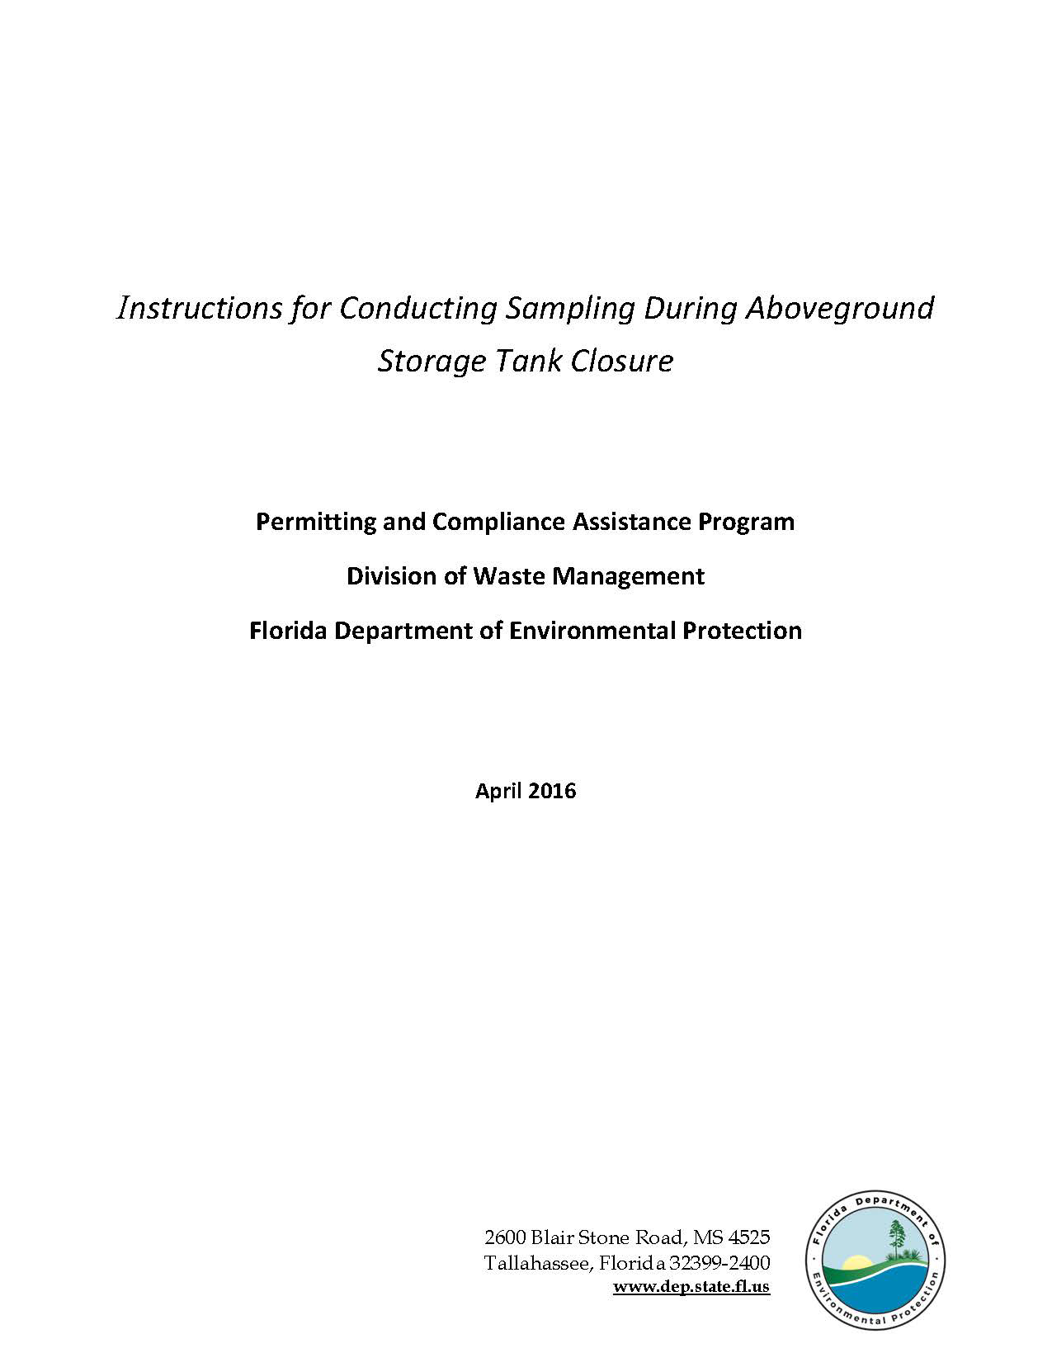
Proposed Changes – Reference Guidelines
Instructions for Conducting Sampling
Recommended Practices for Testing Secondary Containment

Slide 12
Proposed Changes – Applicability
The Department removed the term “de minimus” and replaced
it with more specific rule exemptions:
Storage tanks containing regulated substances of less than 2%, and
Storage tanks containing biofuels with 5% or less of regulated substances.

Slide 13
Registration/Notification - Installations
Former Requirements
New Requirements
Notify county at least 30 days prior to install (verbal or written).
Confirm with county at least 48 hours prior to install (verbal or written).
Register no later than 30 days after putting substance into new tank.
Notify county 30-45 days prior to install (written).
Confirm with county 48-72 hours prior to install (written).
For new facility – register 30 days prior to install. 7 days prior to adding product for existing facility.

Slide 14
Registration/Notification - Closures
Former Requirements
New Requirements
Notify county at least 10 days prior to closure (verbal or written).
Confirm with county at least 48 hours prior to closure (verbal or written).
Register no later than 30 days after closure.
Register no later than 30 days after other changes.
Notify county 30-45 days prior to closure (written).
Confirm with county 48-72 hours prior to closure (written).
Register no later than 10 days after closure.
Register no later than 10 days after other changes.

Slide 15
Registration/Notification - Delivery Prohibition
Motor fuel may not be placed into regulated tanks unless there is a valid registration placard displayed at the facility.
Motor fuel means petroleum products used for the operation of a motor or engine.

Slide 16
Financial Responsibility
Financial responsibility (FR) is the ability to pay for cleanup of a discharge of petroleum or petroleum product and for third-party liability resulting from the discharge.
FR must be maintained until the regulated tank is closed. If it is not maintained, then the AST must be closed.
FR may be demonstrated by owner or operator. The facility owner is liable in event of noncompliance.
FR must be demonstrated in accordance with EPA’s reference guideline, or in accordance with 62-761.900(3).

Slide 17
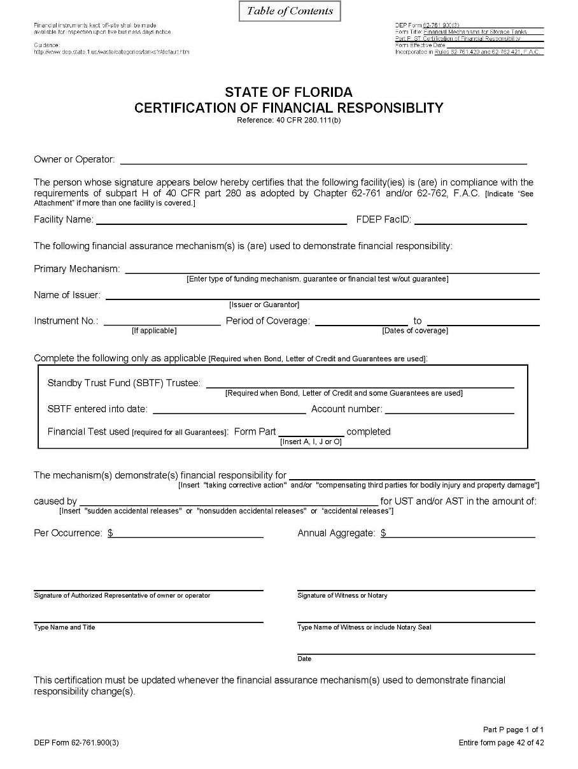
Financial Responsibility
Form 62-761.900(3)
Certificate of Insurance

Slide 18
Incidents
An incident is a situation indicating that a release or discharge may have occurred.
The Incidents section now includes all the possible positive responses of release detection devices.
The facility now has 72 hours to report an incident (former rule – 24 hours). An Incident Notification Form (INF) is not required if during this timeframe it is confirmed that a discharge did not occur.
The facility still has 14 days to investigate, but may be extended, upon approval, to 45 days without having to remove from service.
For every incident that occurs, whether an INF is required or not, there must be documentation maintained of the discovery/investigation/conclusions of the investigation.
This information is very important in instances where closure integrity evaluations are being conducted or repairs are being made due to sump or other secondary containment integrity issues.

Slide 19
Discharges
The owner must report the discovery of a discharge within 24 hours.
However, if it is thought that the discovery is a previously reported discharge, then the owner has 30 days to investigate and submit supporting documentation.

Slide 20
Construction Requirements
For new installations:
A containment integrity test shall be conducted for factory-made spill buckets and single-walled sumps.
An interstitial integrity test shall be conducted for double-walled or double-bottomed ASTs and for double-walled small diameter piping in contact with the soil or over surface waters of the state.
In general the testing must be conducted for one hour, instead of the former three hours in accordance with PEI/RP1200-12.

Slide 21
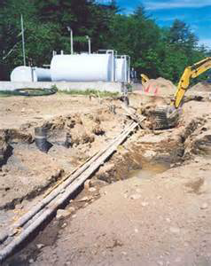
Construction Requirements
For new piping installed in contact with the soil, a survey drawing signed
and sealed by a professional land surveyor or engineer must be completed
and maintained.

Slide 22
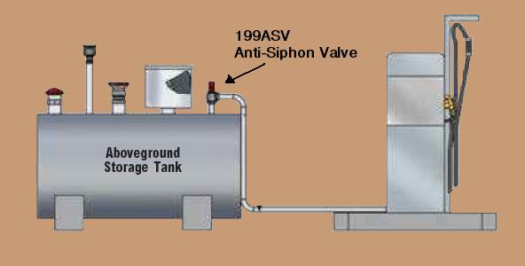
Construction Requirements (Shop Fabricated ASTs)
Storage tank systems that produce a gravity head on small diameter piping
must be installed with anti-siphon valves (ASVs). For existing systems without ASVs, they must be installed within one year (1/11/18).

Slide 23
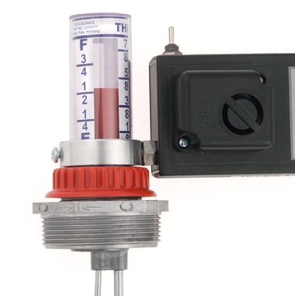
Construction Requirements (Shop Fabricated ASTs)
All overfill protection devices for ASTs must be tested for proper operation annually at intervals not exceeding twelve months. The initial testing must be conducted within 12 months of the effective date of the rule (by 1/11/18).

Slide 24
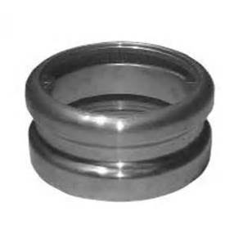
Construction Requirements (Shop Fabricated ASTs)
ASTs with capacities of 15,000 gallons or less that DO NOT receive delivery
by a joined tight fill adaptor connection are exempt from overfill protection
requirements as long as the ASTs are never filled beyond 80% capacity.

Slide 25
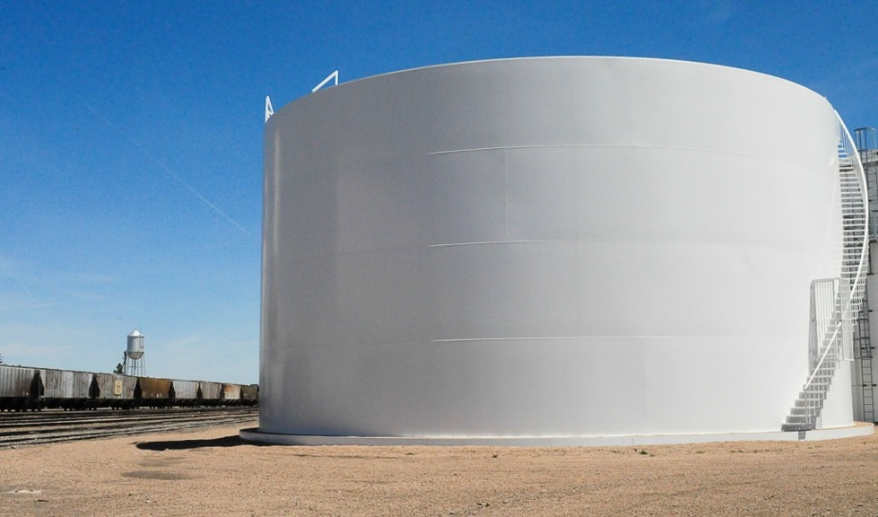
Construction Requirements (Field Erected ASTs)
Field erected ASTs that are loaded by truck are required to have spill containment by July 11, 2017, unless the fill connection already exists within a dike field with secondary containment or within a tank truck containment area.

Slide 26
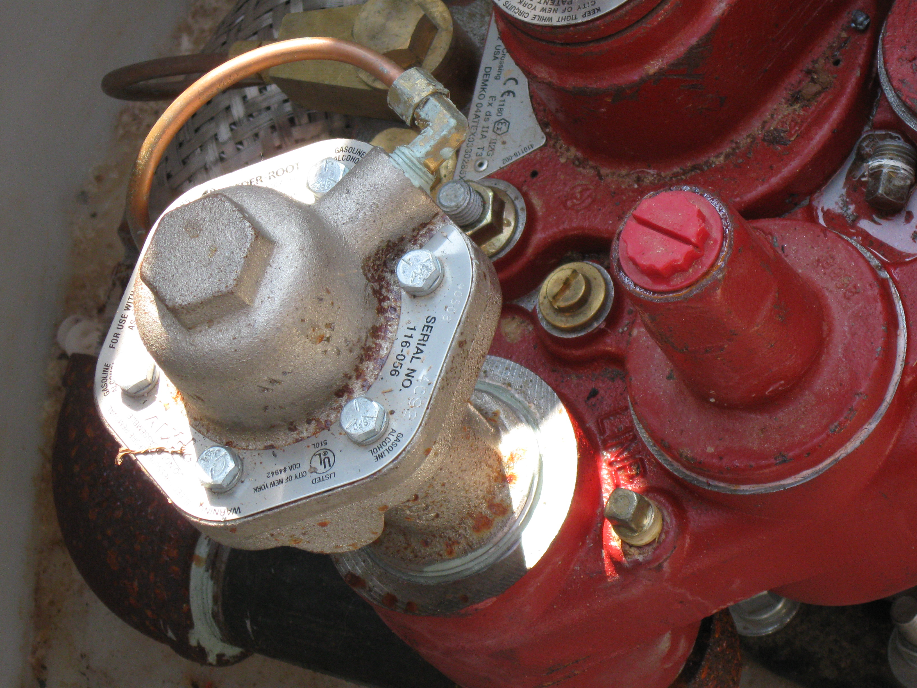
Release Detection Requirements (Shop Fabricated ASTs)
All new pressurized small diameter piping in contact with the soil must be
installed with line leak detectors, and must be tested every 12 months.
Existing systems must be equipped with line leak detectors within one year
of the effective date of the rule (by 1/11/18), and undergo testing every 12 months.

Slide 27
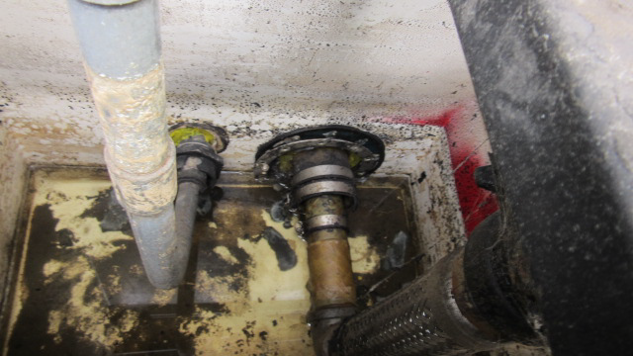
Release Detection Requirements
Piping and dispenser sumps that use electronic release detection must
also be visually inspected every six months.

Slide 28
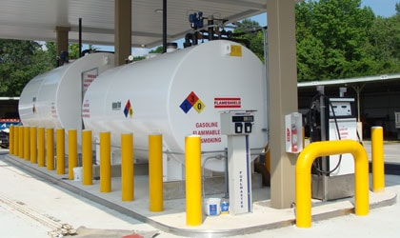
Release Detection Requirements
The rule now specifically requires that facilities maintain a monthly record of alarm history and sensor status for inspection. Each release detection alarm that occurs from a facility’s chosen form(s) of release detection must be investigated as an incident, and findings must be maintained for inspection.

Slide 29
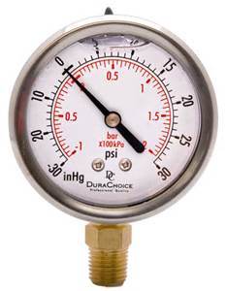
Release Detection Requirements
Pressure readings shall be able to detect a 50% change from month to
month or from the initial level. Vacuum systems shall be able to detect
any complete loss of vacuum or positive pressure reading.

Slide 30
Repairs, Operation and Maintenance
Periodic integrity testing will be required as follows:
Double-walled tanks and below grade double-walled piping at the time of installation and at the time of any repairs.
Below-grade piping/dispenser sumps by October 13, 2018, and every three years after.
Below-grade spill containment systems within one year of rule effective date (by 1/11/18) and every three years after.
Below-grade hydrant sumps by 1/11/18 and every three years after.

Slide 31
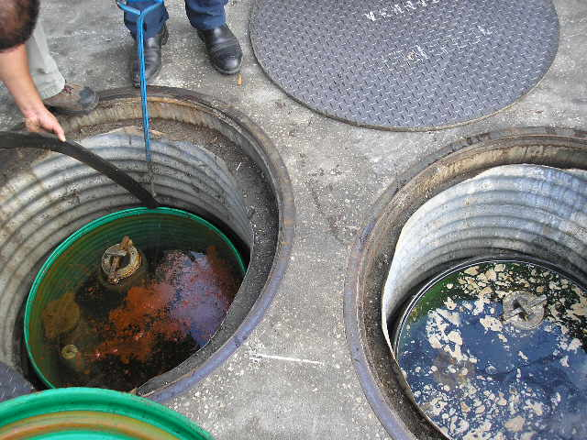
Repairs, Operation and Maintenance
Water in excess of 1” (no longer at the piping penetrations) or any regulated substances must be removed within 72 hours of discovery.

Slide 32
Proposed Changes – Recordkeeping
Records, unless required to be maintained until AST closure,
must be maintained for three years (except that records generated prior to the effective date of the rule must still be kept for two years).

Slide 33
Recordkeeping
The following changes to the records requirements have been made:
The Release Detection Response Level (RDRL) requirement has been removed from the rule.
Release detection records must include a record of alarm history for electronic release detection devices.
Survey drawings shall be kept until closure of the component(s) surveyed.

Slide 34
Out-of-Service Requirements
Whether the tank contains petroleum/petroleum products or not, FR must be maintained. If FR is not maintained, then the tank must be closed within 90 days.
For systems out-of-service for more than 1 year – tanks must be evaluated per STI SP001 (shop fab) or API 653 (field erected) before placing back into service, and piping in contact with soil must be integrity tested.
For field erected tanks, tank bottom release detection systems shall be monitored every 12 months.

Slide 35
Closure Requirements
Single-walled ASTs and piping in contact with the soil must undergo closure sampling during closure.
Double-walled ASTs, double-walled piping, and dispenser/piping/hydrant sumps in contact with the soil, as well as spill containment devices that are totally below grade must undergo a closure integrity evaluation prior to closure to determine if closure sampling is required.
In cases where closure integrity evaluation is required, the closure integrity report must be submitted to the county with closure notification prior to actual closure (30-45 days prior).

Slide 36
Closure Requirements
If a closure integrity evaluation is required but not conducted, then closure sampling is required.
In cases where closure sampling is required, a closure report will be due to the county within 60 days.
In cases where closure sampling is not required, a Limited Closure Report will be due in 60 days using Form 62-762.901(8).

Slide 37
Closure Requirements

Slide 38
Equipment Registration
Currently, storage tank system equipment used in the State of Florida must undergo formal Department equipment approval.
The proposed rule replaces equipment approval process with a registration process.
The registration application must include a third-party evaluation of the equipment.
Registration renewal must occur every five years.

Slide 39
Any Questions?

