Slide 1
Reminders for Owner/Operators of Aboveground Storage Tank Systems
Chapter 62-762, Florida Administrative Code
Effective Date - January 11, 2017
Division of Waste Management
Permitting and Compliance Assistance Program
March 9, 2018

Slide 2
Introduction
The following presentation provides general reminders for owners and operators of regulated aboveground storage tank (AST) systems with a storage capacity greater than 550 gallons.
Nothing herein is intended to modify Florida Statutes, department rules or guidance documents incorporated within those rules.

Slide 3
Intent
The facility shall provide a representative to access storage tank system components for inspection purposes and to demonstrate operational functionality of electronic equipment.

Slide 4
Registration/Notification Installations
Notification Requirements for Installations
Notify county 30-45 days prior to install (written).
Confirm with county 48-72 hours prior to install (written).
For new facility – register 30 days prior to install.
For existing facility – register 7 days prior to adding product.

Slide 5
Registration/Notification Closures
Notification Requirements for Closures
Notify county 30-45 days prior to closure (written).
Confirm with county 48-72 hours prior to closure (written).
Register no later than 10 days after closure.
Register no later than 10 days after other changes.

Slide 6
Registration/Notification Delivery Prohibition
Motor fuel may not be placed into regulated tanks unless there is a valid registration placard displayed at the facility.
Motor fuel means petroleum products used for the operation of a motor or engine.

Slide 7
Financial Responsibility
Financial responsibility (FR) is the ability to pay for cleanup of a discharge of petroleum or petroleum product and for third-party liability resulting from the discharge.
FR must be maintained until the regulated tank is closed. If it is not maintained, then the AST must be closed.
FR must be demonstrated by the owner or operator on DEP’s Financial Mechanisms Form 62-761.900(3), or in accordance with EPA’s reference guideline. The facility owner is liable in the event of noncompliance.

Slide 8
Financial Responsibility
Certificate of Insurance – Part D
To Be Filled Out By Insurance Provider

Slide 9
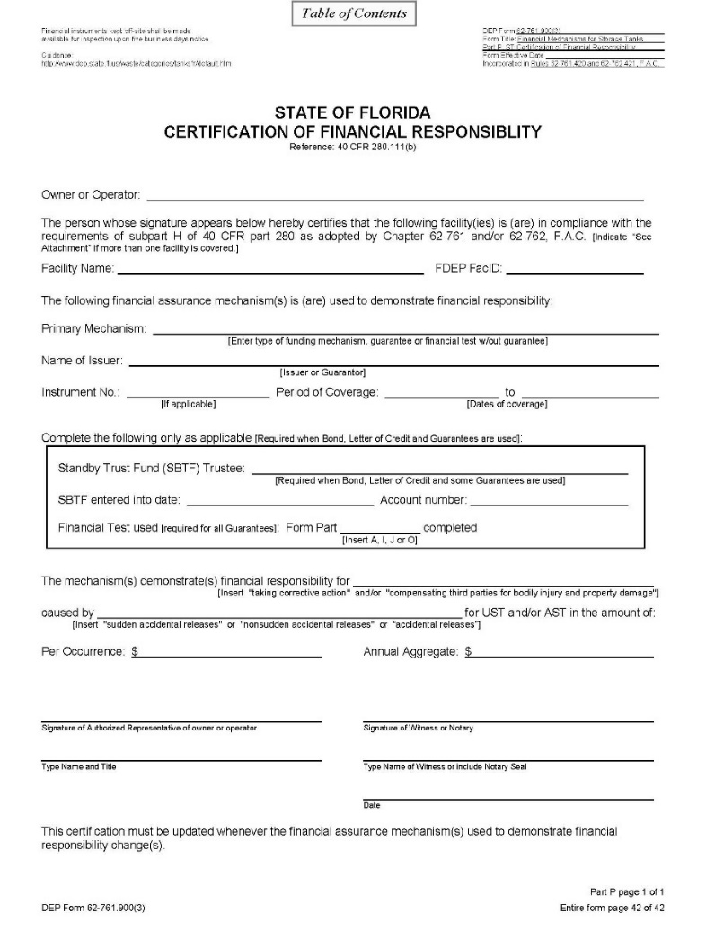
Financial Responsibility
Certification of Financial Responsibility - Part P
To Be Filled Out By Owner

Slide 10
Incidents
An incident is a situation indicating that a release or discharge may have occurred.
Rule 62-761.430, Florida Administrative Code, Incidents, now includes all the possible positive responses of release detection devices.
The facility now has 72 hours to report an incident (former rule – 24 hours). An Incident Notification Form (INF) is not required if during this timeframe it is confirmed that a discharge did not occur. Records of findings must be kept for inspection.
The facility still has 14 days to investigate, but may be extended, upon approval by the county, to 45 days without having to remove from service.
For every incident that occurs, whether an INF is required or not, there must be documentation maintained of the discovery, investigation, and conclusions of the investigation.

Slide 11
Discharges
Discharge Reporting Requirements
The owner or operator must report the discovery of a discharge to the county within 24 hours.
However, if it is thought that the discovery is a previously reported discharge, then the owner has 30 days to investigate and submit supporting documentation.
In addition, pursuant to Section 403.077, Florida Statutes, the department has established a method for regulated entities to submit Public Notices of Pollution for reportable releases.

Slide 12
Discharges
Additional Discharge Notification
Conditions at the site that do not involve spills to navigable waters of the United States, or CERCLA hazardous substances, that pose an immediate threat to human health or the environment must be reported to:
The State Watch Office 1-800-320-0519, or
The Local Fire Department 911.
Anyone witnessing an oil spill or chemical release to navigable waters of the United States should call:
National Response Center hotline 1-800-424-8802.

Slide 13
Construction Requirements
For new installations:
A containment integrity test shall be conducted for factory-made spill containment and single-walled sumps.
An interstitial integrity test shall be conducted for double-walled or double-bottomed ASTs and for double-walled small diameter piping in contact with the soil or over surface waters of the state.
In general the testing must be conducted for one hour, instead of the former three hours in accordance with PEI/RP1200-12.

Slide 14
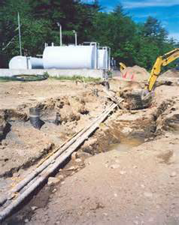
Construction Requirements
For new piping installed in contact with the soil, a survey drawing signed and sealed by a professional land surveyor or engineer must be completed and maintained.

Slide 15
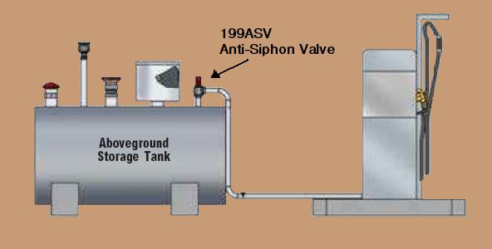
Construction Requirements (Shop Fabricated ASTs)
Storage tank systems that produce a gravity head on small diameter piping must be installed with anti-siphon valves (ASVs).
For existing systems without ASVs, they had to be installed by January 11, 2018.

Slide 16
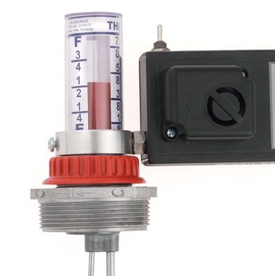
Construction Requirements (Shop Fabricated ASTs)
Liquid Level Gauge
All overfill protection devices for ASTs must be tested for proper operation annually at intervals not exceeding twelve months. The initial testing was required by January 11, 2018.

Slide 17
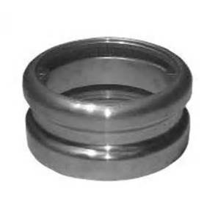
Construction Requirements (Shop Fabricated ASTs)
Tight Fill Adaptor
ASTs with capacities of 15,000 gallons or less that DO NOT receive delivery by a joined tight fill adaptor connection are exempt from overfill protection requirements as long as the ASTs are never filled beyond 80% capacity.

Slide 18
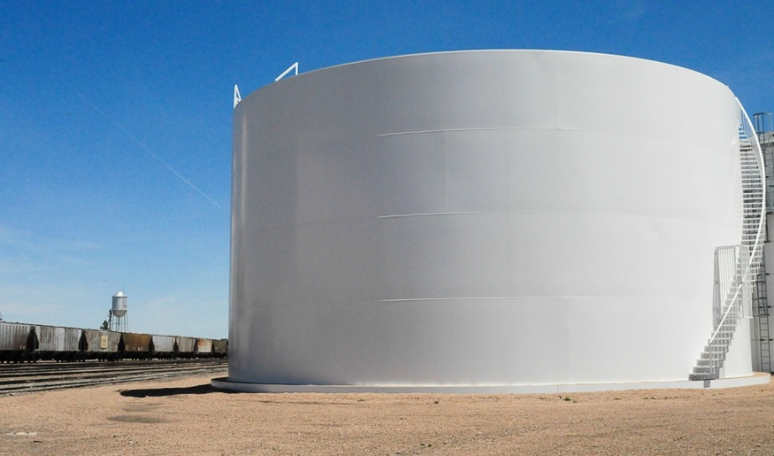
Construction Requirements (Field Erected ASTs)
Field erected ASTs that are loaded by truck are required to have spill containment unless the fill connection already exists within a dike field with secondary containment or within a tank truck containment area.

Slide 19
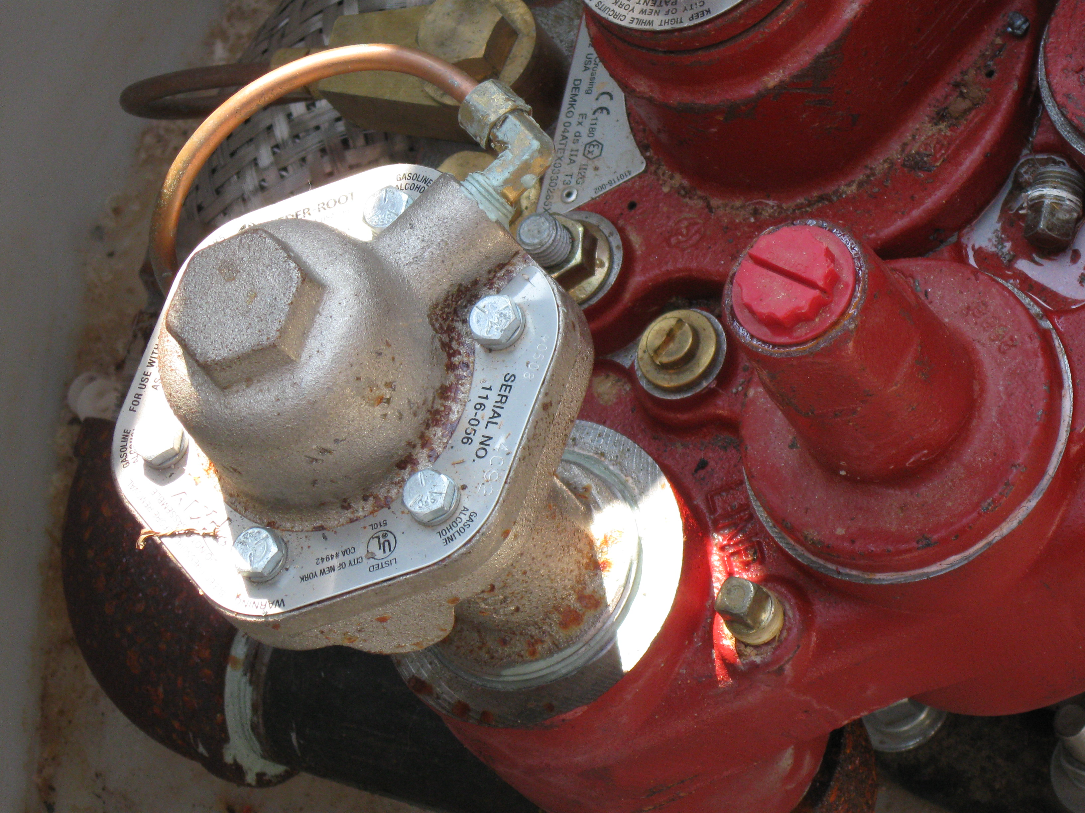
Release Detection Requirements (Shop Fabricated ASTs)
All new pressurized small diameter piping in contact with the soil must be installed with line leak detectors, and must be tested every 12 months.
Existing systems were required to be equipped with line leak detectors by January 11, 2018, and undergo testing every 12 months.

Slide 20
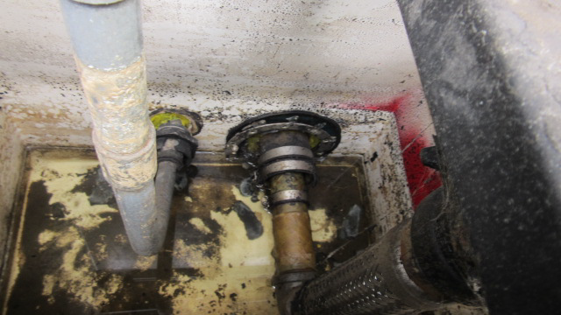
Release Detection Requirements
Piping and dispenser sumps that use electronic release detection must also be visually inspected every six months.

Slide 21
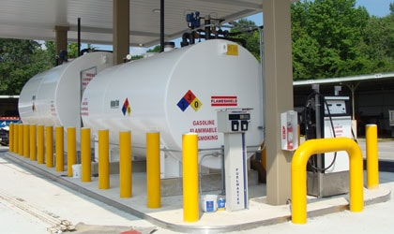
Release Detection Requirements
The rule now specifically requires that facilities maintain a monthly record of alarm history and sensor status for inspection. Each release detection alarm that occurs from a facility’s chosen form(s) of release detection must be investigated as an incident, and findings must be maintained for inspection.

Slide 22
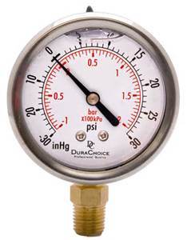
Release Detection Requirements
Pressure readings shall be able to detect a 50% change from month to month or from the initial level. Vacuum systems shall be able to detect any complete loss of vacuum or positive pressure reading.

Slide 23
Repairs, Operation and Maintenance
Periodic integrity testing will be required as follows:
Double-walled tanks and below grade double-walled piping at the time of installation and at the time of any repairs.
Below-grade piping/dispenser sumps by October 13, 2018, and every three years after.
Below-grade spill containment systems by January 11, 2018, and every three years after.
Below-grade hydrant sumps by January 11, 2018, and every three years after.

Slide 24
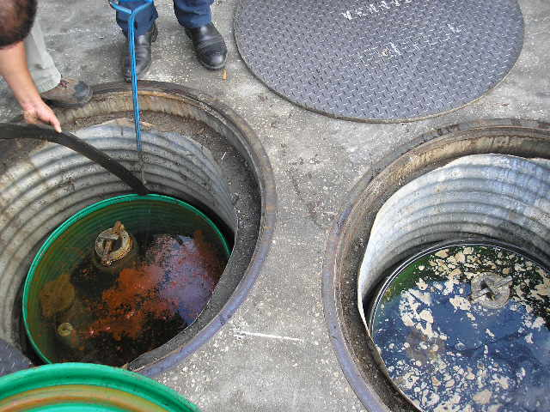
Repairs, Operation and Maintenance
Water in excess of 1” (no longer at the piping penetrations) or any regulated substances must be removed within 72 hours of discovery.

Slide 25
Recordkeeping
Records must be maintained for three years, unless required to be maintained until AST closure.

Slide 26
Recordkeeping
The following changes to the records requirements have been made:
Release detection records must include a record of alarm history for electronic release detection devices.
Survey drawings shall be kept until closure of the component(s) surveyed.

Slide 27
Out-of-Service Requirements
Whether the tank contains petroleum/petroleum products or not, FR must be maintained. If FR is not maintained, then the tank must be closed within 90 days.
For systems out-of-service for more than 1 year – tanks must be evaluated per STI SP001 (shop fab) or API 653 (field erected) before placing back into service, and piping in contact with soil must be integrity tested.
For field erected tanks, tank bottom release detection systems shall be monitored every 12 months.
Florida DEP

Slide 28
Closure Requirements
Single-walled ASTs and piping in contact with the soil must undergo closure sampling during closure.
Double-walled ASTs, double-walled piping, and dispenser/piping/hydrant sumps in contact with the soil, as well as spill containment devices that are totally below grade must undergo a closure integrity evaluation prior to closure to determine if closure sampling is required.
In cases where closure integrity evaluation is required, the closure integrity report must be submitted to the county with closure notification prior to actual closure (30-45 days prior).

Slide 29
Closure Requirements
If a closure integrity evaluation is required but not conducted, then closure sampling is required.
In cases where closure sampling is required, a closure report will be due to the county within 60 days.
In cases where closure sampling is not required, a Limited Closure Report will be due in 60 days using Form 62-762.901(8).

Slide 30
Storage Tank System Equipment
Your storage tank system equipment and release detection systems must be registered with the department by the manufacturers and vendors of the equipment and have an EQ number prior to being installed in Florida.
Storage Tank System Equipment Registration
Storage Tank System Equipment Registration List

Slide 31
Website Links
FOR ADDITIONAL INFORMATION SEE THE FOLLOWING WEBSITES:
Storage Tank Compliance
Storage Tank System Rules, Forms and Reference Guidelines
Storage Tank Systems Guidance and Information
Storage Tank Facility Registration
Financial Responsibility
Storage Tank Contacts

Slide 32
Storage Tank Contacts
Storage Tank Facility Registration – Main: 850-245-8839
Karen.S.Moore@floridadep.gov Environmental Administrator (EA)
Madhuri.Madala@floridadep.gov
Ernest.L.Stephens@floridadep.gov
Derbra.Owete@floridadep.gov
Storage Tank Financial Responsibility
Tor.Bejnar@floridadep.gov 850-245-8743
Susan.F.Eldredge@floridadep.gov 850-245-8740
Edgar.Echevarria@floridadep.gov 850-245-8793
Storage Tank Compliance
Bill.Burns@floridadep.gov (EA) 850-245-8842
Kimberley.Curran@floridadep.gov 850-245-8849
Roberta.Dusky@floridadep.gov 850-245-8799

