Slide 1
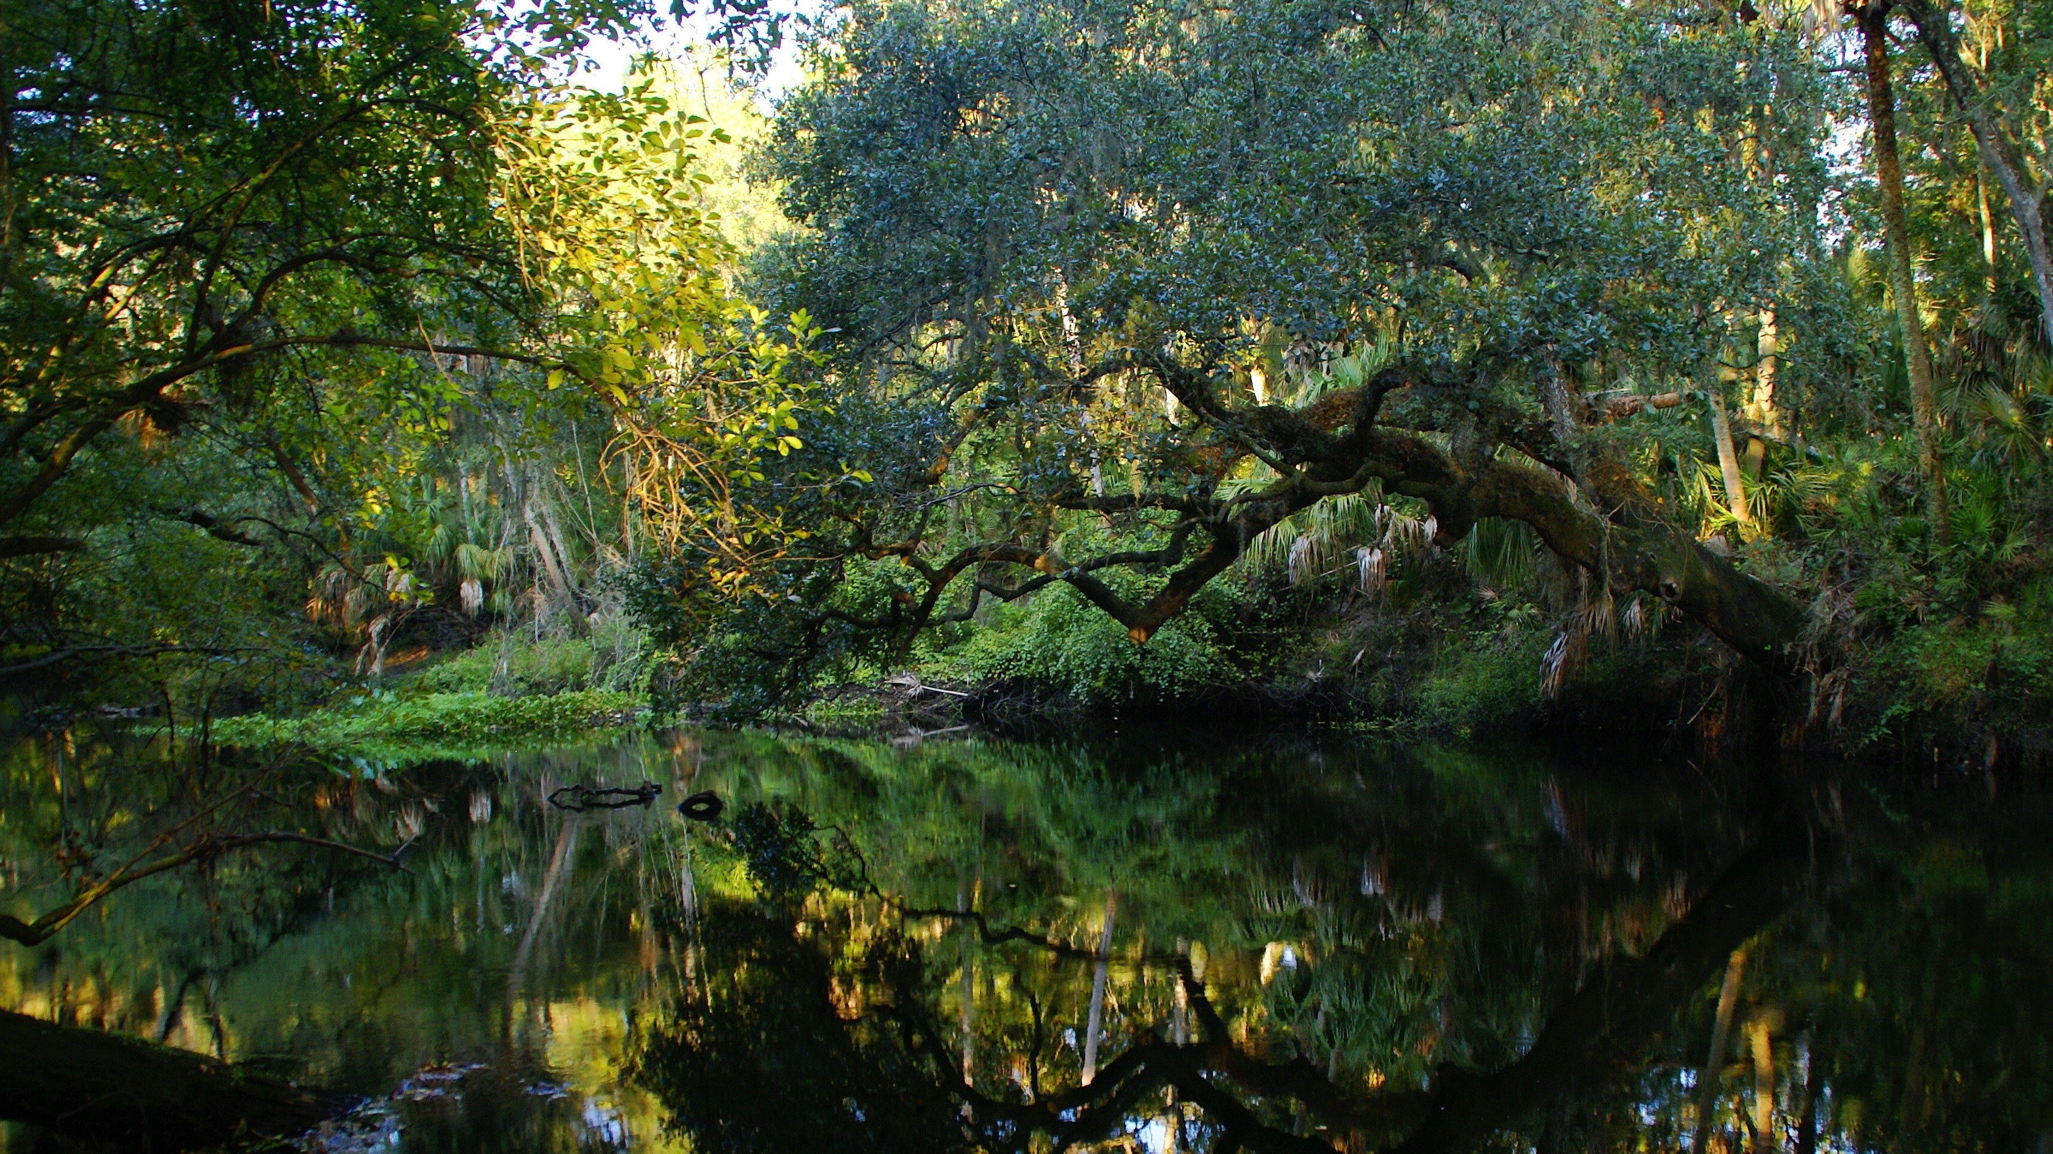
Petroleum Restoration Program
Agency Term Contracts
Quarterly Meeting
February 7, 2019
Notes:
This slide can be used to introduce a new topic or highlight an important point in your presentation. This slide should use very minimal text and should not include any detailed, bulleted information. Please follow it with slide 2, 3 or 5 if you need to add more information to expand on a topic or point highlighted in Template Slide number four.
Customization: You may choose to use or switch out the photo in the background. To change out the picture, right-click the image and select “Change Picture” from the drop-down menu. From there, browse to select your desired photo replacement. Make sure to select a high-resolution photo that is horizontally oriented. If the photo needs to be resized to fill the PowerPoint frame, adjust the size from the corners of the image so as not to stretch the photo out of proportion. There should be no white frame peeking from behind your selected image.

Slide 2
Agenda
Training Webinars – Natasha Lampkin
Closures – Natasha Lampkin
Program Encumbrance Data – Natasha Lampkin
Update on ATC Renewals - Natasha Lampkin
Update on ATC Rate Change Requests – Natasha Lampkin

Slide 3
Topics for Training
PRP will be hosting training webinars
Please recommend topics for webinars to prp.contracts@dep.state.fl.us
Planned PRP training webinars
Tips for Implementation of the Agency Term Contract
Invoicing

Slide 4
Closures Update

Slide 5
Encumbrance Activity
Month | Projection | Encumbered | Net Encumbered | Net Percentage
July | $11.7 M | $9.3 M | $8 M | 68%
August | $11.7 M | $10.5 M | $8.4 M | 72%
September | $11.7 M | $9.5 M | $7.2 M | 62%
October | $11.7 M | $10 M | $6.3 M | 54%
November | $11.7 M | $12.1 M | $12.8 M | 109%
December | $11.7 M | $10.8 M | $11.6 M | 99%
January* | $11.7 M | $5 M | $4 M | 35%
Feb - June | $58.5 M |  | - | 0%
Grand Total | $140 M | $66.2 | $57.3 M | 41%

Slide 6
Contract Renewals
Renewals were executed on 1-17-2019
Expiration date for all ATCs renewed is 2-14-2024

Slide 7
ATC Rate Change Update
Decrease requests can be submitted at any time
Increase requests must be submitted in February
Justification is required for increase requests
Rates must be to the cent, no decimals beyond 2
Increase requests cannot exceed 5.00%
Notes:
ERIC: Environmental Restoration Integrated Cleanup

Slide 8
Add relevant picture as slide background and include presentation title
Discussion / Questions?

