Slide 1


Petroleum Restoration Program
Agency Term Contracts
Quarterly Meeting
May 23, 2019
Notes:
This slide can be used to introduce a new topic or highlight an important point in your presentation. This slide should use very minimal text and should not include any detailed, bulleted information. Please follow it with slide 2, 3 or 5 if you need to add more information to expand on a topic or point highlighted in Template Slide number four.
Customization: You may choose to use or switch out the photo in the background. To change out the picture, right-click the image and select “Change Picture” from the drop-down menu. From there, browse to select your desired photo replacement. Make sure to select a high-resolution photo that is horizontally oriented. If the photo needs to be resized to fill the PowerPoint frame, adjust the size from the corners of the image so as not to stretch the photo out of proportion. There should be no white frame peeking from behind your selected image.

Slide 2
Agenda
Introduction – Blake Miller
Program Updates – Blake Miller
Closures/Encumbrance – Blake Miller
Closure Integrity Evaluations – Blake Miller
Reminders – Jamie Lopez
Questions/Comments

Slide 3
Program Updates
“New” Late Deliverable Site Reassignment Process:
    On PRP Templates Webpage
    Applicable to any scheduled deliverable (reports, quotes, etc.)
Subcontractor Utilization Form:
    List all Subs/vendors paid directly by the ATC, for work in a P.O.
    Do not list incidental costs on the form (i.e. gas, tolls, food, etc.)

Slide 4
Program Updates
PBC Extensions:
  Pay attention to the contract terms and expiration dates
  Extension = Amendment to PBC Contract
  Amendments take time to process
Closure Sampling Clarification Memorandum 11-29-18:
  Please review and consider requirements prior to recommending No Further Action (NFA) status

Slide 5
Program Updates
New Per Diem Guidance
Posted on webpage
  April 25, 2019

Slide 6
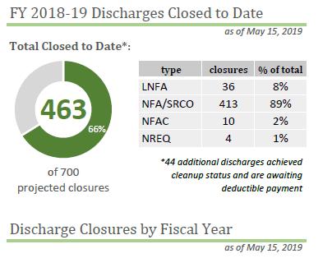
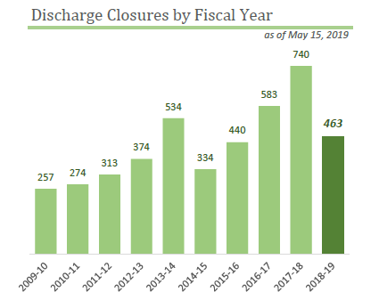
Closures Update
PRP Monthly Dashboard update

Slide 7
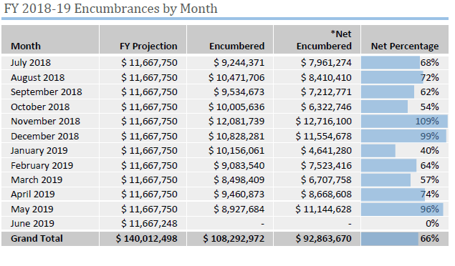
Encumbrance Activity

Slide 8
Closure Integrity Evaluations
USTs & ASTs Rule Update, 01-11-17
  Ch 62-761 update adopted federal regulations which include a requirement to do a closure integrity evaluation.
    Performed no more than 45 days prior to:
            System closure
            Replacement
            Change in service from regulated to non-regulated
    Contact Bill Burns, Bill.Burns@floridadep.gov, 850-245-8842

Slide 9
Topics for Training
PRP will be hosting training webinars
Please recommend topics for webinars to prp.contracts@dep.state.fl.us
Planned PRP training webinars
  Contractor Performance Evaluations (CPEs) -TBD
  Invoicing – June 27th

Slide 10
Reminders
Field Work Reminders
  Drum Labeling
  Predrilling meetings
    Schedule technology
    Night drilling
  Fieldwork notifications
    CC: PRPInspector@dep.state.fl.us

Slide 11
Reminders
Invoice Rate Sheet Versions
  Use the most recent version available for invoices
Electronic Documents
  All reports and data shall be delivered in electronic data retrievable from e-mail attachments or computer disks.
  Map data and engineering drawings shall be in a format compatible with AutoCAD.
  Oculus can store native format documents
    AutoCAD, excel, word, etc.

Slide 12
Reminders
OSHA Requirements:
  Onsite staff must meet OSHA criteria minimums set in the ATC Contract
Health & Safety Plans:
  Must be present onsite
  Must be for the “site” work is being performed on
Canceling Fieldwork
  CC: PRPInspector@dep.state.fl.us

Slide 13
Links
  Updated Per Diem Drawing:
    https://floridadep.gov/waste/petroleum-restoration/documents/late-deliverable-site-reassignment-process
  USTs ASTs Info:
    https://floridadep.gov/waste/permitting-compliance-assistance/content/storage-tank-compliance
  Closure Sampling Clarification Memorandum
    https://floridadep.gov/waste/petroleum-restoration/documents/closure-sampling-clarification-memorandum

Slide 14
Contacts
Blake Miller, Team Leader, 850-245-8821, Blake.Miller@floridadep.gov
Jamie Lopez, Contract Manager, 850-245-8925, Jamie.L.Lopez@dep.state.fl.us
Carol Carnley, Contract Manager, 850-245-8916, Carol.Carnley@dep.state.fl.us
Charles “Chuck” Williams, Contract Manager, 850-245-8863, Charles.Williams@dep.state.fl.us
Tim Foster, Contract Manager, 850-245-8874, Tim.Foster@dep.state.fl.us

Slide 15

Add relevant picture as slide background and include presentation title
Discussion / Questions?

