Slide 1
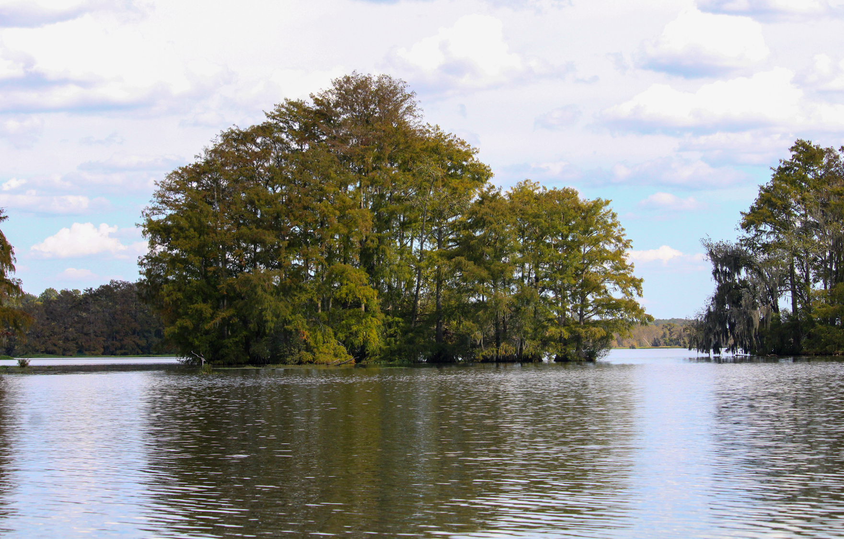

SYNTHETIC TURF STANDARDS
PUBLIC WORKSHOP
Emily Lang
Environmental Administrator
Division of Water Restoration Assistance
Florida Department of Environmental Protection
Tallahassee, FL │ Nov. 20, 2025

Slide 2
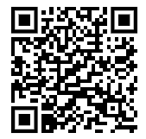
SYNTHETIC TURF RULEMAKING
MEETING AGENDA
  Welcome.
  Review of s. 125.572, F.S.
  Draft Rule.
  Public comment.
  Adjourn.
Please scan the QR code or visit the Division of Water Restoration Assistance’s Rules and Rulemaking webpage to learn more.

Slide 3
SYNTHETIC TURF RULEMAKING
DEFINITION OF SYNTHETIC TURF
Synthetic Turf is defined in s. 125.572(1), F.S. as
“a manufactured product that resembles natural grass and is used as a surface for landscaping and recreational areas."

Slide 4
SYNTHETIC TURF RULEMAKING
Section 125.572(2), F.S., provides:
The Florida Department of Environmental Protection (DEP) shall:
“…adopt minimum standards for the installation of synthetic turf on single-family residential properties 1 acre or less in size.”

Slide 5
SYNTHETIC TURF RULEMAKING
Section 125.572(2), F.S., provides:
The standards must take into account:
Material type.
Color.
Permeability.
Stormwater management.
Potable water conservation.
Water quality.
Proximity to trees and other vegetation.
Any other factors impacting environmental conditions of adjacent properties.

Slide 6
SYNTHETIC TURF RULEMAKING
Section 125.572(3), F.S., provides:
Upon adoption of the rule, local governments may not:
Adopt or enforce any ordinance, resolution, order, rule or policy that prohibits or is enforced to prohibit, a property owner from installing synthetic turf that complies with DEP standards.
Adopt or enforce any ordinance, resolution, order, rule or policy that regulates synthetic turf which is inconsistent with the DEP standards.
Notes:
Emily reads slide.
After the first workshop, the Department received a large number of public comments. We appreciate everyone’s attention to this rule. Before we go through the draft rule to present changes made based on comments received, I wanted to address this particular provision of the statute and how it relates to the Department’s rule. The Department did get a lot of comments asking about the topic of preemption. The Department can’t provide legal advice to communities asking whether a component of their existing or any proposed ordinance or requirement is permissible. Instead, we can go back to this language which establishes what a local government cannot do in their own ordinance, resolution, order, rule or policy as it relates to the installation or regulation of synthetic turf.

Slide 7
SYNTHETIC TURF RULEMAKING
(1) The minimum standards provided in this rule only apply to the installation of synthetic turf, as defined by section 125.572(1), F.S., on single-family residential properties of 1 acre or less in size. Any ordinance, resolution, order, rule or policy adopted by a local government pertaining to the installation of synthetic turf must be consistent with this rule. Nothing in this rule prohibits a local government from the following:
(a) Requiring documentation of compliance, including but not limited to, a permit or inspections associated with the installation of synthetic turf in accordance with this rule.
(b) Restricting synthetic turf on rights-of-way owned or giving legal right or control to an entity other than the homeowner.
Notes:
To that end, the first paragraph of the rule does address the scope of this rule, which is that this rule only pertains to requirements for the installation synthetic turf on residential properties 1 acre or less.
We did receive comments on several topics not addressed by this rule. The rule addresses the standards described in the statute. We did want to clarify two points, however; one that this rule does not prohibit permitting or inspection requirements. Additionally, this rule does not address owned property rights, such as rights of way.

Slide 8
SYNTHETIC TURF RULEMAKING
MATERIAL TYPE
Material Type:
  Synthetic turf, including backing material and infill, must not contain heavy metals or intentionally added per- and polyfluoroalkyl substances.
  Synthetic turf, including backing materials and infill, must be disposable under normal conditions at any Chapter 62-701, F.A.C., Florida permitted landfill.
  Infill material, if used, must be clean silica sand, rock, shell, or other natural material. Rubber or any other synthetic infill material is not permitted. Installation shall be designed to prevent washing away of any infill material off the residential property.
  Subgrade shall be composed of natural materials, such as crushed rock, that meets the permeability requirements of this rule.

Slide 9
SYNTHETIC TURF RULEMAKING
COLOR AND PERMEABILITY
Color:
  No local government may prohibit the use of green synthetic turf.
Permeability:
Synthetic turf must be permeable and affixed to permeable backing with a pervious subgrade.
  Synthetic turf must be installed over a subgrade prepared for positive drainage and evenly graded porous material.

Slide 10
SYNTHETIC TURF RULEMAKING
STORMWATER MANAGEMENT AND POTABLE WATER CONSERVATION
Stormwater Management:
Installation of synthetic turf must be designed and installed to prevent pooling or an increase in the stormwater runoff volume, direction, or rates to adjacent properties and, where possible, runoff shall be directed to on-site pervious areas.
  Installation of synthetic turf must not alter the permitted stormwater management system as designed and shall not be installed within a swale, ditch, stormwater pond, or a stormwater pond’s littoral zone.

Slide 11
SYNTHETIC TURF RULEMAKING
STORMWATER MANAGEMENT AND POTABLE WATER CONSERVATION
Potable Water Conservation:
In-ground irrigation systems cannot be used to irrigate synthetic turf areas.
  If any in-ground system is already installed, a local government may require that irrigation heads be removed and pipe capped.

Slide 12
SYNTHETIC TURF RULEMAKING
WATER QUALITY AND PROXIMITY TO TREES AND OTHER VEGETATION
Water Quality:
Synthetic turf shall not cause or contribute to violations of state water quality standards.
  Buffer zones around natural or man-made waterbodies may be established to protect against erosion and reduce pollution provided that such buffer for synthetic turf is no greater or restrictive than what is applicable to natural turf. Where no buffer zone has been established, synthetic turf shall be installed no closer than 10 feet from natural or man-made waterbodies as measured from the applicable ordinary or mean high water line except where there is a physical barrier between the synthetic turf and the waterbody (such as, but not limited to, a seawall or bulkhead).

Slide 13
SYNTHETIC TURF RULEMAKING
WATER QUALITY AND PROXIMITY TO TREES AND OTHER VEGETATION
Proximity to Trees and Other Vegetation:
Installation of synthetic turf cannot compromise the health of non-invasive nearby trees (which may include damage to tree roots) and vegetation.
  Synthetic turf shall not be installed inside the non-invasive tree drip lines, whether on the property or adjacent properties unless a certified arborist certifies that installation within that drip line would not be harmful to the tree.

Slide 14
SYNTHETIC TURF RULEMAKING
ANY OTHER FACTORS IMPACTING ENVIRONMENTAL CONDITIONS OF ADJACENT PROPERTIES
Any Other Factors Impacting Environmental Conditions of Adjacent Properties:
Synthetic turf shall be installed according to manufacturer’s specifications.
  Synthetic turf shall be anchored at all edges and seams to ensure that turf will withstand the effects of wind or flooding.
  If installed, synthetic turf must provide for access to the septic tank for routine pumpout.
  If installed, synthetic turf shall be installed landward of any dune system and shall not be used to replace any existing dune vegetation.

Slide 15

SYNTHETIC TURF RULEMAKING
PUBLIC COMMENT
Speakers will be given three minutes to make their comments.

Slide 16
SYNTHETIC TURF RULEMAKING
NEXT STEPS
Next Steps:
  Written public comments will be accepted through Dec. 10, 2025.
  Email written comments to:
  DWRA.Rulemaking@FloridaDEP.gov
  DEP will review all comments for the draft rule.
  DEP will publish a Notice of Proposed Rule.

Slide 17
THANK YOU
Emily Lang
Environmental Administrator
Division of Water Restoration Assistance
Florida Department of Environmental Protection
Contact Information:
DWRA.Rulemaking@FloridaDEP.gov

