Slide 1
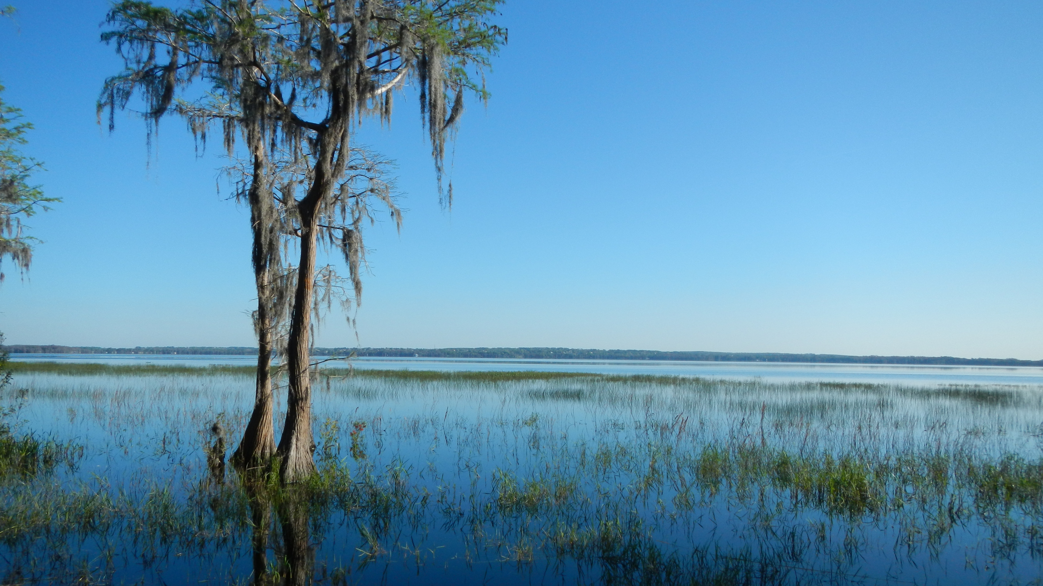

Tom Frick, Director
Division of Environmental Assessment and Restoration

Slide 2


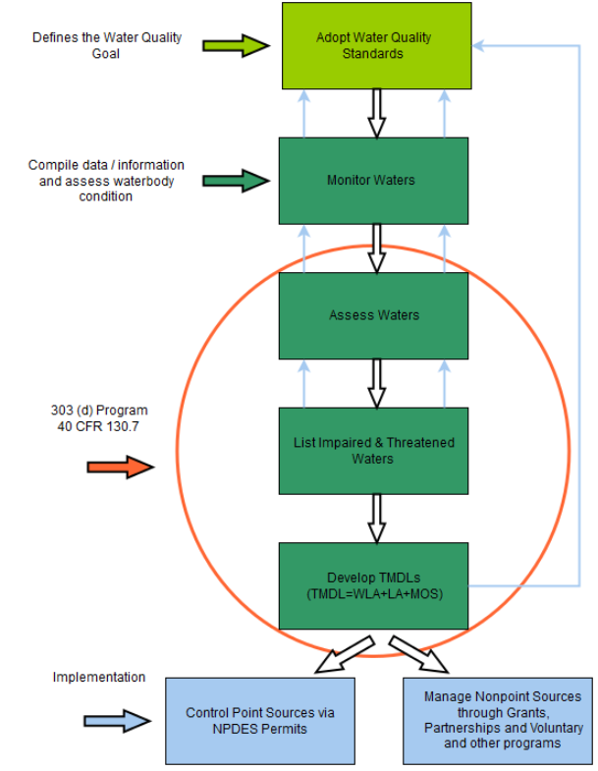
Federal Water Quality Laws
Clean Water Act (CWA): 33 U.S.C. §1251 et seq. (1972)
Section 303(d) requires states to:
    Identify waters that are impaired or in danger of becoming impaired
    Calculate and allocate pollutant reduction levels necessary to meet approved water quality standards
Section 319(h) addresses nonpoint sources
    provides funds to states to implement approved nonpoint source management programs
https://www.epa.gov/tmdl/overview-identifying-and-restoring-impaired-waters-under-section-303d-cwa

Slide 3
Florida’s Implementation of CWA
403.067 Florida Statutes
Set Water Quality Standards
Monitor and Assess Waterbodies
Impaired Waterbodies (303d) List
Total Maximum Daily Load Development
Restoration - Basin Management Action Plan/WLA
Established 1999
Updated 2005 (BMAPs) and 2016 (Water Bill)
Requires “Good Science”
Requires “Public Participation”
Requires “Equitable Allocation” of load reductions

Slide 4
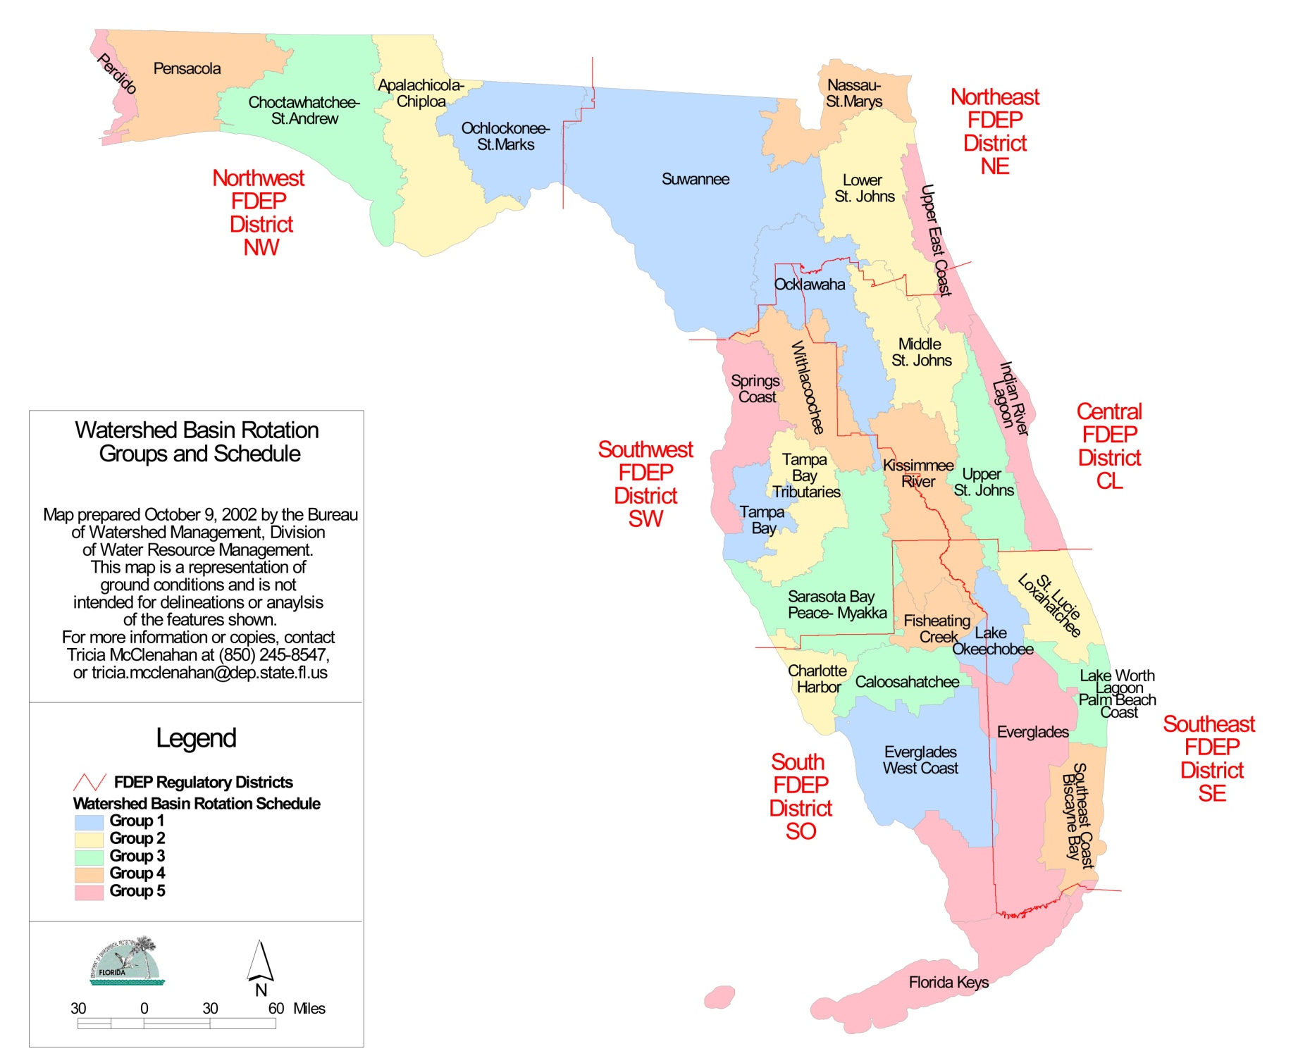
Florida’s Implementation of CWA
Basin Rotation
Phase 1 – Preliminary Assessment
  Produce Planning List
Phase 2 – Targeted Monitoring and Listing
  Monitor, verify impairment and adopt verified list
Phase 3 – Develop and adopt TMDLs
Phase 4 – Develop BMAPs
Phase 5 – Implement BMAPs

Slide 5
Water Quality Monitoring
403.067 Florida Statutes
Set Water Quality Standards
Monitor and Assess Waterbodies
Impaired Waterbodies (303d) List
Total Maximum Daily Load Development
Restoration - Basin Management Action Plan/WLA
DEP visits, at least once, >13,000 monitoring sites per year
65 entities currently providing data to WIN
>35.5M records
>2.6M records since 7/1/2017
FL contributes ~25% of all nutrient records in EPA’s database

Slide 6
Water Quality Assessment
Impaired Waters Rule
Set Water Quality Standards
Monitor and Assess Waterbodies
Impaired Waterbodies (303d) List
Total Maximum Daily Load Development
Restoration - Basin Management Action Plan/WLA
Categories
Category 1 – Not Impaired (attains ALL uses)
Category 2 – Meets standards; aka not impaired
Category 3 – Insufficient data to verify
Category 4 – Does not meet standards but a TMDL is not needed
Category 5 – Does not meet standards; impaired by a pollutant; needs TMDL

Slide 7
Total Maximum Daily Loads
Maximum amount of a pollutant that can be introduced into a waterbody without causing exceedances of water quality standards
Restoration Target
Set Water Quality Standards
Monitor and Assess Waterbodies
Impaired Waterbodies (303d) List
Total Maximum Daily Load Development
Restoration - Basin Management Action Plan/WLA
TMDL ≅ ∑ WLAs_{NPDES wastewater} + ∑ WLAs_{NPDES stormwater} + …
… + ∑ LAs + MOS

Slide 8
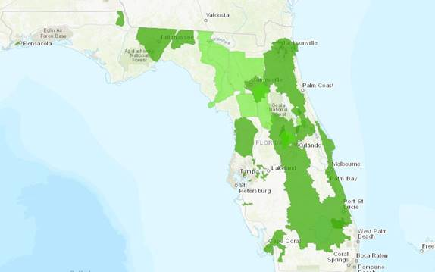
Components of BMAPs
TMDL(s) being addressed
Area addressed by the restoration plan (i.e. watershed extent)
Projects to meet the TMDL
  Implementation timeline
  Commitment to project
  Expected water quality improvement
Process to assess progress towards achieving the TMDL
  Monitoring plan
  Project reporting
  Periodic follow-up meetings
Adaptive management

Slide 9
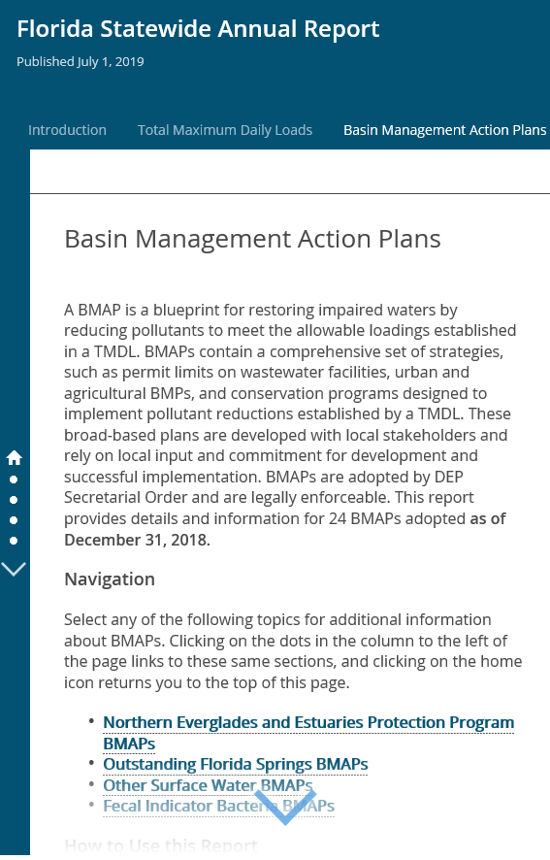
Projects in BMAPs
BMAP documents water quality projects aimed at helping achieve the TMDL
Project Types
Education and Outreach Efforts
Land Acquisition
Regulations, Ordinances, and Programs
Restoration Projects
Stormwater Projects
Wastewater
    Facilities
    Septic Systems
Agricultural Best Management Practices
Studies, Research, Assessments, and Planning Efforts

Slide 10
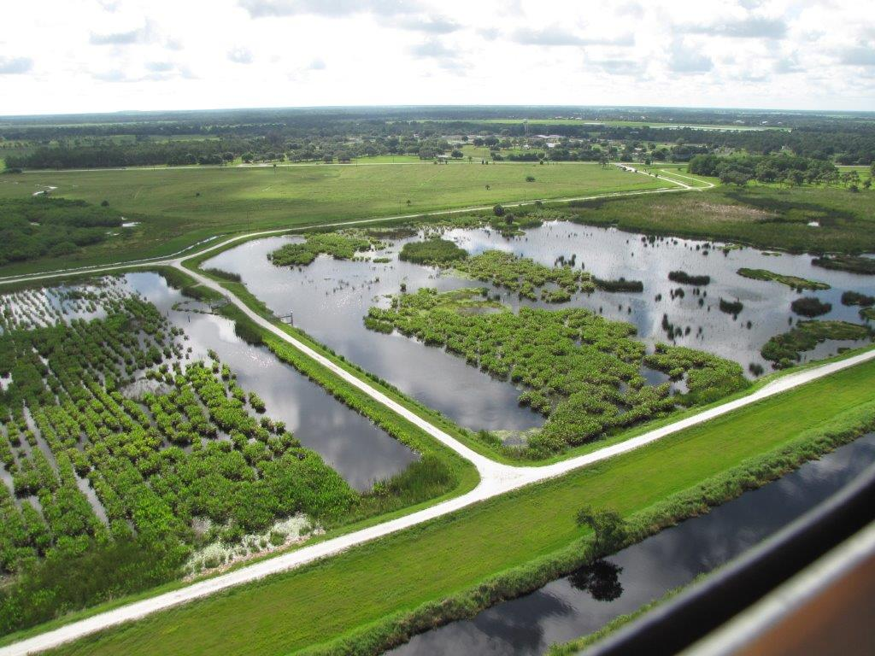
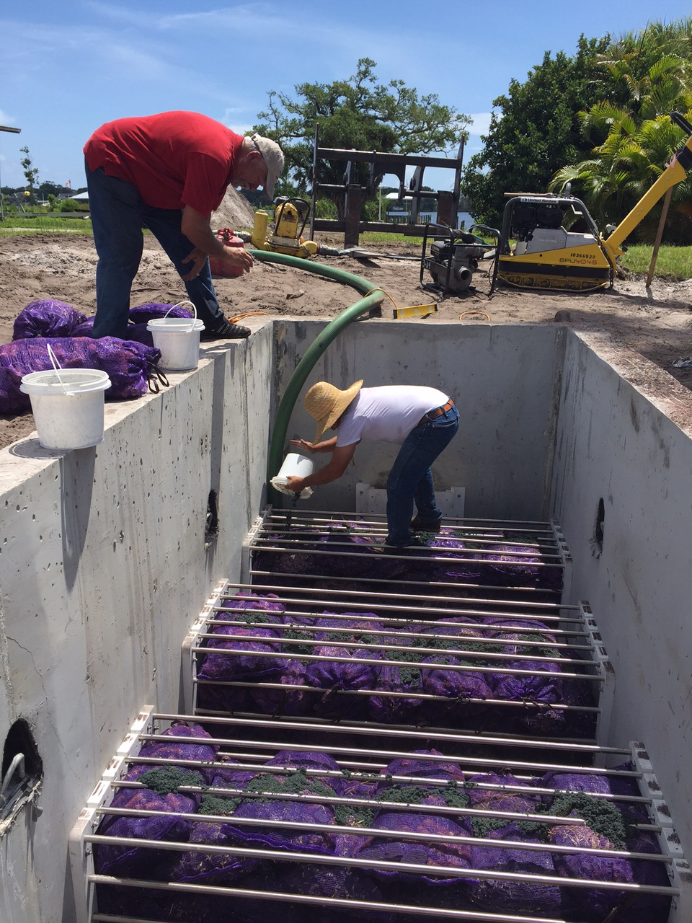
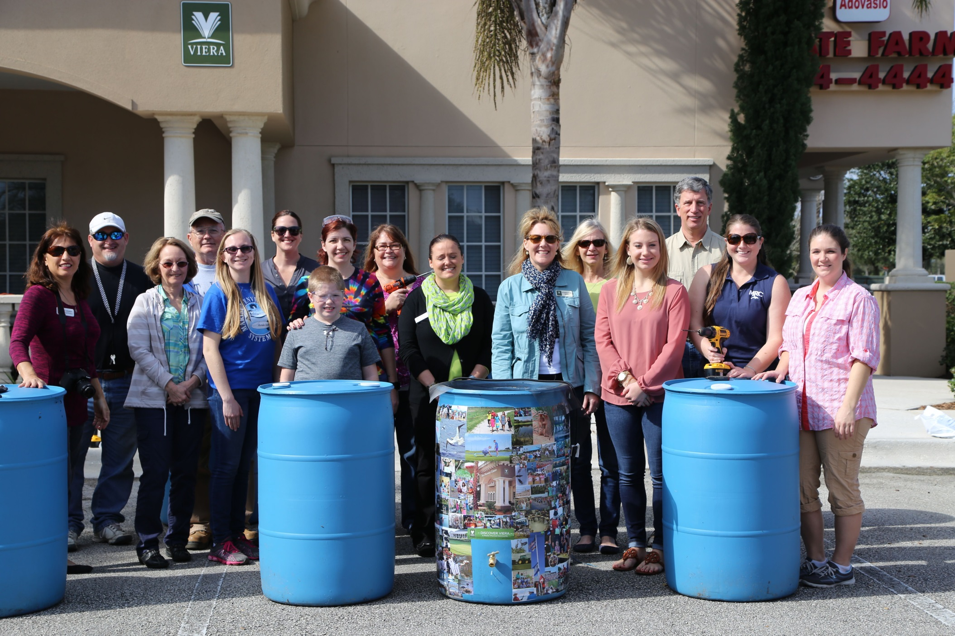
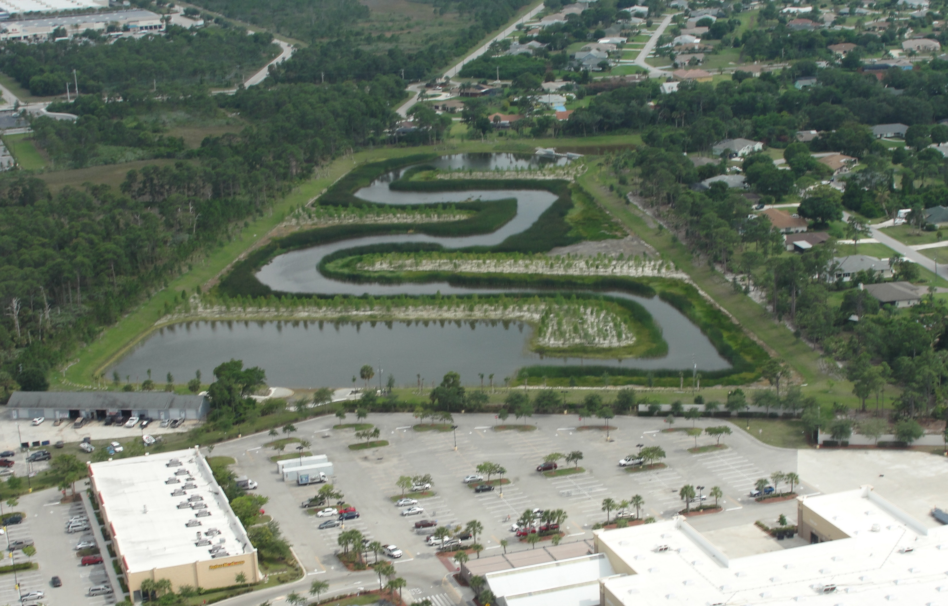
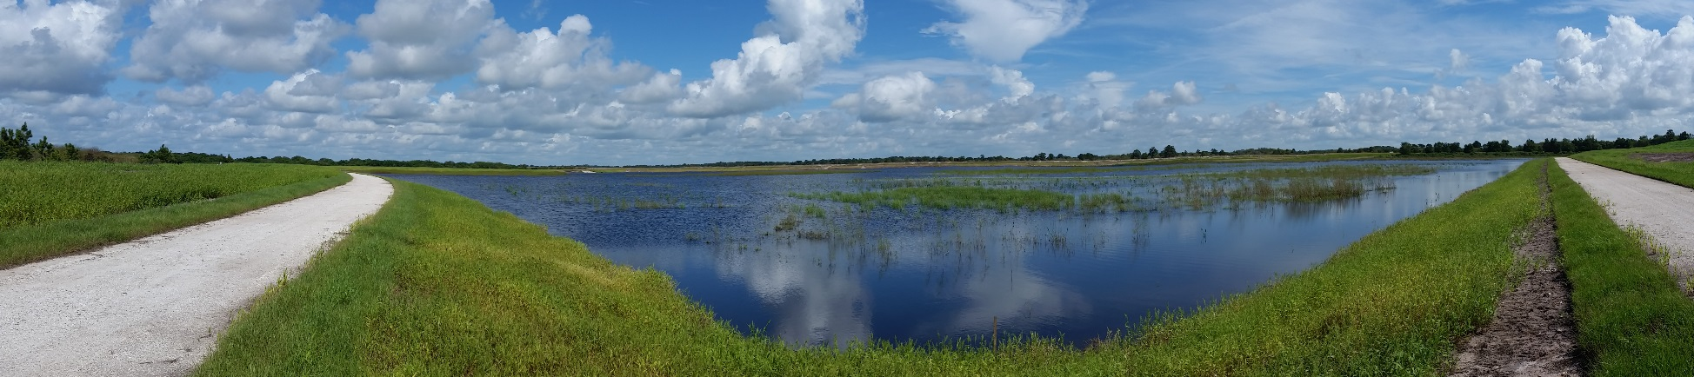
Example Projects
Cell 2
Cell 1
Taylor Creek STA, facing SE

Slide 11
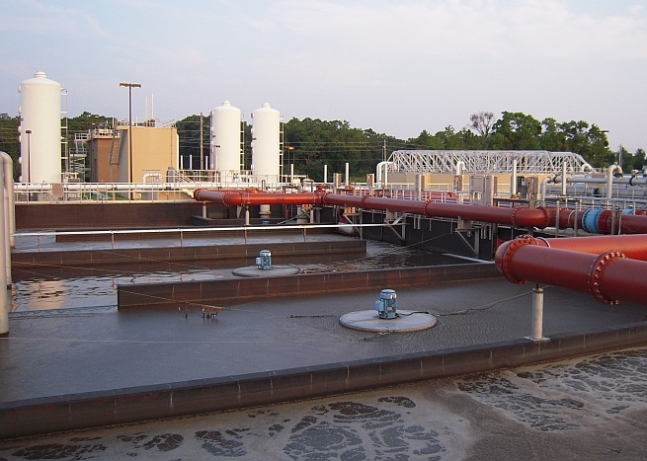
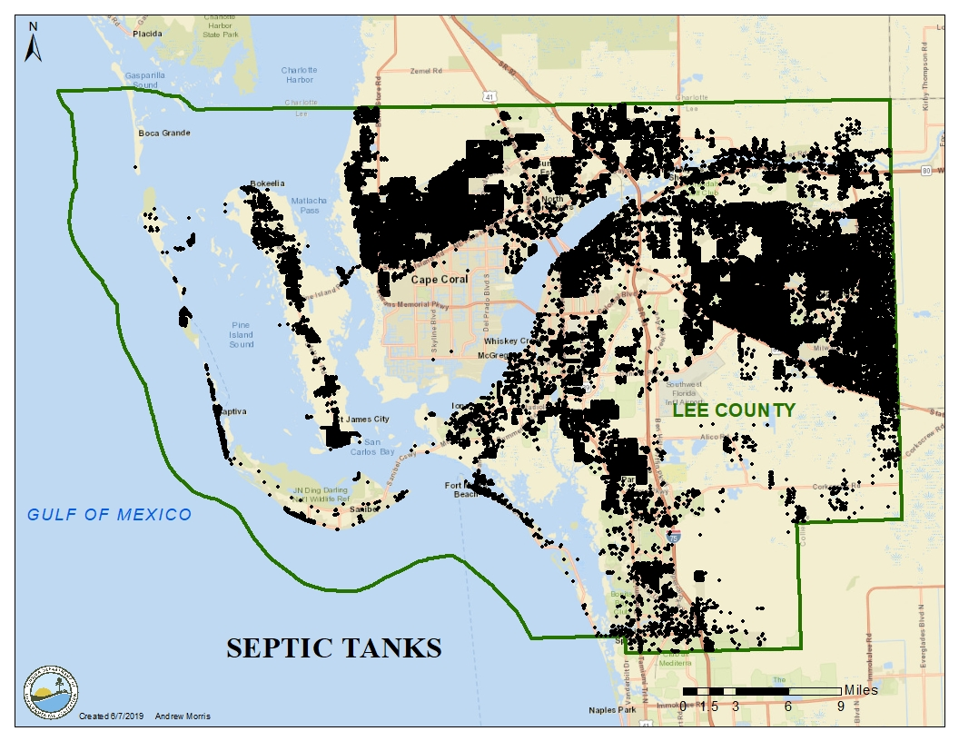
Wastewater

Slide 12
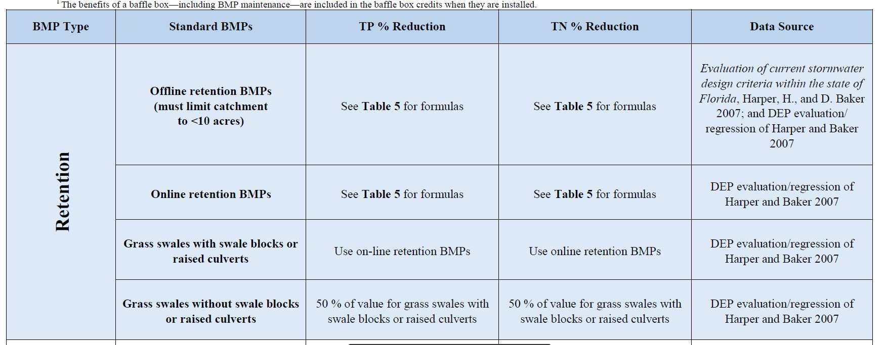
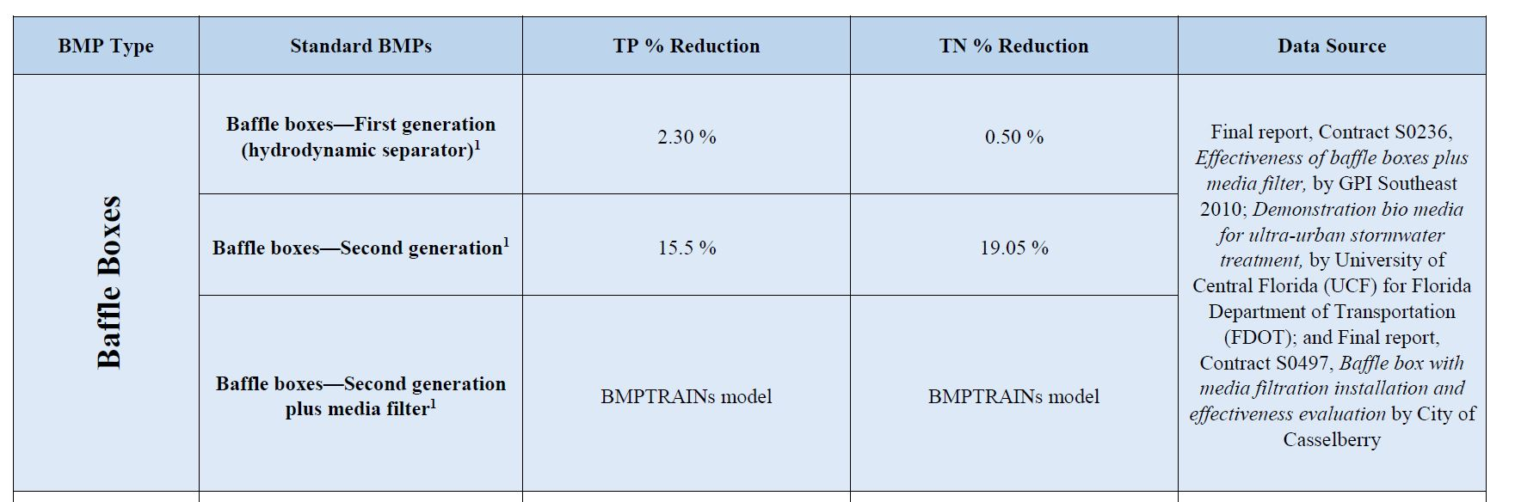
Project Reductions

Slide 13
DEP Project Funding Selection Criteria
Capital improvement project or land acquisition
Improved water quality or quantity & amount of benefit
Address an impairment
In a Restoration Plan (e.g., BMAP, RA)
Benefit a Minimum Flow & Level
Project readiness & time to complete
Cost & cost effectiveness
Local contributions & local commitment
Multi-year project

Slide 14
Project Performance
44/237 projects have post construction monitoring results for TN or TP (1988-2014)

Slide 15
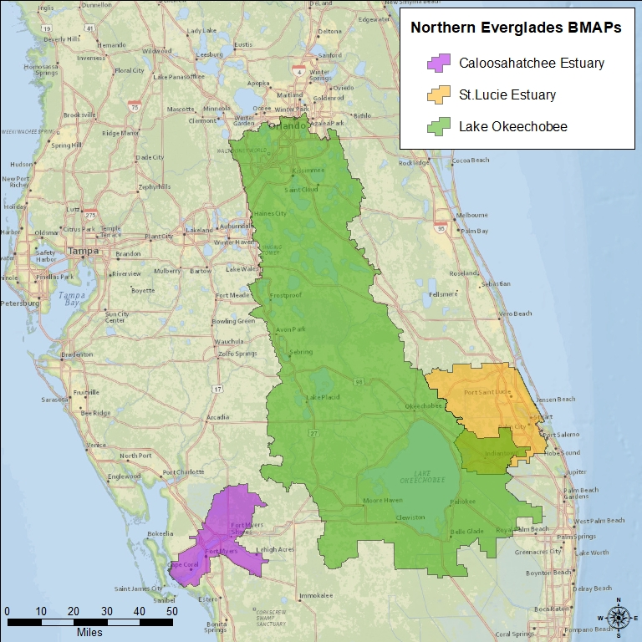
South Florida BMAPs
BMAP | Adoption Date | 5-Year Review Date | 5-Year Review Status
Caloosahatchee | November 2012 | November 2017 | Submitted
St. Lucie | June 2013 | June 2018 | Submitted
Lake Okeechobee | December 2014 | December 2019 | In Progress

Slide 16
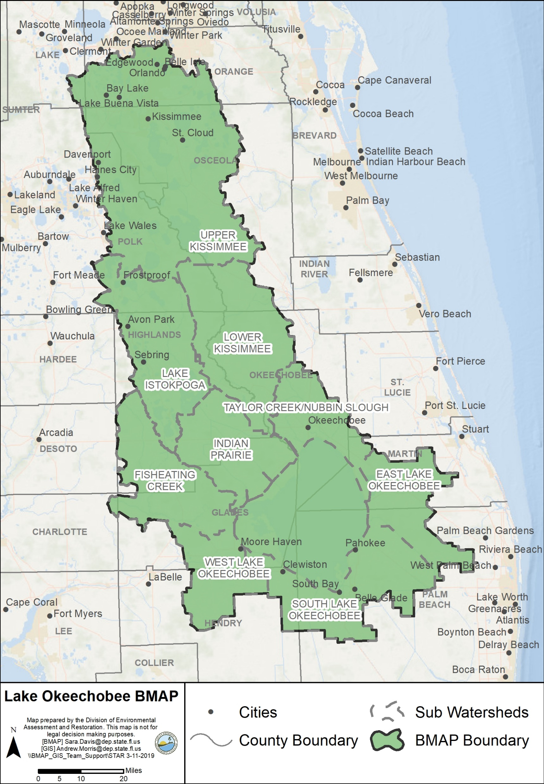
Lake Okeechobee BMAP
Total required reductions:
756,185 lbs/yr TP
Source | TP Load (%)
Natural Lands | 14
Urban Stormwater | 7
Agriculture | 78

Slide 17
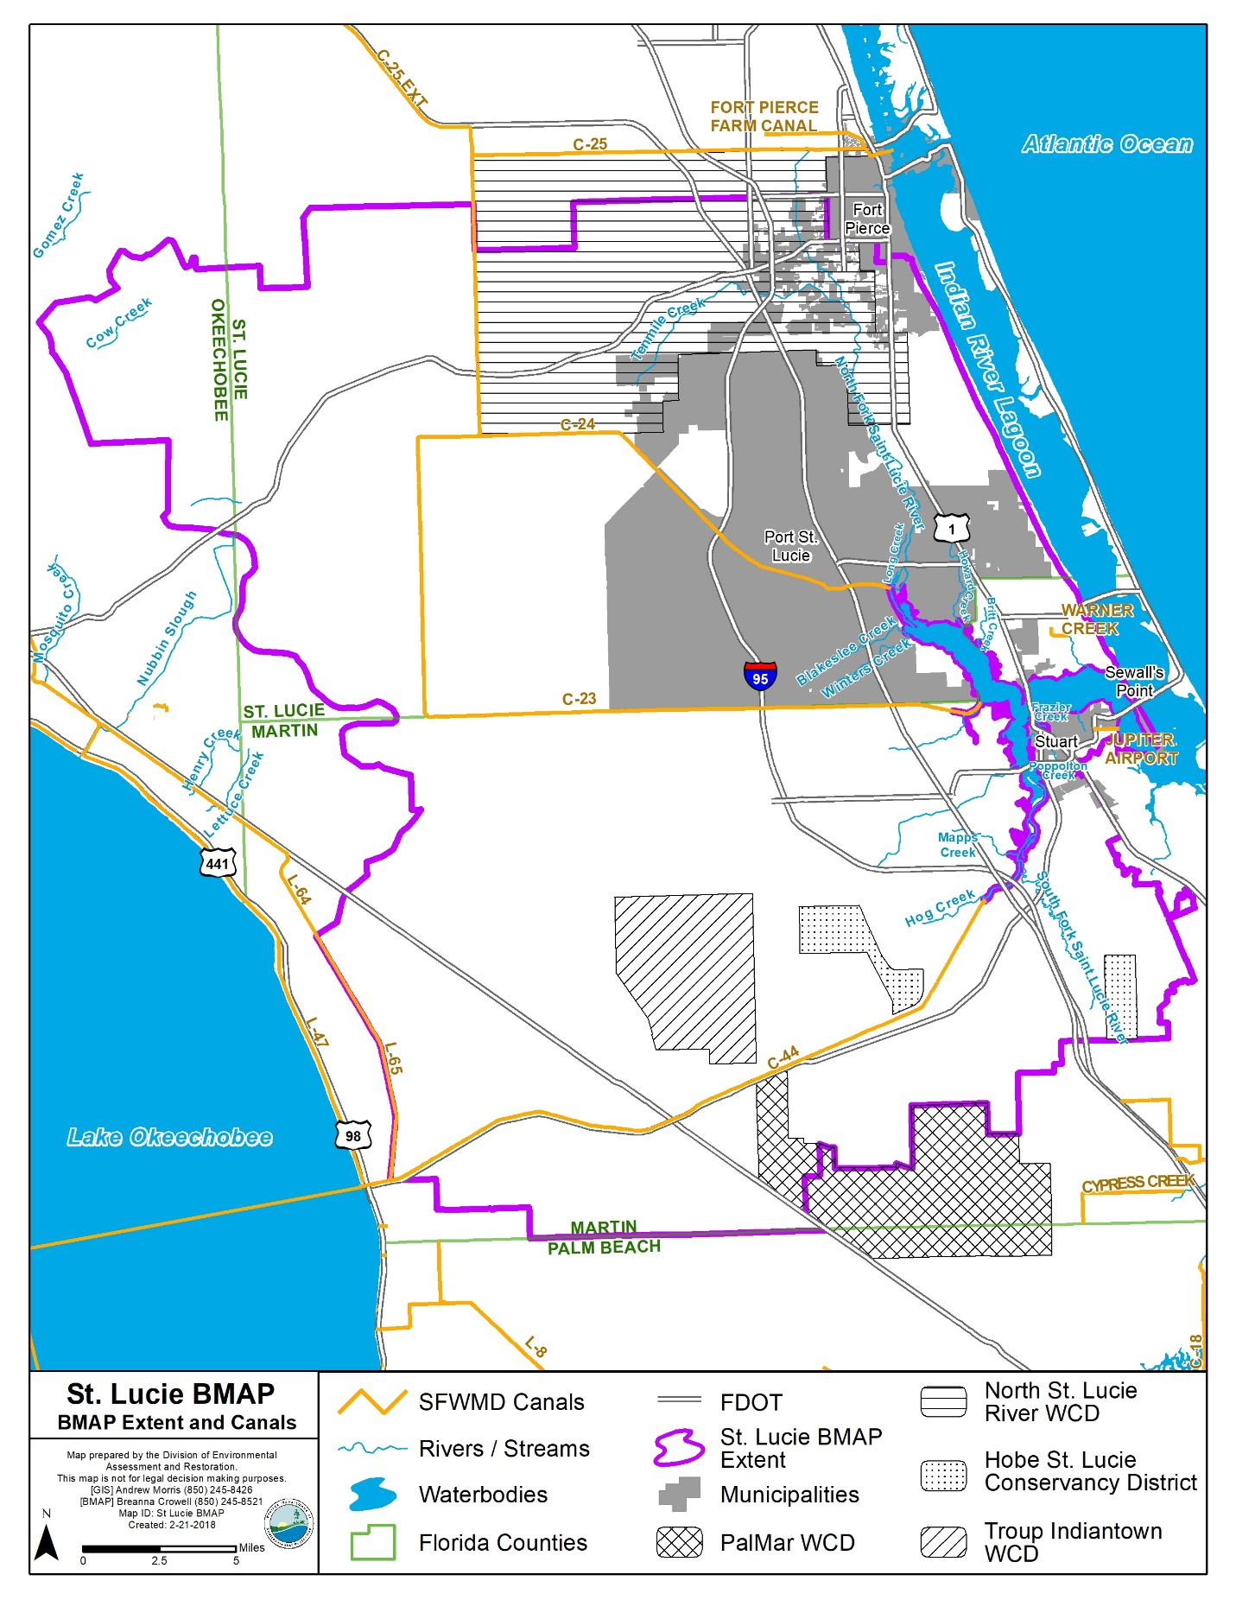
St. Lucie BMAP
Total required reductions:
1,053,414 lbs/yr TN - 404,166 lbs/yr TP
Source | TN Load (%) | TP Load (%)
Natural Lands | 17 | 16
Urban Stormwater | 28 | 24
Agriculture | 55 | 60

Slide 18
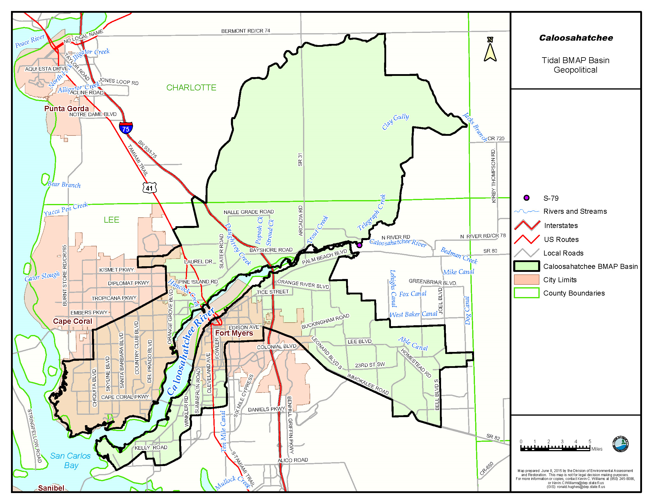
Caloosahatchee Estuary BMAP
Total required reductions:
388,719 lbs/yr TN
Source | TN Load (%)
Wastewater | 1
Urban Stormwater | 53
Agriculture | 45

Slide 19
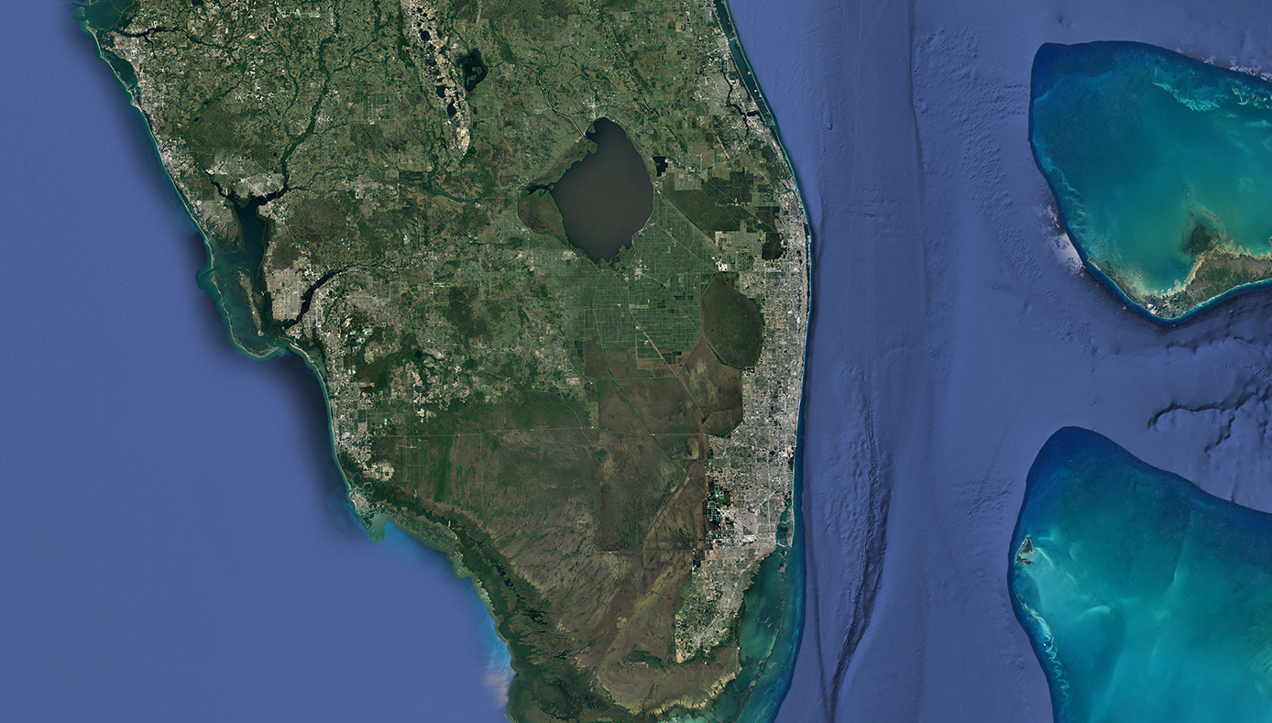


Slide 20
Florida’s Multi-Agency Response
Department of Environmental Protection
Department of Health
Fish and Wildlife Conservation
Water Management Districts
County Governments
Sampling, analysis, and dissemination of results
Water quality protection
Issues health advisories
Investigates reports of illness related to HAB exposure
Addresses fish kills and sick wildlife
Principle agency for marine HABs
Sampling and analysis
Sampling and reconnaissance
Sampling, reconnaissance and advisories

Slide 21
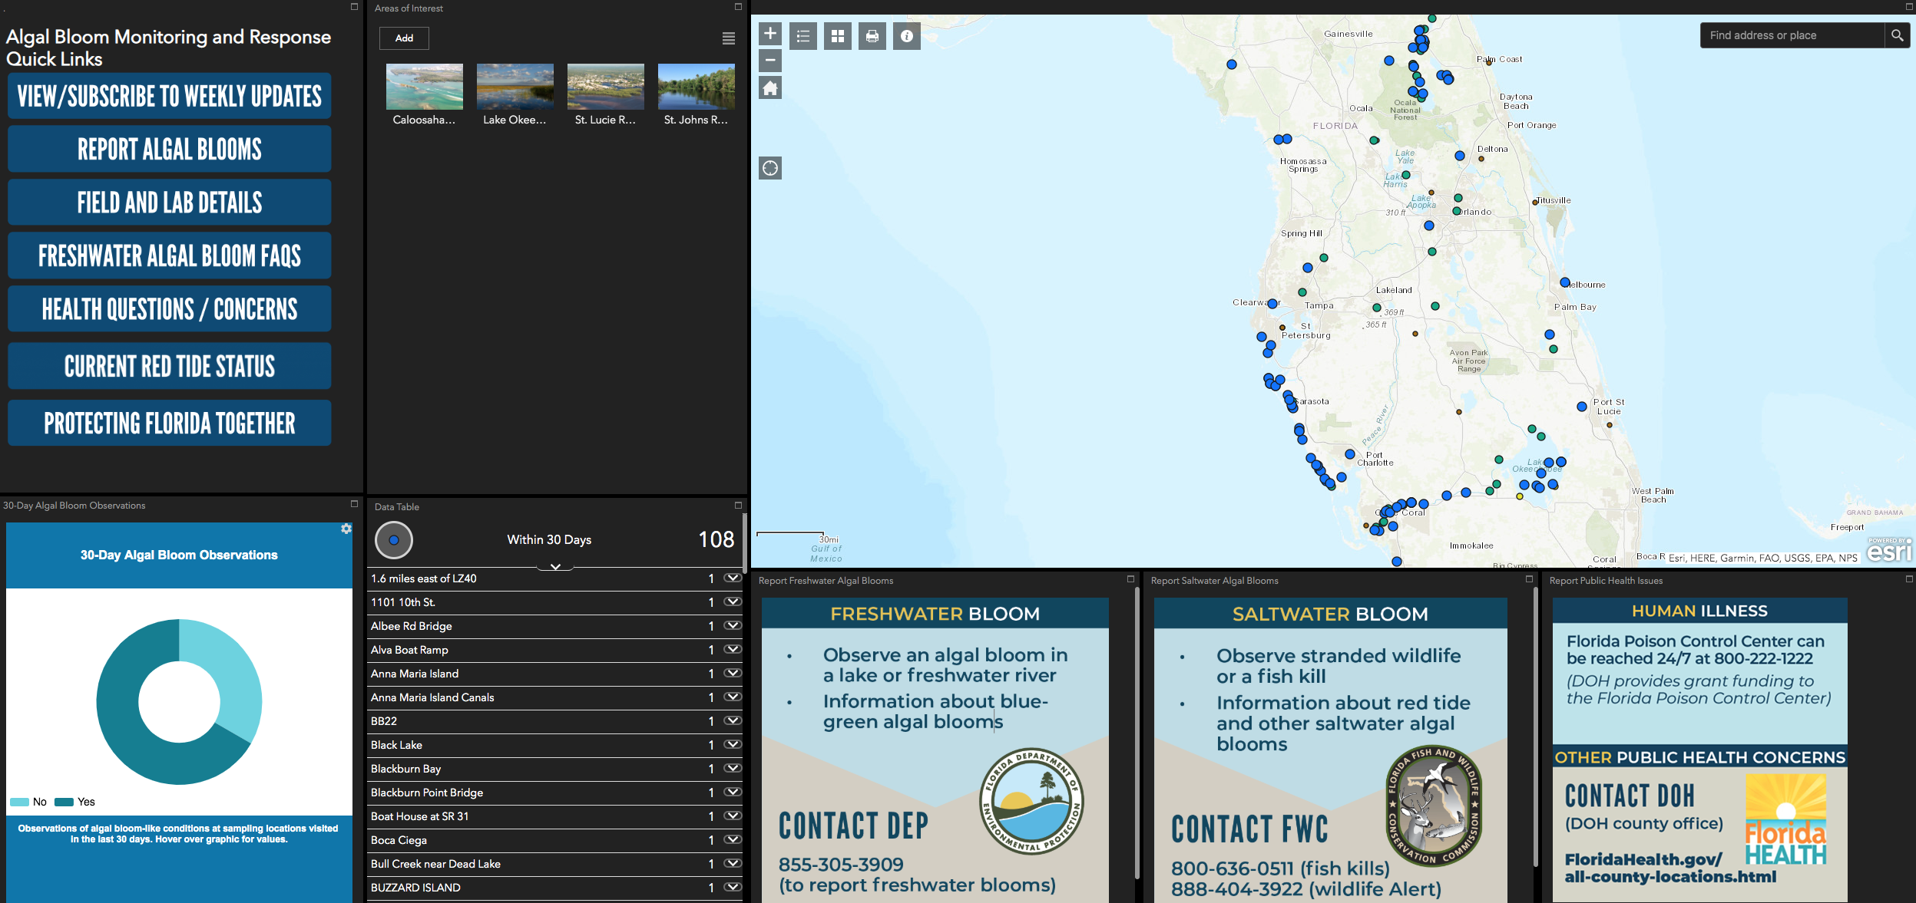

Slide 22
Federal Partners
Environmental Protection Agency
Army Corps of Engineers
National Oceanic and Atmospheric Administration
USGS
Develops Recommended Water Quality Criteria / Thresholds
Develops and publishes analytical methods for the quantification of cyanotoxins in drinking water and ambient waters
Holds HAB-Related Symposiums
Weekly science call
Studies and pilot projects
Satellite imagery
Studies

