Slide 1
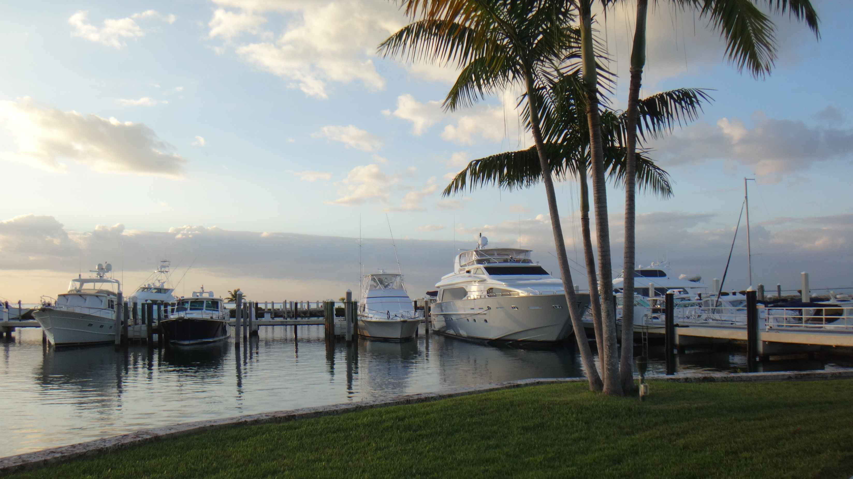


CLEAN VESSEL ACT GRANT PROGRAM: PUMPOUT GRANT APPLICATION PROCESS

Slide 2

CLEAN VESSEL ACT (CVA) GRANT PROGRAM
The Florida Clean Vessel Act Program provides grant funding to marina owners and operators for boater pumpout facilities in service to the public.
CVA grant funds can be obtained for recreational boater
pumpout-related projects.
Grants will cover up to 75% reimbursement of cost for these
projects — with 25% of the approved project cost covered by the grantee.
Grant-funded work cannot be started before an agreement is in place. Costs incurred before an agreement is executed will not be covered or reimbursed by the grant.

Slide 3
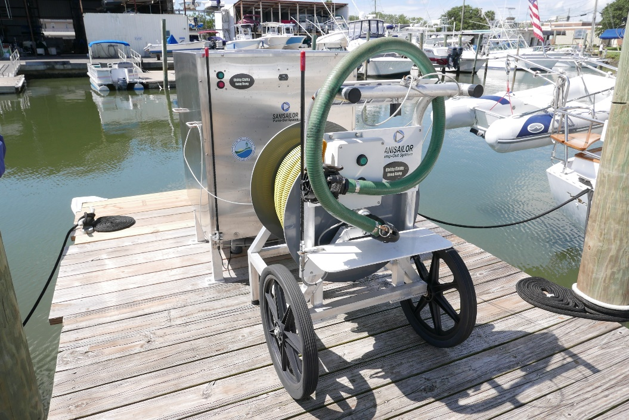
ALLOWABLE PROJECTS AND EXPENSES
Equipment purchase and installation.​
Dump station, portable, stationary, pumpout vessel, holding tank, lift station.​
Piping, plumbing, electrical work.​
Operations, maintenance and repair.​
Sewage hauling and holding tank.​
Pumpout signage.​
Education and outreach materials.​
New Smyrna City Marina

Slide 4
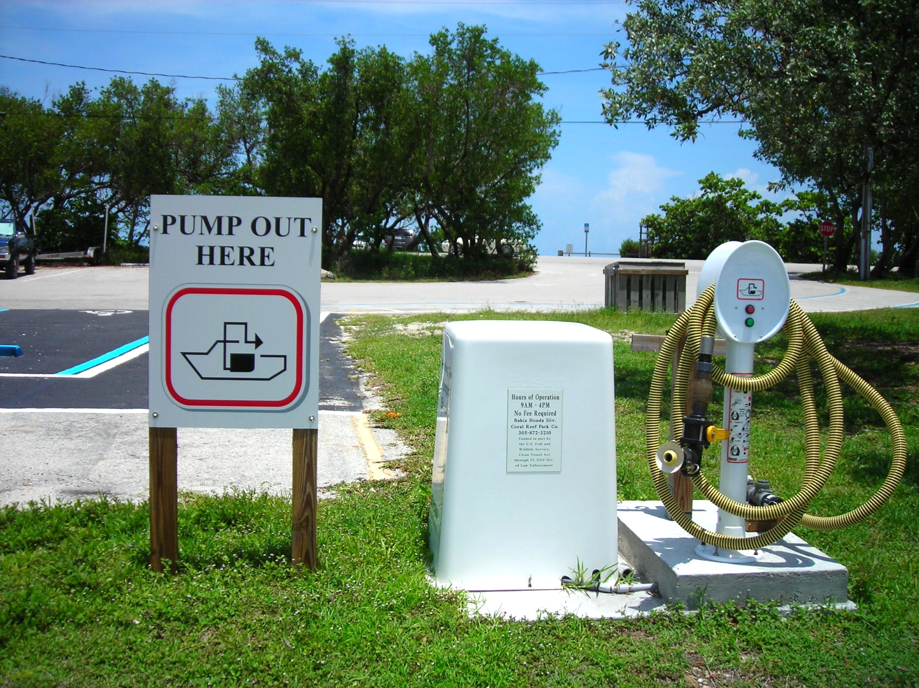
CVA APPLICATION CHECKLIST
CVA Application.
Quotes or bids.
Federal Funding Accountability and Transparency Act (FFATA).
Project plan and pictures.
Division of Corporations Registration.
MyFloridaMarketPlace (MFMP) Vendor Registration.
SAM.Gov Registration.
W-9.
Insurance.
Workers Compensation.

Slide 5
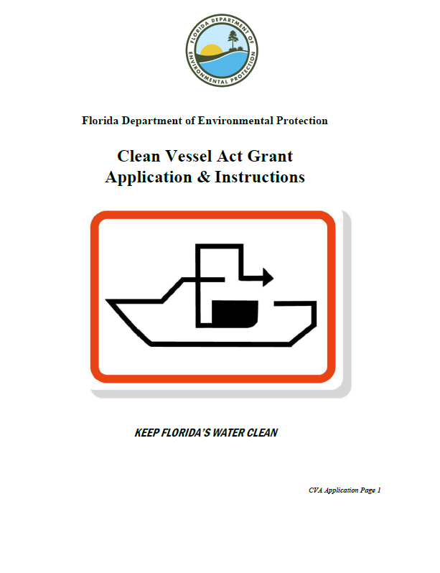
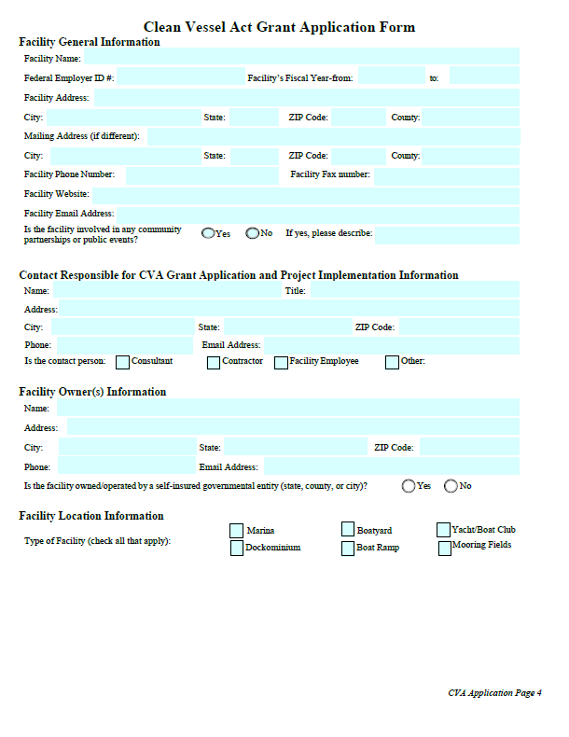
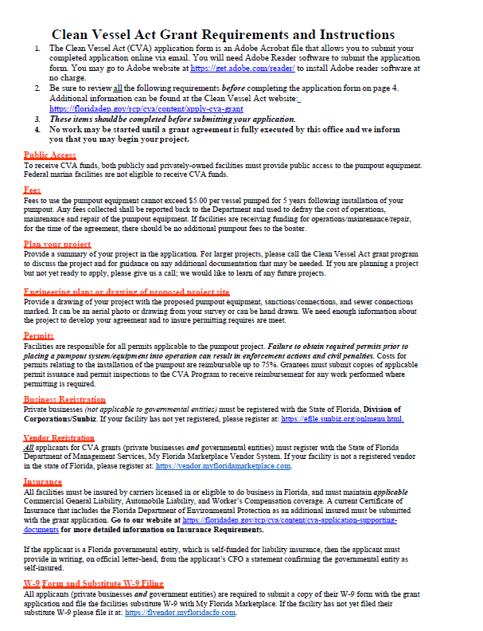
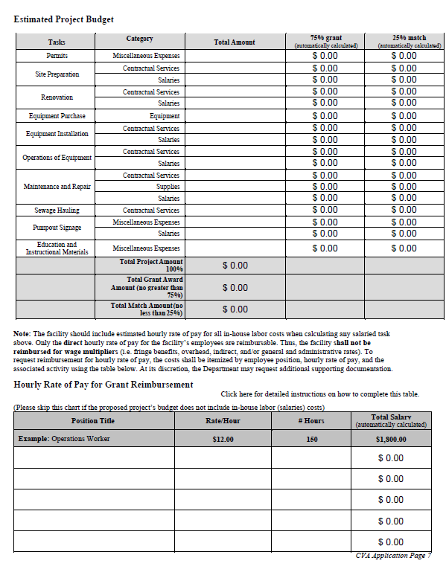
CVA GRANT APPLICATION
CVA Grant application.

Slide 6
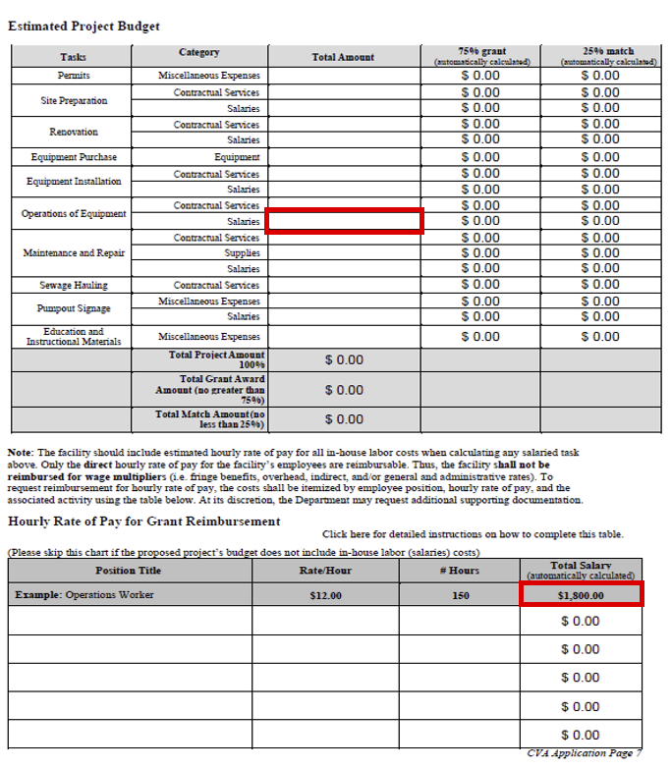
PROJECT BUDGET
Quotes used to fill out the CVA application:
If a category exceeds $2,500, then two quotes must be provided. The lower one should be used to fill the CVA application.
If a category is under $2,500, no quotes are needed.
To find out the maximum hourly rate of pay for each position that the grant can reimburse for, please see: The Hourly Rate of Pay for Grant Reimbursement Guide.

Slide 7
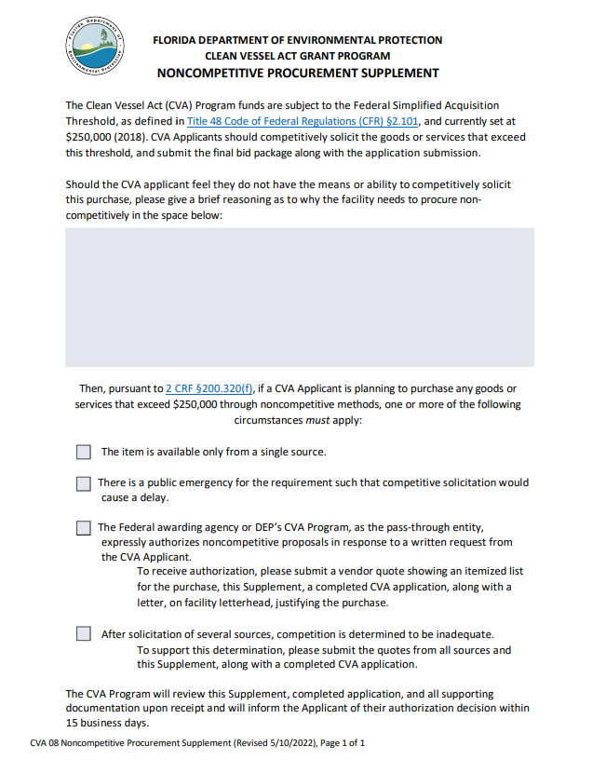
PROJECT BUDGET
If the CVA applicant does not have the means or ability to competitively solicited, then completely fill out the Noncompetitive Procurement Supplement.

Slide 8
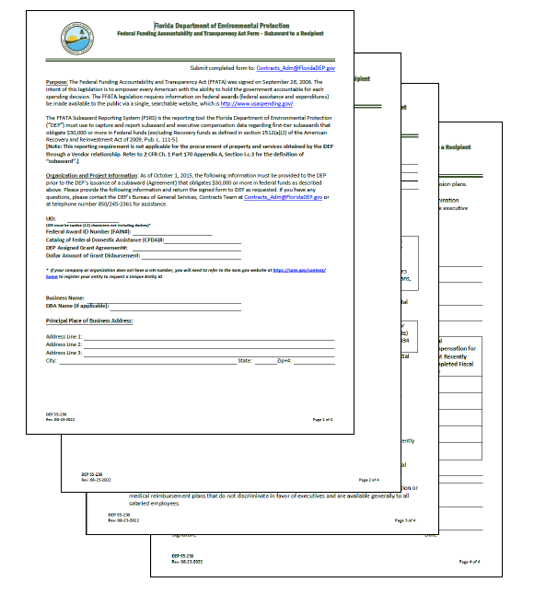
FFATA FORM
    If 75% of the total project cost exceeds $30,000, then a completed FFATA form must be provided with the application.
    This form is used to report the funding awards back to the Federal Government.

Slide 9
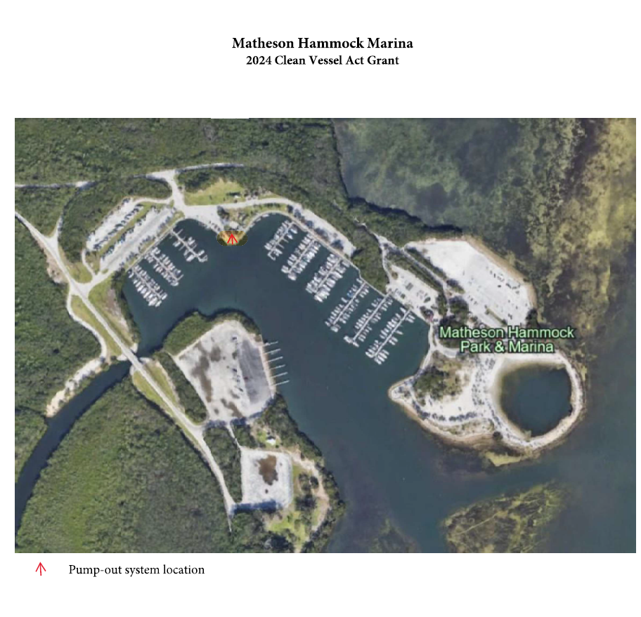
PLAN YOUR PROJECT
Provide an aerial drawing or engineering plans of proposed project site with pumpout location marked.
Use Google Earth and provide a broader marked aerial view of where the pumpout will be placed.

Slide 10
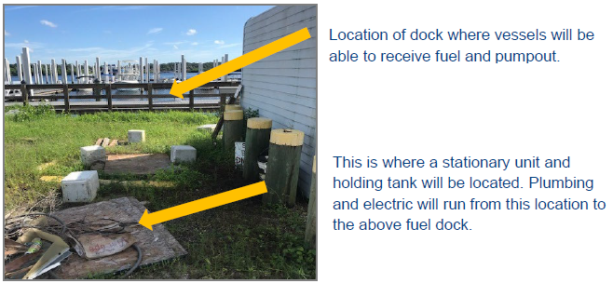
PLAN YOUR PROJECT (CONTINUED)
Pictures of proposed project site.
Pictures of the current pumpout signages present in the facility, if not applying for pumpout signages.
Inter Bay Moorings

Slide 11
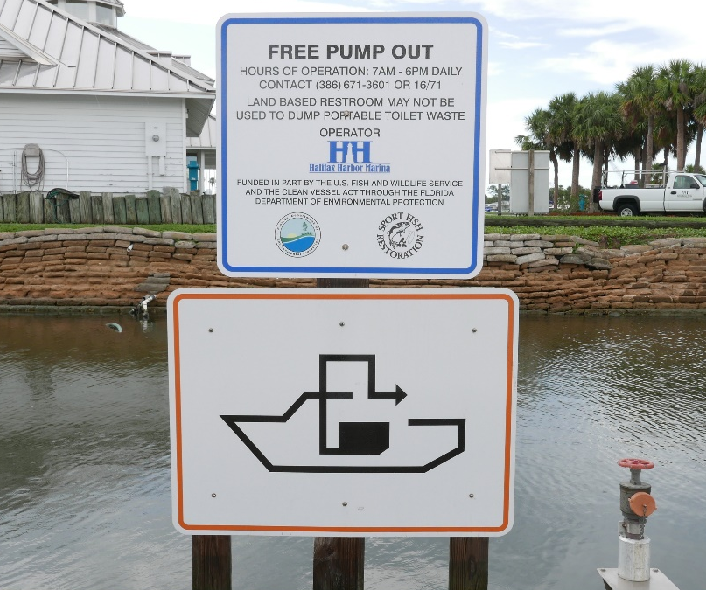
PUMPOUT SIGNAGE
All projects funded with CVA grants are required to have two posted signages:
  3’ x 4’ universal pumpout logo facing waterway.
  Informational placard on or next to the equipment, informing patrons of pumpout instructions and funding accreditation.
For more info, view the Pumpout Signage Requirements.
Halifax Harbor Marina

Slide 12
DIVISION OF CORPORATIONS REGISTRATION
Applicants must be a registered corporation. If marina is not, register at: Sunbiz.org.
To verify a registration online go to: Sunbiz.org.
In the top banner, select the ‘Search Records’ button.
This is Not applicable to governmental entity applicants.

Slide 13
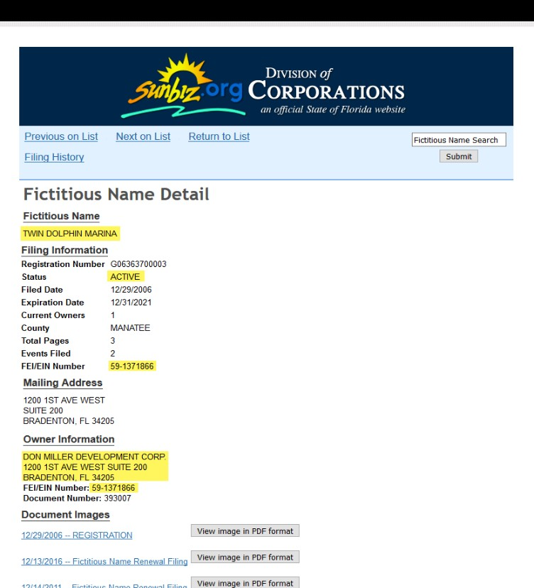
DIVISION OF CORPORATIONS
(FICTITIOUS NAME)
If the corporation is doing business under a different name, that fictitious name must be active as well, and match the owner’s name, principal address and FEI Number from the corporation record.

Slide 14
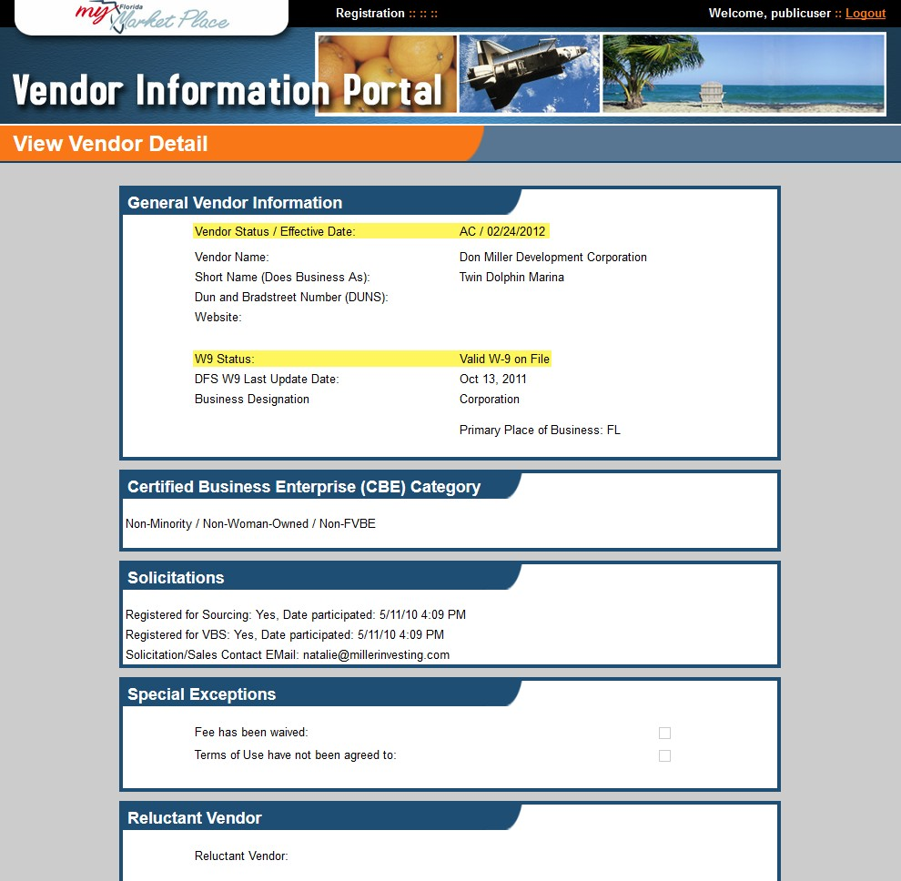
VENDOR REGISTRATION
Applicants must be a registered vendor in Florida. If you are not registered, marinas can register at: MFMP.
To verify a Vendor Registration online, visit MFMP.

Slide 15
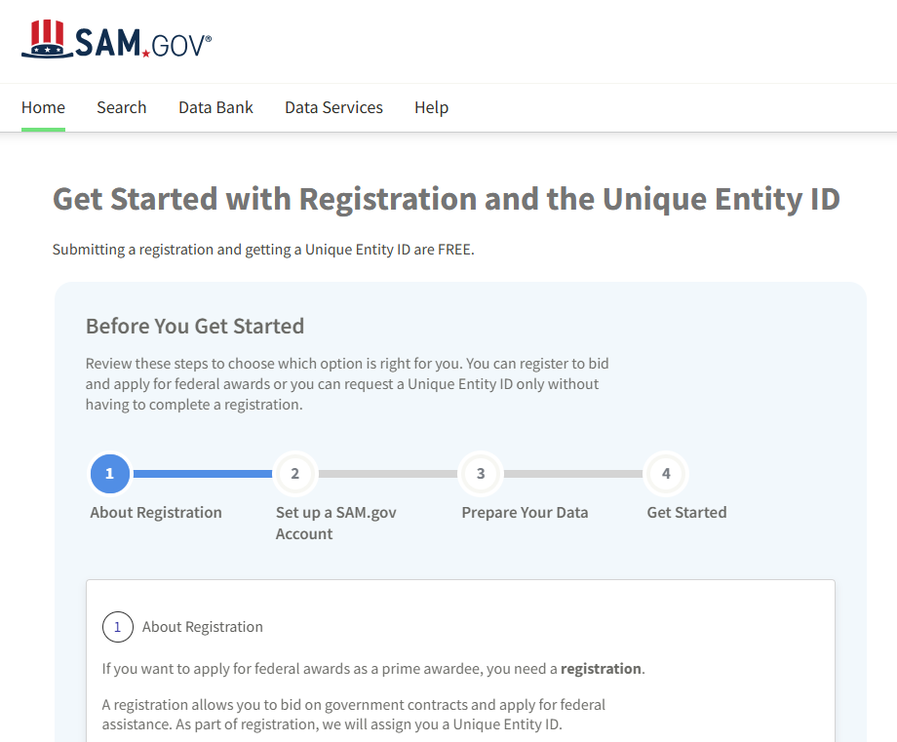
SAM.GOV REGISTRATION
All applicants will need to have a Unique Entity Identification number.
Marinas can register at SAM.Gov.

Slide 16
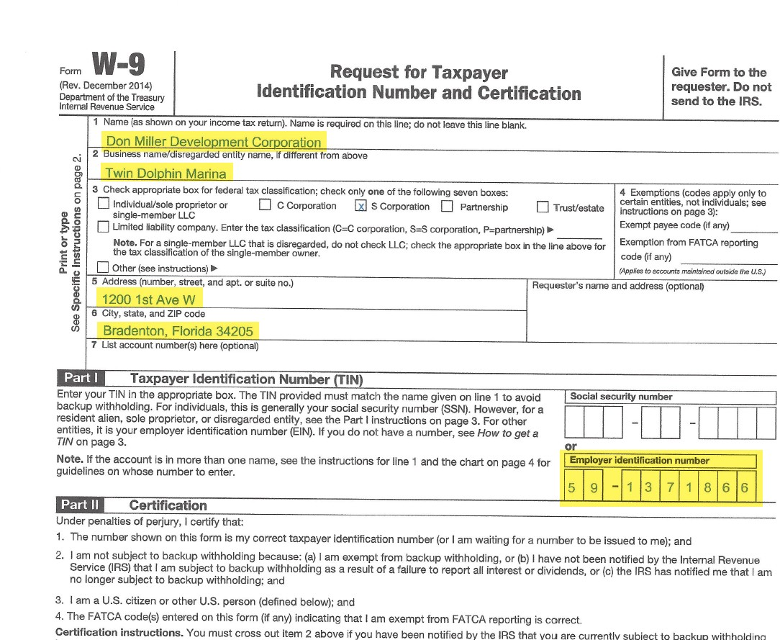
W-9
All applicants will need to submit their W-9.

Slide 17
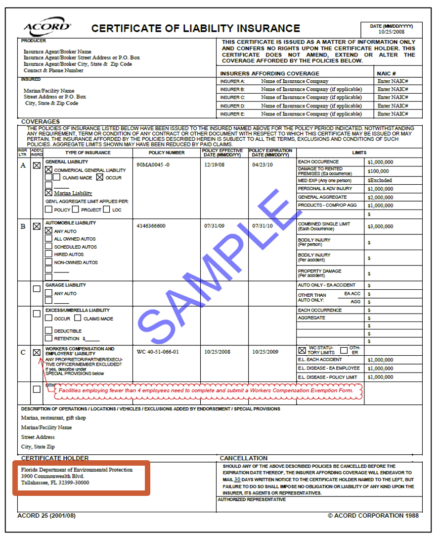
INSURANCE REQUIREMENTS
Commercial General Liability Insurance — $300,000 aggregate/$100,000 per occurrence required for a business.
Commercial Automobile Liability Insurance — vehicles owned by and used at the business must be insured for $300,000. If the business does not own or operate commercial vehicles at the project location, it must submit a written confirmation statement.
Workers Compensation Insurance — applicant must meet legal requirements which are: $100,000 per occurrence, $500,000 aggregate and $100,000 per disease required for four or more employees.
Before submitting your insurance, please make sure that DEP is listed as a certificate holder.
DEP Address: Florida Department of Environmental Protection
2600 Blair Stone Road, MS 235
Tallahassee, Florida 32399-2400

Slide 18
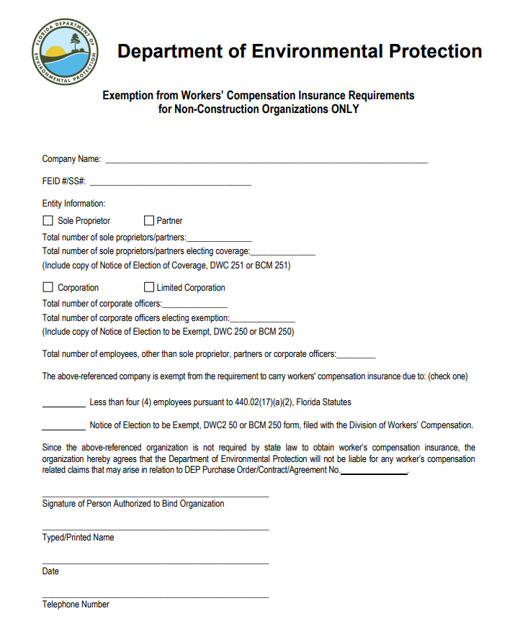
WORKERS COMPENSATION EXEMPTION FORM
Businesses with three or fewer employees can provide a completed Worker's Compensation Exemption Form, in place of providing proof of coverage.

Slide 19
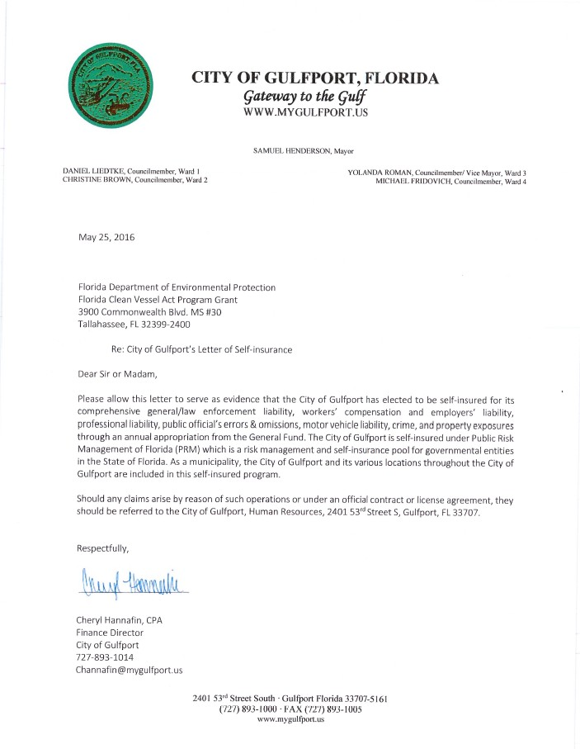
SELF-INSURED
    If the applicant is a Government entity (city, county, state), a written statement can be received, stating that the entity is self-insured.
    If the government entity is not self-insured:
    They must provide proof of insurance as listed previously for for-profit and nonprofit organizations.

Slide 20
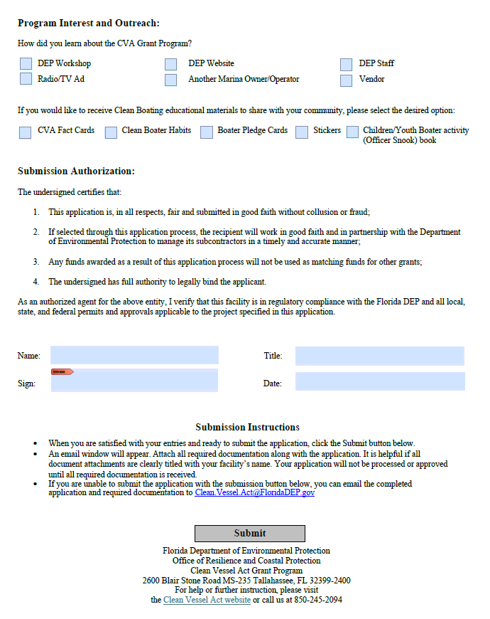
SUBMIT YOUR CVA APPLICATION
    Applications can be submitted by email, with the rest of the documents attached.
    Completely fill out your application.
    Select “Submit”.
    A blank email to Clean.Vessel.Act@DEP.gov will be created with your application attached.
    Include the required supporting documents to complete your application package, before sending your email.

Slide 21
CVA APPLICATION PROCESS
CVA staff will be notified that a new application has been received.
Grant manager is assigned.
The application is checked for completion, and an email confirming the recipient of your application is sent.
Site visit is scheduled.
Grant agreement draft is made and sent to the grantee to sign and sent.
Once the DEP supervisor signs, the grant is executed and the work can begin.
Status reported quarterly until the end of the grant agreement (except for the Quarterly Pumpout Log reported for five years after the grant agreement end date - for equipment purchasing and installation grants).
Invoice CVA program for 75% reimbursement.

Slide 22
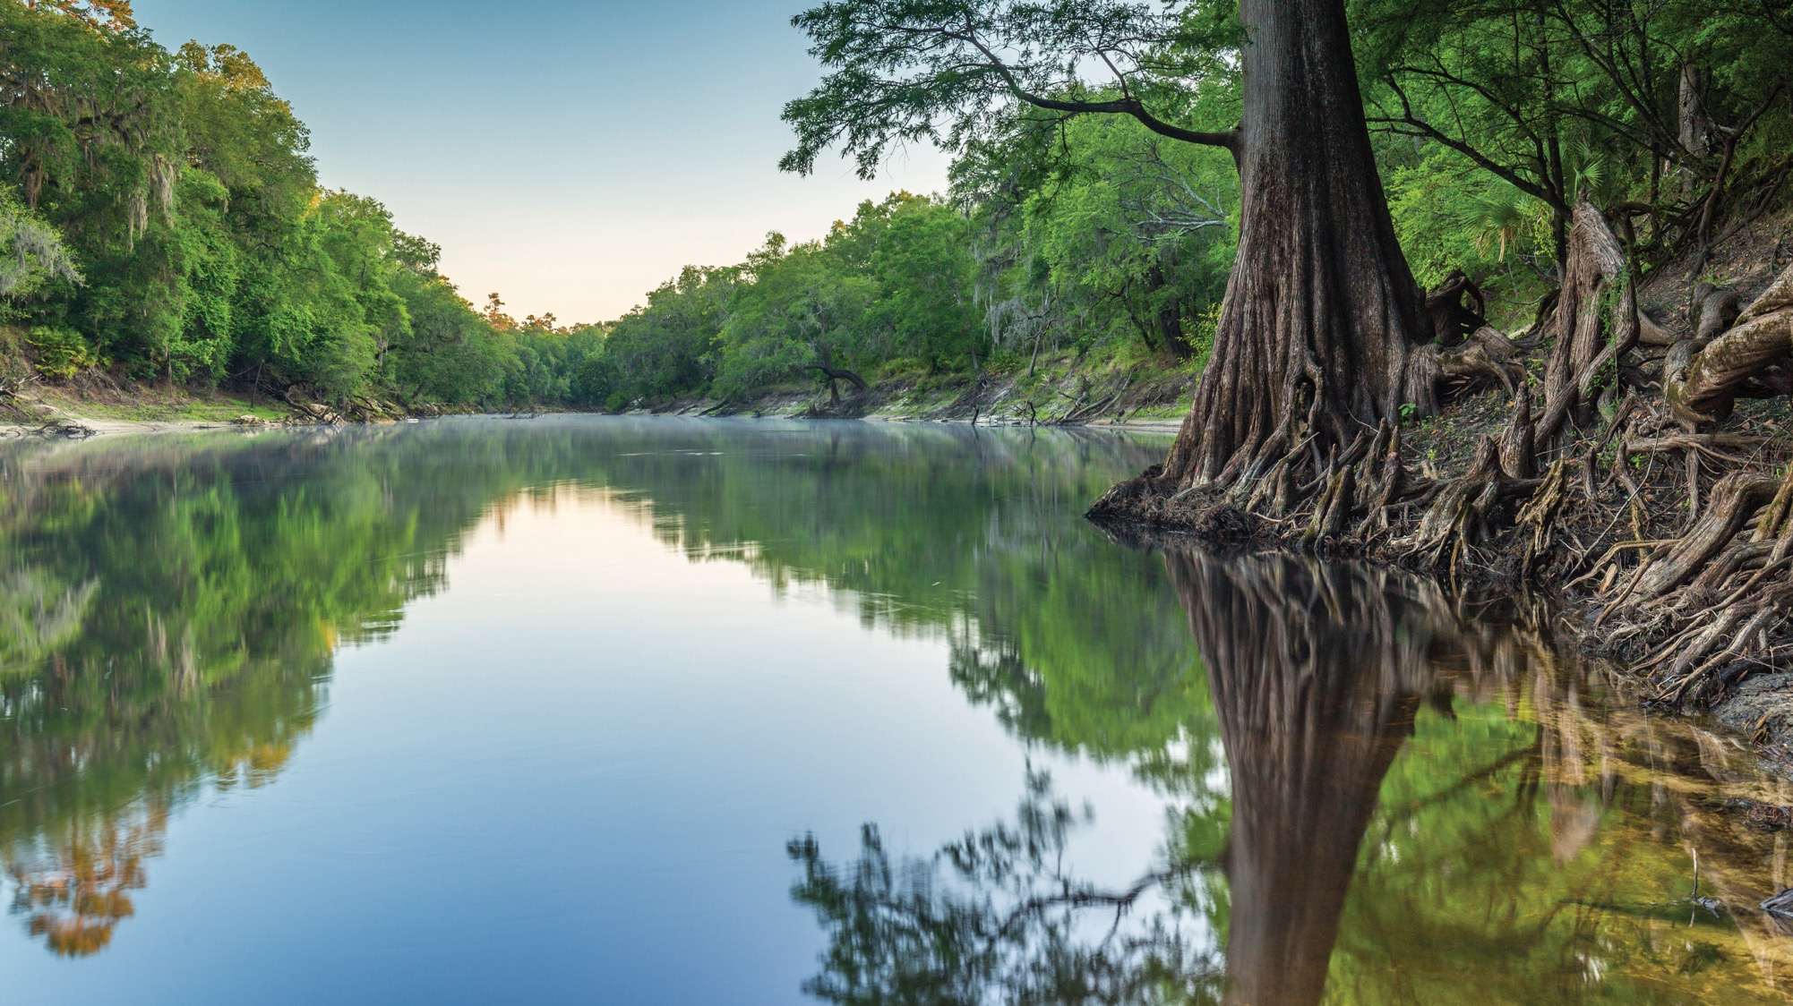
THANK YOU
Clean Boating Programs ​
Office of Resilience and Coastal Protection​
Florida Department of Environmental Protection

