Slide 1
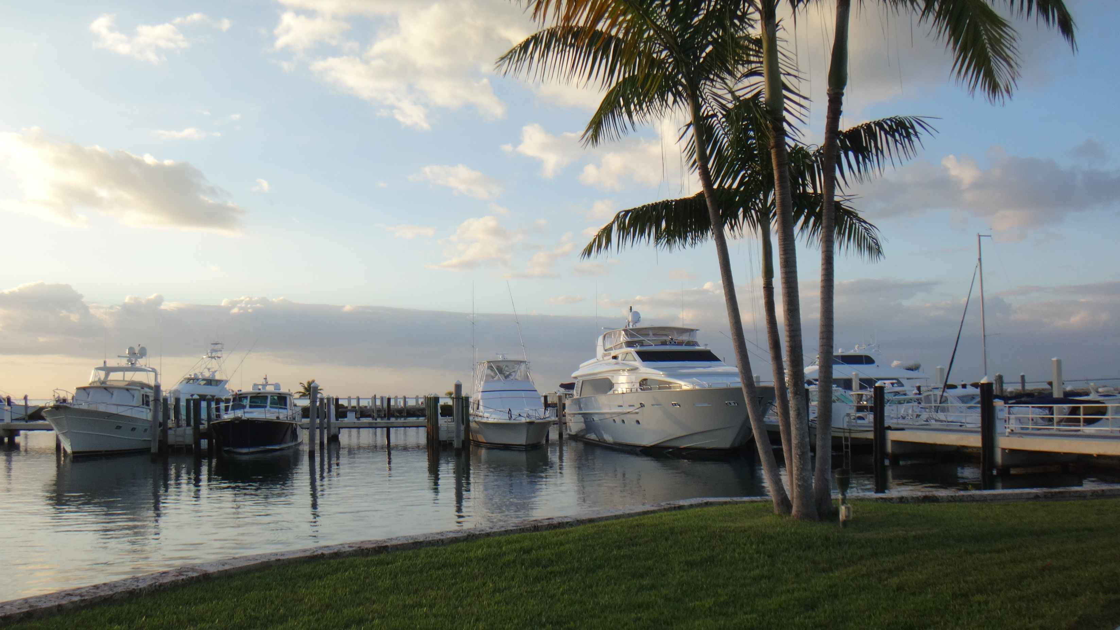


CLEAN VESSEL ACT GRANT PROGRAM: QUARTERLY REPORTS

Slide 2
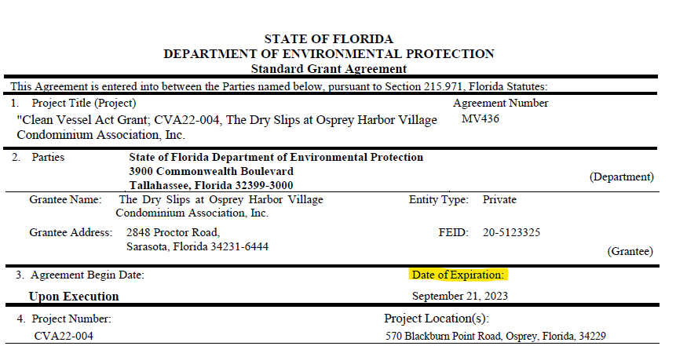
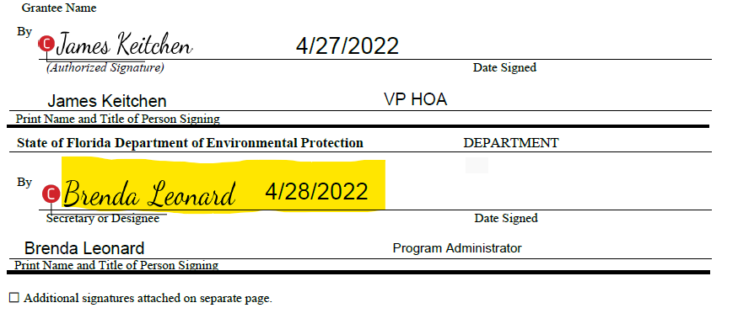
CLEAN VESSEL ACT (CVA) GRANT AGREEMENT
Once an agreement is reached, the grantee will sign first, followed by the DEP supervisor. The DEP supervisor's signature on the second page will establish the agreement's start date.
The expiration date will be listed in the first page.
Only the agreed upon work, within the agreement period, will be eligible for reimbursement.
Grant work should start only after the agreement is fully executed.

Slide 3
QUARTERLY REPORTS
When applying for a CVA grant, it is important to know that quarterly report deliverables will be expected from the grantee. This is to ensure transparency and that the project is on track for completion before the agreement end-date. These reports will also be used when submitting invoices.
Quarterly Progress Report
Quarterly Pumpout Log
Quarter | From | To
1 | Jul 1 | Sep 30
2 | Oct 1 | Dec 31
3 | Jan 1 | Mar 31
4 | Apr 1 | Jun 30

Slide 4
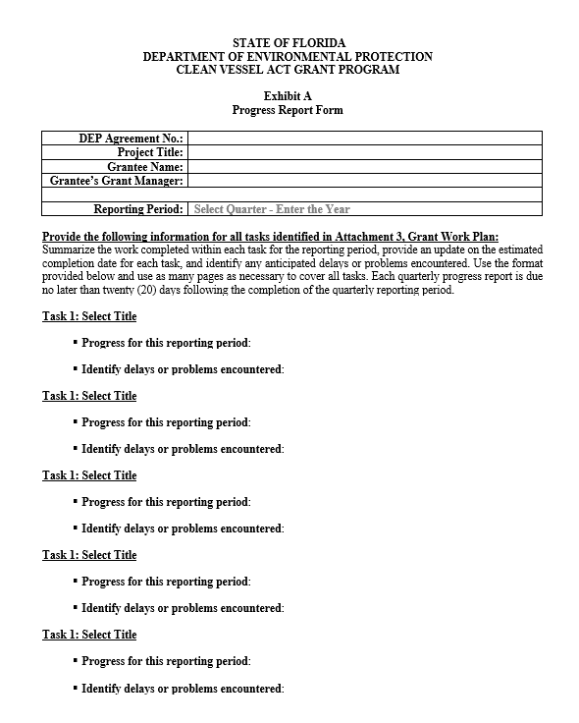
QUARTERLY PROGRESS REPORT FORM — EXHIBIT A
All Clean Vessel Act grantees are required to submit a progress report for each quarter of the grant award period, until the project is complete, as outlined in the agreement.
The Quarterly Progress Report Form is Exhibit A of the grant agreement.

Slide 5
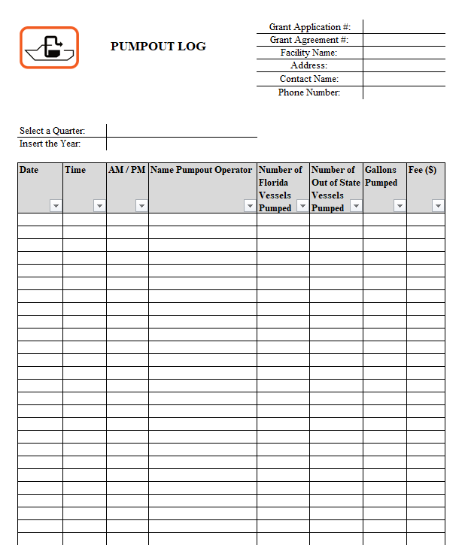
QUARTERLY PUMPOUT LOG REPORT
For CVA equipment purchase and insulation, or operations and maintenance funded agreements, the facility needs to submit the Quarterly Pumpout Log report.
For equipment purchase agreements, the facility will be required to report for five (5) years following the project completion date of the grant agreement.
For operations and maintenance agreements, the facility will be required to report during the grant award period only.

Slide 6

THANK YOU
Clean Boating Programs ​
Office of Resilience and Coastal Protection​
Florida Department of Environmental Protection

