Slide 1


Chapter 62-705
Grease Waste Removal and Disposal
Chapter 62-705
Grease Waste Removal and Disposal
Tim Bahr, Director
El Kromhout, Env. Admin.
Division of Waste Management
Florida Department of Environmental Protection
Environmental Regulation Commission | Dec 13, 2024

Slide 2
Grease Waste
Grease Waste
  “Grease Waste” means liquid or solid material composed primarily of fatty substances, oils, and grease from animal or vegetable sources which is retained in a grease interceptor or grease trap.

Slide 3
Florida Statutes
Florida Statutes (F.S.)
  Section 403.0741, F.S., effective July 1, 2022:
  (1) Definitions – provides definitions, including “grease waste”.
  (2) Disposal of Grease Waste – Requires grease waste haulers to dispose of grease waste at permitted or certified disposal facilities.
  (3) Grease Waste Service Manifest – Requires grease waste haulers to document grease waste removal and disposal with service manifests.
  (4) Compliance Inspections – Inspecting entity must verify contracts for grease waste removal and conduct periodic inspections of service manifests.
  (5) Penalties – Provides penalties for haulers who violate s. 403.0741, F.S.
  (6) Regulation by Local Governments – “may” take specified actions; does not prohibit adoption of ordinances or rules which are stricter or more extensive.
  (7) Rules – the department shall adopt rules to implement s. 403.0741, F.S.
Notes:
In the 2022 Session HB 1110 was passed and Section 403.0741 florida statutes became effective July 1, 2022.

Slide 4

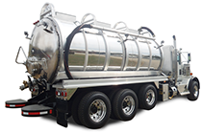
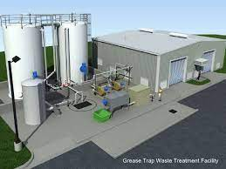
The bottom line
THE BOTTOM LINE
Manifest
Manifest
Hauler
Disposal Facility
Originator
Section 403.0741, F.S., requires that grease waste be manifested from the originator, through management by the hauler, until proper disposal at a certified or permitted disposal facility.

Slide 5
Rulemaking
Rulemaking
Rulemaking steps to adopt rules to implement Section 403.0741, F.S.
  Section 403.0741, F.S., effective July 1, 2022.
  Notice of Rule Development published on November 1, 2022.
  First rule workshop held on March 22, 2023.
  Second rule workshop held on March 22, 2024.
  ERC briefing notice published November 15, 2024
  ERC briefing on December 13, 2024.

Slide 6





Originator Responsibilities
ORGINATOR RESPONSIBILITIES
Maintain a contract with a hauler for grease waste removal.
Maintain copies of completed service manifests for one year.
Section 403.0741, F.S., does not provide penalties for non-compliance by Originator.
Schools
Hotels
Commercial kitchens
Prisons
Restaurants

Slide 7
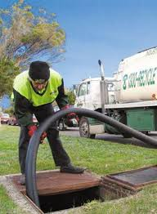
Hauler Responsibilities
HAULER RESPONSIBILITIES
Document removal and disposal of grease waste with a service manifest.
Upon completion of grease waste removal, sign the service manifest (originator signs also if removal is conducted during operating hours).
Provide copy of the service manifest to originator (manifest left at a designated location if removal is not during originator’s operating hours or provided electronically).
Dispose of the grease at a permitted or certified waste management facility (waste management facility signs manifest).
Provide the completed service manifest to the originator and the county and municipality in which the originator is located within 30 days after the date of disposal.
Retain the service manifest for one year (hauler and originator).
Subject to enforcement and penalties under Section 403.0741, F.S., for non-compliance.

Slide 8
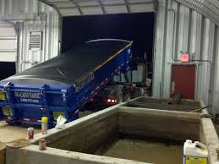
Disposal Facility Responsibilities
DISPOSAL FACILITY RESPONSIBILITIES
Be a permitted or certified waste management facility.
Sign the service manifest to verify that the information is accurate.
Section 403.0741, F.S., does not provide penalties for non-compliance by Disposal Facilities.

Slide 9
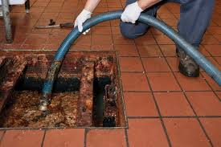
Regulation by Local Government
REGULATION BY LOCAL GOVERNMENT
Local government may:
Receive copies of service manifests from haulers.
Receive reports of violations.
Verify certain contracts and service manifests.
Collect and retain fines for service manifest violations.
Impose license actions.
Adopt or enforce a more stringent or more extensive local ordinance.
Fiscally constrained counties and small counties may opt out of the requirements of Section 403.0741, F.S.

Slide 10
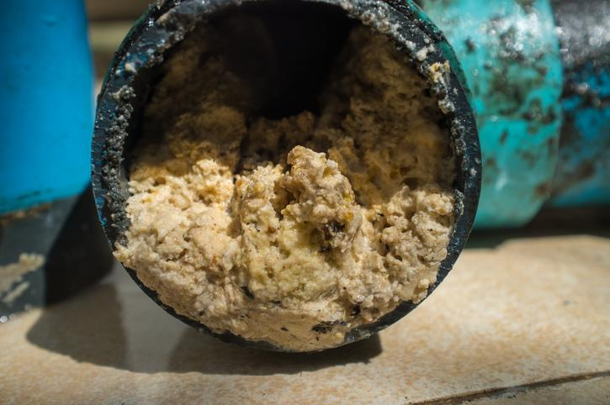
DEP’s Responsibilities
DEP’S RESPONSIBILITIES
Periodically inspect service manifests retained by haulers to verify compliance with the statute.
Authorize an inspecting entity to impose penalty for failure to clean a grease interceptor or grease trap as part of a grease interceptor or grease trap inspection.
Adopt rules to implement Section 403.0741, F.S.

Slide 11
Chapter 62-705, F.A.C.
CHAPTER 62-705, F.A.C.
CHAPTER 62-705 GREASE WASTE REMOVAL AND DISPOSAL
62-705.100 Applicability
62-705.200 Definitions
62-705.300 Grease Waste Hauler Requirements
62-705.400 Procedures for Disposal Facility Certification
62-705.500 Inspecting Entity
62-705.900 Forms

Slide 12
62-705.100 Applicability
62-705.100 Applicability
This Chapter applies to all haulers and disposal facilities in this state who remove, transfer, dispose, process, or recycle grease waste.

Slide 13
62-705.200 Definitions
62-705.200 Definitions
Definitions defined in statute are listed in the introductory paragraph.
“Clean” means the removal of grease waste from a grease trap or grease interceptor so it remains in service and in good working order.
“Disposal” means the discharge or transfer of grease waste to a permitted or certified waste management facility that is authorized to receive grease waste for final disposition.
“Disposal facility” means a permitted or certified waste management facility that is authorized to receive grease waste for disposal, processing, or recycling.

Slide 14
62-705.200 Definitions continued
62-705.200 Definitions continued
“Hauler” means a person who removes and transports grease waste for disposal, processing, or recycling. This definition excludes self-cleaners as defined in this chapter.
“Inspecting entity” means any political subdivision of the state, including the department, any state agency, department, county, municipality, special district, utility authority, or other authority or instrumentality, agency, unit, or department thereof with authority to inspect originator grease interceptors or grease traps, or haulers.
“Self-cleaner” means an originator who removes grease waste from a grease trap at their establishment with a storage capacity of 55 gallons or less, dewaters the grease waste, places the dewatered grease waste into a container and is disposed of in a waste receptacle for transport to a permitted or certified disposal facility.

Slide 15
62-705.300 Grease Waste Hauler Requirements
62-705.300 Grease Waste Hauler Requirements
Licensure requirements apply to haulers, as defined in statute and draft rule.
A hauler shall submit an application using Form 62-705.900(1) to obtain or renew a hauler license.
A hauler must document the removal and disposal of grease waste using Form 62-705.900(2)
Any hauler engaged in collection and removal of grease waste must list the hauler license number obtained from the department on the Service Manifest form.
A hauler must retain a copy of each completed Service Manifest at the hauler’s place of business in an electronic format or hardcopy for one year from the date of disposal.
An inspecting entity conducting a grease interceptor or grease trap inspection is authorized to impose an administrative fine.
A licensed hauler who fails to comply with this rule is subject to having their grease waste hauler license denied, suspended, or revoked, as well as other penalties provided by state law or county/city ordinances, as provided for in Section 403.0741(5), F.S.

Slide 16
62-705.400 Procedures for Disposal Facility Certification
62-705.400 Procedures for Disposal Facility Certification
(1) No person may construct or operate a grease waste disposal facility without a permit or certification.
(2) Applications for certification must be submitted on Form 62-705.900(3).
(3) If accurate, complete and meets rule requirements, Department will issue certification.
(4) Certifications are valid for three years unless suspended or revoked.
(5) Renewal applications need to be submitted at least sixty days before expiration.
(6) Certification is considered a license for purposes of Sections 120.60 and 403.707, F.S.
(7) General provisions found in Chapter 62-701, F.A.C., apply to this rule.
(8) Operation plan requirements.
(9) Contingency plan requirements.
(10) Recordkeeping and Reporting requirements.
(11) Closure requirements.

Slide 17
62-705.500 Inspecting Entity
62-705.500 Inspecting Entity
During a compliance inspection, an inspecting entity shall verify that the originator has a contract with a hauler to remove grease waste from the originator’s establishment, and that the removal and disposal of grease waste is documented on the Service Manifest.
As part of a grease interceptor or grease trap inspection, for each failure to clean a grease interceptor or grease trap by the hauler, the inspecting entity is authorized to impose an administrative fine pursuant to Section 403.0741(5)(a)2., F.S.

Slide 18
62-705.900 Forms
62-705.900 Forms
Form 62-705.900(1) Application for Grease Waste Hauler License
Form 62-705.900(2) Grease Waste Service Manifest
Form 62-705.900(3) Application for Certification of a Grease Waste Disposal Facility

Slide 19
Statement of Estimated Regulatory Costs
Statement of ESTIMATED Regulatory Costs
  Section 403.0741, F.S., became effective July 1, 2022, and grease waste originators, haulers and disposal facilities in Florida have been required to comply with applicable requirements since that time. The statute directed the Department to adopt rules to implement the statute. The proposed rule will specify the requirements of a Grease Waste Removal and Disposal Program and is expected to result in minor increases in regulation for grease waste haulers and disposal facilities. Estimated Costs to complete application forms are as follows:
  Form 62-705.900(1) Application for Grease Waste Hauler License
    Estimated annual cost of $100 for completing application for estimated 650 haulers for 5 years, for total estimated cost of $325,000.
  Form 62-705.900(3) Application for Certification of a Grease Waste Disposal Facility
    Estimated one-time cost of $5,000 for completing estimated 40 applications, for total estimated cost of $200,000.
  Total estimated costs $525,000.

Slide 20
Next Steps
Next Steps
Manifest
Manifest
Hauler
Disposal Facility
Originator
  Individual ERC member briefings upon request
  Finalize Proposed Rule and SERC
  Notice of Proposed Rule
  ERC Adoption Hearing
  Certification

Slide 21
Where to submit comments
Where to submit Comments
Provide written comments no later than December 27, 2024. Comments can be submitted to SWPP@FloridaDEP.gov or Florida Department of Environmental Protection, Solid Waste, 2600 Blair Stone Road, MS 4565, Tallahassee, FL 32399-2400. ATTN: El Kromhout, Environmental Administrator.

Slide 22
Thank you
THANK YOU
Tim Bahr and El Kromhout
Division of Waste Management
Florida Department of Environmental Protection
Contact Information:
850-245-8790
Tim.Bahr@FloridaDEP.gov
850-245-8744
Elizabeth.Kromhout@FloridaDEP.gov

