Slide 1
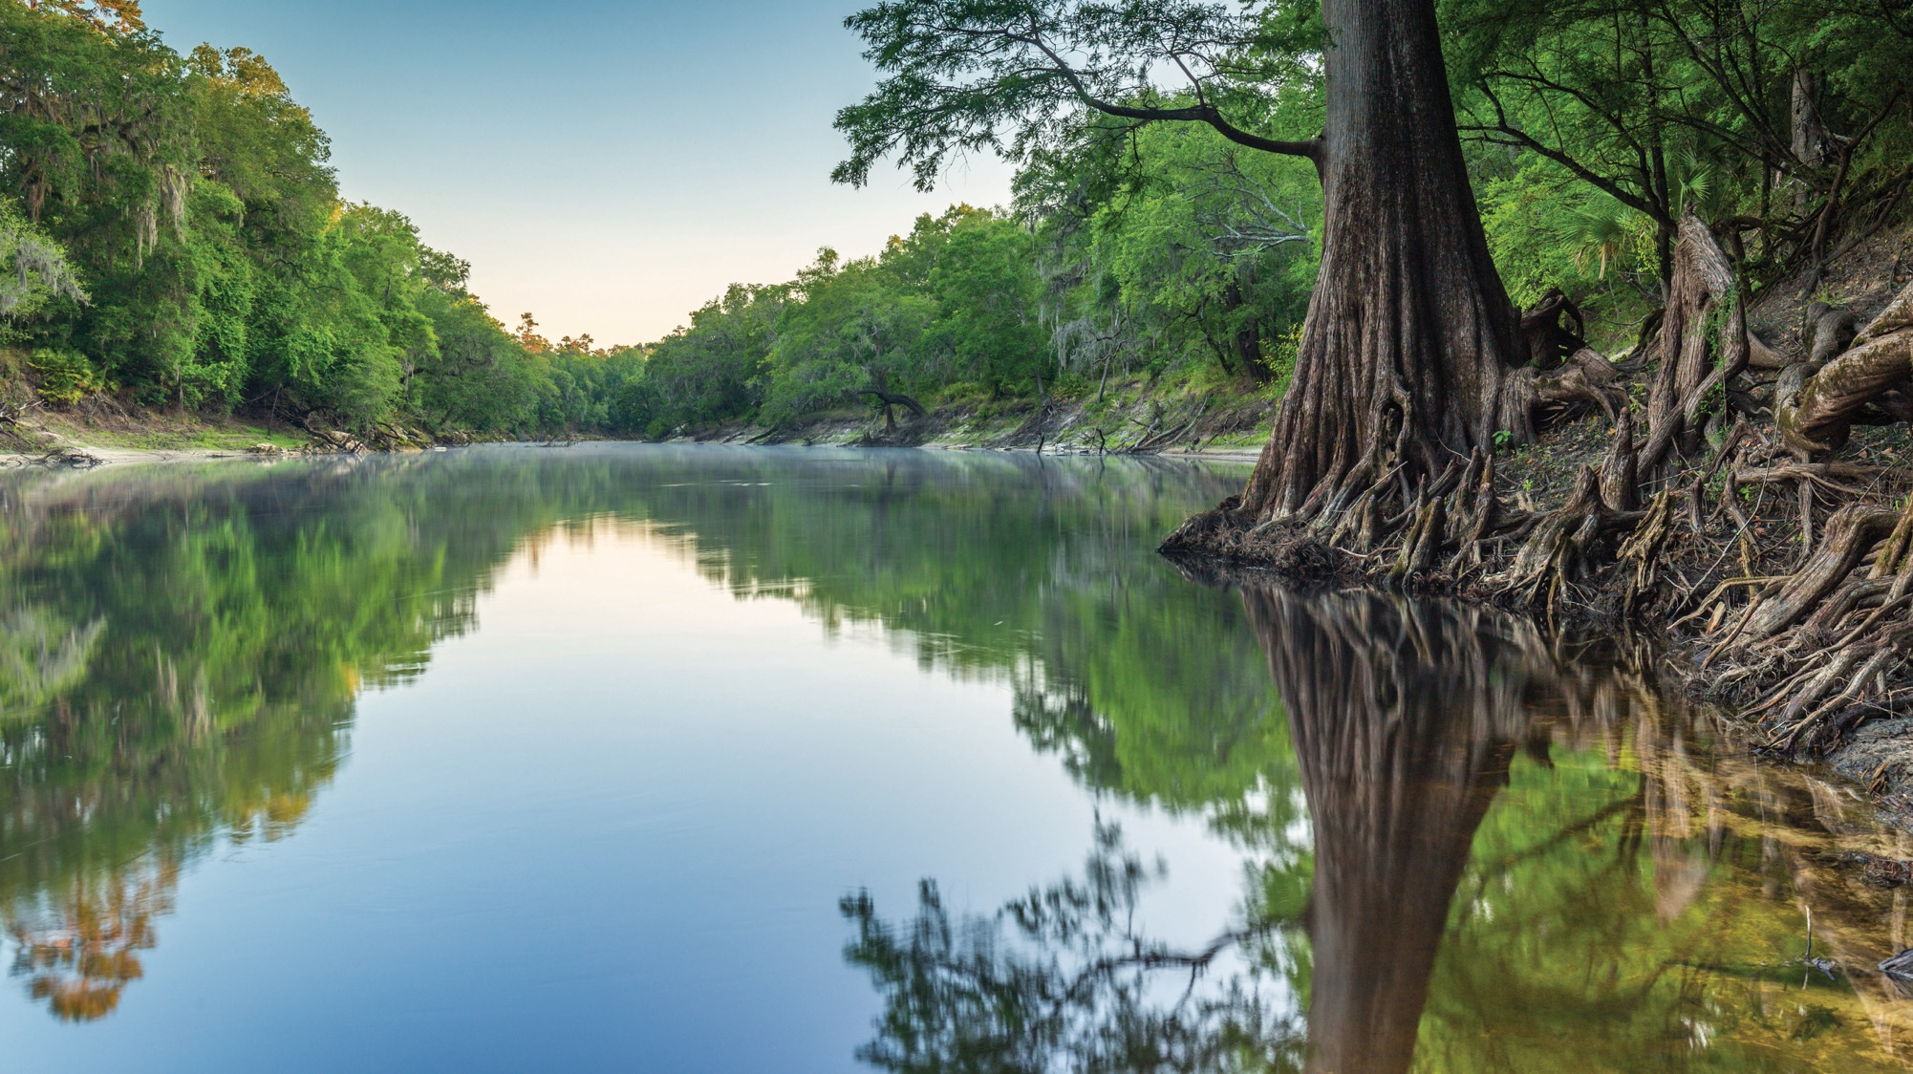
ERP DOCK PERMITTING REQUIREMENTS
Khristian Mangahas
Environmental Manager
Regulatory Programs/Environmental Resource Permitting
Florida Department of Environmental Protection
Jacksonville, FL | April 30, 2025

Slide 2
SLERC PROGRAM
The Submerged Lands and Environmental Resources Coordination Program (SLERC) is responsible for the implementation of the state’s Environmental Resource Permitting.
SLERC regulates activities in, on or over surface waters or wetlands, as well as any activity involving the alteration of surface water flows.
SLERC implements the environmental permitting criteria to ensure there is no net loss in wetland and other surface water functions.

Slide 3
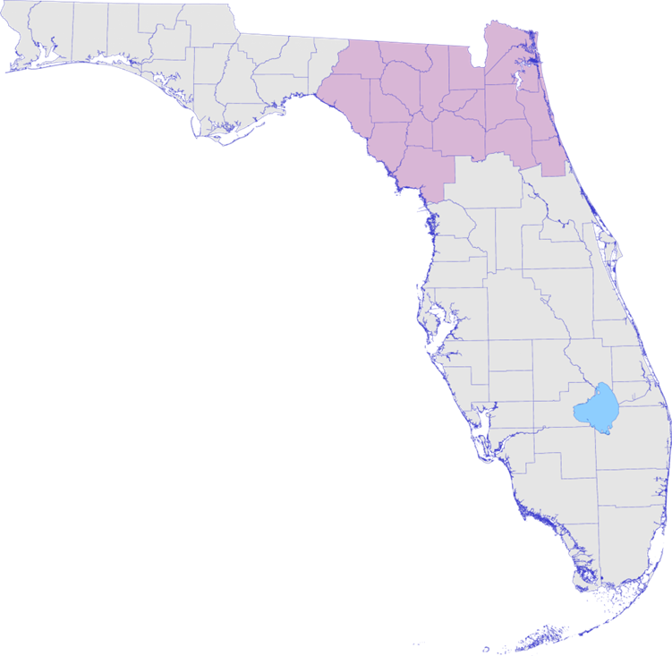
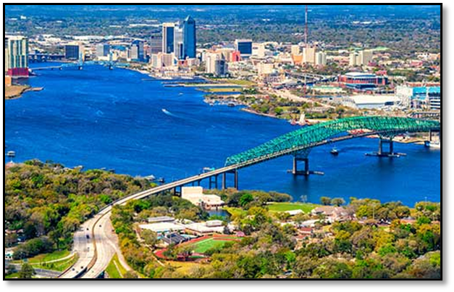
REGULATORY DISTRICTS
Central District – Orlando.
Southeast District – West Palm Beach.
South District – Fort Myers.
Southwest District – Temple Terrace (Tampa).
Northeast District – Jacksonville.
Northwest District – Pensacola.
FloridaDEP.gov/Northeast
Notes:
Headquartered in Tallahassee
The Northeast District encompasses the largest land mass of any department regulatory district. Consisting of 19 counties, the area includes portions of the Atlantic coastal plain and regions bordering the Gulf of Mexico and the state of Georgia.
The district has more rivers than any other district including the St. Johns, Nassau, Tolomato Rivers, as well as the historic Suwannee and Santa Fe Rivers.
The District’s counties include Alachua, Baker, Bradford, Clay, Columbia, Dixie, Duval, Flagler, Gilchrist, Hamilton, Lafayette, Levy, Madison, Nassau, Putnam, St. Johns, Suwannee, Taylor and Union counties.

Slide 4
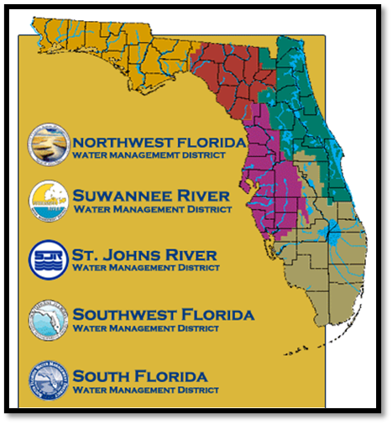
REGULATORY AUTHORITY
OPERATING AGREEMENT
The Environmental Resource Permitting (ERP) program is implemented by the Florida Department of Environmental Protection (DEP) and the state of Florida’s five water management districts (WMDs).
DEP:
Individual single-family residence (SFR).
Marinas not associated with other upland development.
Utilities.
Governmental dredging and other “in water” activities.
Associated sovereign submerged lands (SSL) authorization with the above.
WMDs:
Residential and commercial development.
Roads.
Agriculture.
Associated SSL authorization with the above.

Slide 5
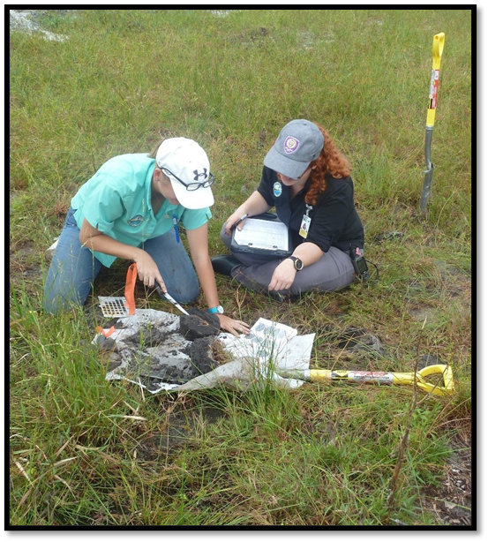
WHAT REQUIRES AN ENVIRONMENTAL RESOURCE PERMIT (ERP)?
Rule 62-330.020(2)(a), Florida Administrative Code (FAC)
“(2) … a permit is required prior to the construction, alteration, operation, maintenance, removal or abandonment of any new project that, by itself or in combination with an activity conducted after [October 1, 2013], cumulatively results in any of the following:
(a) Any project in, on or over wetlands or other surface waters"

Slide 6
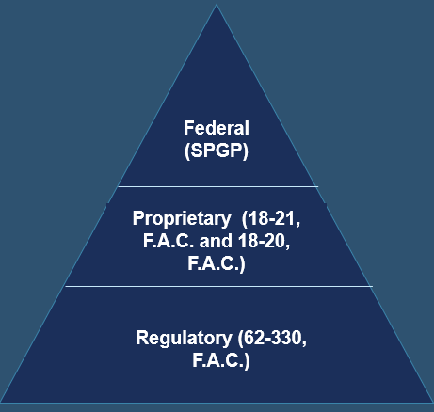
RULE REVIEW
When an ERP application comes into the department, there are up to three authorizations that can be included in one permit, potentially making DEP a “one-stop shop”. ERP reviews can be broken down into:
Regulatory:
62-330 F.A.C. - all types of ERP permitting in, on or over wetlands or other surface waters.
Proprietary:
Rule 18-21 F.A.C. - construction over sovereign submerged state lands (SSL).
Rule 18-20 F.A.C. - construction in Aquatic Preserves.
Federal:
State Programmatic General Permit (SPGP)
Permitting Application Entry Point

Slide 7
DOCK PERMITTING IN FLORIDA

Slide 8
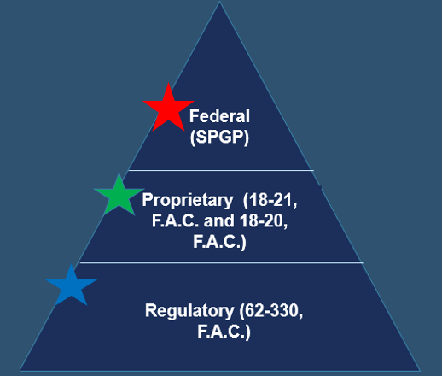
TYPES OF REGULATORY AUTHORIZATIONS
Regulatory program: Depending on the total area of the dock, applicants could qualify for one of three regulatory authorizations:
Exemptions:
Docks less than 1,000 sq ft (and less than 500 sq ft in an Outstanding Florida Waterbody).
General Permits:
Docks between 1,000 and 2,000 sq ft.
Individual Permits:
Docks over 2,000 sq ft; may require a proprietary lease or easement, based on size.

Slide 9
PERMIT FEES
Online Applications : DEP Business Portal
https://www.fldepportal.com/go/apply/
Self-Certification Exemptions – no fee (online only)
Request for Verification of Exemption $100 (online, paper or email)
General Permits $250 (online, paper or email)
Individual Permits $320 (online thru Business Portal only)
Individual Permits $420 (paper or email)
https://www.fldepportal.com/go/apply/

Slide 10
SOVERIEGN SUBMERGED LANDS (STATE LANDS)
Proprietary authorizations consider:
Water dependency, which is defined as:
Activities that can only be conducted in, on, over or adjacent to water areas because the activity requires direct access to the waterbody.
Riparian rights.
Impacts to submerged resources.
Preemption from other uses of the water by the public.
Forms of authorization:
Exceptions – No authorization required.
Consent by rule – Authorization automatic if meet certain criteria.
Letter of consent – Written authorization is required.
Leases – Written agreement with annual fees for all commercial facilities and those facilities that do not qualify for a lesser authorization.
Easements – Written agreement with fees (not necessarily annual), generally for linear activities.
SSL:
Including but not limited to, tidal lands, islands, sand bars, shallow banks and lands waterward of the ordinary or mean high water line, beneath navigable fresh water or beneath tidally-influenced waters, which the state of Florida acquired title to on March 3, 1845, by virtue of statehood.
Notes:
SSL:
Title to these lands is held by the Board of Trustees of the Internal Improvement Trust Fund of the State of Florida.
The DEP and water management districts serve as staff to the Board and are delegated authority to carry out certain functions of the Board.
The State is responsible for maintaining these submerged lands for a reasonable degree of public use and access, and to protect the lands for future public use.

Slide 11
TYPES OF PROPRIETARY AUTHORIZATIONS
Proprietary authorizations for use to consider:
Letter of Consent:
One minimum-size private residential single-family dock per parcel.
Private residential single-family or multi-family docks that cumulatively preempt no more than 10 square feet of sovereignty submerged land for each linear foot of the applicant’s riparian shoreline.
Lease
Private residential single-family or multi-family docks or piers, boat ramps or other similar activities that do not qualify for consent by rule or letter of consent.
Private residential multi-family docks designed or used to moor three or more vessels within aquatic preserves.
Commercial/industrial docks, as defined in Rule 18-18.004, F.A.C., in Biscayne Bay Aquatic Preserve, as required by paragraph 18-18.006(3)(c), F.A.C.
All revenue-generating activities, except as provided for in this chapter.

Slide 12
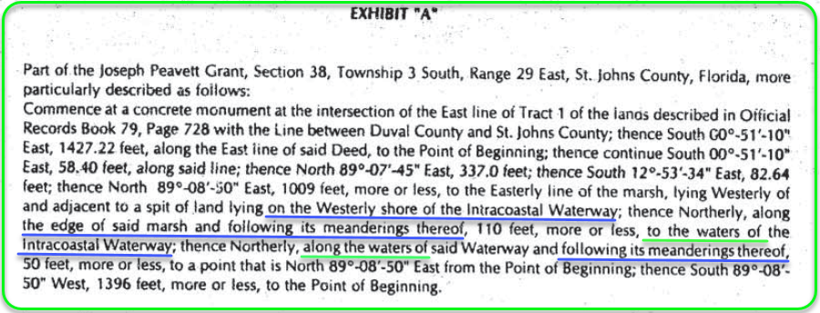
SUFFICIENT UPLAND INTEREST
Applicants must show they have sufficient upland interest, which is usually done through a warranty deed and/or plat description that describes the property to “mean high water” or “to the waters of…”

Slide 13
RIPARIAN RIGHTS AND SETBACK WAIVERS
Riparian rights are those rights incident to lands bordering upon navigable waters, as recognized by the courts and common law.
Apparent riparian lines extend from the mean high-water line (MHWL) to the center of the waterbody.
These lines are considered apparent until they are adjudicated.

Slide 14
RIPARIAN RIGHTS AND SETBACK WAIVERS CONTINUED
For properties with shorelines greater than 65 ft in length, there must be at least a 25-ft setback to the property's riparian lines.
If the shoreline is less than 65 ft., the dock must be centered on the property.
If the shoreline is greater than 65 ft., and the dock is marginal (no access pier), the dock must have at least a 10-ft setback to the property's riparian lines.

Slide 15
FEDERAL AUTHORIZATION: SPGP
State Programmatic General Permit (SPGP):
Current: SPGP VI-R1, valid Aug. 16, 2021.
Must submit project design criteria checklist and activity specific sheet with application.
Includes only the following categories of work:
Shoreline stabilization.
Boat ramps and boat launch areas and structures associated with such ramps or launch areas.
Docks, piers, associated facilities and other minor piling-supported structures.
Removal of derelict vessels.
Scientific sampling, measurement and monitoring devices.
State Programmatic General Permit | U.S. Army Corps of Engineers Nationwide Permits |
U.S. Army Corps of Engineers Operating Agreement with DEP and WMDs.
Notes:
The Department of Army State Programmatic General Permit (SPGP) authorizes various activities if the applicant obtains a verification and performs the work in accordance with the terms and conditions of the SPGP. The SPGP enables the Florida Department of Environmental Protection (DEP) and other agencies to issue the verification to an applicant, concurrently with their other State authorization(s), that the applicant's proposed work is authorized pursuant to the SPGP and that a separate application to the U.S. Army Corps of Engineers (Corps) is not required.
The Jacksonville District of the U.S. Army Corps of Engineers (Corps) issued an expanded State Programmatic General Permit (SPGP VI) on July 27, 2021. The purpose of the SPGP VI is to avoid duplication of permitting between the Corps and the Florida Department of Environmental Protection (DEP) for minor work located in waters of the United States, including navigable waters. SPGP VI reduces the need for separate approval from the Corps for the approved project types, and it increases the efficiency of both state and federal staff in serving the public. SPGP VI is implemented throughout the state of Florida, continuing environmental protection while increasing service to the public.

Slide 16
DOCKS IN AQUATIC PRESERVES

Slide 17
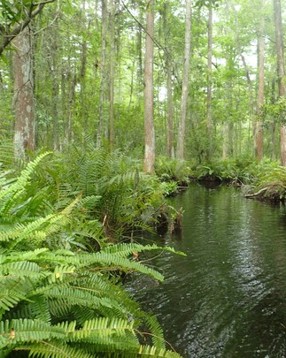
AQUATIC PRESERVES
Rule 18-20, Florida Administrative Code
Provides for more restrictive design criteria for docks and shoreline stabilization
1975 with Aquatic Preserve Act
Bird rookeries
Fish Hatcheries
Public recreation
Intent: To be preserved in an essentially natural or existing condition so that their aesthetic, biological and scientific values may endure for the enjoyment of future generations.

Slide 18
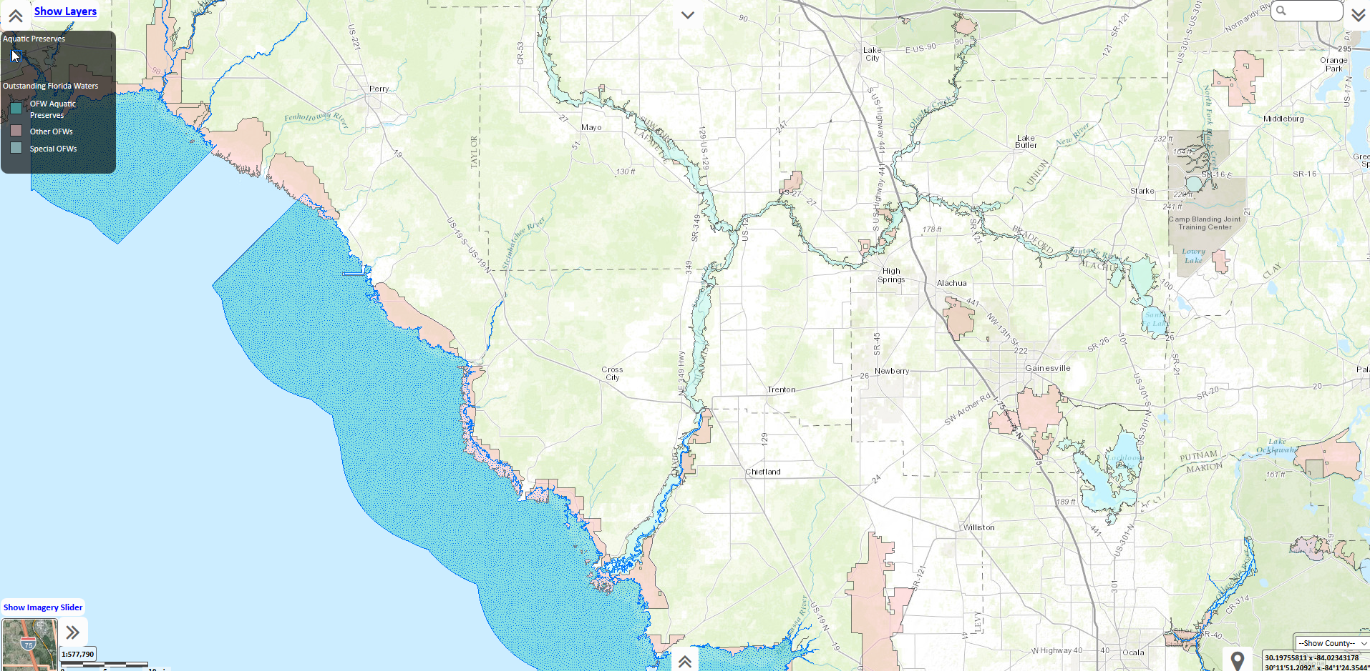
NORTHEAST DISTRICT AQUATIC PRESERVES
BIG BEND SEAGRASSES AQUATIC PRESERVE​

Slide 19
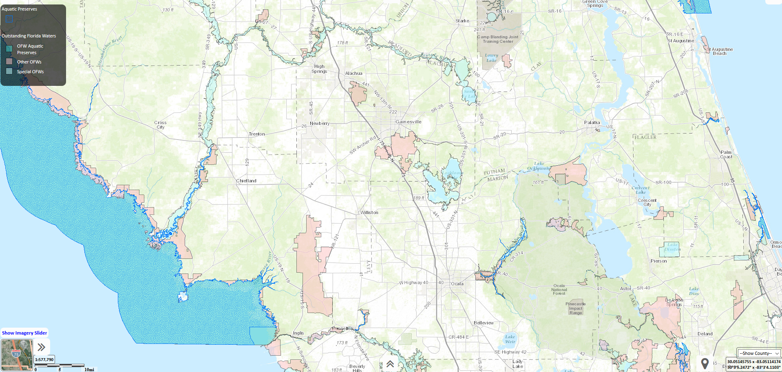
NORTHEAST DISTRICT AQUATIC PRESERVES
BIG BEND SEAGRASSES AQUATIC PRESERVE
BIG BEND SEAGRASSES AQUATIC PRESERVE​

Slide 20
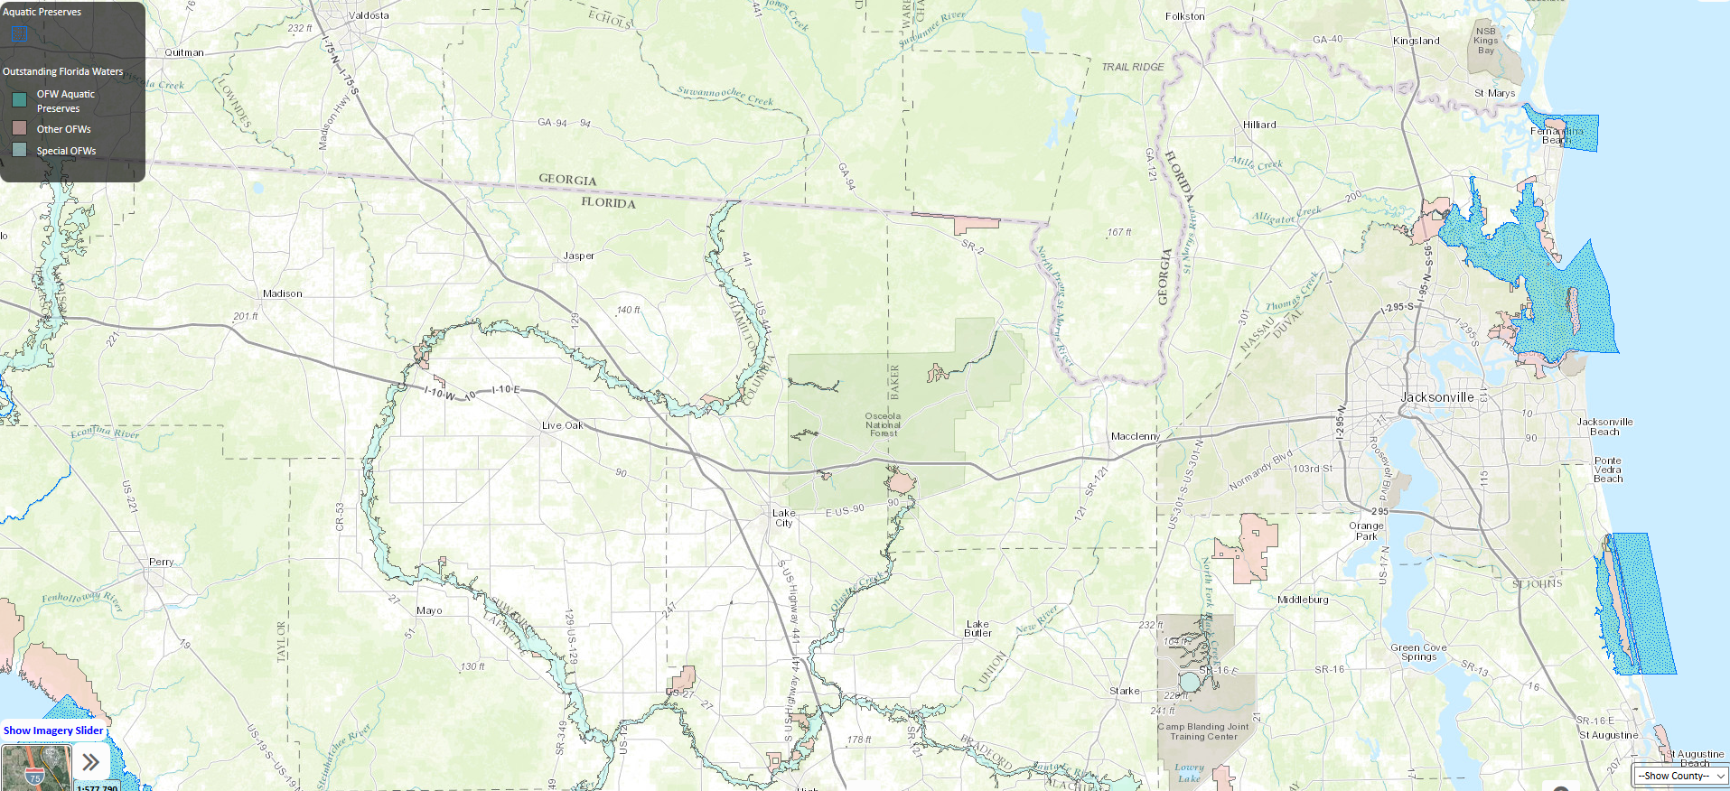
NORTHEAST DISTRICT AQUATIC PRESERVES
FORT CLINCH
NASSAU RIVER-ST.JOHNS RIVER MARSHES AQUATIC PRESERVE​
GUANA RIVER MARSH AQUATIC PRESERVE

Slide 21
DESIGN STANDARDS IN AN AQUATIC PRESERVE
According to 18-20 Florida Administrative Code, single family residence docks in an aquatic preserve must meet the following criteria:
No dock may extend more than 500 feet waterward of ordinary or mean high water line or 20% of the width of the waterbody, whichever is smaller.
Maximum water depth is –4ft at mean low water.
Elevated 5 ft above mean high or ordinary high water in resource protection area (RPA) 1 and 2.
Deck planks spaced for sufficient light penetration.
4-ft wide access pier; 160 sq ft terminal platform (maximum).
Boat slip may be covered; up to 1 ft of roof overhang (258.42(3)(e) Florida Statute).
https://FloridaDEP.gov/rcp/aquatic-preserve

Slide 22
DOCK TERMINOLOGY
Notes:
18 -21:
(40) “Minimum-size dock or pier” means a dock or pier that is the smallest size necessary to provide reasonable access to the water for navigating, fishing, or swimming based on consideration of the immediate area’s physical and natural characteristics, customary recreational and navigational practices, and docks and piers previously authorized under this chapter. The term minimum-size dock or pier shall also include a dock or pier constructed in conformance with the exemption criteria in Section 403.813(1)(b), F.S., or in conformance with the private residential single-family dock criteria in subsection 18-20.004(5), F.A.C.
18-20
(29) “Main access dock” means that walkway which connects a riparian owner’s property to a terminal platform.
(44) “Private residential single-family dock” means a dock which is used for private, recreational or leisure purposes for a single-family residence, cottage or other such single dwelling unit and which is designed to moor no more than two boats. This also includes docks, with mooring of no more than a total of four boats, located on property lines between two upland single-family residences, where the dock is shared for use by both upland, single-family residences.
(64) “Slip” or “wet slip” means an area of the water column above sovereign submerged lands specifically set aside for a boatlift or the mooring of a single vessel associated with a docking facility.
(67) “Terminal platform” means that part of a dock or pier, including finger piers, that is connected to the access walkway, is located at the terminus of the facility, and is designed to secure and load or unload a vessel or conduct other water dependent activities.
(72) “Water dependent activity” means an activity which can only be conducted on, in, over, or adjacent to, water areas because the activity requires direct access to the water body or sovereignty lands for transportation, recreation, energy production or transmission, or source of water and where the use of the water or sovereignty lands is an integral part of the activity.

Slide 23
DEFINITIONS
Applicant’s Handbook Volume I:
“Dock” means a fixed or floating structure extending from land out over water, including access walkways, terminal platforms, catwalks, mooring pilings, lifts, davits and other associated water-dependent structures, used for mooring and accessing vessels.
“Marginal dock” means a dock placed adjacent to and parallel with and no more than 10 feet waterward from the shoreline or seawall, bulkhead or revetment.
“Pier” means a fixed or floating structure extending from land out over water, that is used primarily for fishing or swimming and not designed or used for mooring or accessing vessels.

Slide 24
DEFINITIONS
CONTINUED
Sovereignty Submerged Lands Management; Chapter 18-21 F.A.C.:
“Minimum-size dock or pier” means a dock or pier that is the smallest size necessary to provide reasonable access to the water for navigating, fishing or swimming based on consideration of the immediate area’s physical and natural characteristics, customary recreational and navigational practices and docks and piers previously authorized under this chapter. The term minimum-size dock or pier shall also include a dock or pier constructed in conformance with the exemption criteria in Section 403.813(1)(b) Florida Statute, or in conformance with the private residential single-family dock criteria in subsection 18-20.004(5), F.A.C.

Slide 25
DEFINITIONS CONTINUED
Florida Aquatic Preserves; Chapter 18-20 Florida Administrative Code (F.A.C.):
“Main Access Dock” means that walkway which connects a riparian owner’s property to a terminal platform.
“Terminal platform” means that part of a dock or pier, including finger piers, that is connected to the access walkway, is located at the terminus of the facility and is designed to secure and load or unload a vessel or conduct other water dependent activities.
“Water dependent activity” means an activity which can only be conducted on, in, over or adjacent to, water areas because the activity requires direct access to the water body or sovereignty lands for transportation, recreation, energy production or transmission or source of water and where the use of the water or sovereignty lands is an integral part of the activity.

Slide 26
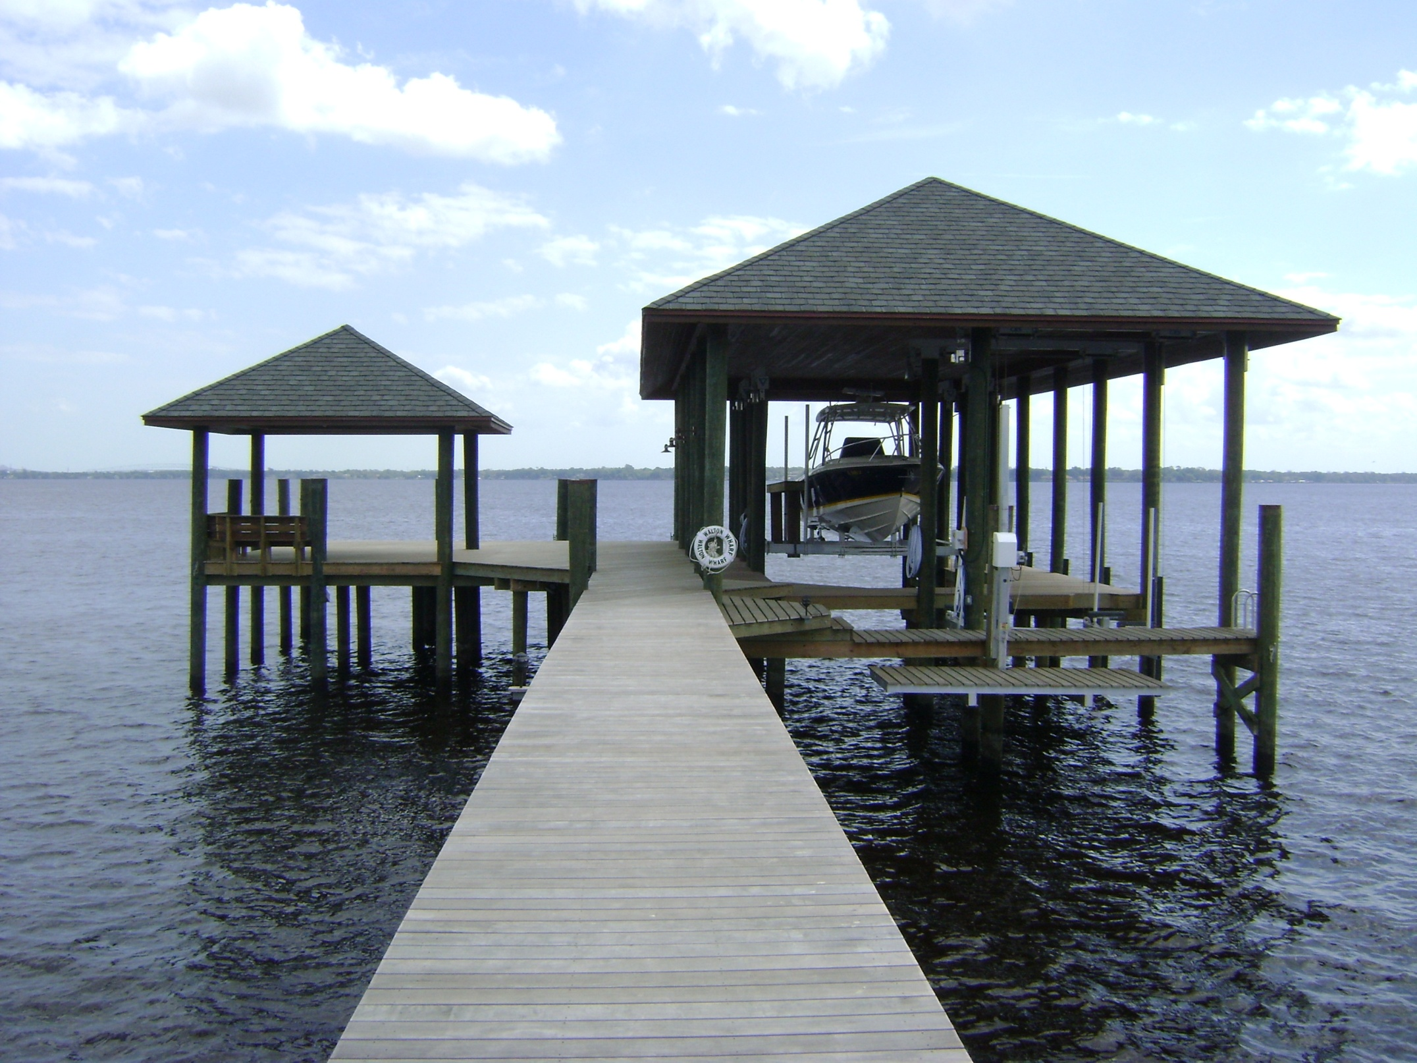
DOCK TERMINOLOGY
Boat House
Terminal Platform
Cat walk
Jet ski lift
Access Pier
Notes:
“Dock” means a fixed or floating structure, including access walkways, terminal platforms, catwalks, mooring pilings, lifts, davits and other associated water-dependent structures, used for mooring and accessing vessels.

Slide 27
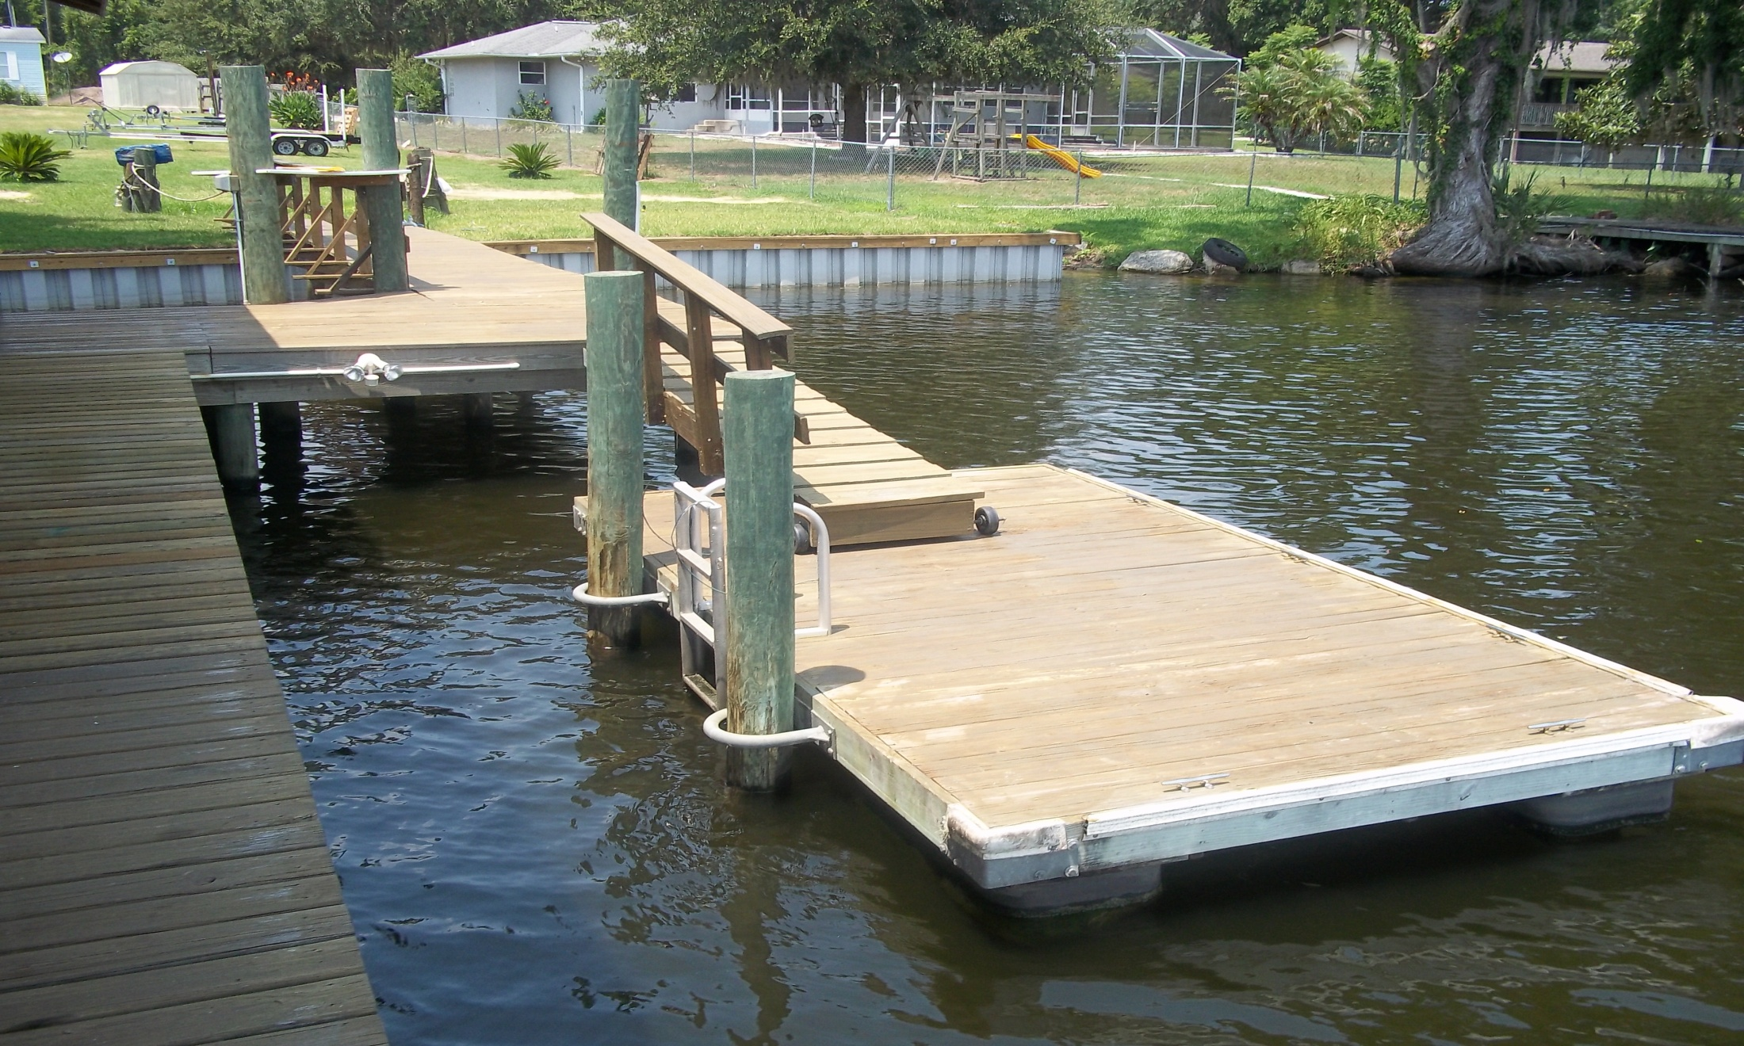
DOCK TERMINOLOGY
CONTINUED
Gangway
Access Pier
Floating Platform

Slide 28
DOCK PROJECT DRAWINGS
When reviewing permit applications, staff will review three different diagrams:
Plan View
Profile View
Cross-Section View

Slide 29
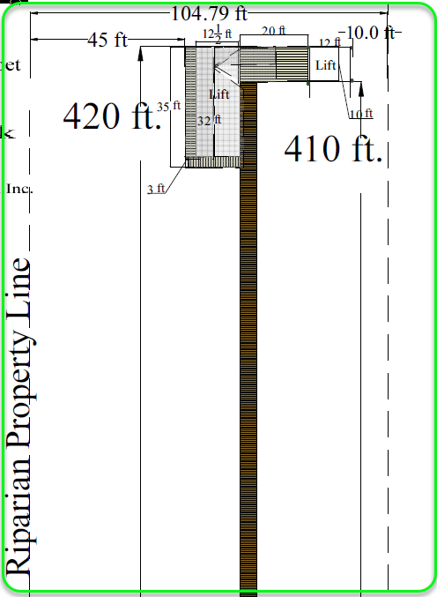
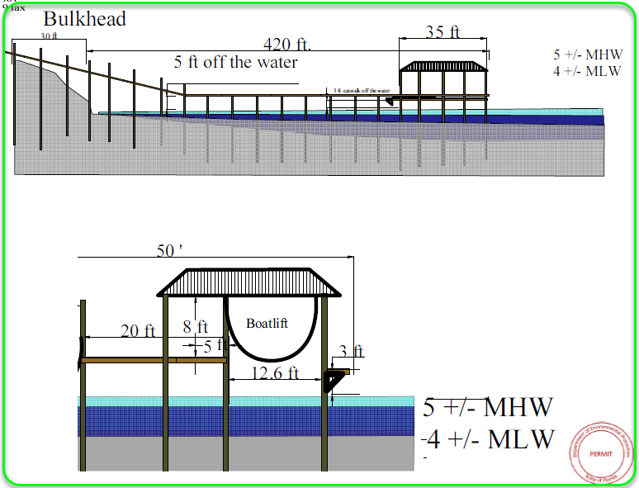
PROJECT DRAWINGS EXAMPLES
Plan view
Profile and Cross-Section views
5ft

Slide 30
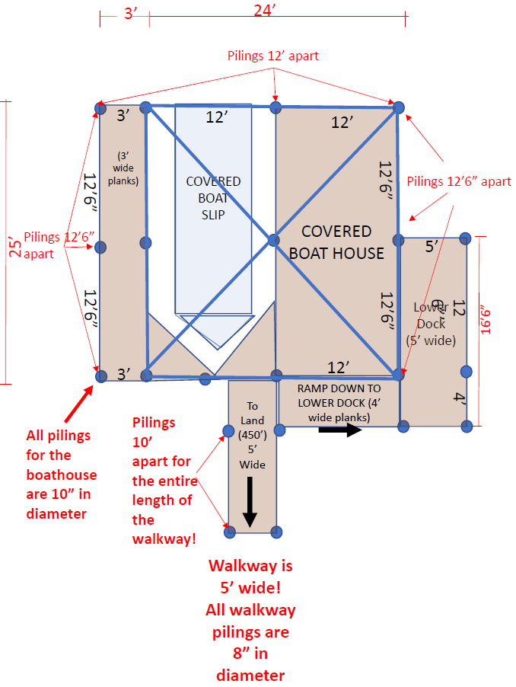
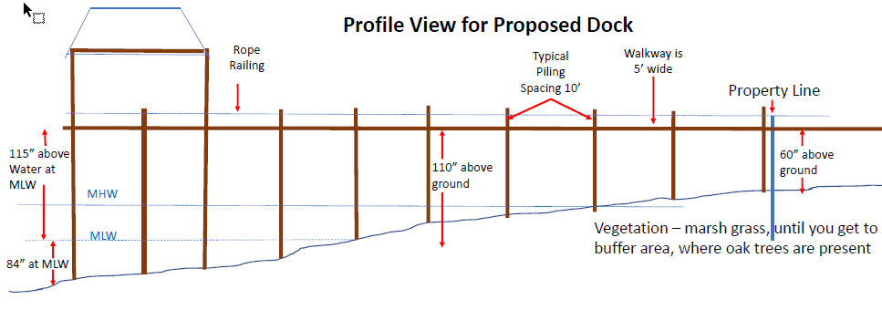
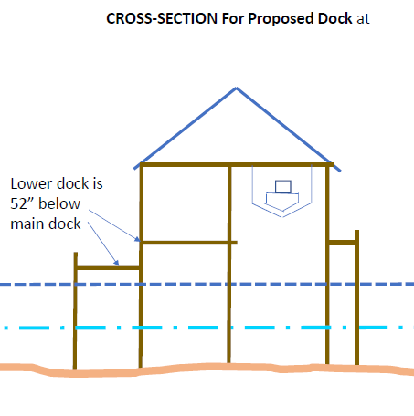
PROJECT DRAWINGS EXAMPLES
CONTINUED
Plan view
Profile and Cross-Section views
74"
115" above water at MLW​
74" from MHW to main deck ​
84" at MLW​
Notes:
-Cross-section should include depths and decking elevation above MHWL/OWHL
-Profile should have MHWL labeled and length of access pier landward and waterward of MHWL indicated as well
-

Slide 31
DESIGN AND BUILDING CONSIDERATIONS
When designing a dock for an applicant, keep in mind the following considerations for ERP permit applications:
What is the overall square footage of the structure in, on or over wetlands or surface waters?
Where do submerged State Lands begin? And what is square footage of structure from this point?
Does my design strive to minimize and avoid unnecessary impacts to environment?
Where are the apparent Riparian Rights lines? Does the dock meet setbacks if a Letter of Concurrence was not attained from my neighbor (if on submerged State Lands)?
Are all structures proposed water dependent?
(when built) Does my dock comply with the authorizations granted in my permit?

Slide 32
THANK YOU
Khristian Mangahas Regulatory Programs
Environmental Resource Permitting
Florida Department of Environmental Protection
Contact Information:
Phone: 904-256-1560
Email: Khristian.Managahas@FloridaDEP.gov

