Slide 1
EAOR Training
Division of Air Resource Management (DARM)
Compliance Assurance Section
January 2025

Slide 2
Overview
Annual Operating Report (AOR)
Purpose
Regulatory Requirements
Submittal Process
EAOR Software
Installation
Completing an EAOR Submission
Emissions Calculation Tips and Common Issues
Revising an EAOR submission
Signing the AOR
Emissions Fees (Title V sources only)
Contacts

Slide 3
AOR Purpose
Emissions data reported on AORs is required to be submitted to the US EPA and is used for a multitude of applications such as:
National emissions trends
Modeling activities
Developing rules/policies
Identifying at risk populations
Assessments of control equipment efficiency
Setting permit requirements
Compliance determinations
Title V emissions fees
Notes:
EPA’s Air Emissions Reporting Rule (https://www.epa.gov/air-emissions-inventories/air-emissions-reporting-requirements-aerr) and our AOR rule requires us to compile and update emissions inventories. These inventories provide the foundation of many air quality decisions, and are critical to setting realistic regulations and attainment strategies, including:
Air quality assessment – National Air Quality & Emissions Trend Report, National Air Toxics Assessment (NATA), State Implementation Plan (SIP) development, (regional haze) planning, pollutant deposition studies, and analysis of issues of great public concern
Air permitting – air quality modeling permit review for setting permitting requirements (National Ambient Air Quality Standards analysis, (PSD) increment analysis) and verification of the “baseline actual-to-projected actual” applicability test for (NSR) new source review.
Compliance – verification of compliance with annual permit limits, such as limits on operation hours, process rates, or fuel usage, and indication of possible noncompliance with any permit limits on annual emissions.
Other uses of annual emissions inventory include– performance-based budgeting, public information, and strategic planning, (not only air, water agencies as well, need to know annual emissions for toxics like Mercury, when assessing water quality); and
For emissions fee programs. *Regulatory agencies rely on emission inventories as indicators of air quality changes, and produce assessments which help guide efforts to cut air pollution (and in identifying those air toxics which are of greatest concern in terms of contribution to population risk), and for setting permitting requirements.

Slide 4
AOR Requirements
In accordance with Rule 62-210.370 (3), F.A.C., the following facilities shall submit an AOR to DEP each calendar year for which the facility operated and/or had an active permit:
All Title V Sources;
All synthetic non-Title V sources;
All facilities with the potential to emit ten (10) tons per year or more of volatile organic compounds or twenty-five (25) tons per year or more of nitrogen oxides and located in an ozone nonattainment area or ozone air quality maintenance area; or
All facilities for which an annual operating report is required by rule or permit.
Complete AOR using DEP Form 62-210.900(5).
Form includes instructions for how to fill out AOR.
Reportable emissions are identified in Appendix A of the form instructions.
Facilities are only required to report hazardous air pollutants (HAPs) every 3 years but encouraged to report annually (this year is not a HAP year).
AORs are due by April 1st of the following year.
Notes:
If your facility is classified as a Title V major or synthetic minor source, has potential to emit above certain regulated pollutant thresholds, or has a requirement in the permit, you must complete an AOR for each calendar year it’s in operation and/or has an active operating permit. The Department sends out an AOR reminder letter in December to facilities that have a status of Active or Construction in our database. It’s also sent to some inactive facilities if the final shutdown occurred during the reporting year.
For facilities that are still under construction status and did not begin operations during 2024, just let us know so we can mark you off the list of facilities requiring an AOR.
For active facilities (or EUs) that are in long term reserve shutdown and didn’t operate at all during the year, you must still submit an AOR and just indicate that you didn’t operate the facility or EU.
For inactive facilities that did operate some during the year, you still need to submit an AOR and include emissions information for the portion of the year you operated.
The Department adopted DEP form 62-210.900(5) for submitting AORs, which can be accessed from our website.
The form includes general instructions and an Appendix A which provides a list of regulated pollutants and thresholds for which annual emissions must be reported. Hazardous air pollutants only need to be reported every three years. However, it’s still encouraged to provide the data as it’s beneficial for the applications discussed on the previous slide, and it’s not overly burdensome to report since facilities keep track of it anyways for compliance purposes. Last year was a HAP reporting year so this year is not; the next reporting year will be 2027.
AORs along with emissions fees for Title V facilities are due to be submitted to the Department by April 1st. It’s a violation if the AOR is submitted late and penalties are assessed if Title V fee payments are late (see Title V Emissions Fee slide).

Slide 5
AOR Submittal Process
There are two ways to submit (for non-Title V sources).
Mail or email a completed/signed PDF copy of the AOR Form to the appropriate DEP District or approved Local Air Program.
You can download a pre-filled PDF Form at: https://fldep.dep.state.fl.us/air/emission/eaor/AOR_Hardcopy.asp.
Submit electronically using DEP’s EAOR software.
If submitted via EAOR, there is no requirement to mail/email it to the DEP or Local Air Program office.
Title V facilities are required to use EAOR unless a technical or financial hardship is claimed.
If a technical or financial hardship claim is accepted, the completed AOR Form should be sent to the Division rather than the compliance office.
Notes:
For non-title V facilities, you have two options for submitting your AOR.
Mail or email a completed and signed PDF Form to your compliance authority whether that be a DEP district or one of the approved local air programs. Contact information for these offices can be obtained by clicking on the links.
If you are doing this option, you can download a pre-filled PDF Form with facility data from our database
Your second option is to use EAOR to submit it electronically. If you do this, there is no need to send the form to your compliance office.
For TV facilities, you are required by rule (62-210.370(3)(c), F.A.C.) to use EAOR unless you claim a technical or financial hardship. If your claim is accepted, then you would need to send your completed AOR form to our Division, not your compliance office. You can email it to EAOR@floridadep.gov, but emissions fee payments are handled differently (see Title V Emissions Fee slide).
If you are mailing in a form, make sure it’s posted marked by April 1st or it will be considered late.

Slide 6
EAOR Software
Benefits:
AOR partially filled in with facility data from DEP’s database.
Allows for comparing data from previous years.
Help buttons, including the definitions of each data field.
Set up formulas to calculate emissions which can be re-used.
Data verification function to catch missing data.
Supporting electronic documents can be attached.
Completed AORs can be saved as PDF files.
Automatically calculates Title V fees.
The report can be submitted and signed electronically.
EAOR webpage where you can download the software and access important information and resources: https://floridadep.gov/air/permitting-compliance/content/annual-operating-report.
Good news for users! The software is being replaced with a web-based version which will hopefully be released the end of this year.
Notes:
Even though use of EAOR is only required for Title V facilities, we do encourage all facilities to use it.
We are currently developing a new application to replace the EAOR software with a web-based version that will be more user friendly. It should be released at the end of this year and be available next year for submitting 2025 AORs.

Slide 7
EAOR Installation
Requires Windows 7or newer.
Current EAOR version is 2022-3.
If you have a previous version on your computer, it needs to be uninstalled before installing the current version.
EAOR Website Resources:
EAOR software & installation instructions
Installation errors & links to resolutions:
Folder Permissions – read / write permissions
Crystal Reports error
EAOR program suddenly stops working
If you have questions or need assistance after reviewing the information posted on the EAOR webpage, please contact us at 850-717-9000 or at EAOR@FloridaDEP.gov.

Slide 8
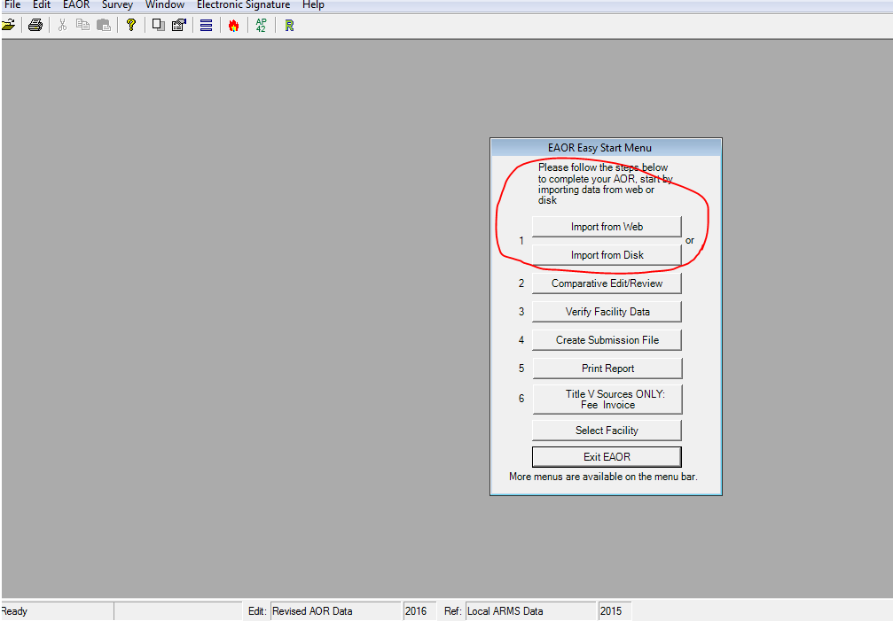
Importing Data to EAOR
On the EAOR Easy Start Menu, first import your facility’s data.
Notes:
Only import your facility’s data file once! If you try to import twice it will give you a warning. Re-importing your data will replace any data you have updated. Unless this is desired, then Click ‘No’ you do not want EAOR to replace your data.
If you can’t find your file for the current reporting year, first make sure you have the proper version of EAOR software installed. To check the EAOR software version, go to HELP on the bar menu at the top of the screen, then click on About EAOR. The version number should match the software version number on the EAOR website.
If you have the right version and still can’t find the file for the current reporting year, or you’re not able to import from the web for other reasons, then please contact DARM.
**In no case, should you overwrite the data of the previous year’s AOR with the current reporting year’s data!

Slide 9
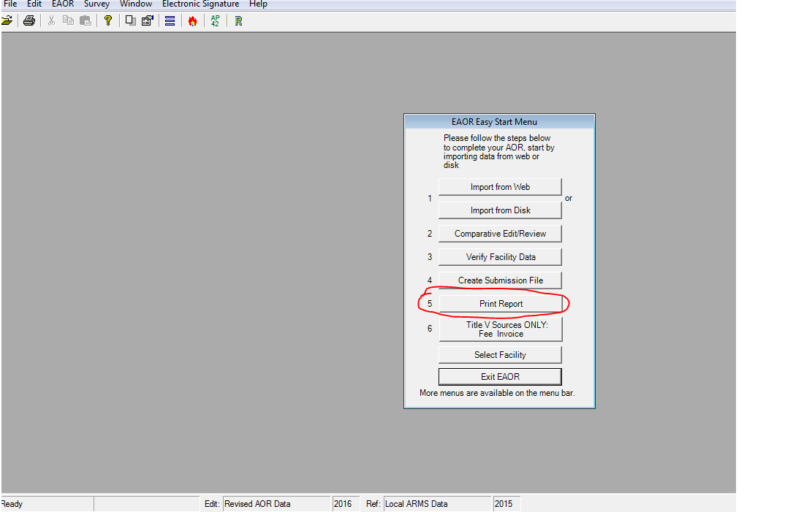
EAOR Print Report
After importing your facility data, first review it, then begin editing.
Notes:
After importing your data file, you should review it prior to completing the report. You can go to Step 5 on the Easy Start Menu and select an Emissions Report by EU to ensure all the EUs and Pollutants are there, and that the pollutants are correctly ‘marked’. They should be marked when there is an emissions limit for the pollutant or it is included in an emissions cap in the permit. This review is important to do especially when your permit has recently changed. If the data are not correct in EAOR, for example a marked pollutant is missing, or facility activities have changed, and an emissions unit is not identified in EAOR, then please contact DARM so we can send you a corrected file. This is to prevent you from possibly having to redo your entire EAOR data entry!
If you are adding (or invalidating) an SCC in EAOR, and there is any question regarding which SCC to use, then please first check with DARM.
Remember the RICE – Emergency / Limited Use/Black Start Engines that have numerical emissions limits for any pollutant or meet the threshold are to be included in AORs as they have not been exempted from the AOR form instructions.

Slide 10
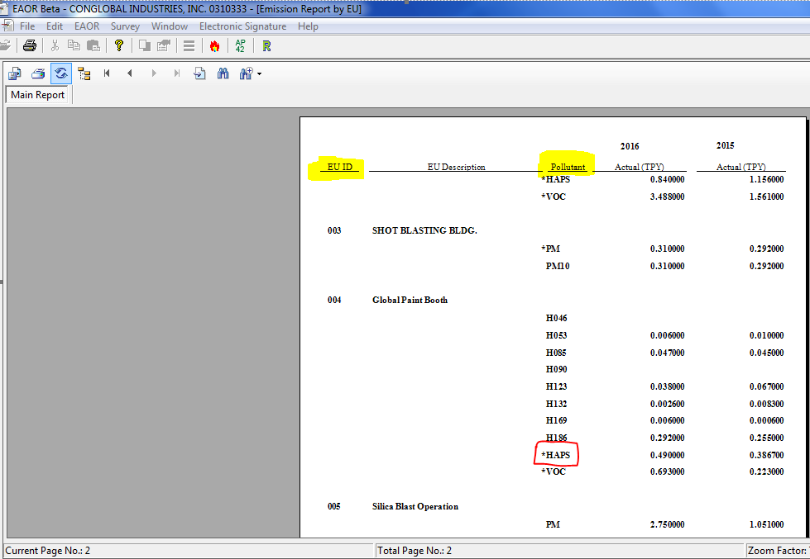
EAOR EU Report
Notes:
This is the EAOR Emissions Report by Emissions Unit, you can use this report to review the emissions units listed and pollutants and marked pollutants are correct. The list of emissions units should include all regulated or unregulated emissions units in an active or construction status (and include those EUs with an Inactive status if the unit permanently shut down during the reporting year), and the list should match the permit. The list of pollutants should include all reportable pollutants, per the AOR rule, those that have emissions limits, or emitted at or above the threshold. The pollutants with emissions limits including an emissions cap, should be marked with an asterisk. As you can see *HAPS is a marked pollutant in this example.

Slide 11
EAOR Facility Data
Facility Information:
Status (as of December 31st) – A, C, Inactive.
Facility Owner/Comp. & Site Name – Owner.
Facility History Information – Previous Owner /Company Name if changed during reporting year.
Owner/Contact Information:
Person who is authorized/responsible for signing this AOR:
Non-Title V: Owner/Authorized Representative or
Title V: Responsible Official

Slide 12
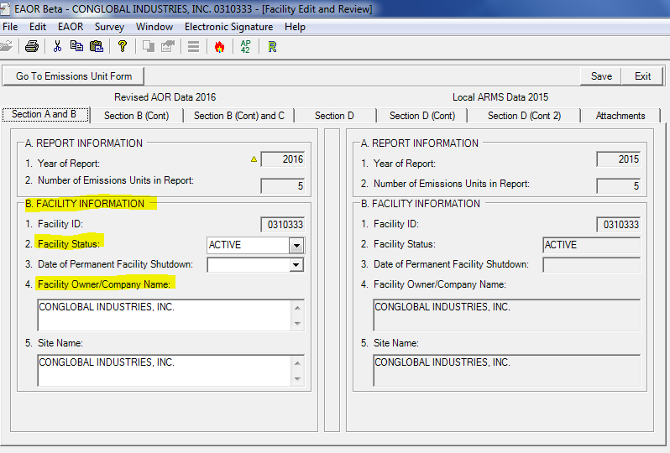
EAOR Facility Data
Notes:
The facility status refers to the status as of December 31 of the reporting year. If this is not correct in EAOR, then please change it:
Active - One or more emissions units in operation, on standby status, temporarily shut down (including any shutdown while undergoing modification), or on long-term reserve shutdown. This code indicates an existing facility which has not been permanently shut down, though it may not be operating at the time of this report.
Construction - All emissions units in planning stage or undergoing initial construction, including reconstruction. This code indicates a proposed new facility, or an existing facility which has been or will be shut down in its entirety for reconstruction.
Inactive - All emissions units permanently shut down; permit(s) surrendered or expired. If shut down during the reporting year, then enter the shutdown date of all operations.
Fac Owner/Company Name & Site Name- This is populated with the owner/company name we have in our system as of the end of the current reporting year (i.e. as of Dec 31) and normally is not changed in EAOR, however if it is not correct in our system and doesn’t match your permit, then you may need to change it in EAOR, and this will also change it in our ARMS data base system, so please only change it when needed and enter exactly what is on your current permit). Note: EAOR is not the mechanism for changing your permit, if your permit needs correcting or a transfer of ownership form needs to be sent in, then this should be done through proper permitting channels.
Your data changes in EAOR will display a yellow triangle (for example, the yellow triangle next to 2016 Year of Report).
Facility History - If the Facility Owner/Company Name changed during the reporting year, then please enter the previous Name in the section for Facility History Information.
Owner/Contact Information – this is the person who will be signing the AOR. If Title V and RO have changed, send an RO Notification form.

Slide 13
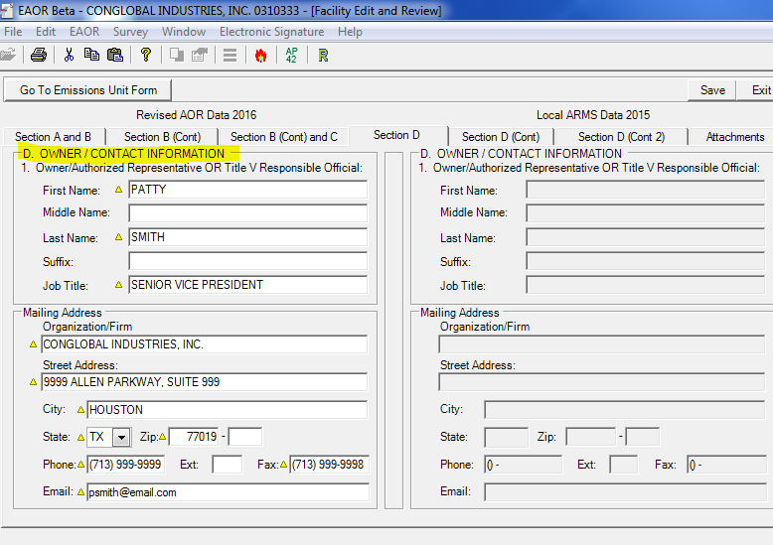
EAOR Facility Data
Notes:
Owner/Contact Information – of the person who will be signing this AOR: The Owner’s contact information entered here, does not update our ARMS system, so to change it in our system, please send an RO Notification Change form (if you’re a TV facility), or for non-TV let the compliance office know:
For Non-Title V: Contact information for the Owner/Authorized Representative who is signing this AOR is required.
For Title V: Contact information of the Responsible Official who is signing this AOR is required.
While here on the Facility level screen in EAOR, please note the tab for Attachments:

Slide 14
EAOR Attachments
Make sure supporting information is attached in EAOR.
Helps communicate the whole picture to us and saves time otherwise spent on follow-up questions to the facility (especially important when the emissions calculation worksheet or emissions comment field does not contain the calculation formula).
Other Attachments
Signature Pages may be attached in EAOR (i.e. AOR pages 1& 2).
However, if e-signing, it is not necessary to attach the signature pages.

Slide 15
EAOR Emissions Unit Data
After updating facility information, go the Emission Unit Form to begin entering emissions data and calculations.

Slide 16
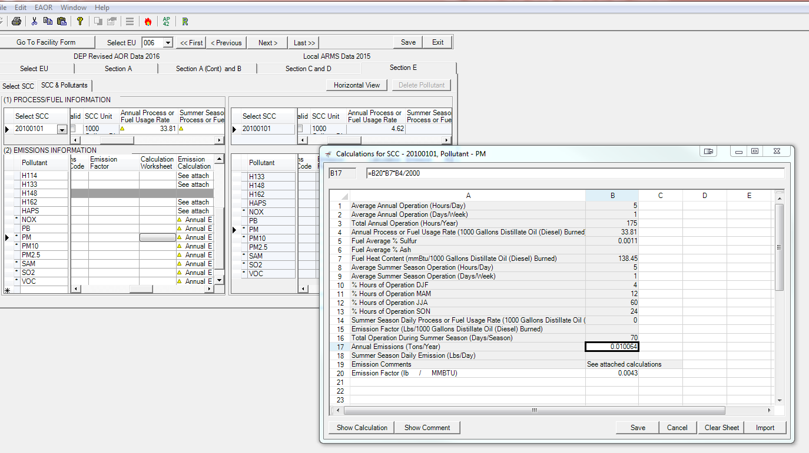
EAOR Emissions Calculation Worksheet
Notes:
Able to set up formulas in the EAOR Calculation Worksheet and reuse on future EAORs.

Slide 17
Emissions Calculations Tips
Make sure the correct SCCs are reported in EAOR. If you are adding (or invalidating) an SCC in EAOR, and there is any question regarding which SCC to use, then please first check with DARM.
Make sure the correct Emissions Method Codes used to calculate emissions are reported.
See Rule 62-210.370, F.A.C., for methods to be used when computing actual emissions.
Make sure to use the correct Emission Factor (EF) for the particular pollutant.
For PM, PM10, and PM2.5 emissions, EFs used were often for the wrong pollutant. For example, AP42/Webfire EF for PM was used to report PM10.
Depending on the SCC and control equipment configuration, there may be emission factors for *primary PM, primary PM10, primary PM2.5, filterable PM, filterable PM10, filterable PM2.5 and condensable PM (CPM).
NOTE: ‘primary PM’ is not reported. Rather, PM determined by standard EPA Method 5 is filterable PM, which is reported.
Notes:
SCC – SCC emissions factors are developed from testing for specific processes, and the SCC used in EAOR should reflect the specific process or activity that emits the air pollutant, as much as possible. For example, if the permit changed because a specific fuel is no longer allowed to be burned, then the SCC for that fuel should not be available in EAOR. Also, when gap filling HAP emissions, EPA bases it on the SCC code, so please make sure the right one is used for reporting your emissions.
Emissions Method Codes – Please make sure the highest ranked applicable emissions method listed in the rule are used for computing actual emissions. In addition, the methods used may change over time, please remember to update EAOR accordingly, including calculation sheets and emissions comments when necessary.

Slide 18
Emissions Calculations Tips
Make sure emission factors have the correct units.
Provide the source of the emission factor in EAOR.
If emissions were calculated using an emission factor based on site specific data such as stack tests, then list the test dates, and EF units; or if the EF was established in a permit, then reference which permit.
Double check your emissions calculation formula.
A minor omission could result in either underreporting emissions or over reporting emissions.
CPM, PM2.5, and PM10 should typically be reported for combustion sources.
If the information is available and the reporting threshold of 5 tons/year was exceeded (or CPM is a marked pollutant), then report the emissions. At the following link a tool is available to help estimate CPM emissions for some SCC: Condensable Particulate Matter (CPM) Reporting Threshold, and Estimated Annual CPM Emissions Calculator for some SCC.

Slide 19
Emissions Calculations Tips
When reporting PM, PM10, and PM2.5 emissions make sure to use the correct emission factor for the pollutant.
Depending on the SCC and control equipment configuration, there may be emission factors for primary PM, primary PM10, primary PM2.5, filterable PM, filterable PM10, filterable PM2.5 and condensable PM (CPM).
PM filterable >= PM10 filterable >= PM2.5 filterable
PM10 primary >= PM2.5 primary >= CPM
NOTE: ‘primary PM’ is not reported. Rather, PM determined by standard EPA Method 5 is filterable PM, which is reported.
The emission factors listed as primary include both the filterable and condensable components. For example, primary PM2.5 is the total of PM2.5 filterable plus condensable PM (CPM), and primary PM10 is the total of PM10 filterable plus CPM.
PM2.5 primary = PM2.5 filterable + CPM
PM10 primary = PM10 filterable + CPM
You should never add the emission factors for primary and filterable together, since primary already includes the filterable.
If reported, report condensable PM10 and condensable PM2.5 as CPM.
PM10 condensable = PM2.5 condensable = CPM

Slide 20
Emissions Calculations Tips
What if I don’t know my CPM (condensable particulate matter) emissions?
CPM emissions must be reported if the emissions unit is subject to a numerical emission limit for CPM.
Otherwise, CPM should be reported if information is available to estimate emissions, and such emissions are equal to or greater than 5.0 tons per year per SCC. Do not add the pollutant CPM in EAOR if you do not have emissions data to report.
A Calculator to estimate CPM emissions based on some available CPM emissions factor information from AP-42 is provided for you at this link: http://www.dep.state.fl.us/air/emission/eaor/CPM-reporting.htm
Here is a link to the Annual Air Emissions Calculators (based on WebFIRE Emissions Factors) for some SCC: Annual Air Emissions Calculators for some SCC.

Slide 21
EPA Resources
EPA’s WEBFIRE (contains EPA’s recommended emissions factors):
https://www.epa.gov/electronic-reporting-air-emissions/webfire
EPA’s Searchable SCC database (contains a list of most updated SCCs):
www.epa.gov/scc

Slide 22
Common Data Quality Issues
A change during the reporting year in the facility’s tracking/reporting methodology resulted in underreporting of emissions (i.e. from AP42- to CEMS).
Different emissions factors are used for reporting in different systems (TRI vs. AOR).
Overestimating previous years emissions.
Instances where the emissions factor or fuel usage/ process rate is off by an order of magnitude; or incorrect value was used in the formula in EAOR.
Duplication of process rate / fuel usage: The exact same process rate was reported for different fuels burned, for example diesel and natural gas.
Notes:
A change during the reporting year in the facility’s tracking/reporting methodology resulted in underreporting of emissions: In this case, the facility went from using AP-42 emissions factor to using CEMS, however programming of the CEMS to switch to calculating the mass value was only available for part of the year, and emissions for the other half of the year not picked up by CEMS were inadvertently excluded (and subsequently had to be calculated based on the fuel consumed during this time using AP-42 emissions factors);
Different emissions factors are used for reporting in different systems (i.e. TRI vs. AOR comparison): AOR reporting schedule may precede TRI reporting, and in some cases, the more accurate emissions factors used for TRI, which considered specific controls, were not available until after the AOR reporting deadline (or were only utilized in TRI, and not EAOR) and consequently a comparison of emissions from the two systems showed a large disparity.
Observed a sig decrease in their NOx emissions in the current reporting year vs. previous year, which seemed out of proportion to process rate inc in current year (i.e. Nox CEMs, and NOX had decreased by 30%, in spite of a slight increase in the tons of coal burned). In this case, after follow-up with the facility, it was determined default CEMS values required to be used in the previous year overestimated actual Nox emissions for that year. Tip: When possible, add a note in EAOR explaining why the Nox emissions were higher in the previous year, compared to the current year.
Instances where the emissions factor or fuel usage/ process rate is off by an order of magnitude; or simply, not the right value was used in the formula in EAOR; or
The exact same process rate was reported for different fuels burned, for example diesel and natural gas.

Slide 23
Common Data Quality Issues
Instances where materials or substances used in the previous year’s processes were discontinued prior to the current reporting year, however were inadvertently reported anyway.
Cases where emissions were normally calculated by applying a control efficiency, however were inadvertently reported without it.
Emissions value reported was in pounds, conversion to tons was excluded from the formula,
Cases where HAP VOCs are not included with the VOC emissions.
Formulas needing revision:
Workbook setup to capture data for the AOR, such as fuel usage, not working;
Formula omits an important conversion factor (i.e. conversion of sulfur to SO2); and
Incorrectly uses a “percentage” (i.e. 10% ash) instead of a “number” (i.e.0.1 ash fraction), resulting in emissions being over reported (for HAPS metals).
Notes:
Instances where materials or substances used in the previous year’s processes were discontinued prior to the current reporting year, however were inadvertently reported anyway;
Cases where emissions were normally calculated by applying a control efficiency, however were inadvertently reported without it, resulting in over reporting of emissions;
Forgetting to convert emissions value to tons, and reporting in pounds because the conversion to tons was excluded from the formula;
Cases where HAP VOCs are not included with the VOC emissions; and
Cases where the workbook setup to capture data for the AOR such as fuel usage, needed the formulas to be revised; or the formula omits a conversion factor (i.e. for conversion of sulfur to SO2), underreporting emissions by half; and spreadsheet incorrectly contains a “percentage” Format type (i.e. 10% ash) instead of a “number” Format type (i.e. 0.1 ash fraction), as a result HAPS metal emissions were over reported.

Slide 24
DARM Edit Checks
DARM performs edit check on AOR data.
Missing AOR Report
Missing Process Rates
Missing Annual Emissions
Missing Cap Emissions
Missing data for SCC (if burning Coal, Oil, Gas) – lists SCC if the sulfur content, or ash content, or heat content is missing
Operating Schedule – if exceeds the permitted schedule
Excess Process Rate – if reported annual process rate larger than the permit limit
Excess Sulfur, Ash – if reported sulfur/ash content is larger than the permit limit
Excess Heat Input
Excess Emissions – reported annual emission larger than the permit limit allowable: equivalent tons/year
Exceeded Emissions Cap – reported annual emission larger than emissions cap (fac wide or multi-unit cap)
Notes:
DARM performs additional edit checks on submitted AORs to look for missing data or potential compliance issues.
Our edit reports list Missing Data:
Missing AORs for emissions units – and we will follow-up with the facility if an AOR is expected but not found – the report includes inactive EUs that permanently shut down operations during the reporting year.
Emissions Units that reported as operating, however are missing annual Process Rate or Emissions.
Missing emissions for pollutants with an allowable emissions limit or emissions cap (usually this occurs when ARMS was updated after the fact, and poll was not ‘marked’ in EAOR, follow-up if allow applied in reporting year).
Additional checks look for possible Exceedances:
Lists EUs with operating schedule which exceeds the permitted operating schedule (hrs/day, days/week/hrs/year)
Exceeded List EUs where the EAOR process rate, or sulfur, or ash content > the permit limit.
Looks for instances of excess heat input, [Max heat input (mmBtu/hour) x Hours/year] < [Annual process rate x Heat content], or pollutants with reported emissions greater than the permit allowable emissions limit or emissions cap.

Slide 25
Revising an EAOR
If Title V, and revisions affect Title V fees or are involved, should resubmit.
Make the revisions in EAOR and resubmit.
Select the file you want to revise and go to Step 2, Comparative/Edit Review.
Save your changes and create submission.
Do not re-import your data file. This will overwrite and null out data values that you have already entered!
Contact DARM if you have questions or problems!
Notes:
If you need to make a correction, then you can revise the EAOR data, and resubmit it, and normally if revisions are complex, or alter the Title V fees, then it is best to revise the EAOR and resubmit it. In EAOR, you Select the file you want to revise and go to Step 2, Comparative/Edit Review. Save your changes and Create Submission file. Do not ‘Import from Web’ again, this will overwrite the data you have already entered.
If this happens, then contact DARM and we should be able to send you the original file.

Slide 26
Signing the AOR
For Non-Title V facilities – The Owner or Authorized Representative must sign.
For Title V facilities, the Title V Responsible Official (RO) must sign. That may be the primary or additional RO if one is designated on the current RO Form on file with DEP.
Whether the AOR is submitted electronically via the web or email, you may sign the AOR electronically or submit signature pages. The AOR is not complete until it is signed.
Note: In order to sign electronically, you will need a user account and PIN. You do not need to download the EAOR software to sign the AOR.
Information on how to sign electronically can be found on the EAOR website: http://www.dep.state.fl.us/air/emission/eaor/default.htm
Click Here to Register a New Account - Note the ‘Help’ button on this screen.
Download PIN Request Form (requires login)
If you forgot your PIN or registration password and need assistance, contact:
Email: DARM.HelpDesk@dep.state.fl.us
Phone: 850-717-9000
Notes:
The person completing the AOR may not necessarily be the person responsible for signing it. Many facilities may have a person or consultant who completes the AOR, but it’s the Owner/Authorized Representative that has to sign for non-TV facilities and for TV facilities, it has to be the Responsible Official (primary or alternate if one is designated on the appropriate RO form).
If you are e-signing, allow time if you need to set up an air account an get a PIN number. PINs are assigned to the person, not the facility. You do Not need to download EAOR software to e-sign.
If you are registering for an account, notice there is a Help button, please note, you may need to first adjust the Compatibility View setting if you are using Internet Explorer 10, and instructions are found by clicking on the Help button. An account is used for both EPSAP and AOR.
Only one signature method is necessary, e-sign or attach signature pages in EAOR, or email them to us: TV go to EAOR@dep.state.fl.us (Tallahassee), Non-Title V go to the district/local compliance office.

Slide 27
Title V Emissions Fees
Title V fees are calculated based on emissions reported for “marked” pollutants.
Marked pollutants are regulated pollutants that have a numerical emissions limit or emissions cap in the permit and are display in EAOR with an asterisk next to them (for example *PM).
Upon submission of the EAOR, a Title V fee invoice is generated.
Fee payments are also due April 1st.
A penalty of 50% of the amount of the unpaid fee, along with interest fees pursuant to Section 55.03(1), Florida Statutes, is assessed on late payments.
Two methods of payment are available.
If paying by check, send the invoice and check by regular or certified mail to the below address and make the check payable to the Florida Department of Environmental Protection.
Major Air Pollution Source Annual Emissions Fee
P.O. Box 3070
Tallahassee, FL 32315-3070
If paying by electronic transfer of funds, please contact Amy Hilliard at 850-717-9025 or Barbara Friday at 850-717-9095 for wiring instructions or email us at EAOR@FloridaDEP.gov.
More information can be found at: https://floridadep.gov/air/permitting-compliance/content/title-v-fees
Notes:
If mailed a check, it must be posted marked by April 1st. It’s also important to include the invoice with the check or our Finance & Accounting Section will not be able to process the check.

Slide 28
Contacts
Griffin Jones
Griffin.W.Jones@FloridaDEP.gov
850-717-9103
Kris Lanh
Kris.Lanh@FloridaDEP.gov
850-717-9094
Dianne Spingler
Dianne.Spingler@FloridaDEP.gov
850-717-9100
EAOR HelpDesk
EAOR@FloridaDEP.gov.
Jessica Dalton
Jessica.Dalton@FloridaDEP.gov
850-717-9106
Amy Hilliard
Amy.Hilliard@FloridaDEP.gov
850-717-9025
Elizabeth Walker
Elizabeth.Walker@FloridaDEP.gov
850-717-9008
DARM HelpDesk
DARM.HelpDesk@FloridaDEP.gov
Notes:
For assistance with submitting AORs, emissions calculations, installing/using or EAOR contact Griffin Jones, Kris Lanh, Dianne Spingler, or email the EAOR HelpDesk.
For assistance with general AOR regulatory and procedural requirements, contact Jessica Dalton.
For assistance with registering for accounts, obtaining a forgotten PIN or Password, e-signing, or submitting Title V fees, contact Amy Hilliard, Elizabeth Walker, or email the DARM HelpDesk.

