Slide 1
Cyanobacteria Thresholds:
Recreational Advisories and/or Water Quality Criteria
Blue Green Algae Task Force Meeting
David Whiting, Deputy Division Director
Division of Environmental Assessment and Restoration
Florida Department of Environmental Protection
September 24, 2019

Slide 2
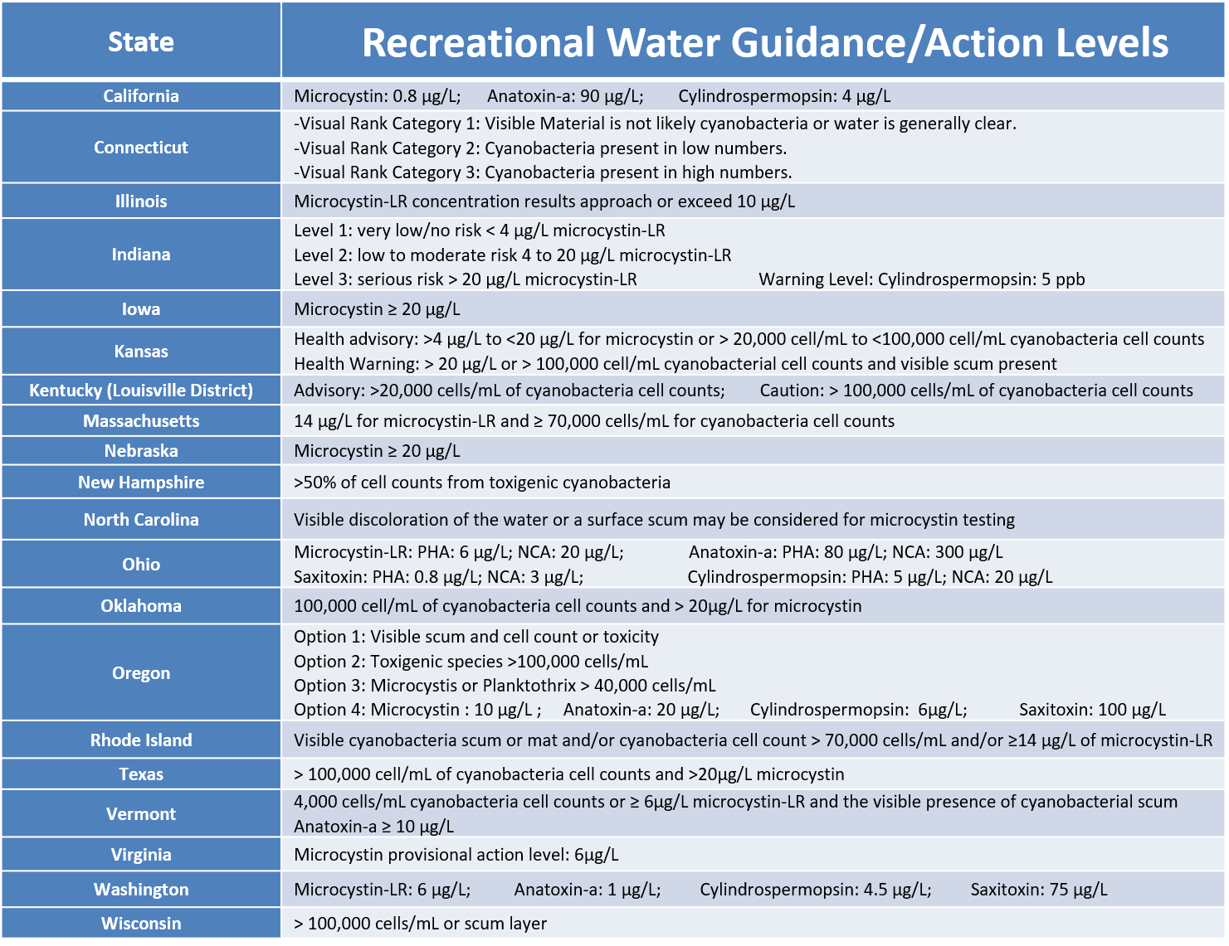
CyanoHAB Surveillance
Slide Courtesy of Lesley D’Anglada, EPA OST

Slide 3
EPA Recommended Cyanotoxin Criteria/Advisory Thresholds

Slide 4
Basis for EPA Recommended
Cyanotoxin Criteria/Advisory Thresholds
31.8 kg
0.05 µg/kg/day X 0.21 L/day = 8 µg/L microcystins
31.8 kg
0.1 µg/kg/day X 0.21 L/day = 15 µg/L cyclindrospermopsin
Assumes 100% of child’s exposure (ages 6 – 10) comes from incidental ingestion during swimming
2016 draft document applied a Relative Source Contribution (RSC) factor of 0.8 and an incidental ingestion estimate of 0.33 L/day, yielding draft values of 4 µg/L microcystins and 8 µg/L cyclindrospermopsin
DEP has received a petition requesting that we adopt 2016 thresholds

Slide 5
Basis for EPA Recommended
Cyanotoxin Criteria/Advisory Thresholds
The Reference Dose (RfD) for microcystins was derived from a 1999 drinking water study with 11-week-old male rats (0, 50, 150 µg/kg/day MC-LR) where LOAEL was 50 µg/kg/day
  Uncertainty factor of 1,000 applied
The Reference Dose (RfD) for Cylindrospermopsin was derived from a 2002 gavage study with male mice for 11 weeks (0, 30, 60, 120, 240 µg/kg/day Cylindrospermopsin) where LOAEL was 60 µg/kg/day
  Uncertainty factor of 300 applied

Slide 6
Current State of Florida Practice
DEP and DOH use visual presence of an algal bloom as one threshold
  Used as a trigger by DEP to perform Algal Bloom Response Sampling (cyanotoxins, algal ID, Nutrients, and Chlorophyll a)
  If cyanobacteria are present, but no toxins detected, DOH encourages local county health units to issue a Caution Advisory
If cyanotoxins are detected (at any concentration), DOH encourages local county health units to issue an Alert Advisory
  DEP performs repeat sampling at sites with detectable toxin levels until toxins are no longer detected
  Alerts are removed once cyanobacteria bloom or toxins are no longer present per DEP HAB Dashboard

Slide 7
Precautionary Principle
Visual presence of bloom used as threshold instead of numeric toxin value because:
  Lag time between sample collection and dissemination of results
  High spatial and temporal variability in algal cell and toxin concentrations
  Concerns regarding EPA’s derivation of cyanotoxin thresholds
  Very low incidence of toxins in waters without visible bloom present
  Allows the public to make decisions about recreating in a water at the time of use
  Application of EPA’s recommended criteria would not cause any additional waters in Florida to be listed as impaired

Slide 8
Cyanotoxins

Slide 9
Cyanotoxin Exposure
The State of Florida currently monitors surface waters for cyanotoxins when blooms are detected
Cyanotoxins are not regularly monitored in fish tissues, sediments, or air, but they have been detected in all three media
EPA’s recommended recreational thresholds assume 100% of exposure is through incidental ingestion of water during recreational activities
There are few commercially available cyanotoxin analytical standards compared to the overall number of known toxins
More realistic estimates of cyanotoxin risk to people, pets, livestock, and wildlife would require additional monitoring and research

