Slide 1
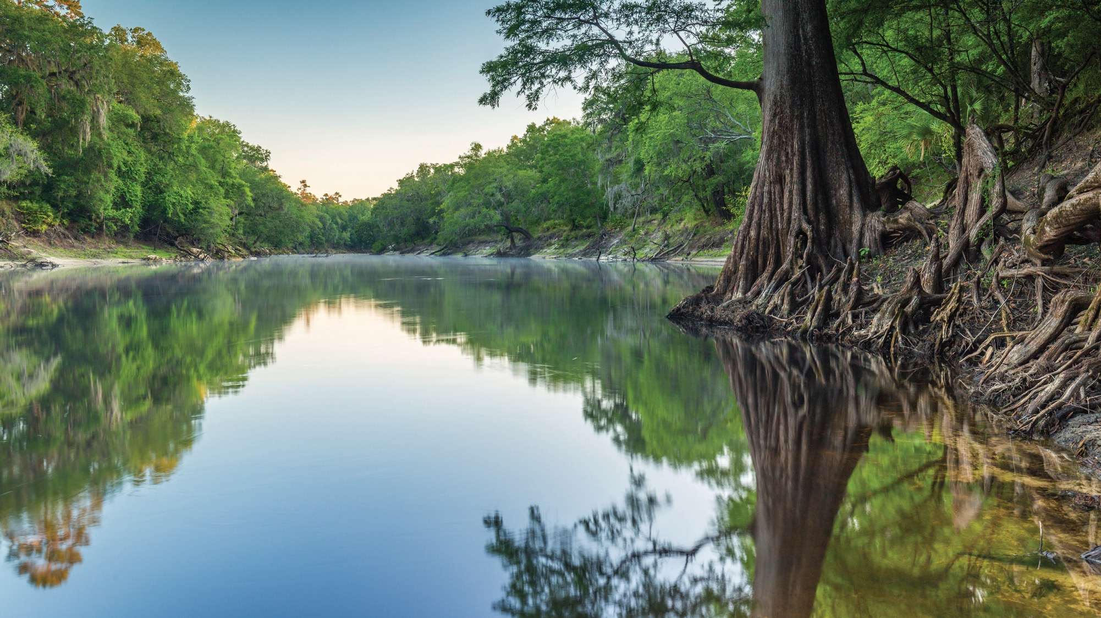
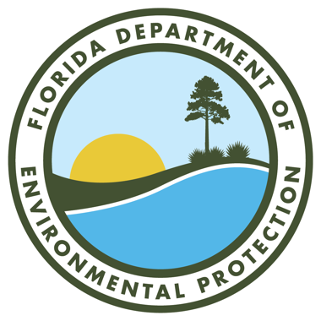
THE ENVIRONMENTAL RESOURCE PROGRAM
THE ENVIRONMENTAL RESOURCE PROGRAM
Katie Craver
Environmental Resource Permitting Program
Northeast District Office
Florida Department of Environmental Protection
ERP Workshop Series | Feb. 19, 2025
Notes:
Howdy all this is a thing

Slide 2
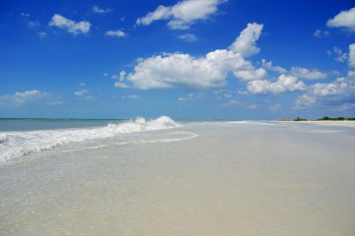
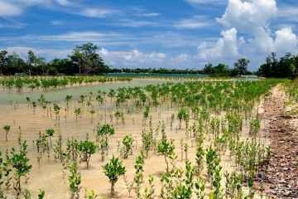
DEP VISION AND MISSION
Florida Department of Environmental Protection (DEP) Vision:
To advance Florida’s position as a world leader in protecting natural resources while growing the state’s economy.
DEP Mission:
DEP’s mission is to protect, conserve and manage the state’s natural resources and enforces its environmental laws. DEP values are leadership, integrity, accountability, communication, innovation and service.

Slide 3
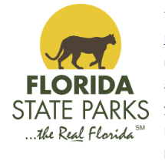
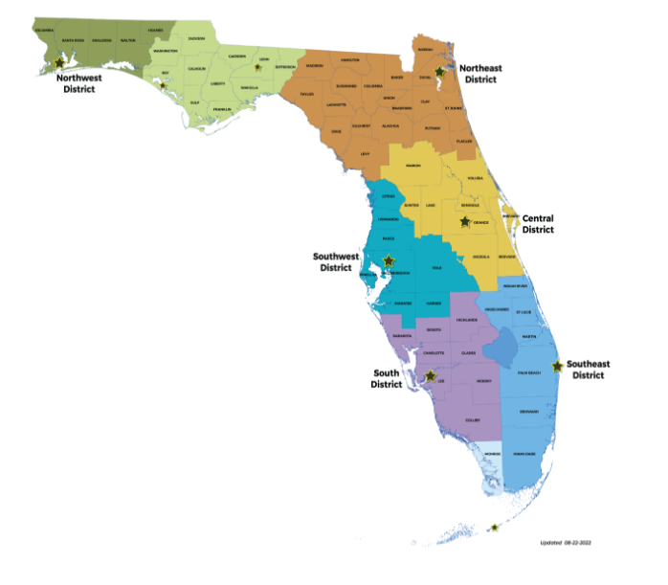
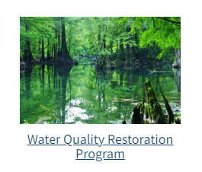
THE THREE PILLARS
Land and Recreation
Regulatory
Ecosystems Restoration
Notes:
About The Florida Department of Environmental Protection
DEP is divided into three primary areas:
Land and Recreation.
Regulatory.
Ecosystems Restoration.
Land: Acquiring and protecting lands for preservation and recreation. DEP oversees 175 state parks and trails and more than 12 million acres of public lands and 4 million acres of coastal uplands and submerged lands.
Regulatory: programs safeguard natural resources by overseeing permitting and compliance activities that protect air and water quality, and manage waste cleanups
Ecosystem: DEP works with communities, local governments and other agencies to protect and restore water quality and supply and to provide funding assistance for water restoration and infrastructure projects, as well as coordinates the protection of Florida’s submerged lands and coastal areas.

Slide 4
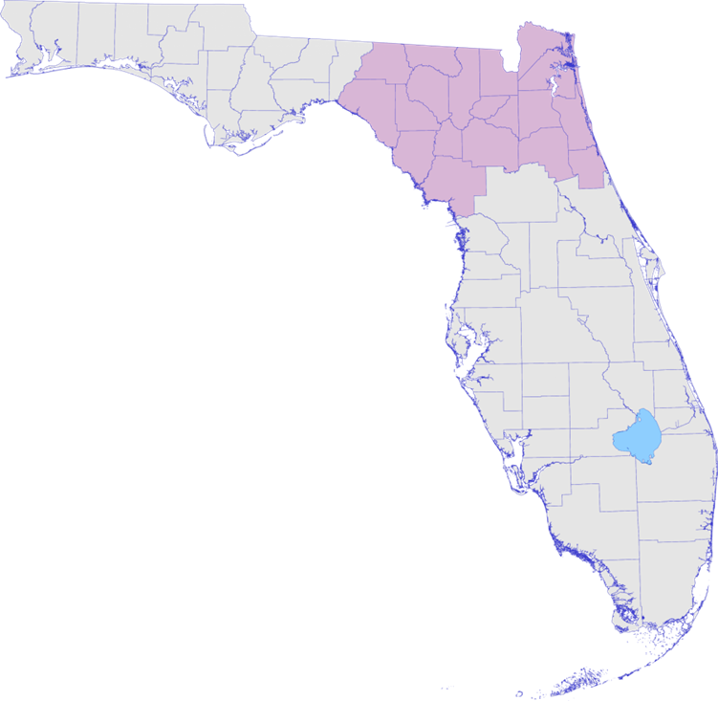

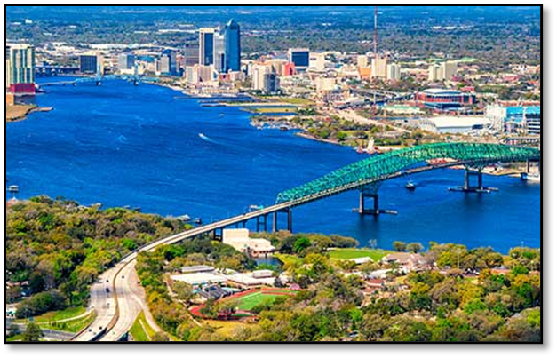

REGULATORY DISTRICTS
Central District - Orlando.
Southeast District – West Palm Beach.
South District – Fort Myers.
Southwest District – Temple Terrace (Tampa).
Northeast District – Jacksonville.
Northwest District – Pensacola.
FloridaDEP.gov/northeast
Notes:
Headquartered in Tallahassee
The Northeast District encompasses the largest land mass of any department regulatory district. Consisting of 19 counties, the area includes portions of the Atlantic coastal plain and regions bordering the Gulf of Mexico and the state of Georgia.
The district has more rivers than any other district including the St. Johns, Nassau, Tolomato Rivers, as well as the historic Suwannee and Santa Fe Rivers.
The District’s counties include Alachua, Baker, Bradford, Clay, Columbia, Dixie, Duval, Flagler, Gilchrist, Hamilton, Lafayette, Levy, Madison, Nassau, Putnam, St. Johns, Suwannee, Taylor and Union counties.

Slide 5
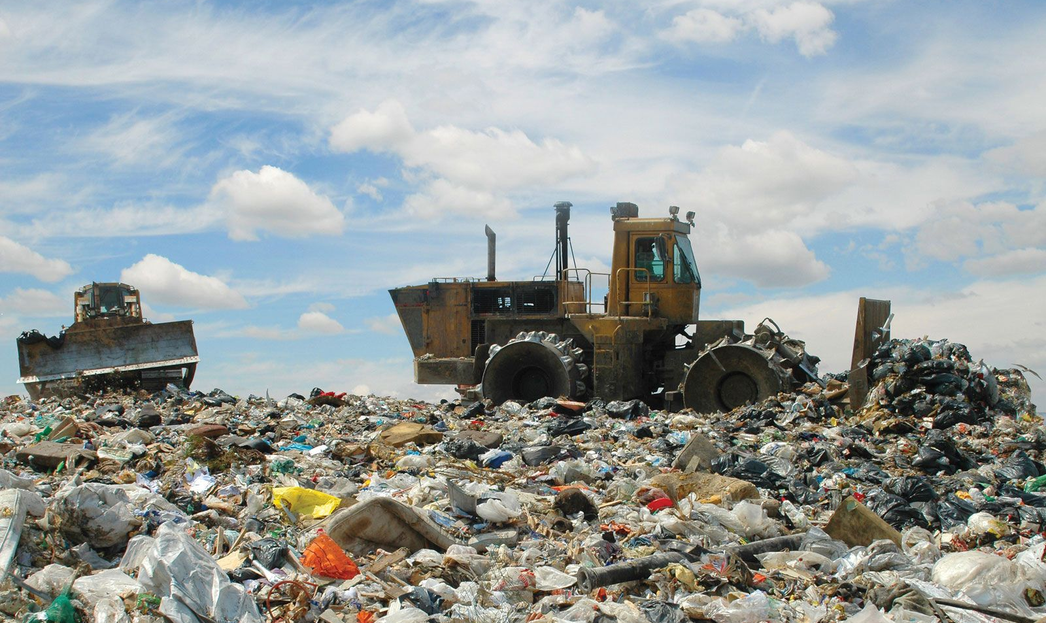
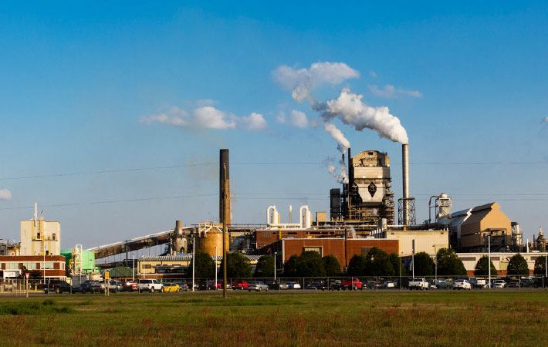
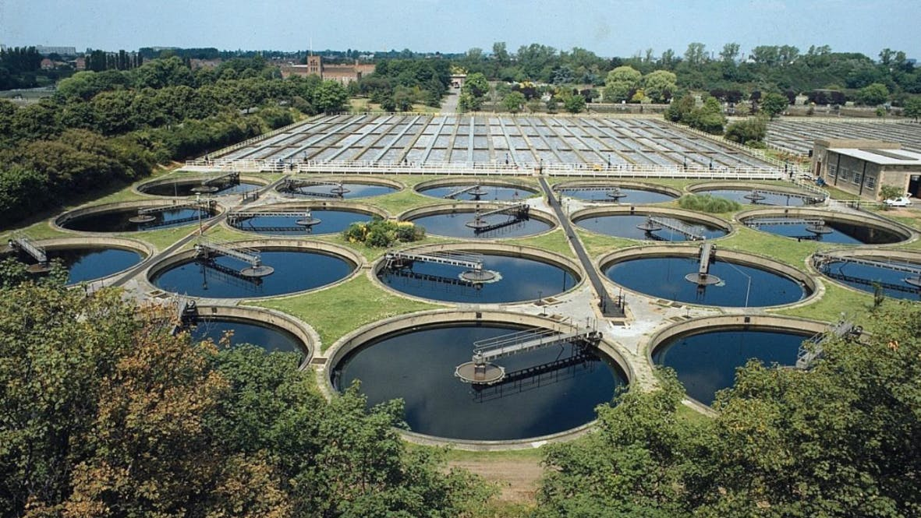
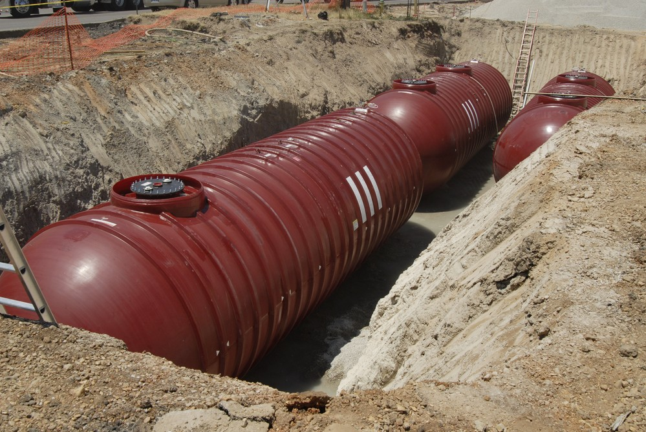

DISTRICT PERMITTING AND COMPLIANCE PROGRAMS:
Solid/Hazardous Waste
Air Resources
Environmental Resource Program (ERP)
Wastewater
Tanks
Potable Water

Slide 6
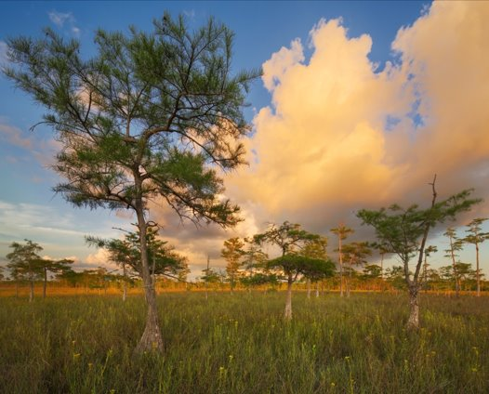
SLERC PROGRAM
The Submerged Lands and Environmental Resources Coordination Program (SLERC) is responsible for the implementation of the state’s Environmental Resource Permitting.
SLERC regulates activities in, on or over surface waters or wetlands, as well as any activity involving the alteration of surface water flows.
SLERC implements the environmental permitting criteria to ensure there is no net loss in wetland and other surface water functions.

Slide 7
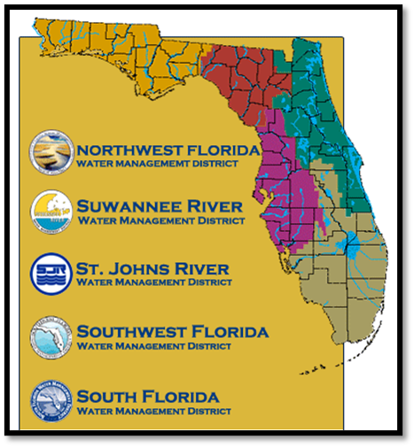
REGULATORY AUTHORITY
OPERATING AGREEMENT
The ERP program is implemented by DEP and the state’s five water management districts (WMDs).
  DEP:
    Individual single-family residence (SFR).
    Marinas not associated with other upland development.
    Utilities.
    Governmental dredging and other “in water” activities.
    Associated sovereign submerged lands (SSL)
    authorization with the above.
  WMDs:
    Residential and commercial development.
    Roads.
    Agriculture.
    Associated SSL authorization with the above.

Slide 8
RULES
ERP rules are established through Florida Administrative Code (F.A.C.)
and implemented through Florida Statutes (F.S.)
Chapter 62-302, F.A.C. State Water Quality Standards: Establishes the minimum surface water quality criteria that are necessary to protect the designated uses of a waterbody.
Chapter 62-330, F.A.C. ERP: Establishes the statewide thresholds, criteria and conditions for the processing and issuance of ERP permits.
  ERP Applicants Handbook Volume I.
Chapter 62-340, F.A.C. Delineation of Landward Extent of Wetlands and Surface Waters.
Chapter 62-345, F.A.C. Uniform Mitigation Assessment Method.

Slide 9
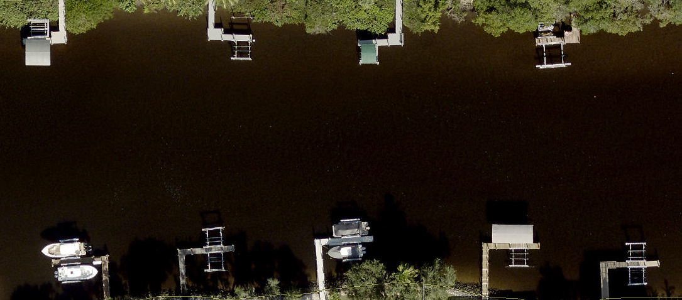
PROJECTS AND ACTIVITIES
Common Projects and Activities:
Docks.
Seawalls.
Boat lifts and canopies.
Upland construction generating stormwater runoff.
Dredge and fill of wetland or surface waters.
Artificial reefs and living shorelines.
Utilities.

Slide 10
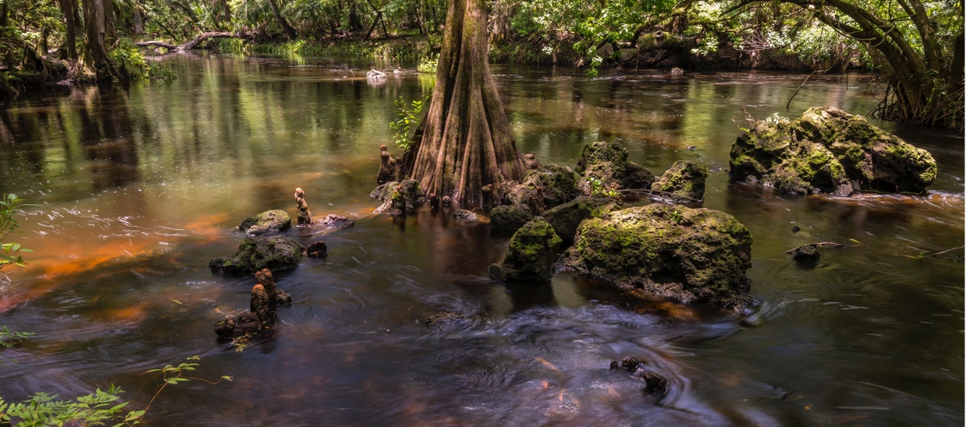
WETLANDS
Wetlands are protected because they:
Support a rich web of life.
Provide food and shelter for fish, birds and other animals.
Offer shoreline protection and buffers for wildlife.
Provide flood control by soaking up rainwater.
Filter out pollutants that degrade water quality.
Provide community recreational opportunities.
The dredging and/or filling in wetlands and other surface waters is a regulated activity.
To further clarify and standardize the definition, a methodology for identifying and delineating wetlands is provided in Rule 62-340, F.A.C.
Certified wetland evaluators are regulatory staff who have registered and received training to conduct wetland delineations.

Slide 11
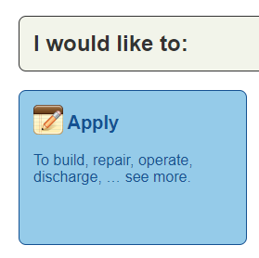
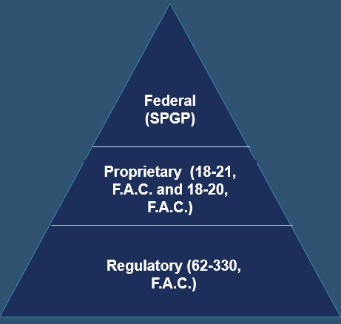
ERP CHAPTER 62-330, F.A.C.
Application Process:
One application will lead to three reviews/authorizations:
Notes:
An example
•Regulatory program: Part IV of Chapter 373, Florida Statute (F.S.); Chapter 62-330, Florida Administrative Code and Environmental Resource Permit Applicant’s Handbook, Volumes, I and II.
•Overall protection of water quality and the other programs (mangroves): Chapter 403, F.S.
Edit pic

Slide 12
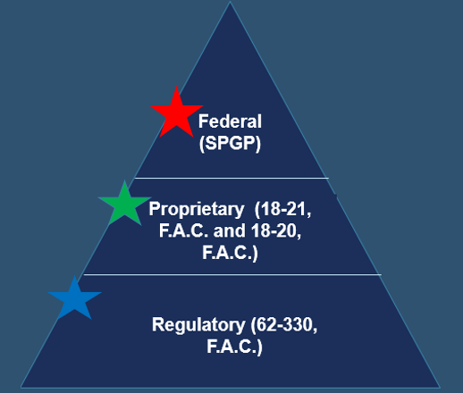
REGULATORY
Regulatory program: Part IV of Chapter 373, F.S.; Chapter 62-330, F.A.C.; and Environmental Resource Permit Applicants Handbook, Volumes I and II.
Chapter 403, F.S.: Overall protection of water quality and the other programs (mangroves).
Chapter 62-330.020, F.A.C.:
  Exemption.
  General permit.
  Individual permit.
  Conceptual approval permit.
Chapter 62-330, F.A.C.

Slide 13
ERP CHAPTER 62-330, F.A.C.
Exemptions: No permit required if activity meets thresholds defined in statute or rule.
General Permits: Activities that have been determined to have minimal direct and secondary impacts.
Individual Permits: All other activities that do not qualify for exemption or general permit and are assessed on an individual, case-by-case basis.
No charge for online self-certification exemption.
  Not available in aquatic preserves.
Verification of ERP exemption = $100.
General permit = $250.
Individual ERP for project 1 acre or less or 10 boat slips or less = $420.
  $100 fee reduction if submitted online using DEP’s Business Portal.

Slide 14
PROPRIETARY
Proprietary authorizations for use consider:
  Water dependency.
  Riparian rights.
  Impacts to submerged resources.
  Preemption from other uses of the water by the public.
Forms of authorization:
  Exceptions – No authorization required.
  Consent by rule – Authorization automatic if meet certain criteria.
  Letter of consent – Written authorization is required.
  Leases – Written agreement with annual fees for all commercial facilities and those facilities that do not qualify for a lesser authorization.
  Easements – Written agreement with fees (not necessarily annual), generally for linear activities.
SSL:
Including but not limited to, tidal lands, islands, sand bars, shallow banks, and lands waterward of the ordinary or mean high water line, beneath navigable fresh water or beneath tidally-influenced waters, which the state of Florida acquired title to on March 3, 1845, by virtue of statehood.
Notes:
If project is located on state lands- even if exempt under regulatory review> requires a prop. Authorization.
All project applications require prop. Review- it is location dependent.
Explanation of Sovereign Submerged Lands (SSL) and the Linkage Between Proprietary Authority and Regulatory Authority in ERP

Slide 15
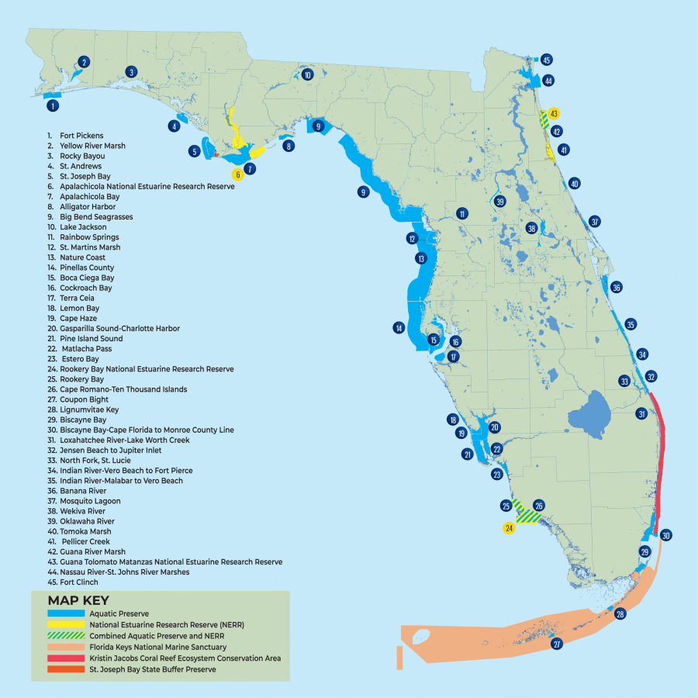
AQUATIC PRESERVES
Aquatic preserves protect Florida's living waters.
Florida's 43 aquatic preserves, dotted up and down the coastline, offer a window into the state's natural and cultural heritage.
In 1975, Florida enacted the Aquatic Preserve Act.
This ensures the continuation of aquatic preserves' natural conditions so "their aesthetic, biological and scientific values may endure for the enjoyment of future generations."
To ensure the continuation of these natural conditions special guidelines and building criteria have been established for ERP projects within aquatic preserves.
Notes:
About our Aquatic Preserves
Much of Florida's distinctive character lies in the beauty of its coastline. The best of our coastal landscapes as well as several inland waters have been set aside for protection as aquatic preserves. Florida's natural beauty always has been a major attraction for both tourists and residents. Ironically, the very features that draw people to Florida are potentially endangered by the increased population pressures. Aquatic preserves protect Florida's living waters to ensure they will always be home for bird rookeries and fish nurseries, freshwater springs and salt marshes, and seagrass meadows and mangrove forests.
These aquatic preserves — dotted up and down Florida's coastline — offer a window into the state's natural and cultural heritage. In 1975, with growing appreciation for their environmental diversity and alluring beauty, Florida enacted the Aquatic Preserve Act. This ensures the continuation of aquatic preserves' natural conditions so "their aesthetic, biological and scientific values may endure for the enjoyment of future generations."

Slide 16

FEDERAL AUTHORIZATION: SPGP
State Programmatic General Permit (SPGP):
  Current: SPGP VI-R1, valid Aug. 16, 2021.
  Includes only the following categories of work:
    Shoreline stabilization.
    Boat ramps and boat launch areas and structures associated with such ramps or launch areas.
    Docks, piers, associated facilities and other minor piling-supported structures.
    Removal of derelict vessels.
    Scientific sampling, measurement and monitoring devices.
State Programmatic General Permit | U.S. Army Corps of Engineers Nationwide Permits |
U.S. Army Corps of Engineers Operating Agreement with DEP and WMDs.
Notes:
The Department of Army State Programmatic General Permit (SPGP) authorizes various activities if the applicant obtains a verification and performs the work in accordance with the terms and conditions of the SPGP. The SPGP enables the Florida Department of Environmental Protection (FDEP) and other agencies to issue the verification to an applicant, concurrently with their other State authorization(s), that the applicant's proposed work is authorized pursuant to the SPGP and that a separate application to the U.S. Army Corps of Engineers (Corps) is not required.
The Jacksonville District of the U.S. Army Corps of Engineers (Corps) issued an expanded State Programmatic General Permit (SPGP VI) on July 27, 2021. The purpose of the SPGP VI is to avoid duplication of permitting between the Corps and the Florida Department of Environmental Protection (DEP) for minor work located in waters of the United States, including navigable waters. SPGP VI reduces the need for separate approval from the Corps for the approved project types, and it increases the efficiency of both state and federal staff in serving the public. SPGP VI is implemented throughout the state of Florida, continuing environmental protection while increasing service to the public.

Slide 17
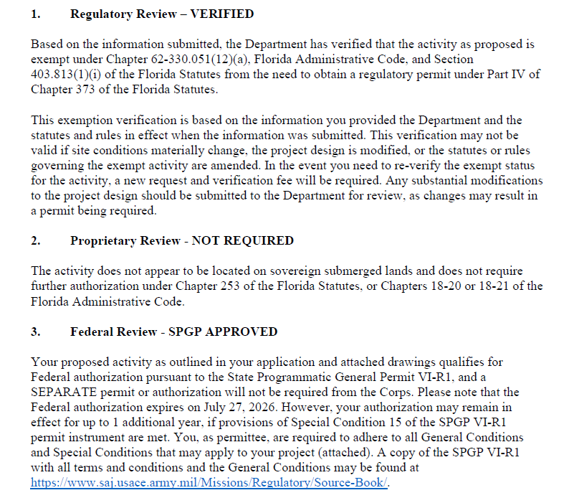
ERP, CHAPTER 62-330 F.A.C.
SAMPLE PERMIT AUTHORIZATION
Example:

Slide 18
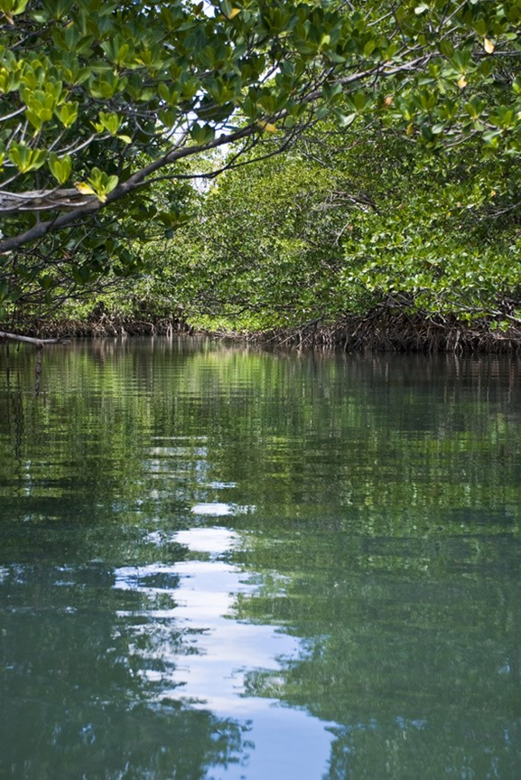
MANGROVE TRIMMING AND ALTERATION
Mangroves are tropical plants that are adapted to loose, wet soils, salt water and being periodically submerged by tides.
The 1996 Mangrove Trimming and Preservation Act defines a mangrove as any specimen of the species:
Laguncularia racemosa (white mangrove).
Rhizophora mangle (red mangrove).
Avicennia germinans (black mangrove).
Mangroves serve as a key ecological component in several ecosystems, including serving as a nursery for many game and sport fisheries. Loss of mangroves reduces fishery productivity, increases land erosion and decreases nearshore water quality.

Slide 19
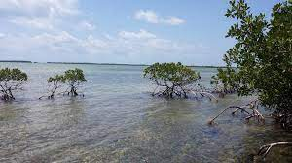
MANGROVE TRIMMING AND ALTERATION
Forms of Authorization:
Exemptions: No written authorization if meets certain defined thresholds; trimming only.
General Permits: Trimming activities that are not exempt but still meet certain defined thresholds can receive an expedited review.
Individual Permits: Trimming activities that are not exempt and do not qualify for General Permit (GP); only authorization for alteration.
A separate permit under the act is not required if the trimming/alteration is associated with work conducted under ERP permit and certain statutory exemptions.
Application for Mangrove Alteration
State Authorized Professional Mangrove Trimmers (PMTs)
Notes:
State Authorized Professional Mangrove Trimmers (PMTs)
list of professional mangrove trimmers (PMTs) who have demonstrated to the department a sufficient level of competence to assure that they are able to conduct mangrove trimming in a manner that will ensure survival of the mangroves that are trimmed. Additionally, the department has determined the below PMTs possess the knowledge and ability to correctly identify and trim mangroves in accordance with the Mangrove Trimming and Preservation Act (sections 403.9321-403.9333, F.S.). As part of their DEP qualification they have provided a minimum of 10 successfully completed mangrove trimming projects which were verified for compliance with the Mangrove Trimming and Preservation Act.

Slide 20
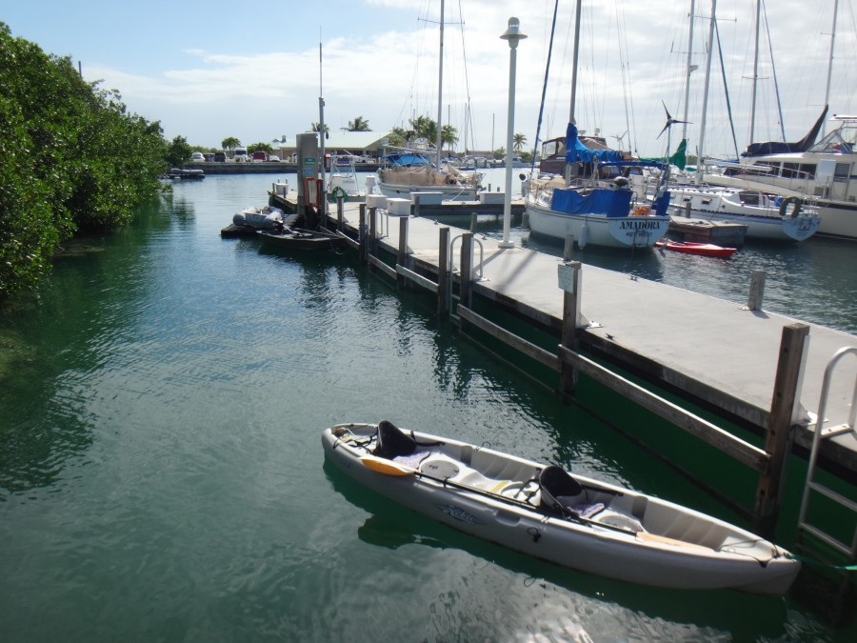
ERP APPLICATIONS
Dock:
Required information.
Sample drawings.
Self-certification.
Dredging:
Required information.
Sample drawings.
What is maintenance dredging?
Shoreline Stabilization:
Required information.
Sample drawings.
Self-certification.
Submitting an ERP
Apply to:
DEP district office.
WMDs.
Delegated local government.
Apply by:
Online.
Mail.
Email.
Wetland Fill:
Application form.
Required information.
Sample drawings.
ERP dredge and fill information​.
Other Projects​:
Multi-slip and commercial docking facilities.
Utility projects.
Stormwater requirements.
Mangroves​.
Notes:
Permit Submission
Environmental Resource Program (ERP) Permits are processed through the DEP district offices, water management districts and delegated local governments. Some activities are exempt. Please contact a local office and schedule a pre-applications meeting for information on permit requirements for your specific project or location. If you want to submit by paper mail, please send the forms to the local DEP district office. If you are mailing large files, please include a CD with an electronic copy of the application

Slide 21
AFTER PERMIT ISSUANCE
Compliance Assurance Program:
The role of the Compliance Assurance Program (CAP) is to work proactively to achieve compliance with environmental regulations that protect Florida’s natural resources.
To help residents and business owners avoid penalties and to protect Florida’s resources, DEP provides compliance assistance through site visits, technical support, workshops, pre-application meetings and online, printable materials.
When non-compliance does occur, DEP has a number of enforcement tools that help bring individuals or facilities back into compliance as quickly as possible.

Slide 22
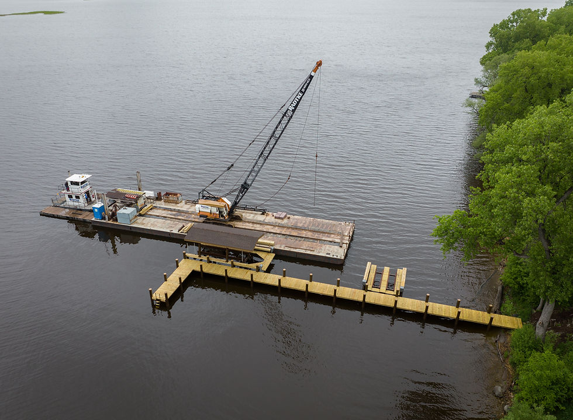
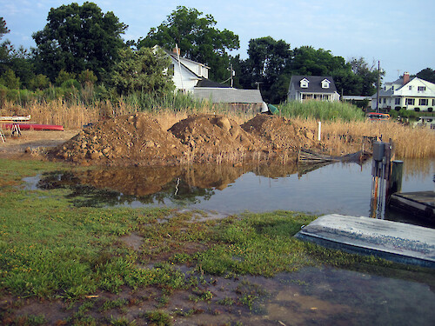
INSPECTION TYPES
Compliance Inspections:
Periodic inspections of the issued department permits.
These are generally docks, seawalls and state land leases.
Complaint Investigations:
Occur when the department receives complaints that a structure may be impacting surface waters or wetlands without proper authorization.

Slide 23
ENFORCEMENT
Compliance Assistance Offer
Consent Order
Notice of Violation
If there is an instance of non-compliance, department staff will first determine if the issue can easily be corrected by the homeowner in a small amount of time.
If so, a Compliance Assistance Offer may be offered.
Usually occur if permanent structures are built or placed in wetlands or surface waters that did not receive prior authorization.
Consent Orders can be written and executed to authorize the work that was done or will determine appropriate corrective actions to return to compliance.
This is for violations that do not have the ability to be consented to or to be removed. Notice of Violations generally occur for very large violations, or for those who chose to not comply.
Notes:
Compliance Assistance Offer: No associated fines and penalties, Handled within a discretionary ~30 days
Consent Order: Has possible fines and penalties, possibly requires the purchase of mitigation, can take time to draft, review, approve, sign, and execute
Notice of Violation: Possibly larger fines and penalties, possibly requires the purchase of mitigation, can take time to draft, review, approve, sign, and execute through the court

Slide 24
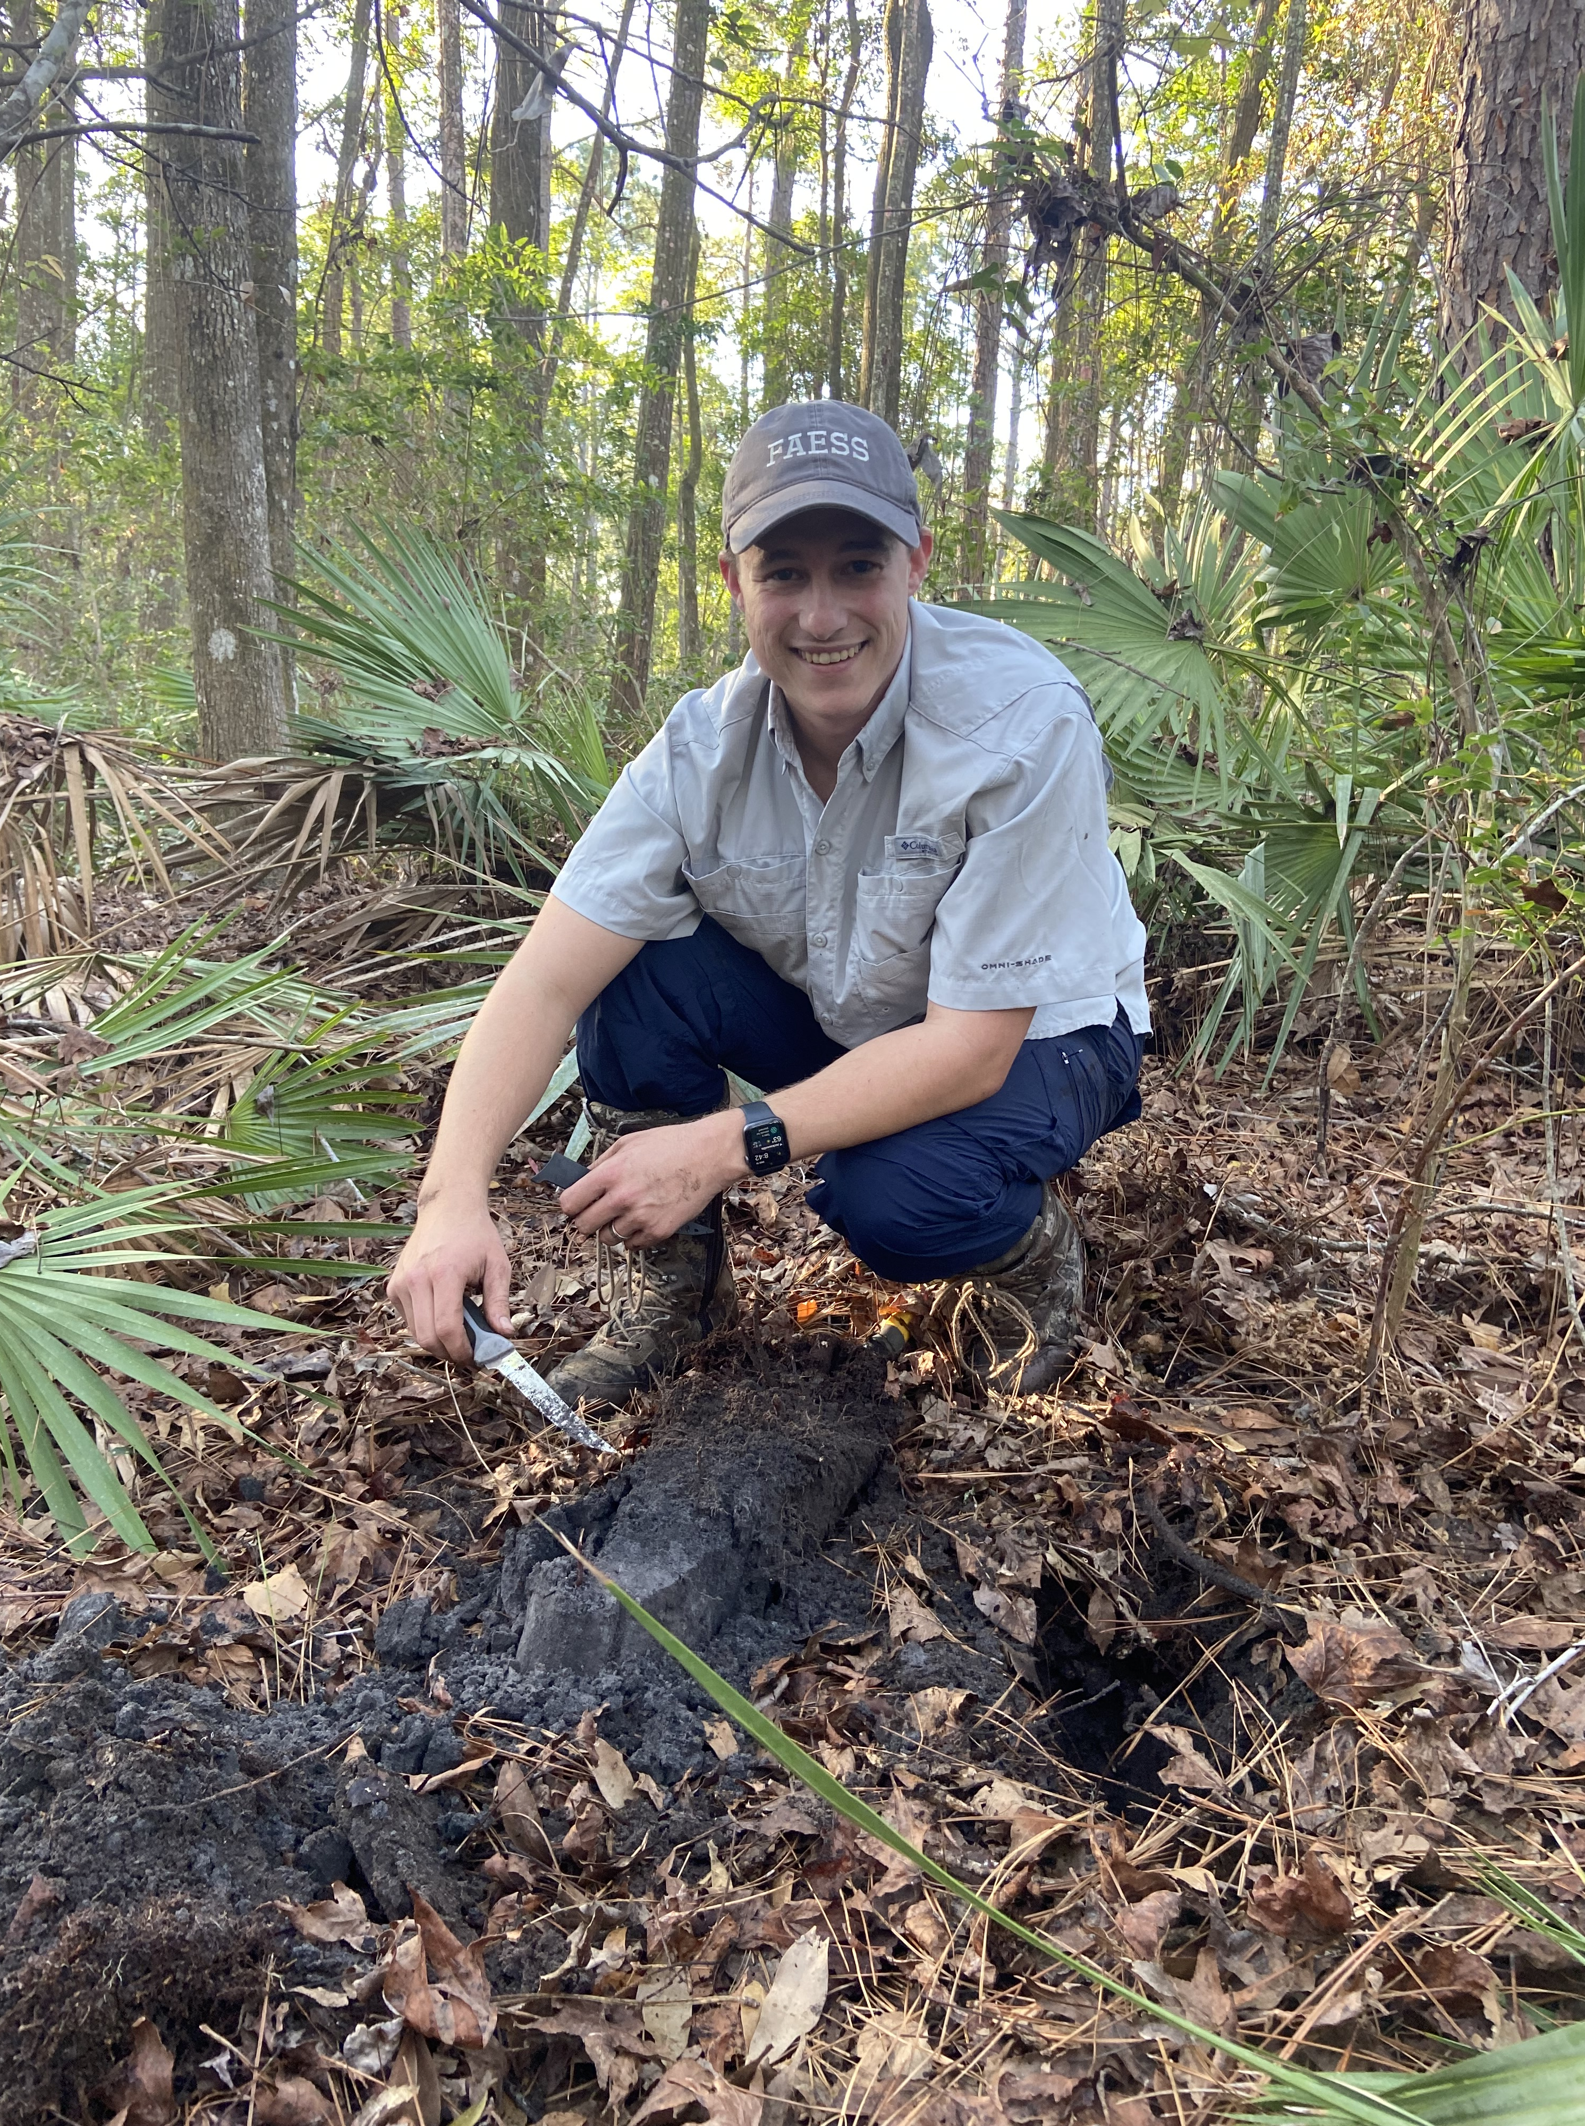
TIPS TO HELP ENSURE COMPLIANCE
Research permit requirements on the federal, state and local levels.
Environmental consulting firms can assist you through the permitting process.
Use resources to determine if your property has wetlands prior to conducting activity.
Provide all information to your permitting processor and ask questions!
Review all parts of issued permits:
  Permits require submission of forms for the commencement of construction and the completion of construction.
  Review special conditions associated with issued permits.

Slide 25
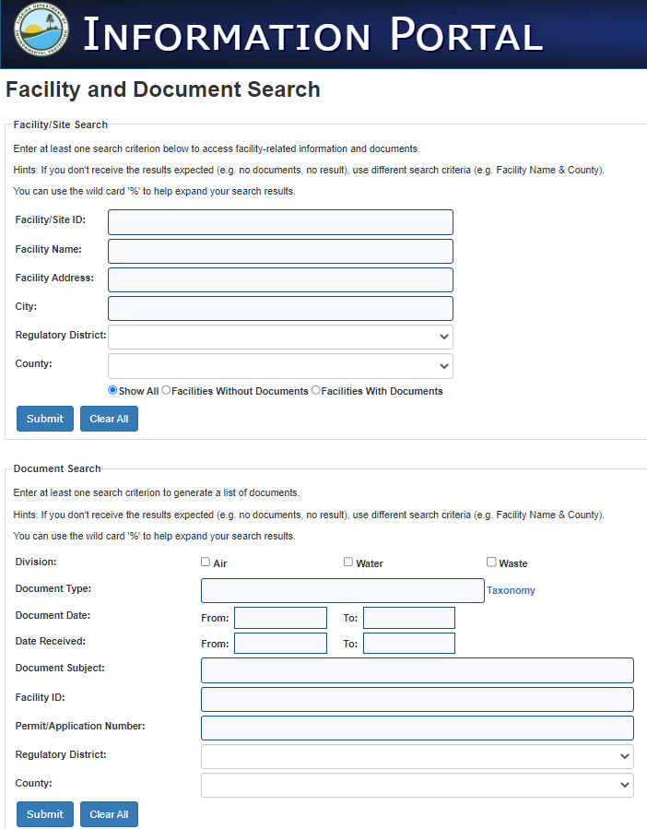
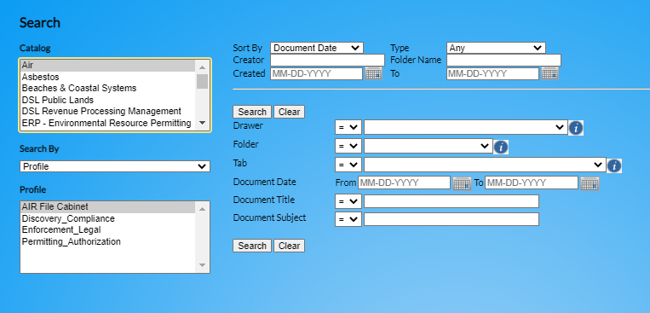
RESOURCES
Most DEP records are available online and can be accessed at any time and at no cost. These are the same databases used by DEP staff for storing and sharing records.
Oculus — Search for records related to permitting, permitted facilities and other regulated activities.
Information Portal — Search for records by facility, site names, street addresses or document type.

Slide 26
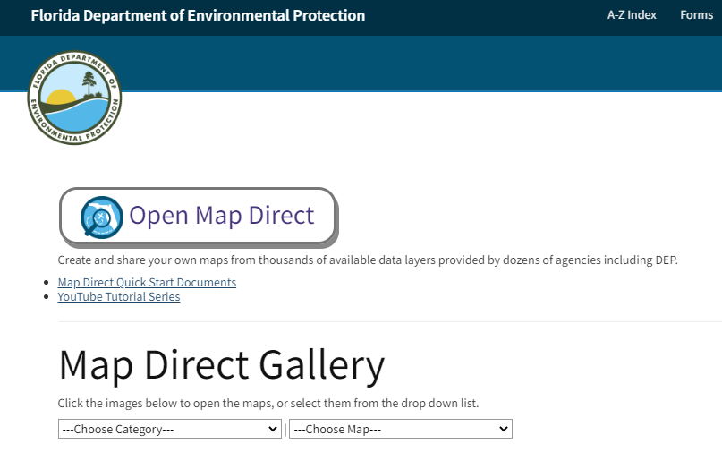
RESOURCES
CONTINUED
Access Map Direct from the DEP Northeast District homepage.
Helpful filters and Map Direct maps can include:
Florida Soil Survey Geographic Database (SSURGO).
National Wetlands Inventory.
Environmental Resource Permitting.
Under the Map Direct link above there are also tutorials on YouTube for working in this software.
Map Direct Quick Start Documents.
YouTube Tutorial Series.
Notes:
MapDirect: ERP map, with Wetlands Layer added
Allows access to:
•Aerial photographs
•Property Appraiser Cadastral (ownership)
•National Wetlands Inventory (NWI) layer (estimate)
•Hydric Soils
•Historical and current permit information

Slide 27
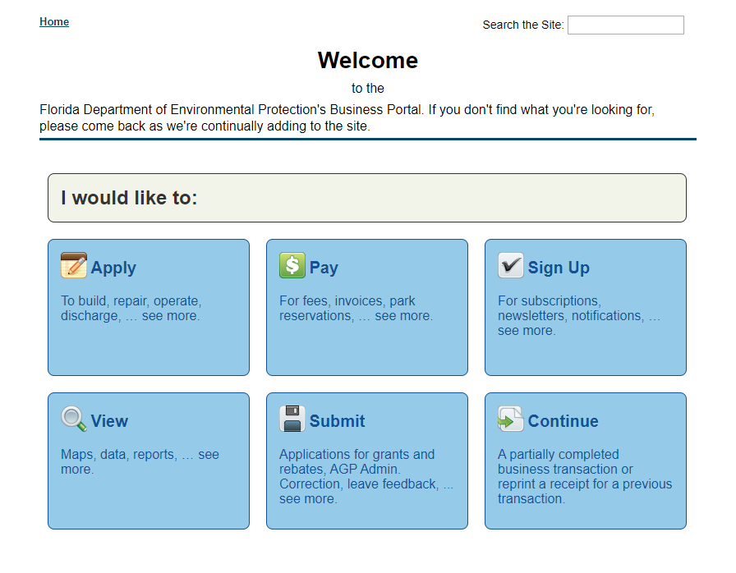
RESOURCES
CONTINUED
Statewide ERP allows users to submit any type of ERP verification of exemption or permit application online. Users can upload supporting documents and pay processing fees online.
To determine what type of permit you need, please schedule a pre-application meeting.
The purpose of the pre-application meeting is to minimize processing steps and potential time delays of your application for a specific project.
Meetings are free and virtual.
Discuss potential projects with Northeast District permitting staff.
ERP E-Permitting.
Business Portal.

Slide 28
THANK YOU
THE FLORIDA DEPARTMENT OF ENVIRONMENTAL PROTECTION
THANK YOU
Katie Craver
Northeast District
Florida Department of Environmental Protection
Contact Information:
904-256-1700
Kathryn.Craver@FloridaDEP.gov

