Slide 1
Hazardous Waste Transfer Facilities
40 CFR 263.12; 40 CFR Part 265; and
62-730.171, FAC

Slide 2
Overview
40 CFR Part 260.10, Definition:
Hazardous Waste Transfer Facility means any transportation-related facility, including loading docks, parking areas, storage areas, and other similar areas where shipments of hazardous waste or hazardous secondary materials are held during the normal course of transportation.
Title 40 Code of Federal Regulations (CFR) Part 263.12;
40 CFR 265.10-19 (Subpart B) General Facility Standards (except 265.13 - General Waste Analysis);
40 CFR 265.30-37 (Subpart C) Preparedness and Prevention;
40 CFR 265.50-56 (Subpart D) Contingency and Emergency Plan;
40 CFR 265.170-178 (Subpart I) Management of Containers; and
Chapter 62-730.171, Florida Administrative Code (FAC).

Slide 3
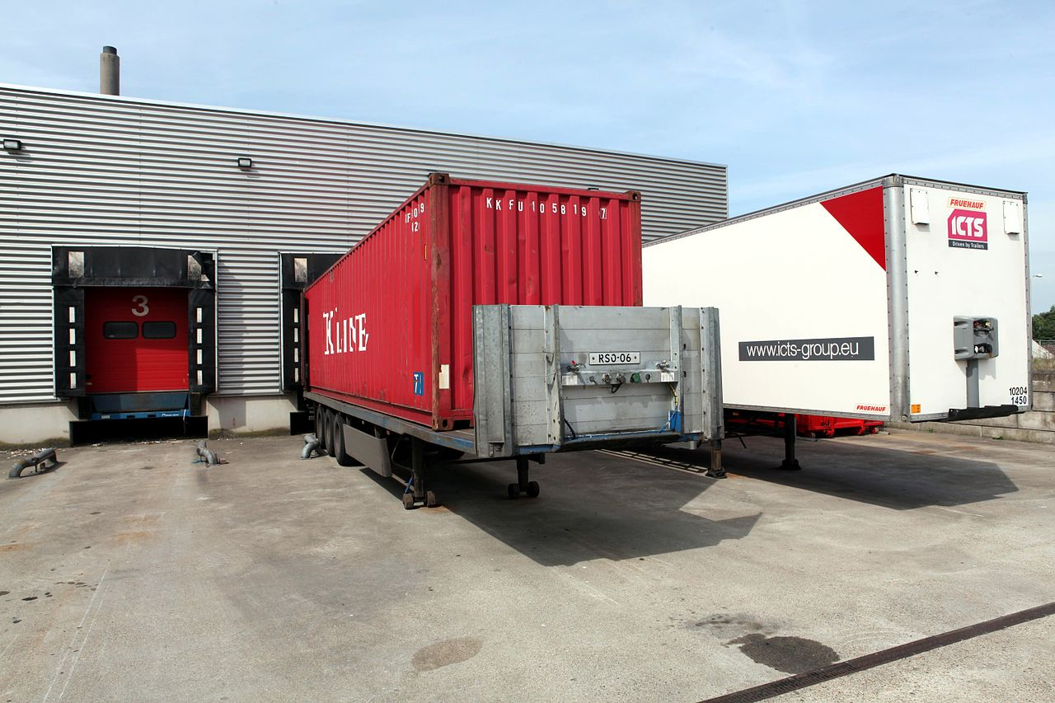
Transfer Facility Requirements – 40 CFR 263.12
A Transporter who stores manifested shipments in proper containers at a transfer facility for ≤10 days are not subject to the permitted hazardous storage facility requirements.
If the waste is stored for more than 10 days, the facility is subject to the permitting requirements for a hazardous waste storage facility.

Slide 4
Transfer Facility Requirements – 40 CFR 263.12
Generator Improvement Rule addition:
(b) When consolidating the same wastes, or compatible wastes, into a new container of ≤119 gallons mark the containers with the following:
“Hazardous Waste;” and
Applicable waste codes in compliance with 40 CFR 262.32(c).

Slide 5
Notification – 62-730.171(2), FAC
(a) A Transporter who is the owner / operator of a transfer facility shall obtain an EPA identification number (Form 8700-12FL);
(b) Notification shall be at least 30 days before storing waste at a transfer facility;
(c) Notification shall include information in section 62-730.171(3)(c);
(d) Re-notify annually including submitting financial responsibility and any change in facility information, operation or status.

Slide 6
Initial Notification – 62-730.171(3)(a), FAC
Certification of siting requirements listed required in Section 403.7211(2), Florida Statutes (FS);
Notification of Regulated Waste Activity (Form 8700-12FL);
Evidence of the Transporter’s financial responsibility;
A brief general description of the Transfer Facility operations:
Customers;
Anticipated waste codes;
Operating procedures;
Structures and equipment including capacity calculations, engineering drawings or sketches as appropriate.
A copy of a Closure Plan demonstrating that the Transfer Facility will be closed in a manner which satisfies requirements of 40 CFR 265.111 thru 115;
A copy of the Contingency and Emergency Plan;
A map(s) of the Transfer Facility depicting:
Property boundaries;
Access control;
Buildings or other structures;
Pertinent features (such as retention areas, stormwater systems, roadways, sanitary/process sewer systems, loading and unloading areas, fire control.

Slide 7
62-730.171, FAC
62-730.171(3)(b) Notification must be made prior to changing items above.
62-730.171(3)(c) No person shall not operate a transfer facility before receiving confirmation that the initial notification package is complete.
62-730.171(4) A transfer facility shall comply with the following requirements:
(a) 40 CFR Part 265 Subparts B, C, D, and I (presentation follows);
(b) The aisle space requirements and incompatible waste requirements shall not apply to containers in trucks that meet DOT regulations in 40 CFR 263.10.
62-730.171(5) Hazardous waste stored at transfer facilities in containers or vehicles shall be stored on a manmade surface which is capable of preventing spills or releases to the ground.
62-730.171(6) - Recordkeeping (presentation follows).
62-730.171(7) - Closure (presentation follows).
62-730.171(8) - Construction, initial operation or substantial modifications to a transfer facility that does not comply with Section 403.7211, Florida Statutes, is prohibited.

Slide 8
40 CFR 265 (Subpart B) General Facility Standards
40 CFR 265.10 – Applicability.
40 CFR 265.11 - Identification number.
40 CFR 265.12 - Required notices.
40 CFR 265.13 - [Not Applicable]
40 CFR 265.14 – Security.
40 CFR 265.15 - General inspection requirements.
40 CFR 265.16 - Personnel training.
40 CFR 265.17 - General requirements for ignitable, reactive, or incompatible wastes.
40 CFR 265.18 - Location standards.
40 CFR 265.19 - Construction quality assurance program.

Slide 9
Required Notices: 40 CFR 265.12
40 CFR 265.12(a) Receipt of hazardous waste from a foreign source requires submittal of notices described in this section.
40 CFR 265.12(b) Before transfer of ownership or operation of a facility during its operating life, notify the new owner/operator of all requirements in 40 CFR 265.

Slide 10
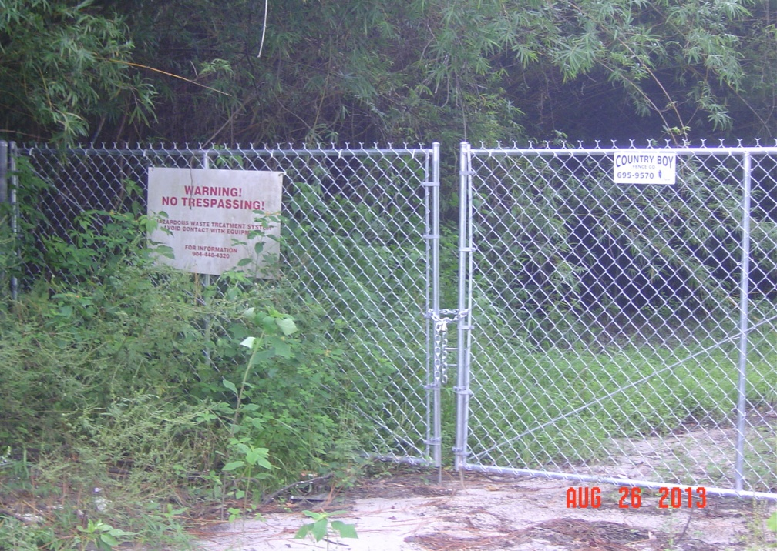
Security: 40 CFR 265.14
Prevent unknowing entry and minimize unauthorized entry to your facility;
Must have 24-hour surveillance system to monitor and control entry; or
Barrier surrounding the
facility (usually a fence); and
Means to control the entry to
facility;
Warning signs posted at
entrance(s) and legible at 25’.

Slide 11
General Inspection Requirements: 40 CFR 265.15
Conduct inspections often enough to identify and correct problems before they harm human health or the environment;
Develop a written schedule to inspect emergency, safety, and security equipment that is important to prevent/detect/respond to environmental or human health hazards;
The schedule must identify the types of problems (e.g., malfunctions or deterioration) to look for during the inspection;
The schedule must include the type of items to be inspected and frequency of inspection;
Where a hazard is imminent, or has already occurred, remedial action must be taken immediately;
Record inspections in a log and keep at least three years from the date of inspection. (date, time, inspector name, observations made, date/type of any repairs/actions.

Slide 12
Personnel Training: 40 CFR 265.16
Do facility personnel complete hazardous waste training?
Is the trainer adequately trained in hazardous waste management procedures?
Does the training cover safety?
Does the training cover emergency response procedures, including equipment handling and inspection?
Does the training cover hazardous waste identification and handling procedures?
Does the facility maintain job titles and job descriptions for employees managing hazardous waste?

Slide 13
Personnel Training: 40 CFR 265.16
Do the job descriptions include the requisite skills, education, and experience?
Do the job descriptions include a list of the person’s duties?
Do employees complete initial training within six months of hiring or assignment of hazardous waste management responsibility?
Do they work unsupervised until training is complete?
Is the training reviewed annually?
Are all required training records kept at the facility? Until closure/three years?

Slide 14
Personnel Training: 40 CFR 265.16
Evaporating paint/open containers…an indication of inadequate training.

Slide 15
40 CFR 265 (Subpart B) General Facility Standards
40 CFR 265.17 - General requirements for ignitable, reactive, or incompatible wastes.
(a) Take precautions to prevent accidental ignition or reaction of ignitable or reactive waste. “No Smoking” signs must be conspicuously placed wherever there is a hazard from ignitable or reactive waste.
(b) Management of ignitable or reactive waste must be conducted safely and in such a manner as to prevent any threat to human health or the environment.
40 CFR 265.18 - Location standards. The placement of any hazardous waste in a salt dome, salt bed formation, underground mine or cave is prohibited, except for the Department of Energy Waste Isolation Pilot Project in New Mexico.
40 CFR 265.19 - Construction Quality Assurance program applies to surface impoundments, waste piles, and landfill units that are required to comply with §§265.221(a), 265.254, and 265.301(a).

Slide 16
40 CFR 265 (Subpart C) Preparedness and Prevention
40 CFR 265.30 – Applicability.
40 CFR 265.31 - Maintenance and Operation of Facility.
40 CFR 265.32 - Required Equipment.
40 CFR 265.33 - Testing and Maintenance of Equipment.
40 CFR 265.34 - Access to Communications or Alarm System.
40 CFR 265.35 - Required Aisle Space.
40 CFR 265.36 - [Reserved]
40 CFR 265.37 - Arrangements with Local Authorities.

Slide 17
Maintenance and Operation of Facility - 40 CFR 265.31
The Facility must be maintained and operated in a manner that minimizes the possibility of fire, explosion, or any release of hazardous waste or hazardous waste constituents to the air, soil, surface water or groundwater which could threaten human health or the environment.

Slide 18
Maintenance and Operation of Facility - 40 CFR 265.31
40 CFR 265.31 - Maintenance and Operation
Bad - spills not addressed

Slide 19
Maintenance and Operation of Facility - 40 CFR 265.31
Good – neat, orderly and compliant.

Slide 20
Required Equipment - 40 CFR 265.32
40 CFR 265.32(a) Internal communications or alarm system to notify employees of emergency situation.
40 CFR 265.32(b) Telephone or two-way radio to summon emergency assistance.
40 CFR 265.32(c) Fire extinguishers, fire control equipment, spill control equipment, and decontamination equipment.
40 CFR 265.32(d) Water at adequate volume and pressure to supply water hose streams, or foam producing equipment, automatic sprinklers, or water spray systems.

Slide 21
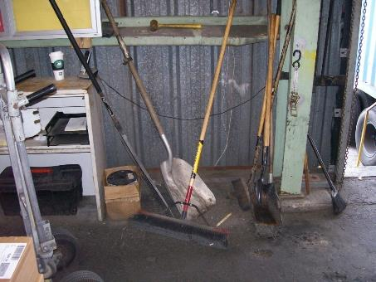
Required Equipment - 40 CFR 265.32
Good – appropriate safety equipment for waste being generated.

Slide 22
Required Equipment - 40 CFR 265.32
Bad – cannot access fire extinguisher.

Slide 23
Testing and Maintenance - 40 CFR 265.33
Bad – eyewash not tested OR maintained.

Slide 24
Access to Communications or Alarm – 40 CFR 265.34
(a) Whenever hazardous waste is being poured, mixed, spread, or otherwise handled, all personnel involved in the operation must have immediate access to an internal alarm or emergency communication device, either directly or through visual or voice contact with another employee, unless such a device is not required under §265.32.
(b) If there is ever just one employee on the premises while the facility is operating, he must have immediate access to a device, such as a telephone (immediately available at the scene of operation) or a hand-held two-way radio, capable of summoning external emergency assistance, unless such a device is not required under §265.32.

Slide 25
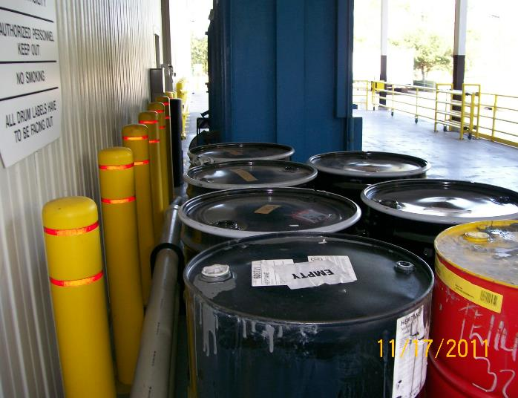
Aisle Space – 40 CFR 265.35
Bad – insufficient aisle space.
Also 62-730.160(7), FAC

Slide 26
Arrangements with Local Authorities – 40 CFR 265.37
(a) Make arrangements – and document attempt to do so - for the type of waste and specific need for services from these organizations:
40 CFR 265.37(a)(1) Police, fire, emergency response teams – familiarize them with the facility layout, waste properties / hazards, occupied locations around the facility, entrance / evacuation routes.
40 CFR 265.37(a)(2) If more than one response organization, designate a primary and back-up.
40 CFR 265.37(a)(3) Agreements with State and/or emergency response contractors and necessary equipment.
40 CFR 265.37(a)(4) Hospitals – familiarize them with waste properties / hazards, potential injuries.
(b) Where State or local authorities decline to enter into such arrangements, document the refusal in the operating record.

Slide 27
Arrangements with Local Authorities – 40 CFR 265.37
Notes:
Who is the Emergency Response contractor? If the Fire Dept is the initial responder, they won’t clean-up the aftermath, so, who is your response contractor and are they prepared to respond to large quantities of contaminated water, solids, and debris…..a mess. How and where will it be stored until sample results come in? Or how / what other manner would you use to characterize it for disposal?

Slide 28
40 CFR 265 (Subpart D) Contingency and Emergency Plan
40 CFR 265.50 - Applicability.
40 CFR 265.51 - Purpose And Implementation Of Contingency Plan.
40 CFR 265.52 - Content Of Contingency Plan.
40 CFR 265.53 - Copies Of Contingency Plan.
40 CFR 265.54 - Amendment Of Contingency Plan.
40 CFR 265.55 - Emergency Coordinator.
40 CFR 265.56 - Emergency Procedures.

Slide 29
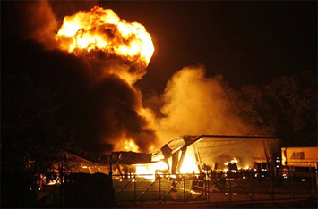
Purpose and Implementation – 40 CFR 265.51
Each owner/operator MUST have a Contingency Plan for their facility;
Designed to minimize hazards from fire, explosions, or release of hazardous wastes to the environment;
Plan must be implemented immediately when there is fire, explosions, or release of hazardous wastes to the environment.

Slide 30
Content of Plan - 40 CFR 265.52
Fire, Spill, Explosion Response Procedures;
A description of arrangements with local authorities;
Emergency Coordinator’s name, addresses and telephone numbers;
Emergency equipment list;
Specifications and capabilities of emergency;
Locations of emergency equipment;
An evacuation plan and routes;
Evacuation / alarm signals.

Slide 31
Copies and Amendment of Plan – 40 CFR 265.53 - 54
40 CFR 265.53 Copies of Contingency Plan.
Maintained at the facility (keep hard copies);
Submitted to all local police and fire departments, state and local emergency response teams.
40 CFR 265.54 Amendment of Contingency Plan.
When applicable regulations change (i.e., new Generator Rule);
The Plan (or part of it) fails in an actual emergency;
The facility changes (layout, infrastructure, etc.) in a manner that increases the potential for fires, explosions or releases of waste, or changes the response requirements;
The Emergency Coordinator(s) changes;
The emergency equipment changes.
Notes:
Need at least one paper copy of the Contingency Plan in case of a power outage

Slide 32
Emergency Coordinator – 40 CFR 265.55
At all times….
At least one employee either on the facility premises or on call (near-by) to coordinate all emergency response measures;
Must be thoroughly familiar with the contingency plan, all operations at the facility, waste handled, the location of records, and facility layout;
Must have the authority to commit the resources to carry out the contingency plan.

Slide 33
Emergency Procedures 40 CFR 265.56
For imminent or actual emergency, the Emergency Coordinator must:
Activate internal alarms or communication system;
Notify appropriate State or locate agencies with designated response roles, if needed;
Identify source, quantity, extent, characteristics of released materials;
Assess possible hazardous to humans and/or environmental, direct or indirect affects from incident (e.g., impacts to air and/or water);
Coordinate with local authorities if local evacuation is required;
Notify government on-scene coordinator or National Response Center and report all known pertinent data of the incident;
Take all measures practicable to incident doesn’t spread to other areas;
Monitor potential impacts to other internal systems;
Arrange for management of contaminated waste resulting from incident;
No waste that may be incompatible with released material is stored, treated or disposed until cleanup procedures are complete;
All emergency equipment in Contingency Plan is cleaned and/or restocked before normal operations are resumed.
Notes:
There A LOT of duties and requires a significant amount of responsibility – make sure the right person is assigned to this critical position appropriately. If you have been designated the EC, make sure you understand the responsibilities of this position and ensure you are adequately trained to perform your duties.

Slide 34
Emergency Procedures 40 CFR 265.56
After emergency that requires implementation of the Contingency Plan, the Owner / Operator must:
Note in the facility’s Operating Record the date, time, details of the incident.
Within 15 days of the incident, submit a written report to FDEP with the following details:
Owner / Operator’s name, address, telephone number;
Date, time, type of incident;
Name and quantity of material(s) involved;
Extent of injuries, if any;
Assessment of actual or resultant hazards to human health / environment;
Estimated quantity and disposition of recovered material.

Slide 35
40 CFR 265 (Subpart I) Management of Containers
40 CFR 265.170 - Applicability
40 CFR 265.171 - Condition of containers
40 CFR 265.172 - Compatibility of containers
40 CFR 265.173 - Management of containers
40 CFR 265.174 - Weekly inspections
40 CFR 265.175 - [Reserved]
40 CFR 265.176 - Special requirements for ignitable or reactive waste (50 foot setback)
40 CFR 265.178 - Air emission standards

Slide 36
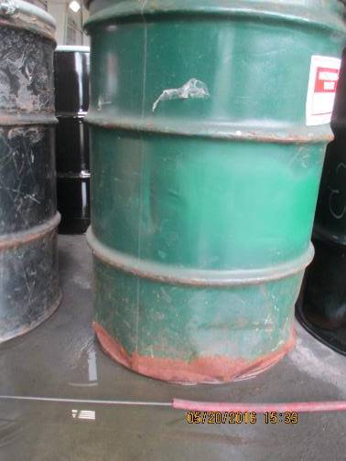
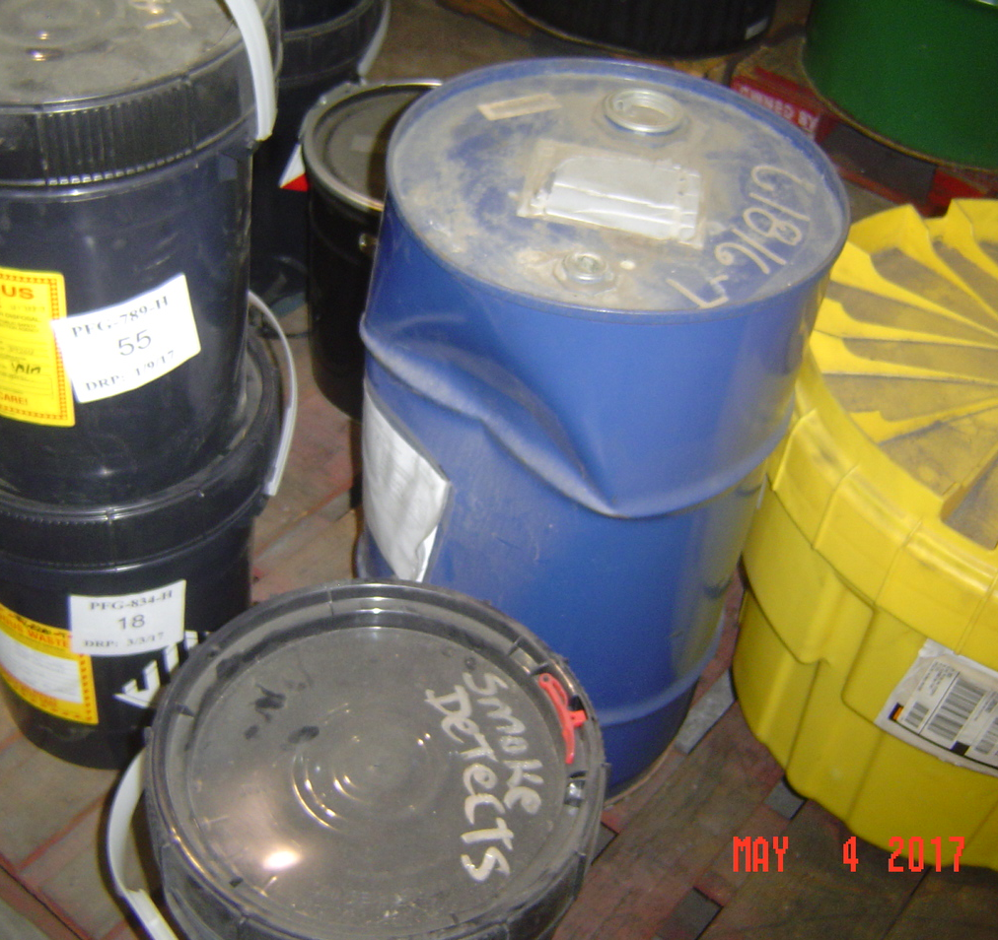
Condition of Containers – 40 CFR 265.171
Bad condition

Slide 37
Condition of Containers – 40 CFR 265.171
Good condition

Slide 38
Compatibility of Containers – 40 CFR 265.172

Slide 39
Management of Containers – 40 CFR 265.173
Open container

Slide 40
Management of Containers – 40 CFR 265.173
Closed container

Slide 41
Inspections – 40 CFR 265.174
At least weekly, the owner/operator must inspect areas where containers are stored. The owner / operator must look for leaking containers and for deterioration of containers caused by corrosion or other factors.
Follow requirements in Part 265.171 for remedial action if deterioration or leaks are detected.

Slide 42
Special Requirements – 40 CFR 265.176 - 178
40 CFR 265.176 Special requirements for ignitable or reactive waste.
Containers must be located at least 50’ from the facility's property line.
40 CFR 265.177 Special requirements for incompatible wastes.
(a) Incompatible wastes, or incompatible wastes and materials must not be placed in the same container, unless Part 265.17(b) is complied with.
(b) Waste must not be placed in an unwashed container that previously held an incompatible waste or material unless Part 265.17(b) is complied with.
(c) A waste container that is incompatible with any waste or other materials nearby must be physically separated from them.
40 CFR 265.178 Air emission standards.
The owner or operator shall manage all hazardous waste placed in a container in accordance with the applicable requirements of subparts AA, BB, and CC of this part (i.e., keep containers closed).

Slide 43
Recordkeeping – 62-730.171(6), FAC
Maintain on-site a written record/log of:
Manifest number for each shipment that enters and leaves the facility;
The date when all hazardous waste enters and leaves the facility;
The Generator’s name and the EPA identification number (CESQGs include the name and address of the generator);
Amounts of hazardous waste and hazardous waste codes associated with each shipment into and out of the facility.

Slide 44
Closure - 62-730.171(7), FAC
Submit a closure certification within 60 days of closure;
Closed in accordance with the Closure Plan;
The certification shall be signed by:
The owner or operator of the Transfer Facility;
The property owner;
A Florida-registered Professional Engineer.

Slide 45
Questions?
Hazardous Waste Program
8800 Baymeadows Way West
Suite 100 Jacksonville, Florida 32256 (904) 256-1700

