Slide 1
Hazardous Waste Transfer Facilities
62-730.171, FAC; 40 CFR 263.12 and 40 CFR Part 265

Slide 2
Regulation Overview
Definition of “Transfer Facility” - 40 Code of Federal Regulations (CFR) 263.12
40 CFR Part 265
Chapter 62-730.171, Florida Administrative Code (FAC)
Notification
Facility Standards
Preparedness and Prevention
Contingency Plan
Container Management
Recordkeeping
Closure

Slide 3
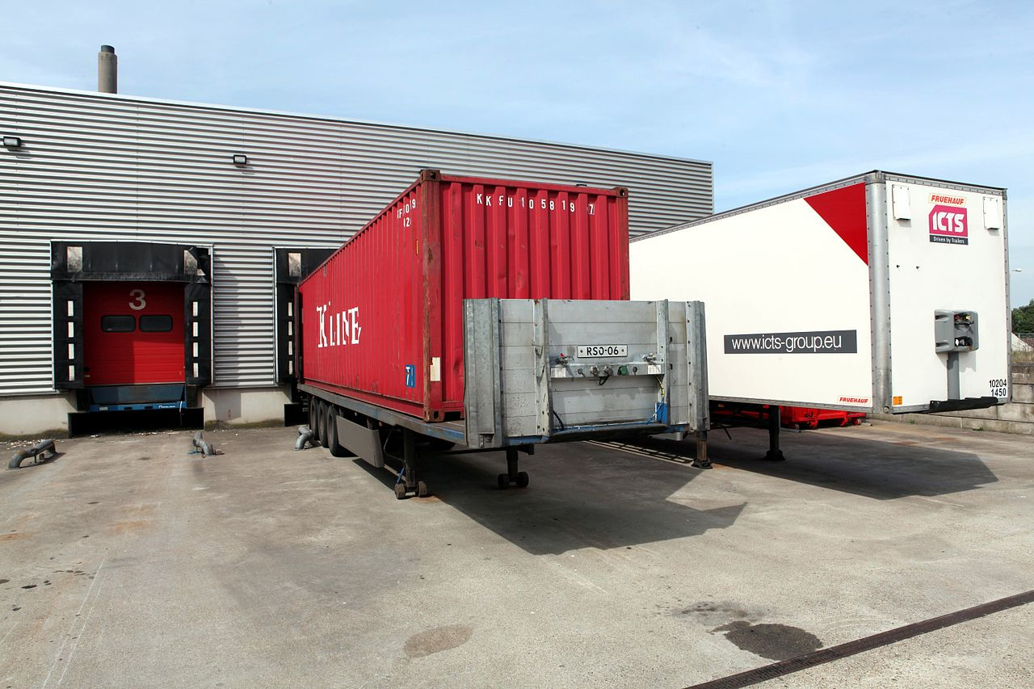
Transfer Facility
A Transfer Facility is defined as any transportation-related facility, such as loading docks, parking areas, storage areas, and other similar areas where shipments are held during the normal course of transportation [40 CFR 261.10].
Stores manifested shipments of hazardous waste for more than 24 hours but less than 10 days.

Slide 4
Notification
Notify and get an EPA ID#;
Notify at least 30 days prior to storing waste;
Initial notification should include all requirements per Rule 62-730.171(3), FAC;
Annually submit updated information.

Slide 5
Notification (cont)
62-730.171(3), FAC
The following items constitute initial facility notification:
Certification required in Section 403.7211(2), Florida Statutes (FS);
8700-12FL Form;
Evidence of the Transporter’s financial responsibility;
A brief general description of the Transfer Facility operations:
Customers’
Anticipated waste codes
Operating procedures
Structures and equipment (with the maximum design capacity for storage) including engineering drawings or sketches as appropriate.

Slide 6
Notification (cont.)
The following items constitute initial facility notification:
A copy of a closure plan demonstrating that the Transfer Facility will be closed in a manner which satisfies the closure performance, notification, and decontamination standards of 40 CFR 265.111 thru 115;
A copy of the contingency and emergency plan;
A map or maps of the Transfer Facility depicting:
Property boundaries;
Access control;
Buildings or other structures;
Pertinent features (such as retention areas, runoff and stormwater control systems, access or internal roads, sanitary and process sewer systems, loading and unloading areas, and fire control equipment.

Slide 7
Regulations
62-730.171(4), FAC - A Transfer Facility shall comply with the following requirements:
Subpart B – 265.10-19 General Facility Standards
(except 265.13 - General Waste Analysis);
Subpart C – 265.30-37 Preparedness and Prevention;
Subpart D – 265.50-56 Contingency and Emergency Plan;
Subpart I – 265.170-178 Management of Containers.

Slide 8
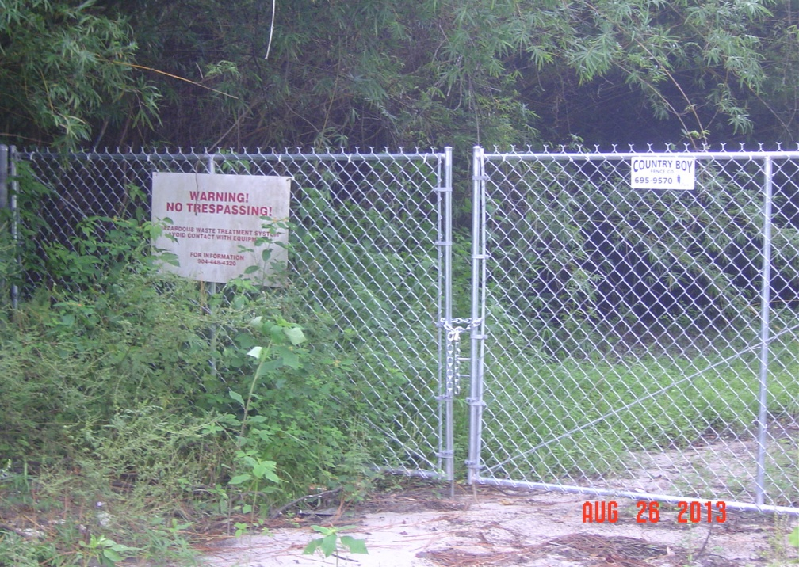
Facility Standards
40 CFR 265.14 – Security
Prevent unknowing entry and minimize unauthorized entry to your facility;
24-hour surveillance system;
Barrier surrounding the
facility (usually a fence);
Control the entry to
facility;
Signs posted and legible
at 25 feet.

Slide 9
Facility Standards (a)
40 CFR 265.15 - Inspection Requirements
Conduct inspections to minimize releases or threats to human health and the environment;
Develop a written schedule to inspect emergency, safety, and security equipment;
Keep this log at the facility and records for three years.

Slide 10
Facility Standards (b)
40 CFR 265.16 – Training
Do facility personnel complete hazardous waste training?
Is the trainer adequately trained in hazardous waste management procedures?
Does the training cover safety?
Does the training cover emergency response procedures, including equipment handling and inspection?

Slide 11
Facility Standards (c)
40 CFR 265.16 - Training
Does the training cover hazardous waste identification and handling procedures?
Does the facility maintain job titles and job descriptions for employees managing hazardous waste?
Do the job descriptions include the requisite skills, education, and experience?
Do the job descriptions include a list of the person’s duties?

Slide 12
Facility Standards (d)
40 CFR 265.16 - Training
Do employees complete initial training within six months of hiring or assignment of hazardous waste management responsibility?
Do they work unsupervised until training is complete?
Is the training reviewed annually?
Are all required training records kept at the facility? Until closure/three years?

Slide 13
Facility Standards (e)
Personnel Training – 40 CFR 265.16
Evaporating paint/open containers…an indication of inadequate training.

Slide 14
40 CFR 265.30-37 Subpart C – Preparedness and Prevention
Maintenance and Operation of Facility [40 CFR 265.31];
Required Equipment [40 CFR 265.32];
Testing and Maintenance of Equipment [40 CFR 265.33];
Access to Communications or Alarm System [40 CFR 265.34];
Required Aisle Space [40 CFR 265.35];
Arrangements with Local Authorities [40 CFR 265.37].

Slide 15
40 CFR 265.31 Subpart C – Maintenance and Operation
The Facility must be maintained and operated in a manner that minimizes the possibility of fire, explosion, or any release of hazardous waste or hazardous waste constituents to the air, soil, surface water or groundwater which could threaten human health or the environment.
Notes:
Planning and prevention save in many ways…

Slide 16
40 CFR 265.31 Subpart C – Maintenance and Operation (a)
40 CFR 265.31 - Maintenance and Operation
Bad - spills not addressed

Slide 17
40 CFR 265.31 Subpart C – Maintenance and Operation (b)
Good – neat, orderly and compliant.
Notes:
Another good example.

Slide 18
40 CFR 265.32 Subpart C – Required Equipment
Internal communications or alarm system to notify employees of emergency situation [40 CFR 265.32(a)];
Telephone or two-way radio to summon emergency assistance [40 CFR 265.32(b)];
Fire extinguishers, fire control equipment, spill control equipment, and decontamination equipment [40 CFR 265.32(c)];
Water at adequate volume and pressure to supply water hose streams, or foam producing equipment, automatic sprinklers, or water spray systems [40 CFR 265.32(d)].

Slide 19
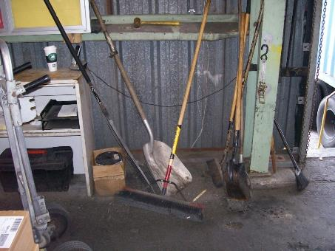
40 CFR 265.32 Subpart C – Required Equipment (a)
Good – appropriate safety equipment for waste being generated.
Notes:
Good example of safety equipment.

Slide 20
40 CFR 265.32 Subpart C – Required Equipment (b)
Bad – cannot access fire extinguisher.
Notes:
A few bulbs nearby…

Slide 21
40 CFR 265.33 Subpart C – Testing and Maintenance
Bad – eyewash not tested OR maintained.
Notes:
Does your eyewash look like this??

Slide 22
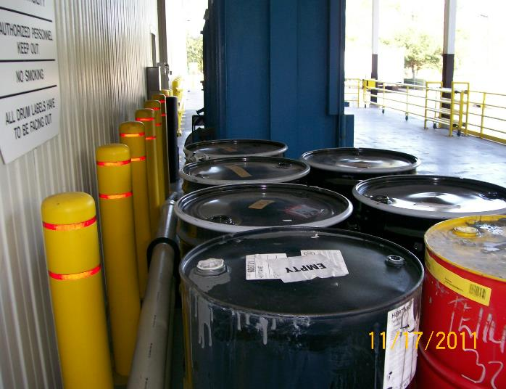
40 CFR 265.35 – Aisle Space
Bad – insufficient aisle space.
Also 62-730.160(7), FAC
Notes:
Is this adequate aisle space?

Slide 23
40 CFR 265.37 Subpart C – Arrangements with Local Authorities
Make arrangements – and document attempt to do so - for the type of waste and specific need for services from these organizations:
Police, fire, response teams – familiarize them with the facility layout, waste properties / hazards, occupied locations around the facility, entrance / evacuation routes [40 CFR 265.37(a)(1)];
If more than one response organization, designate a primary and back-up [40 CFR 265.37(a)(2)];
Agreements with State and/or emergency response contractors and necessary equipment [40 CFR 265.37(a)(3)];
Hospitals – familiarize them with waste properties / hazards, potential injuries [40 CFR 265.37(a)(4)].
Notes:
40 CFR 265.37
(a) The owner or operator must attempt to make the following arrangements, as appropriate for the type of waste handled at his facility and the potential need for the services of these organizations:
(1) Arrangements to familiarize police, fire departments, and emergency response teams with the layout of the facility, properties of hazardous waste handled at the facility and associated hazards, places where facility personnel would normally be working, entrances to roads inside the facility, and possible evacuation routes;
(2) Where more than one police and fire department might respond to an emergency, agreements designating primary emergency authority to a specific police and a specific fire department, and agreements with any others to provide support to the primary emergency authority;
(3) Agreements with State emergency response teams, emergency response contractors, and equipment suppliers; and
(4) Arrangements to familiarize local hospitals with the properties of hazardous waste handled at the facility and the types of injuries or illnesses which could result from fires, explosions, or releases at the facility.
(b) Where State or local authorities decline to enter into such arrangements, the owner or operator must document the refusal in the operating record.

Slide 24
40 CFR 265.37 Subpart C – Arrangements with Local Authorities (a)
Notes:
Who is the Emergency Response contractor? If the Fire Dept is the initial responder, they won’t clean-up the aftermath, so, who is your response contractor and are they prepared to respond to large quantities of contaminated water, solids, and debris…..a mess. How and where will it be stored until sample results come in? Or how / what other manner would you use to characterize it for disposal?

Slide 25
40 CFR 265.50-56 Subpart D - Contingency Plan and Emergency Procedures
Notes:
Is the Contingency Plan up to date?

Slide 26
40 CFR 265.51 Subpart D – Contingency Plan
Purpose and Implementation of Contingency Plan
[40 CFR 265.51]:
Each owner / operator MUST have a Contingency Plan for their facility;
Designed to minimize hazards from fire, explosions, or release of hazardous wastes to the environment;
Plan must be implemented immediately when there is fire, explosions, or release of hazardous wastes to the environment.

Slide 27
40 CFR 265.52-54 Subpart D – Contingency Plan
Content [40 CFR 265.52]:
Fire, Spill, Explosion Response Procedures;
A description of arrangements with local authorities;
Emergency Coordinator’s name, addresses and telephone numbers;
Emergency equipment list;
Specifications and capabilities of emergency;
Locations of emergency equipment;
An evacuation plan and routes;
Evacuation / alarm signals.

Slide 28
40 CFR 265.52-54 Subpart D – Contingency Plan (a)
Copies of Contingency Plan [40 CFR 265.53]
Maintained at the facility (keep hard copies);
Submitted to all local police and fire departments, state and local emergency response teams.
Amendment of Contingency Plan [40 CFR 265.54]
When applicable regulations change (i.e., new Generator Rule effective May 30, 2017);
The Plan (or part of it) fails in an actual emergency;
The facility changes (layout, infrastructure, etc.) in a manner that increases the potential for fires, explosions or releases of waste, or changes the response requirements;
The Emergency Coordinator(s) changes;
The emergency equipment changes.
Notes:
Need at least one paper copy of the Contingency Plan in case of a power outage

Slide 29
40 CFR 265.55 Subpart D – Emergency Coordinator
Have at least one designated coordinator;
Coordinates all emergency response measures;
Either on premises or short distance away;
Familiar with ALL aspects of contingency plan, wastes handled, and location of records;
Has the authority to commit resources.
Notes:
40 CFR 265.55
At all times, there must be at least one employee either on the facility premises or on call (i.e., available to respond to an emergency by reaching the facility within a short period of time) with the responsibility for coordinating all emergency response measures. This emergency coordinator must be thoroughly familiar with all aspects of the facility's contingency plan, all operations and activities at the facility, the location and characteristics of waste handled, the location of all records within the facility, and the facility layout. In addition, this person must have the authority to commit the resources needed to carry out the contingency plan.
[Comment: The emergency coordinator's responsibilities are more fully spelled out in §265.56. Applicable responsibilities for the emergency coordinator vary, depending on factors such as type and variety of waste(s) handled by the facility, and type and complexity of the facility.]

Slide 30
40 CFR 265.56 Subpart D – Emergency Procedures
For imminent or actual emergency, the Emergency Coordinator must:
Activate internal alarms or communication system;
Notify appropriate State or locate agencies with designated response roles, if needed;
Identify source, quantity, extent, characteristics of released materials;
Assess possible hazardous to humans and/or environmental, direct or indirect affects from incident (e.g., impacts to air and/or water);
Coordinate with local authorities if local evacuation is required;
Notify government on-scene coordinator or National Response Center and report all known pertinent data of the incident;
Take all measures practicable to incident doesn’t spread to other areas;
Monitor potential impacts to other internal systems;
Arrange for management of contaminated waste resulting from incident;
No waste that may be incompatible with released material is stored, treated or disposed until cleanup procedures are complete;
All emergency equipment in Contingency Plan is cleaned and/or restocked before normal operations are resumed.
Notes:
There A LOT of duties and requires a significant amount of responsibility – make sure the right person is assigned to this critical position appropriately. If you have been designated the EC, make sure you understand the responsibilities of this position and ensure you are adequately trained to perform your duties.

Slide 31
40 CFR 265.56 Subpart D – Emergency Procedures (a)
After emergency that requires implementation of the Contingency Plan, the Owner / Operator must:
Note in the facility’s Operating Record the date, time, details of the incident.
Within 15 days of the incident, submit a written report to FDEP with the following details:
Owner / Operator’s name, address, telephone number;
Date, time, type of incident;
Name and quantity of material(s) involved;
Extent of injuries, if any;
Assessment of actual or resultant hazards to human health / environment;
Estimated quantity and disposition of recovered material.
Notes:
Need at least one paper copy of the Contingency Plan in case of a power outage

Slide 32
Container Management
40 CFR 265.171 – Condition of containers
40 CFR 265.172 – Compatibility of containers
40 CFR 265.173 – Management of containers
40 CFR 265.174 – Weekly inspections
40 CFR 265.176 – Special requirements for ignitable or reactive waste (50 foot setback)
40 CFR 265.178 – Air emission standards

Slide 33
Container Management (a)
40 CFR 265.171 – Condition of Containers
Good condition

Slide 34
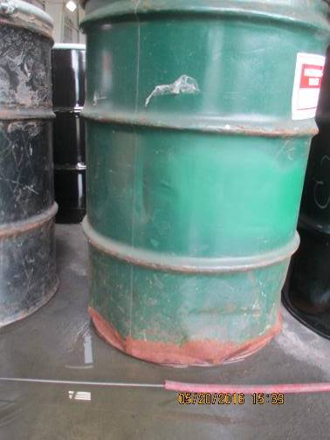
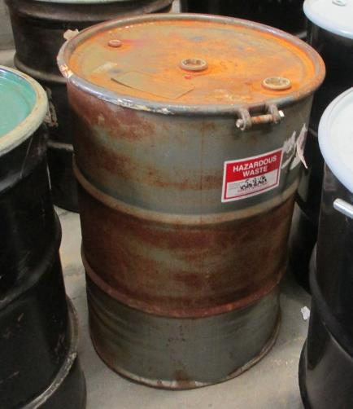
Container Management (b)
Bad condition
Notes:
265.171
Bad condition

Slide 35
Container Management (c)
40 CFR 265.173 – Management of Containers
Closed container

Slide 36
Container Management (d)
40 CFR 265.173 – Management of Containers
Open container

Slide 37
Recordkeeping
62-730.171(6), FAC
Maintain on-site a written record/log of:
Manifest number for each shipment that enters and leaves the facility;
The date when all hazardous waste enters and leaves the facility;
The Generator’s name and the EPA identification number (CESQGs include the name and address of the generator);
Amounts of hazardous waste and hazardous waste codes associated with each shipment into and out of the facility.

Slide 38
Closure
62-730.171(7), FAC
Submit a closure certification within 60 days of closure;
Closed in accordance with the Closure Plan;
The certification shall be signed by:
The owner or operator of the Transfer Facility;
The property owner;
A Florida-registered Professional Engineer.

Slide 39
Resources
EPA: Waste Transfer Stations - A Manual for Decision Making, June 2002
https://www.epa.gov/sites/production/files/2016-03/documents/r02002.pdf

Slide 40
Questions?
Hazardous Waste Program
8800 Baymeadows Way West
Suite 100 Jacksonville, Florida 32256 (904) 256-1700 (904) 256-1588 fax

