Slide 1
Natural Attenuation Monitoring (NAM)
Natural Attenuation Monitoring (NAM)
Jennifer L. Rogers, P.E.
Petroleum Restoration Program
Florida Department of Environmental Protection
PRP | 2025

Slide 2
NATURAL ATTENTUATION MONITORING
AGENDA
Presentation Goals:
Florida Statute (F.S.) and Florida Administrative Code (F.A.C.) Review.
Criteria for Natural Attenuation Monitoring (NAM).
Verifying Progress.
Timeframe for Achieving No Further Action (NFA).
Action Levels.
Expected Reductions.
NAM Parameters.
Cost Effective NAM.
Reviewing NAM Reports.
Underlined text in the presentation has embedded web links to documents.

Slide 3
NATURAL ATTENTUATION MONITORING
Florida Statute
Florida Statute (F.S.):
Chapter 376, F.S. - Pollutant Discharge Prevention And Removal.
Section 376.301, F.S. Definitions for terms used in Sections 376.30-376.317, F.S.
Including Section 376.3071, F.S. - Inland Protection Trust Fund (IPTF).
Section 376.301(25), F.S.
“Natural attenuation” means a verifiable approach to site rehabilitation that allows natural processes to contain the spread of contamination and reduce the concentrations of contaminants in contaminated groundwater and soil. Natural attenuation processes may include the following: sorption, biodegradation, chemical reactions with subsurface materials, diffusion, dispersion, and volatilization.

Slide 4
NATURAL ATTENTUATION MONITORING
Florida Statute
Florida Statute (F.S.):
Section 376.301(23), F.S.
“Long-term natural attenuation” means natural attenuation approved by the department as a site rehabilitation program task for a period of more than 5 years.

Slide 5
NATURAL ATTENTUATION MONITORING
Florida Statute
Florida Statute (F.S.):
Section 376.3071(5), F.S. - Site Selection And Cleanup Criteria.
Section 376.3071(5)(c)2., F.S.
Long-term Natural Attenuation Monitoring (LTNAM) when:
Free Product removal and other source removal completed.
Cost effective.
Plume is shrinking or stable.
Chemicals/Contaminants of Concern (COCs) are below Natural Attenuation Default Concentrations (NADCs).
Plume is confined to source property boundaries.
If beyond source property, NAM may continue per F.A.C.
If site no longer qualifies for NAM or LTNAM, resume active remediation.

Slide 6
NATURAL ATTENTUATION MONITORING
Florida Statute
Florida Statute (F.S.):
Section 376.3071(5), F.S. - Site Selection And Cleanup Criteria.
Section 376.3071(5)(c)2., F.S.
“For long-term NAM, if the petroleum products’ COCs increase or are not significantly reduced after 42 months of monitoring, or if the plume migrates beyond the property boundaries, active remediation shall be resumed as necessary.”
42 months = 3.5 years.
Section 376.3071(5)(c)2., F.S. sets the stage for “Level 1 Criteria.”

Slide 7
NATURAL ATTENTUATION MONITORING
Florida Statute
Florida Statute (F.S.):
Section 376.3071(5), F.S. - Site Selection And Cleanup Criteria.
Section 376.3071(5)(c)3., F.S.
Allows for NAM if COCs above NADCs when:
Cost effective.
Adequately protects public health, safety, welfare, water resources, and the environment.
Evaluation of site-specific characteristics supports NAM.
Section 376.3071(5)(c)3., F.S. sets the stage for “Level 2 Criteria.”

Slide 8
NATURAL ATTENTUATION MONITORING
Florida Administrative Code
Florida Administrative Code (F.A.C.):
Chapter 62-780, F.A.C. - Contaminated Site Cleanup Criteria.
Rule 62-780.690, F.A.C. Natural Attenuation Monitoring.
Paragraph 62-780.690(1)(a) through subparagraph 62-780.690(1)(f)1., F.A.C.
Implementation of Section 376.3071(5)(c)2., F.S.
Criteria for NAM – Applicability.
“Level 1 Criteria.”

Slide 9
NATURAL ATTENTUATION MONITORING
Florida Administrative Code
Florida Administrative Code (F.A.C.):
Chapter 62-780, F.A.C. - Contaminated Site Cleanup Criteria.
Rule 62-780.690, F.A.C. Natural Attenuation Monitoring.
Sub-subparagraphs 62-780.690(1)(f)2.a. through 62-780.690(1)(f)2.c., F.A.C.
Implementation of Section 376.3071(5)(c)3., F.S.
Demonstrate appropriateness of NAM.
“Level 2 Criteria.”

Slide 10
NATURAL ATTENTUATION MONITORING
NAM Criteria
NAM Criteria – Level 1 Criteria – Applicability:
Meet criteria before NAM starts – Verify criteria maintained during NAM.
Paragraph 62-780.690(1)(a) through subparagraph 62-780.690(1)(f)1., F.A.C.
Free product is not present, except where removal is not technologically possible, and no fire or explosion hazard exists.
AND…

Slide 11
NATURAL ATTENTUATION MONITORING
NAM Criteria
NAM Criteria – Level 1 Criteria – Applicability:
Meet criteria before NAM starts – Verify criteria maintained during NAM.
Paragraph 62-780.690(1)(a) through subparagraph 62-780.690(1)(f)1., F.A.C.
Soil contamination is not present in unsaturated zone, except…
Leachability-based Cleanup Target Levels (CTLs) may be exceeded if it has been demonstrated the soil is not a continuing source of groundwater contamination {e.g., determination via Synthetic Precipitation Leaching Procedure (SPLP)} or rate of leaching is less than rate of natural attenuation in the groundwater.
AND…

Slide 12
NATURAL ATTENTUATION MONITORING
NAM Criteria
NAM Criteria – Level 1 Criteria – Applicability:
Meet criteria before NAM starts – Verify criteria maintained during NAM.
Paragraph 62-780.690(1)(a) through subparagraph 62-780.690(1)(f)1., F.A.C.
Contamination is conducive to natural attenuation.
Data show an overall decrease in contamination.
AND…

Slide 13
NATURAL ATTENTUATION MONITORING
NAM Criteria
NAM Criteria – Level 1 Criteria – Applicability:
Meet criteria before NAM starts – Verify criteria maintained during NAM.
Paragraph 62-780.690(1)(a) through subparagraph 62-780.690(1)(f)1., F.A.C.
Contaminant plume (concentrations of COCs above applicable CTLs) is not migrating beyond Temporary Point of Compliance (TPOC) or vertically.
AND…

Slide 14
NATURAL ATTENTUATION MONITORING
NAM Criteria
NAM Criteria – Level 1 Criteria – Applicability:
Meet criteria before NAM starts – Verify criteria maintained during NAM.
Paragraph 62-780.690(1)(a) through subparagraph 62-780.690(1)(f)1., F.A.C.
AND… either: subparagraph 62-780.690(1)(f)1., or 62-780.690(1)(f)2., F.A.C. is met.
Subparagraph 62-780.690(1)(f)1., F.A.C. (Level 1 Criteria):
Site anticipated to meet NFA criteria as a result of Natural Attenuation;
Background or applicable CTLs are not exceeded at TPOC(s); and,
Contaminant concentrations do not exceed NADCs.

Slide 15
NATURAL ATTENTUATION MONITORING
NAM Criteria
NAM Criteria – Level 1 Criteria – Applicability:
Meet criteria before NAM starts – Verify criteria maintained during NAM.
Paragraph 62-780.690(1)(a) through subparagraph 62-780.690(1)(f)1., F.A.C.
AND… either: subparagraph 62-780.690(1)(f)1. or 62-780.690(1)(f)2., F.A.C. is met.
Subparagraph 62-780.690(1)(f)2., F.A.C. (Level 2 Criteria):
Demonstrate the appropriateness of NAM.

Slide 16
NATURAL ATTENTUATION MONITORING
NAM Criteria
NAM Criteria – Level 2 Criteria – Appropriateness:
Is NAM Appropriate?
Meet criteria before NAM starts – Verify criteria maintained during NAM.
Sub-subparagraphs 62-780.690(1)(f)2.a. through 62-780.690(1)(f)2.c., F.A.C.
Technical Evaluation of site-specific conditions;
Scientific Evaluation (e.g., model) of plume migration, estimation of expected annual reductions of COCs in wells, and an estimated timeframe for achieving NFA; and,
Life-Cycle Cost Analysis of remedial alternatives.

Slide 17
NATURAL ATTENTUATION MONITORING
Verifying Progress
Florida Statute (F.S.):
Section 376.3071(5)(c)2., F.S.
Timeframe for achieving NFA:
If COCs are not significantly reduced after 42 months (3.5 years) of monitoring, active remediation shall be resumed, as applicable.
If at or beyond 42 months of NAM the continuation of NAM is recommended, Site Manager and/or Technical Reviewer shall review the site status with PRP Chief or Assistant Chief P.E.

Slide 18
NATURAL ATTENTUATION MONITORING
Verifying Progress
Florida Administrative Code (F.A.C.):
Paragraphs 62-780.690(8)(e) and 62-780.690(8)(f), F.A.C.
Action Levels and Expected Reductions:
Compare COCs concentration data to:
Action Levels; and,
Expected Reductions.

Slide 19
NATURAL ATTENTUATION MONITORING
Verifying Progress
Action Levels:
Specified in NAM Plan Approval.
NAM Plan Approval Orders for non-program discharges.
Template NAM Plan Approval letter for program discharges.
Should be specific to each contaminant and monitoring well.
Should not be NADCs.
Unless “Level 2 NAM Plan” approved.
If COC >NADC – no longer meets “Level 1” criteria for NAM.

Slide 20
NATURAL ATTENTUATION MONITORING
Verifying Progress
Action Levels:
Examples of Action Levels:
For wells within the plume: historical high concentrations or a percent above the average.
For cross- or down-gradient wells: first time detection or exceedance of CTLs.

Slide 21
NATURAL ATTENTUATION MONITORING
Verifying Progress
Action Levels:
If Action Level exceeded, per Chapter 62-780, F.A.C., signed/sealed monitoring report recommends:
Additional assessment;
Continued NAM;
Remedial Action Plan (RAP) for return to active remediation; or,
Any other action allowed under Chapter 62-780, F.A.C.

Slide 22
NATURAL ATTENTUATION MONITORING
Verifying Progress
Action Levels:
Resampling within 30 days to confirm exceedance is not specified for NAM.
It is recommended to resample within 30 days to confirm exceedance of Action Level (unless exceedance anticipated, e.g., potential increasing trend).
Resampling within 30 days to confirm exceedance is specified in Chapter 62-780, F.A.C. for Post Active Remediation Monitoring (PARM).

Slide 23
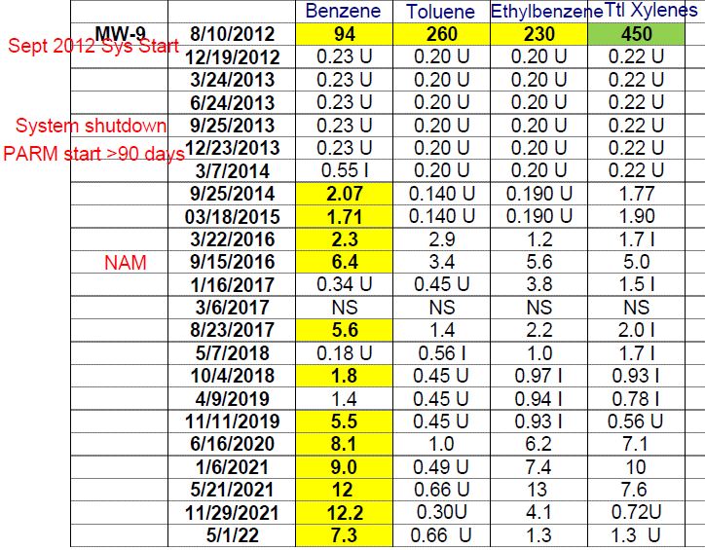
NATURAL ATTENTUATION MONITORING
Verifying Progress
Expected Reductions – Verify Progress:
Graphing.
Example site.

Slide 24
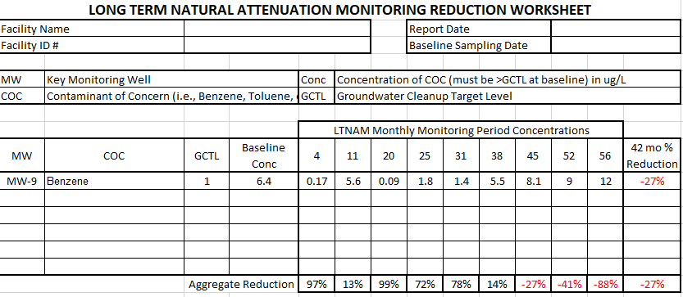
NATURAL ATTENTUATION MONITORING
Verifying Progress
Expected Reductions – Verify Progress:
Percent Reduction Calculations - LTNAM Reduction Worksheet.
Average Reduction – sum of all individual COC percentage changes for all individual key wells during monitoring period divided by the total number of measurements.
Example site.

Slide 25
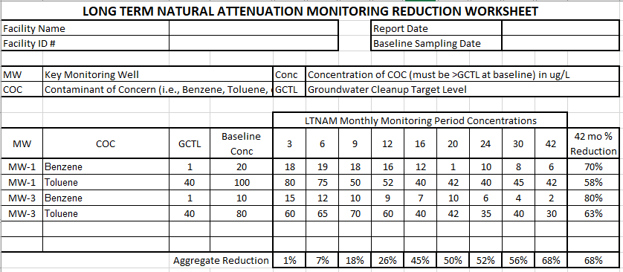
NATURAL ATTENTUATION MONITORING
Verifying Progress
Expected Reductions – Verify Progress:
Percent Reduction Calculations - LTNAM Reduction Worksheet
Average Reduction – sum of all individual COC percentage changes for all individual key wells during monitoring period divided by the total number of measurements.
Example Calculation:
{(20 - 18) / 20 * 100 + (100 - 80) / 100 * 100 +
(10 - 15) / 10 * 100 +
(80 - 60) / 80 * 100}
All divided by 4 = ~1%

Slide 26
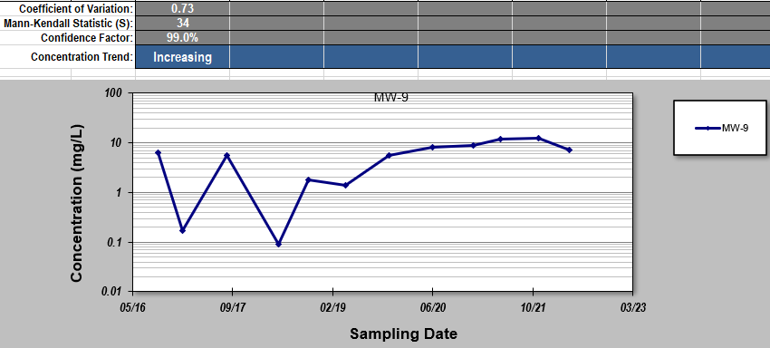
NATURAL ATTENTUATION MONITORING
Verifying Progress
Expected Reductions – Verify Progress:
Trend Calculations:
Mann-Kendall – Plume Characterization.
Approved statistical method per subsection 62-780.610(2), F.A.C.
EPA – ProUCL.
Example site.

Slide 27
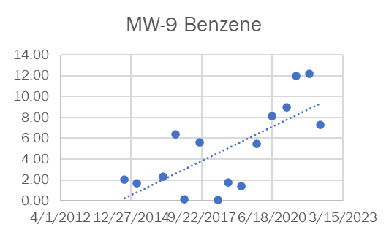
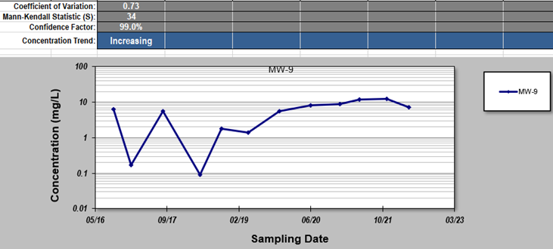
NATURAL ATTENTUATION MONITORING
Verifying Progress
Timeframe for Achieving NFA (Example):
At 42 months (3.5 years).
Trend increasing.
At 45+ months (3.75+ years).
Site no longer meets criteria for NAM.

Slide 28
NATURAL ATTENTUATION MONITORING
Verifying Progress
Timeframe for Achieving NFA:
If significant reduction not being achieved at 42 months (3.5 years):
Recommend active remediation?
Is funding limiting return to active remediation?
Is alternative closure an acceptable option? For example:
Risk Management Option Level II (RMO II);
RMO III; or,
Low-Scored Site Initiative (LSSI) NFA.

Slide 29
NATURAL ATTENTUATION MONITORING
Verifying Progress
Timeframe for Achieving NFA:
If significant reduction not being achieved at 42 months (3.5 years):
Recommend evaluation of Level 2 Criteria to continue NAM?
Preliminarily - Recommend monitoring for NAM parameters.
Are site-specific parameters limiting natural attenuation?
Use to support recommended active remediation (enhancement).
Use to support continuing NAM under Level 2 Criteria.

Slide 30
NATURAL ATTENTUATION MONITORING
Verifying Progress
NAM Parameters:
2018 Technical Protocol for Evaluating NA Parameters at Sites with Petroleum Contaminated Groundwater.
Guidance for evaluating effectiveness and progress of NAM using NAM parameters.
Laboratory: Nitrate and Nitrite, Manganese, Insoluble Iron and Dissolved Iron, Sulfate, Methane.
Field: Dissolved Oxygen, pH, Oxidation-Reduction Potential (ORP), Temperature.
Data may support enhancement(s) for natural attenuation.

Slide 31
NATURAL ATTENTUATION MONITORING
Continuing NAM
If NAM is Continuing – Cost Effective NAM Plan:
Sampling Plan Reductions/Revisions.
Reduce frequency or remove select well(s) or parameters.
Change well(s).
Changes proposed by Contractor.
DEP or Local Program (LP) Site Manager may recommend for consideration.
Anytime applicable.
Review with Professional.

Slide 32
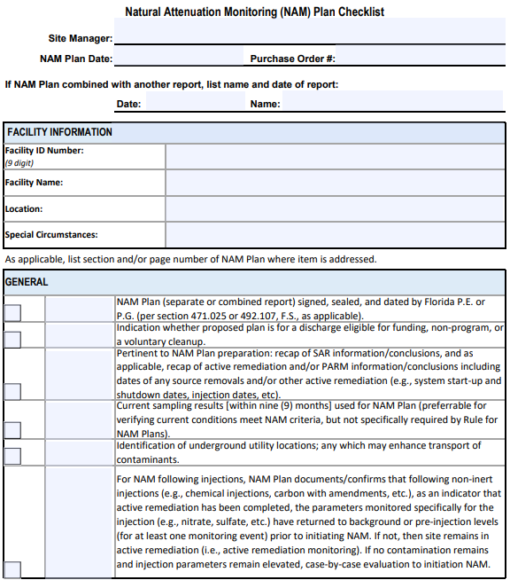
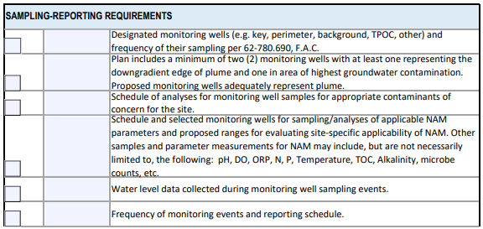
NATURAL ATTENTUATION MONITORING
Continuing NAM
If NAM is Continuing – Cost-Effective NAM Plan:
Maintain Minimum NAM.
Minimum of 2 wells (per Chapter 62-780, F.A.C.).
Downgradient edge of plume.
Highest contamination or source area.
Maintain data required for documenting achievement of closure goals.
Maintain data required for evaluating progress of NAM.
Revise NAM Plan.
Refer to NAM Plan Checklist for additional guidance.

Slide 33
NATURAL ATTENTUATION MONITORING
Template NAM Report
Template NAM Report:
Background.
Brief conclusions of Site Assessment, Active Remediation, PARM, NAM.
Dates any source removal completed and/or system shutdown.
Recent NAM Activities.
Evaluate Progress of NAM.
Criteria for NAM – Verify Maintained.
Comparison of data to Action Levels.
Comparison of data to expected reductions.
Conclusions & Recommendations.
Anticipated timeframe for achieving NFA.

Slide 34
NATURAL ATTENTUATION MONITORING
Reviewing NAM Reports
Reviewing NAM Reports:
Criteria for NAM – Verify Maintained.
Likely unchanged from initial review of NAM criteria:
Free Product?
Soil Contamination? If present, leaching?
COCs conducive to natural attenuation?

Slide 35
NATURAL ATTENTUATION MONITORING
Reviewing NAM Reports
Reviewing NAM Reports:
Criteria for NAM – Verify Maintained.
Potential for change from initial review of NAM criteria:
Plume migrating horizontally? Vertically?
Data indicate a decreasing trend in contamination?
Site anticipated to achieve NFA via natural attenuation?
COCs below applicable CTLs at source property boundary?
If not, are TPOC(s) established and are COCs below applicable CTLs at TPOC(s)?
COCs below NADCs?
If not, is Level 2 NAM Plan approved and are Level 2 criteria met and maintained?

Slide 36
NATURAL ATTENTUATION MONITORING
Reviewing NAM Reports
Reviewing NAM Reports:
Verify Progress:
Compare data to Action Levels.
If Action Level(s) exceeded, is recommended course of action provided?
Compare data to expected reductions.
Is significant reduction being achieved?

Slide 37
NATURAL ATTENTUATION MONITORING
Reviewing NAM Reports
Reviewing NAM Reports:
Conclusions.
Is site anticipated to achieve agreed upon closure goal (e.g., RMO I, RMO II, RMO III, LSSI NFA) by natural attenuation?
Is estimated timeframe for achieving NFA maintained? lengthening?
If NAM criteria not maintained, is recommended course of action provided?
Refer to NAM Report Checklist for additional guidance.

Slide 38
NATURAL ATTENTUATION MONITORING
Summary
Summary:
Florida Statute and Florida Administrative Code Review.
Criteria for NAM.
Verifying Progress.
Timeframe for achieving NFA.
i.e., achieve agreed upon closure goal (e.g., RMO I, II, or III; or LSSI NFA).
Action Levels.
Expected Reductions.
NAM Parameters.
If continuing NAM - Cost Effective NAM.
Reviewing NAM Reports.
If NAM is not progressing – return to active remediation - Achieve NFA.

Slide 39
NATURAL ATTENTUATION MONITORING
Additional NAM Guidance
Additional NAM Guidance:
1998 BPSS-11 NAM Procedures.
Uses Level 1 and Level 2 terminology.
2018 Technical Protocol for Evaluating NA Parameters at Sites with Petroleum Contaminated Groundwater.
Guidance for evaluating effectiveness and progress of NAM using NAM parameters.
2022 Revised Procedures for Implementation of the NAM in PRP (Supersedes February 1, 2011, Procedures).
Uses Level 1 and Level 2 terminology.

Slide 40
Questions?
QUESTIONS?
Jennifer L. Rogers, P.E.
Petroleum Restoration Program Team 1
Florida Department of Environmental Protection
Contact Information:
850-245-8919
Jennifer.L.Rogers@floridadep.gov

