Slide 1
Welcome slide

Slide 2
Opening welcome slide
New GIS Standards for Planning Grants
Updated for 2025
Andy Woeber
Office of Resilience and Coastal Protection / Resilient Florida
Florida Department of Environmental Protection
Online | Wednesday, February 19, 2025
Notes:
Hi, my name is Andy Woeber, a GIS Analyst with the Florida Department of Environmental Protection. I work in the Resilient Florida Program within the Office of Resilience and Coastal Protection. This presentation will cover the new GIS standards for planning grants that have been updated for the year 2025.

Slide 3
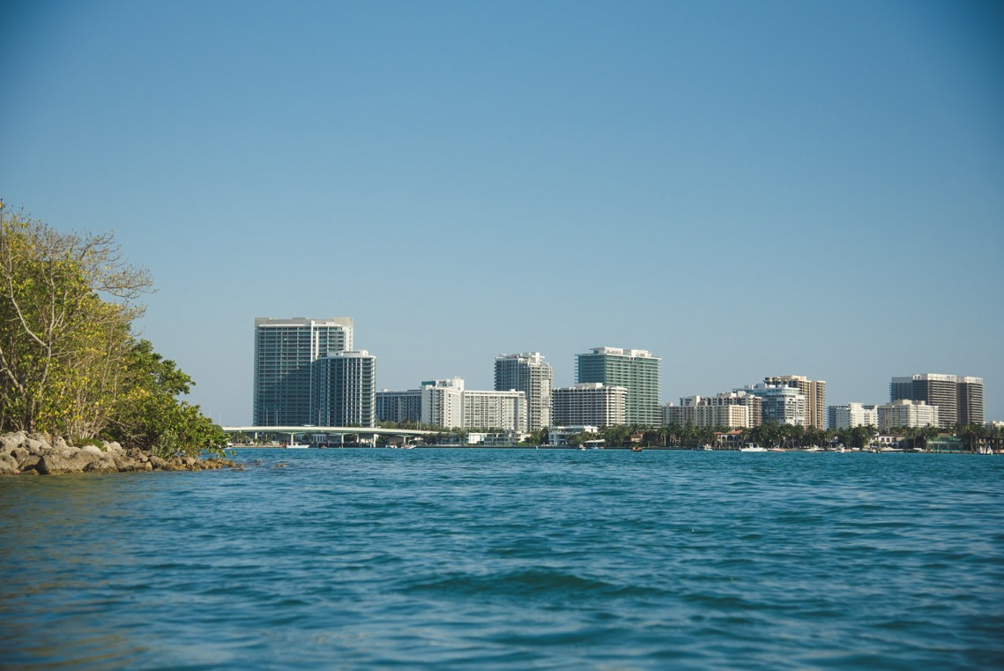
New GIS Standards for Planning Grants
Presentation Agenda
Introduction
GIS Standards
What are they?
Why needed?
What are the 2025 updates?
Acceptable Data Formats and Datums
Sensitive Data
Data Collection and Attribution Schemas
Background Data Catalog
Flood Risk Scenario Matrix
Critical Assets Data\Schema
VA Results Attributes Schema
Elevation Data and Metadata
Resources
Notes:
I will introduce the GIS standards with an overview of what they are and why they are needed and what has been updated. I will go over the acceptable GIS data formats and horizontal and vertical datum requirements for the GIS deliverables. I will include information on how to mark sensitive data and what formats are needed for the data collection and data schema processes. I will also highlight the inclusion of a background data catalog. Also included will be a discussion of the flood risk scenario matrix, the critical assets data schema and the vulnerability assessment attributes schema. I will finish by covering elevation data and metadata requirements and provide a list of resources.

Slide 4
Introduction
New GIS Standards for Planning Grants

Slide 5
New GIS Standards for Planning Grants
Purpose of the GIS Standards
Pursuant to Section 380.093(3)(c), Florida Statutes (F.S.), grantees who receive funding from the Resilient Florida Grant Program (Program) to complete a Vulnerability Assessment (VA) shall submit all electronic mapping data used to illustrate the flooding and sea level rise impacts identified in the VA to the Florida Department of Environmental Protection (aka the “Department”).
Notes:
Section 380.093 Florida Statutes states that grantees who receive funding from the Resilient Florida Grant Program to complete a vulnerability assessment shall submit all electronic mapping data used to illustrate the flooding and sea level rise impacts identified in the VA to the Florida Department of Environmental Protection, also known as the department.

Slide 6
New GIS Standards for Planning Grants
What are they?
A guidance document listing the data formats, attribution schema, and other related requirements regarding all the spatial data to be submitted by grantees as part of a planning grant.
Specifically, grantees are required to submit electronic data as part of a planning grant according to the requirements of the Florida Department of Environmental Protection (aka the “Department”). Therefore, to assist grantees, the guidance document was developed to outline the data formats, attribution schema, coordinate systems, data classifications, and resources necessary for the submittal of spatial data deliverables.
Notes:
The guidance document for the new GIS standards for planning grants ensures that GIS deliverables meet the requirements of the resilient florida grant program. The document provides the required data formats, attribution schema, coordinate systems, data classifications and resources necessary for the submittal of spatial data deliverables.

Slide 7
New GIS Standards for Planning Grants
Why are they needed?
Revisions to the GIS standards were implemented in 2025 to present methods to gain efficiencies to allow faster GIS deliverable reviews and support both the inclusion, update and maintenance of the data for the Department’s Statewide Critical Asset Dataset (SCAD) and the Statewide Vulnerability Assessment (SVA) Dataset.
Notes:
The revisions to the GIS standards are needed to enhance the resilient florida grant program’s mission to update and maintain the data for inclusion in the Department’s statewide critical asset dataset and the statewide vulnerability assessment dataset. By requiring a background data catalog and ensuring complete source, download, and metadata locations for public datasets, the burden of submitting the public data is reduced for the GIS task requirements.

Slide 8
New GIS Standards for Planning Grants
What are the 2025 updates?
Requires submitting a “Background Data Catalog” in Excel format for all data collected as part of the acquire background data task.
Comprehensive and detailed for all sources.
Eliminates the need to submit publicly sourced data if information including sources and metadata are provided in the catalog.
Focuses on locally non-published data for submittals.
Develops specific table schema for the critical asset datasets. Adds ability to mark assets as private or public.
Develops specific table schema for the final vulnerability assessment results.
Minor updates to horizontal coordinate reference systems.
Elevation data – Acceptable data formats and which datasets might be required to be submitted.
Notes:
Major updates to the GIS standards for planning grants include the requirement of a background data catalog for all data sources for the acquire background data task. Therefore, the focus will be on the locally non-published data and custom formatted flood scenario rasters for data submittals and the development of specific table schemas for the critical asset datasets and the final vulnerability assessment results. Minor updates to horizontal coordinate reference systems and acceptable formats and which datasets are required for submittal of elevation data are also addressed in the standards.

Slide 9
Acceptable Data Formats and Datums
New GIS Standards for
Planning Grants

Slide 10
GIS Data Formats
Vector Data Formats
ESRI file geodatabase feature class.
Shapefile (e.g wetlands.shp).
Raster Data Formats
File geodatabase raster
TIFF / GeoTIFF
Project Package
ESRI’s Project Package
Open Geospatial Consortium (OGC) project package
Spatial data requirements
The Department uses the Environmental Systems Research Institute’s (ESRI) suite of GIS tools and products. Therefore, data need to conform to the standard vector and raster formats as listed to the right. Resources are provided in the GIS standards document to provide more details on the types of formats.
Notes:
The Department uses the ESRI suite of GIS software products. The data need to conform to the vector and raster formats illustrated on this slide. More resources are provided in the GIS standards document.

Slide 11
Acceptable Coordinate Systems
Datums and Coordinate Reference Systems (CRS)
Local data are required to use the State Plane coordinate systems in Florida (North, West, or East). Datasets that span multiple State Plane coordinate regions can use the Florida GDL Albers projection. Data that are provided with a geographic coordinate system (GCS) only can be accepted in the special case that the source data is maintained only in a GCS that must be either NAD83/2011 or WGS84.
Horizontal Datum
North American Datum of 1983 (NAD83) with the 2011 Adjustments (NAD83/2011)
Vertical Datum
North American Vertical Datum of 1988 (NAVD88)
Coordinate Reference Systems (CRS)
State Plane Coordinate Systems (local)
Florida GDL Albers (regional)
GCS NAD83/2011 or WGS84 (special case only)
Notes:
A minor change here from the previous standards is the horizontal datum. Datasets are required to be referenced to the North American Datum of 1983 with the 2011 adjustments. The North American vertical datum of 1988 remains unchanged from the previous standards for reporting depth measurements. For coordinate reference systems, if the extent of the project is small in area, please use the appropriate State Plane coordinate system. If the extent is larger and encompasses a region that spans two or more state plane regions, then use the Florida GDL Albers coordinate reference system. If data is provided in a geographic coordinate system only, that data can be accepted in the special case that the source data is maintained only in a GCS of either NAD83/2011 or WGS84.

Slide 12
Sensitive Data
New GIS Standards for
Planning Grants

Slide 13
New GIS Standards for Planning Grants
Sensitive Data
Pursuant to Chapter 119, Florida Statutes – Public Records, any data submitted to the Department becomes public domain and is subject to public record requests.
Any datasets or individual asset features considered to be sensitive by the grantee can be exempt from this requirement by explicitly identifying them and excluding them from public records using one of the following methods:
Marking the data as “sensitive” in the Background Data Catalog.
Marking the data as “sensitive” in the dataset metadata.
Marking the data as “sensitive” using the feature attributes field “Restricted_Public_Disclosure” found in the Critical Assets Basic Attribute Schema.
Notes:
According to Chapter 119 of the Florida Statutes, any data submitted to the Department becomes public domain and is subject to public record requests. Sensitive data can be exempt from this requirement by explicitly identifying and excluding them from public records. Data can be excluded from public records by marking the data as “sensitive” either in the Background Data Catalog, the dataset metadata, or using the feature attributes field “restricted public disclosure” found in the critical assets basic attribute schema. Data can be omitted from the submitted data to the Department, however if this choice is taken, those assets omitted will not be eligible for future grants.

Slide 14
New GIS Standards for Planning Grants
Sensitive Data
Note: Sensitive assets/datasets will still be used in the Department’s Statewide Vulnerability Assessment (SVA), however the results will not be shared with the public.
Notes:
While sensitive assets and datasets can be excluded from the public domain, the results will still be used in analyses conducted in the Department’s statewide vulnerability assessment. However, the results will not be shared with the public.

Slide 15
Data Collection and Attribution Schemas
New GIS Standards for
Planning Grants

Slide 16
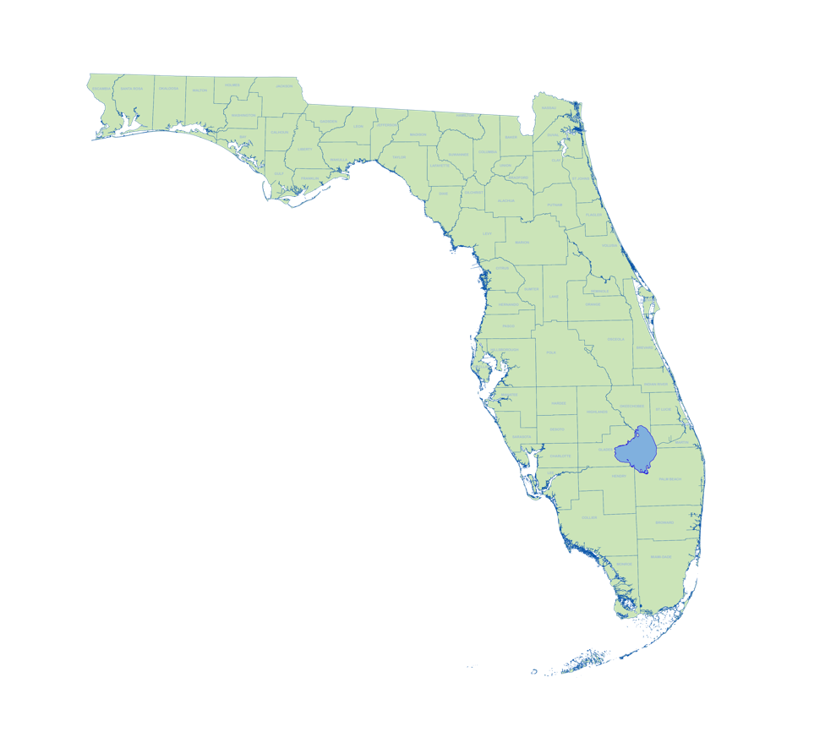
Background Data Catalog
A background data catalog for all acquired data must be created and submitted.
The catalog must be in Excel format and contain information based on the Background Data Catalog Table Description found in the “Resources” section of the Planning Grant GIS Standards.
Notes:
The background data catalog for all acquired data must be created in Excel format and contain information based on the background data catalog table description found in the resources section of the planning grant GIS standards.

Slide 17
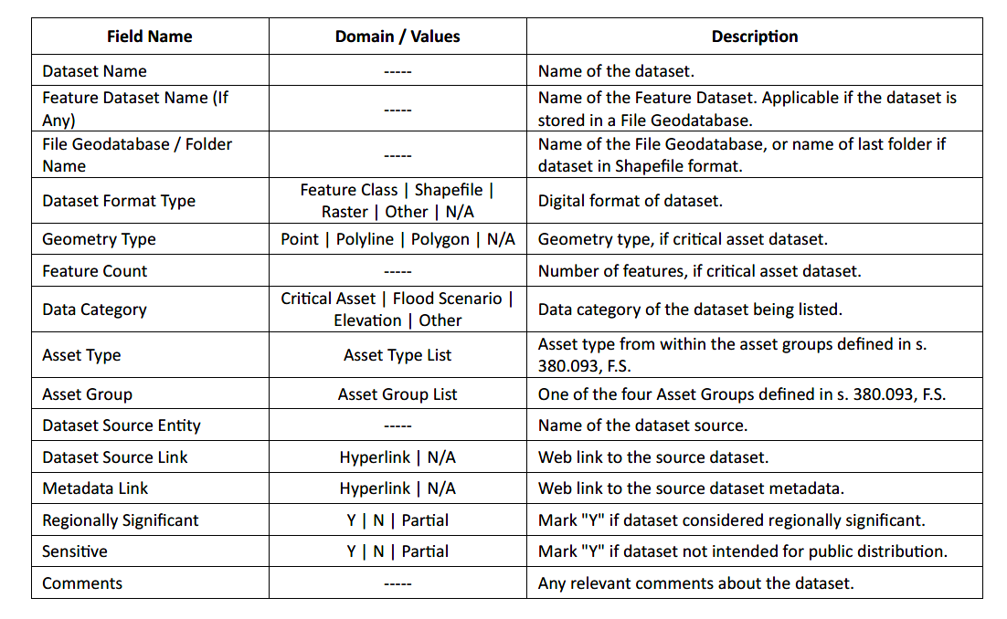
Background Data Catalog
Background Data Catalog Table Description.
Domain values indicate which values are accepted for entry or from which list to lookup the value.
This table and a template and example table are provided in the “Resources” section of the Planning Grant GIS Standards.
Notes:
This slide shows the field names and descriptions for the background data catalog. Domain values are shown to indicate which values are accepted for entry into that field or whether the value comes from a specific list of values in the case of the asset type or asset group fields. For the regionally significant and sensitive field names, the Y for Yes value indicates that all the individual assets in the dataset are “regionally significant” or that all the assets are “intended for public distribution”. If marked N or No, none of the individual assets are “regionally significant” or none of the assets are intended for public distribution. Partial indicates that there is a mix of Y and N values for the individual assets for a particular dataset. This table and a template and example table are provided in the resources section.

Slide 18
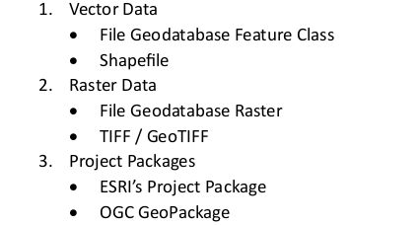
Flood Risk Scenario Data
As part of the Acquire Background Data and Final Vulnerability Assessment (VA) grant tasks, flood risk scenarios used in the VA must be submitted in acceptable data formats. However, the data obtained from publicly available flood scenarios does not have to be submitted but must be provided in the Background Data Catalog.
Data created in custom or modified flood risk scenarios used in the VA and not available publicly will need to be submitted.
Notes:
Flood risk scenario data must be submitted in acceptable formats. However, data obtained from publicly available scenarios does not have to be submitted but can be documented with the source and metadata and download links in the background data catalog.

Slide 19
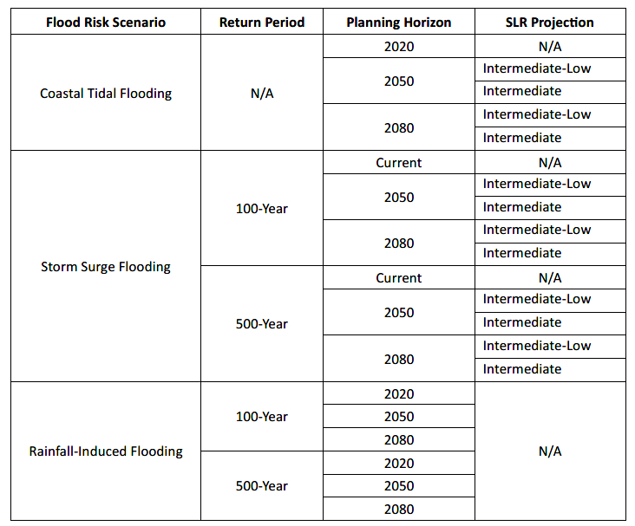
Flood Risk Scenario Matrix
Flood Risk Scenario Matrix Example.
A matrix table for all Flood Risk Scenarios (FRS) used in the Vulnerability Assessment (VA) must be created and submitted.
This table must be in Excel format and follow the matrix shown to the right. A spreadsheet containing a matrix and a template is provided in the “Resources” section of the Planning Grant GIS Standards.
Notes:
A flood risk scenario matrix table in Excel format must be created and submitted for all flood risk scenarios used in the vulnerability assessment. An example is shown here in this slide and templates are provided in the resources section.

Slide 20
Critical Assets Data \ Schema
Purpose: Describes the standard attribution schema and the classification values for the compiled spatial datasets to be submitted for both the Acquire Background Data and the Final Vulnerability Assessment tasks.
A spreadsheet “Critical Assets Basic Attributes Schema” is provided as a template in the “Resources” section of the Planning Grant GIS Standards.
All critical asset features within the dataset must be properly classified by asset types and asset groups as listed in 380.093 Florida Statutes. A complete list of the asset types and asset groups is provided in “Critical Asset Groups and Types” in the “Resources” section.
Notes:
Critical assets data needs to conform to a specific field schema to include the asset types and asset groups listed in 380.093 Florida Statutes. A complete list of the asset types and asset groups is provided in “Critical Asset Groups and Types” in the resources section. An Excel spreadsheet template called Critical Assets Basic Attributes Schema is provided in the Resources section.

Slide 21
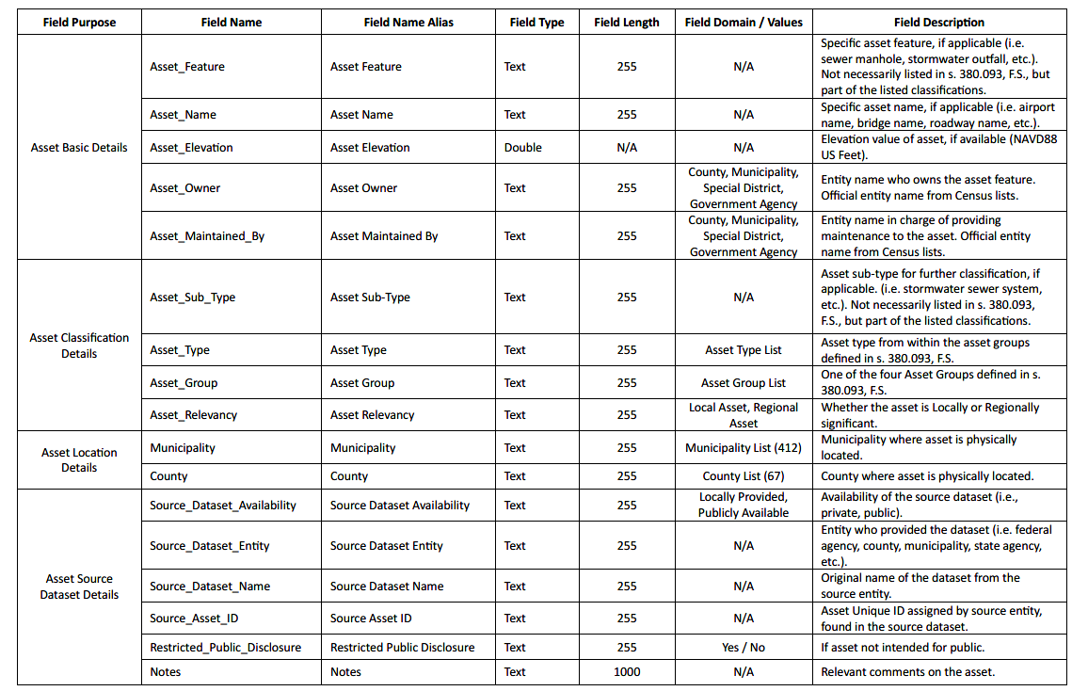
Critical Assets Data \ Schema
Critical Assets Basic Attributes Schema
Notes:
Field names and descriptions for the critical assets basic attributes schema. A note here that the field “asset sub type” can be optionally used to add more details to the asset type classification. Since entire datasets cannot be regionally significant, the regional significance needs to be assigned at the asset level using the field “asset relevancy”. Also the “restricted public disclosure” field allows marking a specific asset as intended for restrictions to private use only or allowed for public disclosure.

Slide 22
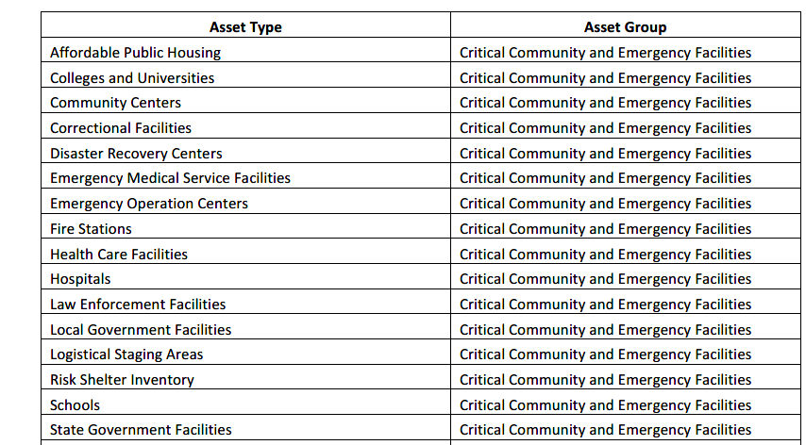
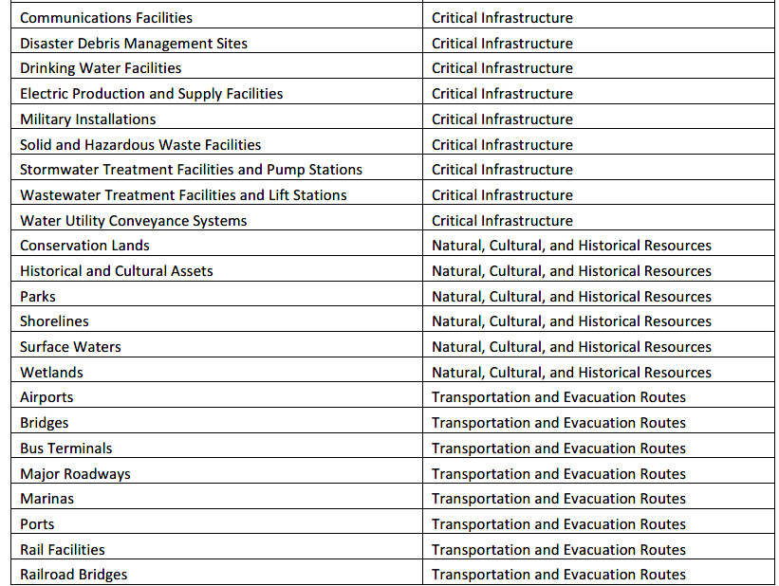
Critical Assets Groups and Types
Notes:
Classifications are shown here for the critical asset groups and types. This list, developed as part of the 380.093 Florida statutes, is not comprehensive but outlines the major categories and serves as a guidance to providing the critical asset lists for a vulnerability assessment.

Slide 23
Vulnerability Assessment Results
Attributes Schema
Purpose: Results of all the flood risk scenarios analyzed must be included with the datasets and formatted to follow the “Vulnerability Assessment Results Attributes Schema” and the “Critical Assets Basic Attributes Schema”.
Specific naming conventions of the field names and field alias and how to create them are provided on pages 7 through 9 of the Planning Grant GIS Standards.
The conventions are needed to integrate all the VA flood risk scenario results for the State of Florida.
Notes:
Results of all the flood risk scenarios analyzed in the VA must be included with the datasets. The results need to be formatted to follow the vulnerability assessment results attributes schema and the critical assets basic attributes schema. The conventions are needed to integrate all the VA flood risk scenario results for the State of Florida.

Slide 24
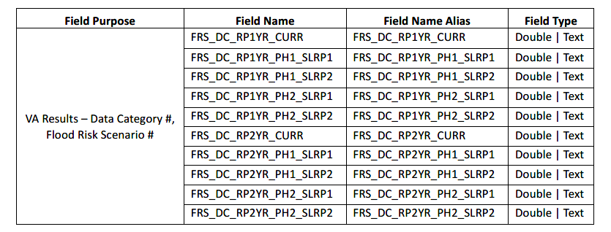
Vulnerability Assessment Results
Attributes Schema Example
Notes:
This example shows the acronyms format for the flood risk scenario field names. More information on how to construct these is provided in pages 7 through 9 of the planning grant GIS standards.

Slide 25
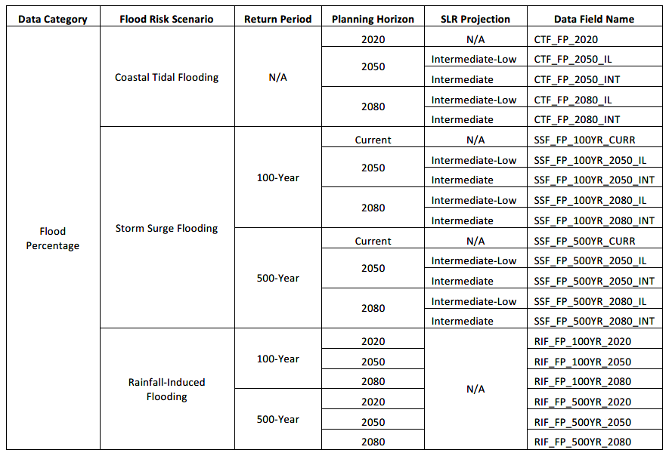
Relationship of Flood Risk Scenarios to Final Field Names in VA Results Attributes Schema
Notes:
Presented here is a table that shows the relationship of the flood risk scenarios to the final field names to be used in the VA results attributes schema.

Slide 26
Elevation Data (Digital Elevation Models)
In the Acquire Background Data task, digital elevation models (DEM) or Elevation Certificate digital data to be used in the VA must be submitted to the Resilient Florida Grant program in an acceptable data format.
However, publicly available elevation data does not need to submitted. Instead, the source and metadata information for these datasets must be provided in the Background Data Catalog, including a link to the online hosted feature service, image service or map service, or link to the data download web page.
Notes:
Digital elevation models or elevation certificate digital data used in the VA must be submitted to the resilient florida grant program in acceptable data format. However, publicly available elevation data does not need to be submitted but source and metadata information provided in the background data catalog. The information must also include links to the online hosted feature service, image service or map service and include links to the data download pages.

Slide 27
Metadata
Metadata must be submitted alongside each spatial dataset, in a format compliant with the Content Standard for Geospatial Metadata (CSDGM) from the Federal Geographic Data Committee (FGDC). The acceptable file formats are listed below:
Feature Dataset Layer or Shapefile FGDC-CSDGM
Extended Markup Language (XML) file
At a minimum, the local dataset metadata is required to contain the following information:
Title
Summary
Description
Date of Creation / Collection
Contact Person
Update Frequency
Use Limitations / Access Constraints
Notes:
Metadata needs to be supplied in acceptable file formats for each spatial dataset submitted. The file formats consist of the feature dataset layer or shapefile or in an extended markup language (xml) file. Metadata is required to contain the minimum information listed in the slide.

Slide 28
Resources
Tables
Table 1: Background Data Catalog Table
Table 2: Flood Risk Scenario Matrix
Table 3: Critical Assets Basic Attributes Schema
Table 4: Critical Assets Groups and Types
Table 5: Vulnerability Assessment Results Attribute Schema
Reference Links
Please see the Planning Grants GIS Standards for the linked references provided.
Notes:
This is the resources slide indicating the hyperlinks to the description and template tables in Excel format. Reference links to other resources can be found in the planning grant GIS standards.

Slide 29
Thank you slide
THE FLORIDA DEPARTMENT OF ENVIRONMENTAL PROTECTION
THANK YOU
Andy Woeber
Office of Resilience and Coastal Protection / Resilient Florida Program
Florida Department of Environmental Protection
Contact Information:
1 (850) 245-8031
Nathan.Woeber@floridadep.gov
Notes:
Thank you for your time today and this concludes the overview of the new GIS standards for planning grants for the resilient florida grant program.

Slide 30
Closing slide
THE FLORIDA DEPARTMENT OF ENVIRONMENTAL PROTECTION

