Slide 1
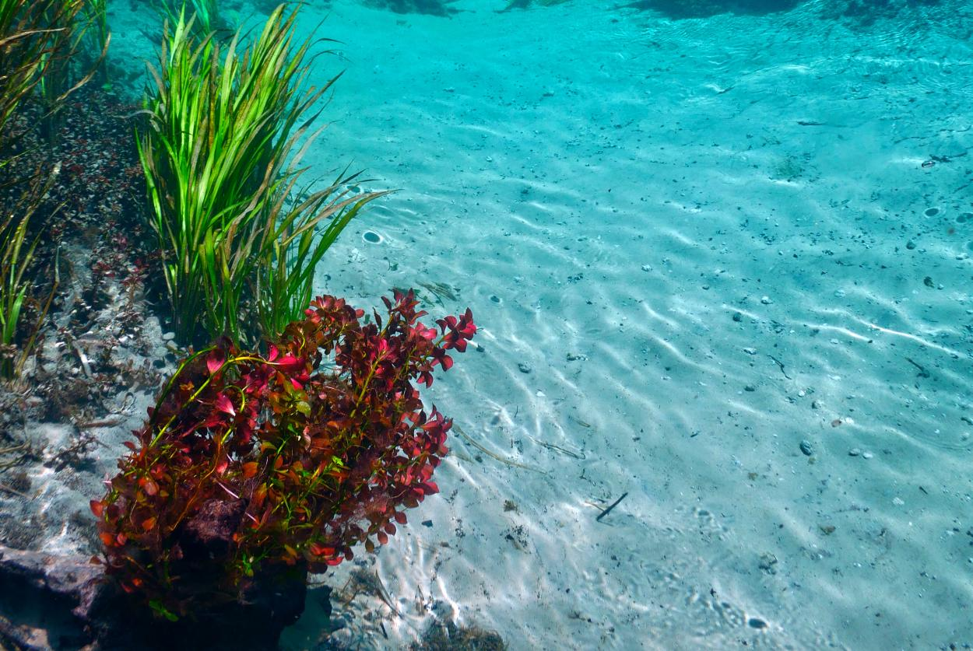
62-41.400-402, FAC Outstanding Florida Springs
Rule Development Workshop
March 21, 2022
Stefani Weeks

Slide 2
Workshop Agenda
Welcome
Background
Draft Rule Overview
Public Comment
Link to OFS Rulemaking:
https://floridadep.gov/water-policy/water-policy/content/outstanding-florida-springs-ofs

Slide 3
Background
For Outstanding Florida Springs, section 373.219(3), F.S., requires the Department to adopt:
uniform rules for issuing permits which prevent groundwater withdrawals that are harmful to the water resources
a uniform definition of the term “harmful to the water resources” to provide water management districts with minimum standards necessary to be consistent with the overall water policy of the state
WMDs can adopt a definition that is more protective of the water resources consistent with local or regional conditions and objectives.

Slide 4
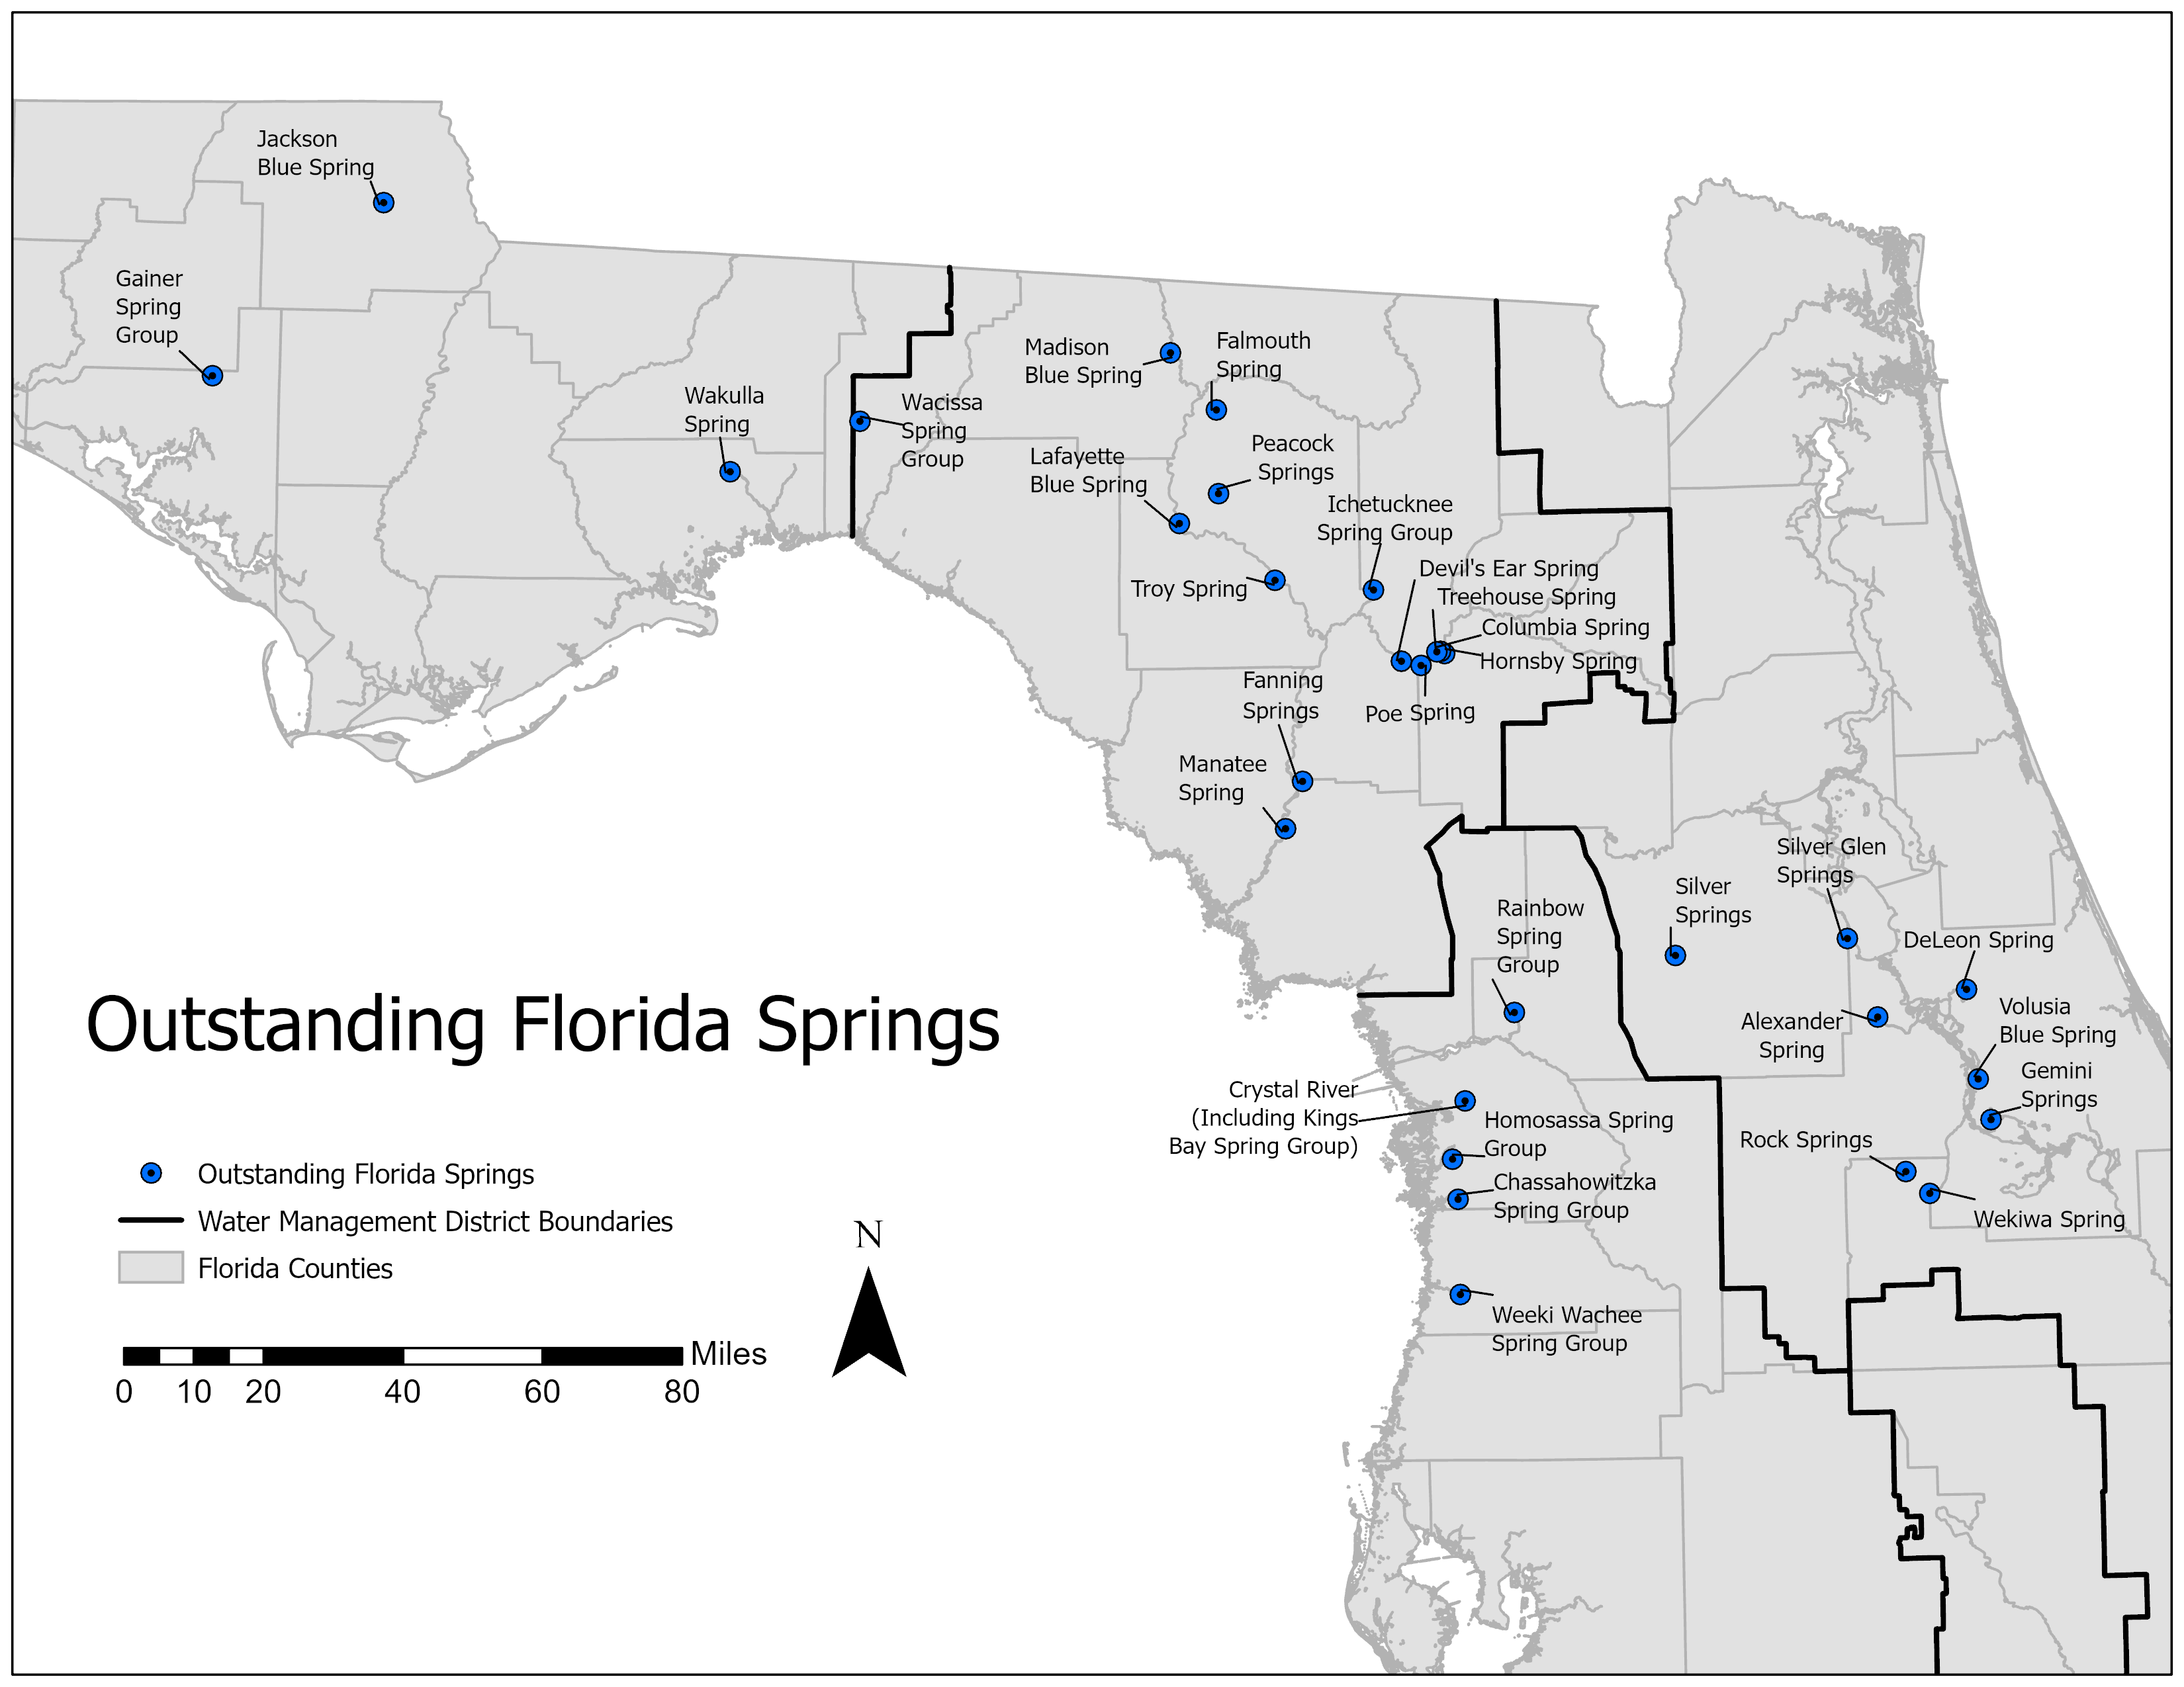
Scope of Rule
Regulates consumptive uses that have the potential to impact an Outstanding Florida Spring as defined in 373.802(4), F.S.

Slide 5
Uniform Conditions for Issuance of Permits
For withdrawals that influence an OFS, permittees must provide reasonable assurance that the condition of issuance are met.
Similar to CUPCon and CFWI Conditions for issuance

Slide 6
Uniform Definition of Harmful to the Water Resources
Harmful to the Water Resources for Outstanding Florida Springs (OFS) means adversely impacting an OFS in one or more of the ways prohibited in paragraph 62-41.401(2)(g), F.A.C
(g) Will not cause harm to the water resources of the area in any of the following ways:
1. Will not cause harmful water quality impacts to the water source resulting from the withdrawal or diversion;
2. Will not cause harmful water quality impacts from dewatering discharge to receiving waters;
3. Will not cause harmful saline water intrusion or harmful upconing;
4. Will not cause harmful hydrologic alterations to natural systems, including wetlands or other surface waters; and
5. Will not otherwise cause harmful hydrologic alterations to the water resources of the area;

Slide 7
Harmful to the Water Resources
Creates criteria for the evaluation of impacts from withdrawals or diversions, on an individual or cumulative basis, on an OFS
Cannot move contamination plume or alter the rate or direction of movement towards an OFS or its spring run
Cannot cause harmful water quality impacts from dewatering discharges to the OFS or its spring run
Cannot increase TDS or chloride concentrations that would detrimentally affect the OFS or its spring run
Cannot cause adverse impacts to aquatic wetland dependent flora or fauna in the spring
Cannot cause hydrologic alterations that decrease flow rates to downgradient watercourses

Slide 8
Public Comment
Participants will be given 3 minutes to make their comments.
Written comments may be submitted to the email address below.
www.floridadep.gov/water-policy
OWP_rulemaking@floridadep.gov
Please submit public comments by April 8
Or contact Stefani.Weeks@FloridaDEP.gov
Notes:
We are looking for input on:
1. Strategy concepts
2. Projects, and please reach to those points of contact as well
3. MFL and MFL expression

