Slide 1
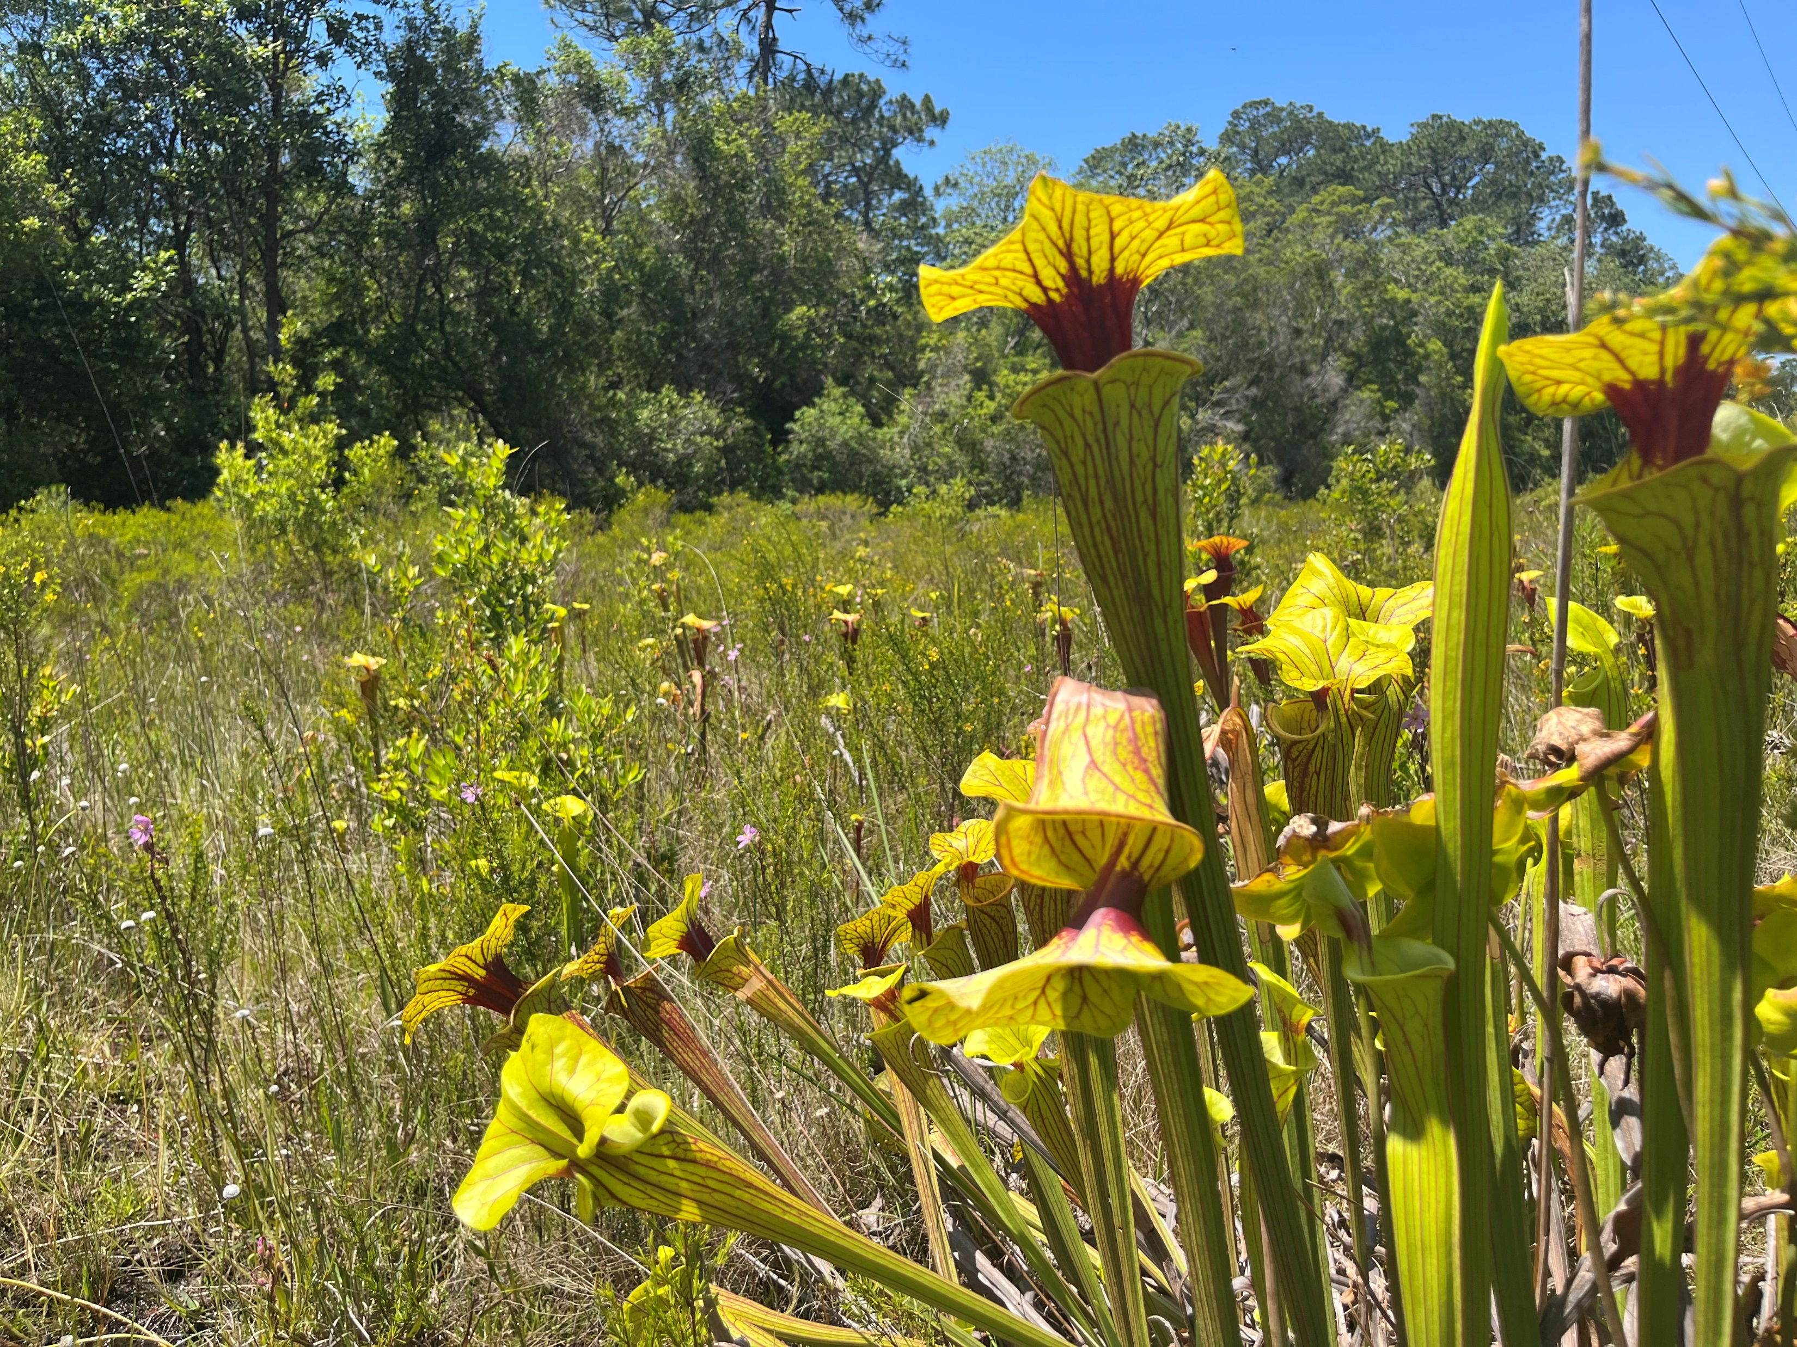
RGP SAJ-86 & Ecosystem Management Agreement 1 2024 Annual Report

Slide 2
Contents 2024 Annual Report
This report contains the project and sub-basin ledgers for all project authorizations issued through
December 31st, 2024.
2024 Project Summary
Overall Summary
Project Ledger
Sub-basin Ledger
“Banked” Altered Wetland Preservation Ledger
Phillips Inlet Subbasin – Mitigation Summary
Conservation Unit Ledger
Conservation Unit Land Management Summary
GIS Projects & Conservation Easement Map Overview
2
3
4-9
10
11
12
13
14
15
1

Slide 3
2024 Project Summary
EMA 1 and RGP SAJ 86 authorizations were issued in 2024 for the following:
Panama City Beach Hospital Phase 1B SAJ-2024-01804; 0274929-011-EA/03
TES Concrete Plant SAJ-2024-02558; 0209847-029-EA/03
Art Park Residential Phase 1 0453915-001-EA/66
South Walton Commerce Park Phase 3 0396442-003-EA/66
2023 Permits modified in 2024:
Watersound Golf Course 0426901-001-EA/03
2024 Projects that commenced construction in 2024:
Panama City Beach Hospital Phase 1 SAJ-2024-01804; 0274929-011-EA/03
TES Concrete Plant SAJ-2024-02558; 0209847-029-EA/03
2

Slide 4
Overall Summary 2024 Annual Report
June 10, 2020 the EMA was renewed and September 22, 2020 the RGP SAJ 86 was reissued. Through the renewal and reissuance process the sub basins were updated to HUC 12 basins to be in line with the other 2 RGP/EMAs that have been issued in the area. In the original permit there were 19 basins with the reissuance the there are now 7 basins. The forms used, nomenclature of wetland quality, and rules citations were also updated. The basins were the only substantive change. The following information includes overall summaries based on the Project Ledger for which final authorizations have been granted as of December 31, 2024. Since 2004, a total of 73 projects have received authorization within the SAJ-86 / EMA areas.
Altered Wetland Impact Summary
Of the total 4,744.42 acres of authorized projects including a total of 1,122.205 acres of altered wetlands, only 377.365 acres of altered wetlands have been authorized to date, leaving 744.84 acres remaining. While the majority of these projects have been completed, the project ledger references impact related to projects not yet initiated in orange.
High Quality Impact Summary
Of the 125 acres of high quality impacts authorized in the RGP(SAJ-86)/EMA 1, only 25.49 acres have been authorized to date, leaving 99.51 acres remaining.
Conservation Easement Summary
Due to the 73 projects authorized 3,288.91 total acres have been committed to conservation easements to date. The following conservation easements were recorded in 2024:
Origins Phase 8 0221322-067-EA/66; 0221322-068-SFRP/66 Offsite Conservation Easement
Walton DSAP Roadway 1A 0377211-002-EA/66; 0377211-003-SFRP/66 Offsite Conservation Easement
Ward Creek Highway 79 Drainage 0393890-014-EA/03; 0393890-015-SFRP/03 Offsite Conservation Easement
Ward Creek Phase 2 and Phases 3-4 0393890-002-EA/03 CU CE 0393890-011-EM/03; 0393890-012-SFM/03 and 0393890-013-EM/03; 0393890-005-SFRP/03 Conservation Unit Conservation Easement
Panama City Beach Hospital Phase 1B SAJ-2024-01804; 0274929-011-EA/03 Offsite Conservation Easement
3

Slide 5
2024 Project Ledger
Number | Type | Permitting Basin | Subbasin | Project | Tot Prj Ac | HQ | HQ IMP | Alt | Alt IMP | WTL | UPL | Onsite CE | Offsite CE | CU MIT CE | CU CE | CR MIT | Status
2007-2016
1 | GP | Breakfast Point | SWWB | SAJ-2008-04490 Pier Park Northeast | 58.77 | 4.30 | 0.00 | 10.33 | 8.00 | 14.63 | 44.14 | 7.57 | 29.69 | 0.00 | 18.28 | 5.20 | CE Recorded
2 | GP | Breakfast Point | SWWB | SAJ-2006-9182 Pier Park Loop Road | 58.25 | 1.55 | 0.00 | 14.94 | 10.13 | 16.49 | 47.76 | 6.21 | 35.71 | 0.00 | 16.90 | 6.58 | CE Recorded
3 | GP | Breakfast Point | SWWB | SAJ-2007-05543 Pier Park NW Hotel | 3.11 | 0.00 | 0.00 | 2.04 | 2.04 | 2.04 | 1.07 | 0.00 | 8.16 | 0.00 | 0.90 | 1.33 | CE Recorded
4 | GP | Breakfast Point | SWWB | SAJ-2004-8221 Pier Park Drive Extension | 2.50 | 0.24 | 0.24 | 0.16 | 0.16 | 0.40 | 2.10 | 0.00 | 1.85 | 0.00 | 0.00 | 0.32 | CE Recorded
5 | GP | Breakfast Point | SWWB | SAJ-2006-6276 Westbay Landings | 494.83 | 86.64 | 1.17 | 111.02 | 9.85 | 197.66 | 294.34 | 189.15 | 0.00 | 0.00 | 143.57 | 7.48 | CE in Recorded
6 | IP | Breakfast Point | SWWB | SAJ-2004-3965 PCB Commerce Park | 219.00 | 9.90 | 0.20 | 41.70 | 9.40 | 41.90 | 177.10 | 55.40 | 0.00 | 0.00 | 47.10 | 6.28 | CE Recorded
7 | IP | Breakfast Point | SWWB | SAJ 2004-8222 Frank Brown Park Trail | 1.47 | 0.00 | 0.00 | 1.32 | 1.32 | 1.32 | 0.45 | 0.00 | 3.95 | 0.00 | 0.00 | 0.80 | CE Recorded
8 | GP | Breakfast Point | Hwy 98 | SAJ-2006-6671 Beckrich Rd. Extension | 7.50 | 0.45 | 0.01 | 1.53 | 0.30 | 1.98 | 5.52 | 1.83 | 0.00 | 0.00 | 0.00 | 0.21 | CE Recorded
9 | GP | Breakfast Point | Hwy 98 | SAJ-2004-10294 Highlands West | 28.20 | 7.68 | 0.70 | 11.89 | 8.99 | 19.57 | 8.63 | 9.77 | 60.59 | 0.00 | 0.00 | 6.48 | CE Recorded
10 | GP | Breakfast Point | Hwy 98 | SAJ-2006-6658 Breakfast Point K-8 | 39.94 | 3.29 | 0.00 | 6.90 | 1.48 | 10.19 | 29.75 | 8.74 | 0.00 | 0.00 | 0.00 | 0.96 | CE Recorded
11 | GP | Breakfast Point | Hwy 98 | SAJ-2007-1364 PCB Mixed Use PDA | 59.43 | 1.59 | 0.09 | 3.13 | 0.49 | 4.72 | 54.71 | 5.93 | 0.00 | 0.00 | 0.00 | 0.40 | CE Recorded
12 | GP | Breakfast Point | Hwy 98 | SAJ-2004-8077 North Glades | 71.37 | 18.30 | 0.00 | 17.80 | 13.20 | 36.10 | 35.27 | 26.87 | 58.30 | 0.00 | 0.00 | 8.60 | CE Recorded
13 | GP | Breakfast Point | Hwy 98 | SAJ-2004-7095 Waterfall | 42.62 | 0.78 | 0.00 | 11.61 | 2.31 | 12.39 | 30.23 | 10.42 | 0.00 | 0.00 | 0.00 | 1.50 | CE Recorded
14 | GP | Devils Swamp | Direct to Bay | SAJ-2002-697 WaterSound North | 102.10 | 16.99 | 0.08 | 13.00 | 2.74 | 29.99 | 72.11 | 34.17 | 0.00 | 0.00 | 11.72 | 1.97 | CE Recorded
Tot Prj Ac | Total Project Acres Within Sub-basin
HQ | High Quality Wetlands
HQ IMP | High Quality Wetland Impacts
Alt | Altered Wetlands
Alt IMP | Altered Wetland Impacts
UPL | Uplands
Onsite CE | Onsite Conservation Easements
Offsite CE | Offsite Conservation Easements
CU MIT CE | Conservation Unit Mitigation Conservation Easement
CU CE | Conservation Unit Conservation Easement
CR MIT | Mitigation Credits
WTL | Wetland
CE’s to be recorded
Impacts have not occurred as of 12/31/2024
Permits Modified in 2023
CE’s Recorded
GP | Regional General Permit SAJ-86
IP | Individual Permit
Permits Modified in 2024
Alt Impact Allowance Drawdown
4

Slide 6
2024 Project Ledger
Number | Type | Permitting Basin | Subbasin | Project | Tot Prj Ac | HQ | HQ IMP | Alt | Alt IMP | Under 20 % Alt Remaining | WTL | UPL | Onsite CE | Offsite CE | CU MIT CE | CU CE | CR MIT | Status
15 | IP | Lake Powell | Phillips Inlet | SAJ-2007-1364 PCB Commerce Park | 118.10 | 18.80 | 0.00 | 27.20 | 1.40 | 4.04 | 46.00 | 72.10 | 25.80 | 0.00 | 7.50 | 14.50 | 0.00 | CE Recorded
16 | GP | Lake Powell | Phillips Inlet | SAJ-2002-00697 WaterSound North | 464.52 | 18.07 | 0.81 | 123.30 | 19.71 | 4.95 | 141.37 | 323.15 | 113.80 | 0.00 | 52.84 | 53.26 | 0.00 | CE Recorded
17 | GP | Breakfast Point | Ward Creek | SAJ-2009-01975 West Bay Fire Station | 6.98 | 0.00 | 0.00 | 5.42 | 0.99 | 0.09 | 5.42 | 1.55 | 4.43 | 0.00 | 0.00 | 0.00 | 0.64 | CE Recorded
18 | EMA Only | Devils Swamp | Phillips Inlet | 03-0267776-001-EA Alexan Apartments | 25.71 | 0.00 | 0.00 | 0.00 | 0.00 | 0.00 | 0.00 | 25.71 | 0.00 | 0.00 | 0.00 | 9.43 | 0.00 | CE Recorded
19 | EMA Only | Devils Swamp | Phillips Inlet | 03-0278434-001-EA Whisper Dunes | 59.48 | 0.00 | 0.00 | 0.00 | 0.00 | 0.00 | 0.00 | 59.48 | 0.00 | 0.00 | 0.00 | 21.83 | 0.00 | CE Recorded
20 | EMA Only | Breakfast Point | SWWB | 03-0292594-001-EA Harley Davidson | 5.02 | 0.00 | 0.00 | 0.00 | 0.00 | 0.00 | 0.00 | 5.02 | 0.00 | 0.00 | 0.00 | 1.49 | 0.00 | CE Recorded
21 | EMA Only | Devils Swamp | Phillips Inlet | 03-0300332-001-EA West End Fire Station | 3.35 | 0.00 | 0.00 | 0.00 | 0.00 | 0.00 | 0.00 | 3.35 | 0.00 | 0.00 | 0.00 | 1.23 | 0.00 | CE Recorded
22 | GP | Breakfast Point | SWWB | SAJ-2011-01329 Laguna Substation(GP) | 25.00 | 0.00 | 0.00 | 20.00 | 20.00 | 0.00 | 20.00 | 5.00 | 0.00 | 105.00 | 0.00 | 8.49 | 13.00 | CE Recorded
23 | GP | Breakfast Point | Hwy 98 | SAJ-2013-02943 Breakfast Point Phase 3 | 114.53 | 6.15 | 0.15 | 47.78 | 20.03 | 0.00 | 53.93 | 60.60 | 34.08 | 53.39 | 0.00 | 0.00 | 13.16 | CE Recorded
24 | GP | Breakfast Point | SWWB | SAJ-2016-01221 Colony Club Connector | 4.83 | 2.20 | 1.32 | 0.00 | 0.00 | 0.00 | 2.20 | 2.63 | 0.64 | 1.35 | 0.00 | 1.40 | 1.21 | CE Recorded
2017
25 | GP | Breakfast Point | Hwy 98 | SAJ-2015-03090 Sports Complex, School and Fire | 210.00 | 21.65 | 1.80 | 58.15 | 11.63 | 0.00 | 79.80 | 130.20 | 66.37 | 0.00 | 0.00 | 0.00 | 9.36 | CE Recorded
26 | GP | Breakfast Point | SWWB | SAJ-2017-01732 Pier Park Crossings | 44.44 | 10.88 | 0.00 | 8.35 | 5.65 | 0.00 | 19.23 | 25.21 | 13.16 | 19.90 | 0.00 | 12.89 | 3.67 | CE Recorded
27 | GP | Devil’s Swamp | Philips Inlet | SAJ-2002-00679 Watersound North (Phase 4) | 48.80 | 0.20 | 0.00 | 2.83 | 2.83 | 0.00 | 3.03 | 45.77 | 0.20 | 0.00 | 41.18 | 0.00 | 0.00 | CE Recorded Note: Boundary overlaps with previous WSN permits.
27A | GP | Devil’s Swamp | Direct to Bay | SAJ-2002-00679 Watersound North (Phase 4) | 87.50 | 20.22 | 0.04 | 9.10 | 1.92 | 0.00 | 29.32 | 58.18 | 27.36 | 0.51 | 0.00 | 39.65 | 1.29 | CE Recorded Note: Boundary overlaps with previous WSN permits.
2018
28 | EMA ONLY | Breakfast Point | Ward Creek | 03-62422-002-EA/03 PCB Conservation Park Parking | 3.21 | 0.00 | 0.00 | 0.00 | 0.00 | 0.00 | 0.00 | 3.21 | 0.00 | 0.00 | 0.00 | 1.8 | 0.00 | CE Recorded
28A | EMA ONLY | Breakfast Point | West Laird | 03-62422-022-EA/03 PCB Conservation Park Parking | 1.1 | 0.00 | 0.00 | 0.00 | 0.00 | 0.00 | 0.00 | 1.1 | 0.00 | 0.00 | 0.00 | 0.2 | 0.00 | CE Recorded
Tot Prj Ac | Total Project Acres Within Sub-basin
HQ | High Quality Wetlands
HQ IMP | High Quality Wetland Impacts
Alt | Altered Wetlands
Alt IMP | Altered Wetland Impacts
UPL | Uplands
Onsite CE | Onsite Conservation Easements
Offsite CE | Offsite Conservation Easements
CU MIT CE | Conservation Unit Mitigation Conservation Easement
CU CE | Conservation Unit Conservation Easement
CR MIT | Mitigation Credits
WTL | Wetland
CE’s to be recorded
Impacts have not occurred as of 12/31/2024
Permits Modified in 2023
CE’s Recorded
GP | Regional General Permit SAJ-86
IP | Individual Permit
Permits Modified in 2024
Alt Impact Allowance Drawdown
5

Slide 7
2024 Project Ledger
Number | Type | Permitting Basin | Subbasin | Project | Tot Prj Ac | HQ | HQ IMP | Alt | Alt IMP | Under 20 % Alt Remaining | WTL | UPL | Onsite CE | Offsite CE | CU MIT CE | CU CE | CR MIT | Rd Removals | Status
2019
29 | GP | Devil’s Swamp | Direct to Bay | 0375790-001 EA/66 & SAJ-2002-0679 Origins Phase 5 | 181.25 | 2.90 | 1.51 | 27.25 | 20.74 | 0.00 | 30.15 | 151.1 | 0.00 | 76.45 | 0 | 119.7 | 14.86 | 2 | CE Recorded
30 | GP | Devil’s Swamp | Direct to Bay | 0377211-001-EA/66 & SAJ-2019-02304 Origins Assisted Living | 11.86 | 0.27 | 0.00 | 0.56 | 0.27 | 0.00 | 0.83 | 11.03 | 0.00 | 1.04 | 0 | 3.74 | .18 | 0 | CE Recorded
31 | GP | Breakfast Point | SWWB | 0373877-002-EA/03 & SAJ-2019-0098 Nautilus | 20.15 | 0.00 | 0.00 | 0.115 | 0.115 | 0.00 | 0.115 | 20.035 | 0.00 | 0.58 | 0 | 5.77 | 0.08 | 0 | CE Recorded
32 | EMA ONLY | West Bay | SWWB | 36439-002-EA/03 PCB Commerce Park Lot 2 | 2.16 | 0.00 | 0.00 | 0.00 | 0.00 | 0.00 | 0.00 | 0.00 | 0.00 | 0.00 | 0 | 0.57 | 0.00 | 0 | CE Recorded
33 | EMA ONLY | Devil’s Swamp | Peach Creek | 0378433-001-EA/66 South Walton CP Lot 34 & 35 | 3.31 | 0.00 | 0.00 | 0.00 | 0.00 | 0.00 | 0.00 | 0.00 | 0.00 | 0.00 | 0 | N/A | 0.00 | 0 | CE Recorded
34 | EMA ONLY | Breakfast Point | Direct to Bay | 0378297-001-EA/03 PCB Commerce Park Lot A1 | 1.53 | 0.00 | 0.00 | 0.00 | 0.00 | 0.00 | 0.00 | 0.00 | 0.00 | 0.00 | 0 | 0.62 | 0.00 | 0 | CE Recorded
35 | RGP/ EMA | Breakfast Point | SWWB | 037628-001-EA/03 & SAJ-2019-01010 Pier Park Northwest | 10.27 | 2.82 | 0.4 | 4.62 | 2.34 | 0.00 | 7.44 | 2.83 | 4.7 | 7.08 | 0 | 2.88 | 1.88 | 1 | CE Recorded
36 | RGP/ EMA | Breakfast Point | SWWB | 0261615-015-EA/03 & SAJ 2005-09182 Bay Parkway Phase 2 | 106.0 | 6.56 | 6.56 | 20.51 | 20.51 | 0.00 | 27.07 | 78.93 | 0.00 | 82.05 | 0 | 27.075 | 19.36 | 2 | CE Recorded
2020
37 | RGP/EMA | Breakfast Point | Hwy 98 | 0379494-003-EA/03; SAJ-2019-04339 Breakfast Point Hotel | 7.27 | 0 | 0 | 0.82 | 0.82 | 0 | 0.82 | 6.18 | 0 | 3.28 | 0 | 0 | .53 FDEP .53 ACOE | 0 | CE Recorded
38 | RGP/EMA | Breakfast Point | Hwy 98 | 0379494-002-EA/03; SAJ-2019-04247 Breakfast Point Apartments | 18.65 | 0.06 | 0 | 16.71 | 15.37 | 0 | 16.77 | 1.88 | 1.34 | 60.15 | 0 | 0 | 8.93 FDEP 9.99 ACOE | 0 | CE Recorded
39 | RGP/EMA | Breakfast Point | Hwy 98 | 0382019-001-EA/03; SAJ-2019-04047 Breakfast Point Phase 4 | 59.44 | 6.31 | 0 | 16.35 | 11.93 | 0 | 22.66 | 36.78 | 10.7 | 43.33 | 0 | 0 | 7.75 FDEP 7.75 ACOE | 0 | CE Recorded
40 | RGP/EMA | Breakfast Point | SWWB | 0375609-002-EA/03; SAJ-2005-09182 Bay Parkway Expansion | 6.73 | 3.81 | 3.81 | 0.15 | 0.15 | 0 | 3.96 | 2.77 | 0 | 0.6 | 0 | 1.92 | 19.36 FDEP 19.36 ACOE | 1 | CE Recorded
Tot Prj Ac | Total Project Acres Within Sub-basin
HQ | High Quality Wetlands
HQ IMP | High Quality Wetland Impacts
Alt | Altered Wetlands
Alt | Altered Wetland Impacts
UPL | Uplands
Onsite CE | Onsite Conservation Easements
Offsite CE | Offsite Conservation Easements
CU MIT CE | Conservation Unit Mitigation Conservation Easement
CU CE | Conservation Unit Conservation Easement
CR MIT | Mitigation Credits
WTL | Wetland
CE’s to be recorded
Impacts have not occurred as of 12/31/2024
Permits Modified in 2023
CE’s Recorded
GP | Regional General Permit SAJ-86
IP | Individual Permit
Permits Modified in 2024
Alt Impact Allowance Drawdown

Slide 8
2024 Project Ledger
Number | Type | Permitting Basin | Subbasin | Project | Tot Prj Ac | HQ | HQ IMP | Alt | Alt IMP | Under 20 % Alt Remaining | WTL | UPL | Onsite CE | Offsite CE | CU MIT CE | CU CE | CR MIT | Rd Removals | Status
2021
41 | EMA/ 404 | Devil’s Swamp | Peach Creek | 0378433-002-EA/66; 0396442-01-SFRG/66 South Walton Commerce Park Phase 2 | 76.61 | 28.73 | 1.43 | 16.68 | 3.32 | +0.08 | 45.41 | 31.2 | 40.66 | 0 | 0 | 11.65 | 3.0 UMAM | 3 | CE Recorded
42 | EMA/ RGP | Breakfast Point | ABBBF | 0382019-002-EA/03; SAJ-2014-03115 Breakfast Point Phase 5 | 84.04 | 4.09 | 0.10 | 16.56 | 9.88 | 0.00 | 20.65 | 63.39 | 9.71 | 33.80 | 0 | 103 | 5.33 UMAM 6.51 WRAP | 0 | CE Recorded
43 | EMA/ 404 | Devil’s Swamp | Peach Creek | 0398702-001-EA/66; 0398702-002-SFRG/66 Walton DSAP Residential | 25.31 | 0.00 | 0.00 | 5.37 | 5.37 | 0.00 | 5.37 | 19.94 | 0.00 | 21.48 | 0 | 3.8 | WRAP 3.49 UMAM 2.85 | 0 | CE Recorded
44 | EMA/ 404 | Breakfast Point | SWWB | 0393890-001-EA/03; 0396477-001-SFRG/03 Ward Creek Phase 1 | 119 | 3.03 | 0.00 | 56.51 | 10.73 | +2.86 | 59.54 | 59.46 | 48.81 | 0 | 0 | 13.58 | WRAP 6.97 UMAM 5.69 | 0 | CE Recorded
45 | EMA/ 404 | Breakfast Point | Peach Creek | 0377211-002-EA/66; 0377211-003-SFRG Walton DSAP Roadway | 8.46 | 048 | 0.43 | 1.8 | 1.68 | 0.00 | 2.23 | 6.23 | 0.00 | 6.72 | 0 | 1.28 | WRAP 1.48 UMAM 1.26 | 1 | CE Recorded
46 | EMA/ 404 | Lake Powell | LPF | 0221322-057-EA/66; 0221322-058-SFRG/66 Origins Phase 7 | 54.11 | 16.87 | 0.76 | 0.38 | 0.00 | 0 | 17.25 | 36.13 | 16.72 | 0 | 0 | 10.87 | WRAP 0.70 UMAM 0.70 | 1 | CE Recorded
47 | EMA/404 | Breakfast Point | ABBBF | 0407352-001-EA/03; 0407352-002-SFRP/03 Breakfast Point East Phase 2 | 90.69 | 9.40 | 0.15 | 35.14 | 6.14 | +4.44 | 44.54 | 46.15 | 38.22 | 0.00 | 0 | 111.22 | WRAP 4.13 UMAM 3.38 | 0 | CE Recorded
48 | EMA/404 | Lake Powell | ELPIF | 0221322-067-EA/66; 0221322-068-SFRP/66 Origins Phase 8 | 57.4 | 1.41 | 0 | 0.97 | 0.47 | 0 | 3.34 | 54.06 | 0.5 | 1.38* | 0 | 11.53 | 0.25 UMAM 0.31 WRAP | 0 | CE in Progress
2022
49 | EMA/404 | Breakfast Point | ABBBF | 0382019-007-EA/03; 0382019-008-SFRP/03 Breakfast Point East Phase 3 | 42.64 | 0.00 | 0.00 | 14.1 | 4.24 | 0.00 | 7.1 | 35.54 | 2.86 | 14.10 | N/A | 52.29 | WRAP 2.76 UMAM 2.25 | 0 | CE in Progress
50 | EMA/404 | Breakfast Point | ABBBF | 0409501-001-EA/03; 0409501-002-SFRP/03 Moylan Road Extension | 12.84 | 0.53 | 0.03 | 2.77 | 2.38 | 0.00 | 3.3 | 9.54 | 0.39 | 9.52 | N/A | 15.75 | WRAP 1.58 UMAM 1.29 | 0 | CE in Progress
51 | EMA/404 | Breakfast Point | IWWB | 0393890-002-EA/03; 0393890-003-SFRP/03 Ward Creek Phase 2 | 114.93 | 8.6 | 0.00 | 47.54 | 9.59 | -0.41 | 56.14 | 58.79 | 46.55 | 0 | N/A | 13.11 | WRAP 6.23 UMAM 5.08 | 0 | CE Recorded
52 | EMA/404 | Breakfast Point | IWWB | 0393890-004-EA/03; 0393890-005-SFRP/03 Ward Creek Phase 3 & 4 | 166 | 18.93 | 0.00 | 53.68 | 14.51 | -0.04 | 72.6 | 93.4 | 57.18 | 19.75 | N/A | 18.94 | WRAP 9.43 UMAM 7.69 | 0 | CE In Progress
*For Origins Phase 8, 0.38 acres preserved in another project site within the ELPIF Sub-basin
Tot Prj Ac | Total Project Acres Within Sub-basin
HQ | High Quality Wetlands
HQ IMP | High Quality Wetland Impacts
Alt | Altered Wetlands
Alt | Altered Wetland Impacts
UPL | Uplands
Onsite CE | Onsite Conservation Easements
Offsite CE | Offsite Conservation Easements
CU MIT CE | Conservation Unit Mitigation Conservation Easement
CU CE | Conservation Unit Conservation Easement
CR MIT | Mitigation Credits
WTL | Wetland
CE’s to be recorded
Impacts have not occurred as of 12/31/2024
Permits Modified in 2023
CE’s Recorded
GP | Regional General Permit SAJ-86
IP | Individual Permit
Permits Modified in 2024
Alt Impact Allowance Drawdown

Slide 9
2024 Project Ledger
Number | Type | Permitting Basin | Subbasin | Project | Tot Prj Ac | HQ | HQ IMP | Alt | Alt IMP | Under 20 % Alt Remaining | WTL | UPL | Onsite CE | Offsite CE | CU MIT CE | CU CE | CR MIT | Rd Removals | Status
53 | EMA/404 | BPMB | IWWB | 0393890-007-EA/03; 0393890-008-SFRP/03; 03093890-009-EM/03; 0393890-010-SM-03 Ward Creek Phase 5 | 121.8 | 0.41 | 0 | 44.6 | 10.4 | 0 | 45.01 | 76.79 | 34.61 | 7.5 | n/a | 13.89 | WRAP 6.76 UMAM 5.51 | 0 | CE In Progress
54 | EMA/404 | DSMB | PWSFCU | 0398702-004-EA/66 Origins Parkway Phase 2 | 14.11 | 0 | 0 | 8.61 | 8.61 | 0 | 8.61 | 5.5 | 0 | 34.44 | 0 | 2.13 | 5.6 WRAP 4.56 UMAM | 0 | CE in Progress
55 | EMA/404 | BPMB | IWWB | 0412425-001-EA/03;0412425-001-SFRP/03 Gateway Crossings | 44.78 | 1.04 | 0.09 | 4.48 | 2.1 | 0 | 5.52 | 15.27 | 3.33 | 6.02 | 0 | 5.11 | 1.45 WRAP 1.19 UMAM | 2 | CE in Progress
56 | EMA/404 | DSMB | PWSFCU | 0398702-008-EA/66 0398702-009-SFRG/66 Longleaf Park Phase 2 | 16.36 | 0 | 0 | 1.05 | 1.05 | 0 | 1.41 | 15.27 | 0 | 4.2 | 0 | 2.47 | 0.68 WRAP 0.56 UMAM | 0 | CE in Progress
57 | EMA/404 | DSMB | Peach Creek | 0398702-011-EA/66; 0398702-016-SFM/66; 0398702-012-SFRP/66 Longleaf Park Phase 3 | 34.99 | 0 | 0 | 2.29 | 2.29 | 0 | 2.29 | 32.67 | 0 | 9.16 | 0 | 5.28 | 1.49 WRAP 1.21 UMAM | 0 | CE in Progress
58 | EMA/404 | Lake Powell | ELPIF | 0420842-001-EA/03 West Laird Phase 1 | 65.11 | 0 | 0 | 1.62 | 1.62 | 0 | 1.73 | 63.38 | 0 | 6.48 | 0 | 13.08 | 1.05 WRAP 0.86 UMAM | 0 | CE in Progress
59a | EMA/404 | DSMB | Peach Creek | 0423257-01-EA/66;0423257-002-SRFP/66 West Bay Parkway Phase 1 | 2.75 | 0 | 0 | 0.47 | 0.47 | 0 | 0.47 | 2.28 | 0 | 1.88 | 0 | 0.42 | 0.31 WRAP 0.25 UMAM | 0 | CE in Progress
59b | EMA/404 | DSMB | Eastern Lake-Phillips Inlet Frontal | 0423257-01-EA/66;0423257-002-SRFP/66 West Bay Parkway Phase 1 | 3.52 | 0 | 0 | 2.58 | 2.58 | 0 | 2.58 | 0.94 | 0 | 10.32 | 0 | 0.36 | 1.68 WRAP 1.37 UMAM | 0 | CE in Progress
60 | EMA Only | Lake Powell | ELPIF | 0221322-069-EA/66; 0221322-070-EM/66 Origins Phase 6 | 63.4 | 10 | 0 | 8.7 | 0 | 0 | 0 | 44.7 | 0 | 0* | 0 | 0* | 0 | 0 | NA
61a | EMA/404 | DSMB | Peach Creek | 0423293-001-EA/66; 0423293-004SFM/66; 0423293-002-SFRP/66 Arborview | 8.11 | 0 | 0 | 3.13 | 3.13 | 0 | 3.13 | 4.98 | 0 | 12.52 | 0 | 1.22 | 2.03 WRAP 1.66 UMAM | 0 | CE in Progress
61b | EMA/404 | DSMB | Eastern Lake-Phillips Inlet Frontal | 0423293-001-EA/66; 0423293-004SFM/66; 0423293-002-SFRP/66 Arborview | 29.94 | 0 | 0 | 2.6 | 2.6 | 0 | 2.6 | 27.34 | 0 | 10.4 | 0 | 2.24 | 1.69 WRAP 3.04 UMAM | 0 | CE in Progress
*For Origins Phase 6, 80:20 preservation and CUCE was recorded with Watersound North SAJ-2002-697
Tot Prj Ac | Total Project Acres Within Sub-basin
HQ | High Quality Wetlands
HQ IMP | High Quality Wetland Impacts
Alt | Altered Wetlands
Alt | Altered Wetland Impacts
UPL | Uplands
Onsite CE | Onsite Conservation Easements
Offsite CE | Offsite Conservation Easements
CU MIT CE | Conservation Unit Mitigation Conservation Easement
CU CE | Conservation Unit Conservation Easement
CR MIT | Mitigation Credits
WTL | Wetland
CE’s to be recorded
Impacts have not occurred as of 12/31/2024
Permits Modified in 2023
CE’s Recorded
GP | Regional General Permit SAJ-86
IP | Individual Permit
Permits Modified in 2024
Alt Impact Allowance Drawdown

Slide 10
2024 Project Ledger
Number | Type | Permitting Basin | Subbasin | Project | Tot Prj Ac | HQ | HQ IMP | Alt | Alt IMP | Under 20 % Alt Remaining | WTL | UPL | Onsite CE | Offsite CE | CU MIT CE | CU CE | CR MIT | Rd Removals | Status
2023
62 | EMA/404 | Lake Powell | Eastern Lake-Phillips Frontal | 0426901-006-EA/03; 0426901-001-EA/03; 0426901-002-SFRP/03 Watersound Golf Course | 324.8 | 87.19* | 1.78* | 40.54 | 1.15 | 0 | 127.73* | 197.07 | 8.84 | 0 | 0 | 65.25 | 1.64 WRAP 1.36 UMAM | 0 | CE in Progress
63 | EMA/404 | BPMB | Intracoastal Waterway - West Bay Subbasin | 0274929-007-EA/03; 0274929-008-SFRP/03 PCB Medical Campus Drainage Improvement | 3.53 | 0 | 0 | 2.18 | 2.18 | 0 | 2.18 | 1.35 | 0 | 8.72 | 0 | 0.4 | 1.42 WRAP 1.16 UMAM | 0 | CE in Progress
64a | EMA/404 | DSMB | Peach Creek | 0398702-014-EA/66; 0398702-015-SFRP/66 Origins Parkway Segment 3 | 9.51 | 0.11 | 0 | 6.15 | 5.86 | 0 | 6.26 | 3.25 | 0.4 | 23.15 | 0 | 1.44 | 3.81 WRAP 3.11 UMAM | 0 | CE in Progress
64b | EMA/404 | DSMB | Eastern Lake-Phillips Inlet Frontal | 0398702-014-EA/66; 0398702-015-SFRP/66 Origins Parkway Segment 3 | 6.88 | 0 | 0 | 1.59 | 1.59 | 0 | 1.59 | 5.29 | 0 | 6.36 | 0 | 0.71 | 1.03 WRAP 0.84 UMAM | 0 | CE in Progress
65 | EMA/404 | DSMB | Peach Creek | 0221322-077-EA/66; 0221322-078-SFRP/66 North Watersound Parkway Phase 2 | 31.08 | 5.16 | 2.14 | 18.88 | 12.55 | 0 | 24.04 | 6.99 | 6.25 | 43.95 | 0 | 12.56 | 10.13 WRAP 8.51 UMAM | 2 | CE in Progress
66 | EMA Only | DSMB | Peach Creek | 0431976-001-EA/66 South Walton Commerce Park Lot 1 Storage | 2.32 | 0 | 0 | 0.1 | 0 | N/A | 0.1 | 2.22 | 0 | 0 | 0 | 0.35 | 0 | 0 | CE in Progress
67 | EMA/404 | BPMB | Alligator Bayou-Botheration Bay Frontal | 0382019-011-SFRP/03; 0382019-010-EA/03 BP East Phase 4 | 118.71 | 8.35 | 0.41 | 55.31 | 17.24 | 0 | 63.66 | 55.05 | 38.07 | 30.90 | 0 | 45.18 | 11.59 WRAP 9.50 UMAM | 0 | CE in Progress
68 | EMA/404 | BPMB | Intracoastal Waterway - West Bay Subbasin | 0393890-014-EA/03; 0393890-015-SFRP/03 Ward Creek- Hwy 79 Drainage Improvements | 1.17 | 0 | 0 | 0.77 | 0.77 | 0 | 0.77 | 0.4 | 0 | 3.08 | 0 | 0.13 | 0.50 WRAP 0.41 UMAM | 0 | CE Complete
69 | EMA | BPMB | Alligator Bayou-Botheration Bay Frontal | 0349510-021-EM/03 SABRE Center | 14.71 | 0 | 0 | 0.57 | 0 | 0 | 0.57 | 14.14 | 0 | 0* | 0 | 0* | 0* | 0 | CE Completed
*For Watersound Golf Course, the high quality wetland total includes 2.34 acres of isolated wetlands and 1.62 acres of isolated wetland impacts.0.84 acres of isolated wetlands will be mitigated due to the wetland size being greater than 0.50 acres.
*For SABRE Center, the mitigation bank credits were previously withdrawn from Breakfast Point Mitigation Bank on June 5, 2018. All impacts were previously permitted and required conservation easements have bee completed.
Tot Prj Ac | Total Project Acres Within Sub-basin
HQ | High Quality Wetlands
HQ IMP | High Quality Wetland Impacts
Alt | Altered Wetlands
Alt | Altered Wetland Impacts
UPL | Uplands
Onsite CE | Onsite Conservation Easements
Offsite CE | Offsite Conservation Easements
CU MIT CE | Conservation Unit Mitigation Conservation Easement
CU CE | Conservation Unit Conservation Easement
CR MIT | Mitigation Credits
WTL | Wetland
CE’s to be recorded
Impacts have not occurred as of 12/31/2024
Permits Modified in 2023
CE’s Recorded
GP | Regional General Permit SAJ-86
IP | Individual Permit
Permits Modified in 2024
Alt Impact Allowance Drawdown

Slide 11
2024 Project Ledger
SAJ-2004-3965
SAJ-2004-3965
Number | Type | Permitting Basin | Subbasin | Project | Tot Prj Ac | HQ | HQ IMP | Alt | Alt IMP | Under 20 % Alt Remaining | WTL | UPL | Onsite CE | Offsite CE | CU MIT CE | CU CE | CR MIT | Rd Removals | Status
2024
70 | RGP/EMA | BPMB | Intracoastal Waterway - West Bay Subbasin (SWWBCU) | SAJ-2024-01804; 0274929-011-EA/03 Panama City Beach Hospital Phase 1B | 23.86 | 0 | 0 | 2.53 | 2.53 | 0.28% | 2.53 | 21.33 | 0 | 10.12 | 0 | 2.72 | 1.4 WRAP 1.35 UMAM | 0 | CE in Progress
71 | RGP/EMA | BPMB | Intracoastal Waterway - West Bay Subbasin (SWWBCU) | SAJ-2024-02558; 0209847-030-EM/03; 0209847-029-EA/03 TES Concrete Plant | 8.58 | 0 | 0 | 2.18 | 0.36* | 0 | 2.18 | 6.4 | 1.85 | 0 | 0 | 0 | 0.23 WRAP 0.19 UMAM | 0 | CE in Progress
72 | EMA | DSMB | Peach Creek (PWSFCU) | 0453915-001-EA/66 Art Park Residential | 45.43 | 0 | 0 | 2.77 | 2.77 | 0 | 2.77 | 42.66 | 0 | 11.08 | 0 | 6.86 | 1.47 UMAM | 0 | CE in Progress
73 | EMA | DSMB | Peach Creek (PWSFCU) | 0396442-003-EA/66 South Walton Commerce Park Phase 3 | 102.46 | 41.07 | 0.52 | 20.42 | 0.4 | 0 | 62.49 | 40.97 | 1.6 | 0 | 0 | 15.47 | 0.66 UMAM | 1 | CE in Progress
 |  |  |  | Totals | 4744.42 | 430.82 | 25.49 | 1122.205 | 377.365 | 16.29 | 1479.455 | 3114.395 | 1015.19 | 1040.99 | 101.52 | 1131.205 | 242.39 WRAP 158.287 UMAM | 16
*For TES Concrete Plant, 9.6 acres of altered wetlands were previously authorized under Panama City Beach Commerce Park SAJ-2004-3965 in 2004
Tot Prj Ac | Total Project Acres Within Sub-basin
HQ | High Quality Wetlands
HQ IMP | High Quality Wetland Impacts
Alt | Altered Wetlands
Alt | Altered Wetland Impacts
UPL | Uplands
Onsite CE | Onsite Conservation Easements
Offsite CE | Offsite Conservation Easements
CU MIT CE | Conservation Unit Mitigation Conservation Easement
CU CE | Conservation Unit Conservation Easement
CR MIT | Mitigation Credits
WTL | Wetland
CE’s to be recorded
Impacts have not occurred as of 12/31/2024
Permits Modified in 2023
CE’s Recorded
GP | Regional General Permit SAJ-86
IP | Individual Permit
Permits Modified in 2024
Alt Impact Allowance Drawdown

Slide 12
2024 Sub-Basin Ledger
2024 Sub-Basin * |  | Sub Basin Ledger
Subbasin | Change ? | Total Ac | Total Alt | Total HQ | Total Alt IMP | %** | Total HQ IMP | %** | Total Alt Remain | Total HQ Remain
Alligator Bayou-Botheration Bay Frontal | N | 1,850.11 | 1,043.18 | 234.78 | 39.88 | 3.82% | 0.69 | 0.29% | 1,003.30 | 234.09
Eastern Lake Phillips Inlet Frontal | N | 4,539.63 | 1,164.01 | 821.68 | 33.95 | 2.91% | 3.35 | 0.41% | 1,130.06 | 818.33
Intercoastal Waterway West Bay | Y | 8,431.63 | 3,562.78 | 2,002.21 | 143.82 | 4.04% | 14.33 | 0.72% | 3,418.96 | 1,987.88
Peach Creek | Y | 3,085.55 | 1,158.73 | 696.40 | 47.5 | 4.10% | 4.52 | 0.65% | 1,111.23 | 691.88
Totals Cumulative thru December 31, 2024. * EMA Acreage less Conservation Unit Acreage |  | 17,906.92 | 6,928.70 | 3,755.07 | 265.15 | 14.87% | 22.89 | 2.07% | 6,663.55 | 3,732.18

Slide 13
“Banked” Altered Wetland Preservation Ledger
* CHANGES IN 2024*
PHILLIPS INLET SUBBASIN
Drawdown of “Banked” Altered Quality Preservation within the following projects:
SAJ-2002-00697 Origins Phase 4
“Banked” Altered Wetland Preservation– Phillips Inlet Summary
Included in the 2017 Watersound Origins Phase 4 authorization, St. Joe followed the EMA section VII. (a) and SAJ-86 section 5b.(1) related to use of remaining unused or “banked” altered quality preservation for other projects in the same subbasin in order to impact more than 20% while keeping the subbasin math balanced. The 2017 project used a portion of the preservation not taken with the previous Watersound North authorized project. A drawdown table for this is included below and will be included going forward in the Annual Reports. The Project Ledger also references this information in yellow.
Phillips Inlet Subbasin | Project Acres | Total Alt Wetlands | Permitted Alt | Required Preservation | Preservation Onsite | Preservation Over/Under | Current Preservation Banked
WSN P1/2B | 464.52 | 123.3 | 19.71 | 78.84 | 103.59 | +24.75 | +24.75
WS Origins P4 | 48.8 | 2.83 | 0.56 | 2.24 | 2.27 | +0.03 | +24.78
West Laird Ph 1 | 65.11 | 1.62 | 1.62 | 6.48 | 0 | -6.48 | +18.33
Origins Ph 7 | 54.11 | 0.38 | 0 | 0 | 0.38 | +0.38 | +18.71
Origins Ph 8 | 57.4 | 0.97 | 0.47 | 1.88 | .50 | -0.38 | +18.33

Slide 14
Phillips Inlet Subbasin Mitigation Summary
PHILLIPS INLET SUBBASIN
Lake Powell Headwaters Conservation Unit
Mitigation Area Summary
* CHANGES IN 2022*
Off-Site Mitigation – Phillips Inlet Summary
For the Phillips Inlet subbasin, compensatory mitigation for individual project wetland impacts must be satisfied with off-site mitigation in the Lake Powell Headwaters Conservation Unit (LPHCU). The required mitigation for the 2017 authorized WaterSound Origins - Phase 4 was calculated based on the .65 FU for the RGP which equals 1.84 acres. After further discussion with ACOE and FDEP regarding logistics of managing such a small area and the anticipation of future impacts within the Phillips Inlet subbasin, St. Joe proposed to place a conservation easement over +/-41.18 acres adjacent to the previously authorized and released mitigation area thereby creating more environmental lift in one concentrated area, simplifying logistics and costs related to monitoring and land management, and planning for near term future impacts in the subbasin. The below is a drawdown table for future impacts in the Phillips Inlet subbasin, which will be included in future annual reports.
Phillips Inlet Subbasin (LPHCU) Mitigation Draw-down Schedule
WS - Origins Off-Site LPHCU Mitigation Acres | 41.18ac x 0.17 lift
WS - Origins Phase 4 LPHCU Off-Site FU | 7.05 total lift
WS - Origins Phase 4 FU Required | (1.84)
WS- Origins Phase 7 LPJCU Required | (0.70)
WS- Origins Phase 8 Functional Unit Loss | (0.31)
Watersound Golf Course Functional Unit Loss | (1.64)
West Laird Phase 1 Functional Unit Loss | (1.05)
Remaining FU for Future Impacts only within Phillips Inlet Subbasin | 1.51 remaining

Slide 15
2024 Conservation Unit Ledger
 |  | Total CU +/- |  | Conservation Easements
 |  | Acres | Required Acres | Recorded Acres | In Process Acres | Additional Acres
Conservation Unit | Ownership
Cypress & Wet Pine Flats | Panama City Beach | 2912.40 | 2912.4 | 2912.4 | 0 | 0
Lake Powell Headwater | St. Joe | 912 | 100.25 | 158.15 | 27.21 | 65.25
South American Swamp | St. Joe | 803 | 67.38 | 67.38 | 0 | 0
Southwest West Bay | St. Joe | 962 | 345.84 | 342.84 | 23.49 | 0.53
Ward Creek | NWFWMD | 1239 | 1.8 | 731.28 | 0 | 0
Point Washington | St. Joe | 466 | 55.74 | 11.65 | 53.24 | 2.5
Wildlife Corridor | St. Joe | 1247 | 187.99 | 39.65 | 12.56 | 0
Side Camp | St. Joe | 2330 | 124.06 | 124.06 | 0 | 0
Salamander Triangle | St. Joe | 42 | 0.2 | 0.2 | 0 | 0
Breakfast Point Peninsula | St. Joe | 2289 | 327.44 | 480 | 327.44 | 45.18
Total Acres |  | 13,202.40 | 4,123.10 | 4,867.48 | 444.07 | 113.46
13

Slide 16
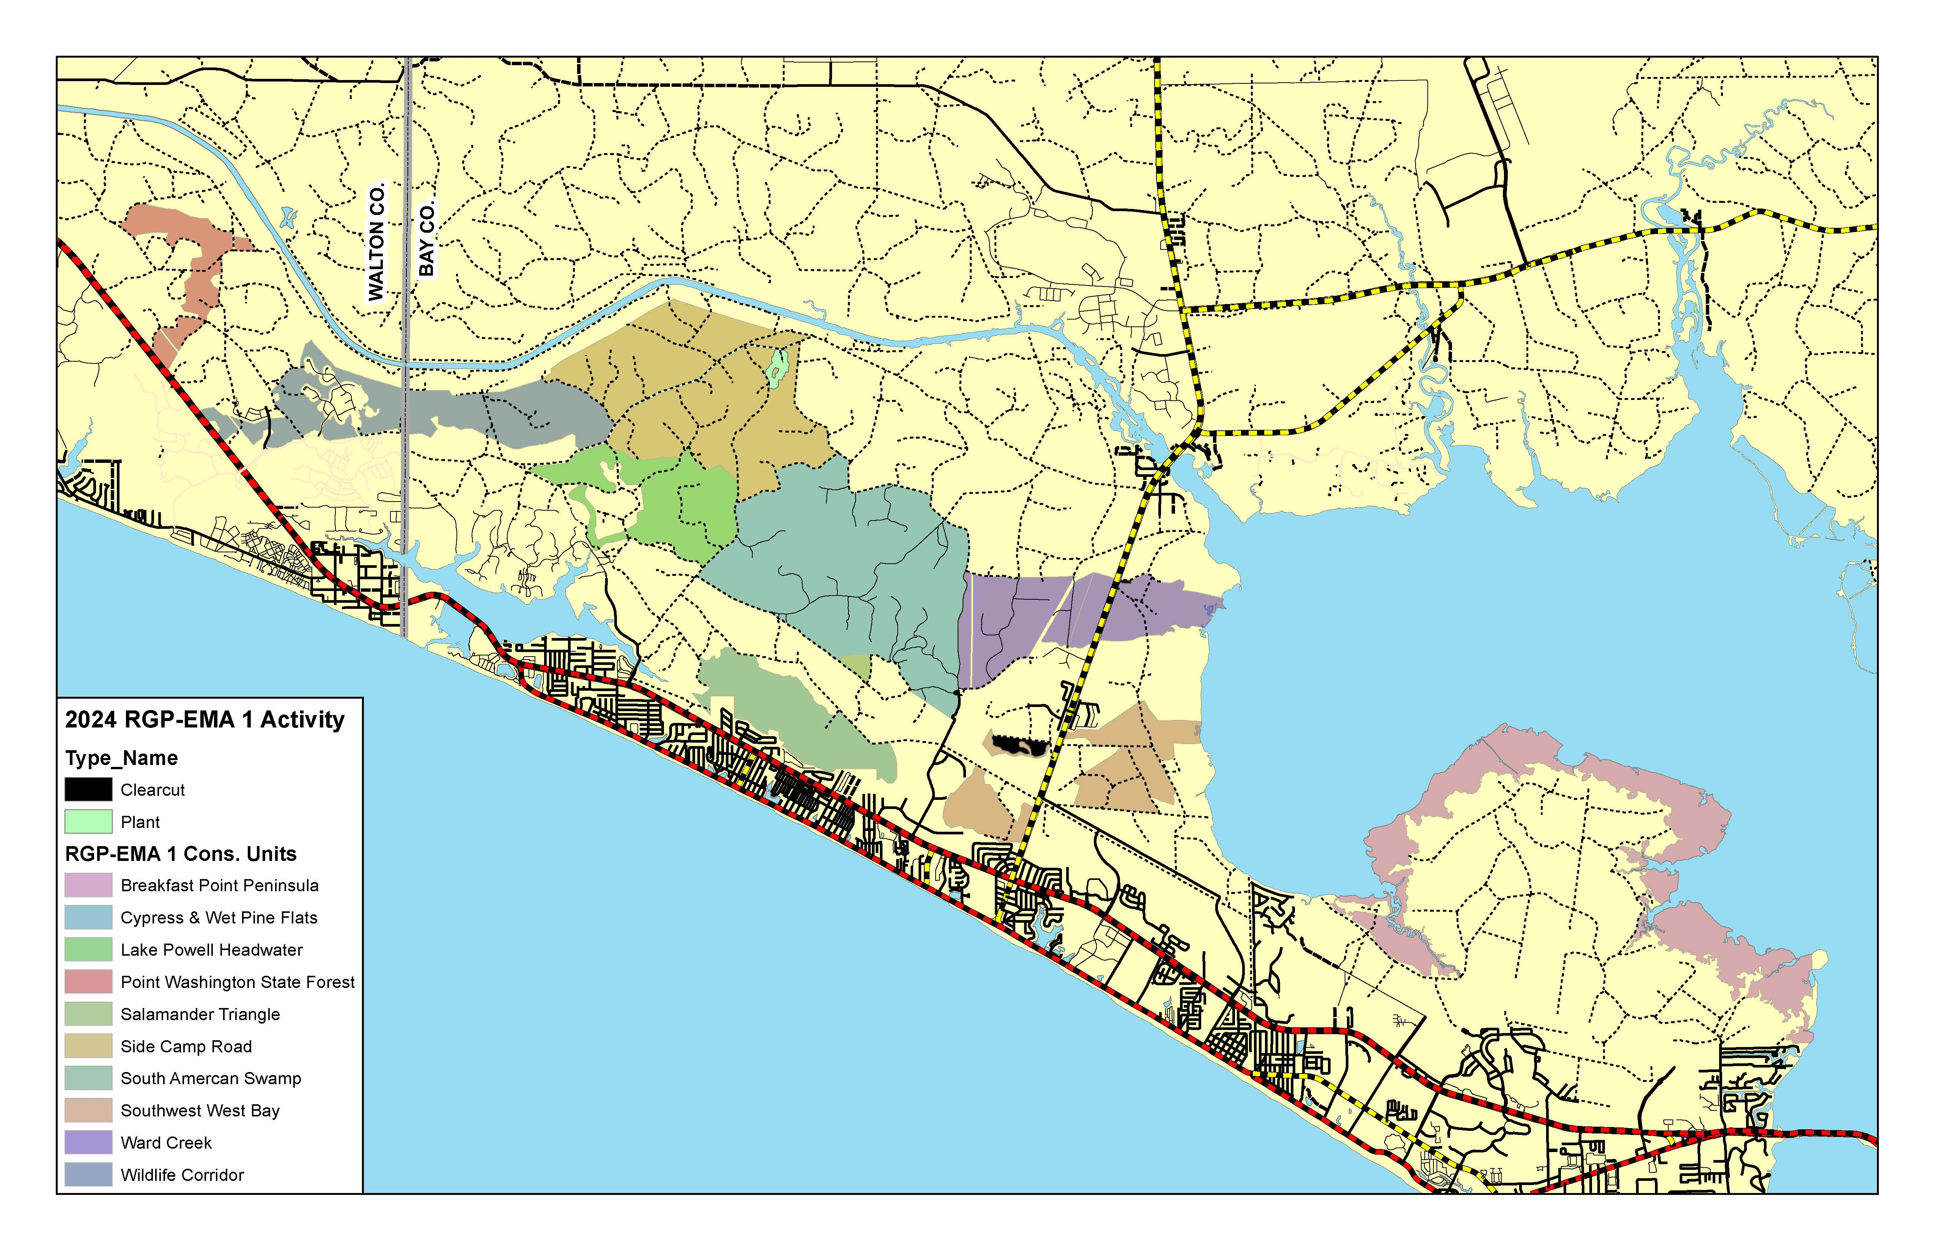
Conservation Unit Land Management Survey
14

Slide 17
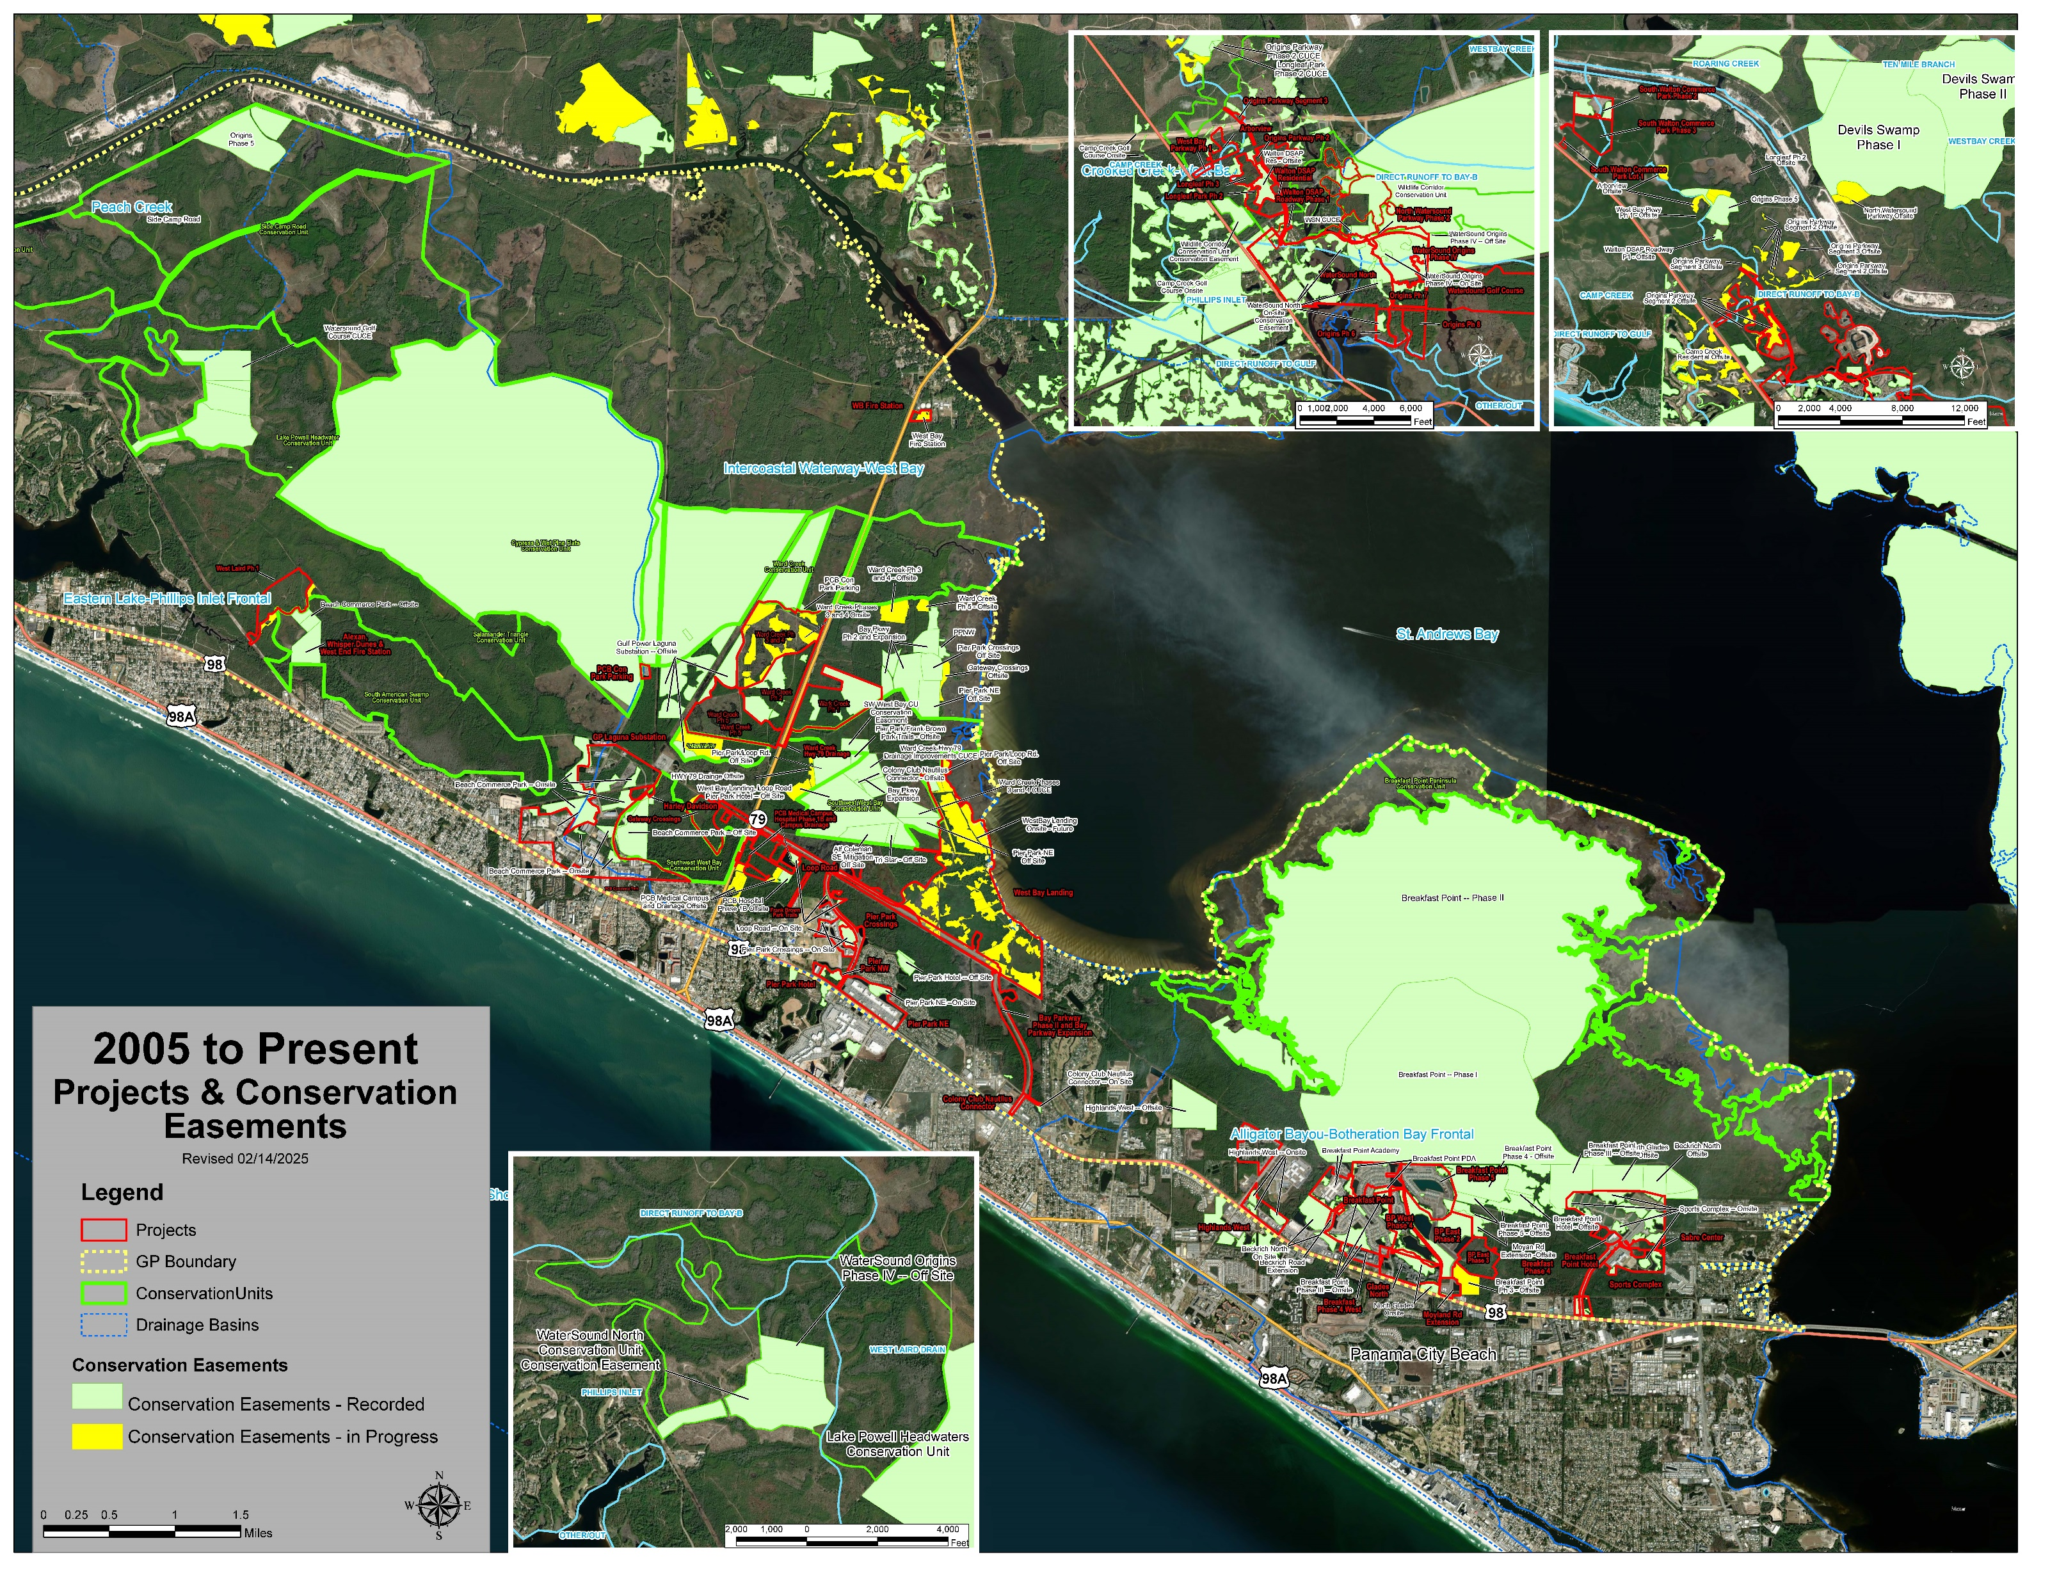
GIS Projects & Conservation Easement Map Overview
15

