Slide 1
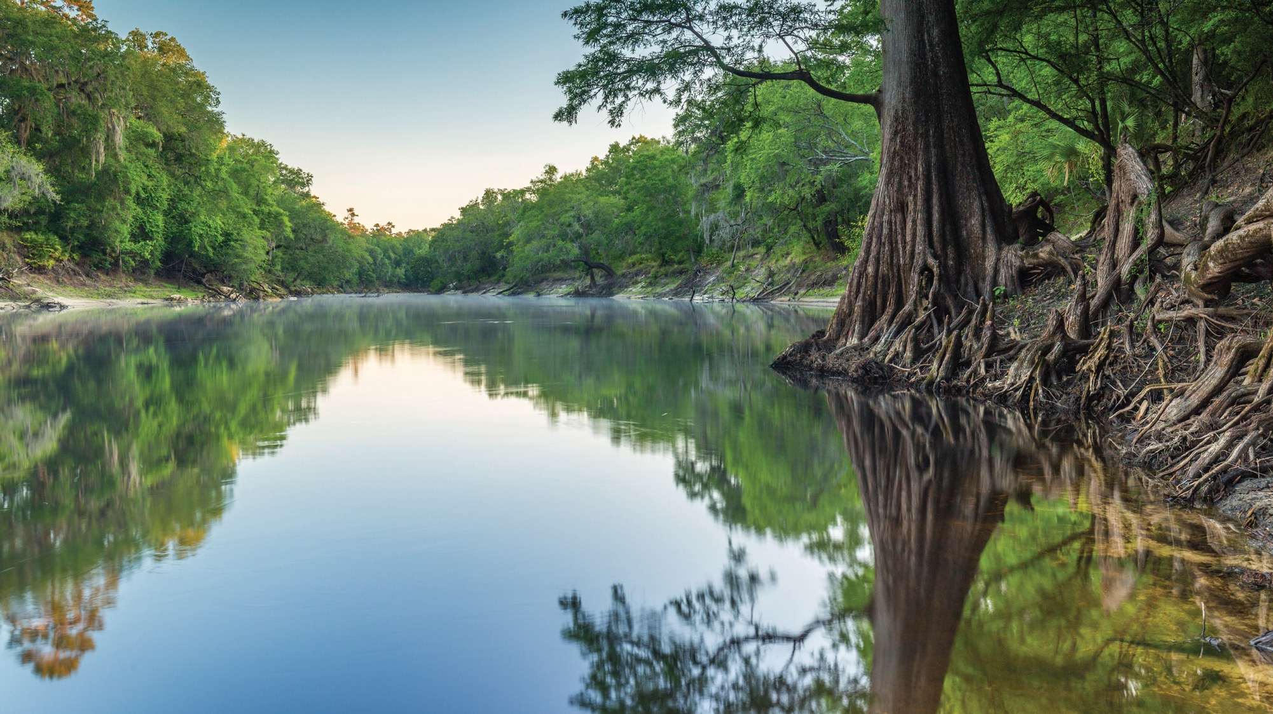

Supplemental Appropriation for Hurricanes Helene and Milton
Eric Meyers, P.E.
Division of Water Restoration Assistance
Drinking Water State Revolving Fund
Florida Department of Environmental Protection
Catherine Murray, P.E.
Division of Water Restoration Assistance
Clean Water State Revolving Fund
Florida Department of Environmental Protection

Slide 2
Supplemental Appropriation for Hurricanes Helene and Milton
In addition to the regular Capitalization Grant and Infrastructure Investment
and Jobs Act (IIJA) General Supplemental
Approximately $806 million for Clean Water SRF (CWSRF)
Approximately $845 million for Drinking Water SRF (DWSRF)
Approximately $36 million for CWSRF Decentralized Projects
0% Finance Rate
Principal Forgiveness
  50% all communities
  100% financially disadvantaged communities and decentralized projects
    CWSRF – Communities Per Capita Income (PCI) < State’s PCI
    DWSRF – Communities Median Household Income (MHI) < State’s MHI

Slide 3
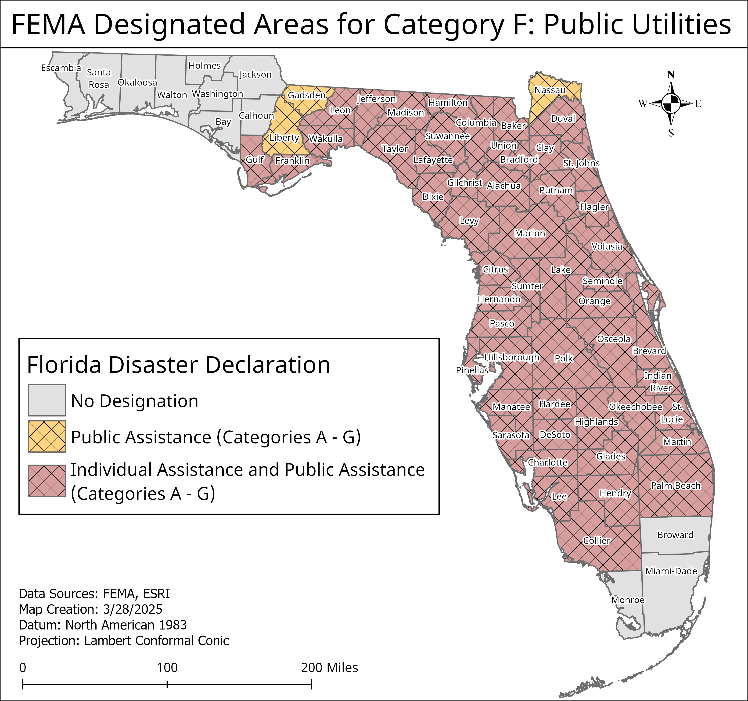
Who Can Apply?
FEMA Designated
Category F Public Utilities
Counties
Municipalities
Special Districts
Private non-profit (Drinking Water Facilities only)

Slide 4
Eligible Projects
Eligible projects must be CWSRF-eligible or DWSRF-eligible, whose purpose is to reduce flood or fire damage risk and vulnerability or to enhance resiliency to rapid hydrologic change or natural disaster at treatment works, as defined by section 212 of the Federal Water Pollution Control Act (i.e., POTWs) and/or section 1452 of the Safe Drinking Water Act.
Decentralized eligible projects to connect homes served by decentralized wastewater treatment systems to centralized wastewater treatment systems. Installation/construction of collection system components and equipment in the public right of way is eligible. Work on private property is not eligible.

Slide 5
DWSRF Eligible Project Types*
Prevent interruption and maintain operation of distribution – relocation of pump stations, redundant distribution, interconnections, larger capacity storage tanks, generators, waterproofing
Prevent flooding at treatment plant – relocation of facilities, physical barriers, floodwater pumping systems
Prevention of saltwater damage
Mobile laboratory equipment
* Refer to Attachment 3 to EPA’s SA-HMW Implementation Memorandum

Slide 6
CWSRF Eligible Project Types*
Prevent interruption and maintain operation of the collection system and treatment works –
  Installation of back-up generators
  Physical hardening or waterproofing of equipment at lift stations or the wastewater treatment plant
  Relocation of equipment or facilities to reduce flooding risk
  Inflow/Infiltration correction to reduce risk of sanitary sewer overflows
  Installation of SCADA systems to allow remote operation
  Installation of larger capacity storage tanks
  Construction of stormwater infrastructure to mitigate flooding
  * Refer to Attachment 3 to EPA’s SA-HMW Implementation Memorandum

Slide 7
How to Apply
Submit Request for Inclusion (RFI) by 11:59 P.M. EDT on June 30, 2025 to SRFRFI@FloridaDEP.gov.
  Clean Water RFI - https://floridadep.gov/wra/srf/documents/cwsrf-request-inclusion
  Drinking Water RFI - https://floridadep.gov/wra/srf/documents/dwsrf-request-inclusion-form-word
Also include:
  Description of the project
  Facility ID number
  Project location
  Proof of impacts to the system (e.g., photographs, power outage reports, mutual aid costs, Water Tracker reports, FLAWarn reports, etc.)
  Explanation of how the project is eligible for SA-HMW funding

Slide 8
State Revolving Fund
Loan Process
Request for Inclusion
Form(Planning)
Request for Inclusion
Form(Design)
Request for Inclusion
Form(Construction)
Priority List Public Meeting
DEP SRF Holds
Priority List Public Meeting
DEP SRF Holds
Priority List Public Meeting
DEP SRF Holds
Loan Application
Sponsor
Planning Document
Preparation & Submittal
Sponsor
Loan Application
Sponsor
Construction Bids
Sponsor
Loan Application
Sponsor
Plans & Specs
Preparation
Sponsor
Loan Agreement
DEP SRF Writes
Loan Agreement
DEP SRF Writes
Bid Review
& Approval
DEP SRF
Loan Agreement
DEP SRF Writes
Agency Reviews
(USFWS, USDA, DEP, DOT,
WMD, etc.)
Permitting
DEP
Planning
Disbursements
Design
Disbursements
Construction
Disbursements
Environmental
Information Document
DEP SRF Writes
Plans & Specs
Approval
DEP SRF
Construction
Sponsor
Planning Document
Approval
DEP SRF
Completion
&
Start-Up
Notes:
To start the SRF process, a project sponsor can complete and submit a Request for Inclusion form, an RFI. The RFI documents the project sponsor, a description of the project, and estimated project cost. Once an RFI is submitted, a project number will be assigned as well as a project manager who will help guide the sponsor through the rest of the SRF process.
To compete for planning funding at a priority list meeting, all that’s needed is an RFI.
After the project successfully competes for planning funding, the sponsor will submit a planning loan application, a loan agreement will be executed, and the sponsor will then develop a planning document. Once the loan agreement has been executed, the sponsor can begin submitting requests for reimbursement of planning activities. The planning document provides information about the project:
Existing conditions
Need for the project
Alternatives evaluated
Environmental effects, which we’ll use to develop an environmental impact document to meet (National Environmental Policy Act) NEPA requirements
Revenues that will be dedicated to repaying the loan, and
We’ll send the proposed project to agencies for review (we’ll send it to the state clearinghouse, as well as to U.S. Fish and Wildlife and sometimes USDA or other agencies
The planning document provides the SRF Program with assurance that…
The project is necessary
The project is in the best interest of the community requesting assistance
To compete for design funding, the sponsor will need to submit an RFI requesting design funding AND have a planning document that is accepted by the program.
After the project successfully competes for design funding, the sponsor will submit a design loan application, a loan agreement will be executed, and the sponsor will prepare plans, technical specifications, and bid documents for the project. Once the loan agreement has been executed, the sponsor can begin submitting requests for reimbursement of design activities. We’re looking for the plans and specs to be consistent with the planning document, ensure fair and open competition, and to include SRF requirements (such as prevailing wages and address debarment requirements). Part of the design approval includes ensuring that the DEP permit(s) have been obtained and that all sites necessary to construct and operate the project have been secured.
To compete for construction funding, the sponsor will need to submit an RFI requesting construction funding AND have both a planning document and 100% complete biddable plans and specifications that have been accepted by the program.
After the project successfully competes for construction funding, the sponsor will submit a construction loan application, a loan agreement will be executed, and the sponsor will advertise the contract for bid. Once the sponsor is ready to award the contract, they will submit bid documents for review (bid documents including proof of advertisement; the lowest responsive, responsible bidder’s bid proposal; and the engineer’s award recommendation). Once we’ve reviewed procurement of the contractor, the sponsor can begin submitting disbursement requests.

