Slide 1

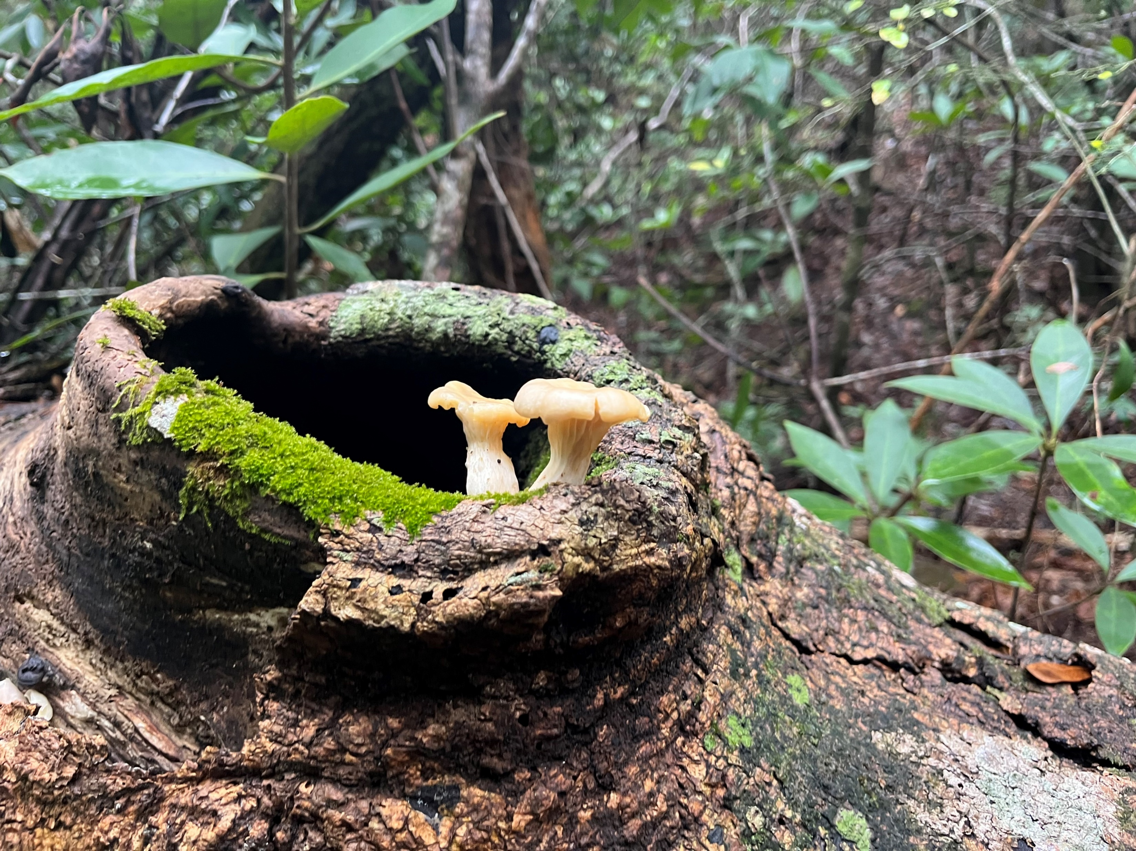
RGP SAJ-105 & Ecosystem Management Agreement 2
2024 Annual Report

Slide 2
Contents
2024 Annual Report
This report contains the project and sub-basin ledgers for all project authorizations issued through
December 31st, 2024.
2024 Project Summary
Overall Summary
2024 Project Ledger
2024 Sub-Basin Ledger
Conservation Unit Ledger
Conservation Unit Land Management Summary
GIS Projects & Conservation Easement Map
2
3
4
7
8
9
10

Slide 3
2024 Project Summary
EMA 2 and RGP SAJ 105 authorizations were issued in 2024 for the following:
Latitude Margaritaville Phase 5A-3 0403572-024-EA/03; SAJ-2024-01704
2024 Projects that commenced construction in 2024:
Latitude Margaritaville Phase 5A-3 0403572-024-EA/03; SAJ-2024-01704

Slide 4
Overall Summary
2024 Annual Report
In 2015, the Florida Department of Environmental Protection executed a second Ecosystem Management Agreement with The St. Joe Company covering 42,889 acres of St. Joe ownership. Subsequently, the Army Corps of Engineers issued SAJ-105 for 43,977 acres including St. Joe ownership as well as other ownership located in the West Bay watershed within Bay County, Florida. This agreement was renewed by Florida Department of Environmental Protection and Army Corps of Engineers on December 20, 2020.
This is the ninth annual report for SAJ 105 and EMA 2. All projects approved under the SAJ-105 EMA 2 criteria are included in the project ledger. One project was approved in 2024. All projects authorized by RGP/EMA 2 are depicted in the Projects and Conservation Easement map and listed in the following project ledger. Due to the seventeen projects authorized, 1,191.131 total acres have been committed to conservation easements to date. The following conservation easements were recorded in 2024:
Latitude Margaritaville Watersound Phase 3 Onsite Mitigation Conservation Easement; Offsite Mitigation Conservation Easement
Latitude Margaritaville West Bay Parkway Segment 3 Onsite Mitigation Conservation Easement; Offsite Mitigation Conservation Easement
Latitude Margaritaville Watersound Phase 4 Onsite Mitigation Conservation Easement; Offsite Mitigation Conservation Easement
Latitude Margaritaville West Bay Parkway Segment 4 Offsite Mitigation Conservation Easement
Latitude Margaritaville Watersound Phase 5B Onsite Mitigation Conservation Easement; Offsite Mitigation Conservation Easement
Latitude Margaritaville Watersound Phase 5A Onsite Mitigation Conservation Easement; Offsite Mitigation Conservation Easement
Latitude Margaritaville Watersound Phase 6A Offsite Mitigation Conservation Easement

Slide 5
2024 Project Ledger
Number | Type | Permitting Basin | Sub-basin | Project | Tot Prj Ac | HQ | HQ IMP | Alt | Alt IMP | WTL | UPL | Onsite CE | Offsite CE | CU Mit CE | CU CE | CR MIT | Rd Removal | Status
1 | ERP/NWP | DSMB/BPMB | CCWB | 03-300713-004-DF; SAJ-2010-02464(NW-AAK) West Bay Business Center Road Crossing | 2.36 | 1.39 | 0.49 | 0 | 0 | 1.41 | 0.97 | 21.75 | 0 | 0 | 0 | 0.43 |  | CE Recorded
2 | ERP/NWP | DSMB/BPMB | CCWB | 03-06141-001 EI; SAJ-2011-01434 (NW- AAK) C-Store/ Express Lane @ Hwy 79 & CR 388 | 2.21 | 0.22 | 0 | 0.39 | 0.17 | 0.6 | 1.61 | 0.883 | 0.81 | 0 | 0.92 | 0.09 |  | CE Recorded
3A | EMA/RGP | BPMB | CCWB | 0354652-002 EA; SAJ-2009-02897 SR 388 Expansion | 154.1 | 10.13 | 7.47 | 23.4 | 20.67 | 33.53 | 123.4 | 5.39 | 114.47 | 0 | 78.531 | 17.46 |  | CE Recorded
3B | EMA/RGP | BPMB | BMC | 0354652-002 EA; SAJ-2009-02897 SR 388 Expansion | 48.3 | 1.55 | 1.3 | 28.13 | 23.2 | 29.68 | 18.62 | 5.18 | 126.61 | 0 | 55.586 | 13.43 |  | CE Recorded
3C | EMA/ RGP | BPMB | ICW | 0354652-002 EA; SAJ-2009-02897 SR 388 Expansion | 2.4 | 0 | 0 | 0.57 | 0.36 | 0.57 | 1.83 | 0.21 | 1.847 | 0 | No CU +0.21% to CCWB | 0.19 |  | CE Recorded
2020 Permits
4 | EMA/RGP | DSMB | ICW | 0381301-002-EA/03; SAJ-2020-00028 Latitude Margaritaville Watersound Area 1 Phase 1 | 54.67 | 1.18 | 0.34 | 14.32 | 12.26 | 14.51 | 39.17 | 1..07 | 68.4 | 0 | N/A | 6.8 UMAM | 1 | CE Recorded
5 | EMA/RGP | DSMB | ICW | 0381301-003-EA/03; SAJ-2020-01070 Latitude Margaritaville Watersound Area 1 Phase 2 | 105 | 14.32 | 0.49 | 22.97 | 10.78 | 37.29 | 112.71 | 9.92 | 51.2 | 0 | N/A | 6.13 UMAM | 3 | CE Recorded
6 | EMA/RGP | DSMB | ICW | 0381301-004-EA/03; SAJ-2020-01909 Latitude Margaritaville Watersound Area 1 Phase 3 | 213 | 28.76 | 0 | 23.74 | 12.31 | 52.5 | 160.5 | 11.43 | 58.37 | 0 | N/A | 6.52 UMAM | 2 | CE Recorded
2021 Permits
7 | EMA/404 | DSMB | ICW | 0403572-002-EA/03 043572-001-SFRG/03 Latitude Margaritaville West Bay Parkway Segment 3 | 18.55 | 1.19 | 1.16 | 7.05 | 6.45 | 8.24 | 10.31 | 0.63 | 35.94 | 0 | N/A | 4.43 UMAM | 1 | CE Recorded
Tot Prj Ac | Total Project Acres Within Sub-basin
HQ | High Quality Wetlands
HQ IMP | High Quality Wetland Impacts
Alt | Altered Wetlands
Alt IMP | Altered Wetland Impacts
UPL | Uplands
Onsite CE | Onsite Conservation Easements
Offsite CE | Offsite Conservation Easements
CU MIT CE | Conservation Unit Mitigation Conservation Easement
CU CE | Conservation Unit Conservation Easement
CR MIT | Mitigation Credits
WTL | Wetland
CE’s to be recorded
Impacts have not occurred as of 12/31/2024
Permits modified in 2023
Regional General Permit SAJ-105
^project located between 2 EMA/ RGP Areas only portion within EMA 2 is included on the sheet
Permits modified in 2024
CE’s recorded

Slide 6
2024 Project Ledger
Number | Type | Permitting Basin | Sub-basin | Project | Tot Prj Ac | HQ | HQ IMP | Alt | Alt IMP | WTL | UPL | Onsite CE | Offsite CE | CU Mit CE | CU CE | CR MIT | Rd Removal | Status
8 | EMA/404 | DSMB | ICW | 040939-002-EA/03; 0404939-001-SFRP/03 Latitude Margaritaville West Bay Town Center Phase 1 | 12.40 | 0.2 | 0.2 | 8.87 | 8.87 | 9.07 | 3.33 | 0 | 50.29 | N/A | N/A | 4.87 UMAM | 1 | CE Recorded
9 | EMA/404 | DSMB | ICW | 0381301-001-EA/03; SAJ-2021-02328 Latitude Margaritaville Watersound Phase 4 | 223.72 | 32.61 | 0.02 | 75.07 | 39.96 | 107.68 | 116.04 | 67.7 | 191.46 | N/A | N/A | 21.20 UMAM | 2 | CE Recorded
10 | EMA Only | DSMB | ICW | 0381301-010-EA/03 Latitude Margaritaville Amenity Center | 87 | 0 | 0 | 0 | 0 | 0 | 0 | 0 | 0 | N/A | N/A | N/A | 0 | N/A
2022 Permits
11 | EMA/404 | DSMB | ICW | 0404939-005/EA-03; 0404939-006-SFRP/03; 0404939-009-SFM/03West Bay Parkway Segment 4 | 23.72 | 1.57 | 1 | 3.66 | 2.83 | 5.6 | 18.12 | 1.4 | 16.05 | 0 | 0 | 2.37 UMAM | 2 | CE Recorded
12 | EMA/404 | DSMB | ICW | 0403572-008-SFRP/03; 0403572-007-EA/03; 0403572-016-EM/03 Latitude Margaritaville Watersound Phase 5B | 29.78 | 0.08 | 0 | 18.45 | 15.95 | 18.53 | 11.25 | 2.5 | 87.94 | 0 | 0 | 8.45 UMAM | 0 | CE Recorded
2023 Permits
13 | EMA/404 | BPMB | ICW | 0403572-009-EA/03 0403572-010-SFRP/03; 0403571-021-EM/03; 0403572-022-SFM/03 Latitude Watersound Phase 5C | 184.7 | 49.14 | 0 | 70.43 | 21.08 | 119.57 | 65.13 | 24.56 | 94.96 | 0 | 0 | 11.17 UMAM | 0 | CE in Progress
14 | EMA/404 | DSMB | ICW | 0403572-005-EA/03; 0403572-006-SFRP/03; 0403572-014-EM/03; Latitude Margaritaville Phase 5A | 26.95 | 7.32 | 0.32 | 2.4 | 0.76 | 9.72 | 17.23 | 1.63 | 2.74 | 0 | 0 | 0.68 UMAM | 1 | CE Recorded
Tot Prj Ac | Total Project Acres Within Sub-basin
HQ | High Quality Wetlands
HQ IMP | High Quality Wetland Impacts
Alt | Altered Wetlands
Alt IMP | Altered Wetland Impacts
UPL | Uplands
Onsite CE | Onsite Conservation Easements
Offsite CE | Offsite Conservation Easements
CU MIT CE | Conservation Unit Mitigation Conservation Easement
CU CE | Conservation Unit Conservation Easement
CR MIT | Mitigation Credits
WTL | Wetland
CE’s to be recorded
Impacts have not occurred as of 12/31/2024
Permits modified in 2023
Regional General Permit SAJ-105
^project located between 2 EMA/ RGP Areas only portion within EMA 2 is included on the sheet
Permits modified in 2024
CE’s recorded

Slide 7
2024 Project Ledger
Number | Type | Permitting Basin | Sub-basin | Project | Tot Prj Ac | HQ | HQ IMP | Alt | Alt IMP | WTL | UPL | Onsite CE | Offsite CE | CU Mit CE | CU CE | CR MIT | Rd Removal | Status
15 | EMA/404 | BPMB | ICW | 0381301-2020-EA/03; 0381301-021-SFRP/03; 0381301-0240EM/03; 0381301-025-SFM/03: Latitude Margaritaville Watersound Phase 6A | 46.72 | 7.92 | 0 | 12.1 | 7.97 | 34.8 | 11.62 | 3.36 | 41.83 | 0 | 0 | 4.22 UMAM | 0 | CE in Progress
16 | EMA/404 | BPMB | ICW | 0403572-013-SFRP/03; 0403572-011-EA03; 0403572-019-EM/03; 0403572-020-SFM/03; LMWS Phase 6B/C | 8.72 | 0.01 | 0 | 1.16 | 1.16 | 1.17 | 7.55 | 0.01 | 6.58 | 0 | 0 | 0.61 UMAM | 0 | CE in Progress
17 | EMA/404 | BPMB | ICW | 0404939-014-SFRP/03; 0404934-013-EA/03 West Bay Center Spine Road | 25.22 | 0.016 | 0.016 | 16.1 | 9.41 | 16.12 | 9.1 | 0 | 53.34 | 0 | 0 | 5 UMAM 6.12 WRAP | 0 | CE in progress
18 | EMA Only | DSMB | ICW | 0437362-001-EA/03 Latitude Margaritaville Phase 6B/C Boardwalk | 0.10 | 0.049 | 0.001 | 0.031 | 0.001 | 0.08 | 0 | 0 | 0 | 0 | 0 | NA | NA | NA
2024 Permits
19 | EMA/RGP/404 | BPMB | ICW | 0403572-024-EA/03; SAJ-2024-01704 LMWS Phase 5A-3 | 29.61 | 4.26 | 0 | 1.04 | 0.42 | 5.3 | 21.61 | 0.62 | 1.76 | 0 | 0 | 0.22 UMAM 0.27 WRAP | 1 | CE in Progress
 |  |  |  | Totals | 1,299.2 | 161.9 | 12.81 | 328.89 | 194.61 | 505.97 | 752.22 | 158.24 | 897.631 | 0 | 135.25 | 114.27 UMAM 6.39 WRAP | 13
Tot Prj Ac | Total Project Acres Within Sub-basin
HQ | High Quality Wetlands
HQ IMP | High Quality Wetland Impacts
Alt | Altered Wetlands
Alt IMP | Altered Wetland Impacts
UPL | Uplands
Onsite CE | Onsite Conservation Easements
Offsite CE | Offsite Conservation Easements
CU MIT CE | Conservation Unit Mitigation Conservation Easement
CU CE | Conservation Unit Conservation Easement
CR MIT | Mitigation Credits
WTL | Wetland
CE’s to be recorded
Impacts have not occurred as of 12/31/2024
Permits modified in 2023
Regional General Permit SAJ-105
^project located between 2 EMA/ RGP Areas only portion within EMA 2 is included on the sheet
Permits modified in 2024
CE’s recorded

Slide 8
2024 Sub-Basin Ledger
2024 Sub-Basin Ledger
Sub-Basin | Change? | Tot_A | Tot_Alt | Tot_HQ | Tot_Alt_IMP | %** | Tot_HQ_IMP | %** | Tot_Alt Remain | Tot_HQ_Remain
Burnt Mill Creek – Doyle Bayou | N | 9168 | 3098 | 2289 | 23.20 | 0.75 | 1.3 | 0.05 | 3074.8 | 2287.7
Crooked Creek – West Bay | N | 12,574 | 3554 | 3036 | 20.84 | 0.6 | 7.96 | 0.26 | 3533.16 | 3028.04
Fannin Bayou – Warren Bayou | N | 5793 | 2226 | 1580 | 0 | 0 | 0 | 0 | 2226 | 1580
Intercoastal Waterway – West Bay | Y | 1871.67 | 525.99 | 408 | 165.42 | 31.45* | 3.55 | 0.87 | 360.57 | 400.92
Little Burnt Mill Creek | N | 12,958 | 3912 | 3250 | 0 | 0 | 0 | 0 | 3912 | 3250
Pine Log Creek | N | 1867 | 328 | 409 | 0 | 0 | 0 | 0 | 328 | 409
* Cumulative through December 31, 2024 |  |  |  |  |  |  |  | Total | 13,434.53 | 10,955.66
** From Total * Greater than 15 % within the EMA, however appropriate preservation has been located within the subbasin in the adjacent EMA 3.

Slide 9
2024 Conservation Unit Ledger
 |  |  | Conservation Easements
 |  |  | Recorded | Required | In Process
Conservation Unit | Subbasin | Ownership | Acres | Acres | Acres
Burnt Mill Creek – Doyle Bayou | Burnt Mill Creek- Doyle Bayou | St. Joe | 55.59 | 55.59 | 0
Crooked Creek – West Bay | Crooked Creek-West Bay | St. Joe | 79.66 | 79.66 | 0
Fannin Bayou – Warren Bayou | Fannin Bayou- Warren Bayou | St. Joe | 0 | 0 | 0
Little Burnt Mill Creek | Little Burnt Mill Creek | St. Joe | 0 | 0 | 0
Pine Log Creek | Pine Log | St. Joe | 0 | 0 | 0
Total |  |  | 135.251 | 135.251 | 0
* No Conservation Units are located within the ICW-WB Basin within the RGP105- EMA 2 boundary.

Slide 10
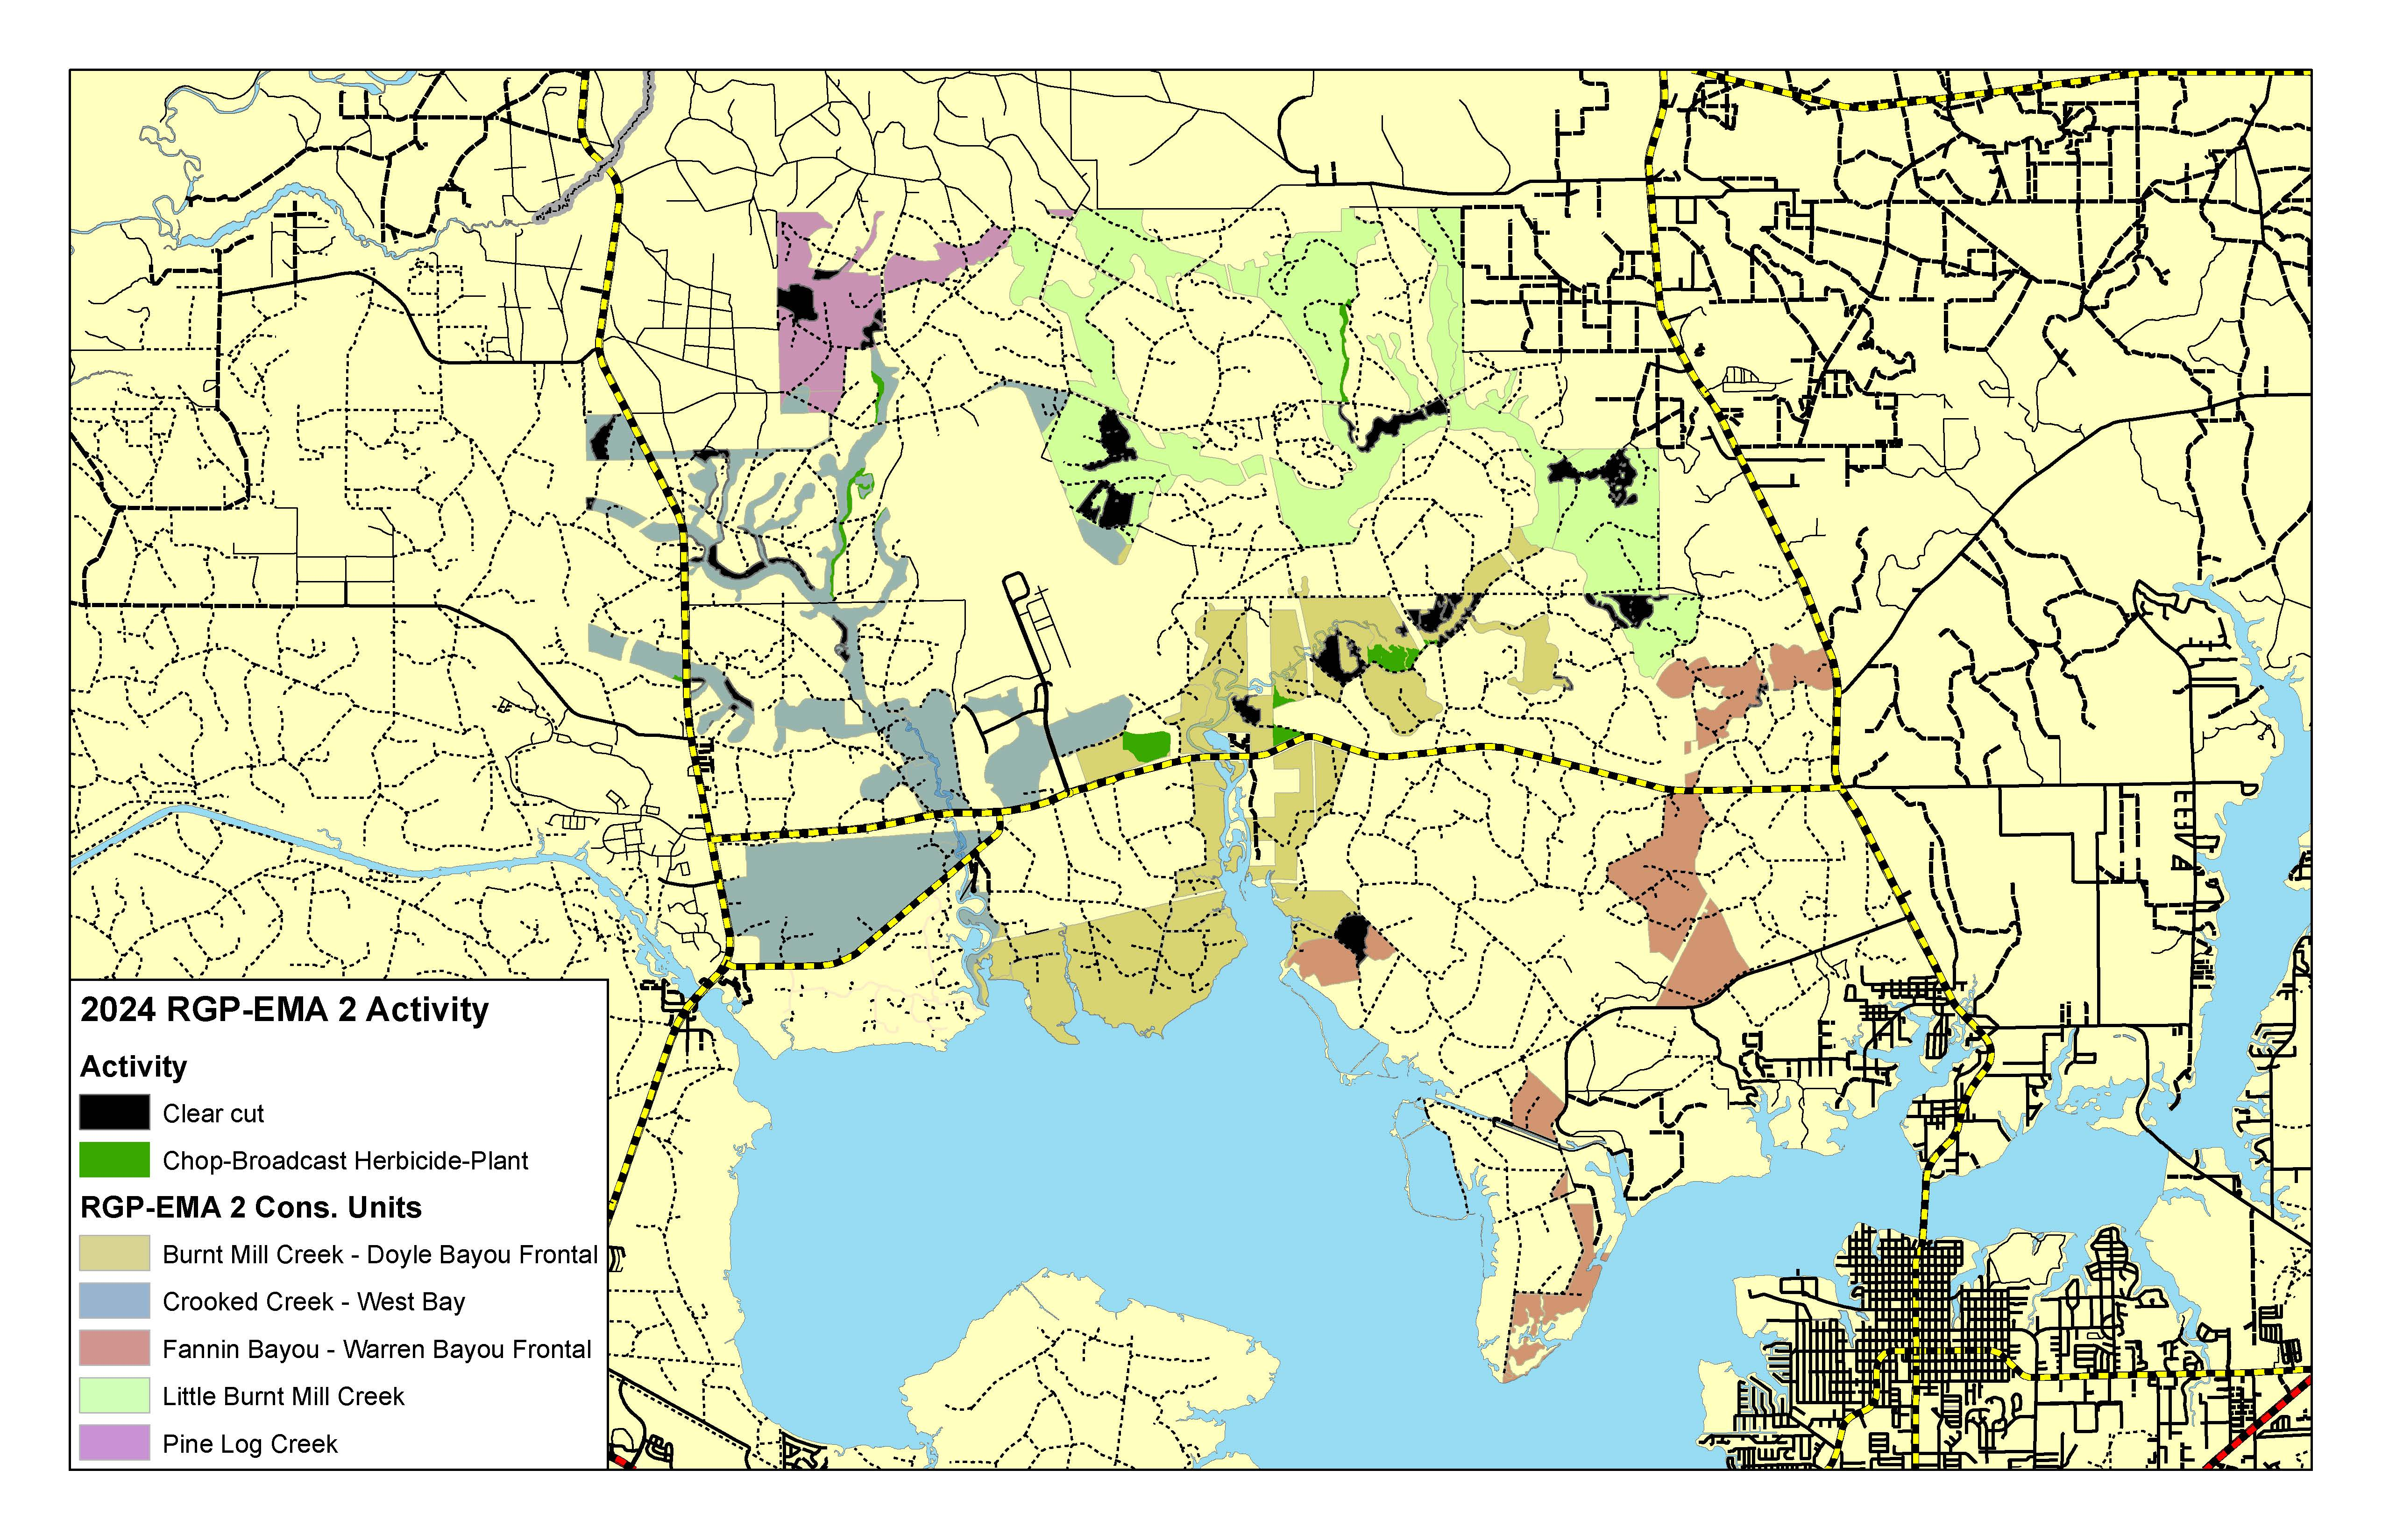
Conservation Unit Land Management Summary

Slide 11
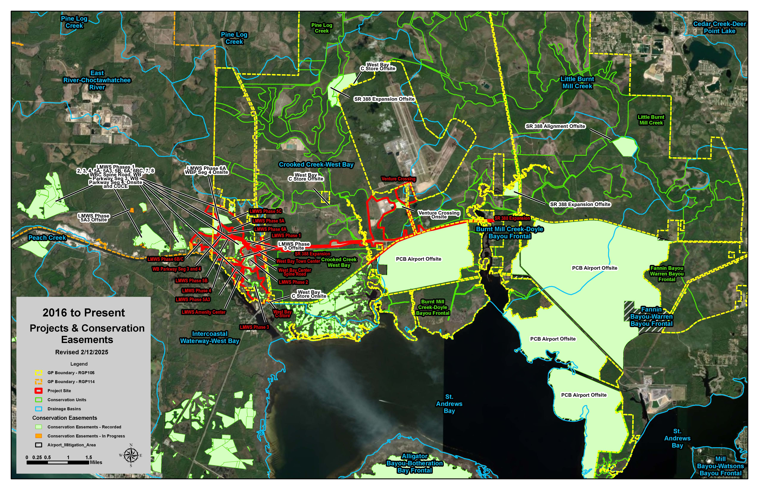
GIS Projects & Conservation Easement Map

