Slide 1
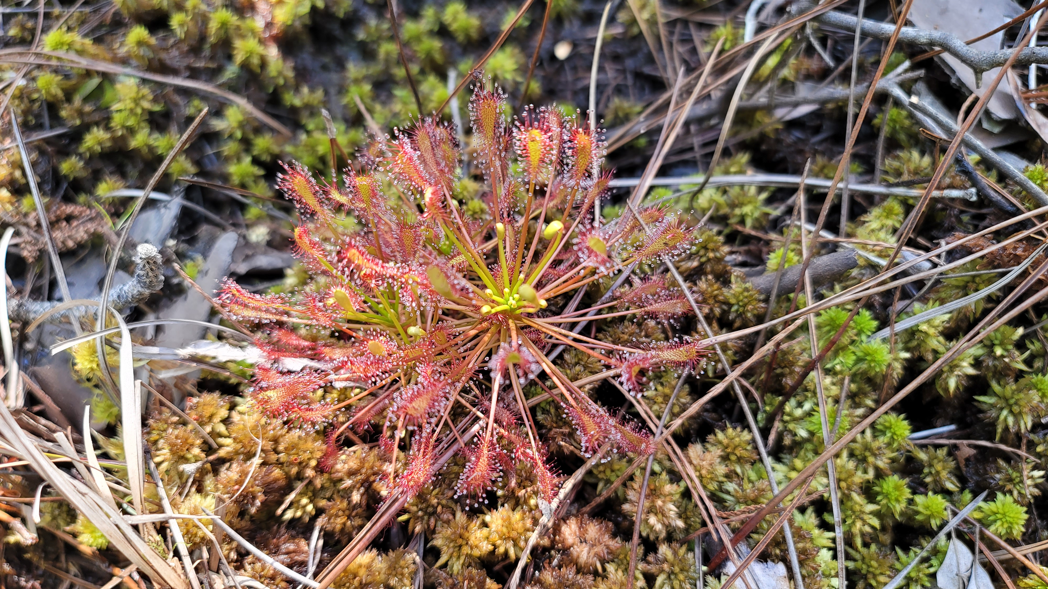
RGP SAJ-105 & Ecosystem Management Agreement 2 2022 Annual Report

Slide 2
Contents
Summary…………………………………………………………………2
2022 Project Ledger………………………………………………..3
2022 Sub-basin Ledger…………………………………………...5
Conservation Unit Ledger……………………………………….6
GIS Projects Conservation Easement Map …………….7
Conservation Unit Land Management Summary…….8

Slide 3
RGP SAJ-105 & Ecosystem Management Agreement 2022 Annual Report
SUMMARY
In 2015, the Florida Department of Environmental Protection executed a second Ecosystem Management Agreement with The St. Joe Company covering 42,889 acres of St. Joe ownership. Subsequently, the Army Corps of Engineers issued SAJ-105 for 43,977 acres including St. Joe ownership as well as other ownership located in the West Bay watershed within Bay County, Florida. This agreement was renewed by Florida Department of Environmental Protection and Army Corps of Engineers on December 20, 2020.
This is the seventh annual report for SAJ 105 and EMA 2. All projects approved under the SAJ-105 EMA 2 criteria are included in the Project Ledger, three projects were approved in 2022. All projects authorized by RGP/EMA 2 are depicted in the Projects and Conservation Easement map and listed in the following project ledger.

Slide 4
2022 Project Ledger
SUMMARY
Number | Type | Permitting Basin | Sub-basin | Project | Tot Prj Ac | HQ | HQ IMP | Alt | Alt IMP | WTL | UPL | Onsite CE | Offsite CE | CU Mit CE | CU CE | CR MIT | Rd Crossing | Status
1 | ERP/NWP | DSMB/BPMB | CCWB | West Bay Business Center Road Crossing 03-300713-004-DF / SAJ-2010-02464(NW-AAK) | 2.36 | 1.39 | 0.49 | 0 | 0 | 1.41 | 0.97 | 21.75 | 0 | 0 | 0 | 0.43 |  | Complete
2 | ERP/NWP | DSMB/BPMB | CCWB | C-Store/ Express Lane @ Hwy 79 & CR 388 03-06141-001 EI/ SAJ-2011-01434 (NW- AAK) | 2.21 | 0.22 | 0 | 0.39 | 0.17 | 0.6 | 1.61 | 0.883 | 0.81 | 0 | 0.92 | 0.09 |  | Complete
3A | EMA/RGP | BPMB | CCWB | SR 388 Expansion 0354652-002 EA/ SAJ-2009-02897 | 154.1 | 10.13 | 7.47 | 23.4 | 20.67 | 33.53 | 123.4 | 5.39 | 114.47 | 0 | 78.531 | 17.46 |  | In Progress
3B | EMA/RGP | BPMB | BMC | SR 388 Expansion 0354652-002 EA/ SAJ-2009-02897 | 48.3 | 1.55 | 1.3 | 28.13 | 23.2 | 29.68 | 18.62 | 5.18 | 126.61 | 0 | 55.586 | 13.43 |  | In Progress
3C | EMA/ RGP | BPMB | ICW | SR 388 Expansion 0354652-002 EA/ SAJ-2009-02897 | 2.4 | 0 | 0 | 0.57 | 0.36 | 0.57 | 1.83 | 0.21 | 1.847 | 0 | No CU +0.21% to CCWB | 0.19 |  | In Progress
2020 Permits
4 | EMA/RGP | DSMB | ICW | Latitude Margaritaville Watersound Area 1 Phase 1 0381301-002-EA/03; SAJ-2020-00028 | 54.67 | 1.18 | 0.34 | 14.32 | 12.26 | 14.51 | 39.17 | 1..07 | 68.4 | 0 | N/A | 6.8 UMAM | 1 | Complete
5 | EMA/RGP | DSMB | ICW | Latitude Margaritaville Watersound Area 1 Phase 2 0381301-003-EA/03; SAJ-2020-01070 | 105 | 14.32 | 0.49 | 22.97 | 10.78 | 37.29 | 112.71 | 9.92 | 51.2 | 0 | N/A | 6.13 UMAM | 3 | Completed
6 | EMA/RGP | DSMB | ICW | Latitude Margaritaville Watersound Area 1 Phase 3 0381301-004-EA/03; SAJ-2020-01909 | 213 | 28.76 | 0 | 23.74 | 12.31 | 52.5 | 160.5 | 11.43 | 58.37 | 0 | N/A | 6.52 UMAM | 2 | Onsite Completed
2021 Permits
7 | EMA/404 | DSMB | ICW | Latitude Margaritaville West Bay Parkway Segment 3 0403572-002-EA/03 043572-001-SFRG/03 | 18.55 | 1.19 | 1.16 | 7.05 | 6.45 | 8.24 | 10.31 | 0.63 | 35.94 | 0 | N/A | 4.43 UMAM | 1 | In Progress
Tot Prj Ac | Total Project Acres Within Sub-basin
HQ | High Quality Wetlands
HQ IMP | High Quality Wetland Impacts
LQ | Low Quality Wetlands
LQ IMP | Low Quality Wetland Impacts
UPL | Uplands
Onsite CE | Onsite Conservation Easements
Offsite CE | Offsite Conservation Easements
CU MIT CE | Conservation Unit Mitigation Conservation Easement
CU CE | Conservation Unit Conservation Easement
CR MIT | Mitigation Credits
WTL | Wetland
GP | Regional General Permit SAJ-86
IP | Individual Permit
Impacts have not occurred
as of 12/31/2022

Slide 5
2022 Project Ledger
SUMMARY
Number | Type | Permitting Basin | Sub-basin | Project | Tot Prj Ac | HQ | HQ IMP | Alt | Alt IMP | WTL | UPL | Onsite CE | Offsite CE | CU Mit CE | CU CE | CR MIT | Rd Crossing | Status
8 | EMA/404 | DSMB | ICW | Latitude Margaritaville West Bay Town Center Ph 1 040939-002-EA/03; 0404939-001-SFRP/03 | 12.40 | 0.2 | 0.2 | 8.87 | 8.87 | 9.07 | 3.33 | 0 | 50.29 | N/A | N/A | 4.87 UMAM | 1 | In Progress
9 | EMA/404 | DSMB | ICW | 0381301-001-EA/03; SAJ-2021-02328 Latitude Margaritaville Watersound Ph 4 | 223.72 | 32.61 | 0.02 | 75.07 | 39.96 | 107.68 | 116.04 | 67.7 | 191.46 | N/A | N/A | 21.20 UMAM | 2 | In Progress
10 | EMA Only | DSMB | ICW | 0381301-010-EA/03 Latitude Margaritaville Amenity Center | 87 | 0 | 0 | 0 | 0 | 0 | 0 | 0 | 0 | N/A | N/A | N/A | 0
2022 Permits
11 | EMA/404 | DSMB | ICW | Latitude Margaritaville Watersoud Phase 5A | 26.95 | 7.32 | 0.32 | 2.4 | 0.77 | 9.72 | 17.23 | 1.63 | 2.74 | N/A | N/A | 0.69 UMAM | 1 | In Progress
12 | EMA/404 | DSMB | ICW | West Bay Parkway Segment 4 0404939-005-EA/03; 0404939-006-SFRP/03 | 23.72 | 1.57 | 1.0 | 3.66 | 2.83 | 5.6 | 18.79 | 1.4 | 15.22 | N/A | N/A | 2.37 UMAM | 2 | In Progress
13 | EMA/404 | DSMB | ICW | Latitude Margaritaville Watersound Phase 5B 043572-007-EA/03; 0403572-008-SFRP/03 | 29.78 | 0.08 | 0 | 18.45 | 18.45 | 15.95 | 11.25 | 2.5 | 87.94 | N/A | N/A | 8.45 UMAM | 0 | In Progress
 |  |  |  | Totals | 1,188.9 | 149.7 | 12.79 | 298.46 | 178.15 | 448.5 | 703.01 | 179.05 | 794.04 | 0 | 135.10 | 104.14 UMAM | 13
Tot Prj Ac | Total Project Acres Within Sub-basin
HQ | High Quality Wetlands
HQ IMP | High Quality Wetland Impacts
LQ | Low Quality Wetlands
LQ IMP | Low Quality Wetland Impacts
UPL | Uplands
Onsite CE | Onsite Conservation Easements
Offsite CE | Offsite Conservation Easements
CU MIT CE | Conservation Unit Mitigation Conservation Easement
CU CE | Conservation Unit Conservation Easement
CR MIT | Mitigation Credits
WTL | Wetland
GP | Regional General Permit SAJ-86
IP | Individual Permit
Impacts have not occurred
as of 12/31/2022.

Slide 6
2022 Sub-basin Ledger
2022 Sub-basin
Sub-basin | Change? | Tot_A | Tot_Alt | Tot_HQ | Tot_Alt_IMP | %** | Tot_HQ_IMP | %** | Tot_Alt Remain | Tot_HQ_Remain
Burnt Mill Creek – Doyle Bayou | N | 9168 | 3098 | 2289 | 23.20 | 0.75 | 1.3 | 0.05 | 3074.8 | 2287.7
Crooked Creek – West Bay | N | 12,574 | 3554 | 3036 | 20.84 | 0.6 | 7.96 | 0.26 | 3533.16 | 3028.04
Fannin Bayou – Warren Bayou | N | 5793 | 2226 | 1580 | 0 | 0 | 0 | 0 | 2226 | 1580
Intercoastal Waterway – West Bay | Y | 1871.67 | 525.99 | 408 | 134.11 | 25* | 3.53 | 0.87 | 391.88 | 404.47
Little Burnt Mill Creek | N | 12,958 | 3912 | 3250 | 0 | 0 | 0 | 0 | 3912 | 3250
Pine Log Creek | N | 1867 | 328 | 409 | 0 | 0 | 0 | 0 | 328 | 409
* Cumulative through December 31, 2022 |  |  |  |  |  |  |  | Total | 13,465.84 | 10,959.21
** From Total * Greater than 15 % within the EMA, however appropriate preservation has been located within the subbasin in the adjacent EMA 3.

Slide 7
2022 Conservation Unit Ledger
 |  |  | Conservation Easements
 |  |  | Recorded | Required | In Process
Conservation Unit | Subbasin | Ownership | Acres | Acres | Acres
Burnt Mill Creek – Doyle Bayou | Burnt Mill Creek- Doyle Bayou | St. Joe | 0 | 55.58 | 55.58
Crooked Creek – West Bay | Crooked Creek-West Bay | St. Joe | 0.92 | 79.45 | 78.52
Fannin Bayou – Warren Bayou | Fannin Bayou- Warren Bayou | St. Joe
Little Burnt Mill Creek | Little Burnt Mill Creek | St. Joe
Pine Log Creek | Pine Log | St. Joe
Total |  |  | 0.92 | 135.03 | 134.1
* No Conservation Units are located within the ICW-WB Basin within the RGP105- EMA 2 boundary.

Slide 8
GIS Projects & Conservation Easement Map

Slide 9
Conservation Unit Land Management Summary

