Slide 1

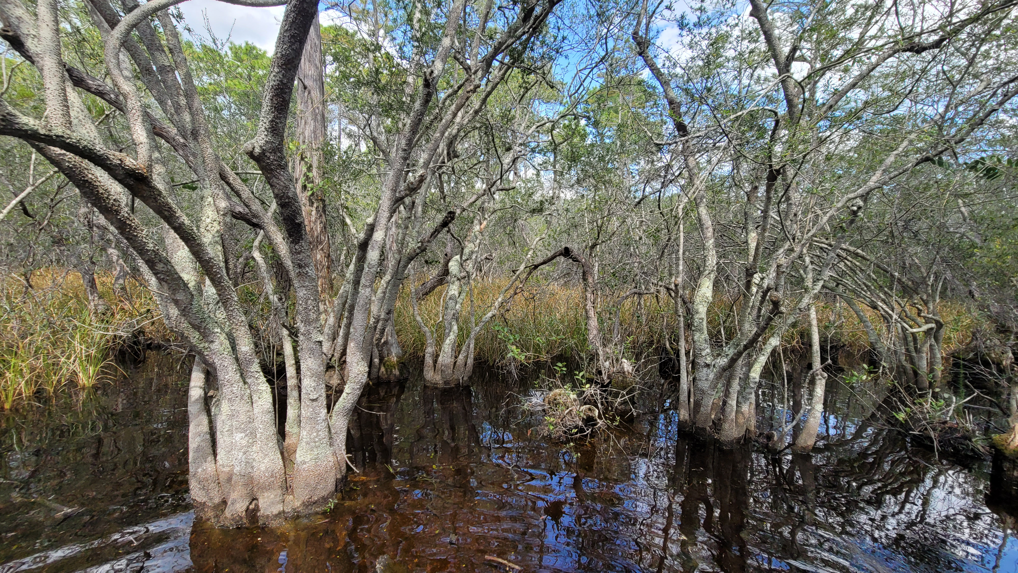
RGP SAJ-114 & Ecosystem Management Agreement 3
2022 Annual Report

Slide 2
Contents
Summary……………………………………………………….. 2
2022 Project Ledger……………………………………………. 3
2022 Sub-basin Ledger………………………………………… 4
2022 Conservation Easements……………... ………………. 5
Conservation Unit Ledger……………………………………… 6
Conservation Easement GIS Map……………………………… 7
Conservation Unit Land Management Summary……………… 8

Slide 3
RGP SAJ-114 & Ecosystem Management Agreement 3
2022 Annual Report
SUMMARY
On July 7, 2020, the Florida Department of Environmental Protection executed a third Ecosystem Management Agreement with The St. Joe Company for 28,327 acres within St. Joe ownership. Subsequently, the Army Corps of Engineers issued SAJ-114 on August 21, 2020, for 41,585 acres including St. Joe lands as well as other ownership located in the West Bay and Choctawhatchee watersheds within Bay and Walton Counties of Florida.
This is the second annual report for SAJ 114 and EMA 3 since issuance in August 2020. All projects approved under the SAJ-114/EMA 3 criteria area will be included in the project ledger. One project has been authorized by this permit at this time and two projects are currently under review by regulatory agencies.

Slide 4
2022 Project Ledger
Number | Type | Permitting Basin | Sub-basin | Project | TOTAL | HQ | HQ IMP | Alt | Alt Imp | WTL | UPL | Onsite CE | Offsite CE | CU Mit CE | CU CE | CR MIT | Rd Remove | Status
1 | EMA/404 | DSMB | ICW | 0404939-005-EA/03; 0404939-006-SFRP West Bay Parkway Segment 4^ | 5.29 | 0 | 0 | 0.51 | 0.22 | 0.51 | 4.78 | 0.29 | 0.45 | 0 | 0.053 | 0.13 |  | CE in Progress
 |  |  |  | Totals | 5.29 | 0 | 0 | 0.51 | 0.22 | 0.51 | 4.78 | 0.29 | 0.45 | 0 | 0.053 | 0.13
Tot Prj Ac | Total Project Acres Within Sub-basin
HQ | High Quality Wetlands Acres
HQ IMP | High Quality Wetland Impacts Acres
LQ | Low Quality Wetlands Acres
LQ IMP | Low Quality Wetland Impacts Acres
UPL | Uplands Acres
Onsite CE | Onsite Conservation Easements Acres
Offsite CE | Offsite Conservation Easements Acres
CU MIT CE | Conservation Unit Mitigation Conservation Easement
CU CE | Conservation Unit Conservation Easement
CR MIT | Mitigation Credits
WTL | Wetland
Impacts occurred as of 2022
CE’s to be recorded
Regional General Permit SAJ-114
^project located between 2 EMA/ RGP Areas only portion within EMA3 is included on the sheet
LQ Impact Allowance Drawdown

Slide 5
2022 Sub-basin Ledger
2022 Sub-basin
Sub-basin | Tot_Area | Tot_Alt | Tot_HQ | Tot_Alt_IMP | %** | Tot_HQ_IMP | %** | Tot_Alt_Remain | Tot_HQ_Remain
Crooked Creek-West Bay | 1,349.22 | 276.22 | 310.18
East River Choctawhatchee River | 7,807.87 | 1,386.91 | 1,779.61
Intercoastal Waterway – West Bay | 9,907.21 | 2,684.89 | 1,912.85 | 0.22 | 0.008 | 0 | 0 | 2,684.67 | 1,912.85
Mitchell River Choctawhatchee River | 4,733.33 | 501.44 | 1,072.25
Peach Creek | 3,339.08 | 644.92 | 635.55
Pine Log Creek | 2,939.97 | 613.63 | 426.67
* Cumulative through December 31, 2022 |  |  |  |  |  |  | Total | 2,684.67 | 1,912.85

Slide 6
2022 Conservation Easements
SUMMARY
The following project are in process of preparing/recording conservation easements:
West Bay Parkway Segment 4

Slide 7
2022 Conservation Unit Ledger
 |  |  |  | Conservation Easements
 |  |  | Total CU | Recorded | Required | In Process
Conservation Unit | Subbasin | Ownership | Acres | Acres | Acres | Acres
Barrett Branch | ERCR | St. Joe | 458
Boutwell Branch | MRCR | St. Joe | 617
Bunker Cove | MRCR | St. Joe | 92
Mitchell River | MRCR | St. Joe | 679
Doe Head Swamp | Peach Creek | St. Joe | 455
Kelly Pond | ICW-WB | St. Joe | 1,614
Otter Creek | ERCR | St. Joe | 1,170
Pigeon Creek | ERCR | St. Joe | 266
Sisters River | MRCR | St. Joe | 561
State Forest | CC-WB | St. Joe | 503
Three Mile Branch | Pine Log | St. Joe | 398
Tiller Branch | IWC-WB | St. Joe | 799 |  |  | 0.053
Total |  |  | 7,612 |  |  | 0.053

Slide 8
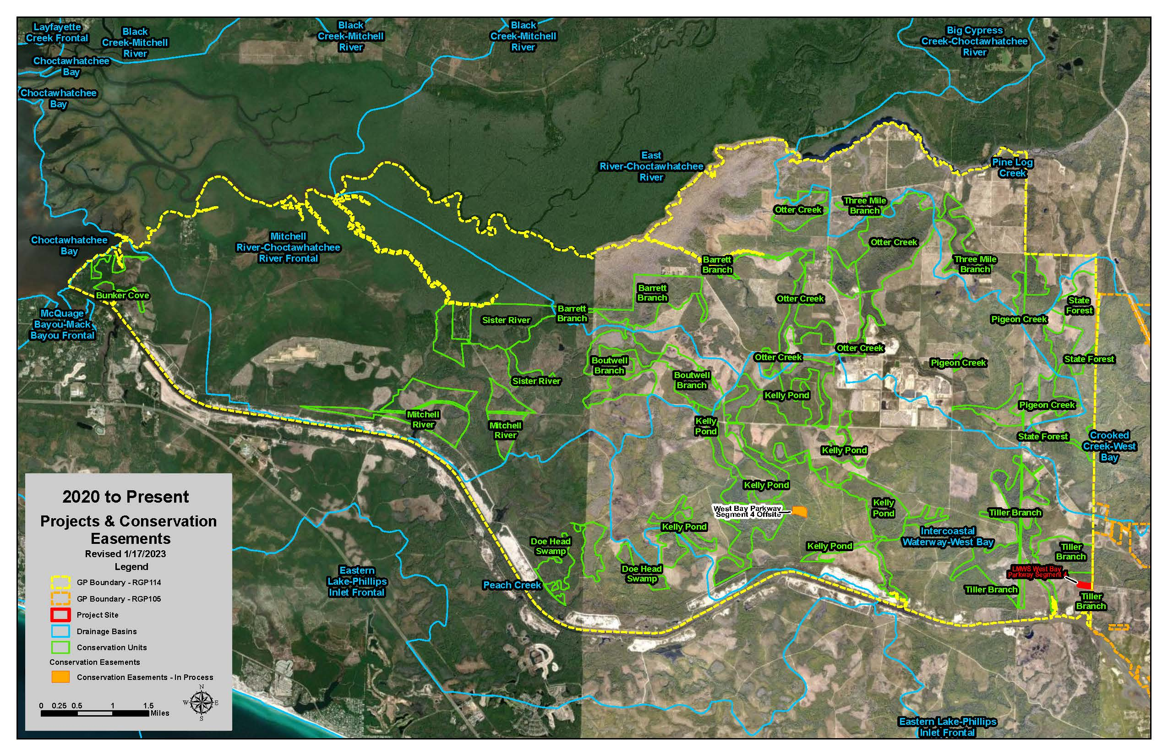
GIS Projects & Conservation Easement Map
77

Slide 9
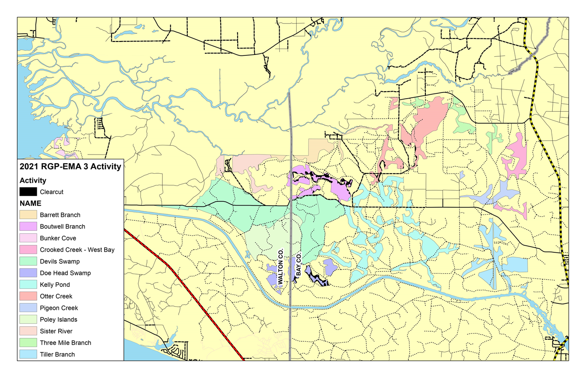
Conservation Unit Land Management Summary

