Slide 1

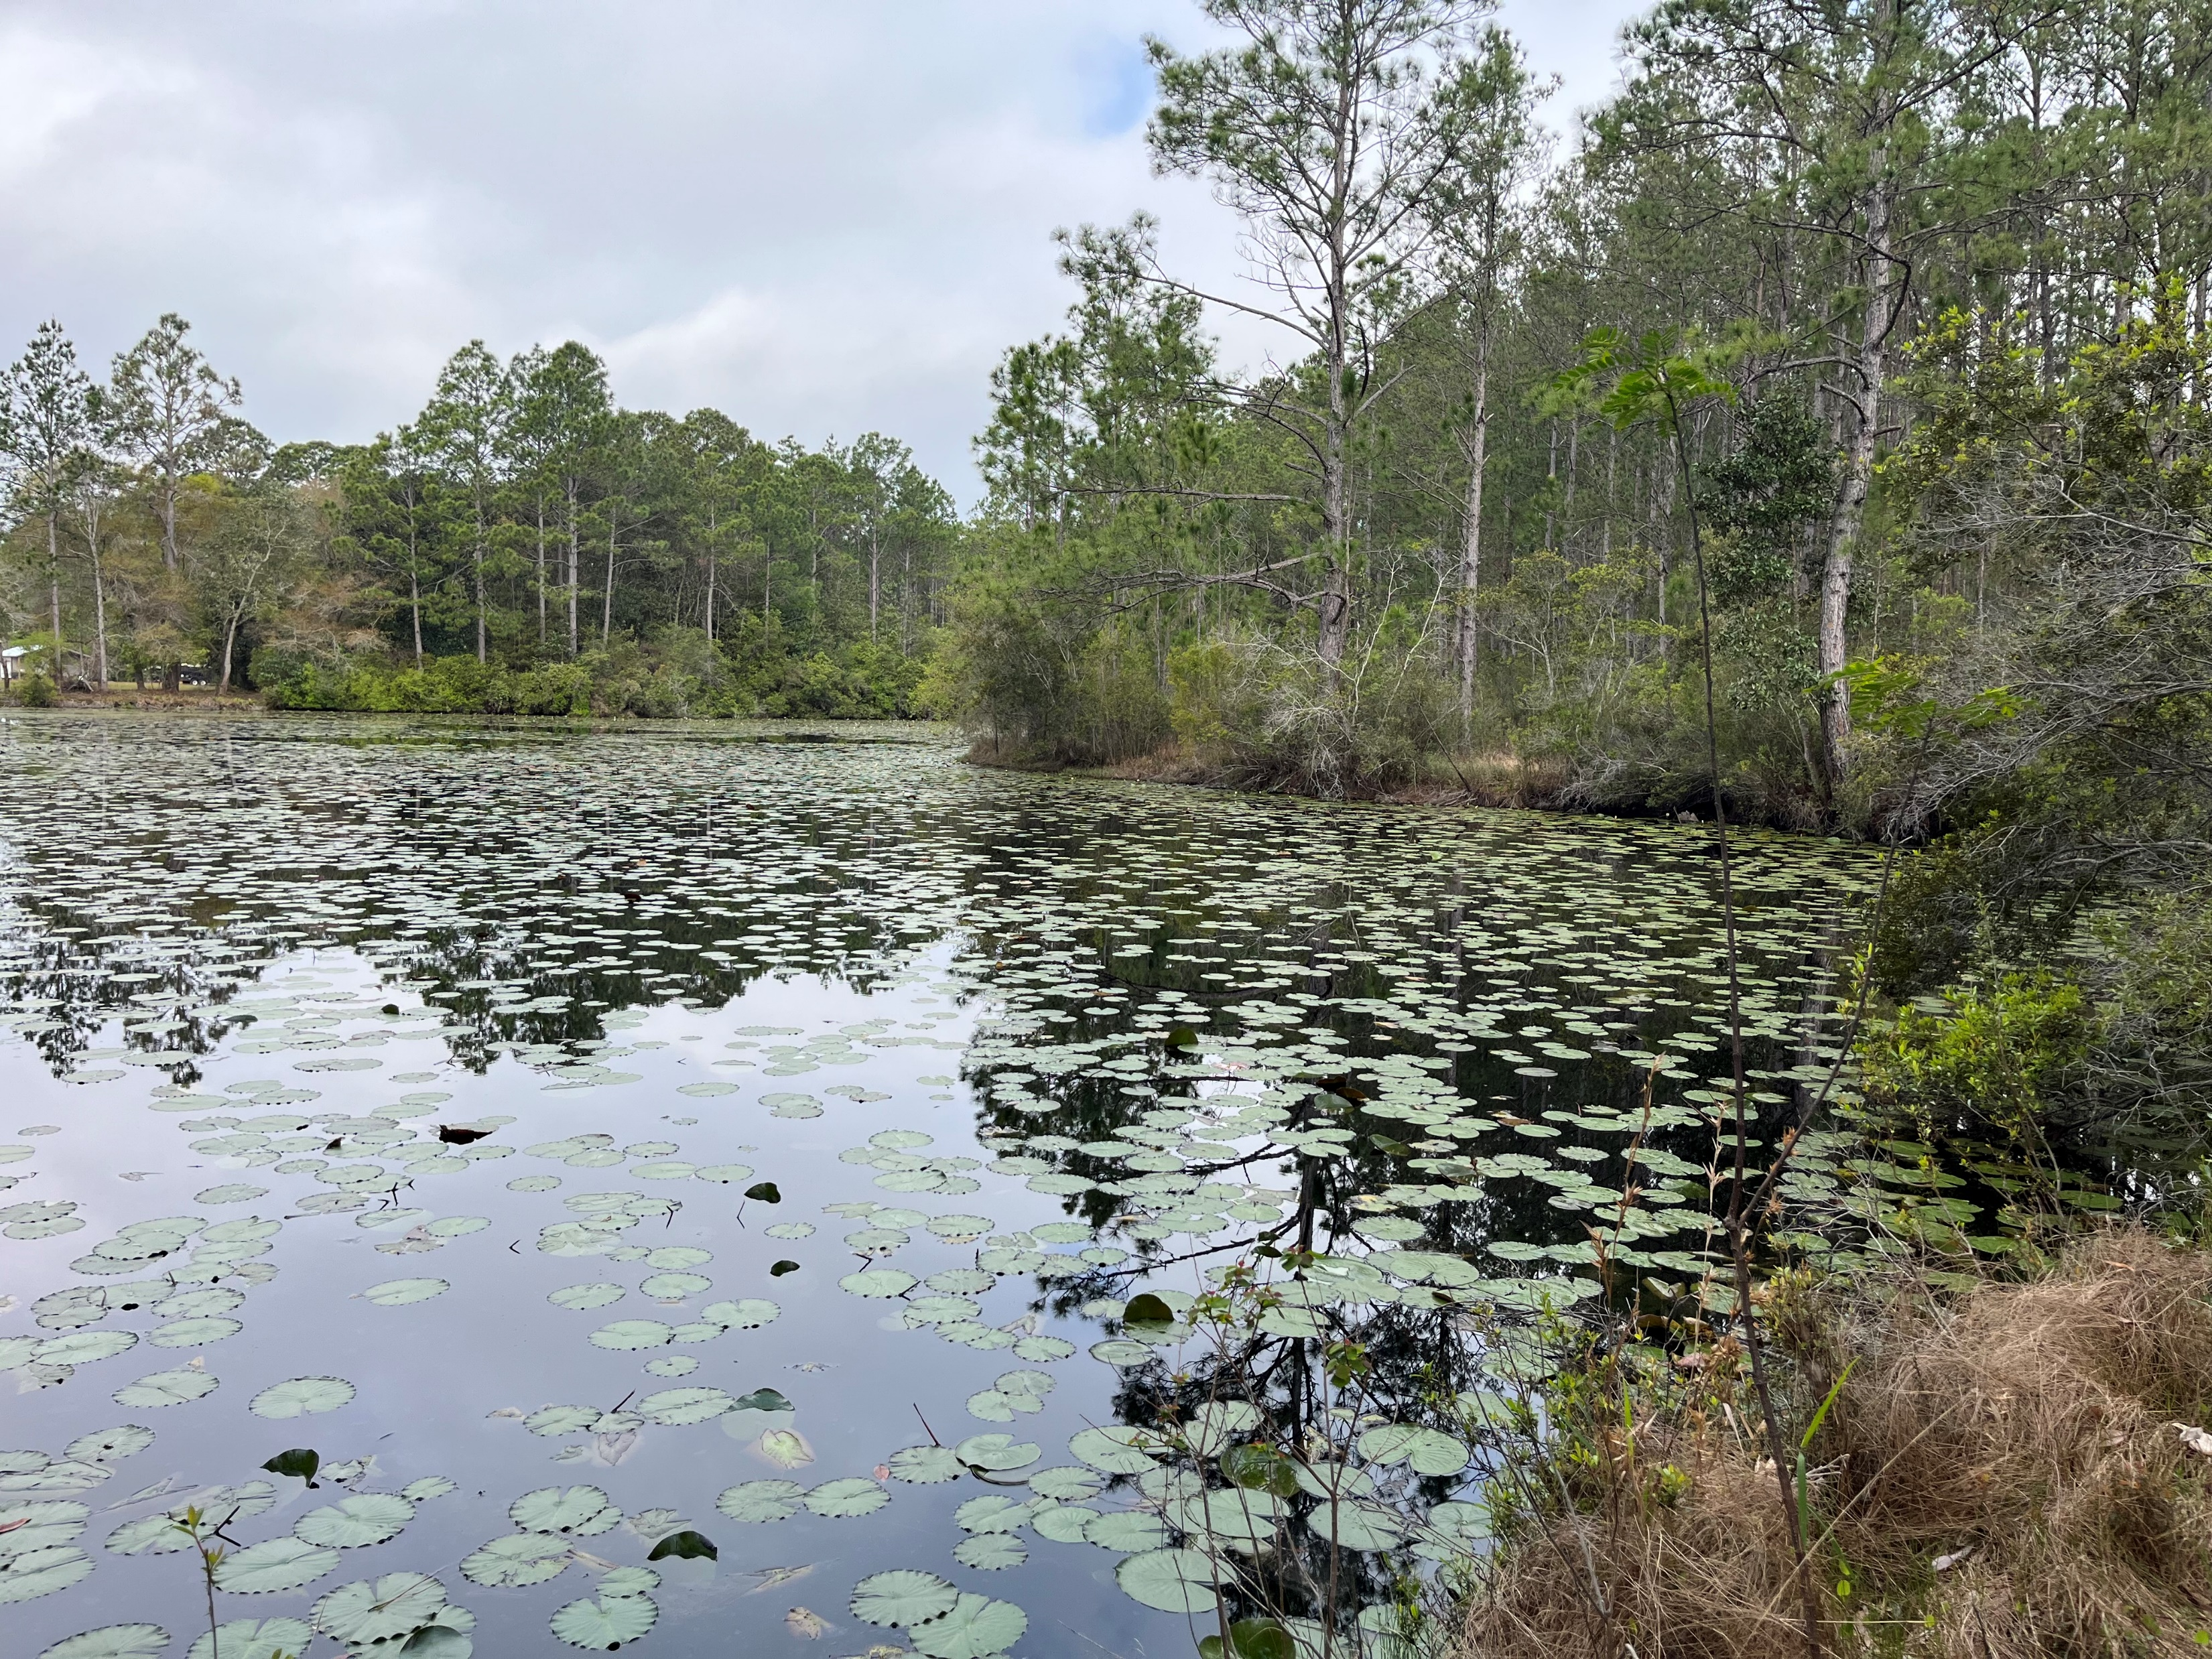
RGP SAJ-114 & Ecosystem Management Agreement 3 2024 Annual Report

Slide 2
Contents 2024 Annual Report
This report contains the project and sub-basin ledgers for all project authorizations issued through
December 31st, 2024.
2024 Project Summary
Overall Summary
2024 Project Ledger
2024 Sub-Basin Ledger
Conservation Unit Ledger
Conservation Unit Land Management Summary
GIS Projects & Conservation Easement Map
2
3
4
5
6
7
8

Slide 3
2024 Project Summary
RGP SAJ 114 and EMA 3 authorizations were issued in 2024 for the following:
Latitude Margaritaville Watersound Phase 9 and West Bay Parkway Segment 6 0381301-026-EA/03; 0381301-027-SFRP/03
Latitude Margaritaville Watersound Phase 6B/C Re-authorization 0403572-027-EA/03
2023 Permits modified in 2024:
Latitude Margaritaville Watersound Phase 7 0437362-002-EA/03; 0437362-003-SFRP/03
Latitude Margaritaville Watersound Phase 8 0381301-022-EA/03; 0381301-023-SFRP/03
2023 Projects that commenced construction in 2024:
Latitude Margaritaville Watersound Phase 8 0381301-022-EA/03; 0381301-023-SFRP/03
2024 Projects that commenced construction in 2024:
Latitude Margaritaville Watersound Phase 9 and West Bay Parkway Segment 6 0381301-026-EA/03; 0381301-027-SFRP/03
Latitude Margaritaville Watersound Phase 6B/C Re-authorization 0403572-027-EA/03

Slide 4
Overall Summary 2024 Annual Report
On July 7, 2020, the Florida Department of Environmental Protection executed a third Ecosystem Management Agreement with The St. Joe Company for 28,327 acres within St. Joe ownership. Subsequently, the Army Corps of Engineers issued SAJ-114 on August 21, 2020, for 41,585 acres including St. Joe lands as well as other ownership located in the West Bay and Choctawhatchee watersheds within Bay and Walton Counties of Florida.
This is the fourth annual report for SAJ 114 and EMA 3 since issuance in August 2020. All projects approved under the SAJ-114/EMA 3 criteria area will be included in the project ledger. Two projects were approved in 2024 and two were modified. Due to the 4 total projects authorized, 269.12 total acres have been committed to conservation easements to date. The following conservation easements were recorded in 2024:
Latitude Margaritaville Watersound West Bay Parkway Segment 4 Offsite Mitigation Conservation Easement
Latitude Margaritaville Watersound Phase 6B/C Conservation Unit Conservation Easement
Latitude Margaritaville Watersound West Bay Parkway Segment 5 Conservation Unit Conservation Easement
Latitude Margaritaville Watersound Phase 7 Conservation Unit Conservation Easement
Latitude Margaritaville Watersound Phase 8 Conservation Unit Conservation Easement
Latitude Margaritaville Watersound Phase 9 and West Bay Parkway Segment 6 Offsite Mitigation Conservation Easement

Slide 5
2024 Project Ledger
Number | Type | Permitting Basin | Sub-basin | Project | TOTAL | HQ | HQ IMP | Alt | Alt Imp | WTL | UPL | Onsite CE | Offsite CE | CU Mit CE | CU CE | CR MIT | Rd Removal | Status
 |  |  |  | 2022 Permits
1 | EMA/404 | DSMB | ICW | 0404939-005-EA/03; 0404939-006-SFRP; 0404939-009-SFM/03 West Bay Parkway Segment 4 | 5.38 | 0 | 0 | 0.51 | 0.22 | 0.51 | 4.87 | 0.29 | 0.45 | 0 | 0 | 0.12 UMAM | 0 | CE Complete
 |  |  |  | 2023 Permits
2 | EMA/404 | BPMB | ICW | 0403572-011-EA/03; 0403572-019-EM/03; 0403572-020-SFM/03; 0403572-013-SFRP/03 LMWS Phase 6B/C | 85.68 | 5.18 | 0 | 35.66 | 27.13 | 40.84 | 44.84 | 5.95 | 84.94 | 0 | 6.91 | 14.38 UMAM | 0 | CE in Progress
3 | EMA/404 | DSMB | ICW | 0403572-017-EA/03; 0381301-021-SFRP/03; LMWS West Bay Parkway Segment 5 | 58.26 | 3.6 | 0.59 | 21.47 | 10.85 | 25.07 | 33.19 | 14.13 | 31.45 | 0 | 4.79 | 6.26 UMAM 7.6 WRAP | 1 | CE in Progress
4 | EMA/404 | DSMB | ICW | 0437362-004-EM/03; 0437362-002-EA/03; 0437362-SFRP/03 LMWS Phase 7 | 105.61 | 7 | 0.74 | 30.1 | 7.09 | 37.1 | 68.6 | 10.63 | 19.08 | 0 | 8.52 | 4.40 UMAM 5.29 WRAP | 1 | CE in Progress
5 | EMA/404 | DSMB | ICW | 0381301-028-EM-03; 0381301-022-EA/03; 0381301-023-SFRP/03 LMWS Phase 8 | 116.36 | 0.93 | 0 | 55.59 | 12.29 | 56.52 | 59.84 | 28.93 | 13.035 | 0 | 9.38 | 6.51 UMAM 7.99 WRAP | 0 | CE in Progress
 |  |  |  | 2024 Permits
6 | EMA/404 | BPMB | ICW | 0381301-027-SFRP/03; 0381301-026-EA/03 LMWS Phase 9/West Bay Parkway Segment 6 | 118.52 | 2.56 | 1.44 | 14.03 | 4.09 | 16.59 | 101.93 | 9.01 | 12.06 | 0 | 9.56 | 3.42 UMAM 3.98 WRAP | 1 | CE in Progress
7 | EMA Only | BPMB | ICW | 0403572-027-EA/03 LMWS Phase 6B/C | NA | NA | NA | NA | NA | NA | NA | NA | NA | NA | NA | NA | NA | NA
 |  |  |  | Totals | 489.81 | 19.27 | 2.77 | 157.36 | 61.67 | 176.63 | 313.27 | 68.94 | 161.02 | 0 | 39.16 | 35.09 UMAM 24.86 WRAP | 3
Tot Prj Ac | Total Project Acres Within Sub-basin
HQ | High Quality Wetlands Acres
HQ IMP | High Quality Wetland Impacts Acres
Alt | Altered Wetlands Acres
Alt IMP | Altered Wetland Impacts Acres
UPL | Uplands Acres
Onsite CE | Onsite Conservation Easements Acres
Offsite CE | Offsite Conservation Easements Acres
CU MIT CE | Conservation Unit Mitigation Conservation Easement
CU CE | Conservation Unit Conservation Easement
CR MIT | Mitigation Credits
WTL | Wetland
CE’s to be recorded
Impacts have not occurred as of 12/31/2024
Regional General Permit SAJ-114
^project located between 2 EMA/ RGP Areas only portion within EMA3 is included on the sheet
Permits modified in 2023
Permits modified in 2024
CE’s recorded

Slide 6
2024 Sub-Basin Ledger
2024 Sub-Basin Ledger
Sub-Basin | Tot_Area | Tot_Alt | Tot_HQ | Tot_Alt_IMP | %** | Tot_HQ_IMP | %** | Tot_Alt_Remain | Tot_HQ_Remain
Crooked Creek-West Bay | 1,349.22 | 276.22 | 310.18 | 0 | 0 | 0 | 0 | 276.22 | 310.18
East River Choctawhatchee River | 7,807.87 | 1,386.91 | 1,779.61 | 0 | 0 | 0 | 0 | 1,386.91 | 1,779.61
Intercoastal Waterway – West Bay | 9,907.21 | 2,684.89 | 1,912.85 | 61.67 | 2.30 | 2.77 | 0.14 | 2,623.22 | 1,910.08
Mitchell River Choctawhatchee River | 4,733.33 | 501.44 | 1,072.25 | 0 | 0 | 0 | 0 | 501.44 | 1,072.25
Peach Creek | 3,339.08 | 644.92 | 635.55 | 0 | 0 | 0 | 0 | 644.92 | 635.55
Pine Log Creek | 2,939.97 | 613.63 | 426.67 | 0 | 0 | 0 | 0 | 613.63 | 426.67
* Cumulative through December 31, 2024 |  |  |  |  |  |  | Total | 6,046.34 | 6,134.34

Slide 7
2024 Conservation Unit Ledger
 |  |  |  | Conservation Easements
 |  |  | Total CU | Recorded | Required | In Process
Conservation Unit | Subbasin | Ownership | Acres | Acres | Acres | Acres
Barrett Branch | ERCR | St. Joe | 458 | 0 | 0 | 0
Boutwell Branch | MRCR | St. Joe | 617 | 0 | 0 | 0
Bunker Cove | MRCR | St. Joe | 92 | 0 | 0 | 0
Mitchell River | MRCR | St. Joe | 679 | 0 | 0 | 0
Doe Head Swamp | Peach Creek | St. Joe | 455 | 0 | 0 | 0
Kelly Pond | ICW-WB | St. Joe | 1,614 | 0 | 0 | 0
Otter Creek | ERCR | St. Joe | 1,170 | 0 | 0 | 0
Pigeon Creek | ERCR | St. Joe | 266 | 0 | 0 | 0
Sisters River | MRCR | St. Joe | 561 | 0 | 0 | 0
State Forest | CC-WB | St. Joe | 503 | 0 | 0 | 0
Three Mile Branch | Pine Log | St. Joe | 398 | 0 | 0 | 0
Tiller Branch | ICW-WB | St. Joe | 799 | 29.6 | 39.16 | 9.56
Total |  |  | 7,612 | 29.6 | 39.26 | 9.56

Slide 8
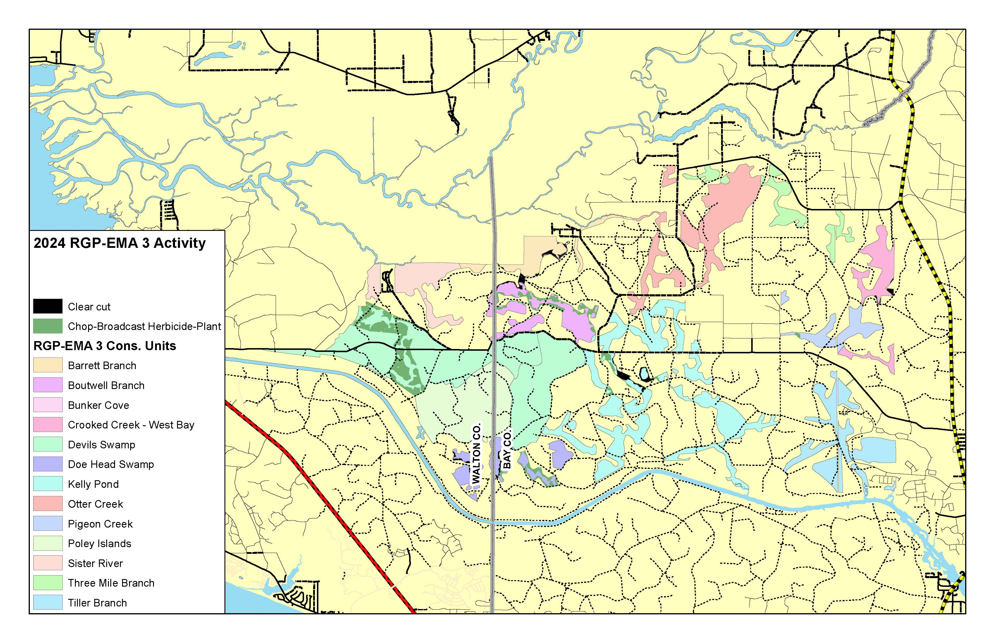
Conservation Unit Land Management Summary

Slide 9
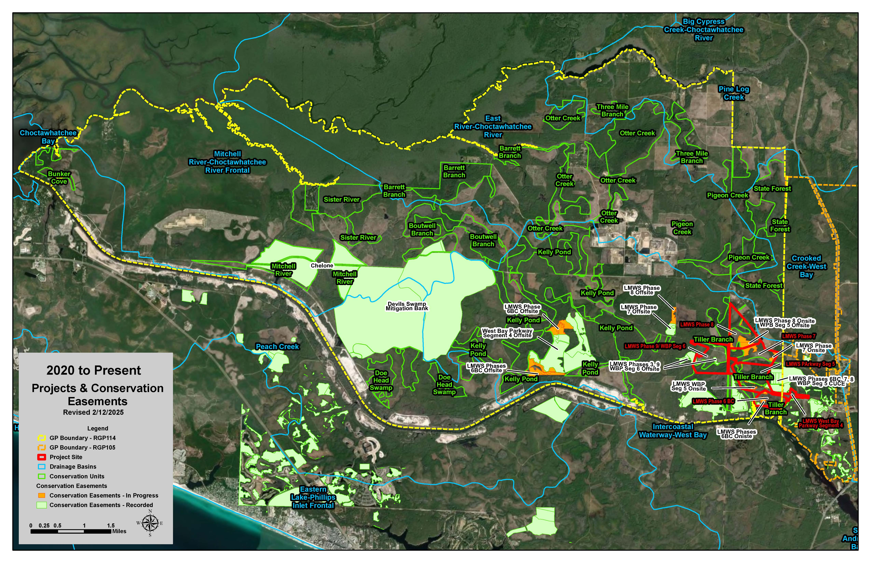
GIS Projects & Conservation Easement Map
77

