Slide 1
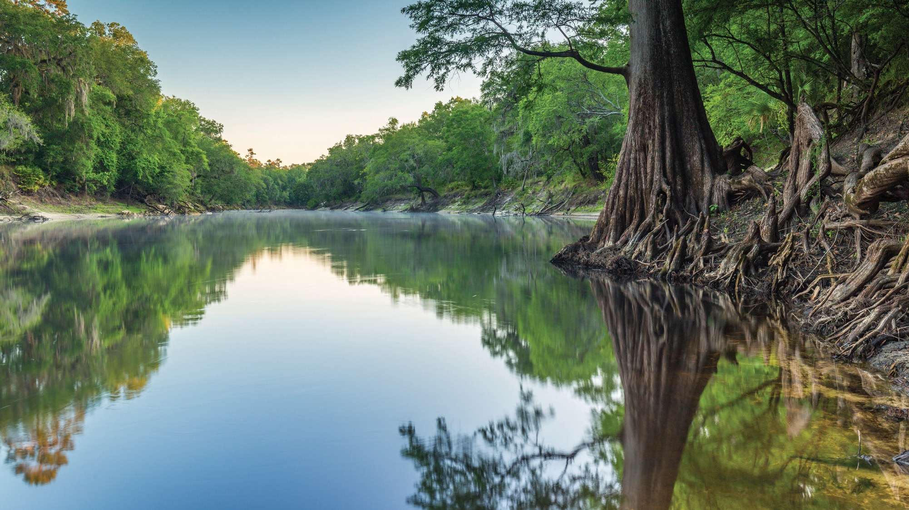

SHORELINE STABILIZATION PERMITTING REQUIREMENTS
SHORELINE STABILIZATION PERMITTING REQUIREMENTS
Shannon Gore
Environmental Consultant
Regulatory Programs/Environmental Resource Permitting
Northeast District
Florida Department of Environmental Protection
Jacksonville, FL| July 23, 2025

Slide 2
PURPOSE
PURPOSE:
To educate contractors and local stakeholders on the rules and regulations pertaining to various shoreline stabilization construction and to promote consistency across the state of Florida.

Slide 3
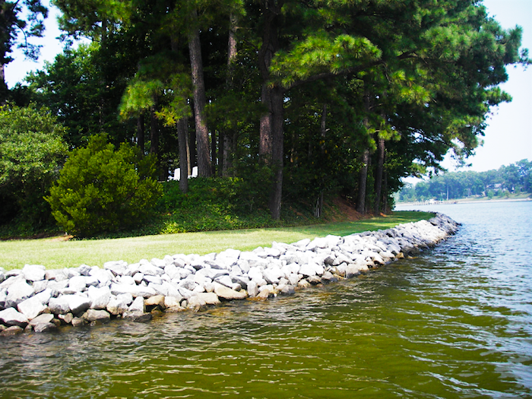
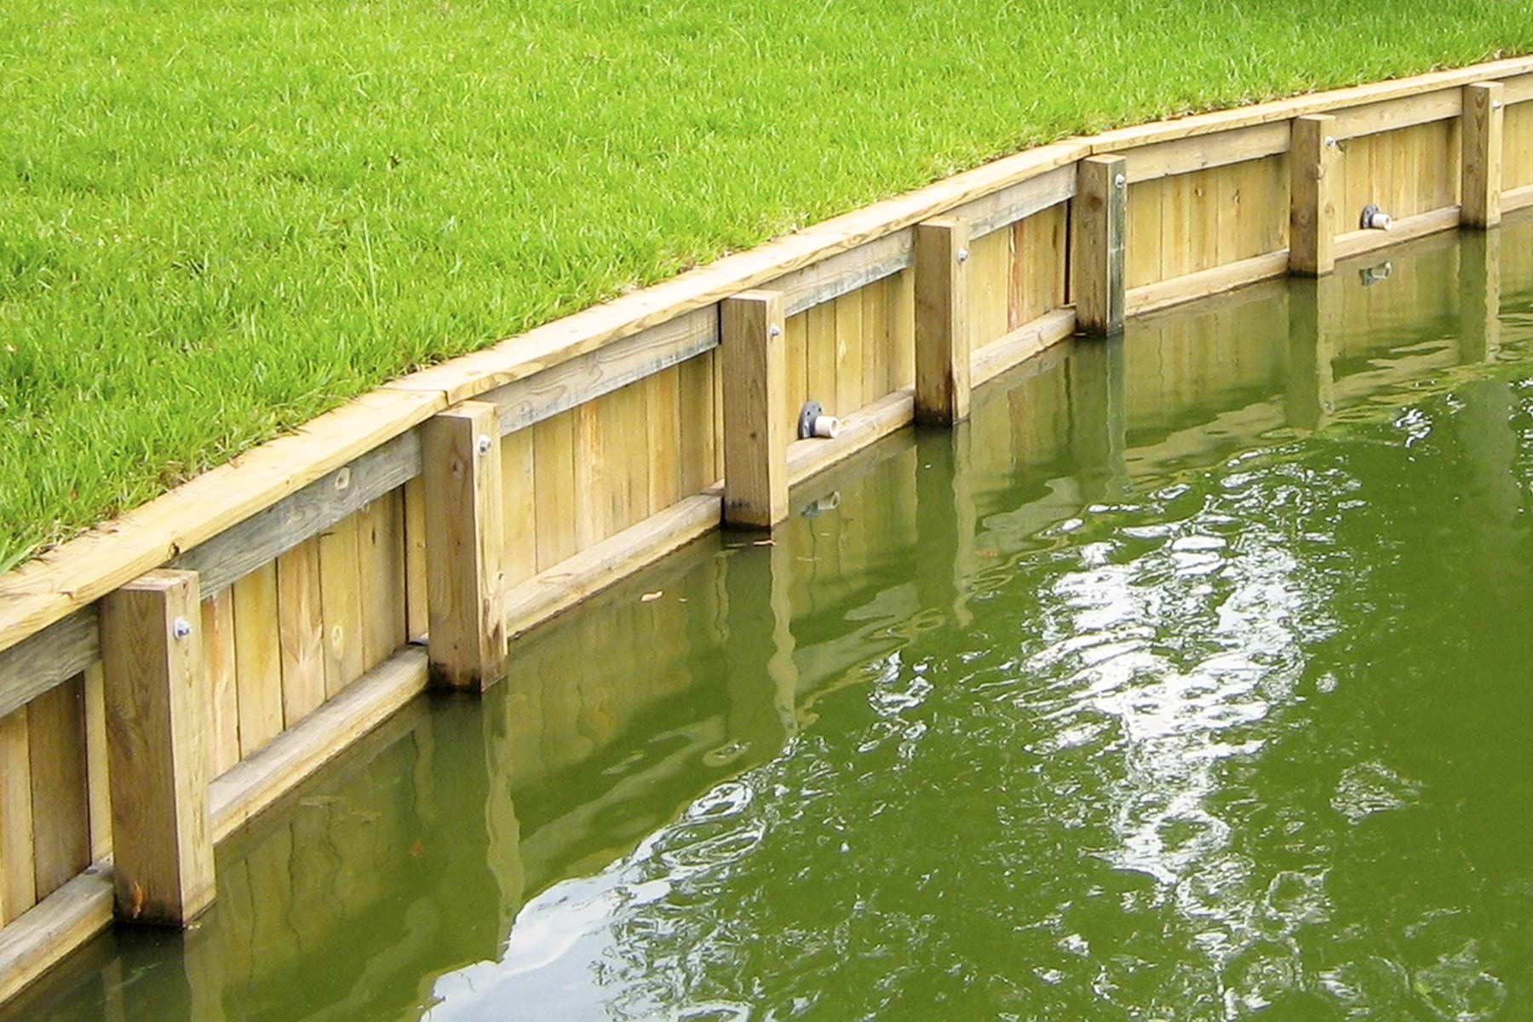
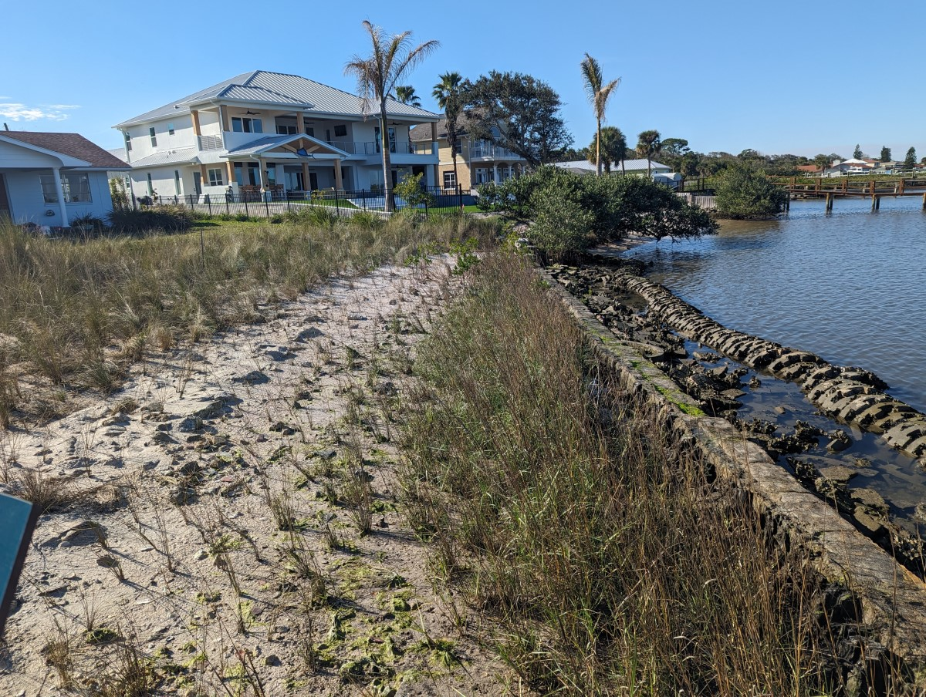
SHORELINE STABILIZATION TECHNIQUES
Shoreline stabilization is defined as the use of engineered structures, vegetation, or land management practices to provide protection of a shoreline from future or existing erosion.
Riprap
Seawall
Living Shoreline
Photo credit: DEP
Photo credit: DEP
Photo credit: DEP

Slide 4
SHORELINE STABILIZATION PERMITTING

Slide 5
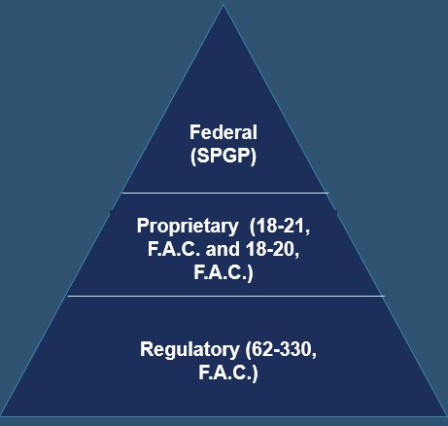
RULE REVIEW
Permitting for shoreline stabilization structures will consider three primary types of authorizations that are present or incorporated in the Florida Administrative Code (F.A.C.), Florida Statutes (F.S.), and coordination agreements with the Army Corps of Engineers (ACOE):
Regulatory:
  Chapter 62-330, F.A.C.
  Section 403.813, F.S.
Proprietary:
  Rule 18-21 F.A.C. - construction over sovereign submerged state lands (SSL).
  Rule 18-20 F.A.C. - construction in Aquatic Preserves.
Federal:
  State Programmatic General Permit (SPGP VI-R1)
Permitting Application Entry Point

Slide 6
REGULATORY AUTHORIZATIONS: EXEMPTIONS

Slide 7
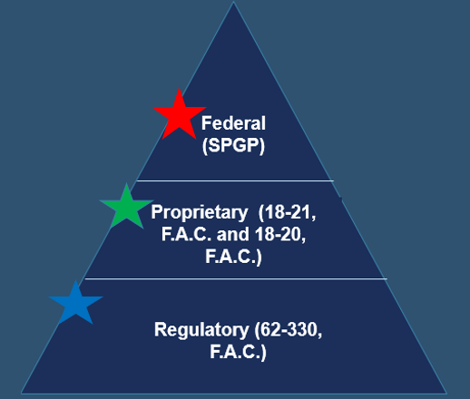
TYPES OF REGULATORY AUTHORIZATIONS
RIPRAP AND SEAWALL EXEMPTIONS
Regulatory program: Exempt activities are listed under Rule 62-330.051, F.A.C., and Section 403.813, F.S.
(12) Construction, Replacement, Restoration, Enhancement, and Repair of Seawall, Riprap, and Other Shoreline Stabilization ‒
(a) Construction, replacement, and repair of seawalls or riprap in artificially created waterways under Section 403.813(1)(i), F.S., and within residential canal systems legally in existence under Chapter 403 or Part IV of Chapter 373, F.S., including only that backfilling needed to level the land behind seawalls or riprap.

Slide 8
RIPRAP AND SEAWALL EXEMPTIONS
CONTINUED
(12) Construction, Replacement, Restoration, Enhancement, and Repair of Seawall, Riprap, and Other Shoreline Stabilization ‒
(b) The restoration of a seawall or riprap under Section 403.813(1)(e), F.S., where:
1. The seawall or riprap has been damaged or destroyed within the last year by a discrete event, such as a storm, flood, accident, or fire or where the seawall or riprap restoration or repair involves only minimal backfilling to level the land directly associated with the restoration or repair and does not involve land reclamation as the primary project purpose. See section 3.2.4 of Volume I for factors used to determine qualification under this provision;
2. Restoration shall be no more than 18 inches waterward of its previous location, as measured from the waterward face of the existing seawall to the face of the restored seawall, or from the waterward slope of the existing riprap to the waterward slope of the restored riprap; and
3. Applicable permits under Chapter 161, F.S., are obtained.
Notes:
Handout for what qualifies for a repair and replace exemption.

Slide 9
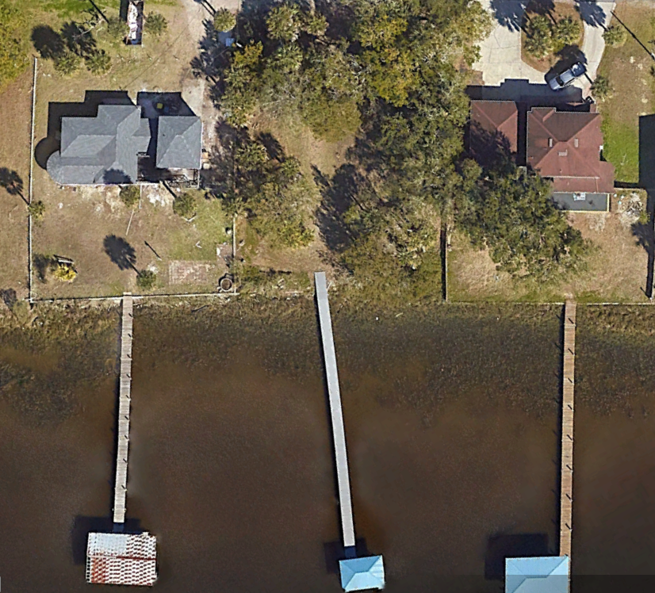
RIPRAP AND SEAWALL EXEMPTIONS
CONTINUED
(12) Construction, Replacement, Restoration, Enhancement, and Repair of Seawall, Riprap, and Other Shoreline Stabilization ‒
(c) The construction of seawalls or riprap in wetlands or other surface waters between and adjoining existing seawalls or riprap at both ends in accordance with Section 403.813(1)(o), F.S. For purposes of this exemption, riprap is subject to the same length and orientation limitations as a seawall.
Photo credit: Google Earth

Slide 10
SECTION 403.813 F.S. REFERENCES
Construction of riprap or seawalls in artificial waterways (Rule 62-330.051(12)(a) F.A.C.) references:
(i) The construction of private docks of 1,000 square feet or less of over-water surface area and seawalls in artificially created waterways when such construction will not violate existing water quality standards, impede navigation, or affect flood control. This exemption does not apply to the construction of vertical seawalls in estuaries or lagoons unless the proposed construction is within an existing manmade canal where the shoreline is currently occupied in whole or part by vertical seawalls.
Restoration of a seawall or riprap (Rule 62-330.051(12)(b) F.A.C.) references:
(e) The restoration of seawalls at their previous locations or upland of, or within 18 inches waterward of, their previous locations. This may not affect the permitting requirements of chapter 161, and department rules shall clearly indicate that this exception does not constitute an exception from the permitting requirements of chapter 161.

Slide 11
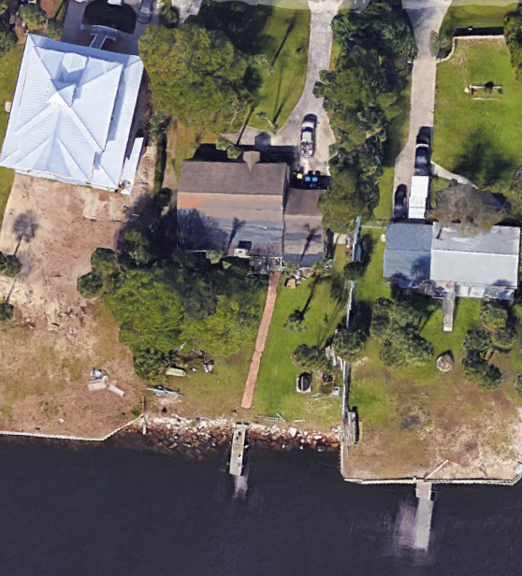
SECTION 403.813 F.S. REFERENCES
CONTINUED
The construction of seawalls or between and adjoining existing seawalls (Rule 62-330.051(12)(c) F.A.C.) references:
(o) The construction of private seawalls in wetlands or other surface waters when such construction is between and adjoins at both ends existing seawalls; follows a continuous and uniform seawall construction line with the existing seawalls; is not more than 150 feet in length; and does not violate existing water quality standards, impede navigation, or affect flood control. However, in estuaries and lagoons the construction of vertical seawalls is limited to the circumstances and purposes stated in s. 373.414(5)(b)1.-4. This paragraph does not affect the permitting requirements of chapter 161, and department rules must clearly indicate that this exception does not constitute an exception from the permitting requirements of chapter 161.
Photo credit: Google Earth

Slide 12
COMMON RIPRAP OR SEAWALL EXEMPTIONS
Rule 62-330.051(12)(b), F.A.C., is more commonly referred to as the “repair and replace” exemption.
Key notes of this exemption include:
The structure must be currently functioning or must have been rendered non-functional within the last year by a discrete event e.g., a storm.
The new structure must be placed a maximum of 18 inches from waterward face/slope of the existing structure to the waterward face/slope of the proposed structure. Drawings must show this.
Rule 62-330.051(12)(c), F.A.C., is more commonly referred to as the “bridge the gap” exemption.
Key notes of this exemption include:
The structure must connect between two existing adjoining riprap/seawall structures at both ends.
The new structure must be uniform and continuous, meaning that there are no angled sections along the length of the structure and connects one existing neighboring structure to the other. Drawings must show this.

Slide 13
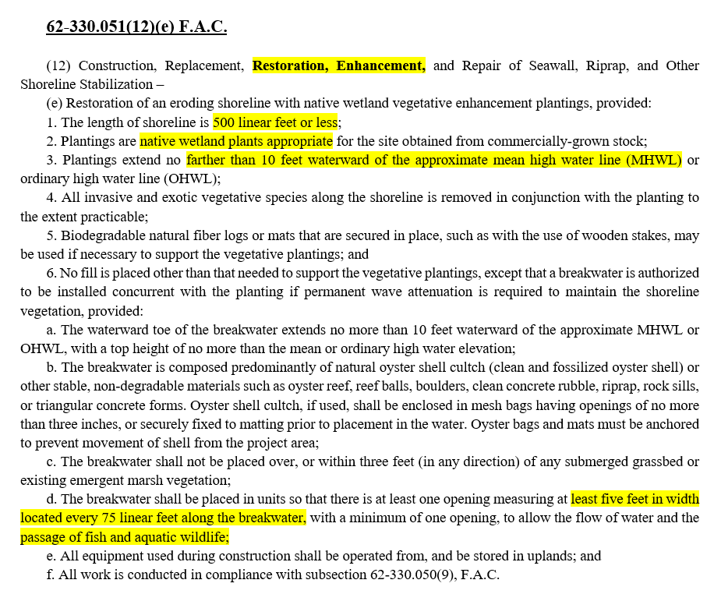
TYPES OF REGULATORY AUTHORIZATIONS
LIVING SHORELINE EXEMPTION

Slide 14
LIVING SHORELINE APPLICATION INFORMATION
When submitting an application, there are several factors and details to consider for a particular site:
Sediment: Sand or rock are the best to hold structures in place. If soft sediments are present at a site, additional stabilization likely will be necessary to prevent sinking.
  Provide details on the sediment for the area and how materials will be adequately anchored, or of sufficient weight that prevents relocation during most wave action or water flow events.
Currents/Fetch: Larger fetch or strong currents lead to higher wave energies, which may alter appropriate designs. Provide details about materials that will be used to minimize wave energy and obtain goals of project.
  If oysters are to be used, where are the shells coming from?
  If reef balls are to be used, include dimensions and photos of the reef balls.
  Provide any details of anticipated maintenance to structures.
Erosion and shoaling: If breakwaters are proposed, provide details of how they will not result in erosion and shoaling.
Plantings: If plantings are proposed, provide details for surrounding vegetation and ecosystems.

Slide 15
REGULATORY AUTHORIZATIONS: GENERAL PERMIT FOR RIPRAP

Slide 16
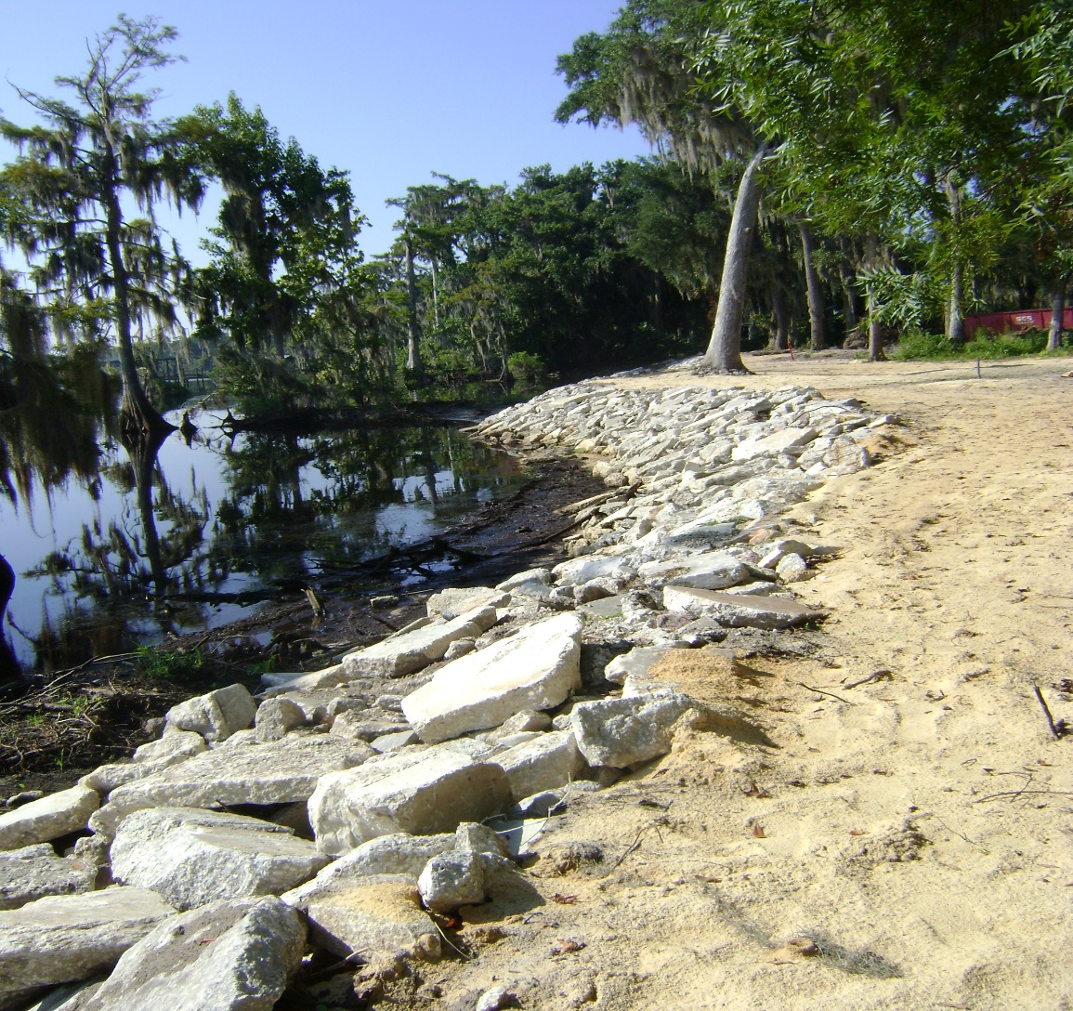
GENERAL PERMIT FOR RIPRAP
Of the three types of shoreline stabilization structures, riprap is currently the only structure that can be permitted under a General Permit under Rule 62-330.431, F.A.C. – General Permit for Installation of Riprap.
Photo credit: DEP

Slide 17
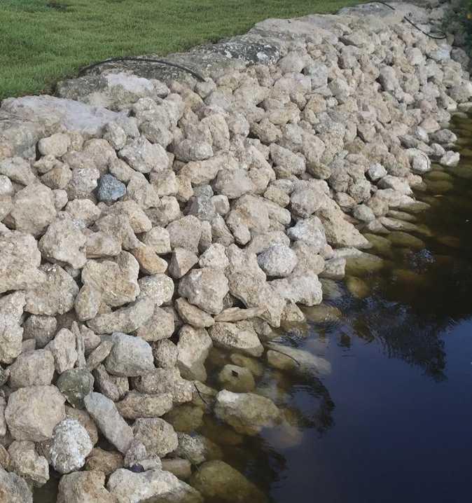
GENERAL PERMIT FOR RIPRAP
RULE 62-330.431 F.A.C.
(1) A general permit is granted to any person to install riprap:
(a) At the toe of an existing vertical seawall, provided the slope of the riprap is no steeper than two horizontal to one vertical and the horizontal distance from the toe of the seawall is no more than 10 feet;
(b) At an individual, private residential single-family property that is not part of a larger plan of common development, provided:
1. The slope of the riprap is no steeper than two horizontal to one vertical, and the toe of the riprap is no more than 10 feet waterward of the existing mean high water line or approximate ordinary high water line;
2. Riprap is not placed along a length of shoreline of more than 100 linear feet, and is not combined as part of any other use of this general permit on the same parcel of land; and
3. Erosion has occurred, or is likely to occur, along the shoreline.
Photo credit: Coast Seawall

Slide 18
GENERAL PERMIT FOR RIPRAP
RULE 62-330.431 F.A.C. CONTINUED
This general permit shall be subject to the following specific conditions:
(a) The riprap consists only of natural boulders or clean concrete rubble one to three feet in diameter in average dimension, and there are no reinforcing rods or other similar protrusions in the concrete rubble;
(b) There is no filling of submerged grassbeds or coral communities;
(c) The amount of wetland area filled shall not exceed 100 square feet; and,
(d) There is no backfilling to obtain useable upland, to straighten an otherwise sinuous shoreline, or to reclaim land lost by avulsion or erosion.
Key notes of the General Permit include:
New installation of riprap can be placed at the toe of an existing seawall.
If not placed at the toe of a seawall, riprap can be placed at a shoreline that is no longer than 100 feet and cannot extend more than 10 feet waterward of the mean high water line.

Slide 19
REGULATORY AUTHORIZATIONS: INDIVIDUAL PERMIT

Slide 20
INDIVIDUAL PERMIT FOR SHORELINE STABILIZATION
If the specifications of the project do not meet the criteria set forth by the exemption or General Permit, the project must then be permitted under an Individual Permit.
Rules 62-330.301 and 62-330.302, F.A.C. – Conditions for Issuance of Individual and Conceptual Approval Permits.
Unlike the Exemptions and General Permit activities, Individual Permits do not have specifications that the structure must meet. Instead, Individual Permits consider the potential for impact that a project may have to environmental factors such as water quality, water quantity, and potential for flooding.
The Exemption and General Permit design criteria ensure that the structure will have minimal impact to the environment. As such, the potential for impact is much higher when not meeting those criteria and any adverse impacts because of the structure must be avoided or mitigated.
Notes:
Please provide handout for conditions for issuance on 62-330.301 and 62-330.302

Slide 21
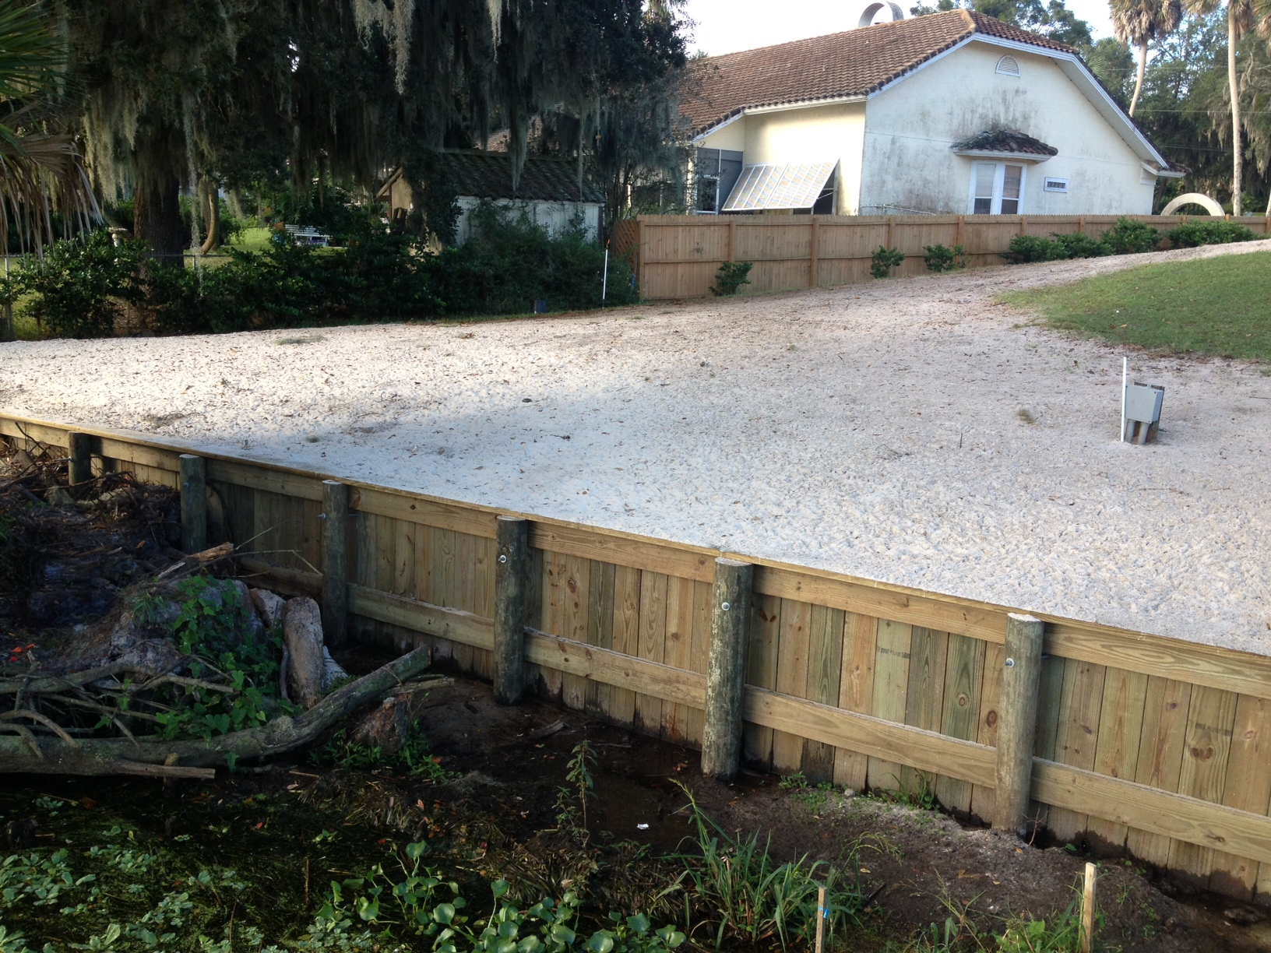
INDIVIDUAL PERMIT FOR SHORELINE STABILIZATION
Key notes of the Individual Permit include:
It is encouraged to first considering riprap and living shorelines as they are “greener,” less impactful forms of shoreline stabilization as compared to seawalls.
The potential for erosion or evidence of erosion must be significant if a seawall will be installed.
Grading and backfill is important to consider for all regulatory authorizations, but especially so in the case of the Individual Permit to ensure that there will be no flooding to on-site or off-site properties.
Must meet vertical seawall criteria of Applicants Handbook 10.2.6.
Photo credit: DEP
Notes:
Seawall with sloped rip rap is not considered a vertical seawall.

Slide 22
PERMIT FEES
Online Applications : DEP Business Portal
                https://www.fldepportal.com/go/apply/
Request for Verification of Exemption $100 (online, paper or email)
General Permits $250 (online, paper or email)
Individual Permits $320 (online through Business Portal only)
Individual Permits $420 (paper or email)
https://www.fldepportal.com/go/apply/

Slide 23
PROPRIETARY AUTHORIZATIONS

Slide 24
SOVERIEGN SUBMERGED LANDS
(STATE LANDS)
Proprietary authorizations consider:
  Water dependency, which is defined as:
    Activities that can only be conducted in, on, over or adjacent to water areas because the activity requires direct access to the waterbody.
  Riparian rights.
  Impacts to submerged resources.
  Preemption from other uses of the water by the public.
Forms of authorization:
  Exceptions – No authorization required.
  Consent by rule – Authorization automatic if app meets certain criteria.
  Letter of consent – Written authorization is required.
  Leases – Written agreement with annual fees for all commercial facilities and those facilities that do not qualify for a lesser authorization.
  Easements – Written agreement with fees (not necessarily annual), generally for linear activities.
SSL:
Including but not limited to, tidal lands, islands, sand bars, shallow banks and lands waterward of the ordinary or mean high water line, beneath navigable fresh water or beneath tidally-influenced waters, which the state of Florida acquired title to on March 3, 1845, by virtue of statehood.
Notes:
SSL:
Title to these lands is held by the Board of Trustees of the Internal Improvement Trust Fund of the State of Florida.
The DEP and water management districts serve as staff to the Board and are delegated authority to carry out certain functions of the Board.
The State is responsible for maintaining these submerged lands for a reasonable degree of public use and access, and to protect the lands for future public use.

Slide 25
TYPES OF PROPRIETARY AUTHORIZATIONS
Proprietary authorizations for use to consider:
Consent by Rule:
  This authorizes the activities for riprap and seawalls that would be exempt activities, (i.e. the “repair and replace” and construction in residential canal systems exemptions).
  The “repair and replace” activity requires the existing structure to have a valid Board authorization.
  Neither the “bridge the gap” or construction in residential canal systems can receive a Consent by Rule authorization if located in an aquatic preserve, but “repair and replace” may, given that the new construction occurs only one foot waterward of the existing structure.

Slide 26
TYPES OF PROPRIETARY AUTHORIZATIONS
Proprietary authorizations for use to consider:
Letter of Consent:
  The Letter of Consent covers the Sections of 403.813, F.S., that may have been excluded from the Consent by Rule by being in the Aquatic Preserve or Manatee “No Entry Zone” or “Motorboat Prohibited Zone.”
  Seawalls may be placed a maximum of 3 feet waterward of the Mean or Ordinary High Water Lines.
  Riprap may be placed a maximum of 10 feet waterward of the Mean or Ordinary High Water Lines.
  These maximums are not guaranteed to be approved, significant erosion must be evident as placement of structures at this distance waterward may result in surface water fill.

Slide 27
TYPES OF PROPRIETARY AUTHORIZATIONS
Proprietary authorizations for use to consider:
Easement:
  A sovereign submerged land easement can be required for groins, breakwaters, and shoreline protection structures if they do not qualify for Consent by Rule or Letter of Consent.
    These are lengthy processes that are not guaranteed to be approved. Following the maximums set forth by the Letter of Consent is recommended, but for living shorelines, easements may be required.

Slide 28
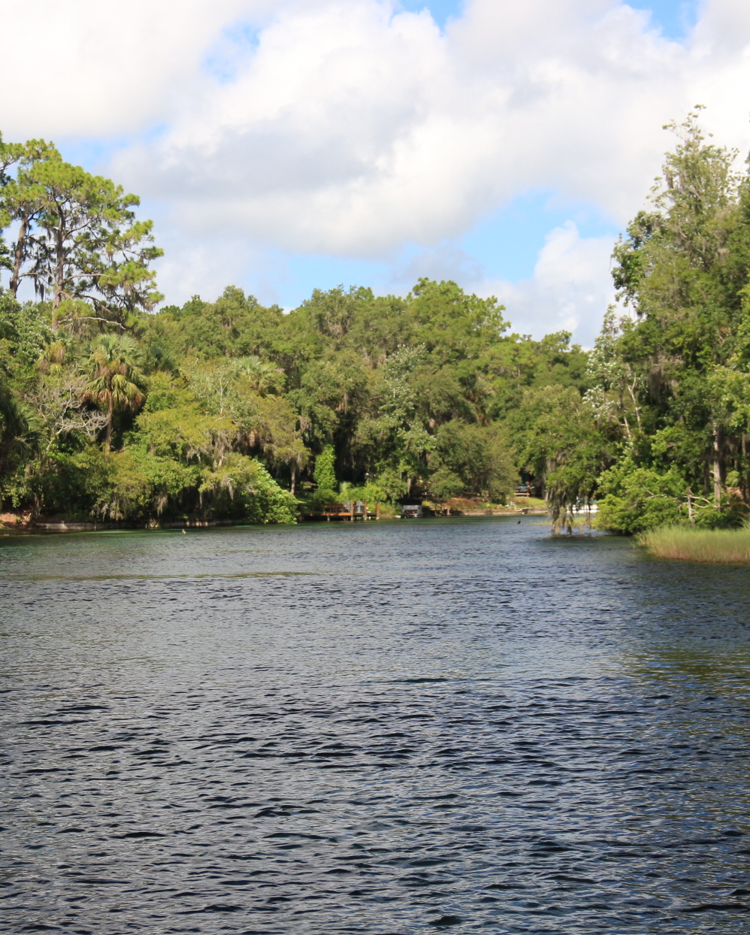
AQUATIC PRESERVES
Rule 18-20, Florida Administrative Code
  Provides for more restrictive design criteria for docks and shoreline stabilization.
Intent: To be preserved in an essentially natural or existing condition so that their aesthetic, biological and scientific values may endure for the enjoyment of future generations.
There are four Aquatic Preserves in the Northeast District:
  Fort Clinch
  Nassau River – St. Johns Marshes
  Guana River Marsh
  Big Bend Seagrasses
Photo credit: DEP

Slide 29
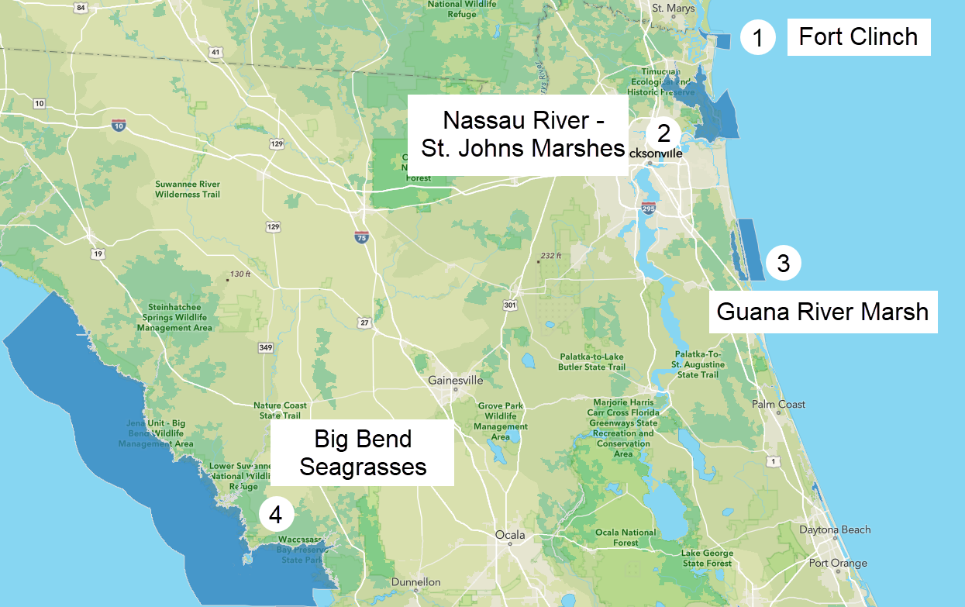
NORTHEAST DISTRICT AQUATIC PRESERVES
Photo credit: Khristian Mangahas, DEP

Slide 30
FEDERAL AUTHORIZATIONS

Slide 31

FEDERAL AUTHORIZATION: SPGP
State Programmatic General Permit (SPGP):
  Current: SPGP VI-R1, valid Aug. 16, 2021.
  Must submit project design criteria checklist and activity specific sheet with application.
  Includes only the following categories of work:
    Shoreline stabilization.
    Boat ramps and boat launch areas and structures associated with such ramps or launch areas.
    Docks, piers, associated facilities and other minor piling-supported structures.
    Removal of derelict vessels.
    Scientific sampling, measurement and monitoring devices.
State Programmatic General Permit | U.S. Army Corps of Engineers Nationwide Permits |
U.S. Army Corps of Engineers Operating Agreement with DEP and WMDs.
Notes:
The Department of Army State Programmatic General Permit (SPGP) authorizes various activities if the applicant obtains a verification and performs the work in accordance with the terms and conditions of the SPGP. The SPGP enables the Florida Department of Environmental Protection (DEP) and other agencies to issue the verification to an applicant, concurrently with their other State authorization(s), that the applicant's proposed work is authorized pursuant to the SPGP and that a separate application to the U.S. Army Corps of Engineers (Corps) is not required.
The Jacksonville District of the U.S. Army Corps of Engineers (Corps) issued an expanded State Programmatic General Permit (SPGP VI) on July 27, 2021. The purpose of the SPGP VI is to avoid duplication of permitting between the Corps and the Florida Department of Environmental Protection (DEP) for minor work located in waters of the United States, including navigable waters. SPGP VI reduces the need for separate approval from the Corps for the approved project types, and it increases the efficiency of both state and federal staff in serving the public. SPGP VI is implemented throughout the state of Florida, continuing environmental protection while increasing service to the public.

Slide 32
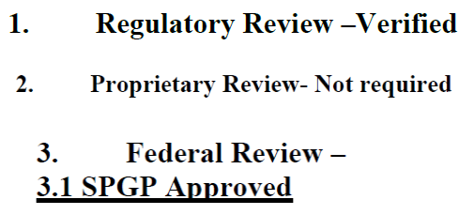
FEDERAL AUTHORIZATION: SPGP
CONTINUED
Only certain Exempt and General Permit activities can qualify for SPGP, these are known as “Works Authorized.”
Fortunately, the exemptions for riprap, seawalls, and living shorelines and the General Permit riprap are all eligible for SPGP.
However, they must provide the applicable Jacksonville Biological Opinion (JaxBO) Forms. These forms are the Summary Sheet/PDC checklist (Required for any type of project) and
Seawalls/Riprap – Shoreline Stabilization Activity 1
Living Shoreline – Aquatic Restoration Activity 7

Slide 33
Thank you
THANK YOU
Presenter Name First Last
Division / Program
Florida Department of Environmental Protection
Contact Information:
Phone
Email

