Slide 1
Solid Waste Definition, Exclusions and Exemptions

Slide 2
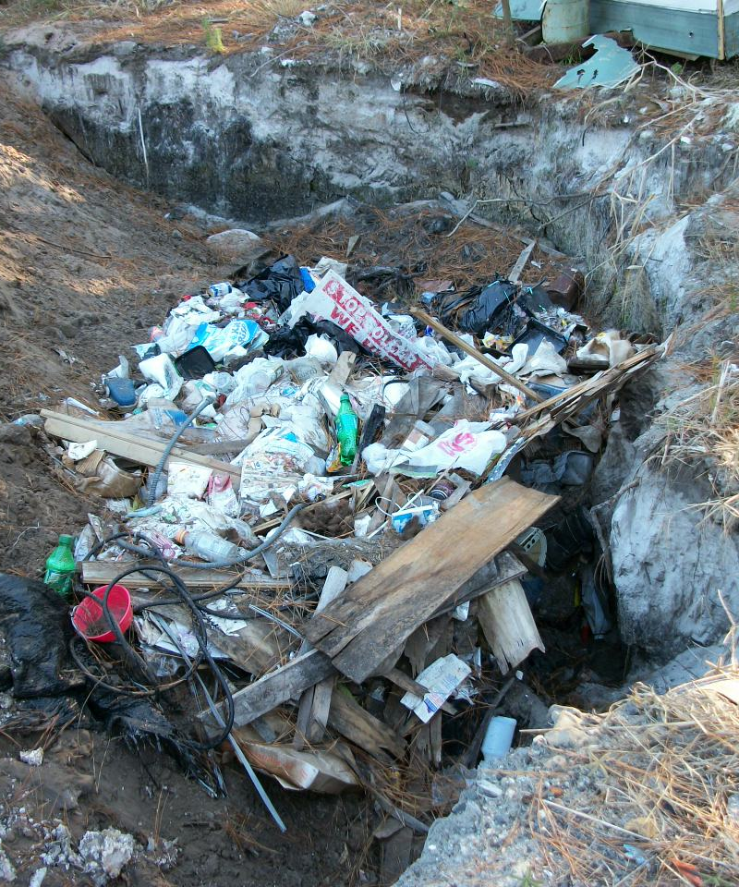
What is a Solid Waste ?
A solid waste is a discarded material not excluded in 40 CFR 261.4 or by a variance [40 CFR 261.2(a)(1)]
A discarded material is:
Abandoned [261.2(a)(2)(i)(A)]
Recycled (with some exceptions) [261.2(a)(2)(i)(B)]
Inherently waste-like [261.2(a)(2)(i)(C)]
Some military munitions [261.2(a)(2)(i)(D)]
Basically anything that you can no longer use for its intended purposed.
Notes:
Defined at 40 CFR 261.2(a)(1)

Slide 3
What is Abandoned ?
Abandoned [261.2(a)(2)(i)(A) and 261.2(b)]:
Disposed of;
Burned or incinerated; or
Accumulated, stored, or treated (but not recycled) before or in lieu of being abandoned by being disposed of, burned, or incinerated; or
Sham recycled, as explained in paragraph (g) of 261.2(g). (New)

Slide 4
What is Recycled ?
Recycled [261.2(a)(2)(i)(B) and 261.2(c)]:
A material is “recycled” if it is used, reused or reclaimed [261.1(c)(7)].
Materials are solid wastes if they are recycled (or accumulated, stored or treated before recycling):
(1) Used in a manner constituting disposal,
(2) Burning for energy recovery,
(3) Reclaimed – with some exceptions [New – (17, 23, 24 or 27)]
(4) Accumulated speculatively

Slide 5
What is Use Constituting Disposal?
Used in a manner constituting disposal 261.2(c)(1):
Materials noted with a “*” in Column 1 of Table 1 are solid wastes when they are:
(A) Applied to or placed on the land in a manner that constitutes disposal
(B) Used to produce products that are applied to or placed on the land or are otherwise contained in products that are applied to or placed on the land – For example – HW added to concrete.
Note, commercial chemical products listed in 261.33 are not solid wastes if they are applied to the land and that is their ordinary manner of use, for example, pesticides.
Notes:
Defined at 40 CFR 261.2(a)(1)

Slide 6
What is Burning for Energy Recovery?
Burning for Energy Recovery 261.2(c)(2):
Materials noted with a “*” in Column 2 of Table 1 are solid wastes when they are:
(A) Burned to recover energy;
(B) Used to produce a fuel or are otherwise contained in fuels (in which case the fuel itself remains a solid waste), for example, F005 spent solvent still bottoms
Note, commercial chemical products listed in 261.33 are not solid wastes if they are themselves fuels, for example, unused benzene since it is a normal component of fuel.
Notes:
Defined at 40 CFR 261.2(a)(1)

Slide 7
What is Reclaimed?
Reclaimed 261.2(c)(3):
A material is “reclaimed” if it processed to recover a useable product, or if it is regenerated. Examples are recovery of lead values from spent batteries and regeneration of spent solvents.
Materials noted with a “-” in column 3 of Table 1 are not solid waste when reclaimed
Materials noted with a “*” in column 3 of Table 1 are solid waste unless they meet the requirements of 261.4(a)(17), 261.4(a)(23), 261.4(a)(24) or 261.4(a)(27).

Slide 8
Reclamation Example
Silver waste from a photo shop:
Liquid would be a D011 hazardous waste, but it can be managed under 266 Subpart F for precious metal recovery.
If they use an on-site recovery unit, waste from the unit would be generated. This is waste from a water pollution control device, so it is a “sludge” by definition. When reclaimed, characteristic sludges reclaimed are not solid wastes.

Slide 9
What is Accumulated Speculatively?
Accumulated Speculatively 261.2(c)(4):
Materials noted with a “*” in Column 4 of Table 1 are solid wastes when accumulated speculatively.
A material is “accumulated speculatively” when it is accumulated before being recycled [261.1(c)(8)]. In order for it to not be speculative accumulation, a person must show:
That the material is potentially recyclable
Has a feasible means of being recycled
The amount during a calendar year that is recycled or transferred to different site for recycling equals at least 75% by weight or volume of the amount accumulated at the beginning of the period
Materials must be placed in a storage unit with a label indicating the fist date that the material began to be accumulated (or some other means if this isn’t practicable). (New)

Slide 10
What is Inherently Waste-Like?
Inherently Waste-Like 261.2(d):
The following materials are solid wastes when they are recycled in any manner:
F020, F021 (unless used as an ingredient at the point of generation to make a product), F022, F023, F026, and F028
Secondary materials fed to a halogen acid furnace that exhibit a characteristic or are listed, except for certain brominated materials
Other wastes deemed by EPA as Inherently Waste-Like
Notes:
Add what is F020…

Slide 11
What is a Military Munition?
Military Munition identified as a solid waste in 266.202:
If unused it is a solid waste when:
It’s abandoned by being disposed of, burned, detonated (except during intended use), incinerated, or treated prior to disposal; or
It is removed from storage in a military magazine or other storage area for the purpose of being disposed of, burned, or incinerated, or treated prior to disposal, or
It is deteriorated or damaged to the point that it cannot be put into serviceable condition, and cannot reasonably be recycled or used for other purposes; or
It has been declared a solid waste by an authorized military official
If used it is a solid waste when:
Transported off-range or from the site of use, where the site of use is not a range, for the purposes of storage, reclamation, treatment, disposal, or treatment prior to disposal; or
It is recovered, collected, and then disposed of by burial, or landfilling either on or off a range

Slide 12
Table 1
Classes of Secondary Materials | Use Constituting Disposal | Energy Recovery / Fuel | Reclamation [except as provided in 261.4(a)(17), (23), (24) and (27)] (New) | Speculative Accumulation
Spent Materials | * | * | * | *
Sludges (listed) | * | * | * | *
Sludges (characteristic) | * | * | Not SW when recycled | *
By-Products (listed) | * | * | * | *
By-Products (characteristic) | * | * | Not SW when recycled | *
Commercial Chemical Products | * | * | Not SW when recycled | Not SW when recycled
Scrap Metal not excluded under 261.4(a)(13) | * | * | * | *
* Solid waste when recycled
Notes:
All the (*) and (-) symbols in the 261-Table 1 are hard to grasp, especially since the meaning of the symbols isn’t explained on the table.
I replaced dashes with “Not SW when recycled.”
Each class of secondary material has a definition that I’ll explain.
UCD and burned for Energy recovery are SW when recycled for all classes of secondary materials.
UCD and burning… are fairly self-explanatory. Reclamation is processing to recover a product or regenerating. Solvents are regenerated.

Slide 13
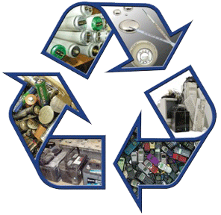
Recycling Exemption
Materials are not Solid Waste when recycled by being [261.2(e)]:
Used or reused as ingredients in an industrial process to make a product, provided they are not being reclaimed; or
Used or reused as effective substitutes for commercial products; or
Returned to the original process from which they were generated, without being reclaimed or land disposed (used as a substitute for feedstock materials).
Notes:
(But they are SW if UCD, burned, accumulated speculatively, or inherently waste-like)

Slide 14
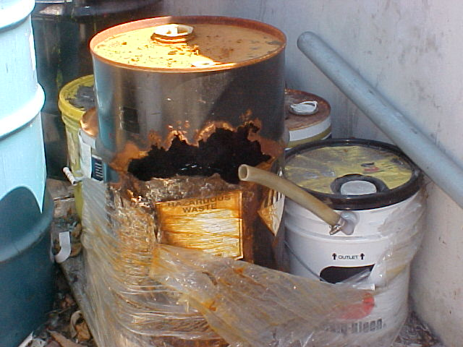
Mechanisms to Ensure Proper Recycling
Legitimate vs. sham recycling (40 CFR 260.43) (Note: some language changed in 2015):
Legitimate recycling must involve a material that provides a useful contribution to the recycling process or product.
Legitimate recycling must produce a product or intermediate that is valuable (sold to a third party, used as an effective substitute or as an ingredient).
The generator and recycler must manage the material as a valuable commodity when it is under their control.
The product of the recycling process must be comparable to a legitimate product or intermediate.
If not legitimately recycled – then it’s a discarded material that is a solid waste
Notes:
These containers are not managed as a valuable commodity.

Slide 15
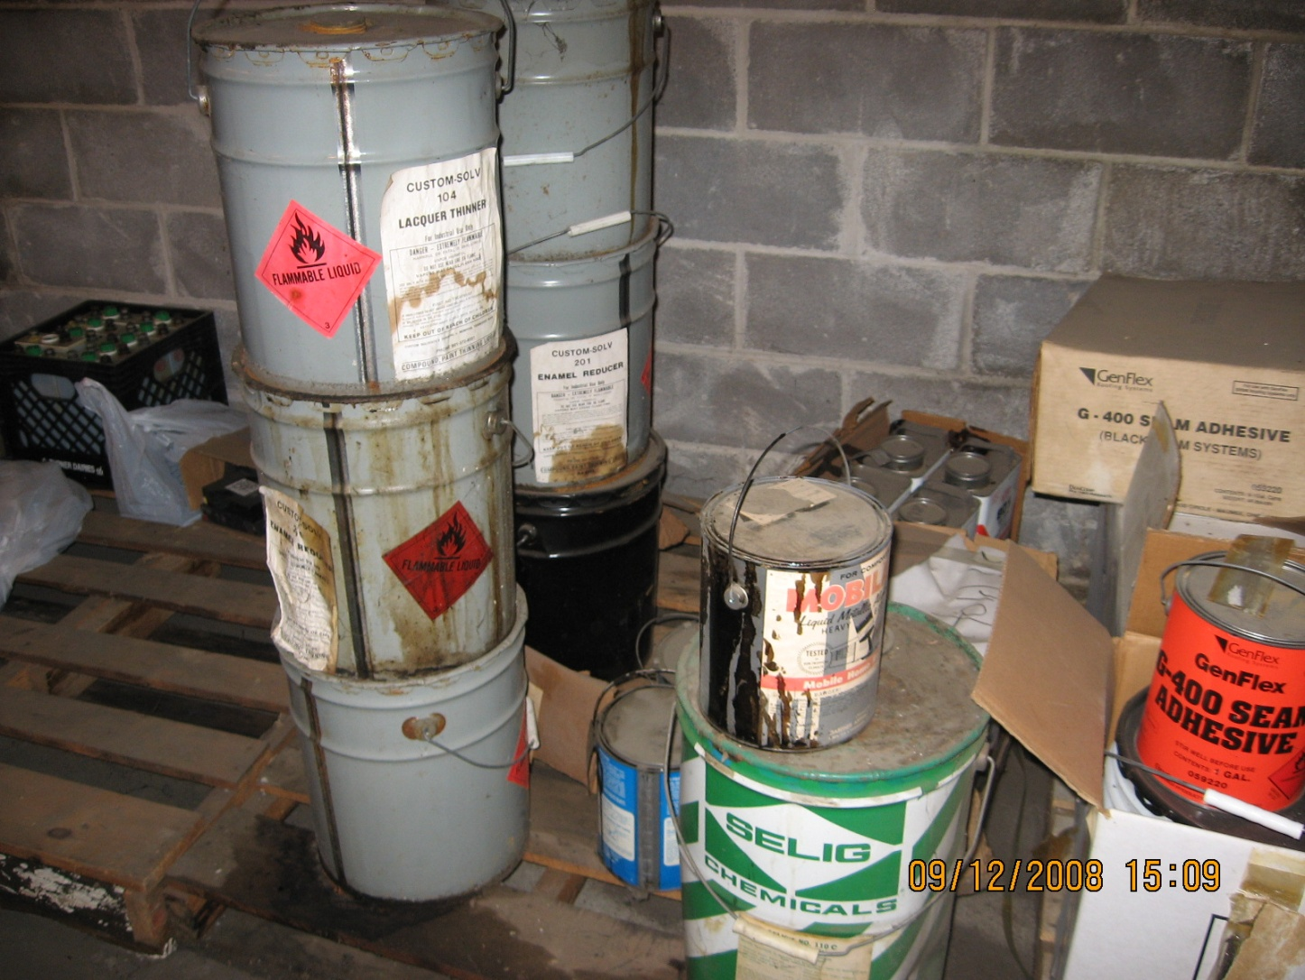
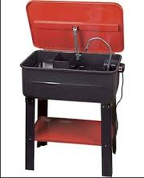
Five Types of Secondary Materials
Spent Materials
Sludges
By-products
Commercial Chemical Products
Scrap Metal
Notes:
These are the 5 types of secondary materials in 261 – Table 1.

Slide 16
Spent Material
A spent material is any material that has been used and as a result of contamination can no longer serve the purpose for which it was produced without processing [40 CFR 261.1(c)(1)]
Spent solvents
Spent catalysts
Spent pickle liquor
Spent plating bath solutions

Slide 17
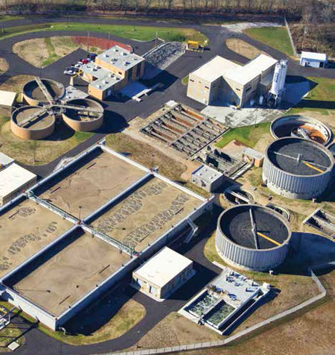
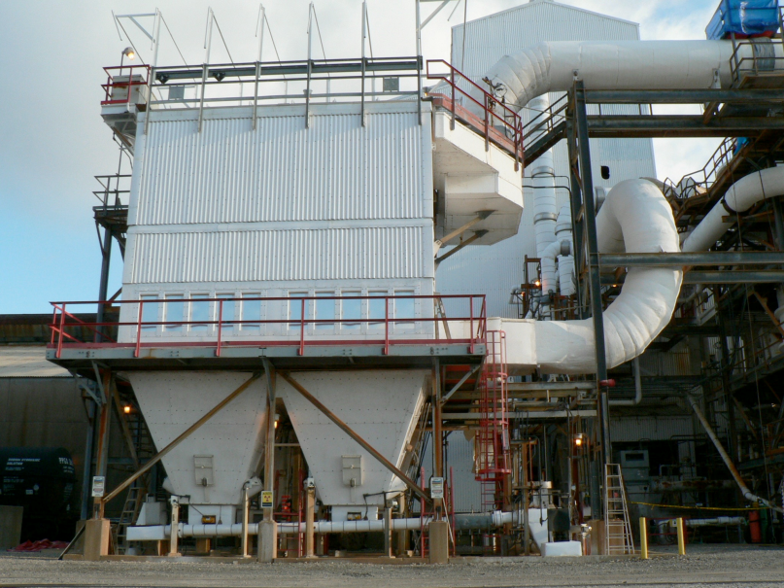
Sludge
A sludge is any solid, semisolid, or liquid waste generated from a municipal, commercial, or industrial wastewater treatment plant, water supply treatment plant, or air pollution control facility, exclusive of the treated effluent from a wastewater treatment plant
[261.1(c)(2), 260.10]
Wastewater treatment plant sludges
Electric arc furnace
dust (K061)
Baghouse dust
Notes:
Sludges generated in ditches, pond, lagoons, surface impoundments etc., meet this definition (specifically from pollution control systems).

Slide 18
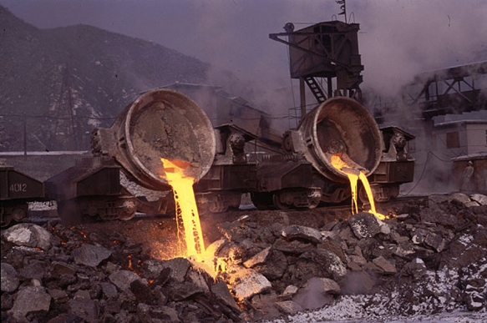
By-Product
A “by-product” is a material that is not one of the primary products of a production process and is not solely or separately produced by the production process [261.1(c)(3)]
Not intentionally produced
Needs further processing
Distillation column bottoms
Heavy ends
Slag
Notes:
Note: Does not include a co-product that is produced for the general public’s use and is ordinarily used in the form it is produced in the process. Sometimes determining by-product vs co-products can be tricky.

Slide 19
Co-Product
A co-product is a material intentionally produced by the manufacturing process and ordinarily used in its existing state as a commodity in trade by the general public [261.1(c)(3)]
Co-products:
have a recognized use and a legitimate or guaranteed market
are manufactured to specifications
must be usable without reprocessing
are managed as a valuable commodity
Co-products are not subject to RCRA regulation if they are used for their intended purpose.
Example: Gasoline, kerosene, fuel oil, and asphalt are co-products from petroleum refining. Petroleum tank bottoms are a by-product.

Slide 20
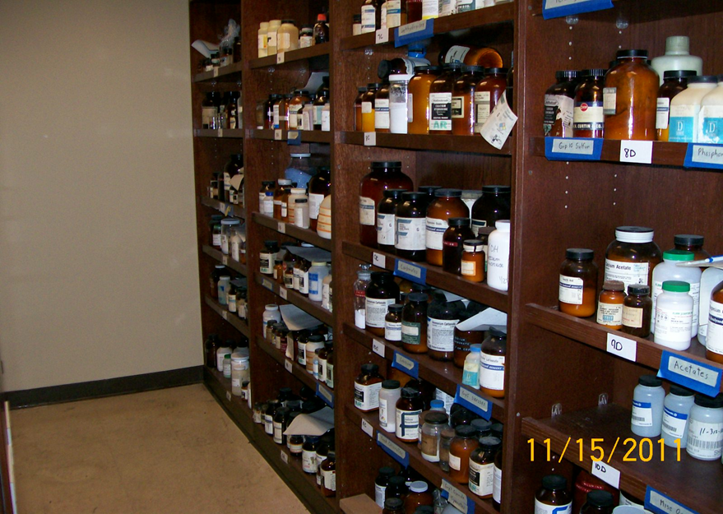
Commercial Chemical Product (CCP)
CCP is unused product (e.g., off-specification chemical)
Any kind of unused product – doesn’t have to be listed in §261.33 (P and U wastes)
paint
batteries
circuit boards
pesticides
off-spec chemical
etc.

Slide 21
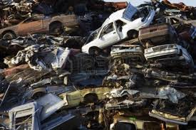
Scrap Metal
Scrap metal is bits and pieces of metal parts …or metal pieces that may be combined together with bolts or soldering … which when worn or superfluous can be recycled [261.1(c)(6)]
Sheet metal
Wire
Metal tanks and containers
Scrap automobiles
Machine shop turnings
Notes:
Also see 261.4(13)

Slide 22
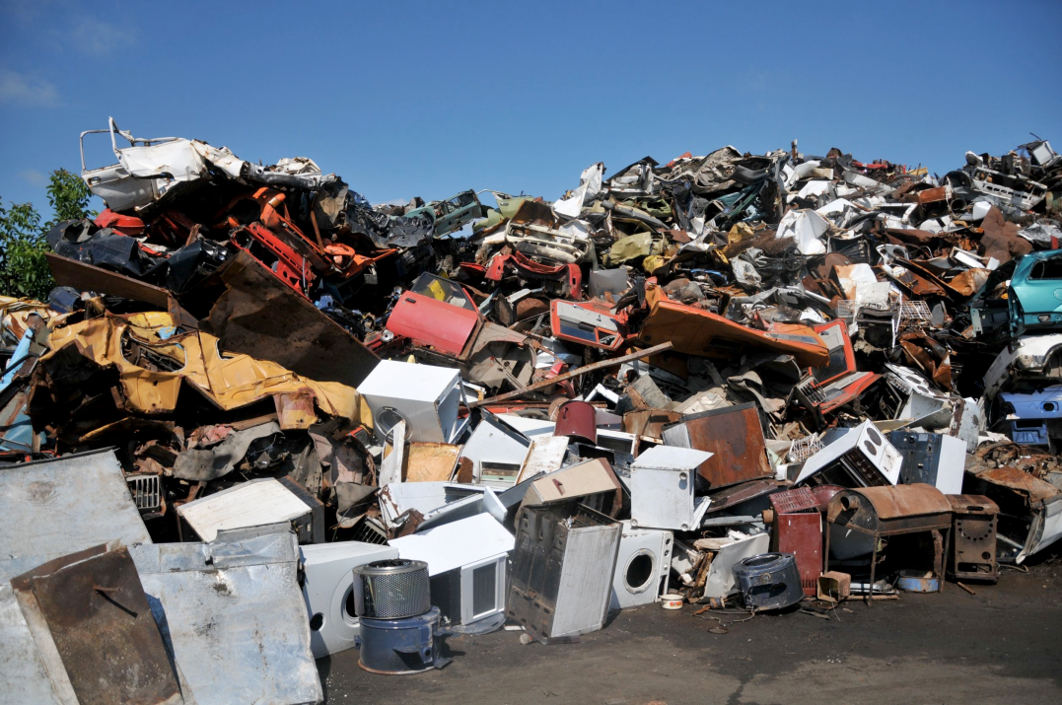
Scrap Metal - Regulated
Regulated scrap metal is scrap metal that is not excluded under 261.4(a)(13).
Examples include scrap metal that is discarded or improperly managed prior to recycling, small fines generated during shredding of circuit boards, solder skimmings or dross.

Slide 23
40 CFR 261.4(a) - Materials which are not solid wastes. If they are never solid wastes, then they will never be hazardous waste
40 CFR 261.4(b) – Solid wastes that are not hazardous wastes. They are solid wastes and they are regulated, but they do not become hazardous wastes. These are addressed in a separate PowerPoint.

Slide 24
Solid Waste Exclusions 3 40 CFR 261.4(a)
Materials which are not solid wastes. The following materials are not solid waste…

Slide 25
Solid Waste Exclusions 1 40 CFR 261.4(a) – Domestic Sewage
Domestic sewage and mixtures of domestic sewage
Domestic sewage or any mixture of domestic sewage and other waste that passes through a sewer system to a publicly-owned treatment works.
Notes:
1 – The domestic sewage exemption is very common. The waste must be discharged to a Publically Owned Treatment Works (POTW), it must be a domestic waste sewer line, and the receiving facility must know about the discharge. Also see 62-730 for Florida requirements.
The POTW is regulated by the CWA

Slide 26
Solid Waste Exclusions 2
62-730.030(4)(a), F.A.C. - “With respect to a claim that a substance…is not a solid waste because it is a mixture of domestic sewage and other wastes that passes through a sewer system to a … POTW for treatment … ‘appropriate documentation’ shall mean a copy of notification to the POTW and the Department …”
This exclusion does not
include discharges to
septic tanks.
Notes:
62-730.030(4)(a), F.A.C. “With respect to a claim that a substance…is not a solid waste because it is a mixture of domestic sewage and other wastes that passes through a sewer system to a publically owned treatment works (POTW) for treatment under 40 CFR 261.4(a)(1)…’appropriate documentation’ shall mean ” a copy of notification to the POTW and the Department in accordance with the requirements of subsection 62-625.600(15), F.A.C., including a copy of the certification required by paragraph 62-625.600(15)(d), F.A.C. In order to avoid penalty for disposal of hazardous waste without proper notification, the documentation must have been submitted to the POTW on a date prior to the date of the Department’s inspection of the facility and prior to the Department’s request for such documentation. This provision applies to all hazardous waste generators, including CESQGs, which discharge more than 15 kilograms of non-acute hazardous wastes in any calendar month, or any quantity of acute hazardous waste.”

Slide 27
Solid Waste Exclusions 3 40 CFR 261.4(a)
40 CFR 261.4(a)(2)
Industrial point source discharges
40 CFR 261.4(a)(3)
Irrigation return flows
40 CFR 261.4(a)(4)
Source, spent nuclear or by-product as defined by the Atomic Energy Act
Notes:
2 – CWA regulated discharges. These could be permitted NPDES discharges. Note: This only applies to the actual point source discharge. It doe not exclude industrial wastewaters while they are being collected, stored or treated before discharge. It also does into exclude sludges generated.
4 – Note: Radioactive wastes that are low level and mixed with hazardous waste are regulated by RCRA.

Slide 28
Solid Waste Exclusions 4 40 CFR 261.4(a)
40 CFR 261.4(a)(5)
In-situ mining materials
40 CFR 261.4(a)(6)
Pulping liquors
40 CFR 261.4(a)(7)
Spent sulfuric acid used to produce sulfuric acid
40 CFR 261.4(a)(8)
Secondary materials reclaimed in a closed-loop process in tanks
Notes:
6 – Pulping liquors like black liquor at a paper mill are excluded if they are reclaimed in a pulping liquor recovery furnace and then reused. Unless they are accumulated speculatively.
7 – Unless accumulated speculatively
8 -Secondary materials that are reclaimed and returned to the original process or processes in which they were generated where they are reused in the production process provided:
(i) Only tank storage is involved, and the entire process through completion of reclamation is closed by being entirely connected with pipes or other comparable enclosed means of conveyance;
(ii) Reclamation does not involve controlled flame combustion (such as occurs in boilers, industrial furnaces, or incinerators);
(iii) The secondary materials are never accumulated in such tanks for over twelve months without being reclaimed; and
(iv) The reclaimed material is not used to produce a fuel, or used to produce products that are used in a manner constituting disposal.

Slide 29
Solid Waste Exclusions 5 40 CFR 261.4(a)
40 CFR 261.4(a)(9)
Spent wood preservatives (when reused)
40 CFR 261.4(a)(10)
Coke by-product wastes (some K-wastes)
40 CFR 261.4(a)(11)
Splash condenser dross residues
40 CFR 261.4(a)(12)
Oil-bearing hazardous secondary materials generated and recycled within the petroleum refining industry
Notes:
9 - (i) Spent wood preserving solutions that have been reclaimed and are reused for their original intended purpose; and
(ii) Wastewaters from the wood preserving process that have been reclaimed and are reused to treat wood.
(iii) Prior to reuse, the wood preserving wastewaters and spent wood preserving solutions described in paragraphs (a)(9)(i) and (a)(9)(ii) of this section, so long as they meet all of the following conditions:
(A) The wood preserving wastewaters and spent wood preserving solutions are reused on-site at water borne plants in the production process for their original intended purpose;
(B) Prior to reuse, the wastewaters and spent wood preserving solutions are managed to prevent release to either land or groundwater or both;
(C) Any unit used to manage wastewaters and/or spent wood preserving solutions prior to reuse can be visually or otherwise determined to prevent such releases;
(D) Any drip pad used to manage the wastewaters and/or spent wood preserving solutions prior to reuse complies with the standards in part 265, subpart W of this chapter, regardless of whether the plant generates a total of less than 100 kg/month of hazardous waste; and
(E) Prior to operating pursuant to this exclusion, the plant owner or operator prepares a one-time notification stating that the plant intends to claim the exclusion, giving the date on which the plant intends to begin operating under the exclusion, and containing the following language: “I have read the applicable regulation establishing an exclusion for wood preserving wastewaters and spent wood preserving solutions and understand it requires me to comply at all times with the conditions set out in the regulation.” The plant must maintain a copy of that document in its on-site records until closure of the facility. The exclusion applies so long as the plant meets all of the conditions. If the plant goes out of compliance with any condition, it may apply to the appropriate Regional Administrator or state Director for reinstatement. The Regional Administrator or state Director may reinstate the exclusion upon finding that the plant has returned to compliance with all conditions and that the violations are not likely to recur.

Slide 30
Solid Waste Exclusions 6 40 CFR 261.4(a)
40 CFR 261.4(a)(13)
Excluded scrap metal
40 CFR 261.4(a)(14)
Shredded circuit boards
40 CFR 261.4(a)(15)
Pulping condensates derived from Kraft mill steam strippers
40 CFR 261.4(a)(16)
Reserved
Notes:
13 - Excluded scrap metal (processed scrap metal, unprocessed home scrap metal, and unprocessed prompt scrap metal) being recycled.
14 - Shredded circuit boards being recycled provided that they are:
(i) Stored in containers sufficient to prevent a release to the environment prior to recovery; and
(ii) Free of mercury switches, mercury relays and nickel-cadmium batteries and lithium batteries.

Slide 31
Solid Waste Exclusions 7 40 CFR 261.4(a)
40 CFR 261.4(a)(17)
Mineral processing spent materials being recycled
Notes:
17 - Spent materials (as defined in §261.1) (other than hazardous wastes listed in subpart D of this part) generated within the primary mineral processing industry from which minerals, acids, cyanide, water, or other values are recovered by mineral processing or by beneficiation, provided that:
(i) The spent material is legitimately recycled to recover minerals, acids, cyanide, water or other values;
(ii) The spent material is not accumulated speculatively;
(iii) Except as provided in paragraph (a)(17)(iv) of this section, the spent material is stored in tanks, containers, or buildings meeting the following minimum integrity standards: a building must be an engineered structure with a floor, walls, and a roof all of which are made of non-earthen materials providing structural support (except smelter buildings may have partially earthen floors provided the secondary material is stored on the non-earthen portion), and have a roof suitable for diverting rainwater away from the foundation; a tank must be free standing, not be a surface impoundment (as defined in 40 CFR 260.10), and be manufactured of a material suitable for containment of its contents; a container must be free standing and be manufactured of a material suitable for containment of its contents. If tanks or containers contain any particulate which may be subject to wind dispersal, the owner/operator must operate these units in a manner which controls fugitive dust. Tanks, containers, and buildings must be designed, constructed and operated to prevent significant releases to the environment of these materials.
(iv) The Regional Administrator or State Director may make a site-specific determination, after public review and comment, that only solid mineral processing spent material may be placed on pads rather than tanks containers, or buildings. Solid mineral processing spent materials do not contain any free liquid. The decision-maker must affirm that pads are designed, constructed and operated to prevent significant releases of the secondary material into the environment. Pads must provide the same degree of containment afforded by the non-RCRA tanks, containers and buildings eligible for exclusion.
(A) The decision-maker must also consider if storage on pads poses the potential for significant releases via groundwater, surface water, and air exposure pathways. Factors to be considered for assessing the groundwater, surface water, air exposure pathways are: The volume and physical and chemical properties of the secondary material, including its potential for migration off the pad; the potential for human or environmental exposure to hazardous constituents migrating from the pad via each exposure pathway, and the possibility and extent of harm to human and environmental receptors via each exposure pathway.
(B) Pads must meet the following minimum standards: Be designed of non-earthen material that is compatible with the chemical nature of the mineral processing spent material, capable of withstanding physical stresses associated with placement and removal, have run on/runoff controls, be operated in a manner which controls fugitive dust, and have integrity assurance through inspections and maintenance programs.
(C) Before making a determination under this paragraph, the Regional Administrator or State Director must provide notice and the opportunity for comment to all persons potentially interested in the determination. This can be accomplished by placing notice of this action in major local newspapers, or broadcasting notice over local radio stations.
(v) The owner or operator provides notice to the Regional Administrator or State Director providing the following information: The types of materials to be recycled; the type and location of the storage units and recycling processes; and the annual quantities expected to be placed in land-based units. This notification must be updated when there is a change in the type of materials recycled or the location of the recycling process.
(vi) For purposes of paragraph (b)(7) of this section, mineral processing spent materials must be the result of mineral processing and may not include any listed hazardous wastes. Listed hazardous wastes and characteristic hazardous wastes generated by non-mineral processing industries are not eligible for the conditional exclusion from the definition of solid waste.

Slide 32
Mineral Processing Exclusion
261.4(a)(17) – Spent materials (other than listed wastes) generated within the primary mineral processing industry from which minerals, acids, cyanide, WATER or other values are recovered by mineral processing or by beneficiation provided that:
Legitimate recycling is occurring
No speculative accumulation
Notification required – 261.4(a)(17)(v)
Materials stored in tanks, containers or containment buildings EXCEPT

Slide 33
Mineral Processing cont.
261.4(a)(17)(iv) – Allows a site specific determination that solid mineral processing wastes may be placed on a pad
No free liquids
Public notice and opportunity for comment required
Pads must be constructed and operated to prevent releases and migration into the environment
Minimum construction standards must be met
Ensures that phosphate fertilizer waste water in recirculation ditches can’t be excluded under this rule (the phosphoric acid production waste water is still excluded from the HW definition)
Notes:
Waste water from non excluded processes, such as sulfuric acid production, ammonium phosphate fertilizer production waste water and tank cleaning waste water can’t be eligible for exclusion under this section on the theory that the water is being recirculated and reused in the plant.

Slide 34
Solid Waste Exclusions 8 40 CFR 261.4(a)
40 CFR 261.4(a)(18)
Petrochemical recovered oil
40 CFR 261.4(a)(19)
Spent caustic solutions from petroleum refining
40 CFR 261.4(a)(20)
Hazardous secondary materials used to make zinc fertilizers

Slide 35
Solid Waste Exclusions 9 40 CFR 261.4(a)
40 CFR 261.4(a)(21)
Zinc fertilizers made from hazardous secondary materials
40 CFR 261.4(a)(22)
Used cathode ray tubes (CRTs)

Slide 36
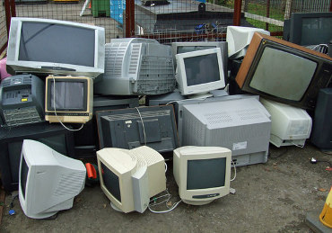
Solid Waste Exclusions 10
Used Cathode Ray Tubes (CRTs)
Used, intact CRTs are not solid waste if they are:
not disposed
not speculatively accumulated by CRT collectors or glass processors
Used, intact CRTs are not solid waste
when exported if they are:
not speculatively accumulated
notification requirements are met
Used broken CRTs and glass removed from CRTs are not solid waste,
provided they meet the requirement of 40 CFR 261.39.
(storage, labeling, transportation, UCD, processing and export requirements).

Slide 37
Solid Waste Exclusions 11
Generator Controlled Exclusion
Adopted and effective 4-5-16
40 CFR 261.4(a)(23) – Generator Controlled Exclusion
Revisions combine and modify EPA’s 2008 changes for non land based [former 40 CFR 261.2(a)(ii)] and land based recycling processes
Hazardous secondary material generated and legitimately reclaimed within the U.S. or its territories and under the control of the generator
Material complies with paragraphs (a)(23)(i) and (ii)
Notes:
40 CFR 260.10 - Hazardous secondary material
Means a secondary material (e.g., spent material, by-product, or sludge) that, when discarded, would be identified as hazardous waste under part 261 of this chapter
40 CFR 260.10 - Hazardous secondary material generator
Means any person whose act or process produces hazardous secondary materials at the generating facility. For purposes of this paragraph, “generating facility” means all contiguous property owned, leased, or otherwise controlled by the hazardous secondary material generator. For the purposes of §261.2(a)(2)(ii) and §261.4(a)(23), a facility that collects hazardous secondary materials from other persons is not the hazardous secondary material generator.

Slide 38
Generator Controlled Exclusion
(i)(A) – The hazardous secondary material (HSM) is generated and reclaimed at the generating facility.
(i)(B) – The HSM is generated and reclaimed at different facilities, if the reclaiming facility is controlled by the generator.
(i)(C) – The HSM is generated pursuant to a written contract between a tolling contractor and a toll manufacturer and is reclaimed by the tolling contractor
Notes:
“Generating Facility” means all contiguous property owned, leased, or otherwise controlled by the hazardous secondary material generator.
Toll manufacturer means a person who produces a product or intermediate made from specified unused materials pursuant to a written contract with a tolling contractor
40 CFR 260.10 – Person
Means an individual, trust, firm, joint stock company, Federal Agency, corporation (including a government corporation), partnership, association, State, municipality, commission, political subdivision of a State, or any interstate body.

Slide 39
Generator Controlled Exclusion 1
(ii)(A) – The HSM is contained
(ii)(B) – The HSM is not speculatively accumulated
(ii)(C) – Notice (notification) is provided
(ii)(D) – The HSM is not otherwise subject to material specific management conditions under 40 CFR 261.4(a)
(ii)(E) – The HSM recycling is legitimate
(ii)(F) – Emergency Preparedness and response requirements are met

Slide 40
Generator Controlled Exclusion 2
Under the Control of the Generator means:
261.4(a)(23)(i)(A) – The HSM is generated and reclaimed at generating facility
Generating Facility means all contiguous property owned, leased, or otherwise controlled by the hazardous secondary material generator.

Slide 41
Generator Controlled Exclusion 3
Under the Control of the Generator means:
261.4(a)(23)(i)(B) – The HSM is generated and reclaimed at different facilities controlled by the generator, or both generator and recycler are controlled by the same person.
“Person” means an individual, trust, firm, joint stock company, Federal Agency, corporation …
“Control” means power to direct policies of facility
Requires generator certification statement
Generator and receiving facility must maintain 3 years of records documenting HSM shipments

Slide 42
Generator Controlled Exclusion 4
Under the Control of the Generator means:
261.4(a)(23)(i)(C) – The HSM is generated pursuant to a written contract between a tolling contractor and a toll manufacturer and is reclaimed by the toll contractor.
“Toll Manufacturer” means a person who produces a product or intermediate made from specified unused materials pursuant to a written contract with a tolling contractor
Tolling contractor certification required
Tolling contractor and toll manufacturer must both maintain 3 years of records of HSM shipped / received pursuant to the written contract

Slide 43
Generator Controlled Exclusion 5
261.4(a)(23)(ii)(A) – The HSM is “contained’ meaning it is held in a unit (including a land-based unit) that:
The unit is in good condition with no leaks or other continuing or intermittent unpermitted releases of HSM to environment.
The unit is properly labeled or otherwise has a system (such as a log) to immediately identify the HSM in the unit.
The unit holds HSM compatible with other HSM placed in the unit and is compatible with materials used to construct the unit and addresses potential risk of fire or explosion.
A hazardous secondary material released to the environment is discarded and a solid waste unless it is immediately recovered for the purpose of reclamation. Hazardous secondary material managed in a unit with leaks or other continuing or intermittent unpermitted releases is discarded and a solid waste.

Slide 44
Generator Controlled Exclusion 6
261.4(a)(23)(ii)(B) – The HSM is not speculatively accumulated. Must show:
Material is potentially recyclable and has a feasible means of being recycled.
During calendar year amount recycled, or transferred for recycling is at least 75%
Material placed in storage unit with label indicating accumulation start date (or use log)

Slide 45
Generator Controlled Exclusion 7
261.4(a)(23)(ii)(C) – Notice is provided…
Prior to operating under the exclusion, and by March 1 of each even numbered year submit 8700-12 Form with:
Name, Address, EPA ID Number of the facility
Name and Telephone Number of Contact
NAICS Code
Regulation under which the HSM will be managed
When facility began, or will begin, managing HSM
List of HSM that will be managed (Waste Codes)
Whether any HSM will be managed in land-based unit
Quantity of HSM to be managed annually
Signed certification contained in the 8700-12 Form
Notes:
Notification as a Requirement of the Exclusion." Sounds similar but has different result. The notification as a condition was added to the Exclusion so failure to Notify could potentially mean loss of the exclusion versus just a notification violation.

Slide 46
Generator Controlled Exclusion 8
261.4(a)(23)(ii)(C) – Notice is provided…
If the facility that has notified as managing HSM and subsequently stops managing the material in accordance with the regulation an updated Notification must be provided within 30 days

Slide 47
Generator Controlled Exclusion 9
261.4(a)(23)(ii)(D) – The material is not otherwise subject to material-specific management conditions under 40 CFR 261.4(a) [exclusions] when reclaimed
Material is not a spent lead-acid battery

Slide 48
Generator Controlled Exclusion 10
261.4(a)(23)(ii)(E) – Persons performing recycling must maintain documentation of legitimate recycling determination on-site
Documentation is written description of how the recycling meets the following 4 factors
HSM provides a useful contribution to recycling process
Recycling process must produce a valuable product or intermediate
The HSM must be managed as a valuable commodity
The product of the recycling process must be comparable to a legitimate product or intermediate.
Documentation must be maintained for 3 years after recycling operation has ceased
Notes:
Must meet all 4 factors identified in 40 CFR 260.43

Slide 49
Generator Controlled Exclusion 11
261.4(a)(23)(ii)(F) – Must meet Preparedness and Response requirements of 261 Subpart M
Applies to those areas of the entity managing the excluded HSM where HSMs are generated or accumulated on-site
Generator of HSM accumulating 6,000 kilograms or less of HSM at any time must comply with 261.410 and 261.411
Generator of HSM accumulating more than 6,000 kilograms of HSM at any time must comply with 261.410 and 261.420

Slide 50
Preparedness and Response 1
Requirement for both <6000 kg and >6000kg generators of HSM
40 CFR 261.410 – Preparedness and Prevention
Maintenance and Operation of Facility to minimize…
Required Equipment
Internal communications or alarm system
Telephone immediately available at scene of operations
Portable fire extinguishers, fire control, spill control, and decontamination equipment
Water of adequate volume and pressure
Testing and Maintenance of Equipment
Access to Communications or Alarm System
Whenever HSM is being actively managed
If ever just 1 employee on premises while facility operating

Slide 51
Preparedness and Response 2
40 CFR 261.410 – Preparedness and Prevention (Continued)
Required Aisle Space
Arrangements with Local Authorities
Generator must attempt to make following arrangements
Familiarize police, fire departments, and emergency response teams… properties of HSM handled at the facility and associated hazards...
Where more than 1 police department...
Agreements with state emergency response teams...
Arrangements to familiarize local hospitals with the properties of hazardous waste handled at the facility...
(The words “hazardous waste” above are not a typo)
Documentation of refusals for arrangements
Notes:
Note the arrangements to local authorities is not the same as the version contained in 40 CFR 265.37. This is a specific requirement tied only to the hazardous secondary material. Not Hazardous Wastes that may also be generated on site. So existing notifications for hazardous wastes generated on site are not acceptable substitutes.

Slide 52
Preparedness and Response 3
Requirement for 6,000 kg or less of HSM
40 CFR 261.411 – Emergency Procedures
Emergency Coordinator (EC)
Must post the following next to telephone
Name and Telephone Number of EC
Location of fire extinguishers, spill control material, fire alarm
Telephone number of fire department
Training of employees
EC must respond to any emergencies that arise

Slide 53
Preparedness and Response 4
Requirement for more than 6,000 kg of HSM
40 CFR 261.420 – Contingency Planning
Purpose and Implementation of Contingency Plan
Content of Contingency Plan
Copies of Contingency Plan
Amendment of Contingency Plan
Emergency Coordinator
Emergency Procedures
Notes:
If facility already has a Contingency Plan developed under 40 CFR 264 Subpart D or 265 Subpart D that should suffice

Slide 54
Verified Reclamation Facility Exclusion
Solid Waste Exclusions
40 CFR 261.4(a)(24) – HSM is generated and transferred to a verified reclamation facility for the purpose of reclamation…provided that:
The material is not speculatively accumulated
The material is not handled by any person or facility other than the HSM generator, transporter, an intermediate facility or the reclaimer
While in transport it cannot be stored for greater than 10 days at a transfer facility
Packaged in accordance with DOT requirements
Notes:
Speculative accumulation was described in detail in earlier slides

Slide 55
Verified Reclamation Facility Exclusion
40 CFR 261.4(a)(24) – Continued
The material is not otherwise subject to material-specific management conditions under 40 CFR 261.4(a) [exclusions] when reclaimed
Material is not a spent lead-acid battery
Document legitimate recycling
Maintain documentation for 3 years after operations cease
The HSM Generator must meet the following:
The material must be “Contained”
HSM generator must arrange for transport to a verified reclamation facility, or facilities in the U.S.
Verified Reclamation Facility would probably be HW TSD
Notes:
Legitimate recycling was described in detail in earlier slides
Contained was explained in detail in earlier slides

Slide 56
Verified Reclamation Facility Exclusion 1
40 CFR 261.4(a)(24) – Continued
The HSM Generator must maintain at the generating facility 3 years of records for all off-site shipments
The HSM Generator must maintain at the generating facility 3 years of records for confirmation of receipt from each reclaimer and intermediate facility
The HSM Generator must comply with Part 260 Subpart M preparedness and response
Notes:
Legitimate recycling was described in detail in earlier slides
Contained was explained in detail in earlier slides

Slide 57
Verified Reclamation Facility Exclusion 2
40 CFR 261.4(a)(24) – Continued
Reclaimers of HSM, and intermediate facilities, must comply with:
3 years of records for all HSM received and/or shipped off-site for further reclamation
Intermediate facility must send the HSM to the reclaimer designated by the HSM generator
Confirmation of receipt of HSM must be provided to generator
HSM must be managed in a manner that is at least as protective as for raw materials and it must be contained.
Reclaimer and Intermediate facilities must have financial assurance as required under 40 CFR Part 261 Subpart H
Must have RCRA Permit or be granted variance
Must provide notification required by 40 CFR 260.42
Notes:
Legitimate recycling was described in detail in earlier slides
Contained was explained in detail in earlier slides

Slide 58
260.31(d) Solid Waste Variance
For waste/HSM sent to verified recyclers without RCRA Permit:
Reclamation facility must demonstrate recycling is legitimate
Financial assurance is required
Facility must not be a SNC or under formal enforcement for the past 3 years
Emergency response – 40 CFR 261 Subpart M
Residuals management must be addressed
Application must address all risk issues not addressed under the permit application

Slide 59
Transfer to Remanufacturer Exclusion
Solid Waste Exclusions
40 CFR 261.4(a)(27) – HSM is transferred to another person for purpose of remanufacturing
The HSM must consist of one or more of 18 specific spent solvents

Slide 60
Transfer to Remanufacturer Exclusion.
40 CFR 261.4(a)(27) – Continued
The HSM originated from using 1 or more of the solvents in a commercial grade for reacting, extracting, purifying, or blending chemicals, or rinsing process lines in one of the following industries
Pharmaceutical Manufacturing – NAICS 325412
Basic Organic Chemical Mfg – NAICS 325199
Plastics and Resins Mfg – NAICS 325211
Paints & Coatings Mfg – NAICS 325510

Slide 61
Transfer to Remanufacturer Exclusion 1
40 CFR 261.4(a)(27) – Continued
The HSM generator sends the HSM solvent to a remanufacturer in one of the following industries
Pharmaceutical Manufacturing – NAICS 325412
Basic Organic Chemical Mfg – NAICS 325199
Plastics and Resins Mfg – NAICS 325211
Paints & Coatings Mfg – NAICS 325510

Slide 62
Transfer to Remanufacturer Exclusion 2
40 CFR 261.4(a)(27) – Continued
After remanufacturing, the use of the remanufactured solvent is limited to reacting, extracting, purifying, or blending chemicals, or for rinsing out process lines associated with those functions in one of the following industries
Pharmaceutical Manufacturing – NAICS 325412
Basic Organic Chemical Mfg – NAICS 325199
Plastics and Resins Mfg – NAICS 325211
Paints & Coatings Mfg – NAICS 325510

Slide 63
Transfer to Remanufacturer Exclusion 3
40 CFR 261.4(a)(27) – Continued
After remanufacturing, the use of the remanufactured solvent does not involve cleaning or degreasing oil, grease, or similar material from textiles, glassware, metal surfaces, or other articles.

Slide 64
Transfer to Remanufacturer Exclusion 4
40 CFR 261.4(a)(27) – Continued
Both the HSM Generator and Remanufacturer must:
Notify as required by 40 CFR 260.42
Develop and maintain an up-to-date remanufacturing plan that identifies
Name, address, EPA ID of generator(s) and remanufacturer(s)
Type and annual volume of solvent to be remanufactured
Processes and industrial sectors generating the HSM
Specific uses and industry sectors for remanufactured solvent
Certification from remanufacturer stating compliance with Part 260 Subparts AA, BB, CC or Clean Air Act permit

Slide 65
Transfer to Remanufacturer Exclusion 5
40 CFR 261.4(a)(27) – Continued
Maintain records of shipments and confirmations of receipts for 3 years from date of shipment
Prior to remanufacturing store the hazardous spent solvents in tanks or containers meeting the requirements of 40 CFR 261 Subparts I and J
Certify remanufacturing equipment is in compliance with 261 Subparts AA, BB, CC or Clean Air Act
Meet requirements prohibiting speculative accumulation

Slide 66
Solid Waste Exclusions 40 CFR 261.4(a)
40 CFR 261.4(a)(26)
Some solvent-contaminated wipes that are cleaned and reused
The EPA created the Excluded Solvent-Contaminated Wipes Rule with the stated purpose of “…reducing overall compliance costs for industry, many of which are small businesses” [78 FR 46448].
The rule was adopted by Florida and became effective at the Federal and State level on January 31, 2014.

Slide 67
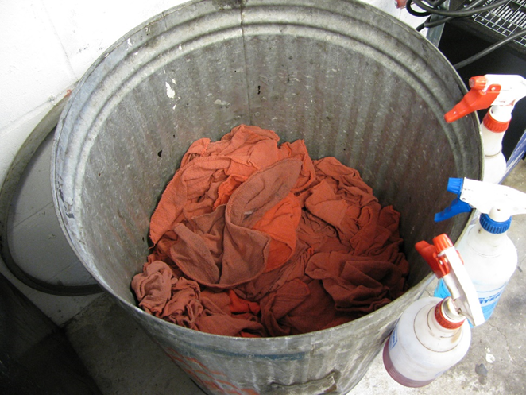
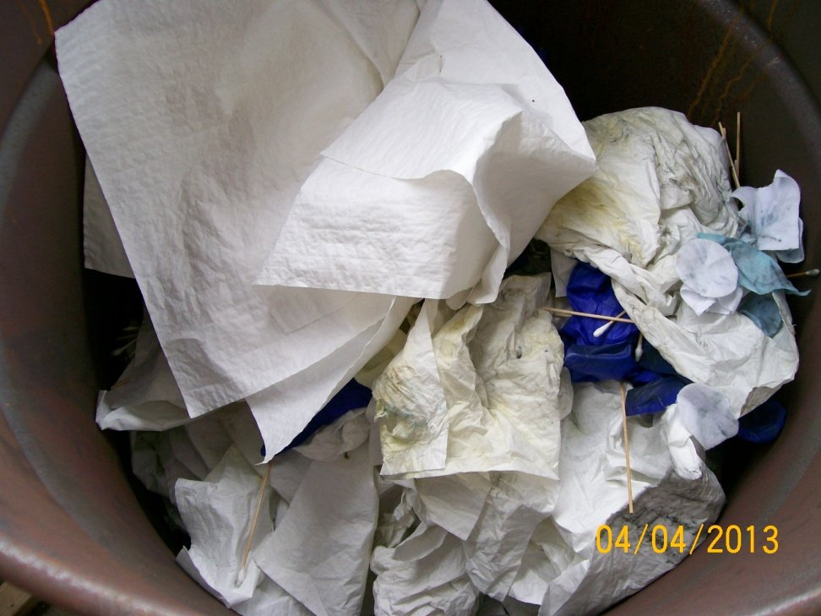
Reusable vs. Disposable Wipes
The rule revises the definition of ‘Solid Waste’ to conditionally exclude solvent-contaminated wipes that are cleaned and reused [40 CFR 261.4(a)(26)].
The rule also revises the definition of ‘Hazardous Waste’ to conditionally exclude solvent-contaminated wipes that are disposable [40 CFR 261.4(b)(18)].
VS.
3

Slide 68
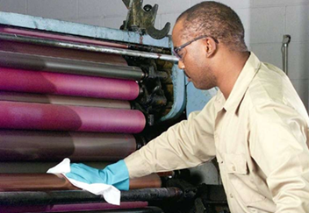
What is a Wipe?
The final rule provides a definition for ‘wipe’ and ‘solvent-contaminated wipe’ in 40 CFR 260.10.
Wipe means a woven or non-woven shop towel, rag, pad, or swab made of wood pulp, fabric, cotton, polyester blends, or other material.
5
Notes:
The Rule does not cover Tyvek suits.

Slide 69
Does it Apply to Your Wipes?
‘Solvent-contaminated wipe’ means
A wipe that, after use or after cleaning up a spill, either:
Contains one or more of the F001 through F005 solvents;
Exhibits a hazardous characteristic when that characteristic results from a listed solvent; or
Exhibits only the hazardous waste characteristic of ignitability due to the presence of solvents that are not listed.
Reusable
It is ok to have the solvent Trichloroethylene on rags going to a laundry.
Disposable
Wipes contaminated with Trichloroethylene must be managed as Hazardous Waste.
VS.
6

Slide 70
Does it Apply to Your Wipes? 1
Some of the most common F001-F005 solvents (not a complete list):
Xylene
Acetone
Methyl Isobutyl Ketone
Toluene
Methyl Ethyl Ketone
Trichloroethylene wipes are only eligible on a reusable wipe. Trichloroethylene contaminated wipes may not be disposed of in the trash.
7
Notes:
Pam & Vicky – is this interpretation correct? How are we handling paint with MEK where the MEK is “ingredients in the formulation of commercial chemical products” RO 13257, 12/31/1985 Federal Register

Slide 71
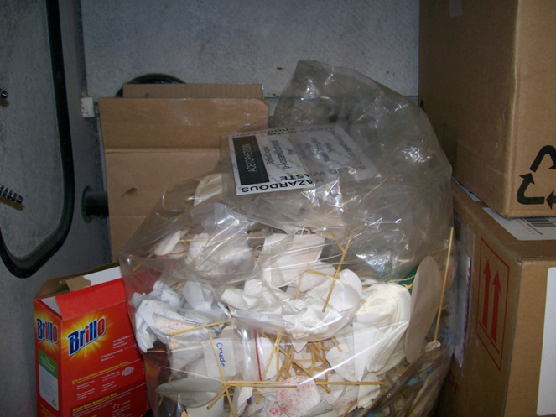
Are you Sure it Applies to Your Wipes?
Solvent-contaminated wipes that contain listed hazardous waste other than solvents, or exhibit the characteristic of toxicity, corrosivity, or reactivity due to contaminants other than solvents, are not eligible for the exclusion.
Wipes contaminated with heavy metals above TCLP levels must be managed as Hazardous Waste, for example:
D006 Cadmium 1.0 mg/L
D007 Chromium 5.0 mg/L
D008 Lead 5.0 mg/L
D011 Silver 5.0 mg/L
8

Slide 72
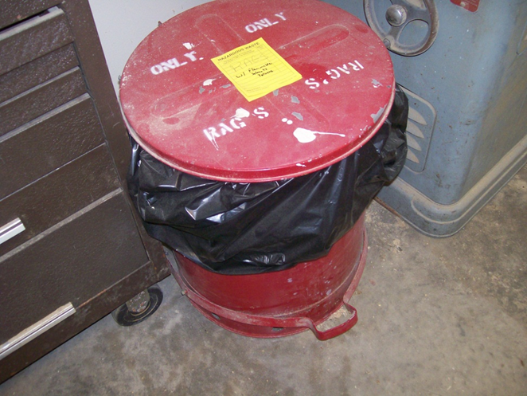
Storage Requirements - Container
The rule uses a performance-based standard, rather than specifying types of containers.
Solvent-contaminated wipes must be accumulated, stored, and transported in non-leaking, closed containers.
The containers must be able to contain free liquids, if they occur (for example, from compression of the wipes).
Containers do not need to be sealed during accumulation (must be closed except when adding or removing wipes).
A container must be sealed when the container is full, when the wipes are no longer being accumulated, and during transportation.
10

Slide 73
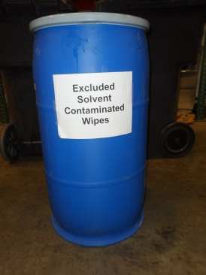
Storage Requirements – Container 1
Standard is performance-based; facilities have flexibility in determining how to meet the standard.
Wipes accumulated in an open-head drum or
container would be considered closed when
the cover makes complete contact between
the fitted lid and the rim.
After accumulation and during transport, this same container must be sealed to meet this standard; thus, the rings must be clamped or bolted to the container.
Note, these examples are consistent with EPA's closed container guidance (RCRA online 14826,12/3/09 and 11/3/11).
11

Slide 74
Storage Requirements – Container 2
Open
Closed
12

Slide 75
Storage Requirements – Container 3
Open
Closed
133

Slide 76
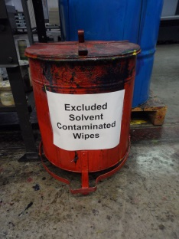
Storage Requirements – Container 4
Examples that may meet the standard:
Containers with covers opened by a foot
pedal (e.g., flip-top or spring-loaded lid) or
with a self-closing swinging door; or
Bags can be used, provided they meet
the standard (i.e., the neck of the bag is
tightly bound and sealed, the bag is able to contain liquids, and is non-leaking).
Examples that do not meet the standard:
Bags leaving a trail of liquid on the ground; and
Cardboard boxes.
14

Slide 77
Storage Requirements – Labeling 5
Containers of solvent-contaminated wipes must be labeled “Excluded Solvent-Contaminated Wipes.”
Containers must be labeled during accumulation, storage, and transportation.
Any free liquids found by handling facilities must be removed and managed as hazardous waste.
15

Slide 78
Accumulation Time Limits
Solvent-contaminated wipes may be accumulated by the generator for up to 180 days from the start date of accumulation for each container.
Generators must keep documentation that the 180-day accumulation time limit is being met.
Reusable
You can use receipts from the laundry service to demonstrate a shipment every 180 days.
Disposable
Consider documenting accumulation time by dating the container or maintaining a log.
VS.
16

Slide 79
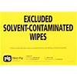
Transporting - Labeling
Remember…storage/labeling requirements continue to apply during transport.
17

Slide 80
Transporting – No Free Liquids
The Heart of the Rule
Solvent-contaminated wipes may not contain free liquids at the point of being sent for cleaning on-site or sent off-site for cleaning or disposal.
“No free liquids” is defined in 40 CFR 260.10 and is determined using the Paint Filter Liquids Test (Method 9095B in SW-846).
Paint Filter Liquids Test consists of placing a portion of the solvent-contaminated wipe into a paint filter, and if any of the material passes through and drops from the filter within five minutes, the material is deemed to contain free liquids.
Generators must document the process they are using to meet the “no free liquids” condition.
Free liquid spent solvent that is removed from the wipes is subject to hazardous waste regulation.
18

Slide 81
Recordkeeping
Generators must maintain the following documentation at their site:
Name and address of the destination facility (laundry, combustor, or landfill) that is receiving the solvent-contaminated wipes.
Documentation that the 180-day accumulation time limit is being met.
Could include a service contract specifying frequency of pick-up, a log that lists the start date of each container, or container labels with the start date.
Description of the process the generator is using to meet the “no free liquids” condition.
Description of technologies, methods, sampling, or knowledge that a generator is using to ensure wipes contain no free liquids at the point of transport.
19

Slide 82
Destination Facility
Reusable
Must be sent to a laundry or drycleaner whose discharge, if any, is regulated under sections 301 (effluent discharge restrictions) and 402 (permitting requirements) or section 307 (indirect discharge to a POTW) of the Clean Water Act.
Disposable
A combustor regulated under section 129 of the Clean Air Act or a hazardous waste combustor, boiler, or industrial furnace regulated under 40 CFR 264, 265, or 266 subpart H; or
A municipal solid waste landfill regulated under 40 CFR 258 or a hazardous waste landfill regulated under 40 CFR 264 or 265.
VS.
Do not dispose of wipes in C & D dumpsters.
820

Slide 83
It Doesn’t Apply to my Wipes, Now What?
The generator must make a hazardous waste determination as required in 40 CFR 262.11.
Non-hazardous waste wipes and shop towels may be disposed or sent to a drycleaner or laundry for cleaning and reuse.
Hazardous waste wipes and shop towels must be managed according to the applicable regulations in 40 CFR 260 through 270.
283

Slide 84
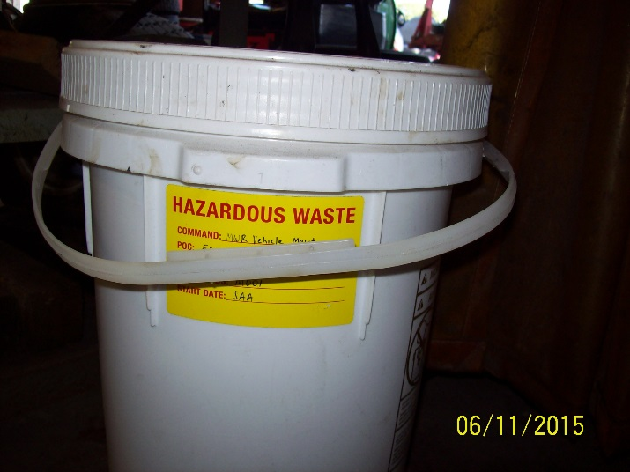
I Don’t Want it to Apply to my Wipes, Now What?
The generator must make a hazardous waste determination as required in 40 CFR 262.11.
Non-hazardous waste wipes and shop towels may be disposed or sent to a dry cleaner or laundry for cleaning and reuse.
Hazardous waste wipes and shop towels must be managed according to the applicable regulations in 40 CFR 260 through 270.
You may choose to manage your wipes as Hazardous Waste.
843

Slide 85
Documentation of Claims that Materials are Not Solid Waste or are Conditionally Exempt from Regulation
Documentation of claims that materials are not solid wastes - 40 CFR 261.2(f):
Respondents in actions to enforce regulations who raise a claim that a certain material is not a solid waste, or is conditionally exempt from regulation must:
Demonstrate the presence of a known market or disposition for the material
Demonstrate that they meet the terms of the exclusion or the exemption
Provide adequate documentation that:
The material is not a waste or is exempt from regulation
Recyclers/reclaimers must show they have the necessary equipment to recycle the material

Slide 86
Definition of Solid Waste Flowchart
Notes:
10 step process, but some steps have multiple sub-steps.

Slide 87
Available Tools and Information
EPA Hazardous Waste Webpage
Definition of Solid Waste Decision Tool
A useful tool that has a ten-step process to help make HW determination and it can generate “Outcome” reports

Slide 88
Questions ?
Hazardous Waste Program
8800 Baymeadows Way West
Suite 100 Jacksonville, Florida 32256 (904) 256-1700 (904) 256-1588 fax

