Slide 1
Universal Waste – SQH Requirements

Slide 2
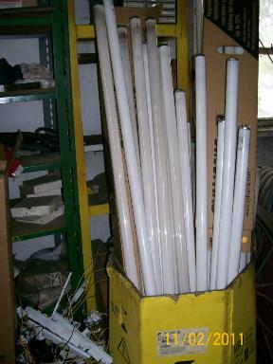
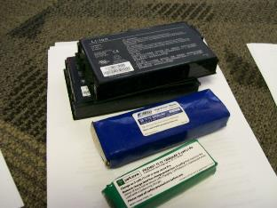
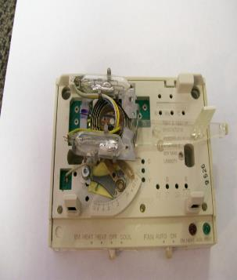
Universal Waste 1
Standards for Universal Waste Management
40 CFR 273.2-5

Slide 3
Universal Waste 2
40 CFR Part 273
Waste Batteries (40 CFR 273.2)
Waste Pesticides - “Suspended and Recalled Pesticides” (40 CFR 273.3)
Waste Mercury-Containing Devices (40 CFR 273.4)
Waste Mercury-Containing Lamps (40 CFR 273.5)
Rule 62-730.186, F.A.C.
Waste Pharmaceuticals (Universal Pharmaceutical Waste rule)
Rule 62-737, F.A.C.
Spent mercury-containing lamps and devices
Notes:
Each category has slightly different requirements

Slide 4
Universal Waste (UW) Handlers
Small Quantity Handler (SQHs) [40 CFR 273 Subpart B]
Does not accumulate 5,000 kilograms or more of universal waste (batteries, pesticides, mercury-containing equipment, or lamps) at any time
Not required to notify DEP or obtain an EPA ID number
Large Quantity Handlers (LQHs) [40 CFR 273 Subpart C]
Accumulates 5,000 kilograms or more of total universal waste (batteries, pesticides, mercury-containing equipment, or lamps) at any time
Designation is retained through the end of the calendar year
Required to notify DEP and obtain an EPA ID number
Note: If managed as UW, waste does not count towards HW generator status

Slide 5
Definitions and Basics
Batteries
Spent lead acid not managed under 40 CFR 266 subpart G
Hazardous waste batteries (those that exhibit a characteristic)
Mercury-Containing Devices
Device or part of a device that contains elemental mercury integral to its function
Excludes waste that is non-hazardous
Excludes equipment or devices where mercury-containing components have been removed (specific regulations cover removal)
Mercury-Containing Lamps
Bulb or tube portion of an electric lighting device
Excludes lamps that are not yet waste
Lamps that are not hazardous waste

Slide 6
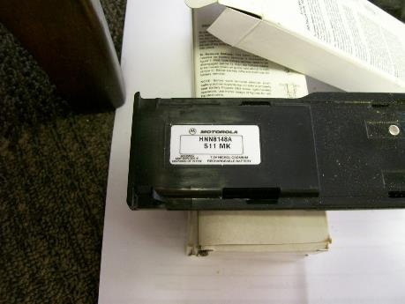
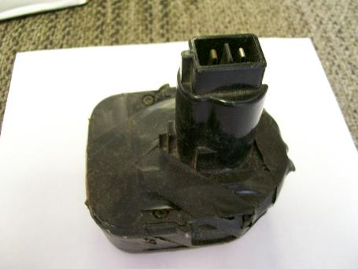
Examples of Universal Waste -Batteries

Slide 7
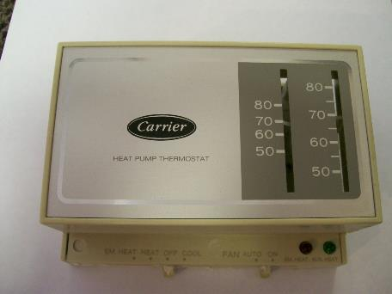
Examples of Universal Waste – Mercury-Containing Equipment

Slide 8
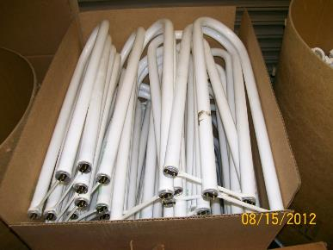
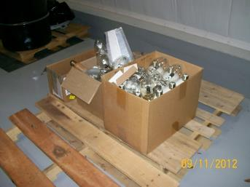
Examples of Universal Waste – Mercury-Containing Lamps
Notes:
Green tips do contain mercury!

Slide 9
Prohibitions
40 CFR 273.11
SQHs of universal waste may not
Dispose of the universal waste (cannot throw in solid waste trash or other means of disposal)
Treat or dilute universal waste, except by responding to a release

Slide 10
Notification
SQHs are not required to notify EPA of universal waste handling activities
40 CFR 273.12

Slide 11
Management
Battery Management (SQH)
40 CFR 273.13 (a) – Must be managed in a way to prevent release
Contain batteries that show signs of leakage
Container must be closed, sealed, and structurally sound
Compatible with the battery type and lack evidence of spillage or leakage
May conduct the following activities as long as each individual battery cell remains intact and closed:
Sort batteries by type
Properly discharge batteries
Regenerate used batteries
Properly remove and manage electrolyte (additional regulations apply)
Notes:
SQHs are not exempt from USDOT standards regarding battery shipments

Slide 12
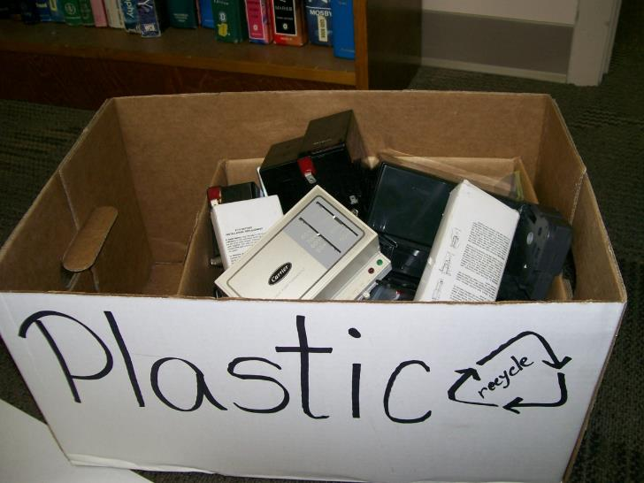
Improper Management 1
Notes:
They should not be comingled with other waste and other types of batteries.

Slide 13
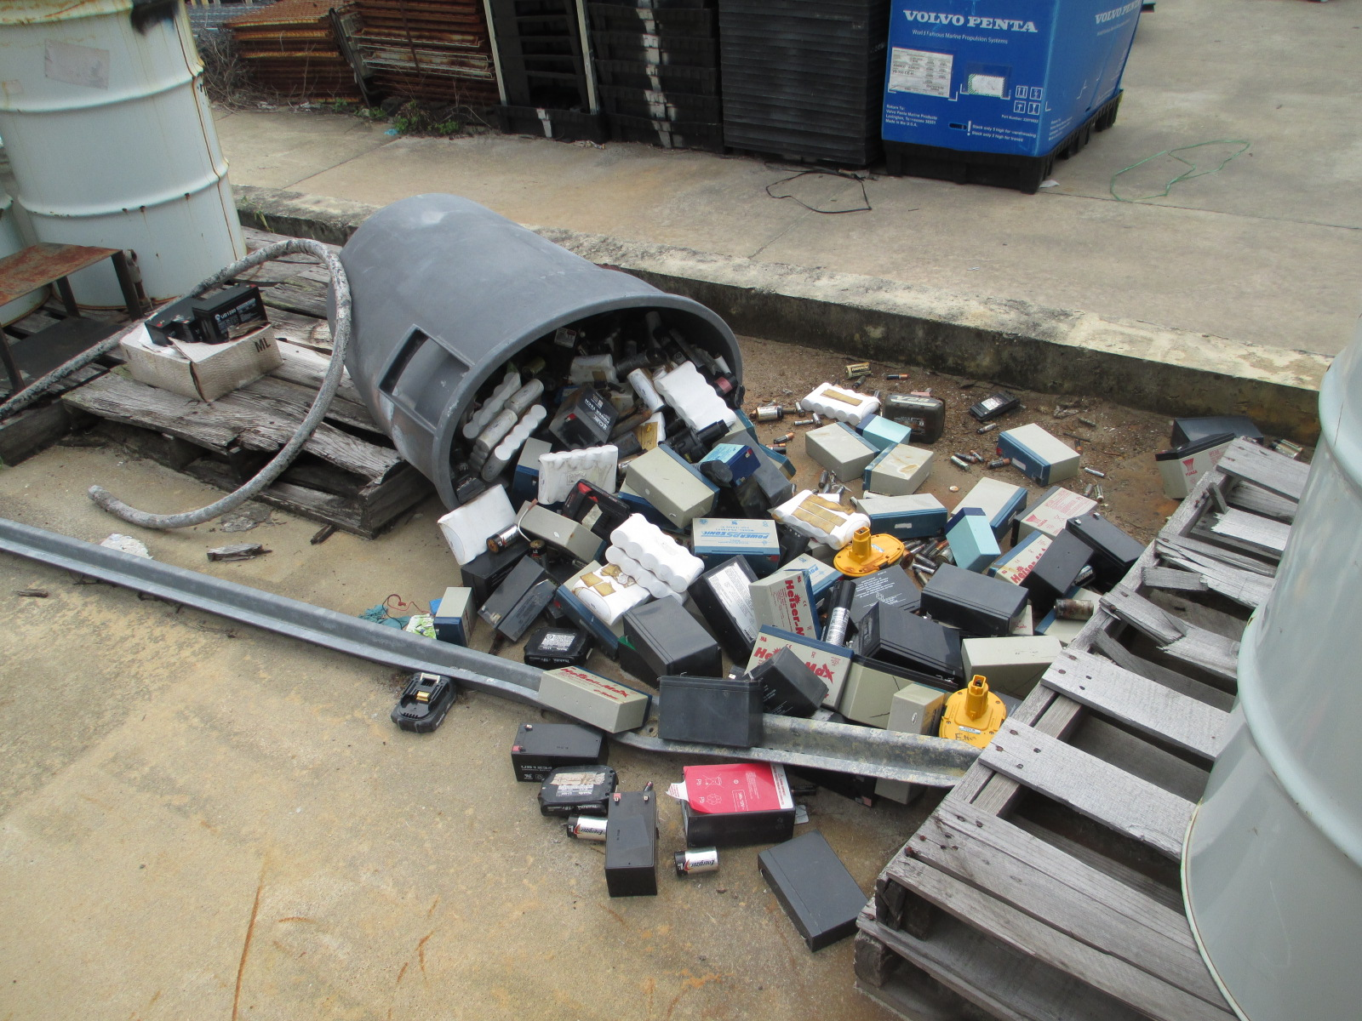
Improper Management 2
Notes:
This container had fallen over AFTER the pallet had rotted and they didn’t attempt to clean-up the UW spill.

Slide 14
Proper Management

Slide 15
Management 1
Mercury-Containing Equipment Management
40 CFR 273.13(c) – Must be managed in a way to prevent release
Contain equipment that shows evidence of leakage
Container must be closed, sealed, and structurally sound
Compatible with the equipment type and lack evidence of spillage or leakage
Must be reasonable capable of preventing release of mercury by any means
May conduct the following activities as long as mercury is not allowed to escape:
Remove and manage ampules
They are removed and managed in a proper manner
They are removed over or in a containment device
There is a mercury clean-up system in place
Spills are managed properly
It is ensured the area is well ventilated and monitored
Proper employee training is ensured
Removed ampules are stored in proper containers with adequate packing material
A hazardous waste determination will be performed on clean-up waste or equipment and then properly managed based upon the determination
Remove mercury from original housing (additional regulations apply)

Slide 16
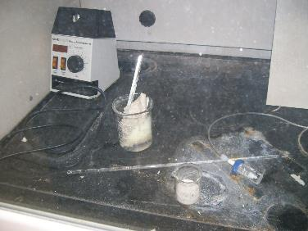
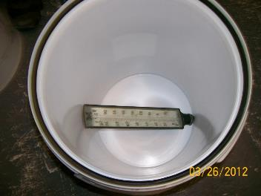
Improper Management 3
Notes:
Open containers and broken mercury thermometers. Also, note the thermostat mixed in with the batteries. This one has mercury ampules in it.

Slide 17
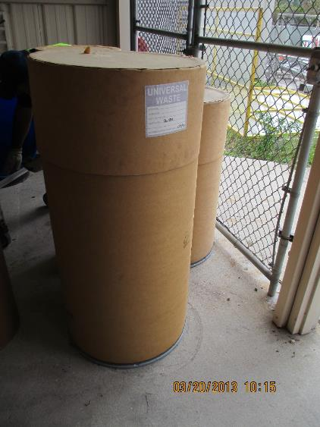
Proper Management 1
Notes:
Closed, properly labeled and dated container.

Slide 18
Management 2
Mercury Containing Lamps Management
40 CFR 273.13(d) – Must be managed in a way to prevent release
Contain ANY lamp (leaking or non-leaking)
Container must be closed, sealed, and structurally sound to prevent breakage
Compatible with the lamp type and lack evidence of spillage or leakage
Must be reasonable capable of preventing release of mercury by any means
Must immediately clean up and place into a container any lamp that is broken or shows signs of leakage

Slide 19
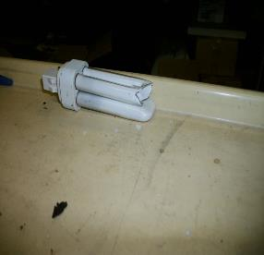
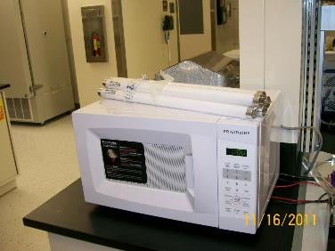
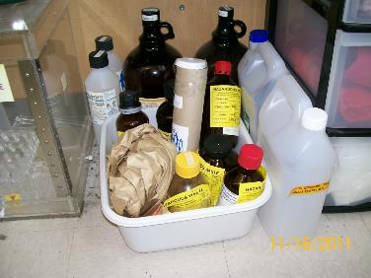
Improper Management 4
Notes:
Bulbs not in a container, a broken bulb in a paper towel, and a broken bulb on a cart are examples of improper management.

Slide 20
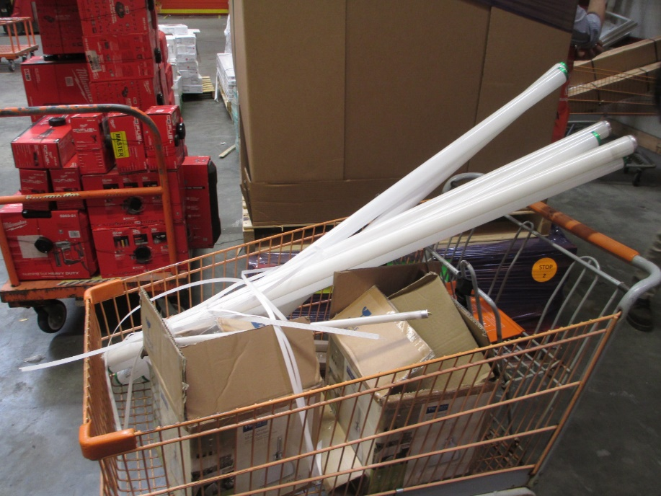
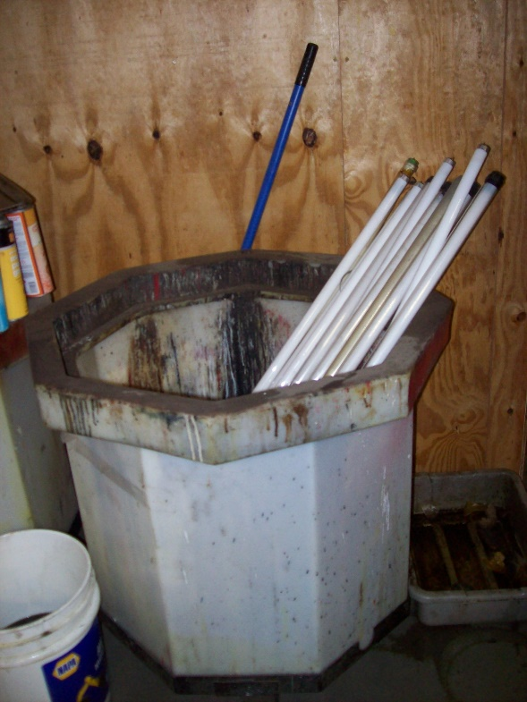
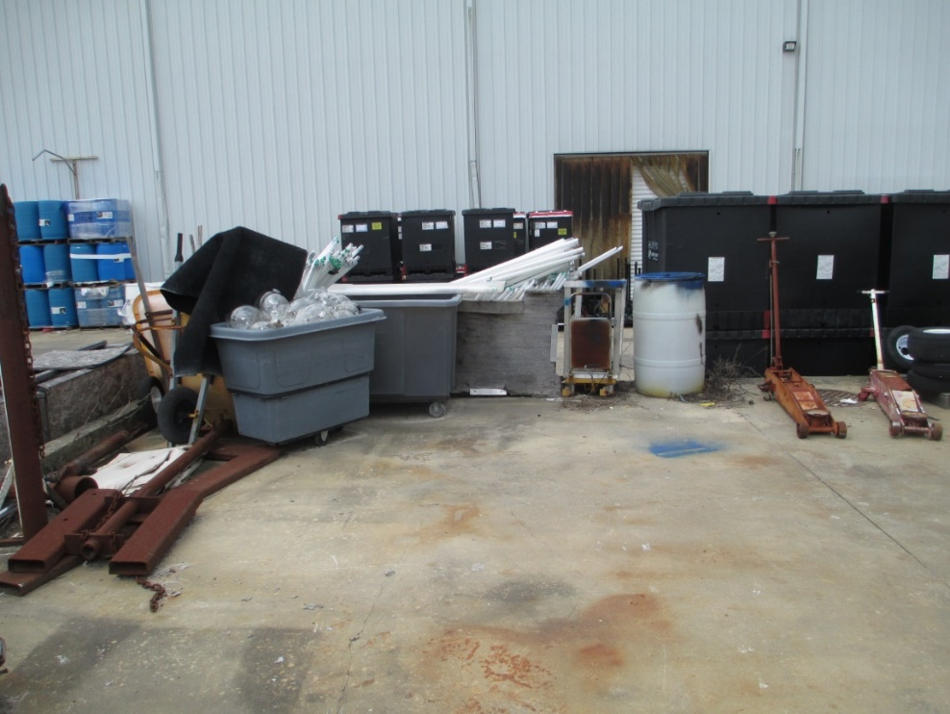
Improper Management 5
Notes:
Bulbs not in a container, broken bulbs on the ground are examples of improper management.

Slide 21
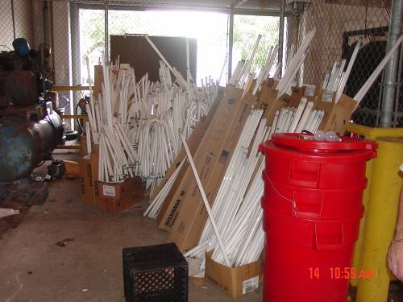
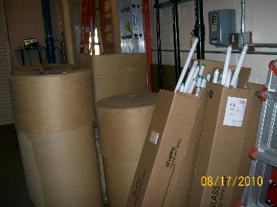
Improper Management 6
Notes:
Bulbs not in closed, properly labeled and dated containers.

Slide 22
Proper Management 2
Notes:
Closed, properly labeled and dated containers.
The facility may want to store these on their sides, however, because they could fall over and the lamps inside may break.

Slide 23
Labeling 1
Batteries
SQHs – 40 CFR 273.14(a)
“Universal Waste–Battery(ies)”
“Waste Battery(ies)”
“Used Battery(ies)”
Mercury-Containing Equipment
SQHs – 40 CFR 273.14(d)
“Universal Waste–Mercury-Containing Equipment”
“Waste Mercury-Containing Equipment”
“Used Mercury-Containing Equipment”
If container contains ONLY thermostats, may replace “Mercury-Containing Equipment” with the word “Thermostats”
Mercury-Containing Lamps
SQHs – 40 CFR 273.14(e)
“Universal Waste Mercury-Containing Lamps”
“Waste Mercury-Containing Lamps”
“Used Mercury-Containing Lamps”

Slide 24
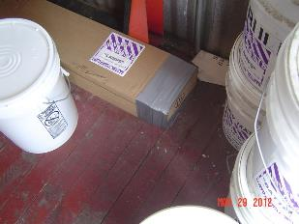
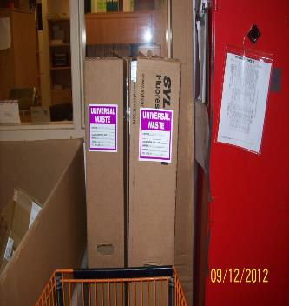
Labeling 2
Notes:
Closed, properly labeled and dated containers.

Slide 25
Accumulation Time Limit 1
SQHs may accumulate universal waste for no longer than one year [40 CFR 273.15 (a - c)]
May accumulate longer IF accumulation is solely for the purposes of accumulation of such quantities necessary to facilitate proper recovery, treatment, or disposal (handler bears burden of proof)
Must be able to demonstrate length of accumulation time
Marking or labeling container
Marking or labeling each individual item
Maintaining an inventory system
Marking the accumulation area
Any other method which clearly demonstrates the length of accumulation

Slide 26
Accumulation Time Limit 2
Notes:
This waste had been accumulating for longer than one year.

Slide 27
Personnel Training 1
SQHs - All employees that handle UW should be trained in the proper handling and emergency procedures appropriate to the type of UW at the facility
40 CFR 273.16

Slide 28
Personnel Training 2
Notes:
Personnel training might be cited if employees intentionally break or dispose of spent bulbs.

Slide 29
Response to Release
SQHs must:
Immediately contain releases
Perform a hazardous waste determination on residues from releases and properly manage residues
40 CFR 273.17 (a and b)

Slide 30
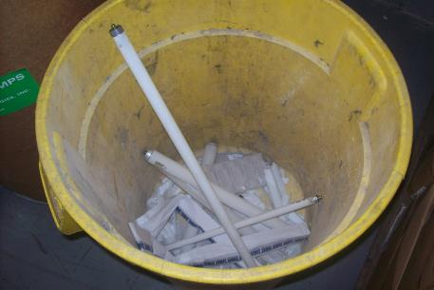
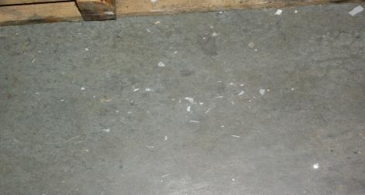
Improper Response to Release
Notes:
Broken bulbs should be managed in closed, properly labeled and dated containers.

Slide 31
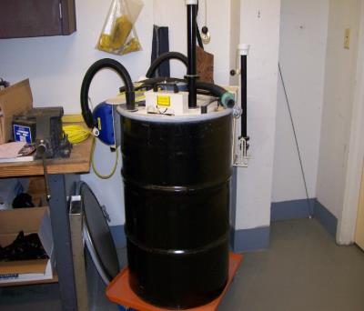
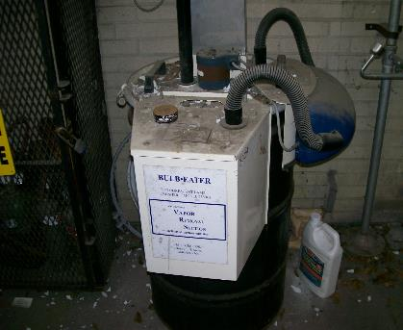
Lamp Crushers
A side note…
Lamp crushers should remain closed when not in use
Area around crusher should be monitored for release, and all releases should be immediately responded to
Notes:
Make sure bulb crusher is closed, that the filter receives proper maintenance, and that there is no broken glass on the floor around or on top of the bulb crusher. The bulb crusher should be one that is purchased. Be wary of home-made bulb crushers.
62-737.400(6), FAC – Also be reminded that we don’t allow them for anyone except the generator and a permitted destination facility. Improper maintenance may expose the employee to mercury.
Crushed lamps are still regulated, as the filter does not make the crushed lamps non-hazardous.

Slide 32
Off-Site Shipments
SQHs must:
Send UW only to a UW handler, destination facility, or foreign destination
May self-transport if complying with transporter requirements in subpart D
Comply with U.S. DOT requirements if UW is a hazardous material
Before shipment, ensure that it will be received
Rejection of shipment
If shipment is rejected, receive it back or ship to another destination facility
If rejecting a shipment, contact originating handler, ship to originating handler or to another destination facility
If shipment received is hazardous waste and not UW, notify EPA/DEP
If shipment received is non-hazardous, but not UW, the waste may be managed appropriately
40 CFR 273.18 (a – h)

Slide 33
Tracking Shipments
SQHs are not required to keep record of shipments
40 CFR 273.19
Notes:
However, pursuant to 40 CFR 261.2(f), you may ask a generator to show that he is managing the waste in accordance with an exclusion, and submit documentation of that.

Slide 34
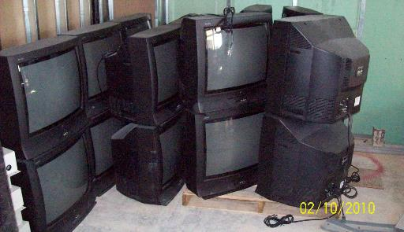
Electronic Waste
E-waste is the term used to describe end-of-life electronics
Computers and televisions are specifically targeted for recycling because of the high levels of lead found in their cathode ray tubes (CRTs)
Notes:
E-waste is not included in the list of universal wastes at this time. We have chosen not to regulate e-waste demanufacturing operations as hazardous waste management facilities. However, many of these products contain universal waste lamps, mercury switches, universal waste batteries, as well as other conditionally excluded materials such as cathode ray tubes and printed circuit boards. Collectors and demanufacturers should manage these items properly.

Slide 35
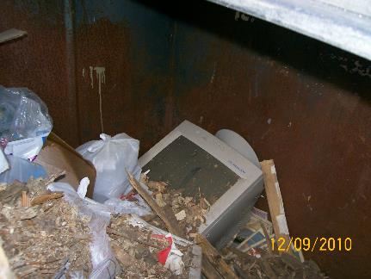
Improper Management – E-Waste
Notes:
Electronic waste may be hazardous waste due to elevated levels of heavy metals. CRTs in the trash is usually cited as improper disposal of hazardous waste due to the lead content of the glass.
These items should be properly recycled.

Slide 36
Questions ?
Hazardous Waste Program
8800 Baymeadows Way West
Suite 100 Jacksonville, Florida 32256 (904) 256-1700 (904) 256-1588 fax

