Slide 1
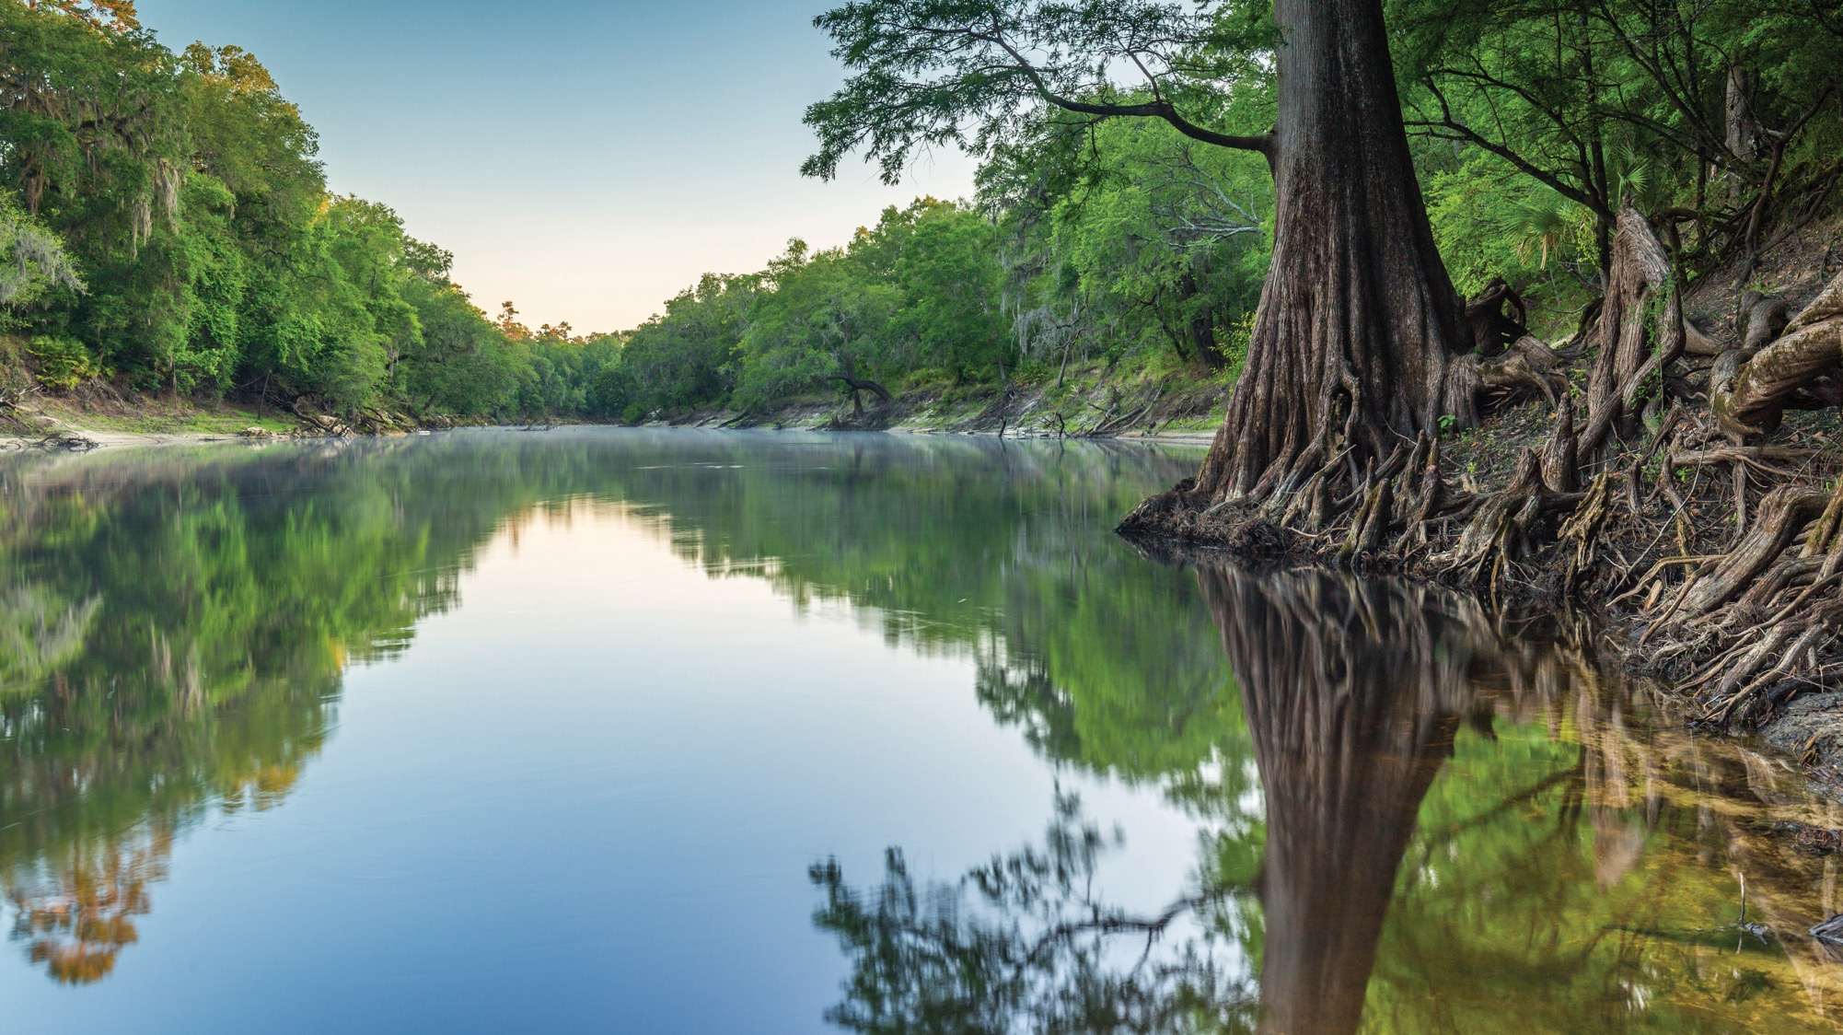
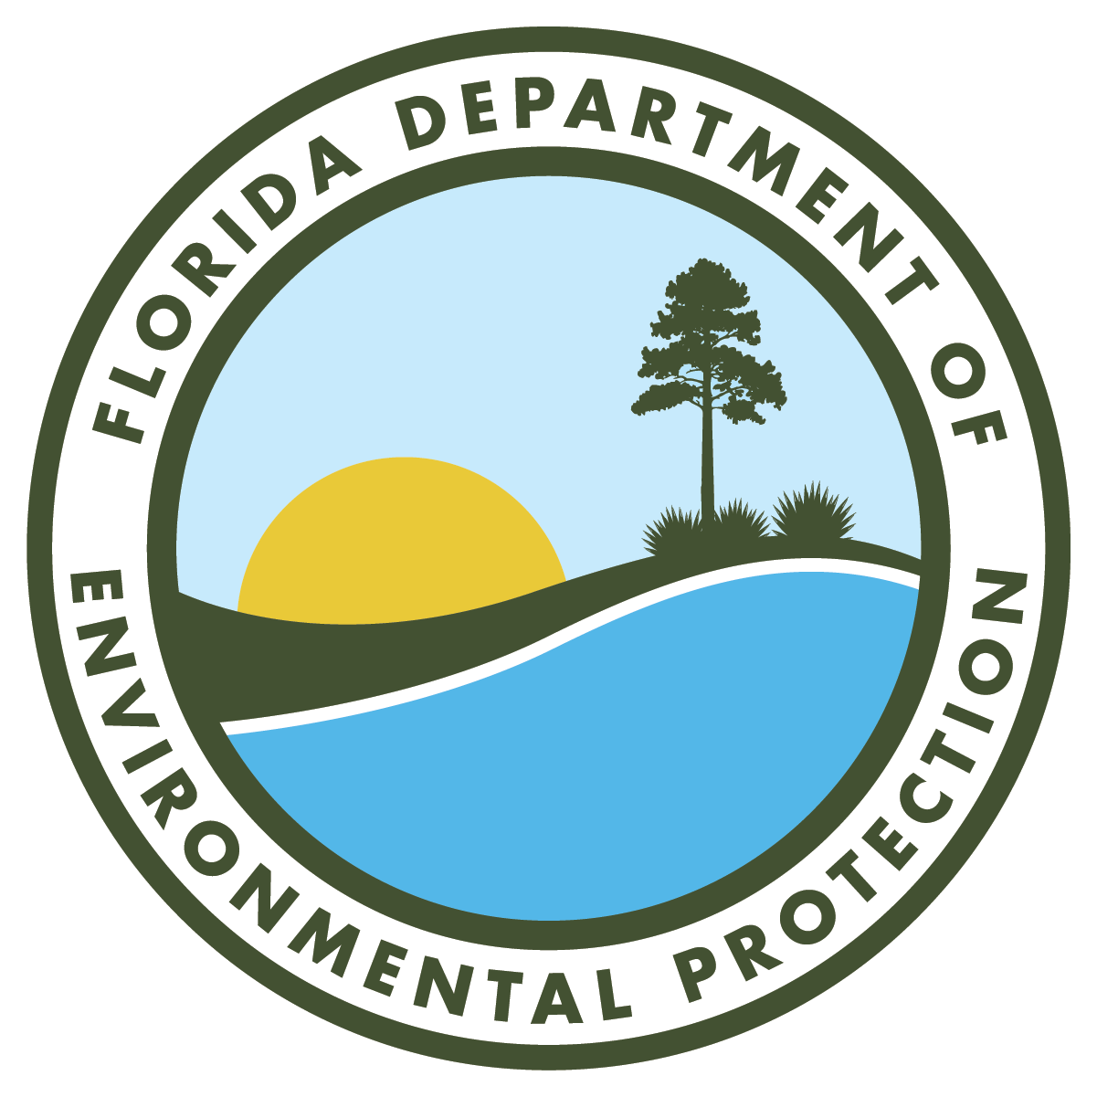
WETLAND DREDGE AND FILL PERMITTING PROJECTS
WETLAND DREDGE AND FILL PERMITTING PROJECTS
Khristian Mangahas
Environmental Manager
Regulatory Programs/Environmental Resource Permitting
Florida Department of Environmental Protection
Jacksonville, FL | Oct. 15, 2025

Slide 2
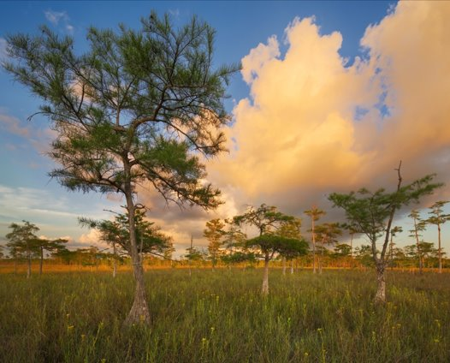
SLERC PROGRAM
The Submerged Lands and Environmental Resources Coordination Program (SLERC) is responsible for the implementation of the state’s Environmental Resource Permitting.
SLERC regulates activities in, on or over surface waters or wetlands, as well as any activity involving the alteration of surface water flows.
SLERC implements the environmental permitting criteria to ensure there is no net loss in wetland and other surface water functions.

Slide 3
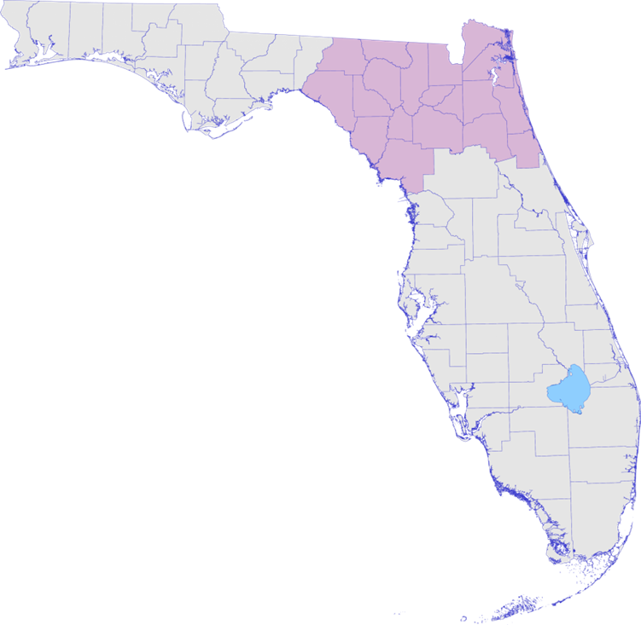

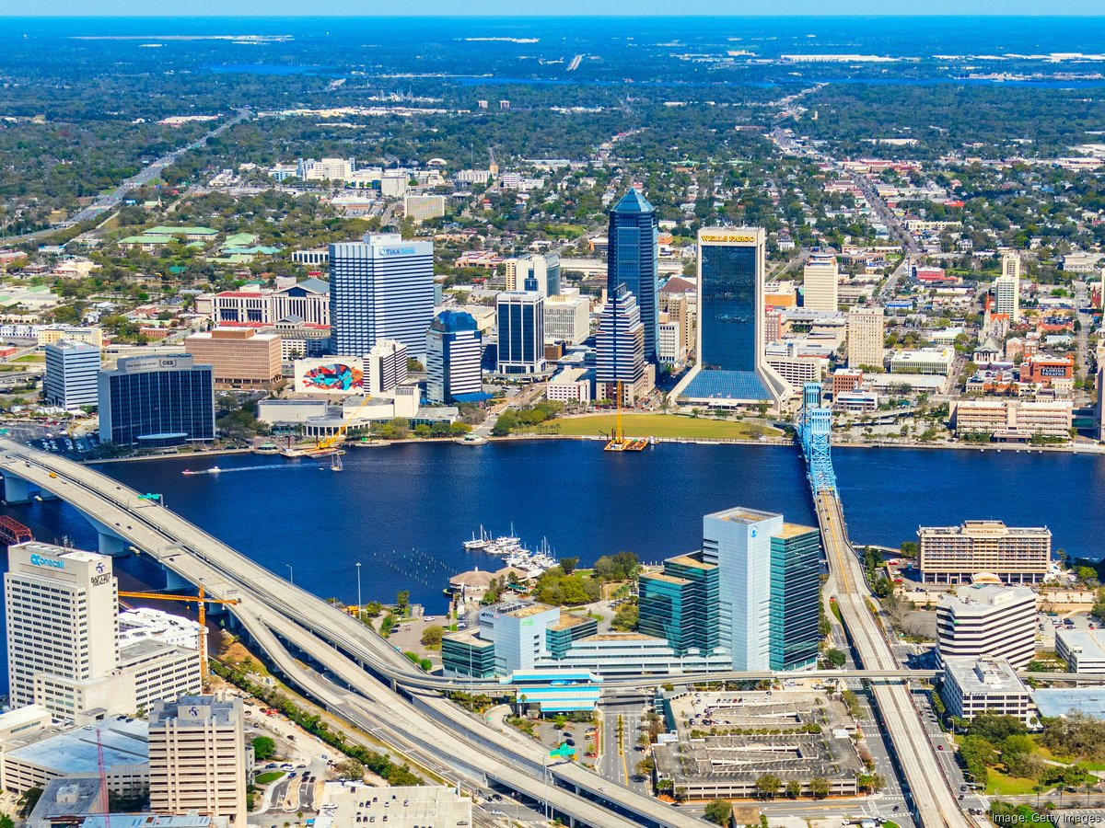

REGULATORY DISTRICTS
Central District – Orlando.
Southeast District – West Palm Beach.
South District – Fort Myers.
Southwest District – Temple Terrace (Tampa).
Northeast District – Jacksonville.
Northwest District – Pensacola.
Photo credit: FDEP/Jacksonville Business Journal
FloridaDEP.gov/Northeast
Notes:
Headquartered in Tallahassee
The Northeast District encompasses the largest land mass of any department regulatory district. Consisting of 19 counties, the area includes portions of the Atlantic coastal plain and regions bordering the Gulf of Mexico and the state of Georgia.
The district has more rivers than any other district including the St. Johns, Nassau, Tolomato Rivers, as well as the historic Suwannee and Santa Fe Rivers.
The District’s counties include Alachua, Baker, Bradford, Clay, Columbia, Dixie, Duval, Flagler, Gilchrist, Hamilton, Lafayette, Levy, Madison, Nassau, Putnam, St. Johns, Suwannee, Taylor and Union counties.

Slide 4
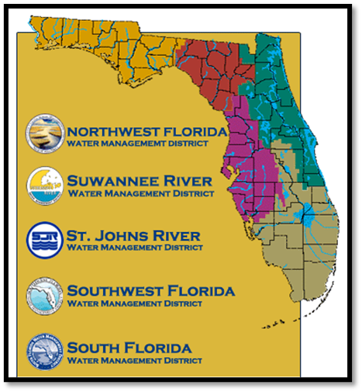
REGULATORY AUTHORITY
OPERATING AGREEMENT
The Environmental Resource Permitting (ERP) program is implemented by the Florida Department of Environmental Protection (DEP) and the state of Florida’s five water management districts (WMDs).
DEP:
Individual single-family residence (SFR).
Marinas not associated with other upland development.
Utilities.
Governmental dredging and other “in water” activities.
Associated sovereign submerged lands (SSL) authorization with the above.
WMDs:
Residential and commercial development.
Roads.
Agriculture.
Associated SSL authorization with the above.
Photo credit: FDEP/Water Management District

Slide 5
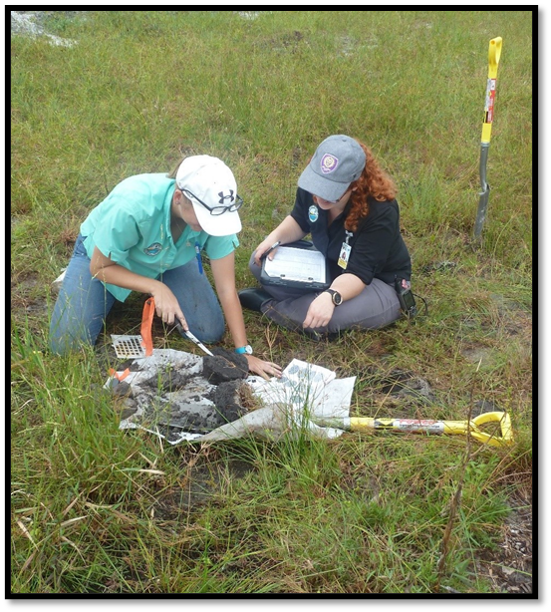
WHAT REQUIRES AN ENVIRONMENTAL RESOURCE PERMIT (ERP)?
Rule 62-330.020(2)(a), Florida Administrative Code (FAC)
“(2) … a permit is required prior to the construction, alteration, operation, maintenance, removal or abandonment of any new project that, by itself or in combination with an activity conducted after [October 1, 2013], cumulatively results in any of the following:
(a) Any project in, on or over wetlands or other surface waters"
Photo credit: FDEP

Slide 6
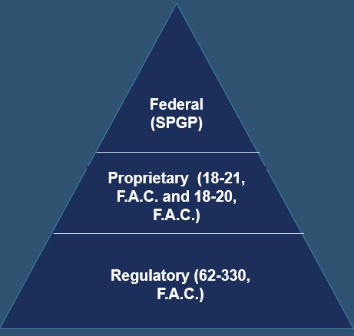
RULE REVIEW
WETLAND FILL PROJECTS
When an ERP application comes into the department, there are up to three authorizations that can be included in one permit, potentially making DEP a “one-stop shop”. ERP reviews can be broken down into:
Regulatory:
62-330 F.A.C. - all types of ERP permitting in, on or over wetlands or other surface waters.
62-340 F.A.C. – used for determinations of the landward extent of wetlands and other surface waters.
62-345 F.A.C. – sets forth the requirements of the Uniform Mitigation Assessment Method.
Proprietary/Federal:
Most wetland fill projects take place landward of Mean High-Water Line (MHWL) and/or do not qualify for federal authorization under SPGP.
Notes:
For the purposes of this training, we will primarily focus on the rule requirements associated with the Regulatory pillar as most wetland fill projects do not need proprietary and SPGP

Slide 7
RULE REVIEW
DREDGE PROJECTS
When an ERP application comes into the department, there are up to three authorizations that can be included in one permit, potentially making DEP a “one-stop shop”. ERP reviews can be broken down into:
Regulatory:
62-330 F.A.C. - all types of ERP permitting in, on or over wetlands or other surface waters.
Proprietary:
Rule 18-21 F.A.C. - construction over sovereign submerged state lands (SSL).
Easements – Written agreement with fees (not necessarily annual), generally for linear activities.
Federal:
Most dredge projects do not qualify for federal authorization under SPGP.
Notes:
For the purposes of this training, we will primarily focus on the rule requirements associated with the Regulatory pillar as most wetland fill projects do not need proprietary and SPGP
Note – Industrial projects would typically go through the easement process.

Slide 8
PERMITTING FOR WETLAND FILL AND DREDGE PROJECTS

Slide 9
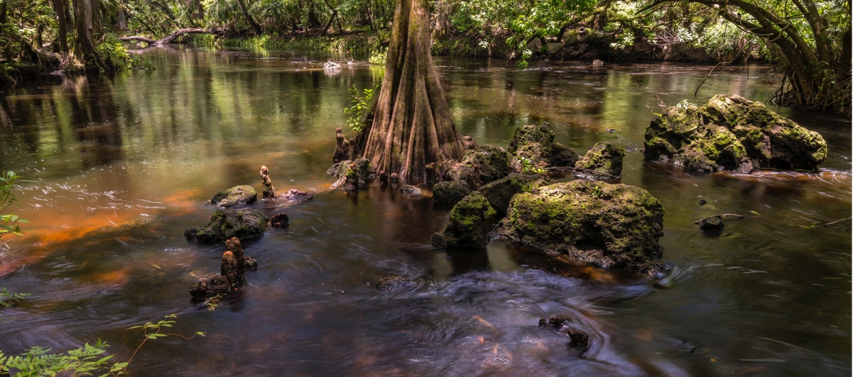
WETLANDS
Wetlands are protected because they:
Support a rich web of life.
Provide food and shelter for fish, birds and other animals.
Offer shoreline protection and buffers for wildlife.
Provide flood control by soaking up rainwater.
Filter out pollutants that degrade water quality.
Provide community recreational opportunities.
The dredging and/or filling in wetlands and other surface waters is a regulated activity.
To further clarify and standardize the definition, a methodology for identifying and delineating wetlands is provided in Rule 62-340, F.A.C.
Certified wetland evaluators are regulatory staff who have registered and received training to conduct wetland delineations.

Slide 10
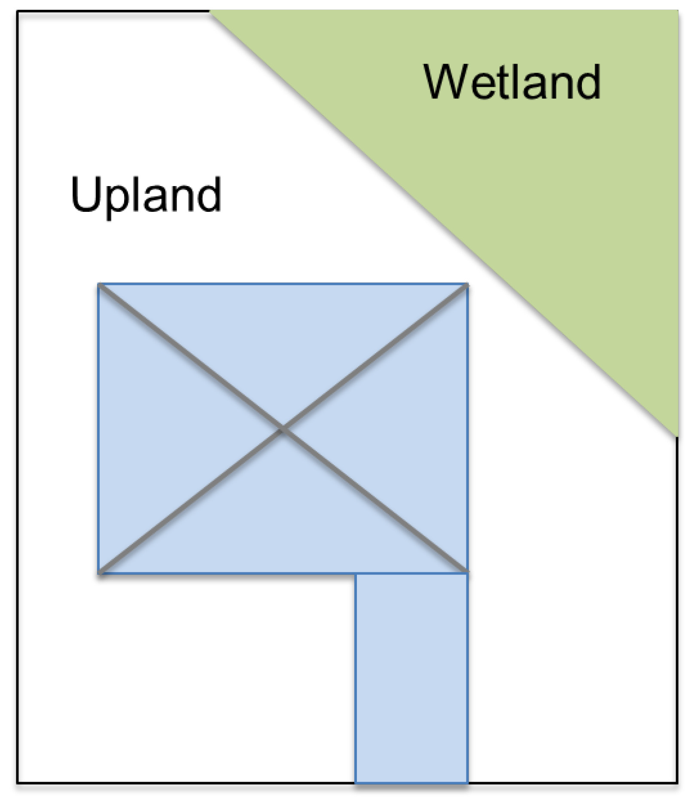
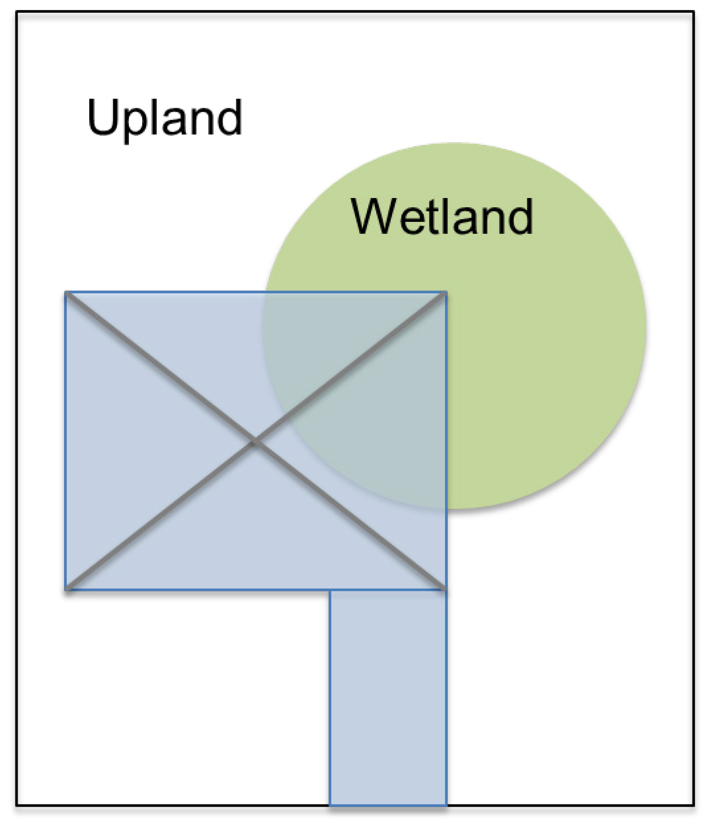
APPLICATIONS AND PERMITTING FOR WETLANDS
Exempt Activity:
No permit is required.
No wetlands impacted or lost due to dredging and filling activities.
$100 fee for DEP to verify.
General Permit Required:
Impacting less than 4,000 square feet of isolated wetlands or less than 100 square feet of connected wetlands
No mitigation required.
$250 fee.
Notes:
Before purchasing a property there isn’t a guaranteed way to determine if there are wetlands or not. The DEP regulatory offices operates by working with current property owners who have applied for a project. Once someone has applied for exemption or permit the department can then conduct a site inspection and determine if there are wetlands.
Khristian to highlight isolation terminology

Slide 11
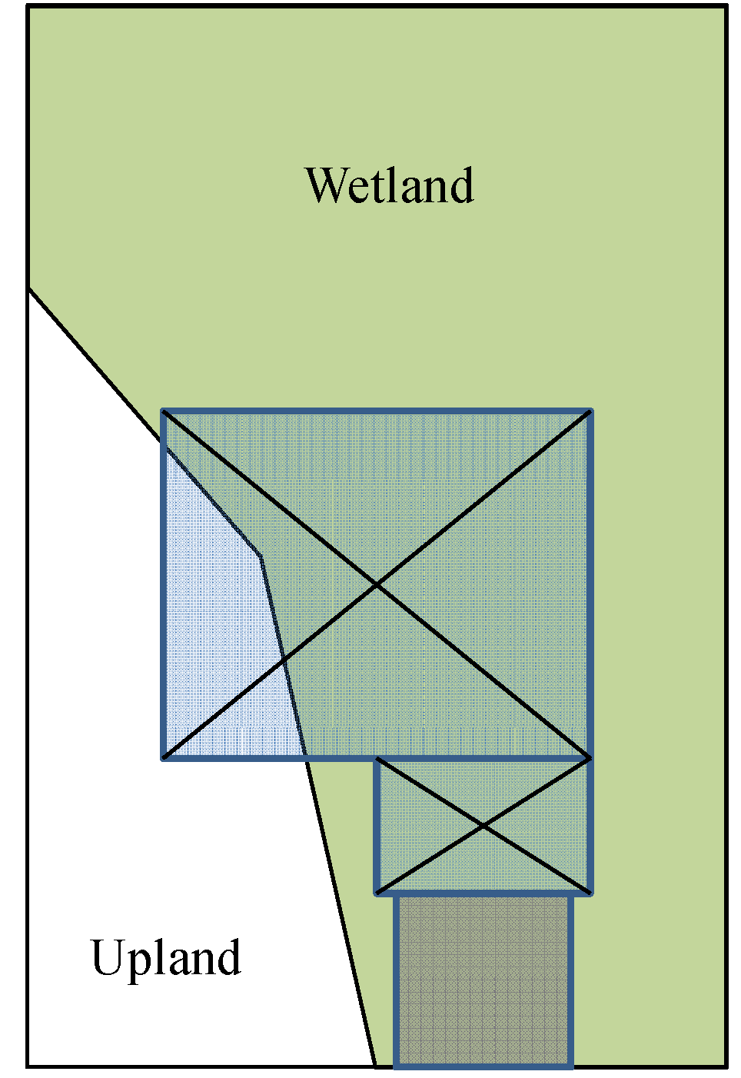
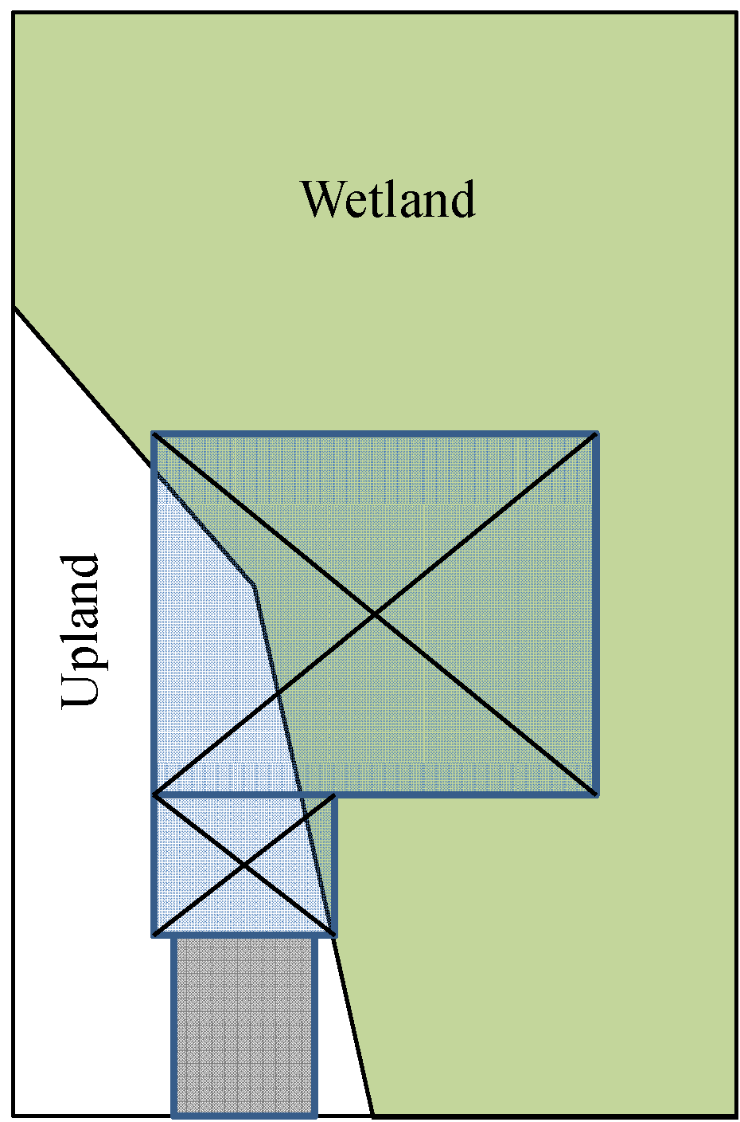
APPLICATIONS AND PERMITTING FOR WETLANDS
ELIMINATION AND REDUCTION
Individual Permit Required:
Impacting wetlands.
Mitigation is required.
$420 fee (less than one acre)
$320 is using e-permitting.
Elimination & Reduction Utilized:
Final proposal: modified to reduce wetland impact.
Fill for house pad only. Reduced amount of mitigation required.
Notes:
Before purchasing a property there isn’t a guaranteed way to determine if there are wetlands or not. The DEP regulatory offices operates by working with current property owners who have applied for a project. Once someone has applied for exemption or permit the department can then conduct a site inspection and determine if there are wetlands.

Slide 12
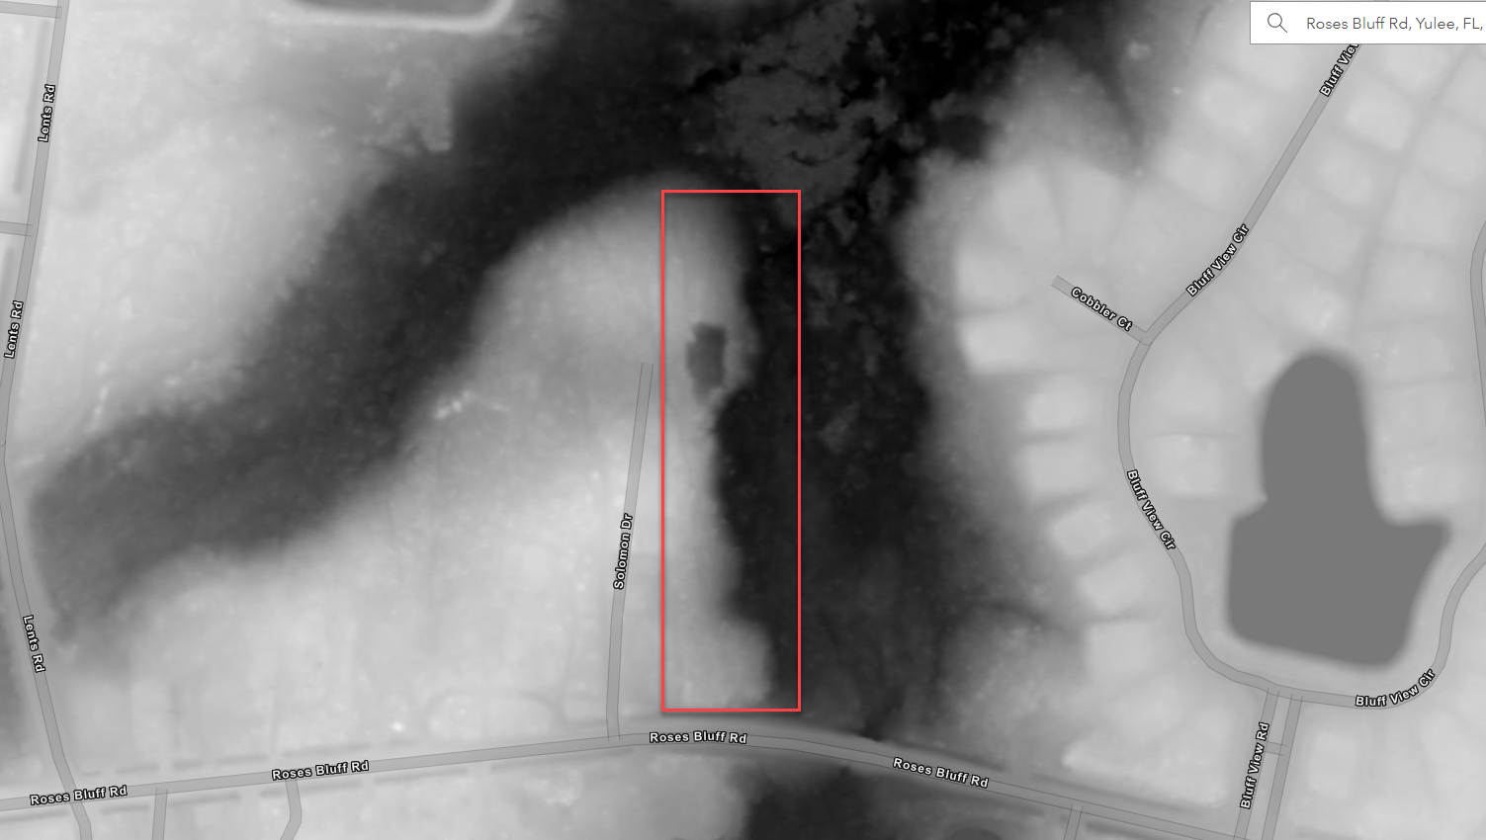
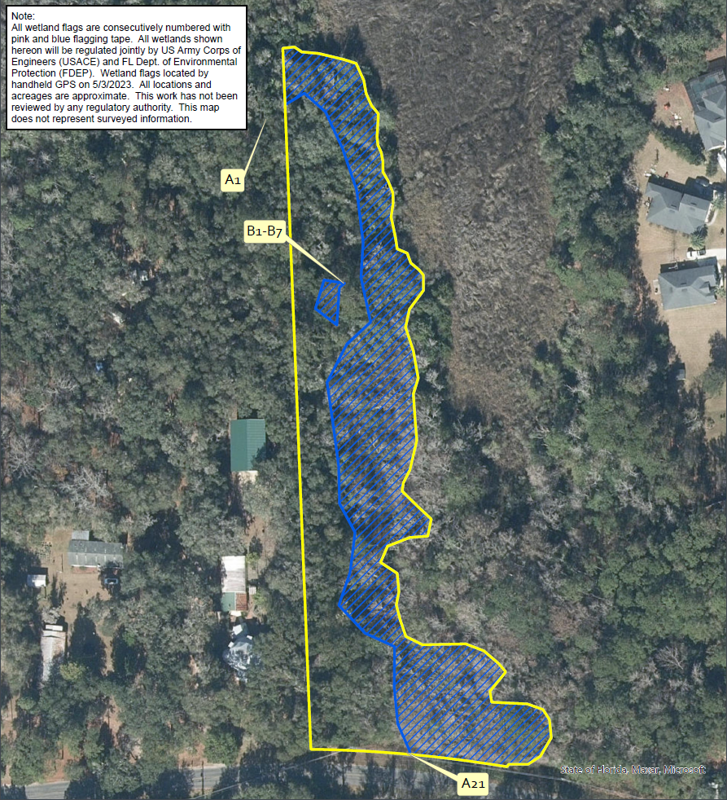
APPLICATIONS AND PERMITTING FOR WETLANDS
ISOLATED WETLANDS
950 sq ft
General Permit Example:
No mitigation is required for impacting less than 4,000 square feet of isolated wetlands.
Staff will conduct a combination of desktop review and field methodologies to verify this.
Notes:
Before purchasing a property there isn’t a guaranteed way to determine if there are wetlands or not. The DEP regulatory offices operates by working with current property owners who have applied for a project. Once someone has applied for exemption or permit the department can then conduct a site inspection and determine if there are wetlands.
Khristian to highlight isolation terminology

Slide 13
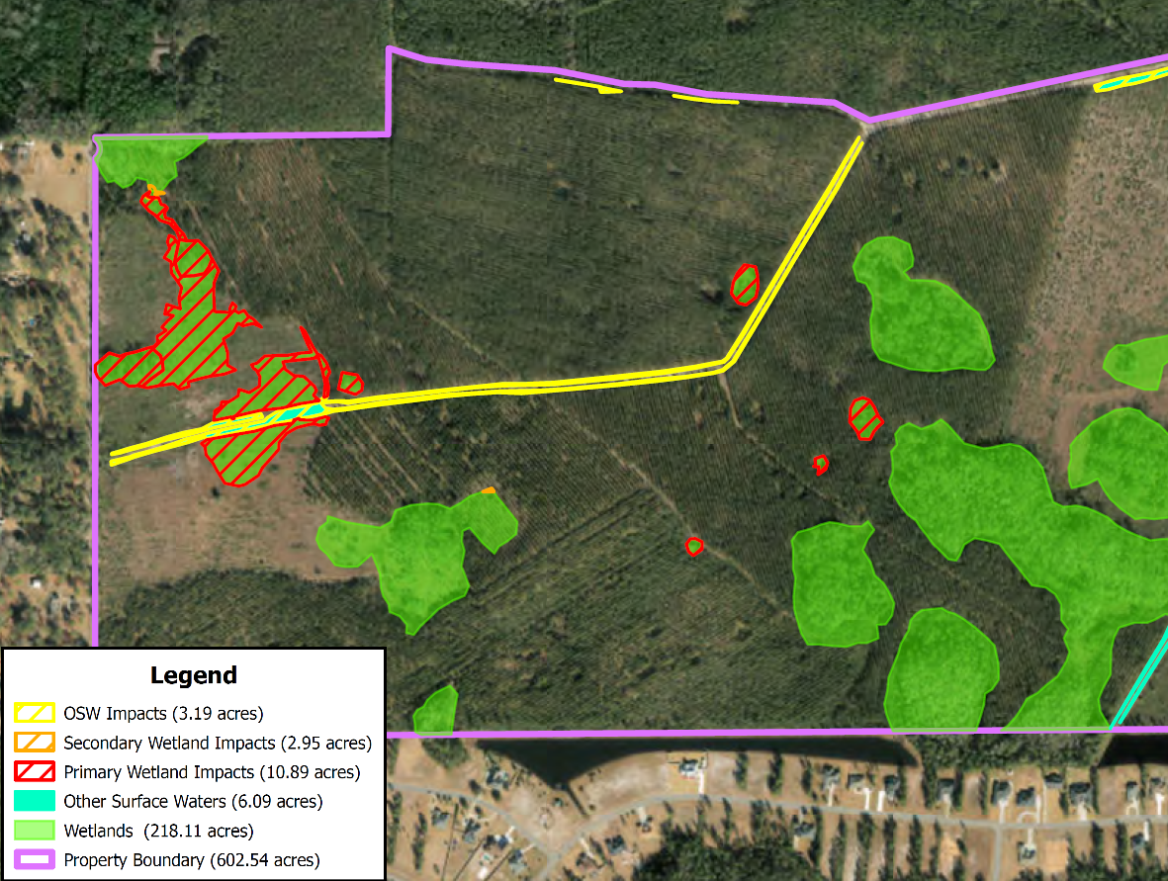
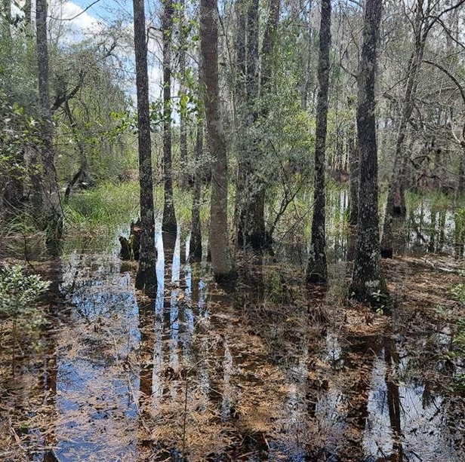
APPLICATIONS AND PERMITTING FOR WETLANDS
ISOLATED WETLANDS
Individual Permit Example:
Mitigation is required for isolated wetlands that are any of the following:
Impacts greater than ½ acre.
High value to fish and wildlife.
Mitigation not required for:
Less than ½ acre and low quality.
Mitigation required for:
Less than ½ acre and high quality.
Greater than ½ acre.
Notes:
Before purchasing a property there isn’t a guaranteed way to determine if there are wetlands or not. The DEP regulatory offices operates by working with current property owners who have applied for a project. Once someone has applied for exemption or permit the department can then conduct a site inspection and determine if there are wetlands.
Khristian to highlight isolation terminology

Slide 14
MITIGATION & PERMITTING FOR WETLANDS
Individual Permits and Mitigation
Wetland mitigation or compensatory mitigation: a wetland enhancement, restoration, creation and/or preservation project that serves to offset unavoidable wetland impacts. The ecological benefits of a mitigation project should compensate for the functional loss resulting from the permitted wetland impact.
The Uniform Mitigation Assessment Method (UMAM) provides a standardized procedure for assessing the ecological values and functions of wetlands and other surface waters. Compensatory mitigation activities may include, but are not limited to, on-site mitigation, off-site mitigation, regional off-site mitigation areas and the purchase of mitigation credits from permitted mitigation banks.
Reducing Costs: Elimination and Reduction methods.
Less impact, less mitigation, less expensive.
Notes:
The bank is the site itself, and the currency sold by the banker to the impact permittee is a credit, which represents the wetland ecological value equivalent to the complete restoration of one acre. The number of potential credits permitted for the bank and the credit debits required for impact permits are determined by the permitting agencies.
Offsets the loss of wetland functions by improving existing wetlands within the area
•Restores
•Enhances
•Preserves
•Creates

Slide 15
APPLICATIONS AND PERMITTING FOR WETLANDS
CONTINUED
Are you a property owner with a planned project or activity?
Did the state, county or another party indicate that you may have wetlands on your property?
Apply for an exemption
DEP will conduct a site inspection following a wetland delineation conducted by an environmental consultant and process the application in 30 days.
Project will be verified exempt or verified not exempt.
Not exempt > withdraw and apply for a permit.
Apply for a permit
DEP will conduct a site inspection following a wetland delineation conducted by an environmental consultant and process the application.
Permit issued or denied.
Notes:
Before purchasing a property there isn’t a guaranteed way to determine if there are wetlands or not. The DEP regulatory offices operates by working with current property owners who have applied for a project. Once someone has applied for exemption or permit the department can then conduct a site inspection and determine if there are wetlands.

Slide 16
PERMITTING APPLICATION MATERIALS
Please include the following for wetland dredge or fill applications:
Application Forms
General permits: Notice of Intent to Use an Environmental Resource General Permit.
Individual permits: Section A, Section B (single-family projects), and/or Section C (non-single-family projects).
Stormwater design plans with all impervious/semi-impervious areas and control components (swales, culverts, etc.) with cross section(s) as applicable
Maps (preferred as georeferenced PDFs)
Elevation, via LiDAR or DEMs.
Soils.
Wetland boundary with points correlated to on-site stakes/flags.
Mitigation Proposal
UMAM Forms: Part I and Part II.
Wetland impact maps, i.e., secondary, permanent, temporary.
Wetland type maps, i.e., FLUCCs.

Slide 17
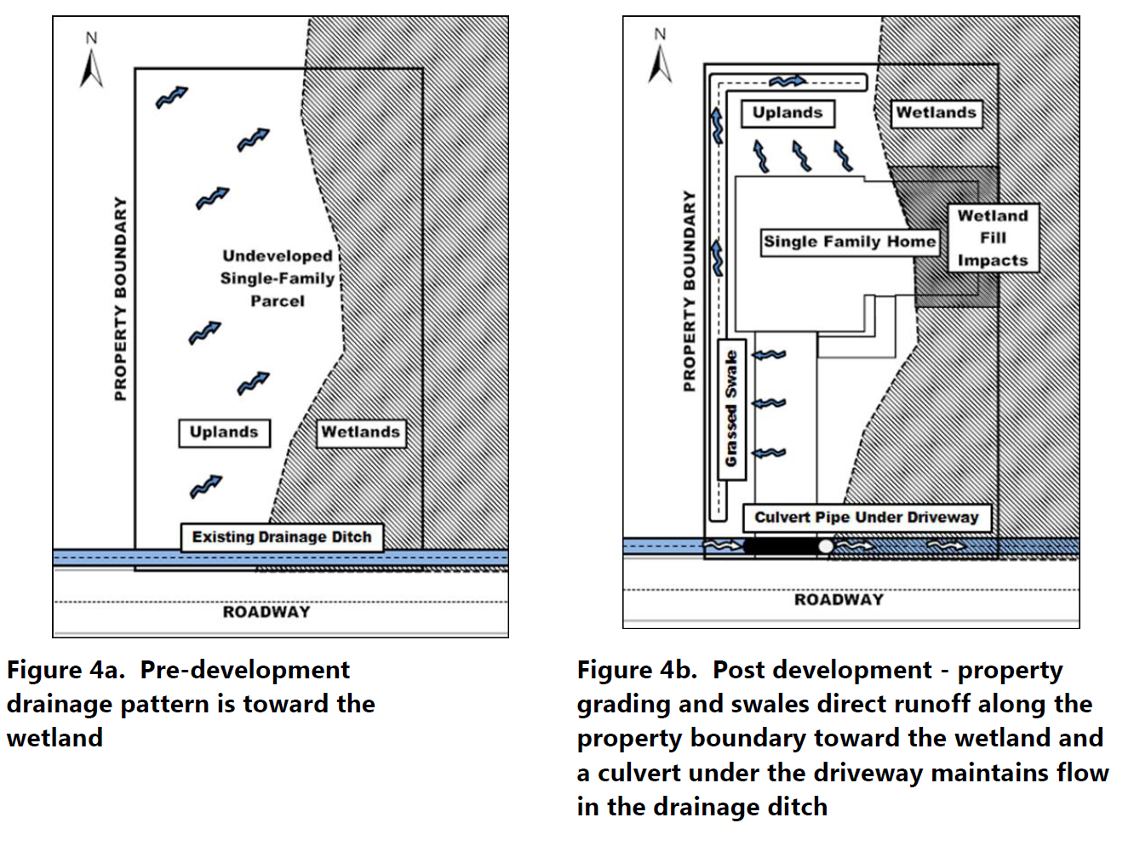
STORMWATER DESIGN
PERMITTING APPLICATION MATERIALS
Pre/Post Development Site Plans:
Plan View:
Stormwater flow directions.
Swales, French drains, culverts, etc.
Impervious/semi-impervious areas.
Multiple Cross Section Transects:
Native and proposed grade.
Swales, French drains, culverts, etc.
Impervious/semi-impervious areas.
Figures taken from "Design And Performance Guidance for an Individual Private, Residential Single-Family Residence Involving Dredging or Filling in Wetlands or Other Surface Waters"
Notes:
Before purchasing a property there isn’t a guaranteed way to determine if there are wetlands or not. The DEP regulatory offices operates by working with current property owners who have applied for a project. Once someone has applied for exemption or permit the department can then conduct a site inspection and determine if there are wetlands.
Khristian to highlight isolation terminology

Slide 18
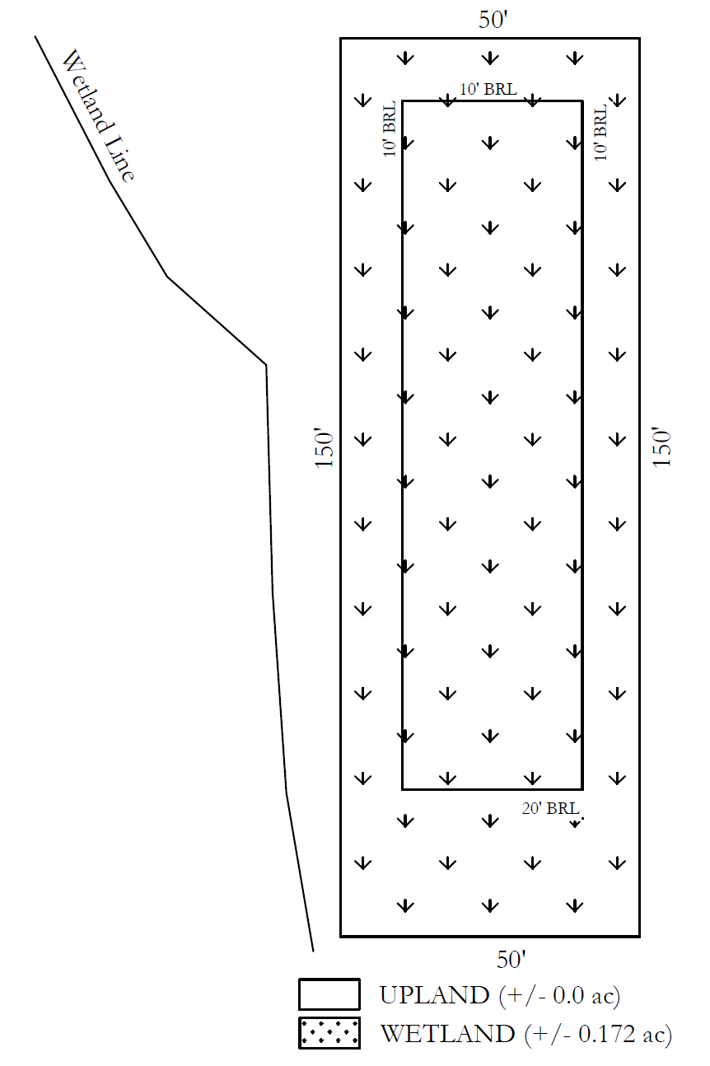
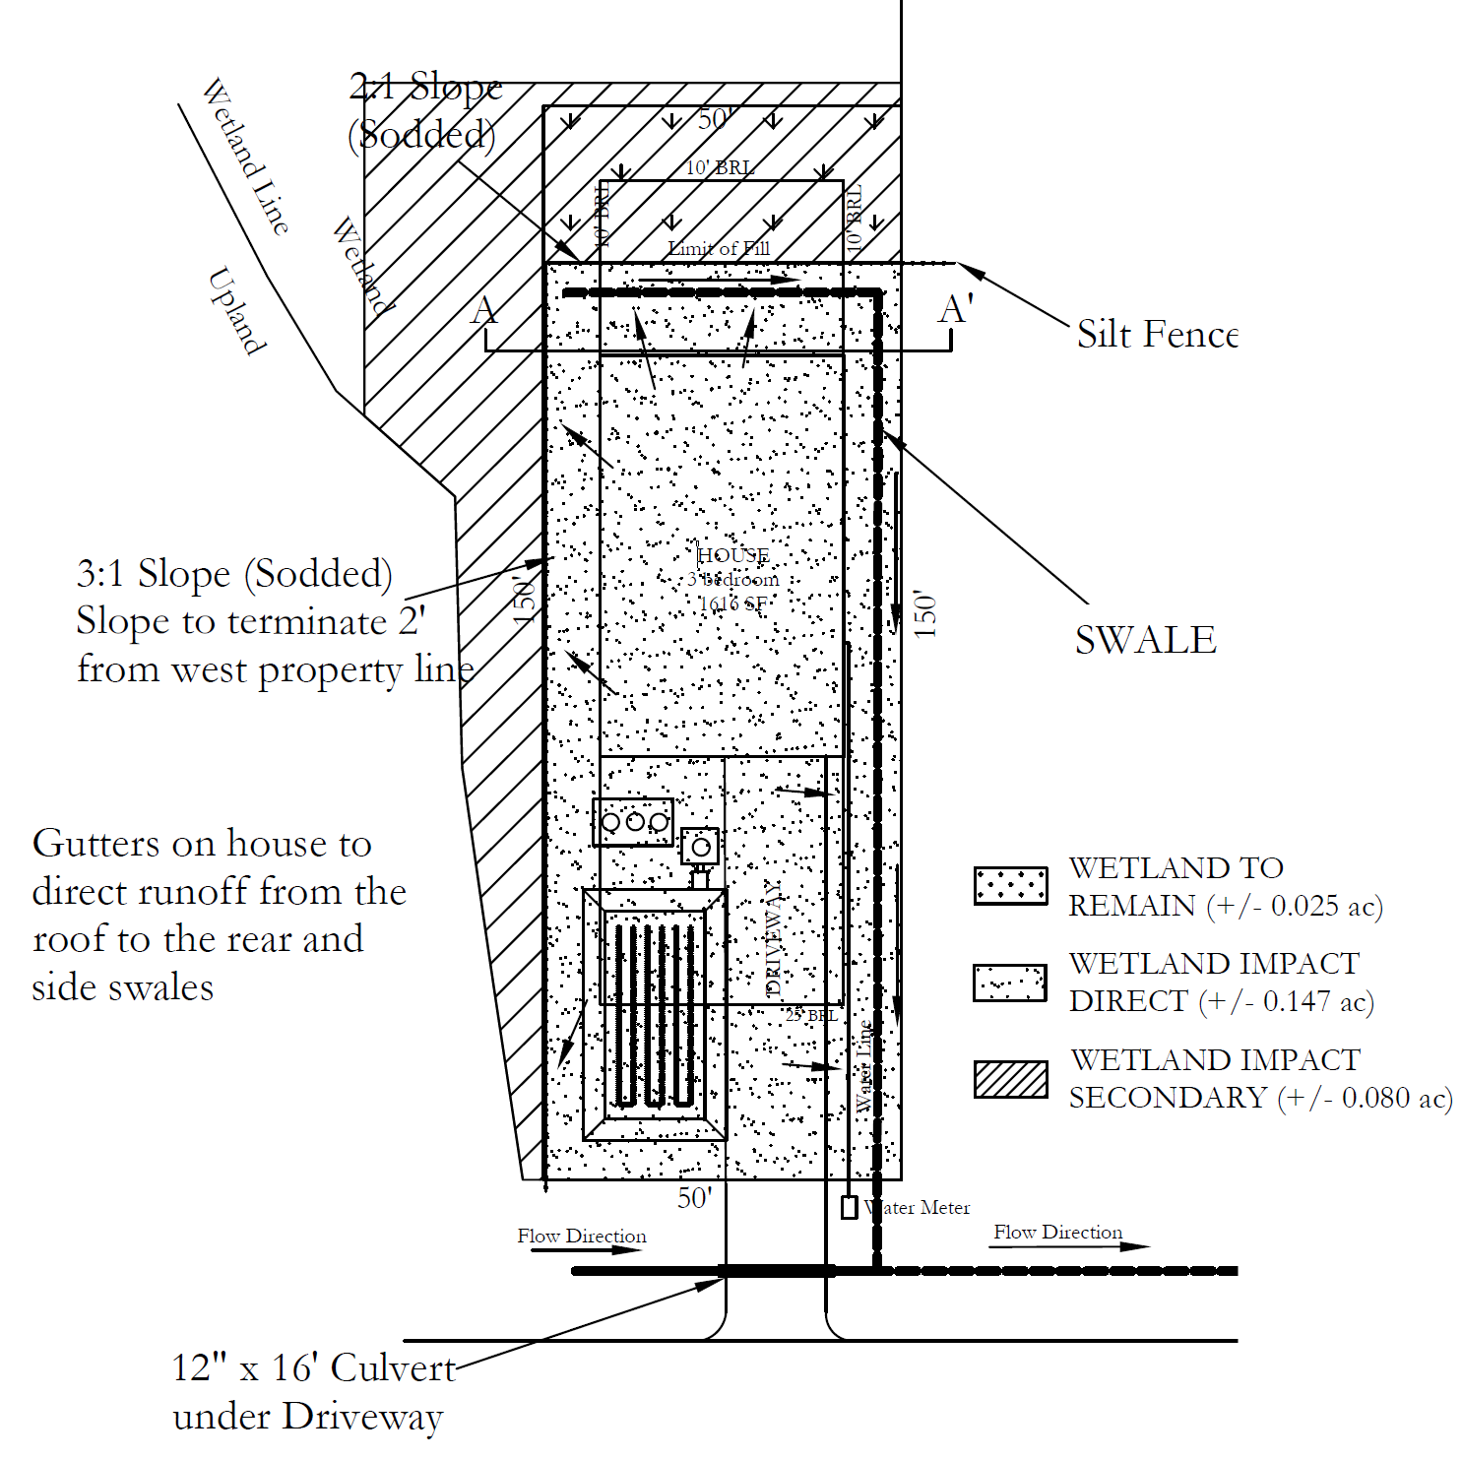
STORMWATER DESIGN
PERMITTING APPLICATION MATERIALS
Notes:
Before purchasing a property there isn’t a guaranteed way to determine if there are wetlands or not. The DEP regulatory offices operates by working with current property owners who have applied for a project. Once someone has applied for exemption or permit the department can then conduct a site inspection and determine if there are wetlands.
Khristian to highlight isolation terminology

Slide 19
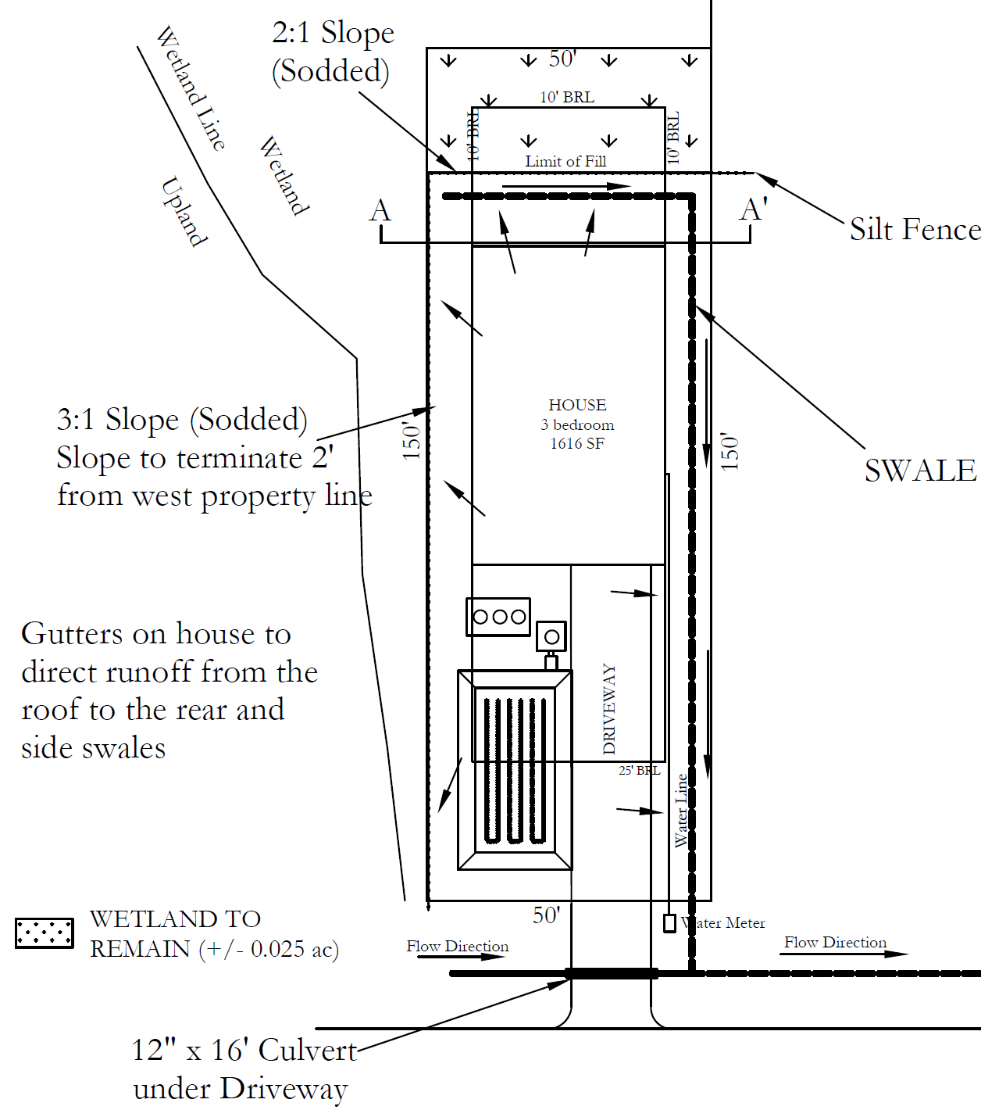
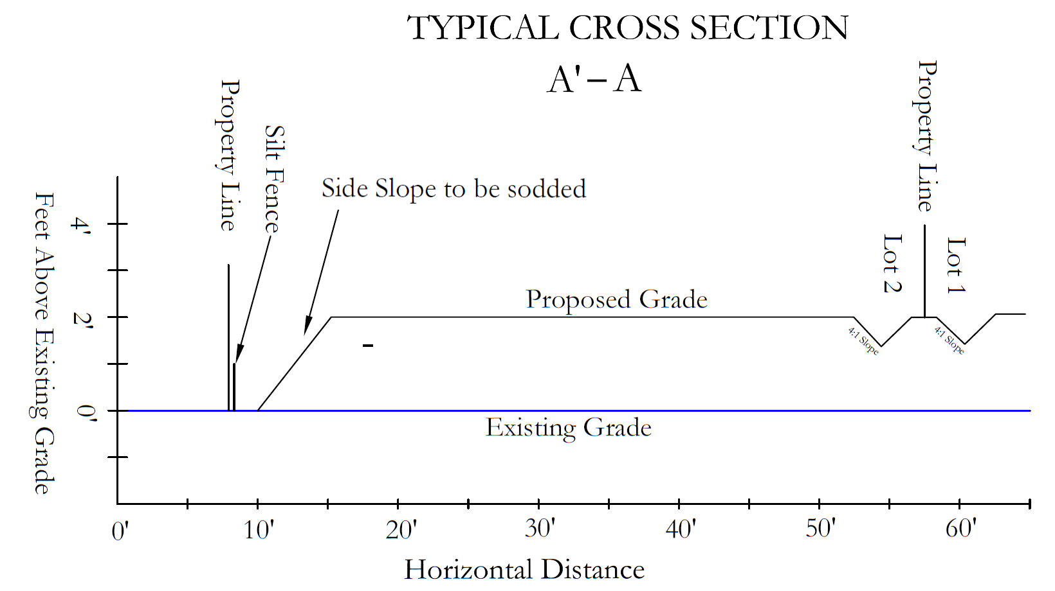
STORMWATER DESIGN
PERMITTING APPLICATION MATERIALS
Notes:
Before purchasing a property there isn’t a guaranteed way to determine if there are wetlands or not. The DEP regulatory offices operates by working with current property owners who have applied for a project. Once someone has applied for exemption or permit the department can then conduct a site inspection and determine if there are wetlands.
Khristian to highlight isolation terminology

Slide 20
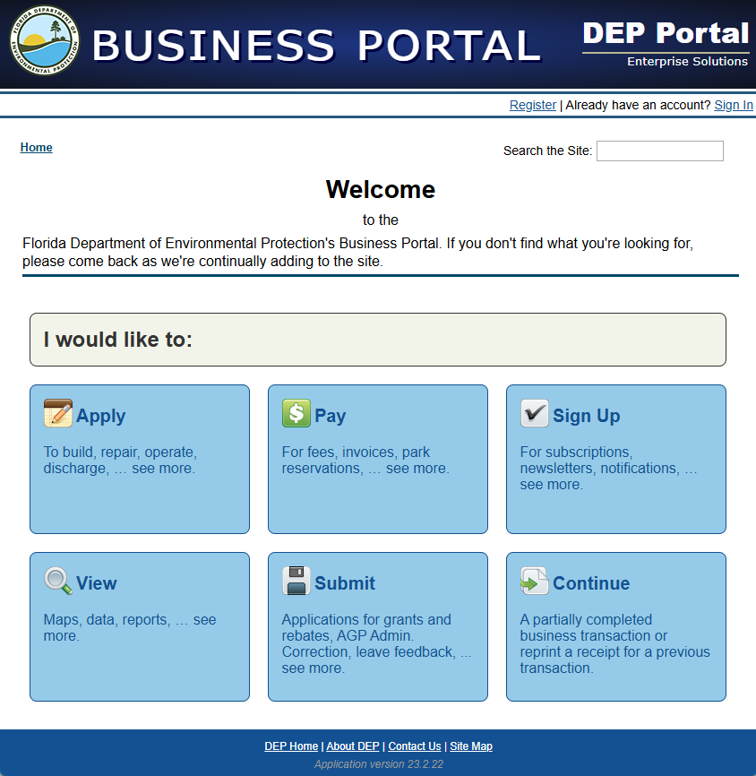
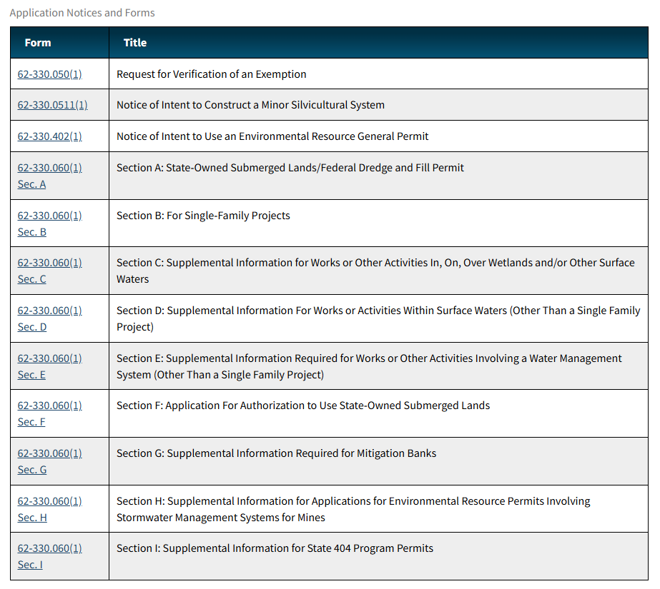
OR
PERMITTING APPLICATION MATERIALS
STORMWATER
Online Business Portal
Downloadable Forms
Submit via mail/e-mail to DEP_NED@FloridaDEP.gov ​
https://floridadep.gov/water/submerged-lands-environmental-resources-coordination/content/forms-environmental-resource
https://www.fldepportal.com/DepPortal/go/apply
Notes:
Before purchasing a property there isn’t a guaranteed way to determine if there are wetlands or not. The DEP regulatory offices operates by working with current property owners who have applied for a project. Once someone has applied for exemption or permit the department can then conduct a site inspection and determine if there are wetlands.
Khristian to highlight isolation terminology

Slide 21
OVERVIEW OF WETLAND DELINEATIONS: 62-340 F.A.C.

Slide 22
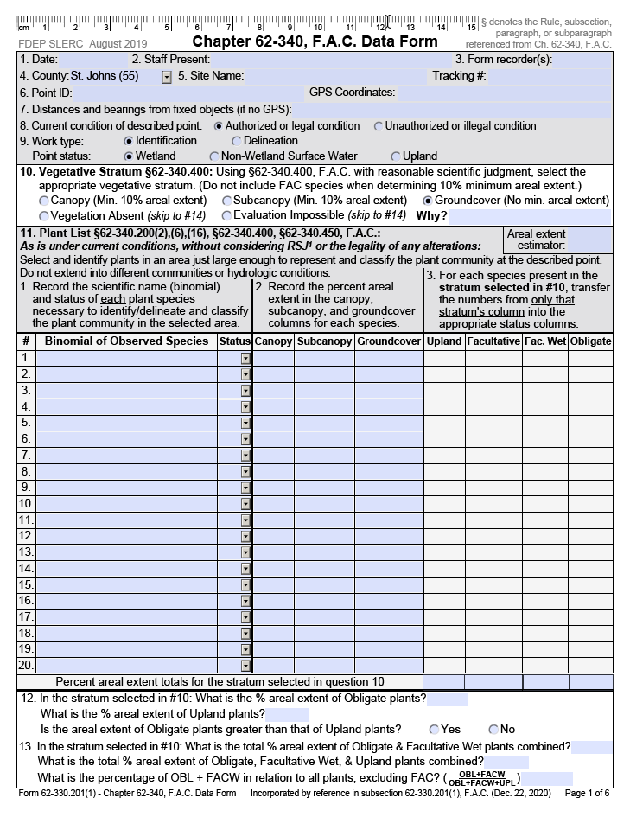
62-340 F.A.C. DATA FORM
Various resources are available for download on the Department’s website. These resources may be used to assist both staff and other environmental professionals in completing the form and performing wetland delineations. Resources include:
Chapter 62-340 F.A.C. Data Form
Chapter 62-340 F.A.C. Data Form Guide
Florida Wetland Delineation Manual
Notes:
Data Form:​
https://floridadep.gov/water/submerged-lands-environmental-resources-coordination/documents/ch-62-340-fac-data-form​
Guide:​
https://floridadep.gov/water/submerged-lands-environmental-resources-coordination/documents/data-form-guide-book

Slide 23
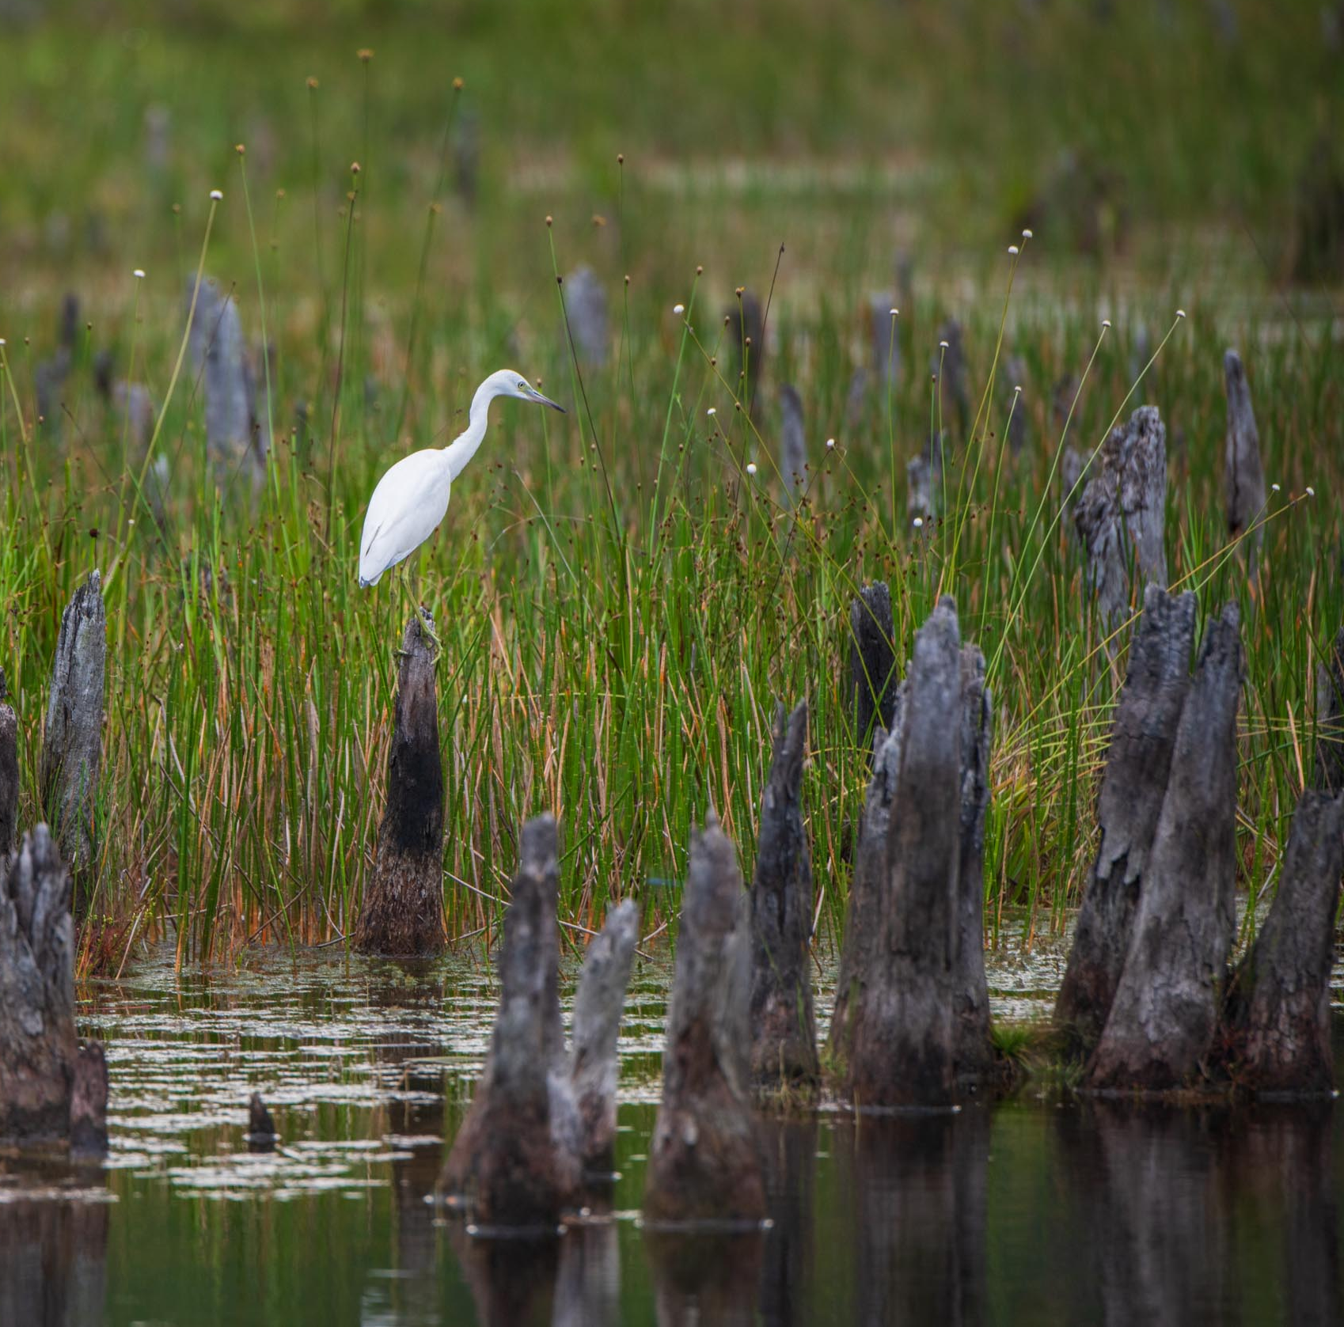
VEGETATION
The prevalent vegetation in wetlands generally consists of species that are adapted for life in saturated soils.
These species, due to morphological, physiological or reproductive adaptations, have the ability to grow, reproduce or persist in aquatic environments or anerobic soil conditions.
Photo credit: FDEP
Notes:
Data Form:​
https://floridadep.gov/water/submerged-lands-environmental-resources-coordination/documents/ch-62-340-fac-data-form​
Guide:​
https://floridadep.gov/water/submerged-lands-environmental-resources-coordination/documents/data-form-guide-book

Slide 24
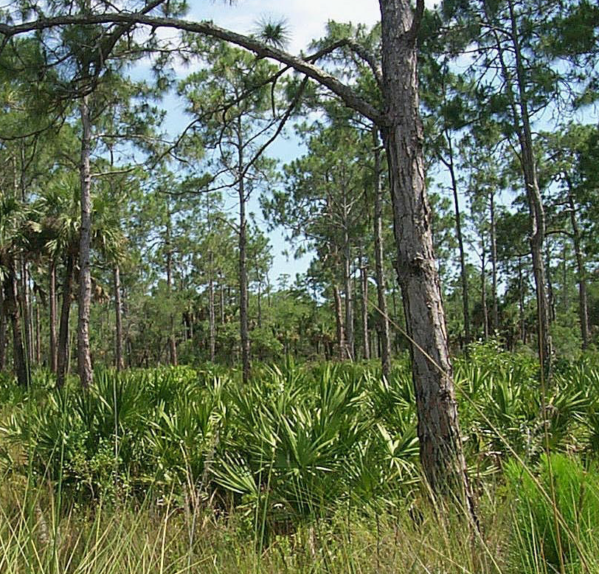
Photo credit: FDEP
VEGETATION
CONTINUED
Vegetation is split into four different statuses:
Obligate.
Facultative wet.
Facultative.
Upland.
62-340 Data Form Guide Appendix A and A2 provide a comprehensive plant index that lists plant binomial, common name and wetland status.
Any plant not specifically listed in 62-340, F.A.C. is considered an upland plant, except vines, aquatic plants and any plant species not introduced into the state of Florida as of July 1, 1994.
Notes:
Refer to wetland delineation handout/review

Slide 25
HYDRIC SOILS
A hydric soil is a soil that is saturated, flooded or ponded long enough during the growing season to develop anaerobic conditions in the upper part of the soil profile that favor the growth of hydrophytic (water loving) vegetation.
A soil is saturated if the water table is within six inches of the soil surface for sandy textured soils or within 12 inches for loamy or clayey textured soils.
Photo credit: FDEP

Slide 26
HYDROLOGIC INDICATORS
Hydrologic indicators can be used as evidence of inundation or saturation.
Definitions of hydrologic indicators can be observed in the 62-340 F.A.C. Data Form Guide.
The following 13 hydrologic indicators are listed in the rule:
Drift lines. Hydrologic data. Morphological plant adaptations. Vegetated tussocks or hummocks. Water marks. Algal Mats. Aquatic Mosses. | Elevated lichen lines. Evidence of aquatic fauna. Secondary flow channels. Sediment deposition. Aufwuchs. Aquatic Plants.
Photo credit: FDEP

Slide 27
HOW ARE CHAPTER 62-340, F.A.C. WETLANDS DELINEATED?
There are six methodologies to meet a wetland definition:
Definition of wetlands: direct application of this definition to identify the upland/wetland boundary.
A test: greater than 50% obligate plants vs. upland plants AND a hydric soil or an indicator of hydrology.
B test: greater than 80% obligate and facultative wet plants vs. upland plants AND a hydric soil or an indicator of hydrology.
C test: proper soil map unit classification AND a hydric soil field indicator.
D test: a hydric soil field indicator AND an indicator of hydrology.
Altered sites test: any natural or artificial alteration which legally masks or eliminates “reliable” expression of wetland indicators (i.e. hydrophytic vegetation, hydric soils, and hydrologic indicators) requires the most “reliable available information” and “reasonable scientific judgement” to delineate the A,B,C,D, or definition boundary is cessation of the alerting activity occurred and “normal” wetland indicators returned.

Slide 28
INTRODUCTION TO UMAM AND ASSESSMENT TOOLS

Slide 29
WHAT IS UMAM?
CHAPTER 62-345, F.A.C.
Chapter 62-345 F.A.C., The Uniform Mitigation Assessment Method (UMAM), is used to determine the amount of mitigation needed to offset adverse impacts to wetlands and other surface waters and to award and deduct mitigation bank credits.
Mitigation types that offset permitted impacts:
Preservation means that protection of wetlands, other surface waters or uplands from adverse impacts by placing a conservation easement over the property.
Enhancement means improving the ecological value of wetlands, other surface waters, or uplands in comparison to their current condition.
Restoration means converting back to a historic condition those wetlands, surface waters or uplands that currently exists as a landform that differs from historic condition.
Creation means the establishment of new wetlands or surface waters by conversion of other landforms.
Notes:
Mitigation is completed with the goal that there is no net loss of wetland functions with any proposed dredge/fill project

Slide 30
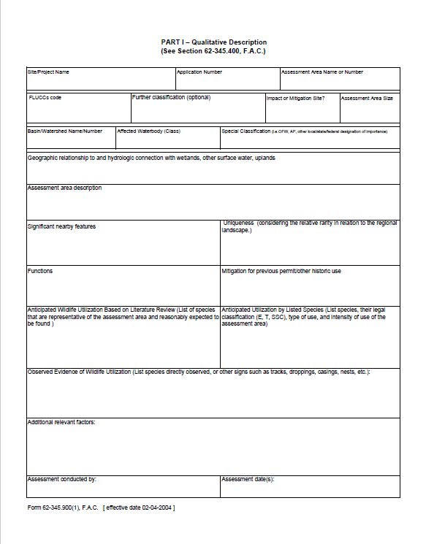
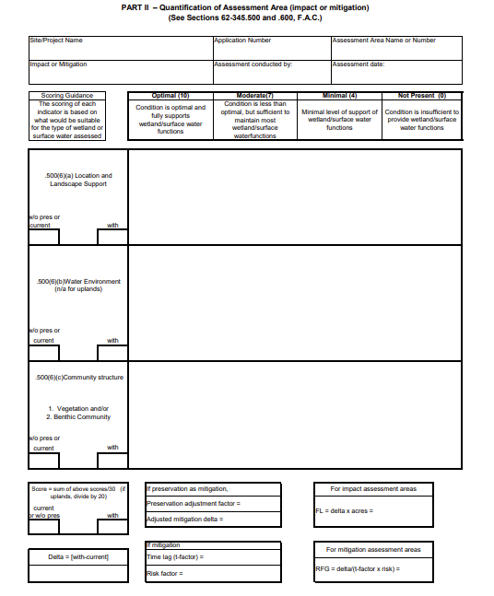
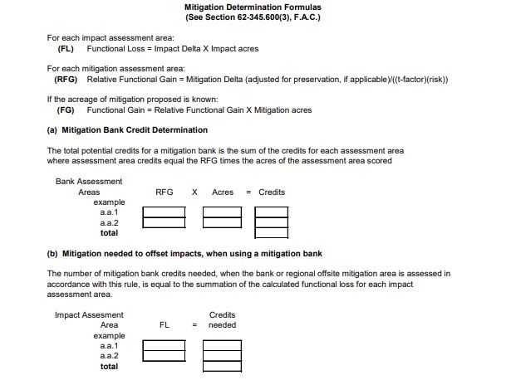
EVALUATING WETLAND FUNCTIONS
FORMS
62-345.300(1) | Part I – Qualitative Description
62-345.300(2) | Part II - Quantification of Assessment Area
62-345.300(3) | Mitigation Determination Formulas
Part I:
Part II:
Field Module / Indicators of Functions
Part III: Mitigation Determination
Office Module / Descriptive Framework

Slide 31
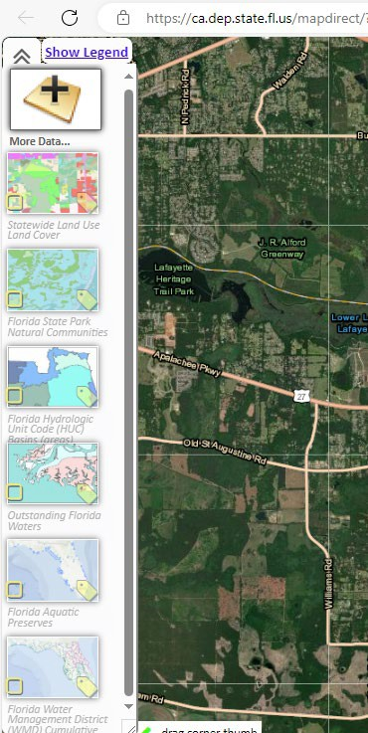
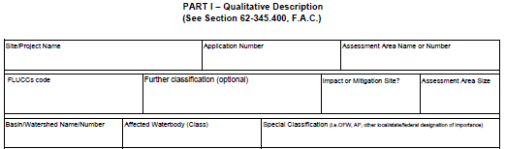
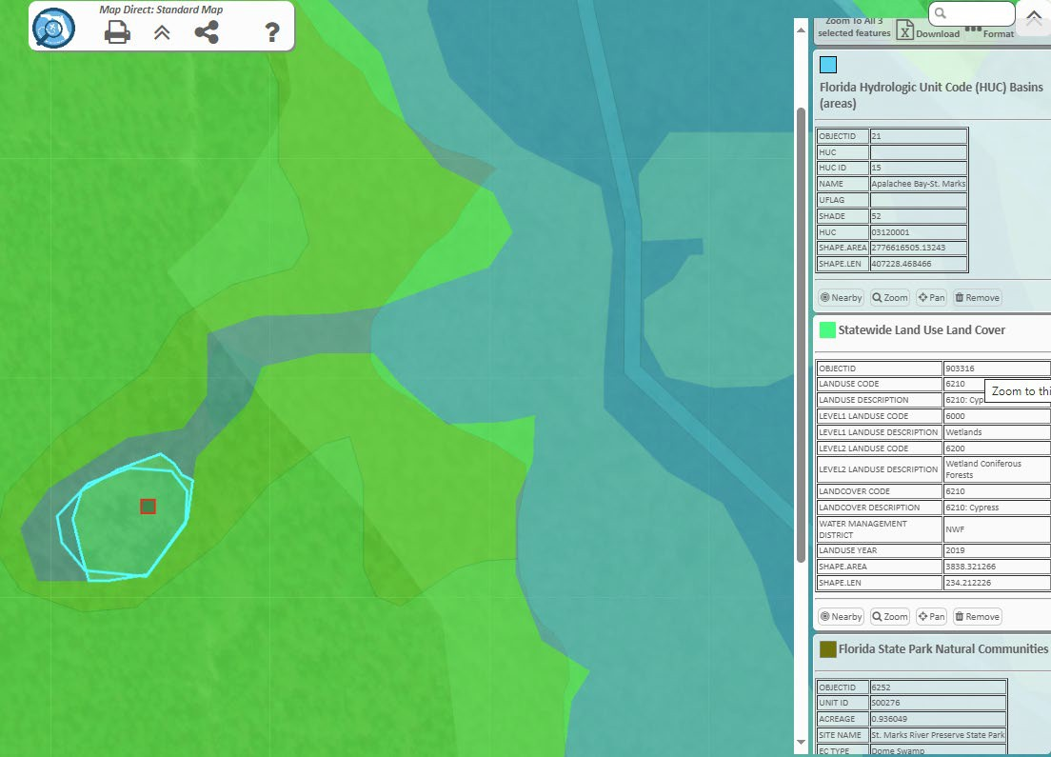
UMAM PART I DESKTOP REVIEW
MapDirect
FLUCCS
FNAI
Basin
Special Classification
Photo credit: MapDirect

Slide 32
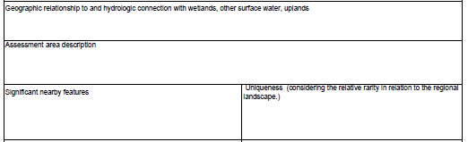
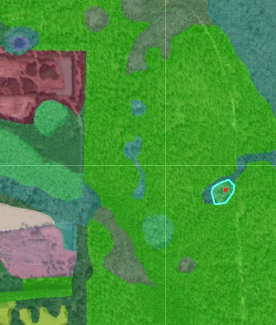
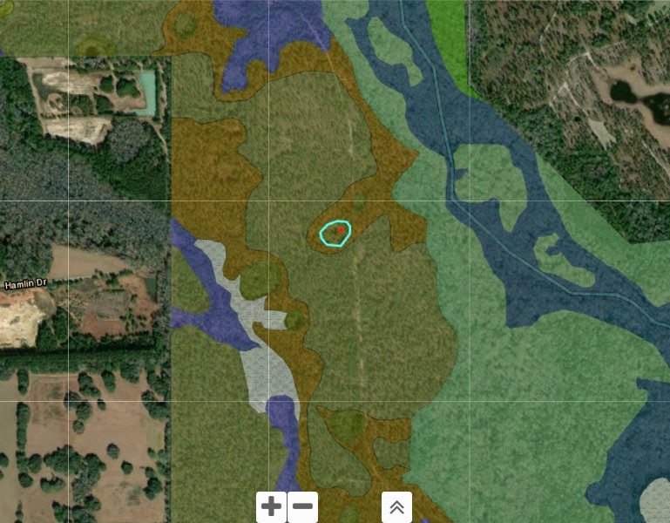
UMAM PART I DESKTOP REVIEW CONTINUED
Geographic Relationship
Significant Nearby Features
Uniqueness
Photo credit: MapDirect

Slide 33
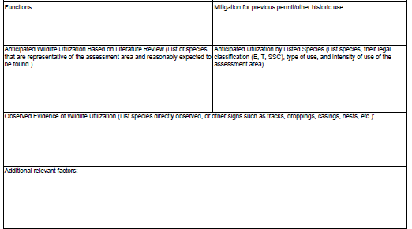
UMAM PART I: EXAMPLE
FUNCTIONS
Functions to be considered include providing:
cover, substrate, and refuge.
breeding, nesting, denning, and nursery areas.
corridors for wildlife movement
food chain support
natural water storage, natural flow attenuation, and water quality improvement, which enhances fish, wildlife, and listed species utilization.

Slide 34
UMAM PART I: EXAMPLE
WILDLIFE AND LISTED SPECIES UTILIZATION
Anticipated wildlife utilization and type of use includes feeding, breeding, nesting, resting, or denning.
Applicable listing classifications includes threatened, endangered, or species of special concern.
The list developed for the assessment area does not need to include all species which use the area but must include all listed species in addition to those species that are characteristic of the native community type, considering the size and geographic location of the assessment area.

Slide 35
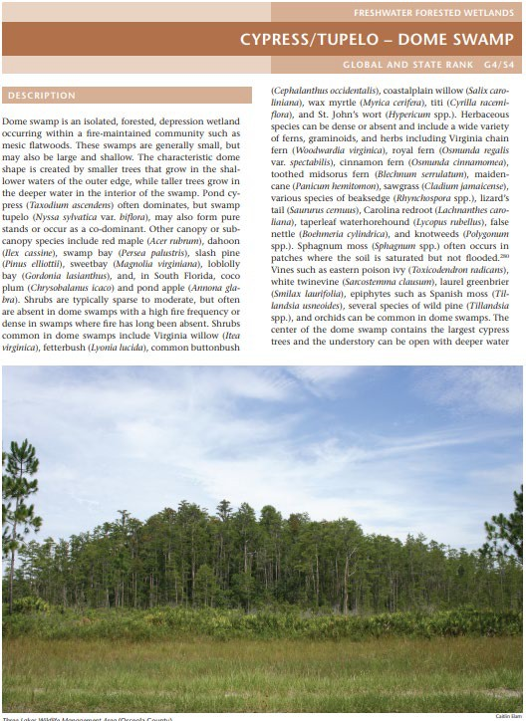
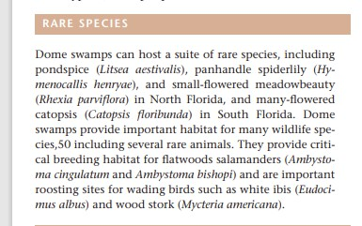
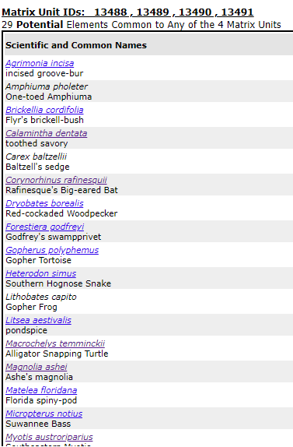
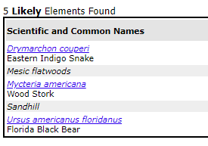
Photo credit: FNAI
UMAM PART I: EXAMPLE
FLORIDA NATURAL AREAS INVENTORY (FNAI)
Florida Natural Areas Inventory
Description of community, landscape position, soils and vegetation.
Discussion of natural and anthropogenic processes influencing community.
Discussion of community variations and associated communities.
Biodiversity Matrix.

Slide 36
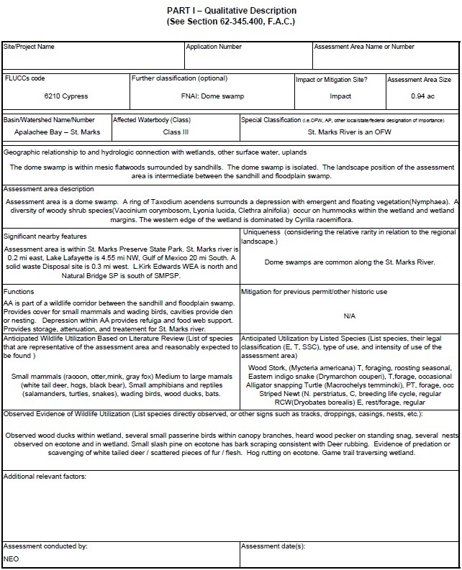
UMAM PART I: EXAMPLE
Use the resources listed in previous slides as the framework to complete the below sections:
Geographic Relationship.
Assessment Area.
Significant Nearby Features.
Functions.
Wildlife Utilization.

Slide 37
The dome swamp is within mesic flatwoods surrounded by sandhills. The dome swamp is isolated. The landscape position of the assessment area is intermediate between the sandhill and floodplain swamp.
UMAM PART I: EXAMPLE
GEOGRAPHIC RELATIONSHIP

Slide 38
UMAM PART I: EXAMPLE
ASSESSMENT AREA
Assessment Area (AA) is a dome swamp.
A ring of Taxodium ascendens surrounds a depression with emergent and floating vegetation (Nymphaea). A diversity of woody shrub species(Vaccinium corymbosom, Lyonia lucida, Clethra alnifolia) occur on hummocks within the wetland and wetland margins. The western edge of the wetland is dominated by Cyrilla racemiflora.

Slide 39
UMAM PART I: EXAMPLE
SIGNIFICANT NEARBY FEATURES
Assessment Area (AA) is within St. Marks Preserve State Park. St. Marks River is 0.2 mi east, Lake Lafayette is
4.55 mi NW, Gulf of Mexico 20 mi South. A solid waste disposal site is 0.3 mi west. L. Kirk Edwards WEA is north and Natural Bridge SP is south of SMPSP. A wood stork nesting colony is 3.5 mi NW

Slide 40
UMAM PART I: EXAMPLE
FUNCTIONS
AA is part of a wildlife corridor between the sandhill and floodplain swamp. Provides cover for small mammals and wading birds, cavities provide den or nesting. Provides nesting materials and foraging areas to support wood stork nesting colony. Depression within AA provides refugia and food web support. Provides storage, attenuation, and treatment for St. Marks River.

Slide 41
UMAM PART I: EXAMPLE
ANTICIPATED WILDLIFE UTILIZATION
Small mammals (racoon, otter, mink, gray fox) Medium to large mammals (white tail deer, hogs, black bear), Small amphibians and reptiles (turtles, snakes), wading birds, wood ducks, bats.
Wood stork, (Mycteria americana) T, foraging/roosting, seasonal. Eastern indigo snake (Drymarchon couperi), T, forage, occasional. Alligator snapping turtle (Macrochelys temmincki), PT, forage, occasional. Striped Newt (N. perstriatus, C, breeding/life cycle, regular RCW(Dryobates borealis) E, rest/forage, regular. Black bear, (Ursus americanus floridanus)E, cover/forage, occasional.

Slide 42
UMAM PART I: EXAMPLE
OBSERVED WILDLIFE UTILIZATION
Observed wood ducks within wetland, several small passerine birds within canopy branches, heard woodpecker on standing snag, several nests observed on ecotone and in wetland. Small slash pine on ecotone has bark scraping consistent with deer rubbing. Evidence of predation or scavenging of white-tailed deer / scattered pieces of fur / flesh. Hog rutting on ecotone. Game trail traversing wetland.

Slide 43
UMAM PART II: EXAMPLE
62-345.300 ASSESSMENT METHOD OVERVIEW AND GUIDANCE
When an applicant proposes mitigation for impacts to wetlands and surface waters as part of an environmental resource permit or wetland resource permit application, the applicant will be responsible for submitting the necessary supporting information for the application of Rules 62-345.400-.600, F.A.C., of this chapter and the reviewing agency will be responsible for verifying this information and applying this assessment method to determine the amount of mitigation necessary to offset the proposed impacts.

Slide 44
UMAM PART II ASSESSMENT: LOCATION AND LANSCAPE
Range of habitats outside the assessment area.
Invasive plant species in the proximity.
Wildlife access to and from outside habitats.
Functions that benefit downstream fish and wildlife; limitations.
Land uses outside the area, impacts on wildlife.
Downstream benefits are not limited by hydrologic impediments or flow restrictions.
Downstream or other hydrologically connected habitats dependence on discharges.
Uplands provide protection of wetland functions (UPL MIT).

Slide 45
UMAM PART II ASSESSMENT: WATER ENVIRONMENT
Water levels and flows appear appropriate.
Water level indicators are distinct and consistent with expected conditions.
Soil moisture is appropriate. No desiccation, oxidation or subsidence.
Soil erosion or deposition patterns.
Evidence of fire history.
Vegetation zonation is appropriate.
Veg shows no signs of hydrologic stress.
Presence or evidence of use by animal species with hydrologic requirements.
Community composition of species tolerant of degradation.
Direct observation of standing water.
Water quality data indicators ditions are optimal for the type of community.

Slide 46
UMAM PART II ASSESSMENT: COMMUNITY STRUCTURE
Plant cover is appropriate.
Invasive exotic presence.
Regeneration and recruitment.
Age and size distribution.
The density and quality of coarse woody debris, snag, den, and cavity.
Plants condition.
Land management practices.
Topographic features.
If submerged aquatic plant communities are present, no evidence of siltation or algal growth.
If upland mitigation, area provides habitat and life history support for fish and wildlife in wetlands.

Slide 47
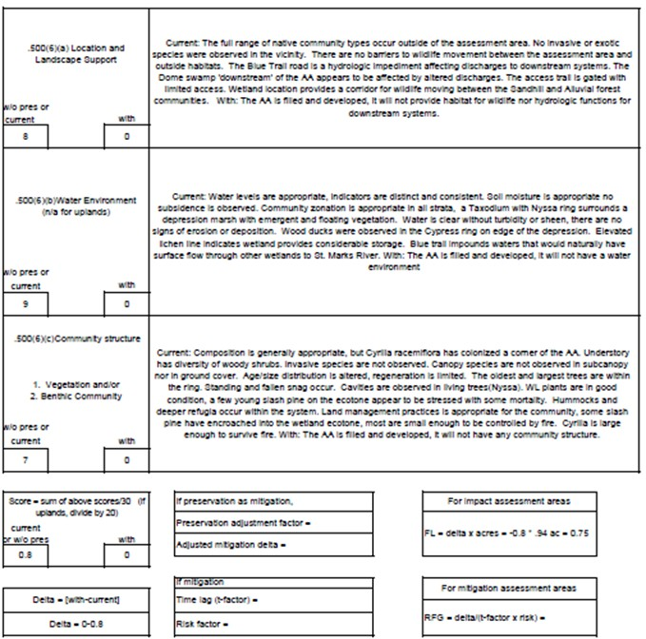
UMAM PART II : FIELD EXAMPLE ASSESSMENT: SCORING
Current 8
9
With Location and Landscape Support 0 Water Environment 0
7 Community Structure 0
24 0
24/30=0.80 0= 0/30
Delta = With – Current Delta = 0 – 0.80
Functional Loss = Delta * Acres Functional Loss = -0.80 * 0.94 ac FL = 0.75
To offset the functional loss from this wetland an applicant may purchase 0.75 credits from a mitigation bank or provide 0.75 functional gain units through permittee responsible mitigation.

Slide 48
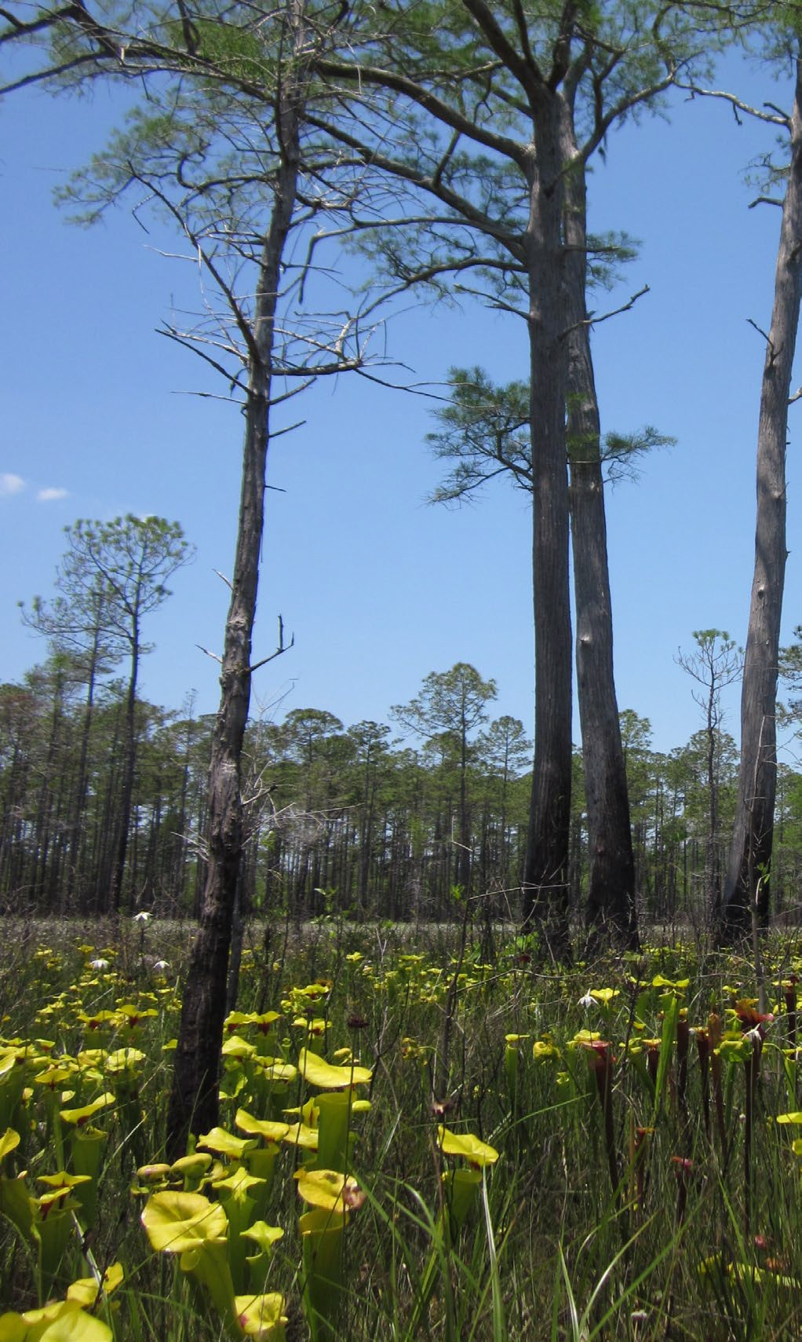
UMAM EVALUATION TOOLS REFERENCE COMMUNITY INFORMATION
Resources:
Florida Natural Areas Inventory (Guide)
FNAI Reference Communities
Florida Invasive Species Council (FLEPPC)
Florida Land Use, Cover and Forms Classification System (FLUCCS)
Useful for:
Vegetative composition of the assessment area
Vegetative structure of the target assessment area
Anticipated wildlife use (specific associations)
Photo credit: FDEP

Slide 49
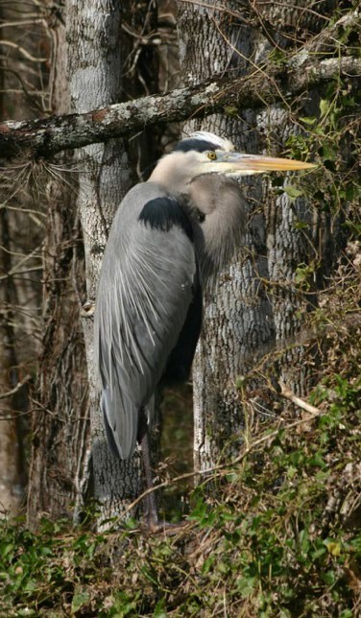
UMAM EVALUATION TOOLS WILDLIFE INFORMATION
Which wildlife species may use the assessment area?
Resources:
FNAI Biodiversity Matrix
Federal Register, listed species PBF/PCE
FWC Species Profiles
Literature Review and Journal Articles
Useful for:
Determining which wildlife species have potential or are likely to occur.
Identifying the specific physical or biological features required to support a species.
Identifying stressors, impairments, or deterrents to use.
Listed plant species that may occur in the vicinity
Photo credit: FDEP

Slide 50
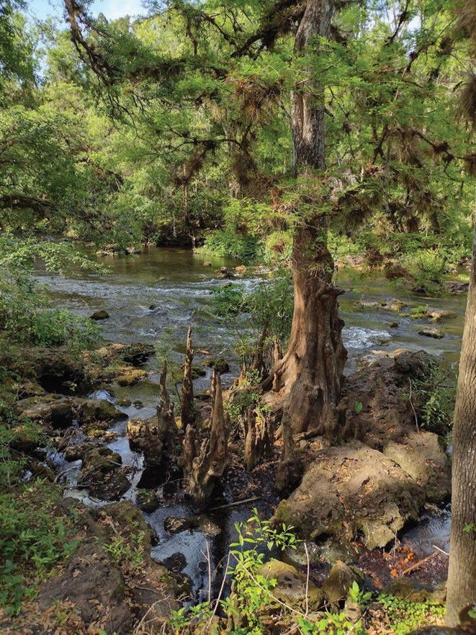
UMAM EVALUATION TOOLS HYDROLOGIC INFORMATION
How does the hydrology of the assessment area function within the landscape?
Resources:
National Hydrographic Dataset, Flowlines (MapDirect).
Water Management District, Hydro data.
Antecedent Precipitation Tool.
DEAR web portal.
Useful for:
Identifying downstream and hydrologically connected wetlands.
Determine relative importance of discharges from assessment area.
Determine hydrologic conditions (normal, wetter than, or drier than) during field assessment.
Identifying verified water quality impairments.
Photo credit: FDEP

Slide 51
SENATE BILL NO. 492 (SB492) AMENDMENT TO SECTION 373.4136, F.S.
SB492 establishes that a mitigation bank is deemed to implement a plan that provides regional ecological value once the mitigation bank service area has been established by the department or a water management district.
Per Section 10.2.1.2 of the Applicant's Handbook, Volume 1, the Agency will not require the applicant to implement practicable design modifications to reduce or eliminate impacts when:
The ecological value of the functions provided by the area of wetland or other surface water to be adversely affected is low, based on a site specific analysis using the factors in section 10.2.2.3, below, and the proposed mitigation will provide greater long term ecological value than the area of wetland or other surface water to be adversely affected, or
Photo credit: FDEP

Slide 52
SENATE BILL NO. 492 (SB492) AMENDMENT TO SECTION 373.4136, F.S.
SB492 establishes that a mitigation bank is deemed to implement a plan that provides regional ecological value once the mitigation bank service area has been established by the department or a water management district.
Per Section 10.2.1.2 of the Applicant's Handbook, Volume 1, the Agency will not require the applicant to implement practicable design modifications to reduce or eliminate impacts when:
b. The applicant proposes mitigation that implements all or part of a plan that provides regional ecological value and that provides greater long term ecological value than the area of wetland or other surface water to be adversely affected.
Photo credit: FDEP

Slide 53
Thank you
THANK YOU
Khristian Mangahas Regulatory Programs
Environmental Resource Permitting
Florida Department of Environmental Protection
Contact Information:
Phone: 904-256-1560
Email: Khristian.Mangahas@FloridaDEP.gov

